Slide 1
General Supervision System Grant (GSSG) Final Report Preview
2020-2021 Grant Year
For Intermediate School District (ISD) Directors of Special Education

Slide 2
Meet the Webinar Team
Office of Special Education (OSE)
Jessica Brady
Scott Kemmer-Slater
Charles Thomas
Public Sector Consultants (PSC)
Lynne Clark
Josiah Bear

Slide 3
Agenda
2020-21 Timelines
2020-21 GSSG Final Report
Completing the Final Report in Catamaran
2021-22 Timelines
Catamaran Navigation and Tips
Resources
Questions?

Slide 4
2020-21 Timelines

Slide 5
2020-21 Timelines Overview
GSSG Final Report:
Live May 3, 2021
Due May 28, 2021
OSE Office Hours:
May 6, 2021, 9:00 a.m. to 11:00 a.m.
May 27, 2021, 1:00 p.m. to 3:00 p.m.
Final Expenditure Report (Fiscal)
Due August 29, 2021, in Cash Management System (CMS)

Slide 6
2020-21 GSSG Final Report

Slide 7
Complete GSSG 2020-21 Final Report
Getting Started
Components of General Supervision
Priority Area
Making Connections
Fiscal

Slide 8
Preface: Opportunity for the ISD
Reflect and Celebrate
Strengths and Needs
Decision Making
Progress and Momentum
Planning for 2021-2022 Grant Application

Slide 9
Getting Started: Prep and Planning
Lessons Learned
ISD GSSG Team
Consider Progress on the Activities and Timelines Developed and Included in the 2020-2021 Application

Slide 10
2020-21 Components of General Supervision
Stages of Implementation
Activities and Timelines

Slide 11
General Supervision 2020-21 Activities and Timelines Chart
Update progress status and timelines.
Update ISD progress to-date for all identified component activities.

Slide 12
Reminders: General Supervision 2020-21 Activities and Timelines Chart
Completed or discontinued activities will not be carried forward to the 2021-22 GSSG Application.
Timelines for any activities listed may be updated.
No new activities

Slide 13
GSSG 2020-21 Stages of Implementation
Notes:
Also, in this section of the Final Report, the ISD will have an opportunity to review and update the ISD’s current stage of implementation, by General Supervision Component, from the 2020-21 Application. Previously selected stages from the 2019-20 GSSG Application and Final Report are also provided for the ISD’s reference. Update the chart by selecting the current stage of implementation for the 2020-21 GSSG Final Report.
Since the submission of the 2020-21 GSSG Application, has the implementation stage changed? Consider each identified/selected component. If there are no changes, select the same stage of implementation identified in the 2020-21 Application column. In deciding the stage of implementation the ISD should consider the totality of the work thus far on the component (s) of general supervision. As a reminder, ISD's will be able to choose to Add more or Focus on fewer components in the 2021-22 Application.
Please Note: the current definitions have been carried forward from the application to be used to close out the 20-21 grant cycle.

Slide 14
GSSG 2020-21 Stages of Implementation: Overview
Exploration
Installation
Initial Implementation
Full Implementation

Slide 15
GSSG 2020-21 Stages of Implementation: Definitions
Exploration – The ISD continues to learn what this component of general supervision means and how it relates to the work of the ISD.
Installation Stage – The ISD has begun activities to implement this component of general supervision yet continues to identify resources and prepare staff to do the work.

Slide 16
GSSG 2020-21 Stages of Implementation: Definitions Continued
Initial Implementation – The ISD has completed activities that will lead to full implementation of this component of general supervision.
Full Implementation – The ISD has, at least, 50 percent of the activities fully implemented and the ISD personnel are addressing this component in a consistent and meaningful manner.

Slide 17
Priority Area: Progress Toward Improvement
Data
Sources
Measurements
Gauge progress toward improvement
Notes:
In the Priority Area section, the focus is on measuring progress towards improved student outcomes. If data/updated data is not yet available from state systems, member district data sources should be used! This is an opportunity for ISDs to provide data, sources, and measurements used in 2020-21 to gauge progress toward improvement.
If the ISD is unable to populate the table with updated/data, contact us so that we can assist you prior to submission. Incomplete data tables would likely be cause for a report to be returned for modifications.
Also, new for this section! Three data tables, including the creation of a new table, specifically designed to reflect member district/other data sources.

Slide 18
Priority Area Table from Mid-Year Report
Notes:
This first table will be populated with information from the Mid-Year Report. No edits would be made to this table. It is for viewing/informational purposes.

Slide 19
Priority Area Table: Final Report Updates
Notes:
The second table will contain the same prepopulated data and information as the first table, however, the ISD will be allowed to edit this table.
Additionally, ISDs will provide current status and/or update the table with 2020-21 data and status. If data is unavailable/there are no updates available for 2020-21 data at the time of the Final Report submission, the ISD shall provide at least one new data source using local (member district) data in Table 3.

Slide 20
Priority Area Table: Final Report New Data
Notes:
The third table, is new. It is an optional table provided for the ISD to provide new data sources, if appliable. However, if the ISD does not have updates to existing 2020-21 data sources and /or data for 2020-21 then at least one new data source using local (member district) data in this new table.

Slide 21
Making Connections Questions
Building on information shared in the 2020-21 GSSG Application and GSSG Mid-Year report, has the ISD communicated and engaged with any of its member districts in the general supervision system grant work thus far or in 2020-21?

Slide 22
Making Connections Questions (continued)
Describe how the ISD GSSG Team has:
Made connections among the components of general supervision, the priority area, and the fiscal elements.
Worked together in 2020-21.
Made changes to the team.

Slide 23
Fiscal – Personnel
Name | Position/Title | Amount | FTE Staff | Description
Enter the staff member’s name | Enter the staff member’s title | Enter the dollar amount | Enter the FTE | Provide a description
Notes:
The final section of the report focuses on the fiscal elements of the grant. We have revised this section and provided new tables that should provide more opportunity for clarity of work purpose and connection to related activities for those that perform work associated with the GSSG. We have added two new tables in the Final Report. Personnel and Non-Personnel.
It is important to work closely with the ISD Business Official to complete this section which includes both Personnel and Non-Personnel related grant costs.

Slide 24
Fiscal – Non-Personnel
Expense Type | Cost | Description
Select the non-personnel expense type | Enter the actual cost | Provide a description
Notes:
The second table focuses on how General Supervision System Grant funds have been utilized for Non-Personnel related expenses/costs incurred in 2020-2021.

Slide 25
Completing the Final Report in Catamaran

Slide 26
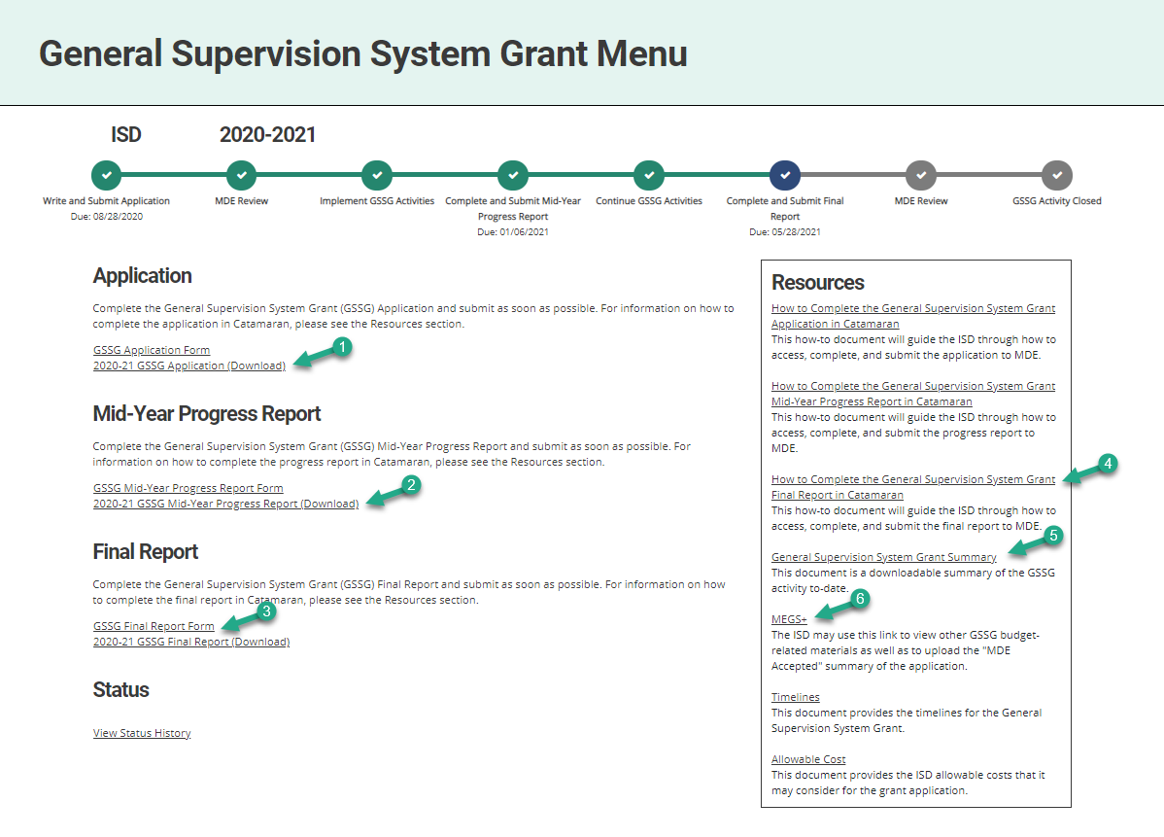
General Supervision System Grant Menu
Review GSSG Resources
Notes:
The GSSG Application and GSSG Mid-Year Report are still available on the menu.
ISDs may access the General Supervision Grant Summary Summary and other helpful links like MEGS+ in the Resources box.
Note: The General Supervision System Grant Summary will include a summary of the entire activity including the ISD’s submitted application, mid-year report, as well as the final report.
Also, the” How To Complete the GSSG Final Report” document may be accessed from this page in the Resources box and is also located in the funding section on the Catamaran Technical Assistance website.

Slide 27
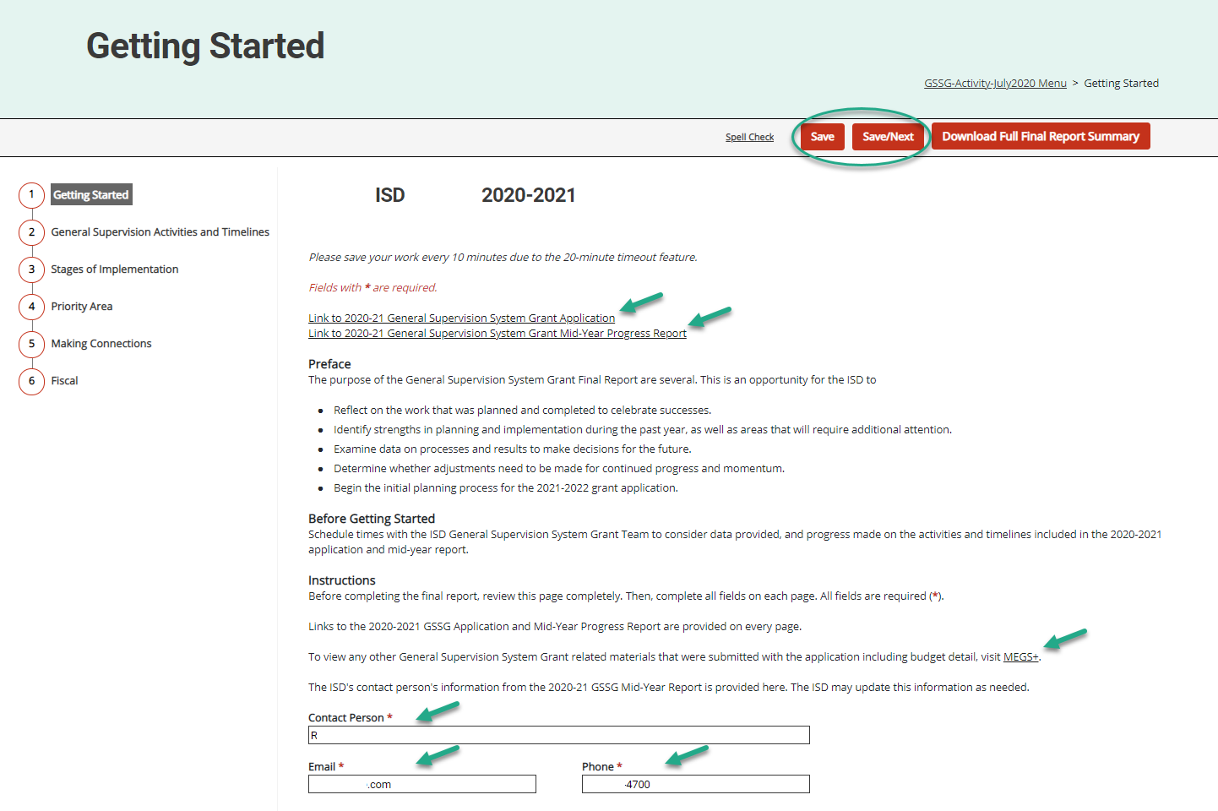
Getting Started Page Overview
Notes:
As we previously discussed, engage with the ISD’s GSSG Team as you begin your work on the 2020-21 Final Report.
Note, the ISD’s contact person, email, and phone has been moved to the bottom of the page and will be pre-populated from the ISD’s mid-year report and will be copied on any Catamaran system notifications once the information has been saved. This is in addition to the ISD Director role’s receipt of the Catamaran system notifications.

Slide 28
Priority Area Table 1 from Mid-Year Report
Data prepopulated from the 2020-21 GSSG Application and Mid-Year Report
Notes:
ISDs will have three tables of information available on the Priority Area Page:
Table 1 – will be populated from the information from the Mid-Year Report

Slide 29
Priority Area Table 2: Final Report Updates
Data prepopulated from the 2020-21 GSSG Application
ISDs may update data sources, data, targets, and measurements
Provide updated 2020-21 data and status for the Final Report
Notes:
Table 2 – contains some of the same information as Table 1; however, the ISD will be allowed to edit data sources, data, targets, as well as measurements.
Additionally, ISDs may provide a current status for the specific data source.
Updates to 2020-21 data should be made in this table.

Slide 30
Priority Area Table 3: Final Report New Data
Optional table provided for ISDs to provide new data sources.
Notes:
Table 3 – If the ISD already provided an update to data in Table 2, Table 3 is optional.
If the ISD does not have updates to existing 2020-21 data sources and /or data for 2020-21, then the ISD must provide at least one new data source using local (member district) data in this new table. Even if the ISD has data sources with updates, this may be a good opportunity to add one or two member district data sources from within the ISD to carry over into the 2021-2022 cycle.
Only two rows will be available for additional data sources.
If questions /if not able to answer all questions: as you are completing this sections of the report, please reach out to us during office hours for additional support.

Slide 31
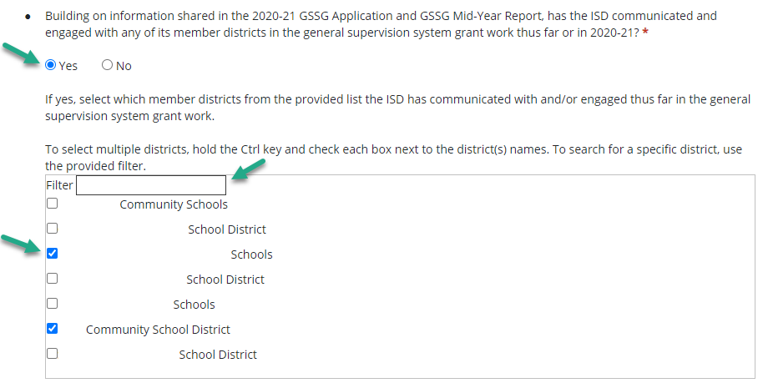
Making Connections Question 1
Making Connections Question: Yes Response
Notes:
As discussed earlier, this is an updated feature that provides the ISD with the opportunity to select the member districts that they have engaged with in 2020-21.
This screenshot reflects the district selection box in Catamaran. Note, this box will remain hidden until the ISD responds with a “Yes” to the first question.
The ISD may select member districts individually or use the provided filter to quickly find and then select specific member districts. This feature works just like it does on the Search page in Catamaran. To select multiple districts, ISDs may do so by using a combination of the Filter box to find and then select each district by holding down the Ctrl key and checking the specific district(s) names.
If the ISD has not begun working with any of its member districts, and selects “No”, there will be a space below the selection box to provide written rationale.
The next slide indicates what the ISD needs to do if the Response is “No”.
This is the first question on the Making Connections page. The ISD will need to respond with either a yes or no to this initial question. If the ISD responds with a yes, then they will be prompted to select which member districts they have engaged in the GSSG work.

Slide 32
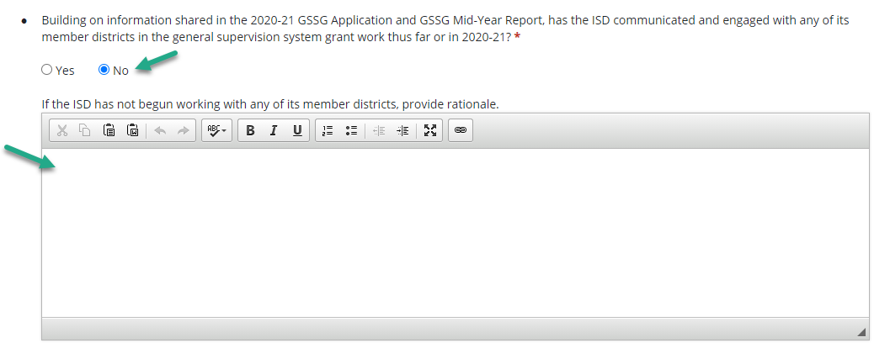
Making Connections Question 1 Continued
Making Connections Question: No Response
Notes:
When the ISD responds with a “No”, then the ISD will be required to provide rationale in the provided text box. As a reminder a response to this question is required if selected.

Slide 33
Fiscal Tables
Personnel
Name | Position/Title | Amount | FTE Staff | Description
Enter the staff member’s name | Enter the staff member’s title | Enter the dollar amount | Enter the FTE | Provide a description
Non-Personnel
Expense Type | Cost | Description
Select the non-personnel expense type | Enter the actual cost | Provide a description
Notes:
The Personnel Table: the ISD should use it to describe how the ISD’s General Supervision System Grant funds have been utilized for personnel for 2020-2021.
Provide Personnel information, including name and position/title for personnel at the ISD that are funded or partially funded with the ISD’s General Supervision System Grant funds for 2020-2021.
The information provided should include personnel providing technical assistance to member districts.
The dollar amount entered in the Amount column should be rounded to the nearest whole dollar.
The FTE Staff column should represent the percentage of actual time spent by the specified employee.
The percentage should be in decimal format.
The description column should describe how this personnel’s position connects to the development and implementation of a system of General Supervision for the ISD.
The Non-Personnel Table:
These types of expenses may include Travel to Member Districts for Technical Assistance/PD related to the GSSG, indirect costs, and audit costs (see allowable cost doc).
Provide information concerning non-personnel costs at the ISD.
Select the Expense Type of non-personnel expense incurred by the ISD.
Enter the amount spent.
The cost should be the actual expenditure amount and not an original or previously "budgeted" amount.
Describe how this non-personnel cost connects to the development and implementation of a system of General Supervision for the ISD. If selecting “Travel to Member Districts to Provide TA” then provide the name of the person providing the service in this Description column.
The cost should reflect the actual expenditure amount and not an original or previously "budgeted" amount.
The description of the non-personnel cost should include how it connects to the development and implementation of a system of General Supervision for the ISD. If the cost is related to traveling to a Member District to provide technical assistance, then provide the name of the person providing the service.

Slide 34
Additional Supporting Documentation or Comments (optional)

Slide 35
Submit the Final Report
The GSSG Final Report is due by May 28, 2021.
After completing the final report, select the Submit to MDE button at the top of the Fiscal page.

Slide 36
2021-2022 Timelines

Slide 37
GSSG 2021-2022 Timelines
Application Webinar
June 16, 2021
Application
Live June 28, 2021
Due July 30, 2021
Mid-Year Report
Live December 1, 2021
Due January 7, 2022
Final Report:
Live May 2, 2022
Due May 27, 2022
Final Expenditure Report
Due August 29, 2022 (in NexSys)

Slide 38
Catamaran Navigation and Tips

Slide 39
Login
https://catamaran.partners

Slide 40
Text Editor Tool
The text editor tool is available for all sections of the report.
The ISD has access to light formatting such as bold, italics, underline, as well as the ability to have ordered and unordered lists.

Slide 41
Spell Check and Breadcrumbs
Access spell check by selecting the Spell Check link at the top of the page. The spell check feature functions within each field/cell of text that is currently being completed.
Users may return to the menu by selecting the breadcrumbs link at the top of any page in the final report.

Slide 42
Chat Feature
The Help Desk is available by chat during business hours.
Select the Chat icon in the lower right corner of the screen to begin.
Enter basic information.
The issue will still be logged in the Help Desk database (just like a phone call).

Slide 43
Resources

Slide 44
Catamaran Help Desk
Questions about system navigation or accessing the activity
Available Monday–Friday from 8:00 am to 5:00 pm
Contact by:
Email at help@catamaran.partners
Phone 877-474-9023
Chat feature within Catamaran

Slide 45
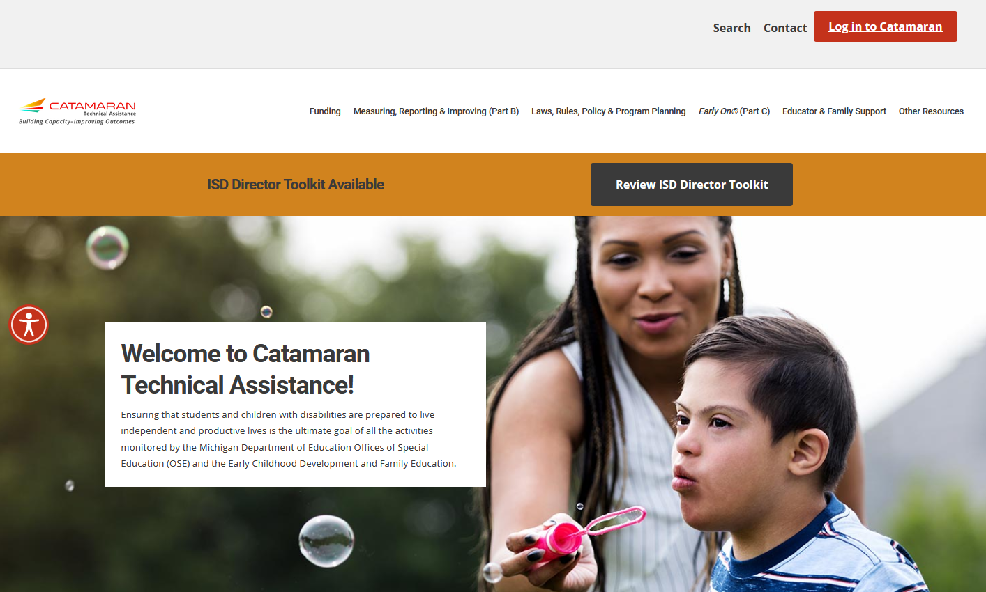
Catamaran Technical Assistance Website
Catamaran Technical Assistance Website
Notes:
ISDs may access the Catamaran Technical Assistance Website at training.catamaran.partners.

Slide 46
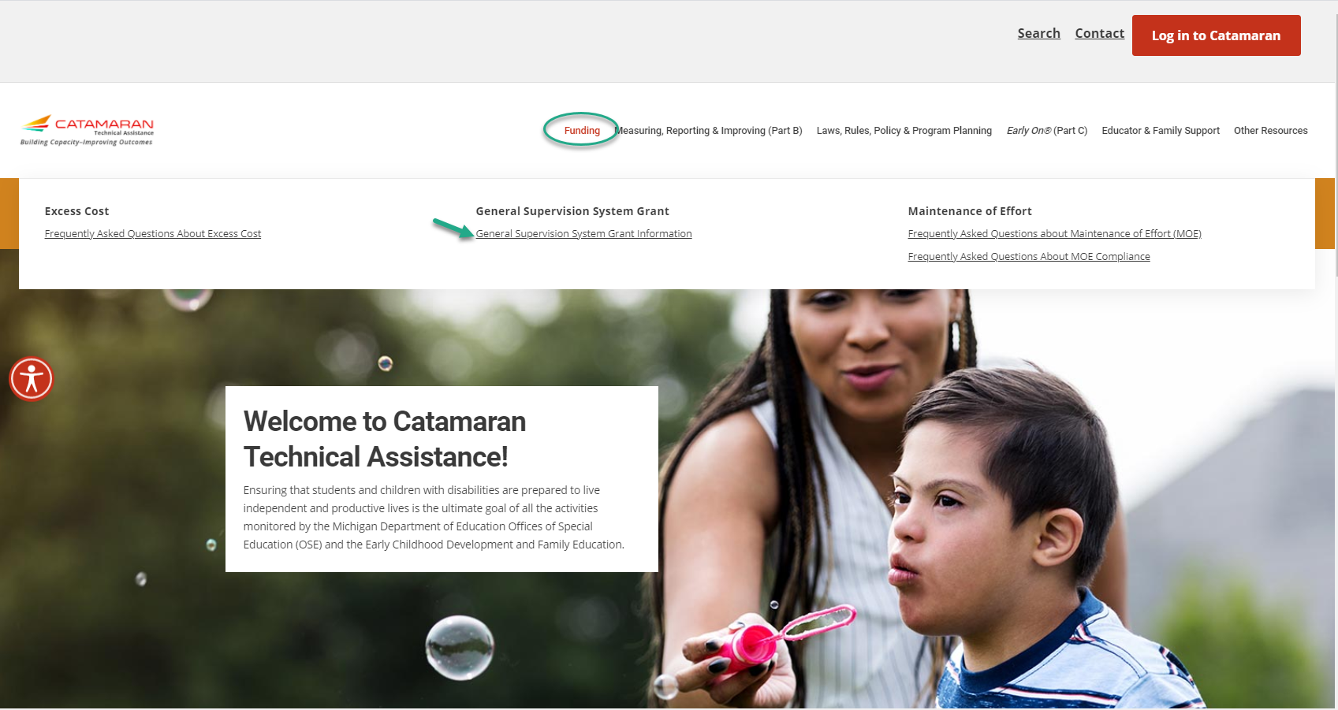
Catamaran Technical Assistance Website Continued
Locating General Supervision System Grant Information
Notes:
ISDs may now locate General Supervision System Grant Information by navigating to the top of the home page and selecting the Funding header.
Next, select the General Supervision System Grant Information link to be taken to important GSSG resources.

Slide 47
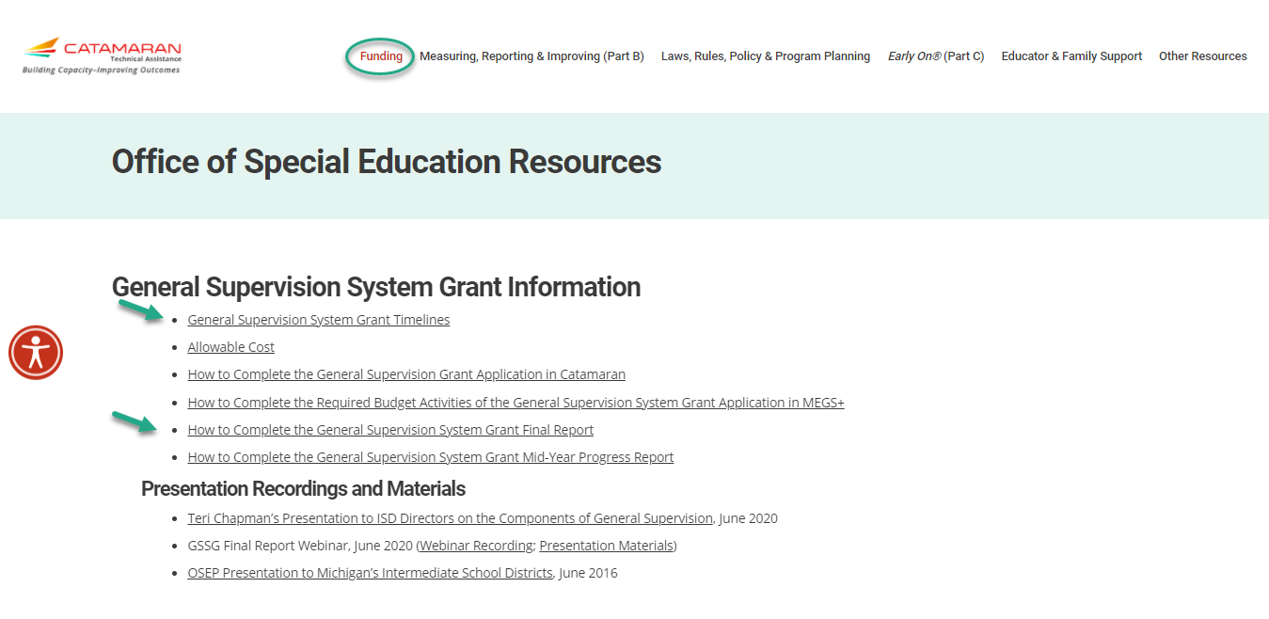
General Supervision System Grant Information Page
General Supervision System Grant Information Page
Notes:
This slide shows the General Supervision System Grant Information page on the Catamaran Technical Assistance Website.
Remember, you may get to this page by selecting the Funding header at the top of the website.

Slide 48
Questions?

Slide 49
Contact MDE OSE
Director & Deputy Director
Teri Rink, rinkt1@michigan.gov
Jan Weckstein, wecksteinj@michigan.gov
MDE OSE Information Line
888-320-8384
mde-ose@michigan.gov
Supervisors
John Andrejack, Program Finance andrejackj@michigan.gov
Jessica Brady, Performance Reporting bradyj@michigan.gov
Rebecca McIntyre, Program Accountability mcintyrer1@michigan.gov
Consultant & Coordinator
Scott Kemmer-Slater, Coordinator kemmerslaters@michigan.gov
Charles Thomas, Consultant thomasc29@michigan.gov

Slide 50
Contact the Catamaran Team
Catamaran Help Desk
877-474-9023
help@catamaran.partners
Project Director
Kelly Rogers
krogers@publicsectorconsultants.com
Senior Consultant
Lynne Clark
lclark@publicsectorconsultants.com

