Slide 1
Welcome!
The 2022-23 General Supervision System Grant Application Preview webinar will begin in a few moments.
The webinar recording and presentation materials will be posted on the Catamaran Technical Assistance Website under Past Events (https://training.catamaran.partners/past-events/)
To communicate with the presenters during the webinar, use the Chat feature.
Closed captioning is available. To select this option, choose the closed caption icon in the webinar player.

Slide 2
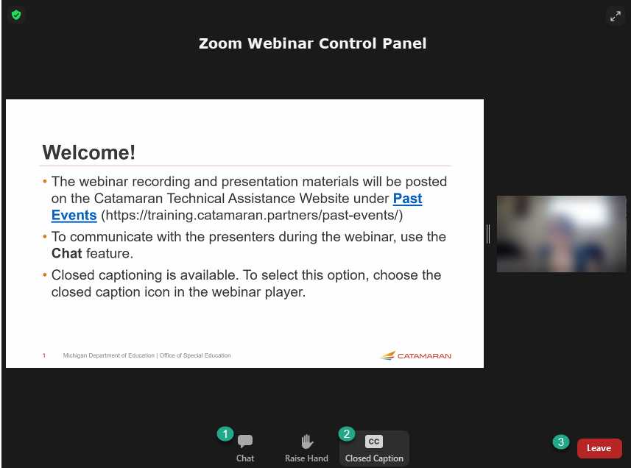
Zoom Webinar Control Panel
Mouse or tab down to the bottom of the webinar screen for the Zoom Webinar Control Panel to become visible.
Features available are:
Chat – select to communicate with presenters.
Closed Captioning (CC) – select the CC icon to turn on captions.
Leave – select to exit the webinar.
Notes:
Before we get started, I would like to highlight some features available on the Zoom Webinar Control Panel. Move your mouse or tab down to the bottom of the screen and you will find the chat feature which will allow you to communicate with the presenters. You can also select the CC icon to turn on captions and Leave will allow you to exit the webinar.

Slide 3
General Supervision System Grant (GSSG)
Application Preview
2022-2023 Grant Year
For Intermediate School District (ISD) Directors of Special Education

Slide 4
Meet the Team
Office of Special Education (OSE)
  Jeanne Anderson Tippett
  Chris Kelley
Public Sector Consultants (PSC)
  Kelly Rogers, Project Director
  Lynne Clark, Senior Project Manager
  Josiah Bear, Project Support Associate

Slide 5
Agenda
Application Overview
Completing the Application in Catamaran
Webinar Wrap-up

Slide 6
Application Overview
Notes:
Thanks Chris. Let’s start by taking a look at grant process this year.

Slide 7
GSSG 2022-23 Application Timelines
Application
  Live July 1, 2022
  Due August 1, 2022
OSE Office Hours:
  July 11, 2022 - 9 am – 11 am
  July 29, 2022 - 1 pm – 3 pm
Notes:
Application timelines will be the same for Catamaran as well as NexSys.

Slide 8
Completing the GSSG Application
Getting Started
Components of General Supervision
General Supervision Activities and Timelines
Priority Area
Fiscal
Notes:
This year's GSSG application will look different from years past. You will have the getting started section which will be the same as years previous. The components of general supervision section will ask you to select components. That is similar to years past. The general supervision activities and timelines page is going to look like a new page. On the priority area page you will be able to select new priority areas. And the final page will be the fiscal page which will be similar but pared down from previous years. Now let's look at each of these pages.

Slide 9
Getting Started: Prep and Planning
General Supervision System Grant Team
Lessons learned
Activities and timelines
Review and use of historical information and data
Notes:
As we begin a new grant cycle this is a good time for the ISD to take a look at their general supervision system grant team. Has the team lost some members? Are they additional members who should join? What lessons have been learned over the past several years when completing the GSSG activities? Were the activities and timelines accurate? Do activities and timelines need revision? GSSG teams should also review the historical information and data regarding the ISD’s performance on the priority area. Will a new priority be selected or will the ISD continue with the previous priority area?

Slide 10
2022-23 Components of General Supervision
Activities and Timelines
Confirming GSSG Components
Notes:
Eight Components of General Supervision are:
State Performance Plan/Annual Performance Report/State Systemic Improvement Plan (SPP/APR/ SSIP)
Data on Results and Processes (Data)
Integrated Monitoring Activities (Monitoring)
Policies, Procedures, and Effective Implementation of Evidence-based Practices (PPEBP)
Professional Learning and Development and Technical Assistance (PLD/TA)
Fiscal Accountability and Management (FAM)
Effective Dispute Resolution (DR)
Improvement, Correction, Incentives, and Sanctions (ICIS)
These 8 priority areas have not changed. if you would like more Information on any of these components, please watch the Teri Rink’s presentation to ISD directors recorded in June of 2020 on the technical assistance page. This recording defines each of the components and describes the relationship among them.

Slide 11
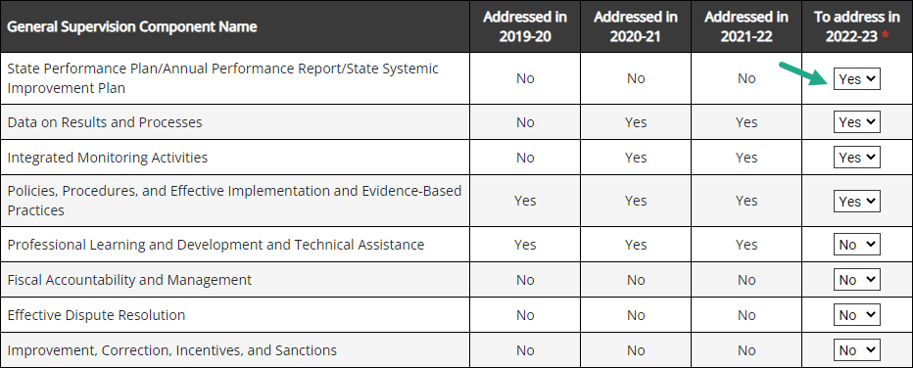
Components of General Supervision
Notes:
Component(s) of a General Supervision System
This chart in Catamaran represents the General Supervision Component(s) the ISD addressed in prior years and those the ISD will choose to address in 2022-2023. (To select components that will be addressed in 2022-23 the ISD will select “Yes” or “No” in the “To address in 2022-23” column)
It’s also possible that you may have chosen to select the same General Supervision Components, making no adjustments for 2022-23.
Notes:
Although an ISD may not be using the funds available through the GSSG to address all components, the ISD is responsible for implementing all components.
The ISD must make selections for components to address in 2022-2023 and save this page to see any updates to the Activities and Timelines

Slide 12
General Supervision Activities and Timelines
Consider the items listed which are reviewed during the general supervision self-assessment activity.
Complete the chart(s) to describe Activities, Timelines, and Personnel Responsible for each activity which the Intermediate School District (ISD) will complete.
Notes:
Will look very different in category in this year. And we will see the new page in just a moment. We should consider the items which will be reviewed during the general supervision system self assessment. Each item to be reviewed will be listed. Although The ISD is not required to address the items which are part of the self-assessment, they may do so when completing this section. The general supervision system grant and the general supervision system self assessment should work in tandem. One activity should inform the other.
Depending on the selected components, the ISD will see above each table the item description from the self-assessment pertaining to that component.
For each component, the ISD will describe the activities, timelines, and personnel responsible for that activity.
Activities: Brief description of planned activities associated with this GSC.
Timelines: Timeline planned for accomplishing this activity
Personnel Responsible: What Role(s) are responsible – can be role(s) or name of individual(s)

Slide 13
Priority Area: Progress Toward Improvement
Indicate if the ISD is continuing with the priority area identified in the prior GSSG.
If selecting a new priority area, provide justification.
Complete the Application Priority Area Data Sources table using local data sources.
Notes:
The ISD’s previously identified priority area will be pre-populated onto the page.
The ISD must decide if they are continuing with the same priority area or select a new one.
If the ISD decides to select a new priority area, then they will need to provide a justification for selecting a new priority area and then select the new priority area.
The next few slides will show what this will look like in Catamaran.

Slide 14
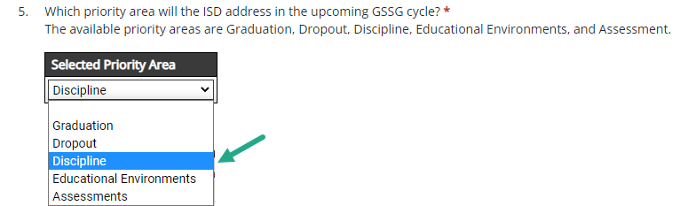
Selecting New Priority Area
Notes:
The priority area choices will remain the same. ISDs can choose from graduation/dropout, educational environments, assessment, and discipline.

Slide 15
Justification Response
Provide a review of the data used to determine sufficient progress has been made on the previous priority area.
Describe how the activities completed as part of the GSSG have led to improvement in this area.
Describe how the ISD will sustain the improvement over time.
Provide a review of the data used to determine the selection of the new priority area.
Notes:
When an ISD has chosen to select a new priority area the ISD must provide an explanation of the choice. The ISD will provide a review of the data that was used to determine that sufficient progress has been made on the previous priority area. The ISD will describe how the activities which were completed as part of the GSSG have led to improvement in this priority area. Please be specific with your data and reasoning. The ISD will also be asked to describe how it will sustain the improvement over time. Finally, the ISD will provide a review of the data that it used to determine which new priority area it will work on.

Slide 16
Priority Area Selection
Which priority area will the ISD address in the upcoming GSSG cycle?
Available priority areas are:
  Graduation
  Dropout
  Discipline
  Educational Environments
  Assessment
Notes:
After providing a justification response to the previous four statements, the ISD will be given the opportunity to select from one of the following priority areas: Graduation, Dropout, Discipline, Educational Environments, and Assessment.

Slide 17
Application Priority Area Data Sources
Local data sources
Sensitive to changes over the course of one year.
May reflect ISD aggregate or Member District level data.
Selecting a priority area and data sources for the General Supervision System Grant.
Notes:
After determining the priority area for the 2022-2023 school year the ISD is required to complete at least one row of the data sources table. In order to complete the data source table, ISDs are encouraged to use the data process and action protocol to determine actionable causes and improvement activities. Once those are improvement activities are determined, the ISD will decide how those improvement activities can be measured and those measures should be used for the data source table.
Local data sources should be used rather than APR, MI School Data, or Strand Report data. In the past when ISDs were completing the midyear report and the final report, we often heard that no new data was available. Many ISDs had chosen APR data as the measure of their improvement. APR data will no longer be accepted in the data source table. It is only collected once per year, is often unavailable due to data analysis timelines, and is not sensitive to change. ISDs should choose data sources which will have updated data available by the time of the final report which will be due in May of 2023.
The data sources do not need to be the indicator data which demonstrated the need to select this priority are. The data could be any measure of the improvement activities. The data should be sensitive to changes over the course of one year.
Data sources may reflect ISD aggregate or Member District level data.
See the training resource “Selecting a priority area and data sources for the General Supervision System Grant” available on the TA site at training.catamaran.partners/office-of-special-education-resources/

Slide 18
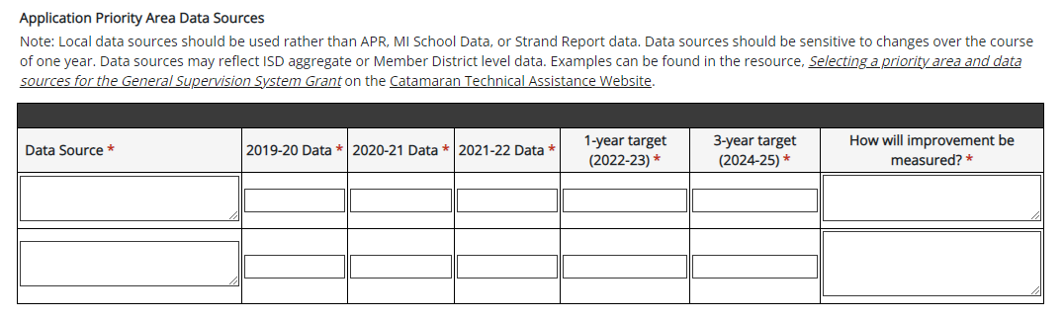
Priority Area Data Source Table

Slide 19
Priority Area Data Source Table Example
Data Source | 2019-20 Data | 2020-21 Data | 2021-22 Data | 1-year target (2022-23) | 3-year target (2024-25) | How will improvement be measured?
District PD documentation | 4% | 4% | 5% | 10% | 25% | Percent of general education teachers (K-5 ISD wide) who have attended CAST training
IEP Monitoring Data | 0 | 0 | 7% | 40% | 90% | Percent of IEPs which document thorough consideration of LRE for students reported in B-5 B and C
Notes:
This slide provides an example of a priority area data table. In this example, the ISD has selected educational environment as its priority area. After the review of the data and exploration of actionable causes, the ISD has decided that one of its improvement activities will be training all general education teachers for kindergarten through 5th grade across the ISD on the principles of cast. Cast is the Center for Applied Special Technology. Their focus in on universal design for learning. In addition to training, the ISD has decided that as part of integrated monitoring, it will look specifically at IEPs for students reported in B-5B and B-5C. In those IEPs, they are going to look for thorough documentation of the consideration of the least restrictive environment. Neither of those data points are going to be dependent on data reported to the state and both will be available at the time of the final report.

Slide 20
Fiscal Table – Personnel
Name | Position/Title | Amount | FTE Staff | Description
Enter the staff member’s name | Enter the staff member’s title | Enter the budgeted amount | Enter the FTE (Decimal) | Provide a description
Notes:
Just like we did in the final report, we have revised this section of the application and provided tables that should provide more opportunity for clarity of work purpose and connection to related activities for those that perform work associated with the GSSG.
The information in this table should include personnel and staffing resources that the ISD plans to use in developing and implementing a system of general supervision.
The dollar amount entered should be the budgeted amount rounded to the nearest whole dollar.
The column labeled, FTE Staff, should represent the percentage of the budgeted time to be spent by the specified staff member. The percentage should be in decimal format (e.g., 50% would be 0.50 FTE).
It is important to work closely with the ISD Business Official to complete this section which includes both Personnel and Non-Personnel related grant costs.
When completing the Personnel Table, a separate row should be completed for each staff member/personnel.

Slide 21
Fiscal Table – Non-Personnel
Expense Type | Amount | Description
Select the non-personnel expense type | Enter the budgeted amount | Provide a description
Notes:
The second table focuses on how General Supervision System Grant funds have been utilized for Non-Personnel related budgeted items for 2021-22.
Select from the Expense Type drop-down menu the type of non-personnel expense the ISD believes will be incurred. If Travel to Member Districts to Provide TA is selected, provide the staff member’s name the ISD plans to use in the Description column.
Drop down options: Audit costs, indirect, travel to member districts to provide TA
Enter the budgeted amount the ISD plans to spend in the Amount column.
Note: This table is optional

Slide 22
Fiscal: Access to Grant Funds
Initial 50 percent released upon submission of the grant in Catamaran and initial review of the submitted budget and current credential(s) in NexSys.
Final 50 percent released once the application is at Michigan Department of Education (MDE) Accepted.
Notes:
We are expecting the NexSys application to be available on the same dates this year and we will be able to go back to this model of access to funds.

Slide 23
Remaining GSSG 2022-23 Timelines
Final Report
  Live May 1, 2023
  Due June 1, 2023
Final Expenditure Report
  Due August 29, 2023 (in NexSys)
Notes:
After the Catamaran and NexSys application have been submitted by ISDs and approved by OSE, these are the remaining items that will need to be completed for the 2022-23 fiscal year. The final expenditure report is the same due date as this year, August 29 in NexSys.

Slide 24

Questions – Application Overview

Slide 25
Completing the Application in Catamaran
Notes:
Now that we’ve seen an overview of the application, let’s take a look at what this will look like in Catamaran.

Slide 26
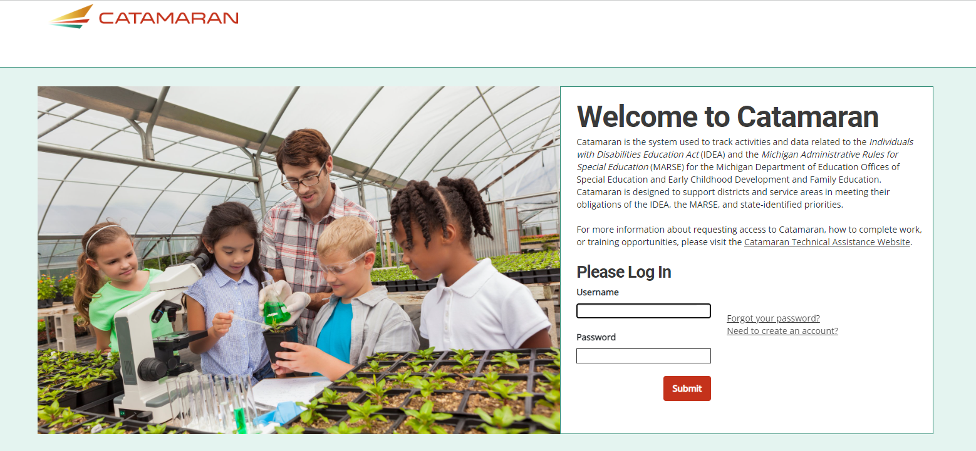
Login
Notes:
First, you will want to go to catamaran.partners to log in to Catamaran.
If you do not have a username and password or if you have forgotten it, you can either select the Need to create an account? or Forgot Password? link on the login screen or you may contact the Catamaran Help Desk.

Slide 27
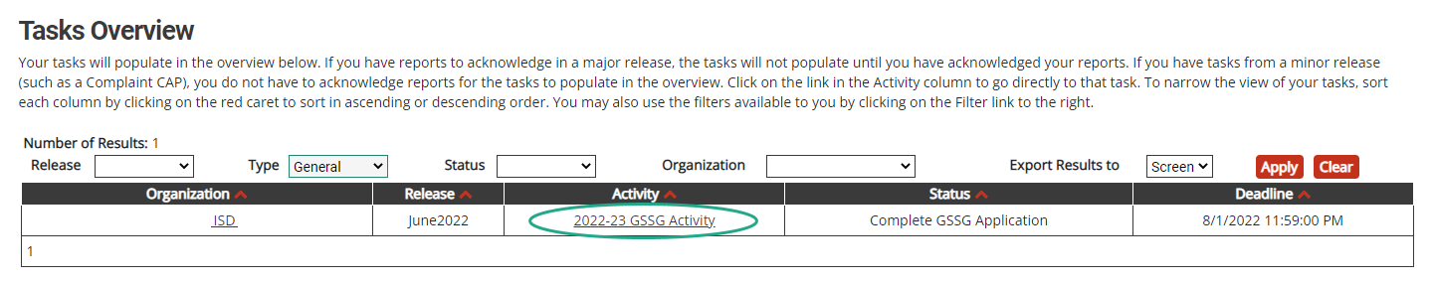
Access the Activity
Log in to Catamaran (https://catamaran.partners)
On the Dashboard, scroll down to the Tasks Overview section.
Use the filters, as needed, to narrow tasks.
Select the link in the Activity column to open the activity.
  Note: The activity name is 2022-23 GSSG Activity
Notes:
Once you have logged into Catamaran, scroll down to the Tasks Overview section on the Dashboard.
You may use the provided filters to narrow your tasks down as needed.
Then, select the 2022-23 GSSG Activity link in the Activity column to open the activity.

Slide 28
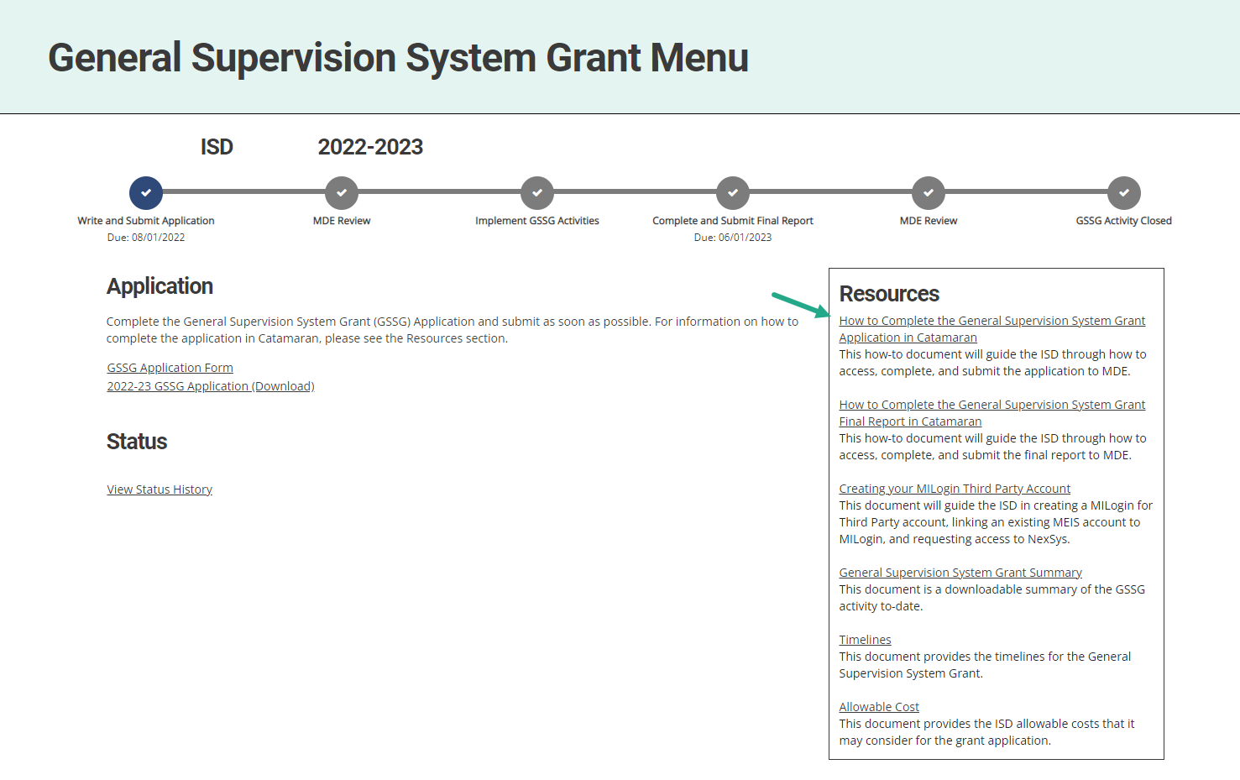
Open the Application & Review Resources
Notes:
Next, on the menu, ISDs may access and review the provided resources in the Resources box. Resources include a how-to document, General Supervision System Grant Summary, Creating your MILogin Third Party Account how-to, and other links such as Timelines and Allowable Cost.
To begin the application, select the GSSG Application Form link under the Application heading.

Slide 29
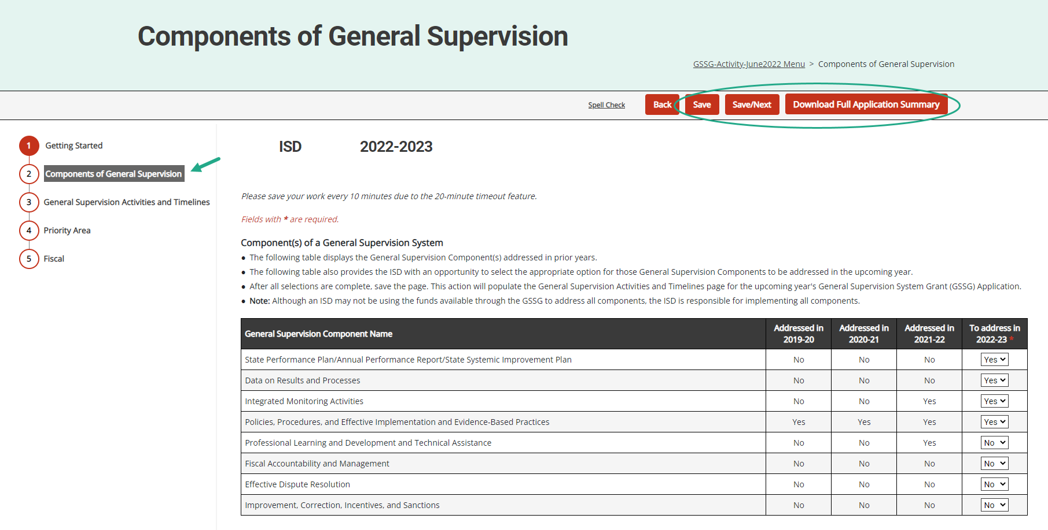
Complete Each Section of the Application
Notes:
Be sure to complete each section of the application.
Complete the application and choose Save or Save/Next to progress to the next section of the form.
Use the navigation menu on the left to move between sections of the report.
As a reminder, those sections include:
Getting Started
Components of General Supervision
General Supervision Activities and Timelines
Priority Area
Fiscal
It is recommended to review all sections of the application before submitting to MDE.
To complete this review, download a full summary of the application by either selecting the “Download Full Application Summary” button within the application or by selecting the 2022-23 GSSG Application (Download) link from the menu.

Slide 30
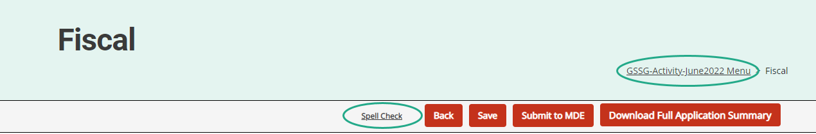
Navigation Notes
Access spell check by selecting the Spell Check link at the top of the page. The spell check feature functions within each field/cell of text that is currently being completed.
Users may return to the menu by selecting the breadcrumbs link at the top of the page.
Notes:
With many users logging in remotely, there may be page refreshing delays. Please make sure to allow time for report pages to completely load so that full functionality such as the text editor become available.
From anywhere with the application, users may run spell check by selecting the Spell Check link at the top of the page. The spell check feature functions within each field/cell of text that is currently being completed.
To return to the menu, select the breadcrumbs link at the top of the page. The breadcrumbs link shown here is labeled “GSSG Activity-June 2021 Menu”.

Slide 31
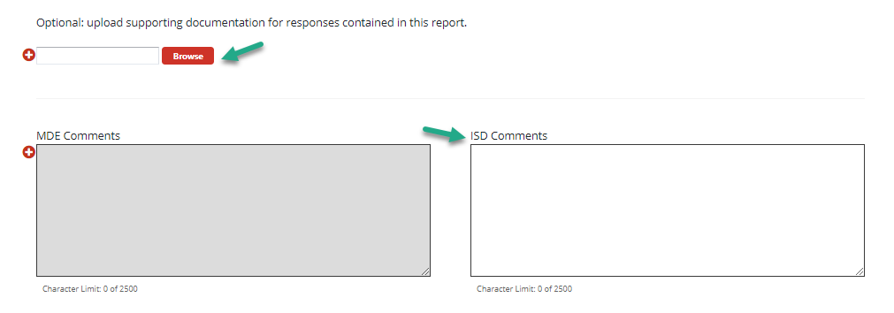
Additional Supporting Documentation or Comments (optional)
Notes:
On each page in the application, we have provided a set of comment boxes. ISDs may enter any additional clarification, as needed.
On the Fiscal page (last page of the application), the ISD may also upload additional supporting documentation.
Remember, the uploads are OPTIONAL. and the intention is to enhance the information provided in the application.

Slide 32
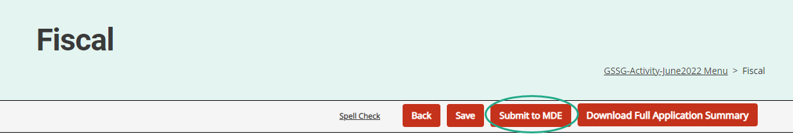
Submit the Application
The GSSG Application is due by August 1.
After completing the application, select the Submit to MDE button at the top of the page.
Notes:
The Application is due by August 1.
After completing the application, the ISD Director must select the Submit to MDE button at the top of the Fiscal page.
The MDE will review all applications. If concerns are identified, applications may be returned to the ISD for additional work. ISDs should check the MDE comment box on the application’s Getting Started page for additional information.
MDE requests that ISDs resubmit any returned applications within one week from the modification request notification.
As a reminder, 50% of the funds are released when the application is received and the other 50% when the application is approved.
One other change to be aware of this year is that there will not be a midyear report. Once the application is approved, you will not have other GSSG work in Catamaran until the Final Report in May.

Slide 33
Questions – Completing the Application

Slide 34
Webinar Wrap-up

Slide 35
Catamaran Help Desk
Questions about system navigation or accessing the activity
Available Monday–Friday from 8:00 am to 5:00 pm
Contact by:
  Email at help@catamaran.partners
  Phone 877-474-9023
  Chat feature within Catamaran
Notes:
The first resource you have available is the Catamaran Help Desk. The help desk is available Monday-Friday from 8-5 pm. Contact them by email, phone or using the chat feature within Catamaran.

Slide 36
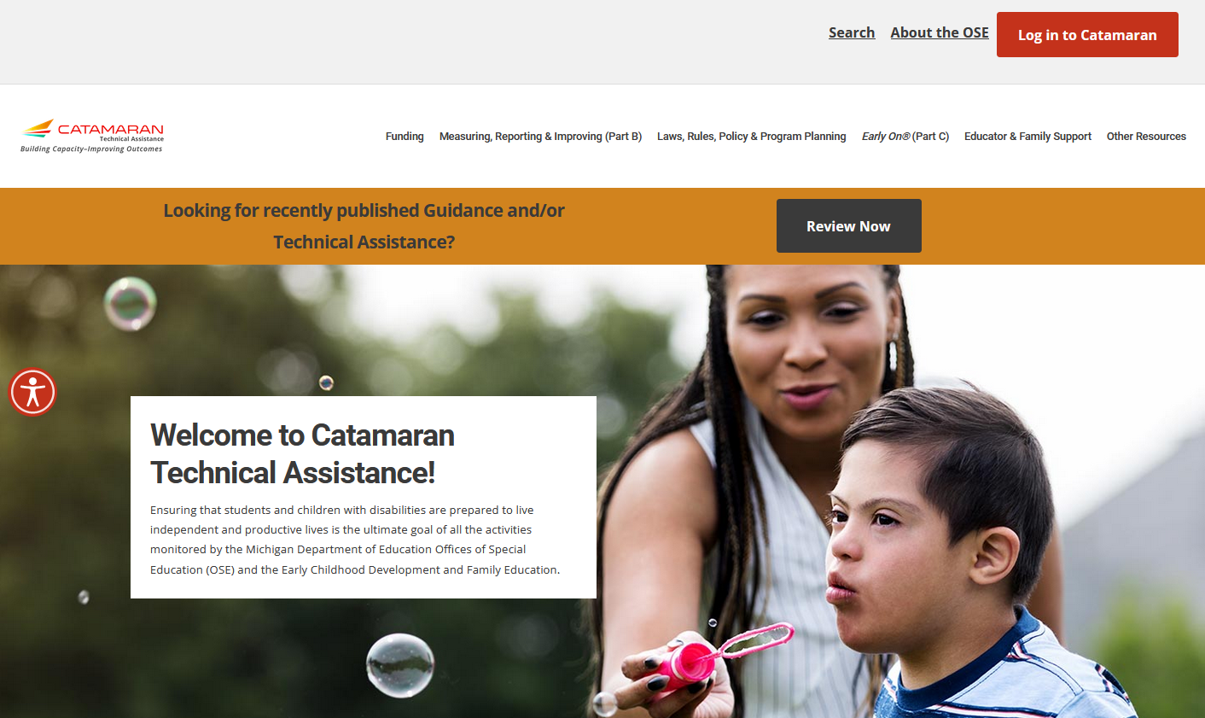
Catamaran Technical Assistance Website
Notes:
The Catamaran Technical Assistance Website is another valuable resource for ISDs. Access the site at training.catamaran.partners.
Examples of resources available on this site are recordings of past webinars, step-by-step how to documents, as well as guidance documents.

Slide 37
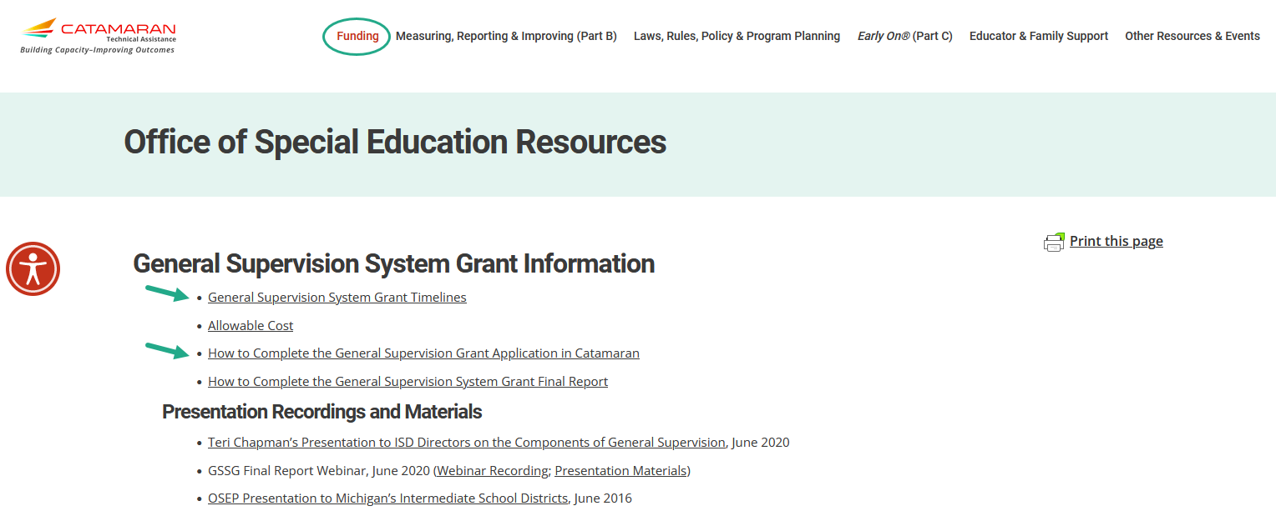
GSSG Information Page
Notes:
Also available on the Catamaran Technical Assistance Website is the General Supervision System Grant Information page.
As a reminder, ISDs may locate the General Supervision System Grant Information by navigating to the top of the home page and selecting the Funding header.

Slide 38
Contact MDE OSE
Presenters
Jeanne Anderson Tippett andersontippettj@michigan.gov
Chris Kelley
kelleyc9@michigan.gov
MDE OSE Information Line
888-320-8384
mde-ose@michigan.gov

Slide 39
Contact the Catamaran Team
Project Director
Kelly Rogers
krogers@publicsectorconsultants.com
Senior Project Manager
Lynne Clark
lclark@publicsectorconsultants.com
Catamaran Help Desk
877-474-9023
help@catamaran.partners

