Slide 1
Welcome!
The Maintenance of Effort Compliance training webinar will begin in a few moments.
The webinar recording and presentation materials will be posted on the Catamaran Technical Assistance Website under Past Events (https://training.catamaran.partners/past-events/)
To communicate with the presenters during the webinar, use the Chat feature.
Closed captioning is available for this webinar. To select this option, choose the closed caption icon in the Zoom webinar player.

Slide 2
Zoom Webinar Control Panel
Mouse or tab down to the bottom of the webinar screen for the Zoom Webinar Control Panel to become visible.
Features available are:
Chat – select to communicate with presenters.
Closed Captioning (CC) – select the CC icon to turn on captions.
Leave – select to exit the webinar.
Notes:
Before we get started, I would like to highlight some features available on the Zoom Webinar Control Panel. Move your mouse or tab down to the bottom of the screen and you will find the chat feature which will allow you to communicate with the presenters. You can also select the CC icon to turn on captions and Leave will allow you to exit the webinar.

Slide 3
Maintenance of Effort Compliance Training Webinar
For ISD Business Officials

Slide 4
Meet the team
Office of Special Education (OSE)
John Andrejack, Financial Manager, Program Finance
Public Sector Consultants (PSC)
Alex Kontras, Senior Consultant
Josiah Bear, Research Associate

Slide 5
Agenda
Maintenance of Effort (MOE) Basics
Completing the MOE Compliance Activity
Resources
Questions

Slide 6
Maintenance of Effort Basics

Slide 7
Purpose of Maintenance of Effort
The purpose of the Maintenance of Effort (MOE) requirement is to ensure that LEAs do not replace (i.e. supplant) state/local funding with federal funds.
MOE means that, in each year for the education of children with disabilities, an LEA:
Budgets at least as much state/local funds as it expended in the most recent year it met MOE (eligibility standard).
Expends at least as much as state/local funds it expended in the most recent year it met MOE (compliance standard).

Slide 8
How are expenditures calculated?
Fiscal effort is the term used to describe the expended amounts that are compared from one year to the next.
Fiscal effort can be calculated using four methods.
Each method uses SE 4096 and SE 4094 reports as the consistent universe of special education spending from year to year.

Slide 9
Four Methods to Calculate Fiscal Effort
Method 1 – Local Funds Only
Sum of SE 4094 and SE 4096 amounts, reduced by certain formulas that eliminate the state-reimbursed portion, leaving only the portion that is spent using local funds.
Method 2 – State and Local Funds
Sum of SE 4094 and SE 4096 amounts.
Method 3 – Local Funds, Per Capita
The Method 2 amount, divided by the number of special education students.
Method 4 – State and Local Funds, Per Capita
The Method 1 amount, divided by the number of special education students.

Slide 10
Member Districts and ISD Aggregation
MOE is tested at the aggregate ISD level. Member district figures (SE 4094, SE 4096, and headcount) are aggregated to the ISD level before MOE calculations are performed.
All individual member districts (districts and PSAs) are included in the MOE testing and have a part in ensuring MOE Compliance is met at the aggregate ISD level.

Slide 11
Aggregation Example
District | SE 4094 | SE 4096 | Headcount
District A | $25 | $100 | 15
District B | $10 | $75 | 8
District C | $15 | $50 | 7
ISD Aggregate | $50 | $225 | 30
Figures from all member districts, including PSAs, are aggregated before MOE calculations are performed.

Slide 12
Fiscal Effort Calculation Example
Method 1 Fiscal Effort (Local Total) | Method 2 Fiscal Effort (State & Local Total) | Method 3 Fiscal Effort (Local Per Capita) | Method4 Fiscal Effort (State & Local Per Capita)
$ 175 | $ 275 | $ 5.83 | $ 9.17
Catamaran uses the aggregated SE 4094, SE 4096, and headcount figures are used to calculate fiscal effort four different ways.
Method 1 is calculated using a formula to remove the state-reimbursed portion of 4096 and 4094 costs. This also accounts for 51F funds.

Slide 13
MOE Compliance Standard, Part 1
Requires that each ISD expends, in the aggregate, at least as much state/local funds as it expended in the most recent year it met MOE.
Occurs mid-spring, after most recently closed school year. For example, MOE Compliance testing for 2018-19 will occur in March 2020.
In this activity, Catamaran uses SE 4094, SE 4096, and headcount figures from the Financial Information Database (FID) to calculate fiscal effort automatically.
Catamaran compares expended fiscal effort in the test year to thresholds established in the previous MOE Compliance activity.

Slide 14
MOE Compliance Standard, Part 2
Fiscal effort comparisons are made on a per-method basis. By comparing fiscal effort for each method to thresholds for each method, Catamaran calculates which methods have been met or not met.
ISD meets the standard if an MOE threshold is met using any one of the four methods.
ISDs that do not pass using any method must add exceptions (more on exceptions later).
New fiscal effort thresholds are established for each method at the end of the MOE Compliance activity. New thresholds account for the last year the ISD met each method, including an exceptions/adjustments approved in any intervening years.

Slide 15
What If My ISD Does Not Pass MOE?
Exceptions/adjustments can be used if an ISD does not pass MOE Compliance or MOE Eligibility.
Exceptions/adjustments do not increase fiscal effort. Rather, they functionally lower the MOE thresholds, thereby allowably justifying a reduced level of fiscal effort.
Since the SE 4094 and SE 4096, are the universe of special education costs considered for MOE in Michigan, any exceptions taken must be costs that were reported on the SE 4094 or SE 4096.

Slide 16
Exception (a): Personnel Changes
As described in 34 CFR §300.204, an LEA may reduce LEA MOE for…
(a) The voluntary departure, by retirement or otherwise, or departure for just cause, of special education or related services personnel.
Exception (a) is taken when special education or related services staff turn over. Departures must be voluntary—someone retires or resigns—or for just cause—such as when an employee is terminated for misconduct. It does not refer to a reduction in force or downsizing.
Replacement staff costs must be entered as well.
Total exception (a) is equal to the departing staff costs, less the replacement staff costs.

Slide 17
Exception (b): Decrease in Students
As described in 34 CFR §300.204, an LEA may reduce MOE for…
(b) A decrease in the enrollment of children with disabilities.
This exception is automatically calculated and applied to all eligible ISDs by Catamaran.

Slide 18
Exception (c): Termination of an Eligible Obligation
As described in 34 CFR §300.204, an LEA may reduce LEA MOE for…
(c) The termination of the obligation of the agency, consistent with this part, to provide a program of special education to a particular child with a disability that is an exceptionally costly program, as determined by the SEA, because the child —
Has left the jurisdiction of the agency;
Has reached the age at which the obligation of the agency to provide FAPE to the child has terminated; or
No longer needs the program of special education.

Slide 19
Exception (d): Termination of an Eligible Costly Expenditure
As described in 34 CFR §300.204, an LEA may reduce LEA MOE for…
(d) The termination of costly expenditures for long-term purchases, such as the acquisition of equipment or the construction of school facilities.

Slide 20
Questions – Maintenance of Effort Basics
Notes:
If you have questions, please use the chat feature to type in questions.

Slide 21
Completing the MOE Compliance Activity
Finding and Completing Your Work

Slide 22
This Activity is for ISD Business Officials
The MOE Compliance activity should be completed by ISD officials who have an understanding of financial administration at their ISD.
This activity can only be completed by Catamaran users with the ISD business official role.
Other roles, such as the ISD director role, can view the activity, but cannot complete it.
If you have questions about your user role, please contact the Help Desk.

Slide 23
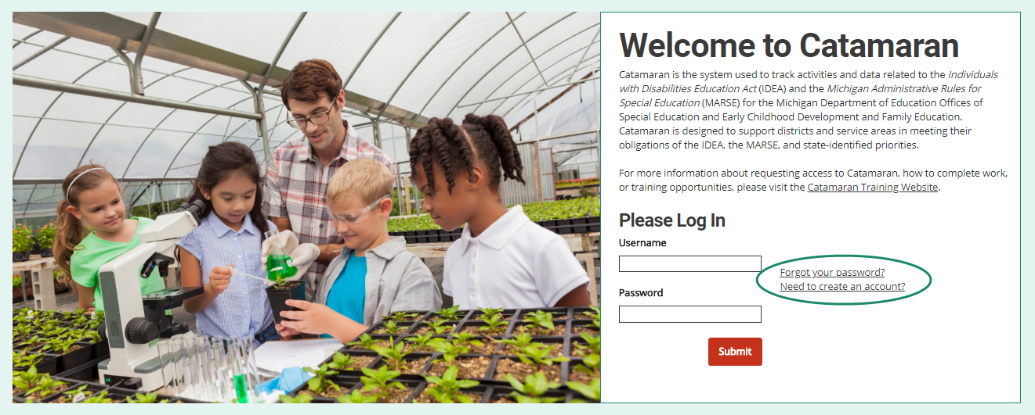
Log in to Catamaran
Log into Catamaran by navigating to https://catamaran.partners.
Create an account if you don’t already have one.

Slide 24
Locate the Activity the Tasks Overview
MOE Compliance is expected to launch March 21, 2022.
ISD business officials will be notified when the activity becomes available.
After logging in, locate the MOE Compliance Task on the Tasks Overview.
Select the Activity link to open the activity.

Slide 25
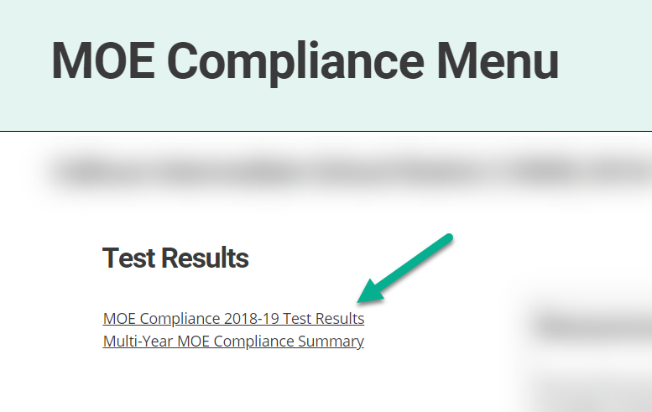
Access the Test Results
Catamaran will have already calculated the test results by using SE 4096 and SE 4094 data.
To view the results, open the MOE Compliance Test Results from the activity menu.
Historical results are also available by opening the Multi-Year MOE Compliance Summary report.

Slide 26
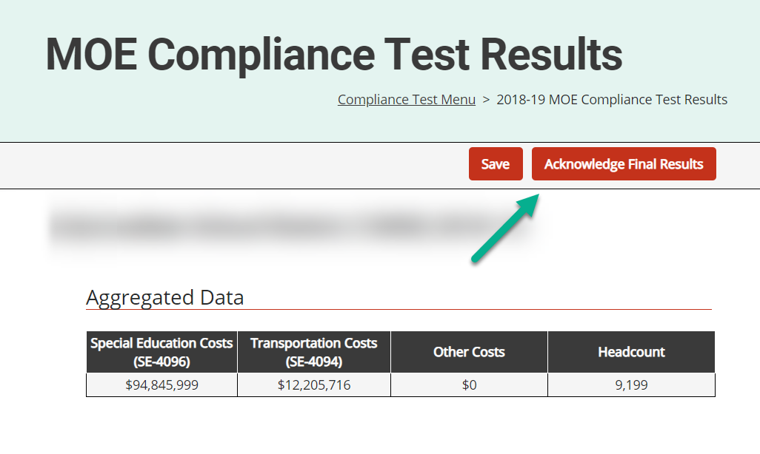
Situation #1: ISD Passes All Four Methods
The ISD has met the thresholds for all four methods and passed the MOE Compliance Test.
The ISDs are not eligible to add or submit exceptions.
Review the results and select Acknowledge Final Results.
Results letter will be emailed and available on the activity menu.

Slide 27
Situation #2: ISD Passes At Least One Method
The ISD has met the threshold for some of the methods and has passed the MOE Compliance Test.
ISDs may enter exceptions to be considered in future years (optional) but must do so before acknowledging final results.
Review the results and select Acknowledge Final Results.
Results letter will be emailed and available on the activity menu.

Slide 28
Situation #3: ISD Does Not Pass Any Method
ISD has not met the threshold for any method and has failed the MOE Compliance Test.
Review the results and select Acknowledge Initial Results.
Initial results letter will be emailed and available on the activity menu.
ISDs must then enter exceptions and submit them to MDE for approval.

Slide 29
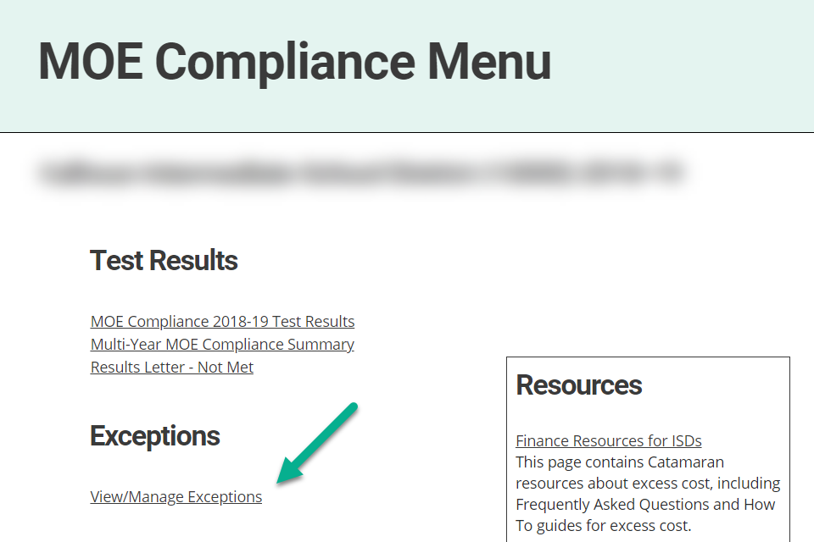
Entering Exceptions, Part 1
Access exceptions forms by selecting View/Manage Exceptions from the activity menu.

Slide 30
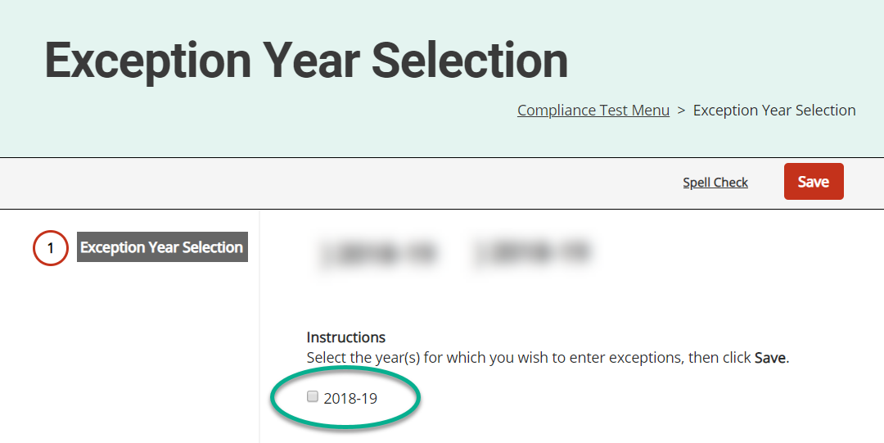
Entering Exceptions, Part 2
Select the year(s) for which you wish to enter exceptions.
Only the years for which the ISD is eligible to add exceptions will be available.

Slide 31
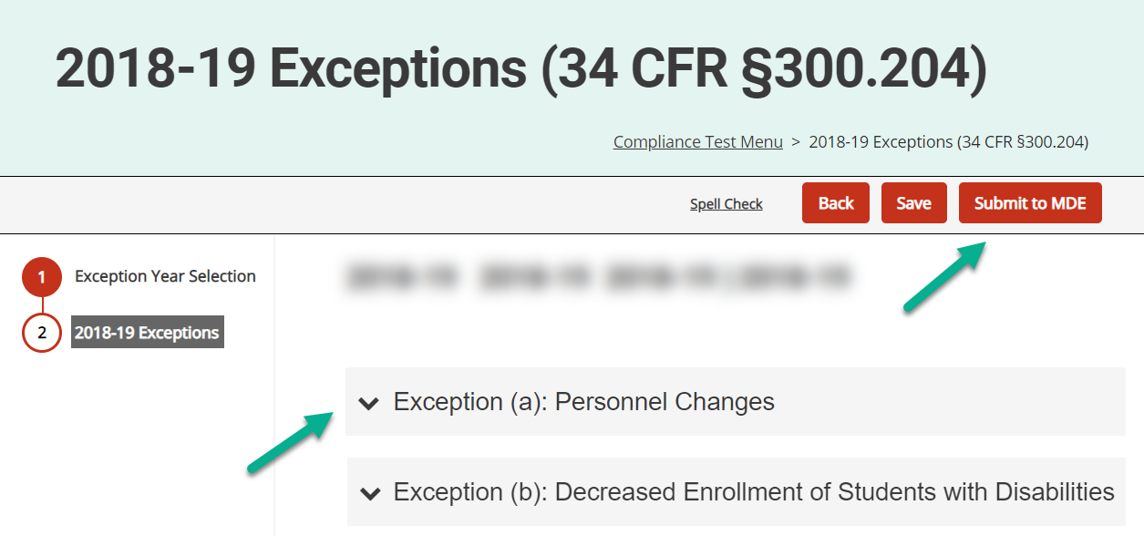
Entering Exceptions, Part 3
Select the section headers to add exceptions of various types.
Exceptions entered by ISD in previous years will prepopulate.
Exception (b) (decrease in enrollment) will have been automatically calculated and accounted for in the test results.
ISDs in situation #2 will not have the option to submit.

Slide 32
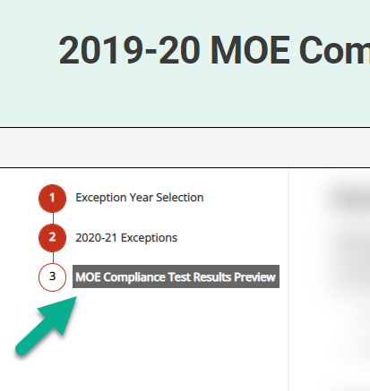
Entering Exceptions, Part 4
New this year is a Test Results Preview page.
After saving exceptions, visit this page to preview the impact of saved exceptions before submitting to the MDE.

Slide 33
Entering Exceptions, Part 5
After an ISD business official submits exceptions, MDE will review and approve or deny.
Catamaran will recalculate the official test results using approved exceptions.
ISD business officials will be notified that updated test results are available.
ISDs that pass must acknowledge their final test results (see above).
ISDs that do not pass must submit additional exceptions.
If the ISD does not have additional exceptions to submit, they must repay funds to the MDE. From the MOE Compliance Test Results page, select Enter Repayment Status.

Slide 34
Resources
FAQs and Training Materials

Slide 35
Catamaran Technical Assistance
Notes:
As many of you may already know, the revised Catamaran Training Website is now called the Catamaran Technical Assistance Website. The OSE in partnership with Catamaran users has redesigned the website to focus on increased technical assistance for Catamaran users. The pages are being reorganized and will be changing to cover broader topic areas.
The following slides highlight some of the features and navigation.
You can access the Catamaran Technical Assistance Website at training dot catamaran dot partners.

Slide 36
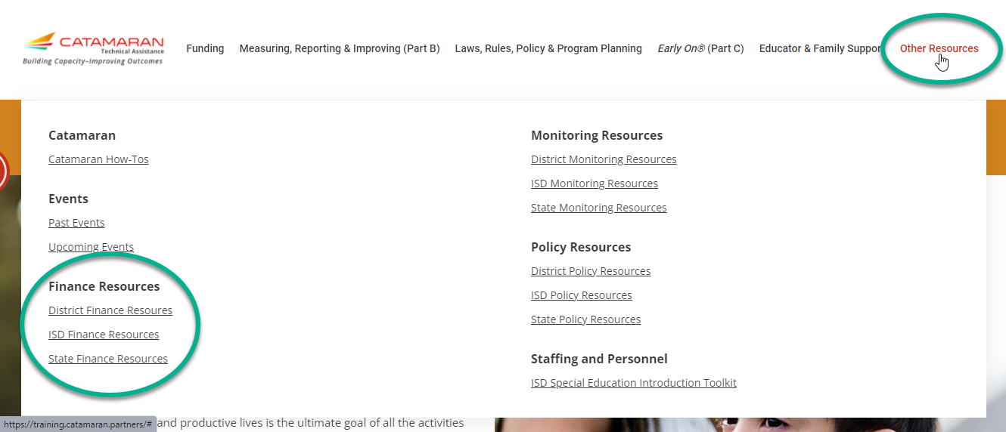
Finance Training Materials

Slide 37
MOE Training Materials
How to Complete MOE Compliance Activity for ISD Business Officials
https://training.catamaran.partners/how-to-complete-the-moe-compliance-activity-2/
Frequently Asked Questions About Maintenance of Effort
https://training.catamaran.partners/maintenance-of-effort-moe-frequently-asked-questions/

Slide 38
Questions
Notes:
If you have questions, please use the chat feature to type in questions.

Slide 39
Contact MDE OSE
Program Finance
John Andrejack
andrejackj@michigan.gov
Cindy Keller
kellerc2@michigan.gov
MDE OSE Information Line
888-320-8384
mde-ose@michigan.gov
Notes:
If you have any questions about today’s presentation, please reach out to John at a n d r e j a c k j @ michgian.gov or Cindy at k e l Andrejcak e r c 2 @michigan.gov. For more general questions about special education, please contact the MDE OSE Information Line at 888-320-8384 or by email at m d e – o s e @ Michigan.gov.

Slide 40
Contact the Catamaran Team
Project Director
Kelly Rogers
krogers@publicsectorconsultants.com
Catamaran Help Desk
877-474-9023
help@catamaran.partners
Senior Consultant
Alex Kontras
akontras@publicsectorconsultants.com
Notes:
Finally, for questions concerning Catamaran,
Reach out to Kelly at k r o g e r s@publicsectorconsultants.com or Alex at a k o n t r a s @publicsectorconsultants.com
As a reminder,
The Catamaran Help Desk is available Monday through Friday from 8-5 PM.
Contact them by email at help@catamaran.partners or by phone at 877-474-9023 or by using the Chat feature within Catamaran.
This concludes the presentation -- thank you for attending!

