Slide 1
General Supervision System Grant (GSSG) Application Preview
2024-25 Grant Year
For Intermediate School District (ISD) Directors of Special Education
Notes:
Welcome to the General Supervision System Grant, or GSSG, Application Preview for the 2024-25 grant year. This presentation is intended for Intermediate School District, or ISD, Directors of Special Education.

Slide 2
Agenda
Application Overview
Focus Area
Completing the Application in Catamaran
Resources
Notes:
On today’s agenda, we will cover four topics. Application Overview, focus area, completing the application in Catamaran, and finally, available resources.

Slide 3
Application Overview
Notes:
Let’s start by looking at the application overview.

Slide 4
GSSG 2024-25 Application Timelines
Application
Live June 28, 2024
Due August 1, 2024
Notes:
The GSSG Application will go live on June 28, 2024, and will be due on August 1, 2024. In NexSys, these application timelines will be the same.

Slide 5
Completing the GSSG Application
Getting Started
General Supervision Activities
Priority Area
Fiscal
Notes:
This year's GSSG application has a few updates. There will be four sections of the application instead of five.
Each ISD has been engaged in meaningful work on several of the eight components of general supervision. This year, all ISDs will focus on Component 4: Policies, Procedures, and Effective Implementation of Evidence-based Practices to explore and improve this component in light of OSE’s thematic goal of providing FAPE in the LRE. We will explain more about this update later in the presentation.
The first page of the application is Getting Started, and the second page, General Supervision Activities, is where you will respond to questions about Component 4.
On the third, Priority Area page, you can either continue with the same priority area or select a new one for this grant cycle.
On the last page, Fiscal, it will look the same as last year.
Now, let’s review each of these pages.

Slide 6
Getting Started: Prep and Planning
General Supervision System Grant Team
Lessons learned
Activities
Review and use of historical information and data
Notes:
As we begin a new grant cycle, this is a good time for the ISD to review its general supervision system grant team. Has the team lost some members? Are there additional members who should join? What lessons have been learned over the past several years when completing the GSSG activities? Were the activities accurate? Do the activities need revision?
GSSG teams should also review the historical information and data regarding the ISD’s performance on the priority area. In light of this year's work around LRE, ISDs have the option to select a new priority area or may choose to continue with the previous priority area.

Slide 7
2024-25 Components of General Supervision
Activities
GSSG Components
Notes:
As you review the Getting Started page, you will see a list of the eight components of general supervision.
The Eight Components of General Supervision are:
State Performance Plan/Annual Performance Report/State Systemic Improvement Plan (SPP/APR/ SSIP)
Data on Results and Processes (Data)
Integrated Monitoring Activities (Monitoring)
Policies, Procedures, and Effective Implementation of Evidence-based Practices (PPEBP)
Professional Learning and Development and Technical Assistance (PLD/TA)
Fiscal Accountability and Management (FAM)
Effective Dispute Resolution (DR)
Improvement, Correction, Incentives, and Sanctions (ICIS)
An ISD may continue to work on developing each of the eight components in addition to the focus area of Component 4. However, that additional work would happen outside of Catamaran. If you wish to continue this work, please refer to the General Supervision Design Tool on the Catamaran Technical Assistance Website on the General Supervision System Grant Information page at training.catamaran.partners/office-of-special-education-resources/

Slide 8
General Supervision Activities: Component 4
Describe what the ISD is currently doing.
Document what the ISD will provide.
List any next steps the ISD will take, and
List the personnel responsible for each activity.
Notes:
As mentioned earlier, this year, for this cycle, the OSE is requiring all ISDs to address Component 4: Policies, Procedures, and Effective Implementation of Evidence-based Practices (PPEBP) with a focus on the least restrictive environments (LRE). ISDs should respond to each statement from the General Supervision Design Tool for component four to describe what the ISD is currently doing, document what the ISD will provide, any next steps the ISD will need to take, and list the personnel responsible for each activity the ISD will complete.
The ISD will not be required to address the other components of the design tool within Catamaran, although they may continue that good work outside of the Catamaran system.

Slide 9
Priority Area: Progress Toward Improvement
Indicate if the ISD is continuing with the priority area identified in the prior GSSG.
If selecting a new priority area, provide justification.
Complete the Application Priority Area Data Sources table using local data sources.
Notes:
The ISD’s previously identified priority area will be pre-populated onto the page.
The ISD must decide if they are continuing with the same priority area or select a new one.
If the ISD decides to select a new priority area, then they will need to provide a justification for selecting a new priority area and then select the new priority area.
The next few slides will show what this will look like in Catamaran.
Given that all ISDs will focus on Component 4 in light of the provision of FAPE in the LRE to support the creation of effective systems of general supervision, this activity should improve and impact results and compliance data across priority areas, thus continuing to build an overall system of general supervision supporting the provision of a FAPE in the LRE.

Slide 10
Selecting New Priority Area
Notes:
If the ISD does not wish to continue with the same priority area as the previous grant cycle, then the ISD will need to select a new priority area after justifying why the ISD wishes to update its priority area. Note that these questions will not appear if the ISD indicates they plan to keep the same priority area.
ISDs can choose from graduation, dropout, discipline, education environments, and assessments. This is the same as last year.

Slide 11
Justification Response
Provide a review of the data used to determine sufficient progress has been made on the previous priority area.
Describe how the activities completed as part of the GSSG have led to improvement in this area.
Describe how the ISD will sustain the improvement over time.
Provide a review of the data used to determine the selection of the new priority area.
Notes:
When an ISD chooses to select a new priority area, the ISD must explain the choice. The ISD will provide a review of the data used to determine that sufficient progress has been made on the previous priority area. The ISD will describe how the activities completed as part of the GSSG have improved this priority area. Please be specific with your data and reasoning. The ISD will also be asked to describe how it will sustain the improvement over time. Finally, the ISD will review the data it used to determine which new priority area it will work on.

Slide 12
Priority Area Selection
Which priority area will the ISD address in the upcoming GSSG cycle?
Available priority areas are:
Graduation
Dropout
Discipline
Educational Environments
Assessment
Notes:
After providing a justification response to the previous four statements, the ISD may select from one of the following priority areas: Graduation, Dropout, Discipline, Educational Environments, and Assessment.

Slide 13
Application Priority Area Data Sources
Local data sources
Sensitive to changes over the course of one year
May reflect ISD aggregate and/or Member District level data
Selecting a priority area and data sources for the General Supervision System Grant
Notes:
After determining the priority area for the 2024-2025 school year, the ISD is required to complete at least one row of the data sources table. To complete the data source table, ISDs are encouraged to use the data use and action process to determine actionable causes and improvement activities. Once those improvement activities are determined, the ISD will decide how they can be measured, and those measures should be used for the data source table.
Local data sources should be used rather than APR, MI School Data, or Strand Report data. In the past, when ISDs were completing the midyear report and the final report, we often heard that no new data was available. Many ISDs had chosen APR data as the measure of their improvement. APR data will no longer be accepted in the data source table. It is only collected once per year, is often unavailable due to data analysis timelines, and is not sensitive to change. ISDs should choose data sources which will have updated data available by the time of the final report which will be due in May of 2025.
The data sources do not need to be the indicator data which demonstrated the need to select a priority area. The data could be any measure of the improvement activities. Data should be sensitive to change over the course of one year.
Data sources may reflect ISD aggregate and/or Member District level data.
See the training resource “Selecting a priority area and data sources for the General Supervision System Grant” available on the TA site at training.catamaran.partners/office-of-special-education-resources/

Slide 14
Priority Area Data Source Table
Notes:
Once the ISD has identified a priority area for the 2024-25 school year, the ISD will determine which data sources will be used to measure progress. The table shown on this slide shows the priority area data source table. The ISD must enter at least one data source and complete the table to indicate the past several years' worth of data and their targets for one year and three years from now. They will also indicate how the improvement will be measured in the last column.

Slide 15
Priority Area Data Source Table Example
Data Source | 2021-22 Data | 2022-23 Data | 2023-24 Data | 1-year target (2024-25) | 3-year target (2026-27) | How will improvement be measured?
District PD documentation | 4% | 4% | 5% | 10% | 25% | Percent of general education teachers (K-5 ISD wide) who have attended CAST training
IEP Monitoring Data | 0 | 0 | 7% | 40% | 90% | Percent of IEPs which document thorough consideration of LRE for students reported in B-5 B and C
Notes:
This slide provides an example of a priority area data table. In this example, the ISD has selected educational environment as its priority area. After the review of the data and exploration of actionable causes, the ISD has decided that one of its improvement activities will be training all general education teachers for kindergarten through 5th grade across the ISD on the principles of CAST. CAST is the Center for Applied Special Technology. Their focus is on universal design for learning. In addition to training, the ISD has decided that as part of integrated monitoring, it will look specifically at IEPs for students reported in B-5B and B-5C. In those IEPs, they are going to look for thorough documentation of the consideration of the least restrictive environment. Neither of those data points are going to be dependent on data reported to the state and both will be available at the time of the final report.

Slide 16
Fiscal Table – Personnel
Name | Position/Title | Amount | FTE Staff | Description
Enter the staff member’s name | Enter the staff member’s title | Enter the budgeted amount | Enter the FTE (Decimal) | Provide a description
Notes:
The fiscal page is the same as last year.
This slide shows the first table on the fiscal page, the personnel table.
The information in this table should include personnel and staffing resources that the ISD plans to use in developing and implementing a system of general supervision.
The dollar amount entered should be the budgeted amount rounded to the nearest whole dollar.
The column labeled “FTE Staff” should represent the percentage of the budgeted time to be spent by the specified staff member. The percentage should be in decimal format (e.g., 50% would be 0.50 FTE).
It is important to work closely with the ISD Business Official to complete this section, which includes both Personnel and Non-Personnel related grant costs.
When completing the Personnel Table, a separate row should be completed for each staff member/personnel.

Slide 17
Fiscal Table – Non-Personnel
Expense Type | Amount | Description
Select the non-personnel expense type | Enter the budgeted amount | Provide a description
Notes:
The second table focuses on how General Supervision System Grant funds will be utilized for Non-Personnel related budgeted items for 2024-25. This table is optional. To complete this table:
Select from the “Expense Type” drop-down menu the type of non-personnel expense the ISD believes will be incurred. Drop-down options include: Audit costs, indirect, and travel to member districts to provide TA.
Enter the budgeted amount the ISD plans to spend in the “Amount” column.
If “Travel to Member Districts to Provide TA” is selected, provide the staff member’s name the ISD plans to use in the Description column.

Slide 18
Fiscal: Access to Grant Funds
Initial 50 percent released upon submission of the grant in Catamaran and initial review of the submitted budget and current credential(s) in NexSys.
Final 50 percent released once the application is at Michigan Department of Education (MDE) Accepted.
Notes:
We expect the NexSys application to be available on the same dates this year as the Catamaran application, so we will be able to use this model of access to funds.
The initial 50 percent of the funds will be made available once the proposed budget and credentials are reviewed and approved by MDE OSE in NexSys. The final 50 percent will be released once the application is MDE accepted in Catamaran. Once the catamaran application is MDE accepted, MDE OSE will upload the PDF of the Catamaran application to NexSys. It will not be a requirement of the ISD.

Slide 19
Remaining GSSG 2024-25 Timelines
Final Report
Live May 1, 2025
Due June 1, 2025
Final Expenditure Report
Due August 29, 2025 (in NexSys)
Notes:
After ISDs submit the application in Catamaran and NexSys and OSE approves them, the remaining items for the 2024-25 fiscal year include:
Final Report – it will become available on May 1, 2025, and will be due to the OSE on June 1, 2025.
Final Expenditure Report – will be due in NexSys on August 29, 2025.

Slide 20
Completing the Application in Catamaran
Notes:
Now that we’ve seen an overview of the application, let’s take a look at what completing the application in Catamaran looks like.

Slide 21
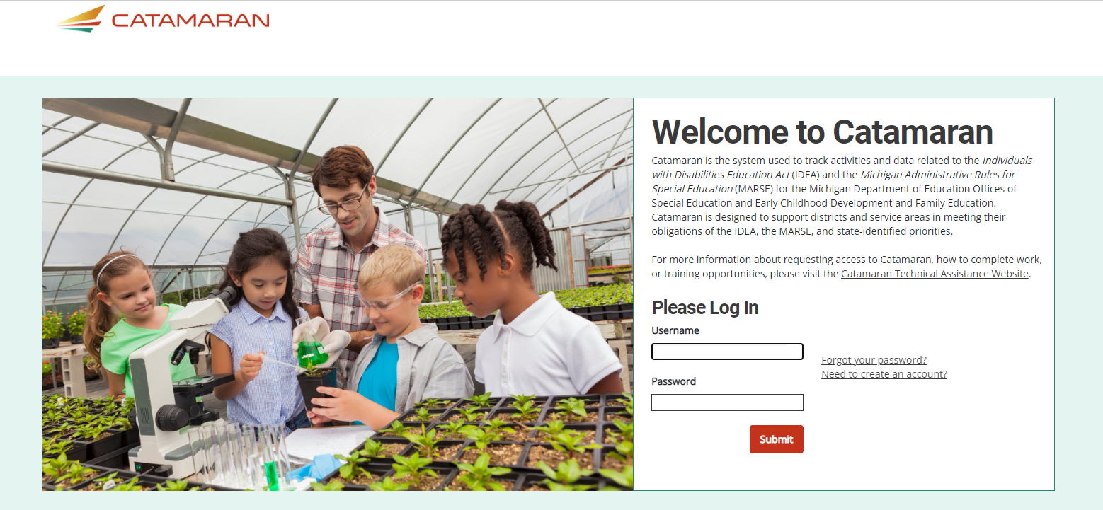
Catamaran Login
Notes:
First, you will want to go to catamaran.partners to log in to Catamaran.
If you do not have a username and password or if you have forgotten it, you can either select the Need to create an account? or Forgot Password? link on the login screen or you may contact the Catamaran Help Desk.

Slide 22
Access the Activity
Log in to Catamaran (https://catamaran.partners)
On the Dashboard, scroll down to the Tasks Overview section.
Use the filters, as needed, to narrow tasks.
Select the link in the Activity column to open the activity.
Note: The activity name is 2024-25 GSSG Activity
Notes:
Once you have logged into Catamaran, scroll down to the Tasks Overview section on the Dashboard.
You may use the provided filters to narrow your tasks down as needed.
Then, select the 2024-25 GSSG Activity link in the Activity column to open the activity.

Slide 23
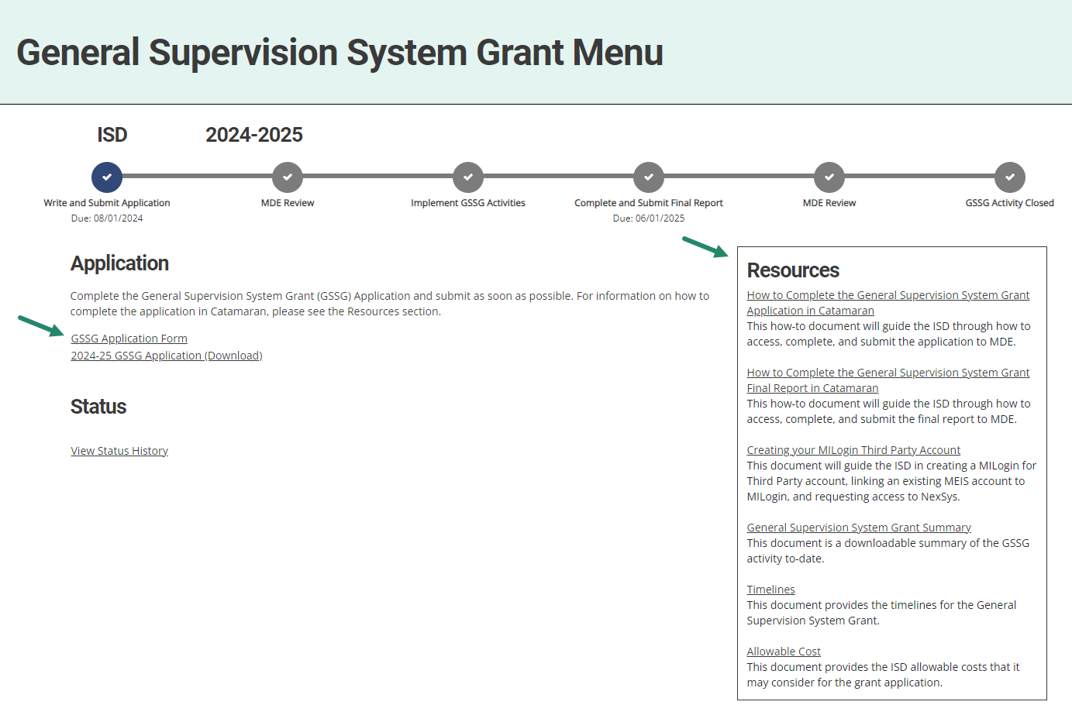
General Supervision System Grant Menu
Notes:
Next, on the menu, ISDs may access and review the provided resources in the Resources box. Resources include a how-to document, General Supervision System Grant Summary, Creating your MILogin Third Party Account how-to, and other links such as Timelines and Allowable Cost.
To begin the application, select the GSSG Application Form link under the Application heading.

Slide 24
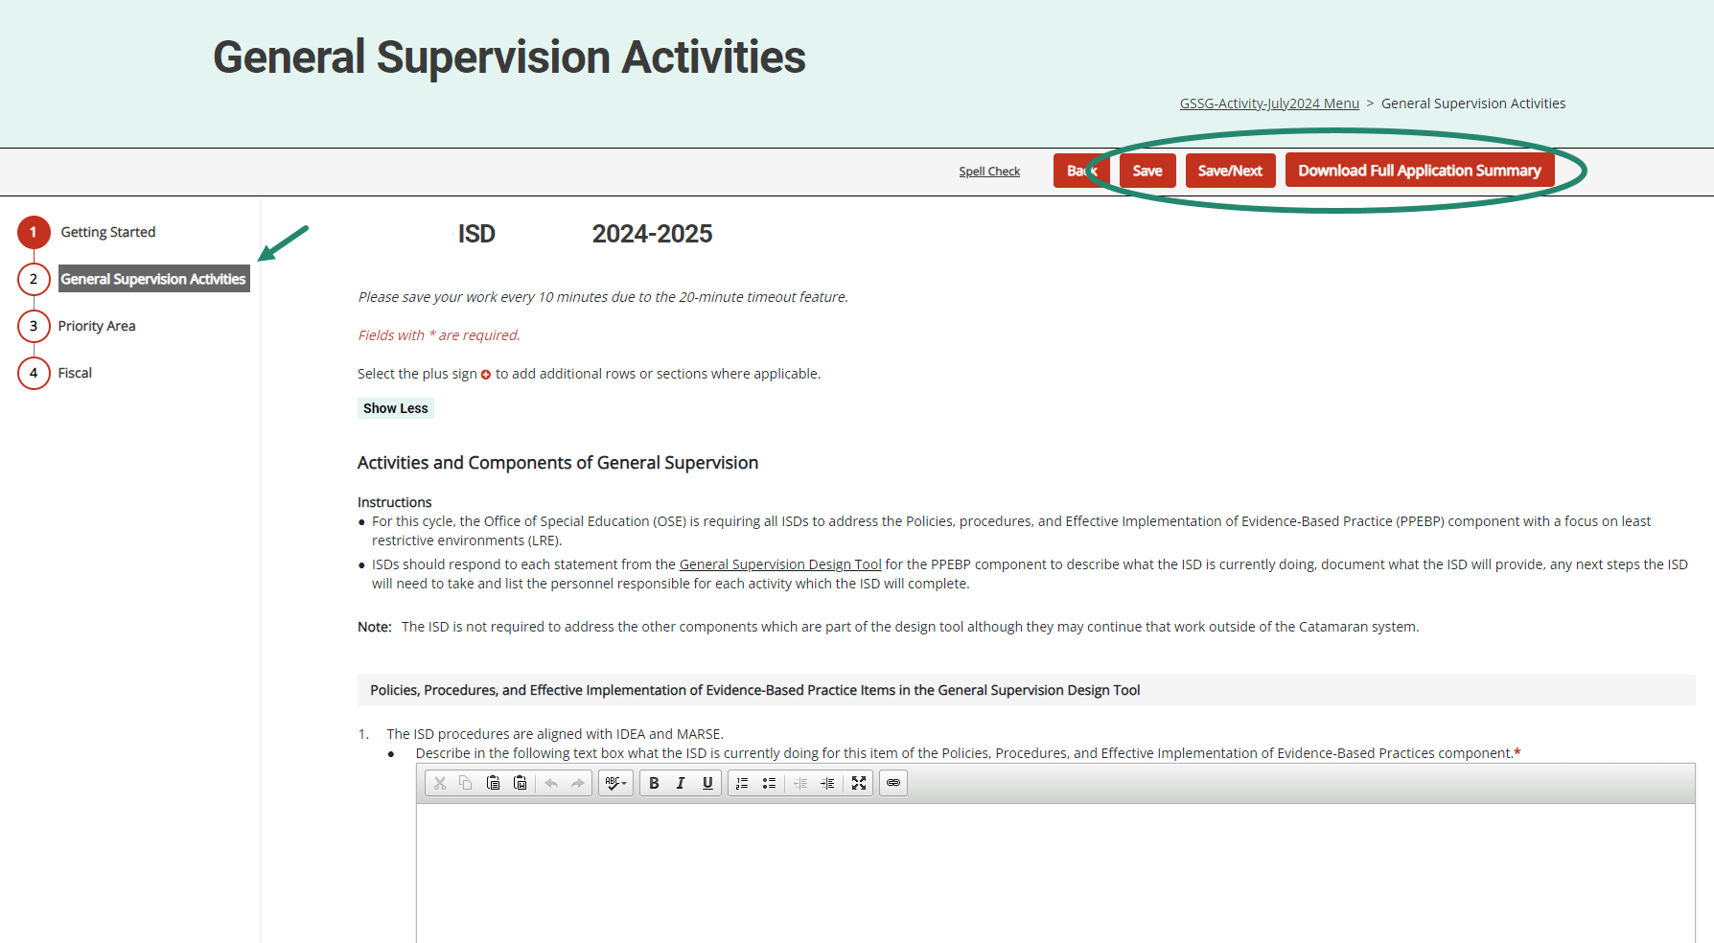
Components of General Supervision Page
Notes:
Be sure to complete each section of the application.
Complete the application and choose Save or Save/Next to progress to the next section of the form.
Use the navigation menu on the left to move between sections of the report.
As a reminder, those sections include:
Getting Started
General Supervision Activities
Priority Area
Fiscal
It is recommended to review all application sections before submitting to MDE.
To complete this review, download a full summary of the application by either selecting the “Download Full Application Summary” button within the application or by selecting the 2024-25 GSSG Application (Download) link from the menu.

Slide 25
Navigation Notes
Access spell check by selecting the Spell Check link at the top of the page. The spell check feature functions within each field/cell of text that is currently being completed.
Users may return to the menu by selecting the breadcrumbs link at the top of the page.
Notes:
With many users logging in remotely, there may be page refreshing delays. Please make sure to allow time for report pages to completely load so that full functionality such as the text editor become available.
From anywhere with the application, users may run spell check by selecting the Spell Check link at the top of the page. The spell check feature functions within each field/cell of text that is currently being completed.
To return to the menu, select the breadcrumbs link at the top of the page. The breadcrumbs link shown here is labeled “GSSG Activity-June 2024 Menu”.

Slide 26
Additional Supporting Documentation or Comments (optional)
Notes:
On each page in the application, we have provided a set of comment boxes. ISDs may enter any additional clarification, as needed.
On the Fiscal page (last page of the application), the ISD may also upload additional supporting documentation.
Remember, the uploads are OPTIONAL, and the intention is to enhance the information provided in the application.

Slide 27
Submit the Application
The GSSG Application is due by August 1.
After completing the application, select the Submit to MDE button at the top of the page.
Notes:
The Application is due by August 1.
After completing the application, the ISD Director must select the Submit to MDE button at the top of the Fiscal page.
The MDE will review all applications. If concerns are identified, applications may be returned to the ISD for additional work. ISDs should check the MDE comment box on the application’s Getting Started page for additional information.
MDE requests that ISDs resubmit any returned applications within one week from the modification request notification.
As a reminder, 50% of the funds are released when the application is received and the other 50% when the application is approved.
Once the application is approved, you will not have other GSSG work in Catamaran until the Final Report in May.

Slide 28
Webinar Wrap-up
Notes:
We will wrap up this webinar by providing you some valuable resources.

Slide 29
Catamaran Help Desk
Questions about system navigation or accessing the activity
Available Monday–Friday from 8:00 am to 5:00 pm
Contact by:
Email at help@catamaran.partners
Phone 877-474-9023
Chat feature within Catamaran
Notes:
The first resource you have available is the Catamaran Help Desk. The help desk is available Monday-Friday from 8 am-5 pm. You can contact the Catamaran help desk by email, phone or by using the chat feature within Catamaran.

Slide 30
Catamaran Technical Assistance Website
Notes:
The Catamaran Technical Assistance Website is another valuable resource for ISDs. You can access the site at training.catamaran.partners.
Examples of resources available on this site are recordings of past webinars, step-by-step how-to documents, as well as guidance documents.

Slide 31
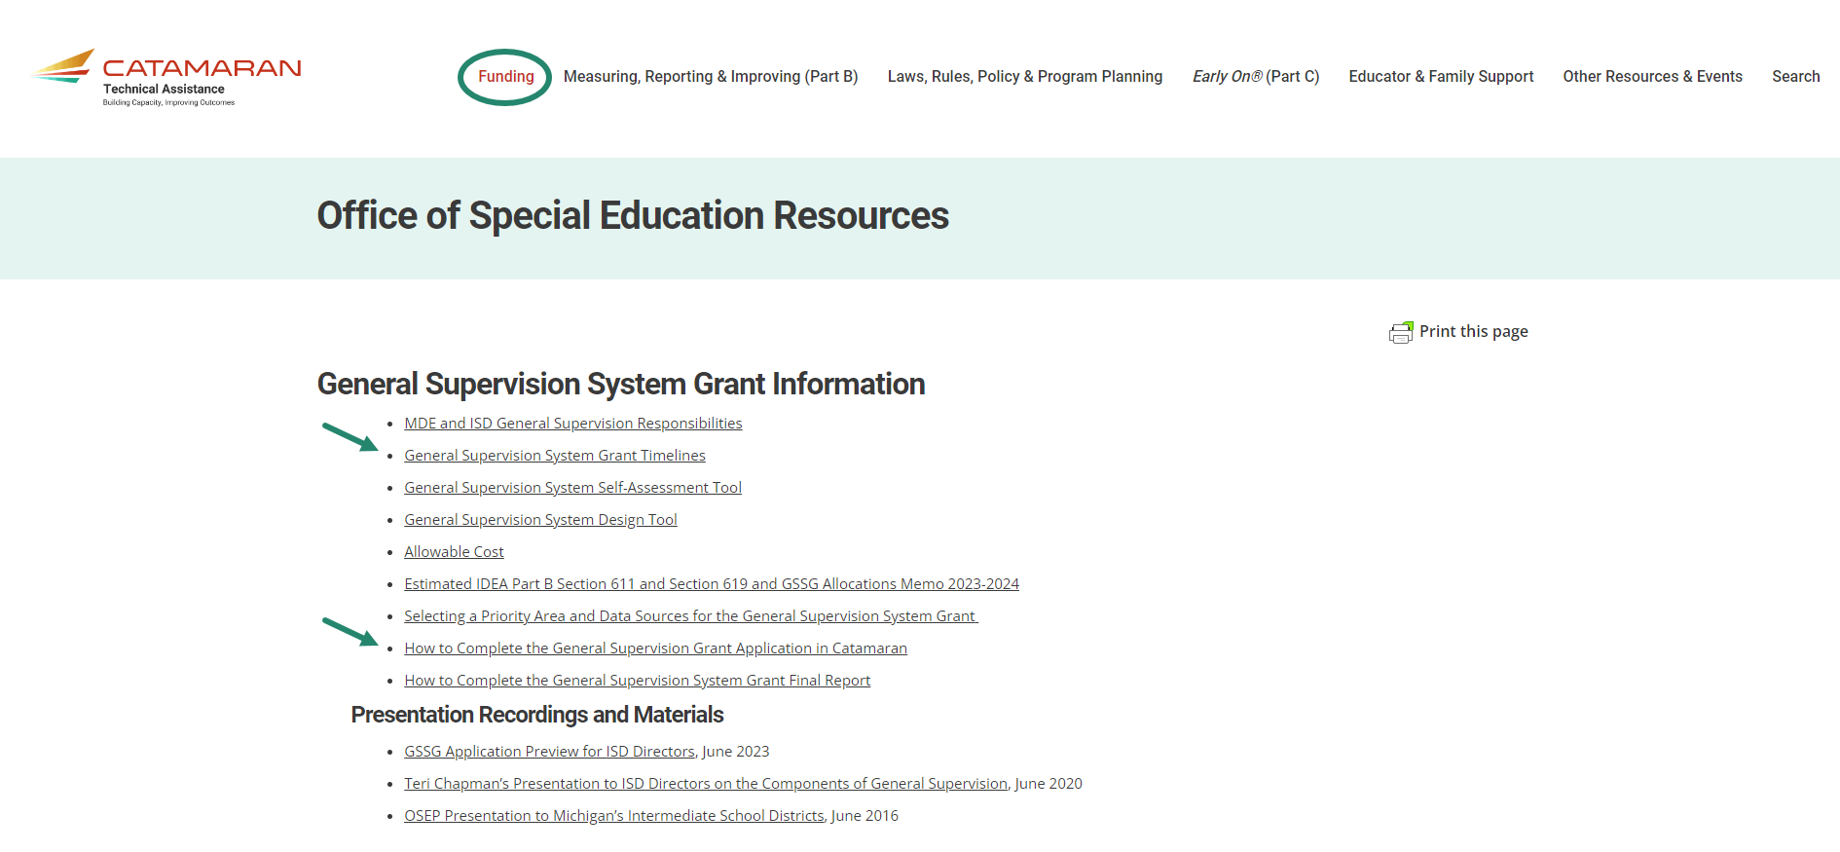
GSSG Information Page
Notes:
Also available on the Catamaran Technical Assistance Website is the General Supervision System Grant Information page.
As a reminder, ISDs may locate the General Supervision System Grant Information by navigating to the top of the home page and selecting the Funding header. Resources available include the General Supervision System Grant Timelines and How to Complete the General Supervision System Grant Application in Catamaran.

Slide 32
Contact MDE OSE
Presenters
Aaron Darling
darlinga4@michigan.gov
Chris Kelley kelleyc9@michigan.gov
MDE OSE Information Line
888-320-8384
mde-ose@michigan.gov
Notes:
If you have questions about the content of this webinar, please contact Aaron at DarlingA4@michigan.gov or Chris at KelleyC9@michigan.gov.
For general questions about special education, you are encouraged to call the OSE information line at 888-320-8384, or email at mde-ose@michigan.gov.
That concludes our webinar for today. Thank you for watching.

