Slide 1
General Supervision System Grant (GSSG) Final Report Preview
2024-25 Grant Year
For Intermediate School District (ISD) Directors of Special Education
Notes:
Welcome to the General Supervision System Grant, or GSSG, Final Report Preview for the 2024-25 grant year. This presentation is intended for Intermediate School District, or ISD, Directors of Special Education.

Slide 2
Agenda
Final Report Overview
Completing the Final Report in Catamaran
Resources
Notes:
On today’s agenda, we will cover three topics. Final Report Overview, completing the final report in Catamaran, and finally, available resources.

Slide 3
Final Report Overview
Notes:
Let’s start by looking at the Final Report overview.

Slide 4
GSSG 2024-25 Final Report Timelines
Final Report
Live May 1, 2025
Due June 1, 2025
Final Expenditure Report
Due August 29, 2025 (in NexSys)
Notes:
The GSSG Final Report will go live on May 1, 2025, and will be due on June 1, 2025. Final Expenditure Report – will be due in NexSys on August 29, 2025.

Slide 5
Completing the GSSG Final Report
Getting Started
General Supervision Activities
Priority Area
Fiscal
Notes:
This year's GSSG Final Report has a few updates. There will be four sections of the final report instead of five, just like the application.
Each ISD has been engaged in meaningful work on several of the eight components of general supervision. This year, all ISDs focused on Component 4: Policies, Procedures, and Effective Implementation of Evidence-based Practices to explore and improve this component in light of OSE’s thematic goal of providing FAPE in the LRE. We will explain more about this update later in the presentation.
The first page of the final report is Getting Started, and the second page, General Supervision Activities, is where you will provide a progress status about Component 4.
On the third, Priority Area page, you will provide current data for the priority area while also describing any updates or additional information related to the data.
On the last page, Fiscal, it will look the same as last year.
Now, let’s review each of these pages.

Slide 6
Getting Started: Review Information
Review submitted application and budget
Review provided data
Consider activities progress
Notes:
As we end the grant cycle, this is a good time for the ISD to review its submitted application and budget, provided data, and consider progress on their activities. It’s also a good time for the ISD to reflect on the work that was planned and completed to celebrate successes; Identify strengths in planning and implementation during the past year, as well as areas that will require additional attention; Examine data on processes and results to make decisions for the future; Determine whether adjustments need to be made for continued progress and momentum; and begin the initial planning process for the next grant application.

Slide 7
General Supervision Activities: Component 4
Review Next Steps and Personnel Responsible
Select Progress Status
Provide Progress Notes
Upload Documentation and Evidence
Notes:
As mentioned earlier, the OSE required all ISDs to address Component 4 (Policies, Procedures, and Effective Implementation of Evidence-based Practices (PPEBP) with a focus on the least restrictive environments (LRE)) in this year’s application.
First, the ISD should review the Next Steps and Personnel Responsible shown on the page. This information will be carried over from the application to the final report.
The ISD will then select the progress status (there are four options: completed, completed and continuing, continuing, or discontinue) that best describes the progress on the next step.
Next, can provide notes on its progress using the Progress Notes field, and
Finally, they should plan to upload documentation and evidence for each statement for component 4.

Slide 8
Priority Area
Review Application Data
Provide Current Final Report Data
Describe Updates/Additional Information
Notes:
The ISD’s previously identified priority area, along with the provided data sources, will be populated from the application. ISDs will be responsible for entering current Final Report data in the table as well as describing updates or providing additional information related to the final report data.
Given that all ISDs focused on Component 4 in light of the provision of FAPE in the LRE to support the creation of effective systems of general supervision, this activity should improve and impact results and compliance data across priority areas, thus continuing to build an overall system of general supervision supporting the provision of a FAPE in the LRE.
As a reminder when reviewing data,
Local data sources should have been used rather than APR, MI School Data, or Strand Report data. The data sources do not need to be the indicator data which demonstrated the need to select a priority area. The data could be any measure of the improvement activities. Data should be sensitive to change over the course of one year.
Data sources may reflect ISD aggregate and/or Member District level data.
See the training resource “Selecting a priority area and data sources for the General Supervision System Grant” available on the TA site at training.catamaran.partners/office-of-special-education-resources/ for more information about data sources for GSSG, or refer to the 2024-25 GSSG Application Preview for ISD Directors Webinar on the Past Events page of the TA site.

Slide 9
Fiscal Table – Personnel
Name | Position/Title | Amount | FTE Staff | Description
Enter the staff member’s name | Enter the staff member’s title | Enter the budgeted amount | Enter the FTE (Decimal) | Provide a description
Notes:
The fiscal page will be the same as last year.
This slide shows the first table on the fiscal page, the personnel table. ISDs will be posed with a question if there are updates to the personnel or non-personnel tables. If yes, updates are needed, then ISDs will be allowed to edit the data submitted in the application. If the ISD responded no, updates are not needed, the information from the application will be populated onto the page and no edits can be made.
The information in this table should include personnel and staffing resources that the ISD plans to use in developing and implementing a system of general supervision. A separate row should be completed for each staff member.
The dollar amount entered should be the budgeted amount rounded to the nearest whole dollar.
The column labeled “FTE Staff” should represent the percentage of the budgeted time to be spent by the specified staff member. The percentage should be in decimal format (e.g., 50% would be 0.50 FTE).
It is important to work closely with the ISD Business Official to complete this section, which includes both Personnel and Non-Personnel related grant costs. If edits are made, please make sure your budget is amended in NexSys and the proper credentials are provided for any new personnel added.

Slide 10
Fiscal Table – Non-Personnel
Expense Type | Amount | Description
Select the non-personnel expense type | Enter the budgeted amount | Provide a description
Notes:
The second table focuses on how General Supervision System Grant funds will be utilized for Non-Personnel related budgeted items for 2024-25. This table is optional.
If ISDs selected yes, updates are needed, then ISDs will be allowed to edit the data in the non-personnel table as well. If the ISD responded no, updates are not needed; the information from the application will be populated onto the page, and no edits can be made.
As a reminder, to complete this table:
Select from the “Expense Type” drop-down menu the type of non-personnel expense the ISD believes will be incurred. Drop-down options include audit costs, indirect, and travel to member districts to provide TA.
Enter the budgeted amount the ISD plans to spend in the “Amount” column.
If “Travel to Member Districts to Provide TA” is selected, provide the staff member’s name that the ISD plans to use in the Description column.
Again, if edits are made, please make sure your budget is amended in NexSys and the proper credentials are provided for any new personnel added.

Slide 11
Completing the Final Report in Catamaran
Notes:
Now that we’ve seen an overview of the final report, let’s take a look at what completing the final report in Catamaran looks like.

Slide 12
Catamaran Login
Notes:
First, you will want to go to catamaran.partners to log in to Catamaran.
If you do not have a username and password or if you have forgotten it, you can either select the Need to create an account? or Forgot Password? link on the login screen or you may contact the Catamaran Help Desk.

Slide 13
Access the Activity
Log in to Catamaran (https://catamaran.partners)
On the Dashboard, scroll down to the Tasks Overview section.
Use the filters, as needed, to narrow tasks.
Select the link in the Activity column to open the activity.
Note: The activity name is 2024-25 GSSG Activity
Notes:
Once you have logged into Catamaran, scroll down to the Tasks Overview section on the Dashboard.
You may use the provided filters to narrow your tasks down as needed.
Then, select the 2024-25 GSSG Activity link in the Activity column to open the activity.

Slide 14
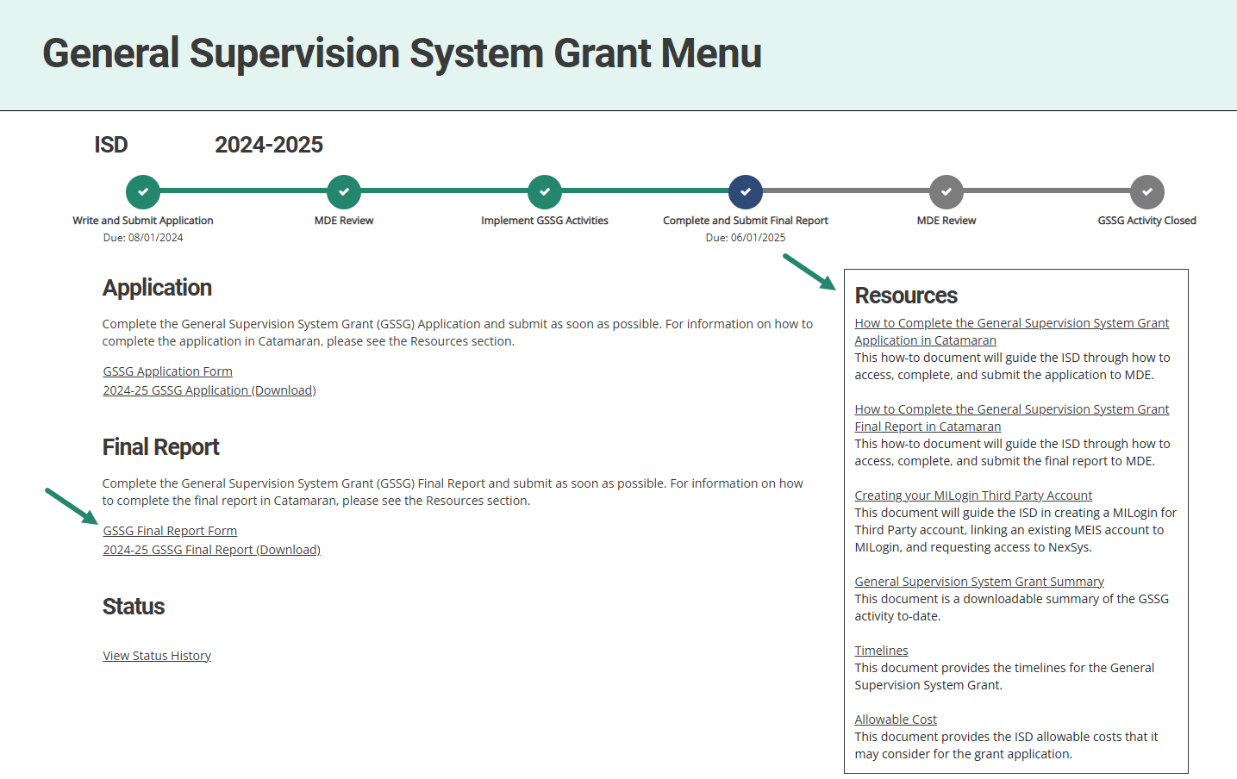
General Supervision System Grant Menu
Notes:
Next, on the menu, ISDs may access and review the provided resources in the Resources box. Resources include a how-to document, General Supervision System Grant Summary, Creating your MILogin Third Party Account how-to, and other links such as Timelines and Allowable Cost.
To begin the final report, select the GSSG Final Report Form link under the Final Report heading.

Slide 15
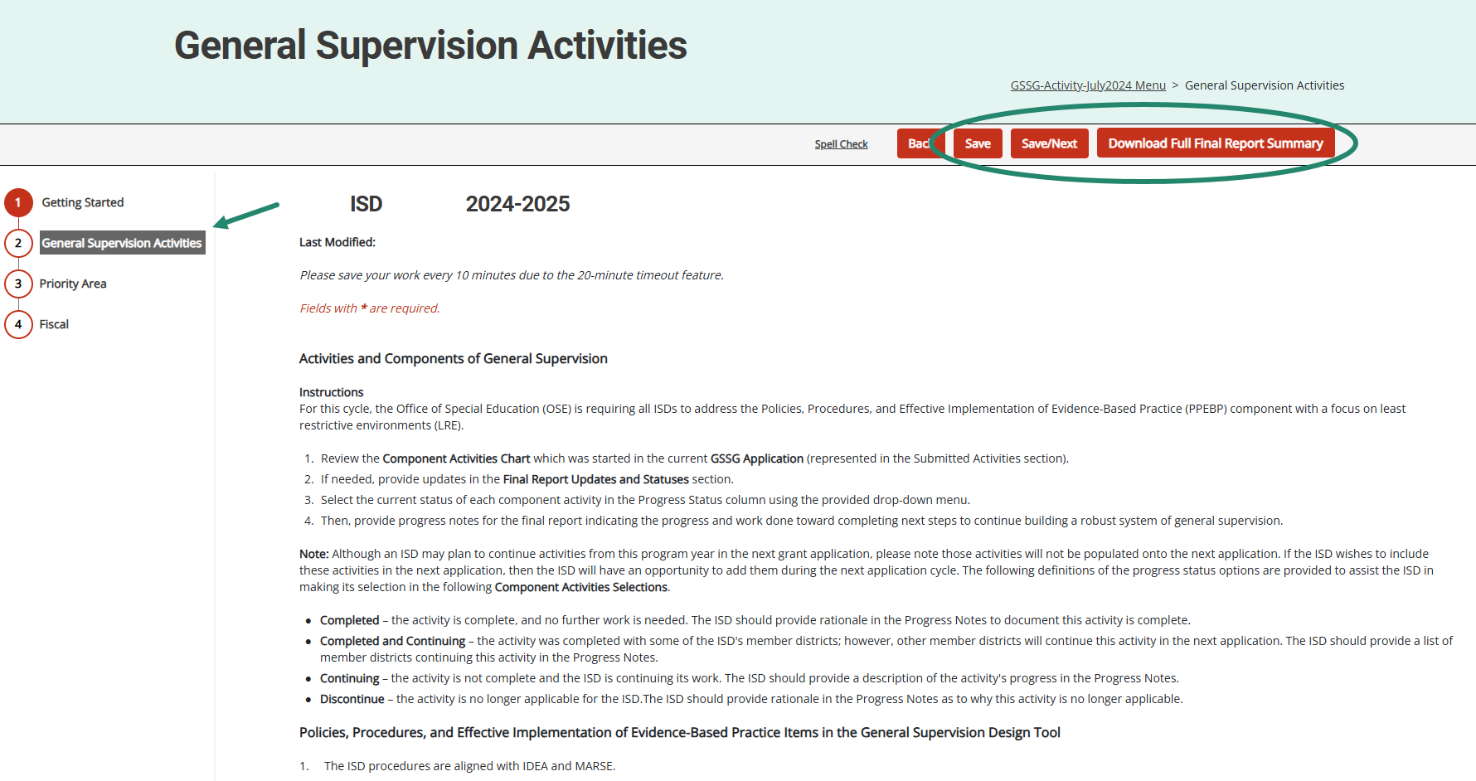
General Supervision Activities Page
Notes:
Be sure to complete each section of the final report.
Complete the final report and choose Save or Save/Next to progress to the next section of the form.
Use the navigation menu on the left to move between sections of the report.
As a reminder, those sections include:
Getting Started
General Supervision Activities
Priority Area
Fiscal
It is recommended to review all final report sections before submitting to MDE.
To complete this review, download a full summary of the final report by either selecting the “Download Full Final Report Summary” button within the application or by selecting the 2024-25 GSSG Final Report (Download) link from the menu.

Slide 16
Additional Supporting Documentation or Comments (optional)
Notes:
On each page in the final report, we have provided a set of comment boxes. ISDs may enter any additional clarification, as needed.
On the Fiscal page (last page of the final report), the ISD may also upload additional supporting documentation.
Remember, the uploads are OPTIONAL, and the intention is to enhance the information provided in the application.

Slide 17
Submit the Final Report
The GSSG Final Report is due by June 1.
After completing the final report, select the Submit to MDE button at the top of the page.
Notes:
The final report is due by June 1.
After completing the final report, the ISD Director must select the Submit to MDE button at the top of the Fiscal page.
The MDE will review all final reports. If concerns are identified, final reports may be returned to the ISD for additional work. ISDs should check the MDE comment box on the Final Report’s Getting Started page for additional information.
MDE requests that ISDs resubmit any returned final reports within one week from the modification request notification.
Once the final report is approved, you will not have other GSSG work in Catamaran until the next fiscal year.

Slide 18
Resources
Notes:
We will wrap up this training video by providing you some valuable resources.

Slide 19
Catamaran Technical Assistance Website
Notes:
The Catamaran Technical Assistance Website is a valuable resource for ISDs. You can access the site at training.catamaran.partners.
Examples of resources available on this site are recordings of past webinars, step-by-step how-to documents, as well as guidance documents.

Slide 20
Catamaran Navigation Tips Training Video
Notes:
New this year, we have a separate training video that includes Catamaran navigation tips. This video can be found in the Spotlight section on the homepage of the Catamaran Technical Assistance Website.

Slide 21
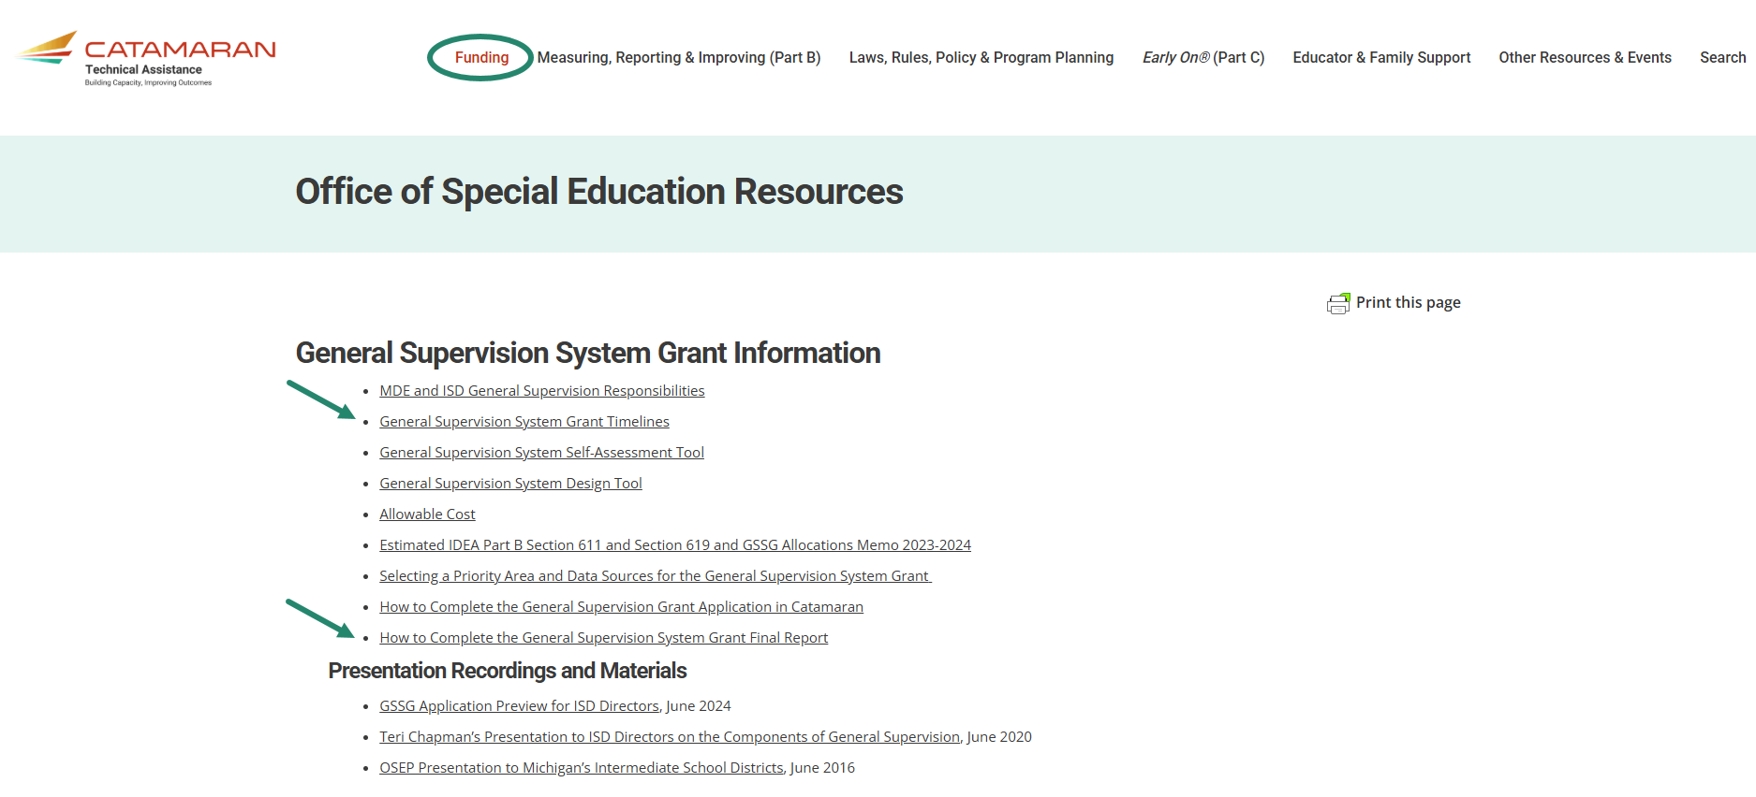
GSSG Information Page
Notes:
Also available on the Catamaran Technical Assistance Website is the General Supervision System Grant Information page.
ISDs may locate the General Supervision System Grant Information page by navigating to the top of the home page and selecting the Funding header. Resources available include the General Supervision System Grant Timelines and How to Complete the General Supervision System Grant Final Report in Catamaran.

Slide 22
Catamaran Help Desk
Questions about system navigation or accessing the activity
Available Monday–Friday from 8:00 am to 5:00 pm
Contact by:
Email at help@catamaran.partners
Phone 877-474-9023
Chat feature within Catamaran
Notes:
Another resource you have available is the Catamaran Help Desk. The help desk is available Monday-Friday from 8 am-5 pm. You can contact the Catamaran help desk by email, phone or by using the chat feature within Catamaran.

Slide 23
Contact MDE OSE
Presenters
Aaron Darling
darlinga4@michigan.gov
Chris Kelley kelleyc9@michigan.gov
MDE OSE Information Line
888-320-8384
mde-ose@michigan.gov
Notes:
If you have questions about the content of this training video, please contact Aaron at DarlingA4@michigan.gov or Chris at KelleyC9@michigan.gov.
For general questions about special education, you are encouraged to call the OSE information line at 888-320-8384, or email at mde-ose@michigan.gov.
That concludes our training video for today. Thank you for watching.

