Slide 1
Welcome!
The B-13 Interrater Reliability Training will begin in a few moments.
To communicate with the presenters during the webinar, use the Chat feature.
Closed captioning is available for this webinar. To select this option, choose the closed caption icon in the Zoom webinar player.
MDE Office of Special Education

Slide 2
Zoom Webinar Control Panel
Mouse or tab down to the bottom of the webinar screen for the Zoom Webinar Control Panel to become visible.
Features available are:
Chat – select to communicate with presenters.
Live Transcription – select the CC icon to turn on captions and then select Show Subtitles.
Leave – select to exit the webinar.
MDE Office of Special Education

Slide 3
Indicator B-13 Checklist - Interrater Reliability Training
Fall 2024
Michigan Department of Education Office of Special Education
Notes:
Welcome to the Fall 2024 Indicator B-13 Checklist Interrater Reliability Training

Slide 4
Today’s Outcomes
Develop a better understanding of compliance to apply when reviewing individualized education programs (IEPs) for Indicator B-13 data collection.
Improve consistency among reviewers using the Indicator B-13 checklist.
Increase awareness of and familiarity with data collection review tools.
Notes:
Today’s Outcomes include:
Developing a better understanding of compliance versus best practice when reviewing IEPs for B-13 data collection.
Increase interrater reliability to improve consistency among reviewers using the Indicator B-13 checklist
Increase awareness of and familiarity with data collection review tools.

Slide 5
State Performance Plan (SPP) Annual Performance Report (APR) Measurement - Part 1
Percent of youth with IEPs aged 16 and above which include appropriate measurable postsecondary goals that are updated annually.
Based upon an age-appropriate transition assessment.
Transition services.
Include courses of study, that will reasonably enable the student to meet those postsecondary goals.
Annual IEP goals related to the student's transition service needs.
Notes:
Jamie
•SPP Indicator B-13 Addresses secondary transition and specifically requires data collection on: Percent of youth with individualized education program (IEPs) aged 16 and above with an IEP that includes appropriate measurable postsecondary goals that are annually updated and based upon an age-appropriate transition assessment, transition services, including courses of study, that will reasonably enable the student to meet those postsecondary goals, and annual IEP goals related to the student’s transition service's needs.

Slide 6
SPP APR Measurement- Part 2
There also must be evidence that the student was invited to the IEP Team meeting where transition services are to be discussed.
Evidence that, if appropriate, a representative of any participating agency that is likely to be responsible for providing or paying for transition services was invited to the IEP Team meeting.
Prior consent of the parent or student who has reached the age of majority.
Notes:
Jamie
•There also must be evidence the student was invited to the IEP Team meeting where transition services are to be discussed and evidence that, if appropriate, a representative of any participating agency was invited to the IEP Team meeting with the prior consent of the parent or student who has reached the age of majority.

Slide 7
Why Interrater Reliability Matters
Consistency
Methods for improving interrater reliability for Indicator B-13:
Training
Written Manual
5th IEP Upload
Inconsistency results in sanctions at the intermediate school district (ISD) level.
Notes:
Interrater reliability means that no matter which person reviews the data, the results between the reviewers are consistent.
Consistency during data collection is key and different raters must be able to yield the same results when viewing the same data.
This degree of agreement can help highlight the LEA’s compliance with IDEA requirements or the lack thereof.
The OSE uses a few methods to ensure interrater reliability.
The first is through training such as this. We work with the individuals who conduct the activity. We also have a webinar in the spring just before the data collection and offer live support via office hours during the data collection window.
The second method is the B-13 manual. This is updated annually and available on the technical assistance website.
Finally, the OSE reviews at least one IEP from each ISD.
Despite these methods, we have found there is still considerable variation in the data. The data for more than 20 LEAs was changed following the data collection in 2021.
Starting with the data collection in the spring of 2022, inconsistency in data collection will result in sanctions to the Intermediate School District (ISD).
Those sanctions may include a corrective action, a data reliability letter issued in Catamaran, the ISD participating in additional required technical assistance or the impact of the ISD determination rating. The stakes have been raised and so the OSE wants to provide all the additional support necessary to increase consistency among those who complete the checklists.

Slide 8
Indicator B-13 Manual & Checklist
Notes:
We will now review the B-13 Secondary Transition Compliance Checklist and Data Collection Manual. You can locate copies of each on the Catamaran Technical Assistance website.

Slide 9
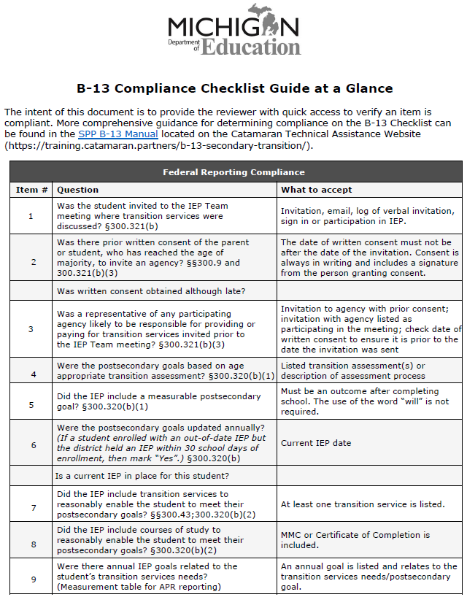
B-13 Checklist Content
9 questions covering
Invitation processes:
Student
Agency
IEP development:
Assessment
Postsecondary goals
Transition Services
Annual goal
Notes:
The B-13 Checklist contains 9 questions covering the Invitation Process and IEP Development
Today we are going to take a deeper look into these 9 questions

Slide 10
B-13 Manual
Addresses each of the checklist questions.
Best Practice vs Compliance.
The manual is posted to the Catamaran Technical Assistance Website Catamaran Technical Assistance (https://training.catamaran.partners/).
Notes:
The B-13 Manual reviews each checklist question and outlines IDEA requirements and best practice. Again, this manual can be located on the Catamaran technical assistance website at training.catamaran.partners.
Some schools or ISDs have used this manual as their B-13 procedures.
The OSE does not recommend this practice. We would recommend that you use this manual as a basis for developing procedures. This manual describes what to look for when evaluating for compliance. It does not provide timelines, identify the person responsible for these items, or assign accountability. We know districts are using them and until we have some model procedures written, we will continue to accept them in CAPs but we don’t recommend this practice.
Also, this presentation will not address best practices. We are going to limit the scope of this to the compliant/noncompliant determination.
Now let’s begin our review of the 9 checklist questions.

Slide 11
Question 1
Was the student invited to the IEP Team meeting where transition services were discussed?
Yes
No
Notes:
Question 1- Is there evidence the student was invited to the IEP Team meeting where transition services were discussed? Please respond by marking YES or NO

Slide 12
Question 1: Compliance in Practice
Documentation the student was invited prior to the IEP Team meeting:
Note of verbal invite
Phone log
Written invitation
Documentation that an invitation to the IEP Team meeting was addressed specifically to the student or co-addressed with parent.
Student is signed in as a participant of the IEP Team or, when there is no sign-in, evidence of participation in the IEP Team meeting.
Notes:
Compliant documentation would be documentation the student was invited prior to the IEP Team meeting.
This could include an invitation that is addressed to the student (it may be co-addressed with the parent), a note of a verbal invite or phone log, or evidence the student signed in as a participant or participated in the IEP.

Slide 13
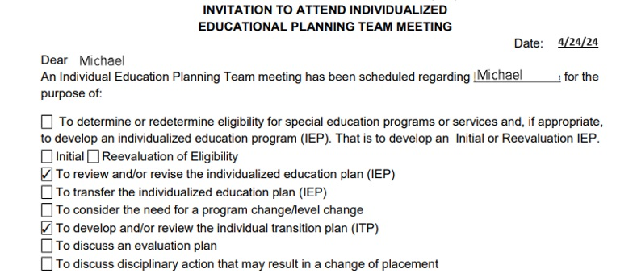
Question 1 Compliance - example 1
Notes:
Here is an example of Compliance for Question #1. This IEP invite is addressed to Michael for the purpose of reviewing his annual IEP and Transition Plan.

Slide 14
Question 1 Compliance – examples 2-3
Notes:
What does compliance look like?
Here is an example of evidence that a student was invited and participated (Note the student box is checked)
*
Another example of student participation is the varying documented attempts to invite the student. This contact documentation contains multiple methods of contact (a call and a letter).

Slide 15
Question 1 Noncompliance
No evidence the student was invited to the IEP Team meeting:
No written invitation
No contact log
No sign in
No evidence of participation
Notes:
What does non-compliance look like?
There is no evidence that the student was invited or participated in the IEP.
There is no written invitation, No contact log, No sign-in, and no evidence of participation.
You would mark “No” for Question #1

Slide 16
Question 1 You be the judge
Invitation was addressed to the parent only.
Student was not listed as a participant at the IEP Team meeting.
IEP has no additional student input.
Notes:
It's time for our first round of you be the judge.
In this example, the invitation was addressed to the parent and not co-addressed to include the student. The IEP participants’ list does not include the student’s name. When the OSE looked at the IEP, there was no additional student input in the IEP.
Is this record compliant for question one on the checklist? Reminder, question one is Is there evidence the student was invited to the IEP Team meeting where transition services were discussed?
Use poll 1
Collect answers. Display results. Discussion ensues.
The answer is No. The invitation needs to be sent to the student (can be co-addressed with the parent) and there must be evidence the student participated in the IEP.

Slide 17
Question 2
Was there prior consent of the parent or student, who has reached the age of majority, to invite an agency?
Yes
No
N/A
Notes:
Question 2- Is there evidence of prior consent of the parent or student, who has reached the age of majority, to invite an agency? Please respond with YES, NO or NA.
There is a lot of meaning embedded in this question.
First of all, the district has to determine if there is an agency likely to be responsible for paying for or providing transition services. Those services are not time bound. IDEA doesn’t say that schools only need to invite the agency if they are going to provide them during the current year or at a certain age of the student, or when the agency likes to get involved.
The IDEA requires that if an agency is likely to provide or pay for services, they be invited to the IEP meeting where transition services will be discussed. In order to make that invitation, the district must seek consent from the parent or the student who has reached the age of majority.
If the Team has decided there is an agency likely to provide or pay for services, did they seek consent to invite the agency prior to inviting the agency?
We know from Letter to Gray that the ideal is that the agency representative is identified on the consent form. We also know from practice that the agency representative is not always known. Case managers change, etc. So minimally, the agency must be identified on the consent form to meet the requirements of consent which we will go over on the coming slides.
If there is not an Agency likely to provide or pay for services, then the reviewer can use NA on the checklist. Do Not select “No”.

Slide 18
Question 2 N/A Clarification
N/A should be marked when documenting the member district determines a participating agency is not likely to provide or pay for services.
N/A should be marked when documenting the parent, or student who has reached the age of majority, denied consent, or did not respond to requests for consent.
Notes:
If the team determines that an agency is likely to pay for or provide transition services, but you were unable to obtain consent after multiple documented attempts, question #2 should be marked N/A. Ensure the IEP reflects the IEP Teams determination of the need to invite an outside agency.

Slide 19
Question 2: Follow-Up
If No for question 2, was written consent obtained although late?
Yes-No Student-Level Corrective Action Plan (SLCAP)
No-Corrective Action will be issued to include Family Educational Rights and Privacy Act (FERPA) training.
Notes:
Jamie
There is an additional question to question 2. If there is a NO response for question 2, there will be a sub question asking, was written consent obtained but it was late?
If yes, consent was obtained although after the invitation was sent, no student-level corrective action plan will be issued. However, if the sub question is also answered no, meaning consent was never obtained, then there will be a change in activities for the Corrective Action issued. The required activities will address confidentiality directly. All relevant personnel must watch the following training videos: Consent and Invite-Secondary Transition, FERPA 101, For Local Education Agencies from US Dept of Education, and FERPA 201 Data Sharing under FERPA from US Dept of Education.
FERPA and confidentiality are the reason question 2 exists.

Slide 20
Confidentiality Requirements
ISDs/Districts inviting outside agencies without prior consent are violating Individuals with Disabilities Education Act (IDEA) and FERPA confidentiality provisions!
Obtaining parent/guardian/student consent prior to inviting an outside agency is imperative to maintain confidentiality provisions.
For more information about confidentiality visit 34 CFR §300.622.
Notes:
When it comes to the agency we need to do a better job about emphasizing that its not just about informed consent under §300.9 but about consent as it relates to confidentiality under §300.622. If teams invite an agency without obtaining prior consent then they are violating IDEA confidentiality requirements AND FERPA. https://sites.ed.gov/idea/regs/b/f/300.622

Slide 21
Consent Defined
Fully informed in native language or another mode of communication.
Understands and agrees in writing.
Describes activity and lists records (if any) that will be released and to whom.
Voluntary and may be revoked at any time.
Notes:
Section 300.9 of the Individuals with Disabilities Education Act (IDEA) states consent means:
1. The parent is fully informed of all the relevant information to the activity for which consent is being sought, in their native language or through another mode of communication; Relevant information here means identifying which agency the school wants to invite
2. The parent understands and agrees in writing to the carrying out of the activity for which consent is being sought and
3. The consent describes that activity and lists the records (if any) that will be released and to whom.
4. And finally the parent understands that the granting of consent is voluntary on the part of the parent and may be revoked at any time.

Slide 22
Question 2: Compliance Example
We are requesting your permission to invite the listed community agency: Michigan Rehabilitation Services
Consent to Invite:
I hereby authorize the school district to invite the community agency listed above. I understand that this authorization is valid for up to one year from the date of consent or until the first IEP Team meeting at which transition services are discussed; whichever occurs first.
.
Signature of Consent: Sample Signature
Date: 1/3/24
Notes:
Jamie
If an agency is likely to pay for or provide transition services, then compliant documentation would include a request for consent provided to the parent, or student who has reached the age of majority, even if it’s not signed or returned.
*
This example shows consent dated on 1-3-24
* Note that the consent is valid for up to one year from the date of consent or until the first IEP Team meeting at which transition services are discussed, whichever occurs first.

Slide 23
Acceptable Forms of Written Consent
Documentation:
Hard copy consent form.
Electronic consent form provided through signature applications such as DocuSign, HelloSign, Adobe Sign.
Consent form emailed which is printed out.
Parent, or student who has reached the age of majority, signs, dates, and returns the form.
Notes:
When you're looking at acceptable forms of written consent, that consent can come in many forms. First of all, there might be a hard copy of the consent form provided to the parent or student who has reached the age of majority. It could be an electronic consent form which was provided through signature applications such as DocuSign or hellosign. Those are just some examples but there are many, many programs. The consent form could be emailed out and then printed out. What is important is the consent form has been signed, dated, and returned to the district.
Note that an email to the parent is not considered compliant.
It is Critical that you document every attempt to obtain consent and note that in the IEP.

Slide 24
Question 2 Noncompliance
No documentation the member district determined there was no need to invite an outside agency.
When an agency was likely to pay or provide transition services, written consent was not sought or received from the parent, or student who has reached the age of majority, before inviting an agency.
Parent, or student who has reached the age of majority, agreed verbally but didn’t sign/return the consent, and the agency was invited.
Notes:
Question 2 is non-compliant if there is no documentation that the member district determined there was no need to invite an outside agency.
Question 2 is non-compliant when an agency was likely to pay or provide transition services, and written consent was not sought or received from the parent/student who has reached the age of majority
Or the parent/student who has reached the age of majority agreed verbally but didn’t sign the consent and the agency was invited

Slide 25
Question 2 You be the judge
Scenario:
The IEP Team determined an outside agency is likely to pay for or provide transition services.
On 1/7/24 the teacher calls the parent to discuss inviting the outside agency.
The parent verbally provides consent to invite the outside agency and follows up with an email.
Teacher invites agency to the IEP Team meeting.
Parent provides written consent at the IEP Team meeting.
Notes:
Here's another opportunity for you to be the judge.
(Read scenario)
Is this compliant? Remember, question 2 Is there evidence of prior consent of the parent or student, who has reached the age of majority, to invite an agency?
Launch Poll 2
Collect responses. Discuss.
No, not compliant. Consent must be in writing before an invitation is sent. Email is not considered written consent.
This scenario refers to the subcategory as discussed earlier. Consent was received late therefore resulting in a CAP and not an SLCAP for this student.

Slide 26
Question 3
Was a representative of any participating agency likely to be responsible for providing or paying for transition services invited prior to the IEP Team meeting?
Yes
No
N/A
Notes:
Question 3- Is there evidence that a representative of any participating agency likely to be responsible for providing or paying for transition services was invited prior to the IEP Team meeting?
This question presumes the district has determined that an agency is likely to be responsible for providing or paying for transition services.
If you have marked NA to question two, then you should just mark NA for question three.
If you marked yes or no for question two, then you have to answer question three with a yes or a no.

Slide 27
Question 3 Compliance
Compliance
Noncompliance
The meeting invitation must indicate the time, purpose, and location of the meeting and be sent prior to the IEP Team meeting.
Paper invitation addressed to agency and student/parent.
Paper invitation addressed to the student/parent with agency listed as potential attendee.
Copy of a dated email invitation.
Written log of a verbal invitation.
No documentation that, if an agency likely to pay or provide transition services was invited to the IEP by the local education agency (LEA), written consent was provided by the parent, or student who has reached the age of majority.
No documentation the LEA determined there was no need to invite an outside agency.
No invitation to the agency.
Notes:
What are some things we would expect to see for compliance? (Read the bullets)
Read the bullets
What would we mark as noncompliance (read the bullets)

Slide 28
Put these activities in a compliant order
The district invites an agency which is likely to be responsible for providing or paying for transition services.
The district obtains written consent to invite an agency to an IEP Team meeting.
The district determines there is an agency likely to be responsible for providing or paying for transition services.
The district convenes an IEP Team meeting.
Notes:
(Speaker will read the slide)
Please Launch Poll 3
Collect responses. Display.
Now we will take a look at the order of compliance

Slide 29
The activities in a compliant order
3. The district determines there is an agency likely to be responsible for providing or paying for transition services.
2. The district obtains written consent to invite an agency to an IEP Team meeting.
1. The district invites an agency which is likely to be responsible for providing or paying for transition services.
4. The district convenes an IEP Team meeting.
Notes:
Answer – 3,2,1,4

Slide 30
Knowledge Check
1. Consent must always be in writing and include a date.
2. The agency may be invited before written consent is obtained if the parent agreed by phone.
3. If the student is given a written invitation to the IEP Team meeting, the invitation must be addressed to the student.
4. Electronic signature applications are acceptable forms of written consent.
5. It is acceptable to obtain written consent to invite an outside agency the same day as the IEP meeting if the parent agrees.
Notes:
The first three questions are typically questions where we see the most non-compliance, therefore we are going to pause and do a knowledge check. We are going to read the 5 statements and mark each as True or False based on our knowledge
Read slide
Please Launch the Knowledge Check
Collect responses Display Discuss --- True, False (Hang up the phone...nothing is done by phone), True, True, False (An agency that is likely to pay or provide services needs a reasonable amount of time for meaningful participation)

Slide 31
Question 4
Were the postsecondary goals based on age-appropriate transition assessment(s)?
Yes
No
Notes:
Question 4- Is there evidence that postsecondary goals were based on age-appropriate transition assessment?

Slide 32
Question 4 Compliance
Compliance
There is evidence of age-appropriate transition assessment results.
Noncompliance
No documentation of transition assessment information/data which were used to develop the postsecondary goals.
Notes:
A variety of sources and instruments can be used for transition assessment data. Evidence of compliance can be found in several places in the IEP such as the PLAAFP statement or the transition plan.
Please mark NO if there is no documentation of transition assessment information/data.
A student or parent interview/questionnaire alone is not sufficient.

Slide 33
Question 4 Compliance - Example
Data Sources Used
Educational Development Plan (EDP) If EDP, select the Career Pathway: Manufacturing
Transition Assessment(s) specify: Enderle-Severson Transition Rating Scale (ESTR-J) Revised
Transition Assessments Completed
ESTR-J was administered in May 2024 with the results being the following:
Employment: 9/13 or 70%
Recreation & Leisure: 4/4 or 100%
Home Living: 13/15 or 87%
Community Participation: 3/7 or 43%
Post Secondary Education: 4/8 or 50%
Total: 33/47 or 70%
Preferences/Interests
Based on the Student Transition Assessment Tool (STAT-R) (10/13/24) after graduating from high school, student will attend the transition academy to learn the necessary skills for working in the entertainment field. STAT-R Post-Secondary Education: 75%
Notes:
Jamie
To reiterate- this information can be embedded in different places in the IEP, for example,
Data sources used In the Transition plan
*Example of a few transition assessments are the Enderle-Severson Transition Rating Scale ESTR-J and the STAT R: STUDENT TRANSITION ASSESSMENT TOOL
*we may see it in the Assessments
**Or under the students Preferences and Interests , any of these would be acceptable

Slide 34
Question 5
Did the IEP include a measurable postsecondary goal?
Yes
No
Notes:
Moving on to question 5, did the IEP include a measurable postsecondary goal

Slide 35
Question 5 Compliance
Compliance
There is at least one measurable postsecondary goal in an area of training, education, employment or, where appropriate, independent living that will be achieved after the student exits the public school system.
Noncompliance
There is no measurable goal in at least one of the areas of training, education, employment or, where appropriate independent living.
Notes:
We are really only looking for a minimum of 1 post-secondary goal to meet B-13 Compliance for the purpose of the checklist
If there is no measurable goal in at least one of the areas, question 5 is noncompliant and should be marked “NO.”

Slide 36
Postsecondary Goals
Measurable = Countable/Observable.
Identifies an outcome.
At least one measurable postsecondary goal in any area of:
Education
Training
Employment
Independent Living
Notes:
What is a measurable postsecondary goal? Measurable means it is something that can be counted or observed.
It must identify an outcome
It must be measurable in at least one area: Education, Training, Employment or Independent Living

Slide 37
Examples of Postsecondary Goals
Education: Upon completion of high school, Rebecca will enroll in a community college to complete general study coursework towards a degree of her choosing.
Employment: Upon completion of high school, Jessica will obtain part-time employment in the restaurant industry.
Notes:
Notice In the two goals we see a lead in statement, “Upon completion of school”, although this is best practice it is not required. What’s important is the goals reflect what the student is going to do or achieve after leaving school.

Slide 38
Postsecondary Goal Examples
The student will be a truck driver in his hometown upon the completion of high school.
Following high school graduation, the student will take art courses at the community college.
After leaving high school, the student will complete the trade school requirements for an Associate’s Degree in Automotive Technology.
The student will live in the community in a group home upon exiting the school system.
Sample Formula for Writing Measurable Postsecondary Goals
____________ __________________ will ______________ _______________
(After high school) (The Student) (Behavior) (Where and how)
Notes:
Read the sample goals and review the formula for writing Measurable Postsecondary Goals

Slide 39
Question 5 You be the judge
Goal: The student will participate in a program that offers social and employability job training with adult support upon completion of school services.
Notes:
Read goal. Remember question 5 is did the IEP include a measurable postsecondary goal?
Poll 5
Collect responses.
Discuss. Yes, this is compliant. This post-secondary goal reflects what the student will do upon the completion of school services.

Slide 40
Question 6
Were the postsecondary goals updated annually? (If a student enrolled with an out-of-date IEP but the district held an IEP within 30 school days of enrollment, then mark “Yes”).
Yes
No
Notes:
This is not typically an area where we see non-compliance. You need to verify if the IEP was written within one year of the previous IEP.
The postsecondary goals may be repeated from the previous IEP. If a student is certain about what they want to do, then repeating goals is acceptable.
The MDE received several questions related to out of date IEPs. In previous school years, many students were not attending school despite the best efforts of school personnel and therefore, the students’ IEPs were not updated.
Please note, however, if a student enrolled with an out-of-date IEP but the district held an IEP within 30 school days of enrollment, then mark “Yes”. The intent is to determine compliance. If a student enrolled with an out of date IEP, the expectation is that the receiving district holds an IEP within 30 school days. If that IEP was held within that timeline, then the compliance standard was met, and the question should be marked yes.
If you mark no to this question, an additional question will be generated.

Slide 41
Question 6 Follow-up
Is a current IEP in place for this student?
Yes
No
Notes:
In order to determine an appropriate response to noncompliance identified in question 6, a follow up question is generated with a No response.
If the student has a current IEP, mark yes and no student level corrective action will be triggered.
If there is not a current IEP in place, this question is non-compliant and a student level corrective action plan will be issued.

Slide 42
Question 7
Did the IEP include transition services to reasonably enable the student to meet their postsecondary goals?
Yes
No
Notes:
Question 7, did the IEP include transition services to reasonably enable the student to meet their postsecondary goals?

Slide 43
Intent of Transition Services
Relate to and support the attainment of the student's measurable postsecondary goal.
Based on the student's areas of need.
Coordinated set of activities that align with the postsecondary goal.
Notes:
What is the intent of transition services?
To support the attainment of the student’s postsecondary goals based on the student’s areas of needs.
Remember- those services are a coordinated set of activities that align with the student’s goals.

Slide 44
Transition Services Defined
A coordinated set of activities:
Designed to be within a results-oriented process;
Focused on improving the student's academic and functional achievement;
Intended to facilitate the student’s movement from school to post-school activities; and
Based on the individual student’s needs, strengths, preferences, and interests.
Notes:
Transition services means a coordinated set of activities for a child with a disability which are designed to be within a results-oriented process, focused on improving the academic and functional achievement of the student with a disability to facilitate the student’s movement from school to post-school activities, including postsecondary education, vocational education, integrated employment (including supported employment), continuing and adult education, adult services, independent living, or community participation. These services must also be based on the individual student’s needs, strengths, preferences, and interests.

Slide 45
Transition Services
Instruction & Related Services
Community Experiences
Development of Employment
Post-School Adult-Living Objectives
Acquisition of Daily Living Skills
Functional Vocational Evaluation
Notes:
Transition services include:
Instruction: Teaching specific skills in both formal and informal educational settings and in the community.
Related Services: Supports needed for students to access more integrated work, education, and living environments. Related services, within the context of transition services, are to help the student and family determine if services are needed beyond high school, help identify who or what agency might provide those services, help identify how the student and family can access those services and make the connections to needed services prior to the student leaving school.
Community Experience: Includes participation in community work experiences, recreation/leisure activities, residential and community engagement activities, volunteering opportunities, training in accessing community settings, or joining a team/club/organization.
Development of Employment: Includes job-seeking skills, career exploration, skill training, and actual employment opportunities. Volunteer work also provides important skills and experiences that could lead to integrated employment.
Other Post-School Adult-Living Objectives: Includes those services and support activities, such as access to employment support agencies, establishing a bank account, registering to vote, filing taxes, renting a home, accessing medical services, filing for insurance, or accessing adult services, college information, or Social Security Income (SSI).
Acquisition of Daily Living Skills (when appropriate): Creating opportunities at school and in the community to learn skills to live independently or with support(s). These skills may include housekeeping, medication, self-management, transportation and mobility, self-advocacy and self-awareness, and others associated with being an active community member.
Functional Vocational Evaluation: An in-depth look at the career and vocational interests and skills of a student with disabilities within the context of authentic work experiences. This includes situational assessments or community-based assessments in the setting where the actual skills and/or job are performed. The evaluation provides specific data regarding general work behaviors across a variety of job sites.

Slide 46
Question 7 Compliance
Compliance
Documentation of transition services including:
instruction
related services
community experience
development of employment and other post-school adult living objectives
acquisition of daily living skills and functional vocational evaluation
courses of study
Noncompliance
There are no documented transition services.
Notes:
These are services to be provided during the IEP year which will help the child achieve their postsecondary goals.
There must be at least 1 transition service or activity for compliance and services for any of the postsecondary goals are acceptable.
The transition services must be related to and in support of the student’s measurable postsecondary goal, so the student is actively working towards the attainment of their postsecondary goal.
Question 7 is noncompliant if there is no documentation of transition services.

Slide 47
Examples of transition services
Skills training
Applying for community health services
Investigate transportation options in the community
Practice completing job applications
Register to vote
Obtain a state I.D.
Creating a budget
Preparing meals
Doing Laundry
Using a calendar to manage appointments and events
Self-advocacy
Accessing adult services
Notes:
Examples of transition services may include accessing tutoring services or learning about community agencies in the area of instruction.
*
Or meeting with adult workers in the student’s chosen career field.
*
Or participating in functional skills curriculum.

Slide 48
Question 8
Did the IEP include courses of study that will reasonably enable the student to meet their postsecondary goals?
Yes
No
Notes:
Did the IEP include courses of study that will reasonably enable the student to meet their postsecondary goals?

Slide 49
Course of Study Defined
“A multi-year description of coursework from the student’s current to anticipated exit year needed to achieve the student’s desired post-school goals.”
The educational program can be planned and relate directly to the student’s goals beyond secondary education.
Courses are linked to post-secondary and IEP goals.
Notes:
Transition services also include the course of study for the student.
According to the National Technical Assistance Center on Transition: The Collaborative, a course of study as “A multi-year description of coursework from the student’s current to anticipated exit year needed to achieve the student’s desired post-school goals.”
NTACT: C provides information, tools, and supports to assist multiple stakeholders (SEAS, LEAS, Students and Parents) in delivering effective services and instruction for secondary students and out of school youth with disabilities.
The course of study should focus on:
How the educational program can be planned and relate directly to the student’s goals beyond secondary education anc.
How those courses are linked to post-secondary and Individualized Education Program (IEP) goals.
If the student is on a path to receive a diploma, the district must ensure the course of study aligns with the Michigan Merit Curriculum (MMC)

Slide 50
Certificate of Completion
A form of recognition for students completing a program or meeting a pre-defined set of skills but who have not met the requirements of the Michigan Merit Curriculum (MMC).
Not equivalent to a diploma.
Notes:
A certificate of completion is a form of recognition for students completing a program or meeting a pre-defined set of skills but who have not met the requirements of the Michigan Merit Curriculum.
A certificate of completion is not equivalent to a high school diploma. Some districts have other forms of recognition for students who did not complete MMC requirements such as a certificate of attendance or participation.
For students who do not receive a diploma their eligibility might continue through post high school with a focus on independent and community living skills. These programs may be available until students are 26 years of age.

Slide 51
Question 8 Compliance
Compliance
The documented courses of study enable the student to achieve their postsecondary goals:
Michigan Merit Curriculum
Certificate of Completion
If they are not aligned, then there are transition services to align the two items.
Noncompliance
No courses of study documented.
The documented courses of study do not enable the student to achieve their postsecondary goals and there are no services to align the two items.
Notes:
Courses of study must align with the postsecondary goal for compliance.
The documented courses of study enable the student to achieve their postsecondary goals.
If there is no documented course of study or no transition services to align courses of study and post secondary goals, question 8 is noncompliant.

Slide 52
Question 9
Were there annual IEP goals related to the student’s transition services needs?
Yes
No
Notes:
Were there annual IEP goals related to the student’s transition services needs?

Slide 53
Question 9 Compliance
Compliance
Documentation of an annual IEP goal that supports the student’s transition services needs listed in the IEP.
Noncompliance
No documentation of an annual goal in the IEP related to the student’s transition services needs.
Notes:
We are looking for at least one goal that supports the students transition needs/postsecondary goals.
Do you see the connection between how the transition services support the student in reaching their short- term IEP goal and the long term postsecondary goal?
If there is documentation of an annual goal it is compliant.
If not, question 9 must be marked NO.

Slide 54
Question 9 Compliance Example
Transition domain: Education/Training
Baseline data: Student currently solves multi-step equations 2 out of 5 times.
Annual Goal:
Given… | The Student will… | Target or Performance Criteria… | As measured by…
By January 2025, given notes and a calculator. | Student will solve multi-step equations. | 4 out of 5 times. | On a teacher-created assessment.
Notes:
The transition domain related to the sample goal is Education/Training.
The student currently solves multi-step equations 2 out of 5 times.
By January 2025, given notes and a calculator, student will solve multi-step equations 4 out of 5 times on a teacher-created assessment.

Slide 55
Annual Goal – Example
Annual goal: By November 2024, the student will increase her third-grade level sight word recognition from 50 words to 75 words, as measured on 4 out of 5 documented trials.
Notes:
Here’s another goal, not tied directly to transition. Still compliant. The connection doesn’t need to be explicit. If the goal is tied to the MMC and the student is on diploma track, that’s compliant. If the goal is like this one and is tied to a functional skill or related in some way to their transition services, it’s compliant.

Slide 56
Question 9 – You be the judge
Baseline Data: Student currently utilizes an adding machine with 50% accuracy in Business Math. Post-secondary goals include employment in retail.
Annual Goal:
By (Date) when given direct instruction in the high school Business Math course and guided practice, the student will use an adding machine with 85% accuracy as measured by 4/5 documented trials in order to earn his diploma and pursue his post-secondary goals.
Notes:
Poll 6
Read goal. Remember, question 9 is Were there annual IEP goals related to the student’s transition services needs?
Collect responses.
Discuss. Yes, this is a compliant goal.
We can see the Annual goal is related to the students transition service needs.

Slide 57
Questions?
Notes:
Are there any questions at this time?

Slide 58
Work in Catamaran
The B-13 Data Collection is completed in Catamaran (https://catamaran.partners).
The work is completed by ISD Transition Coordinators, and member district Transition Coordinator Contacts.
Student lists and checklists are available in Catamaran March 3, 2025.
Checklists must be completed, verified by the ISD, and submitted by April 14, 2025.
Notes:
Read each bullet
Remember-The data submitted on the checklist in Catamaran should reflect information obtained from the student’s most current IEP as of March 1st of the current school year.
No revisions, new IEPs, or amendments dated after March 1 will be accepted for indicator B-13 checklist reporting.

Slide 59
Timeline
Activity | Date | Description
Data Collection | March 3 to 31 | Complete data collection checklists
Data Collection Review | April 1 to April 14 | ISD reviews submitted checklists
Checklist Due to MDE | April 14 | ISD submits checklists to MDE
MDE Review | April 14 to 22 | MDE reviews submitted checklists
Student Level Corrective Action | April 30 | SLCAPs issued by April 25 and due by June 10
District Level Corrective Action | May 15 | CAPs or Corrective Action issued
Notes:
New last year, MDE provided a suggested timeline to allow for ISDs to have a review period during the overall data collection window.*
ISDs of course can follow the timeline that works best for them; however, we recommend that you take advantage of the suggested review period of April 1- April 14 to avoid having to ask for items to be changed after the submission or for SLCAPs to be rescinded after they are released.
Now, let’s take a look at the Summary Report!

Slide 60
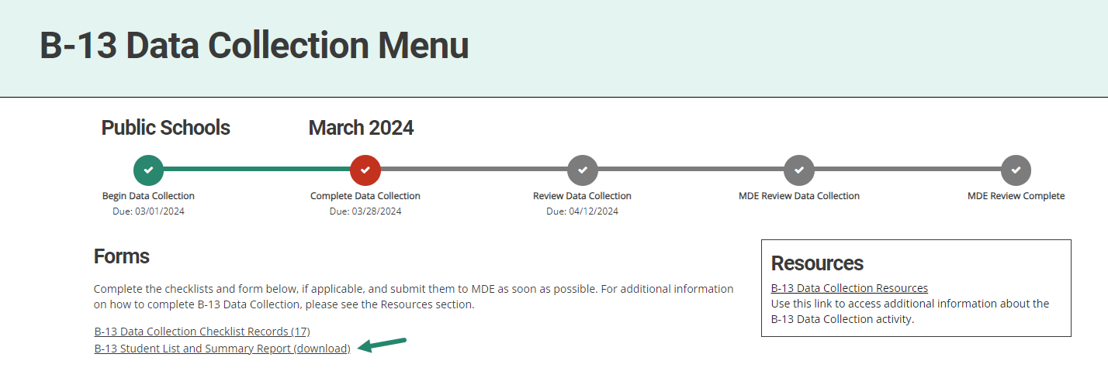
Review the Summary Report
From the B-13 Data Collection Menu, choose B-13 Student List and Summary Report (download).
Notes:
Once all the checklists for a district have been completed, the Transition Coordinator will be able to run the Summary Report using the link from the forms section of the menu page.
The summary report allows the TC to see all the record review responses on one page. This will help to see if there is any missed information or incorrect responses that need to be changed prior to submission.

Slide 61
Review the Summary Report (cont.)
Review the summary report for any No or blank responses:
A No identifies that item is noncompliant. This will result in a finding of noncompliance and the member district will be required to complete a Corrective Action Plan (CAP) and a Student-Level Corrective Action Plan (SLCAP).
Note: If checklists are not completed, all or some of the report will be blank.
Notes:
The summary report also allows the TC to see the checklist responses for each student in one place. There should be no blank responses. If there are, it means the review for that student file was not completed and must either be returned for completion, or the ISD will need to complete the review.
This step can be done with Transition Coordinator Contacts if your ISD uses them to review the district level data before submitting to the ISD.

Slide 62
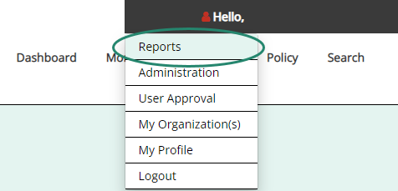
Review Submitted Data
Notes:
Once the data is submitted to the ISD but BEFORE approving the activity, review the submitted data and verify that it is correct.
To do this, open the B-13 Student List and Summary Report Download for the ISD and review the responses for each member district.
Check for any questions where there are No’s or any questions that are blank
A No answer identifies that item as noncompliant. This will result in a finding of noncompliance and the member district will be required to complete an SLCAP and a CAP.
Note: If the member district has not completed all checklists, all or some of the report will be blank. Once exported to Excel, ISDs may choose to filter this report to display districts that have completed checklists.
If the ISD is satisfied the submitted data are accurate, proceed to the next step.

Slide 63
Review Uploaded IEPs
Notes:
Next, review the IEP the member district uploaded. Note that ISDs will have only one to review.
To review these, go to Reports to then open the B-13 Data Collection-Student IEP Upload report.
See a line for the member district with a link to the uploaded IEP.
To review the uploaded document, select the provided link.
If the member district did not provide all of the documentation needed to verify compliance, the ISD must return it to the member district to provide additional documentation.
If the uploaded IEP provides sufficient evidence the checklist is accurate, proceed to the next step.
Note: if the ISD disagrees with the member district’s responses on the checklist, the ISD should change district responses by accessing the individual student’s checklist page in Catamaran.
Only after the data has been reviewed should you accept the work and submit the data collection to the OSE.

Slide 64
Further Questions?
Notes:
Questions

Slide 65
Need Assistance?
Questions?
Need Information?
OSE Information Desk
888-320-8384
M-F 9:00 am-4:00 pm
mde-ose@michigan.gov
Notes:
Read entire slide and spell out the email address.

