Slide 1
Welcome!
The B-13 (Secondary Transition) Data Collection Webinar will begin in a few moments.
The webinar recording and presentation materials will be posted on the Catamaran Technical Assistance Website under Past Events (https://training.catamaran.partners/past-events/)
To communicate with the presenters during the webinar, use the
Chat feature.
Closed captioning is available for this webinar. To select this option, choose the closed caption icon in the Zoom webinar player.

Slide 2
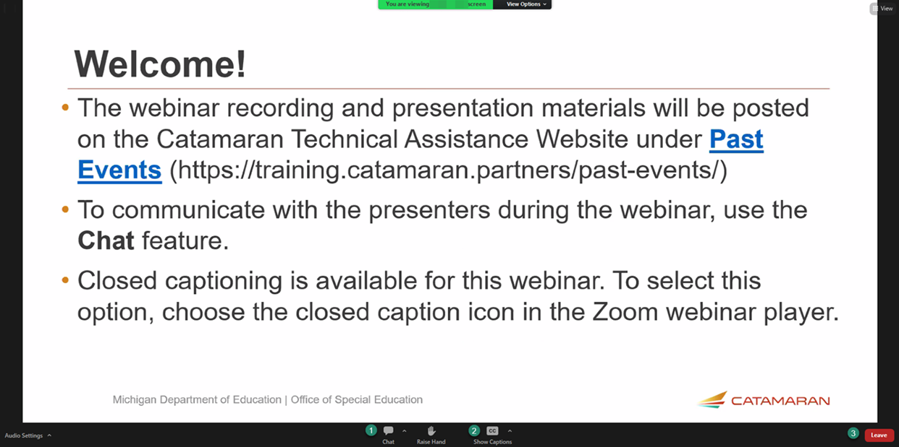
Zoom Webinar Control Panel
Mouse or tab down to the bottom of the webinar screen for the Zoom Webinar Control Panel to become visible.
Features available are:
Chat – select to communicate with presenters.
Closed Captioning (CC) – select the CC icon to show captions.
Leave – select to exit the webinar.
Notes:
Before we get started, I would like to highlight some features available on the Zoom Webinar Control Panel. Move your mouse or tab down to the bottom of the screen and you will find the chat feature which will allow you to communicate with the presenters. You can also select the CC icon to turn on captions and Leave will allow you to exit the webinar.

Slide 3
B-13 Secondary Transition
Data Collection Webinar
For Transition Coordinators and Transition Coordinator Contacts
Notes:
Nichole - Welcome to the B-13 Secondary Transition Data Collection Webinar

Slide 4
Meet the Team
Office of Special Education (OSE)
  Jessica Brady, Supervisor
  Shawan Dortch, Coordinator
  Nichole Moore, Coordinator
  Charles Thomas, Consultant
  Aaron Darling, Analyst
Public Sector Consultants (PSC)
  Lynne Clark, Project Director
  Donna Seeger, Project Manager
  Gabrielle Steinacker, Project Support Associate
  Lynn Delpy, Statewide Monitor
  Kelly Kendrick-Miller, Statewide Monitor
  Christie McKey, Statewide Monitor
  Kaitlyn Pace, Statewide Monitor
  Jamie Swiger, Statewide Monitor
Notes:
Nichole - Read slide to introduce team.

Slide 5
Agenda
B-13 Overview
Username and Passwords
Approving Users for Transition Coordinators (TCs)
Viewing the Student List
Completing the Activity
Reviewing the Activity for TCs
Resources
Questions
Notes:
Nichole - Go through agenda, then add,
Some of you may have been to this presentation in prior years and expect to see slides on determining compliance for each checklist question. We are not going to cover that in this presentation. We are focused today on how to complete the work in Catamaran. The only question we will look at will be question 2, which changed last year.
For more information on determining compliance for each question, please watch the interrater reliability training webinar from last fall on the TA site under Past Events.

Slide 6
B-13 Overview
Notes:
Nichole -

Slide 7
Process Highlights
The B-13 Data Collection is completed in Catamaran (https://catamaran.partners).
The work is completed by intermediate school district (ISD) Transition Coordinator (TCs), and member district Transition Coordinator Contacts (TCCs).
Student lists and checklists will be available in Catamaran on March 1, 2024.
Checklists must be completed, verified by the ISD, and submitted to Michigan Department of Education (MDE) by
April 12, 2024.
Notes:
Nichole -

Slide 8
Timeline
Activity | Date | Description
Data Collection | March 1 to 28 | Complete data collection checklists
Data Collection Review | March 29 to April 12 | ISD reviews submitted checklists
Checklist Due to MDE | April 12 | ISD submits checklists to MDE
MDE Review | April 13 to 19 | MDE reviews submitted checklists
Student Level Corrective Action (SLCAP) | April 25 | SLCAPs issued by April 25 and due by June 9
District Level Corrective Action | May 15 | CAPs or Corrective Action issued
Notes:
Nichole - Like last year, MDE is providing a suggested timeline to allow for ISDs to have a review period during the overall data collection window.
ISDs, of course, can follow the timeline that works best for them; however, we recommend that you take advantage of the suggested review period to avoid having to ask for items to be changed after the submission or for SLCAPs to be rescinded after they have been released.
A progress bar (seen on the next slide) will guide the district and ISD through the different milestones of the data collection activity.
Please note that ISDs and State Agencies should plan to submit checklists to MDE by April 12.
After MDE’s review is complete, SLCAPs will be issued in Catamaran no later than April 25 and will be due on June 9. Any Corrective Actions or CAPs will be issued in the May 15 release.

Slide 9
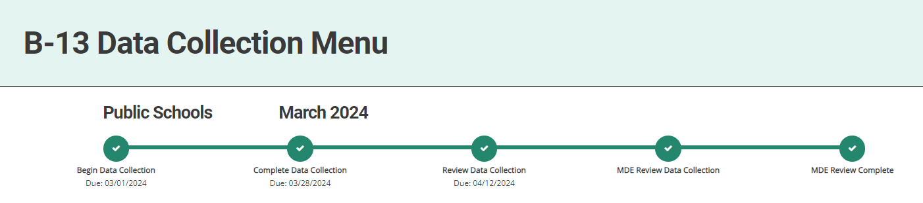
Progress Bar
Notes:
Nichole - The progress bar will be available in this activity and looks like what’s shown on this slide.

Slide 10
Who Uses Catamaran?
Catamaran Coordinators:
  Member district personnel who manage Catamaran for a member district.
  Catamaran Coordinators can view, but not edit, a member district checklist.
State Agencies:
  State Agency personnel who manage Catamaran for the state agency.
  State Agencies have access to complete all checklists for students at the state agency.
Transition Coordinators (TCs):
  TCs are ISD-level Transition Coordinators.
  TCs have access to complete all checklists for students at member districts within the ISD.
Transition Coordinator Contacts (TCCs):
  TCCs are member district personnel who complete the checklists.
  TCCs have access to complete only the checklists for students in the member district.
Notes:
Nichole - Many different groups of people use Catamaran to complete this activity: Catamaran Coordinators, State Agencies, Transition Coordinators, known as TCs, and Transition Coordinator Contacts, known as TCCs.
ISD users, if you’re wondering about whom to contact in some of your member districts, contact Lists are available to ISD personnel through the administrative reports page that shows who in Catamaran is assigned as either a Catamaran Coordinator or a Transition Coordinator Contact. Remember the administrative reports are a drop-down list you access by hovering your cursor over your name in the upper right hand corner of the page when you’re logged in to the system.

Slide 11
Tip: Know the Catamaran Coordinator
Every member district has a Catamaran Coordinator.
To find out the Catamaran Coordinator, run the report or ask the:
  Special Education Director
  Building Principal
  Responsible Party at the ISD
  Catamaran Help Desk
    877-474-9023
Notes:
Nichole –
Here’s a tip: … (read slide)
The Catamaran Coordinator can pull records ahead of a file review visit.

Slide 12
Usernames and Passwords
Notes:
Nichole

Slide 13
Existing Transition Coordinators (TCs) and
Transition Coordinator Contacts (TCCs)
Consider the following for existing TCs and TCCs:
  Did you complete B-13 data collection last year?
  Are you still at the same member district as last year?
  Can you still remember the username and password?
If so, access Catamaran.
Notes:
Nichole -

Slide 14
TCs and TCCs Continued...
If not?
If you’re at a new member district:
  Must be reapproved for access to Catamaran.
  Complete the new user form by choosing the Need to create an account? link on the Catamaran login page.
Cannot remember username or password:
  Use the Forgot your password? link on the Catamaran login page.
  The account email address must match the one on file with Catamaran.
  Still need help? Call the Catamaran Help Desk at 877-474-9023.
Notes:
Nichole -

Slide 15
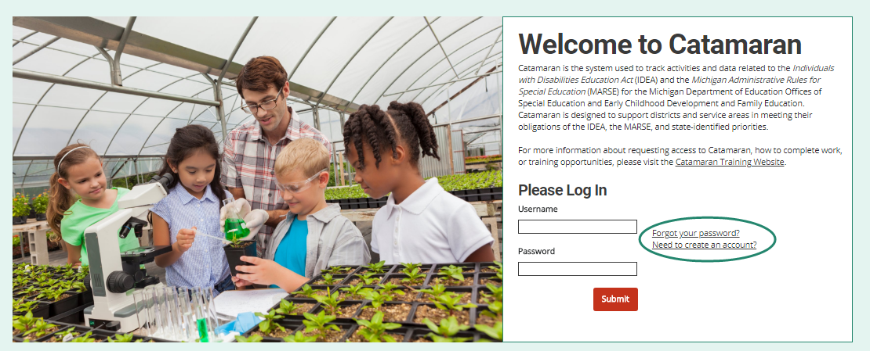
New TCs and TCCs:
Username and Password
Select the Need to create an account link on the Catamaran login page.
Complete and submit the new user form.
Notes:
Nichole -

Slide 16
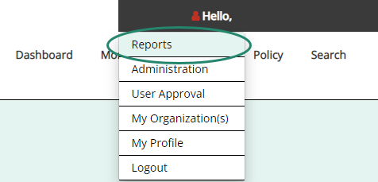
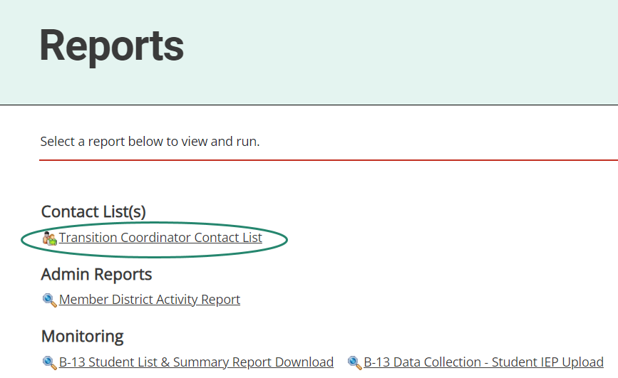
TCC Contact Lists for TCs
TCs may access a report of all the assigned TCCs in the ISD.
Use this report to determine where to assign TCCs.
To access and run the report:
  Select Reports from the drop-down menu located beneath the user’s name; and
  Choose Transition Coordinator Contact List to run the report.
Notes:
Nichole - To access the contact list for transition coordinator contacts for each member district, the ISD transition coordinator selects “reports” from the dropdown menu just below the user’s name on the top right side of page. Choose Transition Coordinator Contact List to run the report. This same path will also take you to a Catamaran Coordinator list.

Slide 17
Approving Users for Transition Coordinators
Notes:
Nichole - Now, let’s look at how TCs can approve users in Catamaran.

Slide 18
TCs Approving TCCs to access Catamaran
ISD Transition Coordinators (TCs) may approve member district Transition Coordinator Contacts (TCCs) in Catamaran.
Once the TCC has completed the new user form, the ISD TC will be notified by Catamaran.
The next few slides show how to approve TCCs.
Notes:
Nichole -

Slide 19
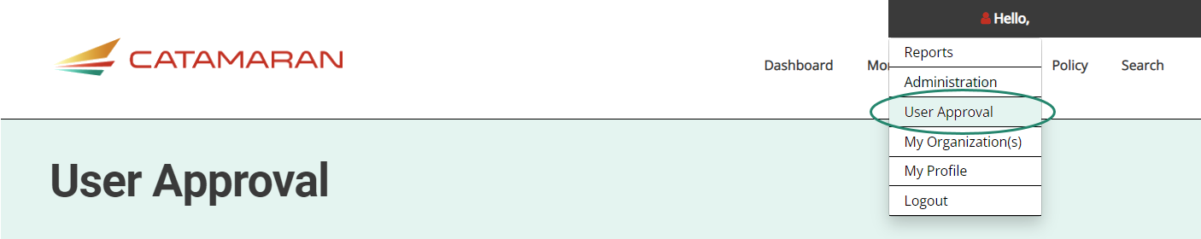
Access the User Approval Page
Log into Catamaran.
Choose User Approval from the dropdown menu located beneath the user’s name on the Dashboard.
Notes:
Nichole -

Slide 20
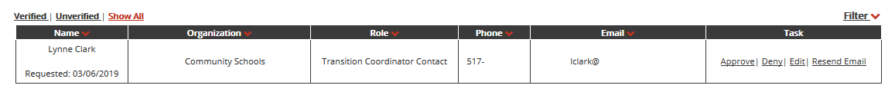
Review User Requests
From the User Approval page, review the list of Transition Coordinator Contact requests:
  Verified means the user has verified the email address after requesting access.
  Unverified means the user has not yet verified the email address.
  Show All will show all user requests.
Notes:
Nichole -

Slide 21
Verify Requester is at the Member District
As the ISD TC, verify the individual(s) requesting user access to Catamaran need access to complete the B-13 Data Collection activity.
Do this by:
  Verifying in the Educational Entity Master (EEM) the individual requesting access is at the member district.
  Or contact the member district’s special education director.
After determining the individual(s) requesting access to Catamaran should have access, verify and approve in Catamaran.
Notes:
Nichole -

Slide 22
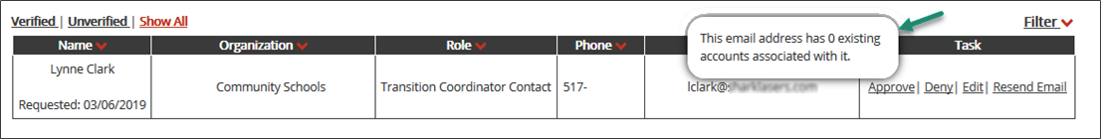
Verify Account in Catamaran
When reviewing the user request, hover over the email address to see if the individual already has an existing account in Catamaran.
If the individual has an account, do not take any user approval action. Instead, contact the Catamaran Help Desk for assistance in adding the Transition Coordinator Contact to the user’s existing role.
Notes:
Nichole -

Slide 23
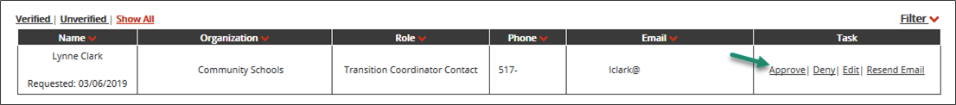
Approve User in Catamaran
Finally, after verifying that there are no existing accounts in Catamaran, approve the user request.
To do this, select Approve next to the user’s name.
After approving the user request, the user will receive an email confirming Catamaran access.
Notes:
Nichole -
If during the verification process the individual requesting access to Catamaran should not have access to the system, then deny the request by clicking Deny next to the user’s name.
After denying the user request, the user will receive an email informing them that the user request has been denied.

Slide 24
Viewing the Student List
Notes:
Nichole -

Slide 25
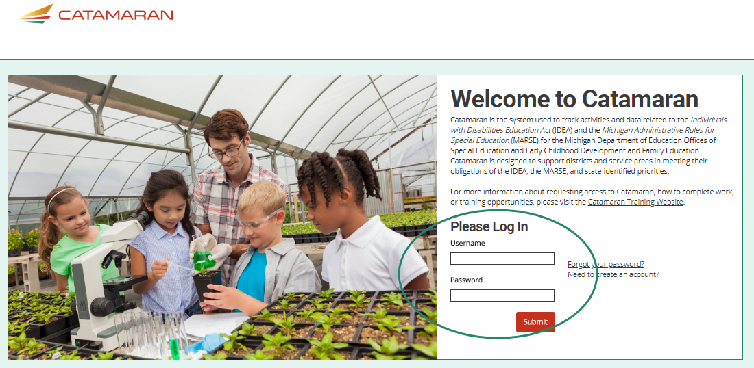
Log in to Catamaran
Log in to Catamaran (https://catamaran.partners)
Notes:
Nichole -

Slide 26
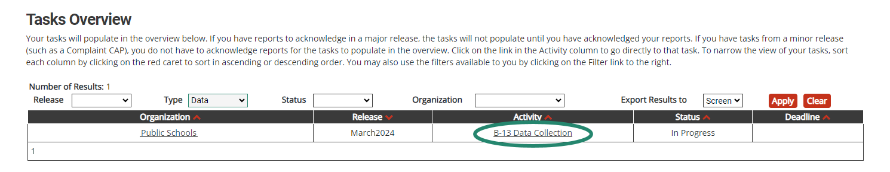
Access the Student List
Access the Data Collection Activity on the Tasks Overview.
Notes:
Nichole - Click on the link under “activity” to access the data collection activity.

Slide 27
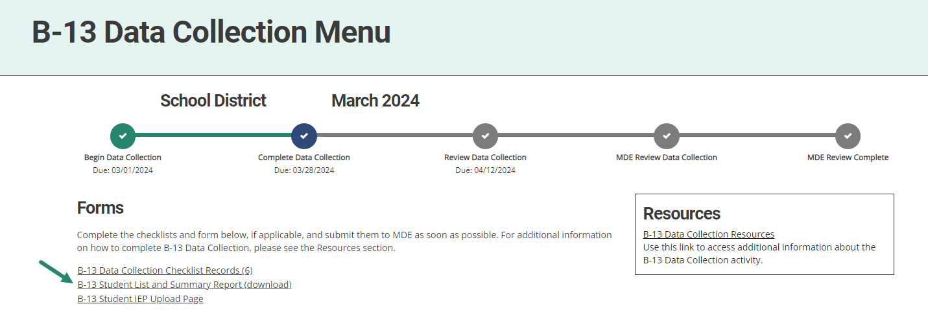
View the Student List
From the B-13 Data Collection Menu, select B-13 Student List and Summary Report (download).
Notes:
Nichole - Click on the B-13 Student List and Summary Report (download)

Slide 28
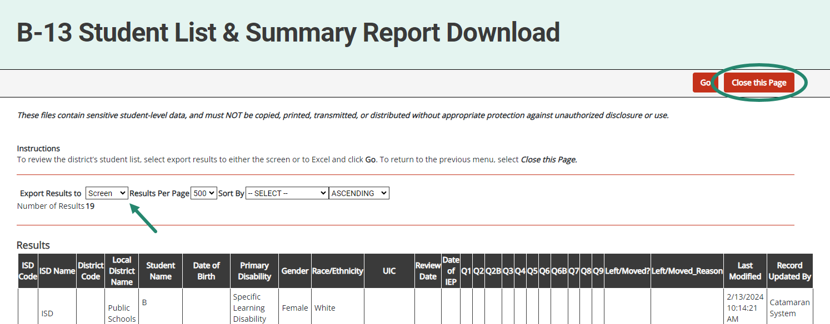
View the Student List (cont.)
Export results to screen or Excel.
To return to the B-13 Data Collection Menu, choose, Close This Page.
Notes:
Nichole - Export the results to either the screen or Excel by using the export tab.

Slide 29
Review the Student List
Download a copy of the B-13 Data Collection Checklist on the Catamaran Technical Assistance Website’s B-13 Secondary Transition page (https://training.catamaran.partners/secondary-transition/).
Print a paper copy of the checklist for each student.
Review each student’s file using a paper copy of the B-13 Data Collection Checklist.
All B-13 checklists must be submitted to MDE in Catamaran by April 12, 2024. Please submit to the ISD by March 28, 2024.
Notes:
Nichole - Some people like to complete their reviews using paper copies before entering data in Catamaran. To do this…
Remember that the checklists should be verified by the ISD before submitting them to MDE. To help ISDs complete their review in a timely manner, we suggest submitting to the ISD by March 28.

Slide 30
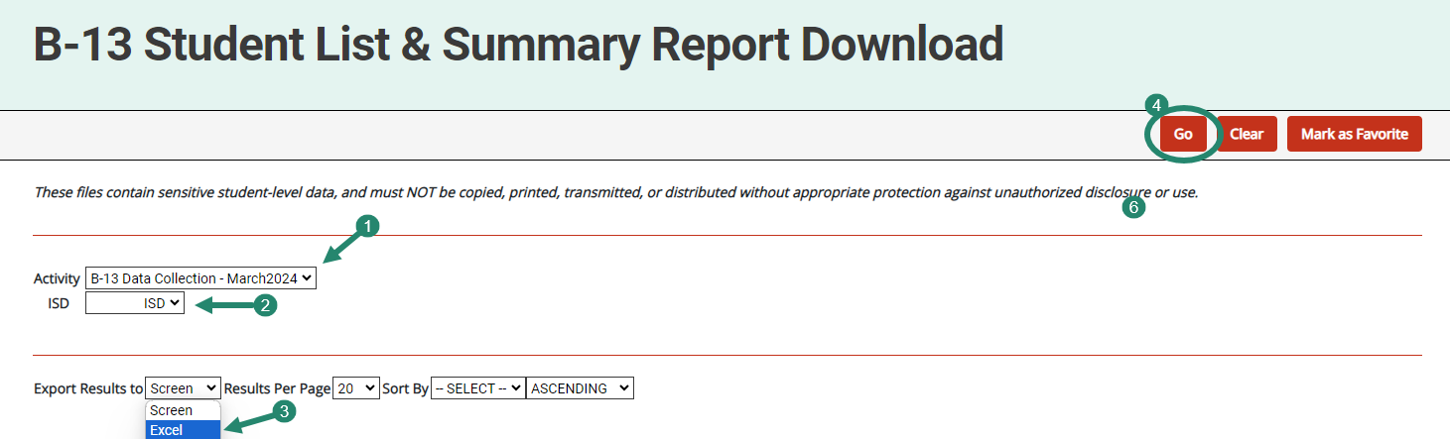
Access the Student List for the Entire ISD
To run the report:
  Choose Reports from the dropdown menu beneath the user’s name on the Dashboard.
  Select B-13 Student List and Summary Report Download to open the report page.
  Next, choose the activity year and ISD.
  Select Excel to export results.
  Choose Go.
Notes:
Nichole - Some ISD Transition Coordinators may want to see the full student list for their entire ISD. (read the slide bullets)
Remember, selecting “GO” launches the export.

Slide 31
Completing the Activity
Notes:
Jamie -

Slide 32
Access Catamaran to Complete Activity
Log into Catamaran (https://catamaran.partners)
Notes:
Jamie - So, if you’ve completed paper copies or you’re just ready to put data in the system, these are the steps to follow.

Slide 33
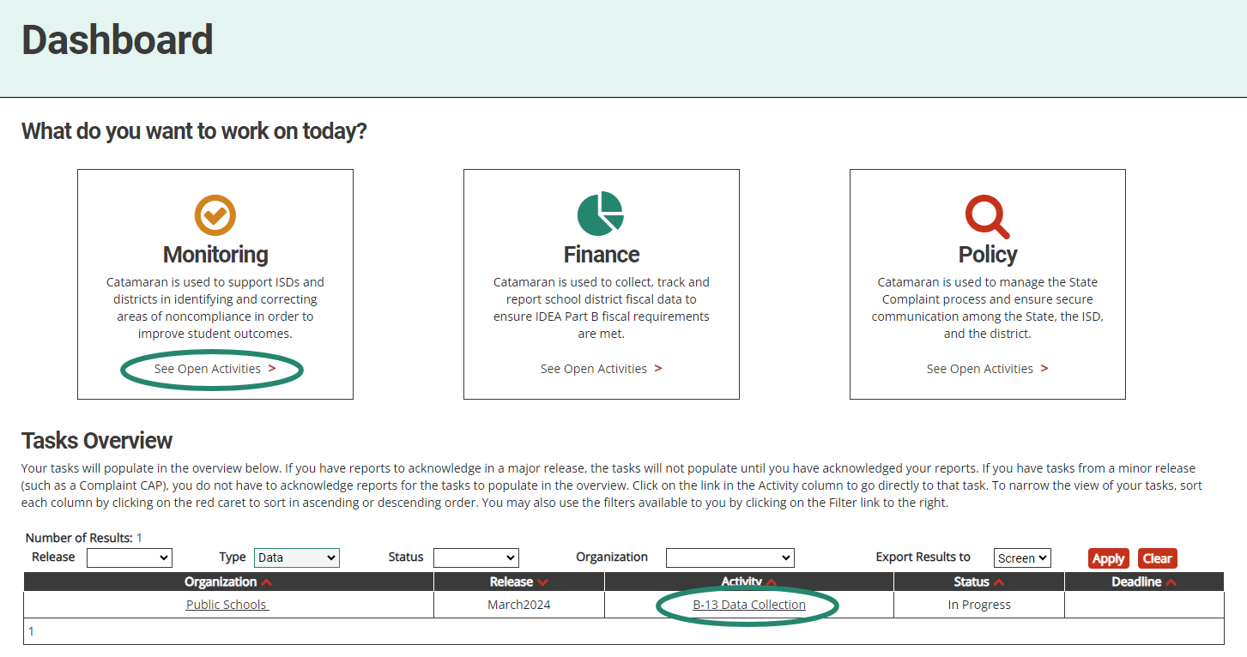
2. Access the B-13 Data Collection Activity
Tasks Overview (member district); or
Monitoring Tasks Overview (ISD).
Notes:
Jamie - From the Dashboard, select the B-13 Data Collection link on the Tasks Overview to open the activity.

Slide 34
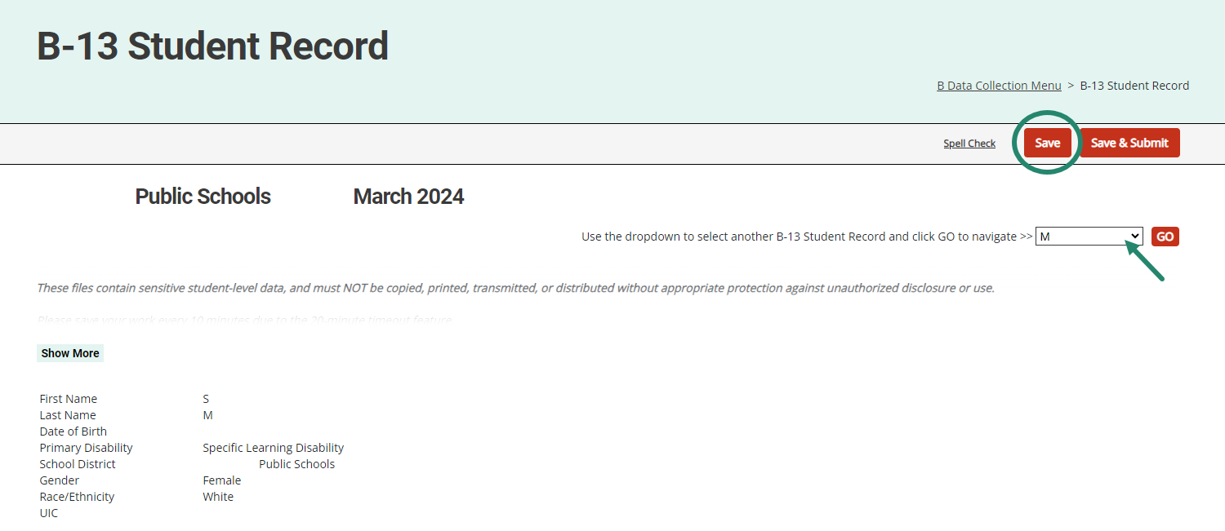
3. Begin the Activity
From the menu, select B-13 Data Collection Checklist Records.
Complete a student checklist and choose Save.
Note: Save each student record before moving to a new record.
Notes:
Jamie - Here you will find the checklist for each student. Remember to save after completing each checklist. To access the next student file, click on the drop-down then click on the “go” button.

Slide 35
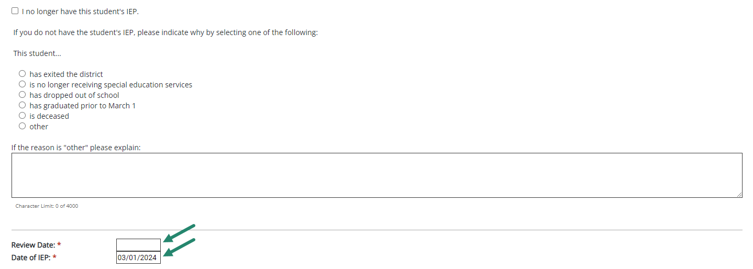
B-13 Data Collection Checklist Dates
Include information from the student’s Individualized Education Program (IEP) as of March 1.
Reflect initially reviewed data for each student.
Include both the Review Date and the Date of the IEP.
Notes:
Jamie - Remember – the IEPs being reviewed are the IEPs in effect as of March 1. Once a file is reviewed, that is the data to be submitted. There is no opportunity to correct the IEP before submitting the data.
Be sure to include the review date and the date of the IEP. If you opt out of reviewing this student’s record, do not include an IEP date.

Slide 36
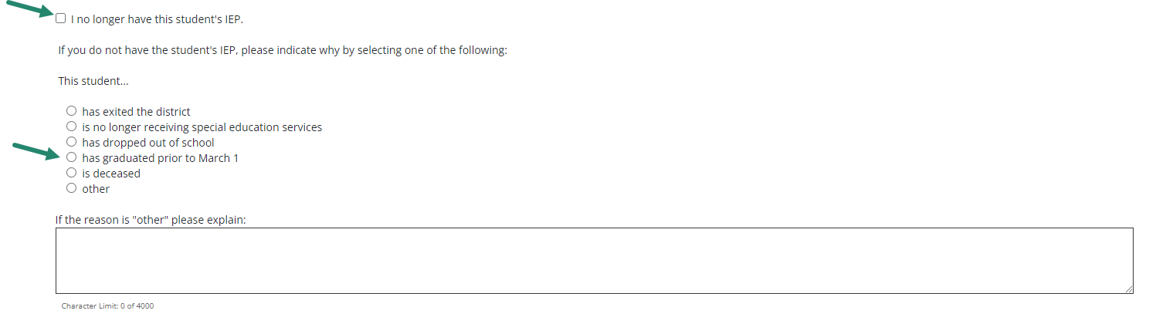
How to Opt-Out of a Student Checklist
Every checklist, has the option to select, “I no longer have this student’s IEP,” and choose a reason.
A student must have graduated prior to March 1 to choose “has graduated”.
If a reason is selected, the rest of the checklist will be hidden.
Notes:
Jamie - There are occasions when a district will need to opt out of a student record/checklist. This occurs when a student selected for data collection is no longer in the district. Every checklist has the option to select “I no longer have this student’s IEP. Check the box as shown by the top green arrow on this slide. Next, you must select a reason from the list provided. Remember, you can only choose “graduated” as a reason if the student graduated prior to March 1. Once a reason is selected, the rest of the checklist will be hidden.
Please do not enter an IEP date on the page if you are opting out of the checklist for this student.

Slide 37
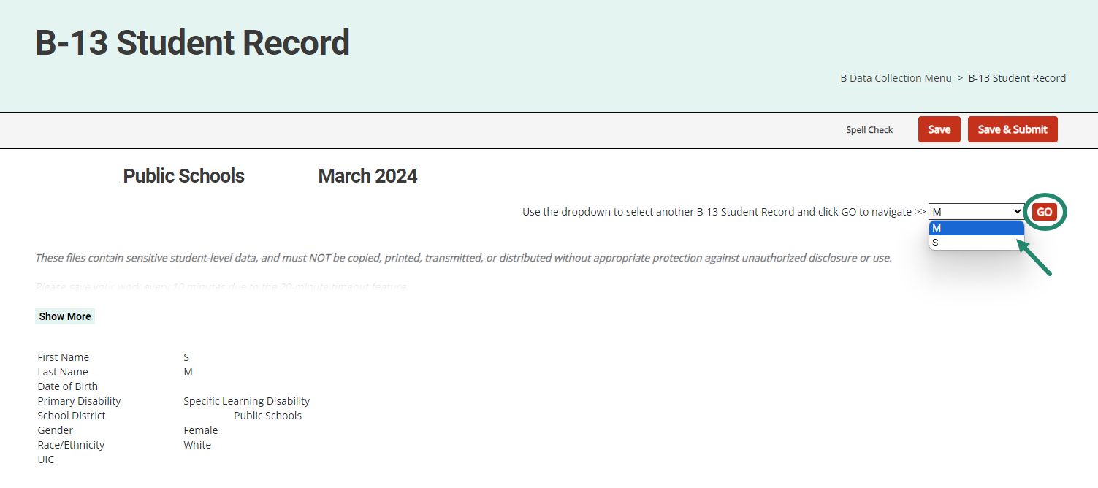
Complete a Checklist for all Students
Use the dropdown menu to select a new student record and then choose Go to complete another checklist.
Notes:
Jamie - You will need to complete a checklist for all students on your list. To do this, use the dropdown menu to select a new student record, the click on “go”. This will open the new student record.
If you didn’t remember to save this record before attempting to move to another record, the system will prompt you to save.

Slide 38
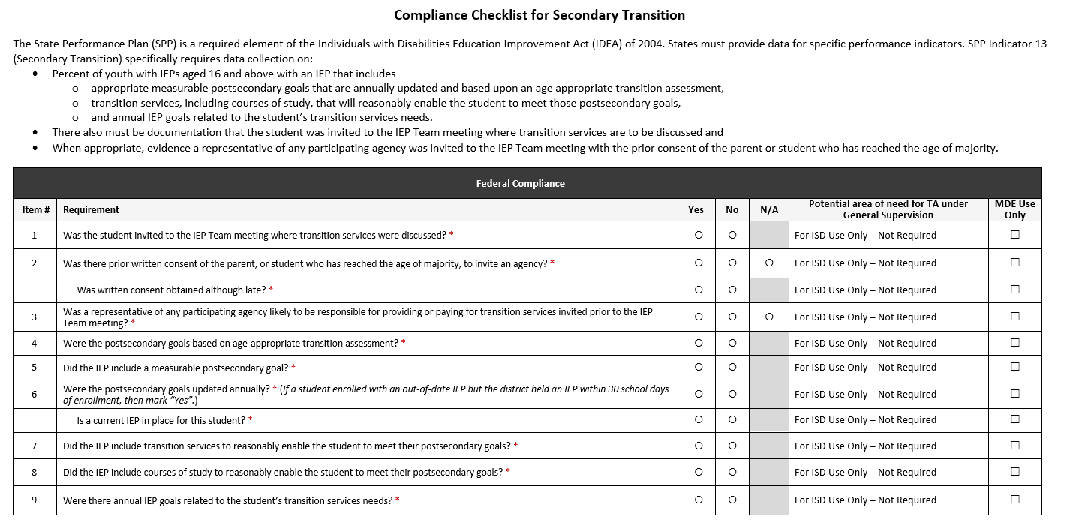
B-13 Data Collection Checklist
Notes:
Jamie - The checklist for the 2024 data collection is the same checklist used in 2023.
Note the columns on the right of the checklist:
Potential area of need for TA under General Supervision – this field is not required by any user; the ISD may use this field to make notes about a checklist, as appropriate. ISD TCs can run a summary report of any comments they recorded for professional learning opportunities.
MDE Use Only – this field is for the MDE reviewer to select if any changes need to be made to the checklist based on the review of the uploaded student IEP.

Slide 39
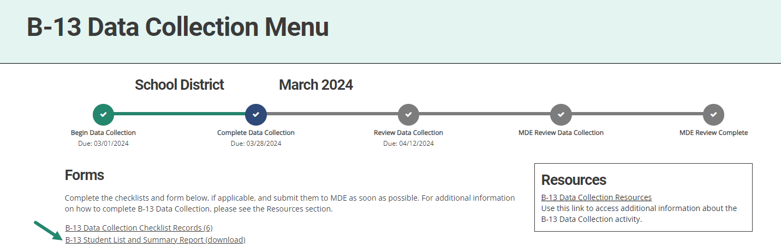
4. Review the Summary Report
From the B-13 Data Collection Menu, choose B-13 Student List and Summary Report (download).
Notes:
Jamie - Once all checklists have been completed, the TC can run the Summary Report using the B-13 Data Collection forms menu link.
The summary report allows the TC to see all the record review responses on one page. This will help to see if there is any missed information or incorrect responses that need to be changed before submission.

Slide 40
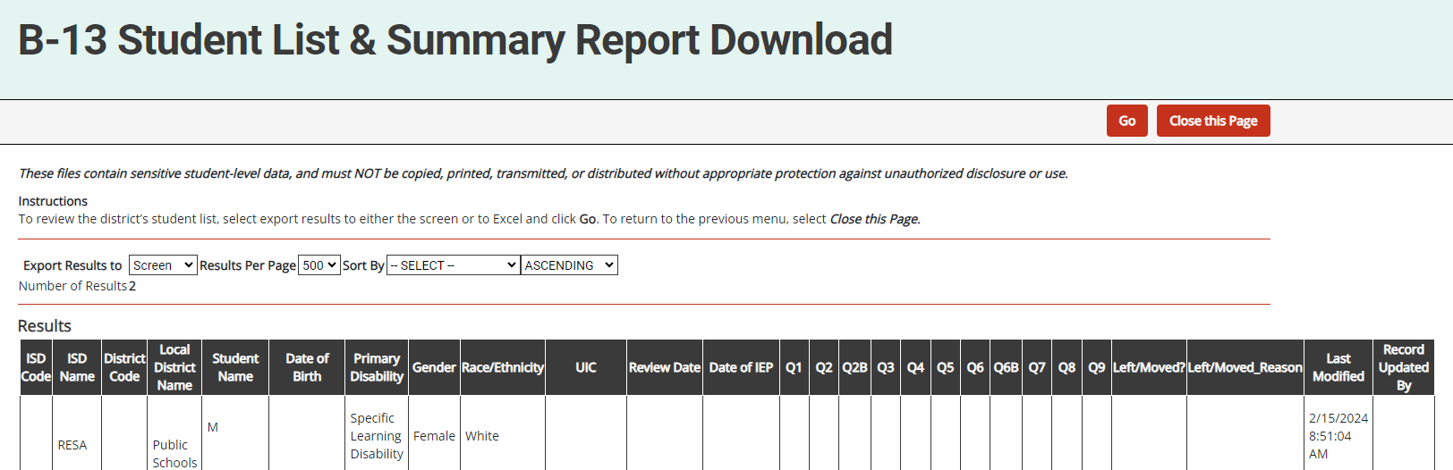
4. Review the Summary Report (cont.)
Review the summary report for any No or blank responses:
  A No identifies that item is noncompliant. This will result in a finding of noncompliance and the member district will be required to complete a Corrective Action Plan (CAP) and a Student-Level Corrective Action Plan (SLCAP).
Note: If checklists are not completed, all or some of the report will be blank.
Notes:
Jamie - The summary report allows the TC to see the checklist responses for each student in one place. There should be no blank responses. If there are, it means the review for that student file was not completed and must either be returned for completion or the ISD will need to complete the review.

Slide 41
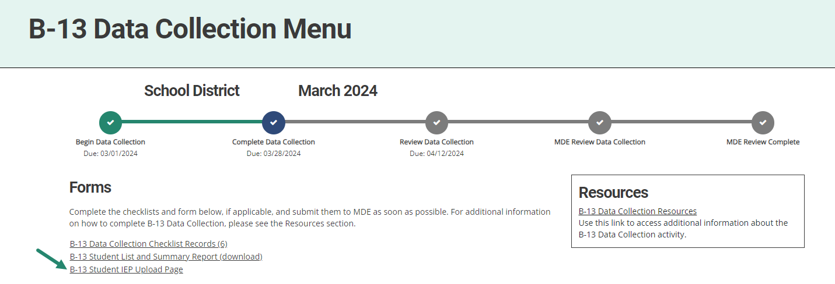
5. Access Student IEP Upload Page
From the menu, choose B-13 Student IEP Upload Page.
Starting from the top of the list, select and upload the fifth available student record.
Not every member district will complete this page.
Notes:
Jamie - Again, this year, the ISD is required to upload 1 student record for MDE review
Notes:
Only one file needs to be uploaded. Do not upload every 5th file.
Available student records are those from the list provided by MDE in Catamaran.
Only one district in each ISD and all State Agencies will complete a B-13 Student IEP Upload Page. If this page is not on the district’s menu, then there is no page to complete. If the student upload page is on the district’s menu page, select the link and proceed to the upload page.
Remember -The purpose of the uploaded IEP review is to check for consistency with how ISDs review files for compliance using the new understanding of what constitutes compliance.

Slide 42
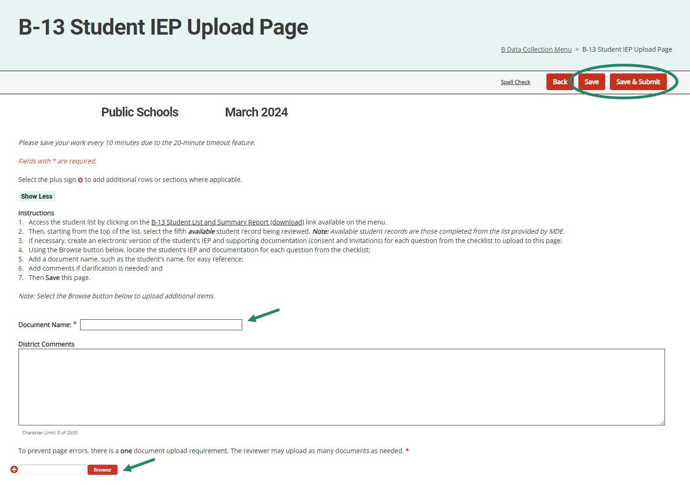
5. Upload Student’s IEP
Upload the student’s IEP and supporting documentation.
Add a document name (student name) and clarifying comments and Save.
Upload multiple documents as needed.
Users may Save and Submit the entire activity on this page or the B-13 Student Record page depending on the order the work is completed.
Also provided on this page are comment boxes for the ISD and the MDE should the activity need to be returned.
Notes:
Jamie - Once on the upload page, you will use the browse button to upload the student’s IEP and supporting documents. Add a document name-typically the student’s name and add any clarifying comments if needed. Then SAVE. Multiple documents may be uploaded as needed.
Remember to upload invitations, consents, etc. If there is no evidence to support compliance for a question on the checklist, it will be considered non-compliant.
Users may save & submit from this page or the B-13 student record page. Either way, save your work before moving to another page. If, for some reason, the activity is returned, for example, missing the invitation, a comment box is provided to explain why.

Slide 43
Reviewing the Activity for TCs
Notes:
Jamie -
Reviewing the activity – this next section pertains only to TCs.
Once member districts complete their student record reviews, ISDs can review the data from member districts and may return the checklists to member districts if modifications are needed, such as additional documentation for the student record uploaded to the B-13 Student IEP Upload Page. (This is not to allow the district to correct the IEP.)
This section reviews how an ISD completes this review in Catamaran.
Important notes:
ISDs still have the option to either assign the data collection checklist completion to member districts or they may choose to complete all checklists.
If the ISD chooses to complete the checklists, then as the ISD TC, the ISD will submit the checklists directly to MDE.

Slide 44
What does this review step mean?
By having a dedicated ISD review step in the process, ISDs may streamline work.
Catamaran will continue to prompt ISDs with system notifications and reminders.
Catamaran approval tools include:
  B-13 Student List and Summary Report Download
  B-13 Data Collection-Student IEP Upload Report
  Data Collection Batch Acceptance
Notes:
Jamie -

Slide 45
Access the Activity in Catamaran
Log in to Catamaran (https://catamaran.partners)
Notes:
Jamie - Once the ISD has received a system notification that a member district has submitted the B-13 data collection activity to the ISD, log into Catamaran.

Slide 46
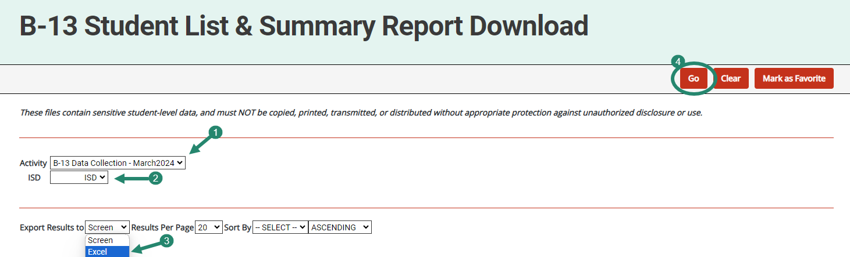
2. Review Submitted Data
Notes:
Jamie -
Before approving the activity, review the submitted data and verify that it is correct.
To do this, open the B-13 Student List and Summary Report Download for the ISD and review the responses for each member district.
Check for any questions where there are No’s or any questions that are blank
A No answer identifies that item as noncompliant. This will result in a finding of noncompliance and the member district will be required to complete a CAP and an SLCAP.
Note: If the member district has not completed all checklists, all or some of the report will be blank. Once exported to Excel, ISDs may choose to filter this report to display districts that have completed checklists.
If the ISD is satisfied the submitted data are accurate, proceed to the next step.

Slide 47
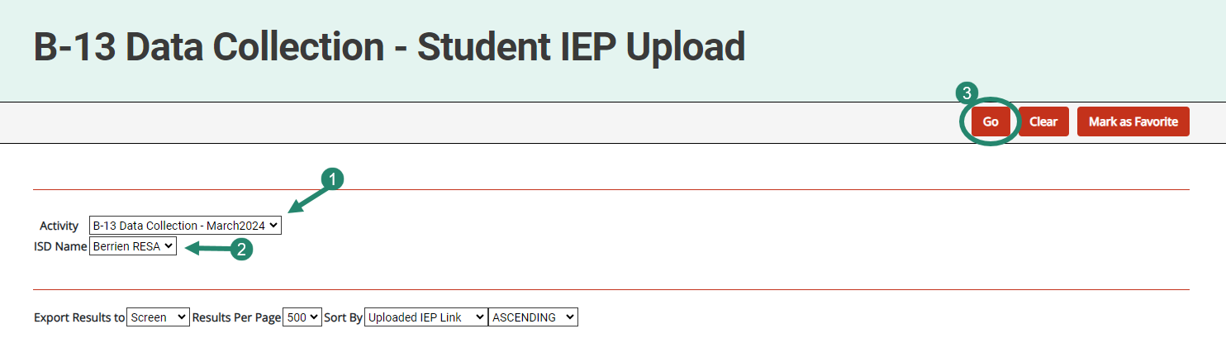
3. Review Uploaded IEPs
Notes:
Jamie -
Next, review the IEP the member district uploaded. Note that ISDs will have only one to review.
To review these, go to Reports to then open the B-13 Data Collection-Student IEP Upload report.
See a line for the member district with a link to the uploaded IEP.
To review the uploaded document, select the provided link.
If the member district did not provide all of the documentation needed to verify compliance, the ISD must return it to the member district to provide additional documentation.
If the uploaded IEP provides sufficient evidence the checklist is accurate, proceed to the next step.
Note: if the ISD disagrees with the member district’s responses on the checklist, the ISD should change district responses by accessing the individual student’s checklist page in Catamaran.

Slide 48
4. Access the Activity
Notes:
Jamie -
Access the activity either through the Tasks Overview (district) or through the Monitoring Tasks Overview (ISD).
To update a checklist response, open the member district’s activity to make the update.

Slide 49
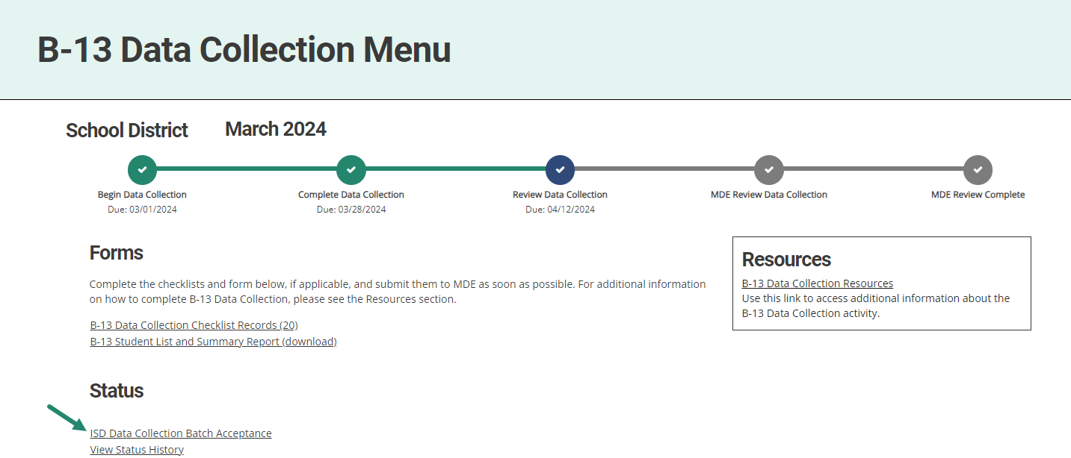
5. Open ISD Data Collection Batch Acceptance
Select ISD Data Collection Batch Acceptance from the menu.
Access batch acceptance to view all submitted checklists from any B-13 Data Collection Menu within the ISD.
Notes:
Jamie - The batch acceptance tool is available for the ISD again this year.

Slide 50
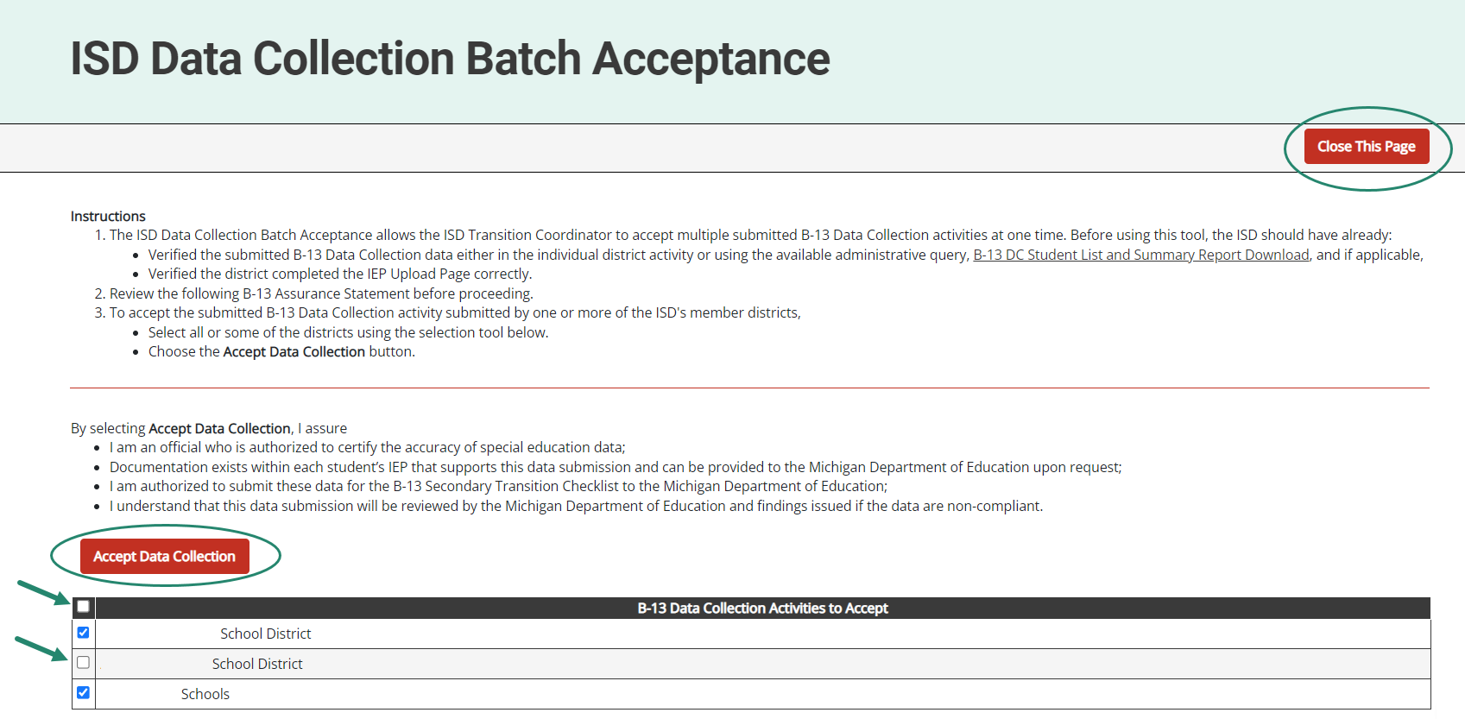
6. Accept Submitted Checklists
Select submitted member district data collection activities that are ready for acceptance.
Choose Accept Data Collection.
Select Close This Page, to return to the menu.
Notes:
Jamie -
The ISD Data Collection Batch Acceptance allows the ISD Transition Coordinator to accept multiple submitted B-13 Data Collection activities at one time. Before using this tool, the ISD should have already:
Verified the submitted B-13 Data Collection data either in the individual district activity or using the available administrative query, B-13 DC Student List and Summary Report Download, and
Verified the district completed the IEP Upload Page correctly.
Review the following B-13 Assurance Statement before proceeding.
To accept the submitted B-13 Data Collection activity submitted by one or more of the ISD’s member districts,
Select all of some of the districts using the selection tool below.
Choose the Accept Data Collection button at the top of this page.
By clicking Accept Data Collection, the TC is assuring that:
They are authorized to certify the accuracy of special education data;
That documentation exists within each student’s IEP that supports this data submission and can be provided to the Michigan Department of Education upon request;
They are authorized to submit these data for the B-13 Secondary Transition Checklist to the Michigan Department of Education;
They understand that this data submission will be reviewed by the Michigan Department of Education and findings issued if the data are non-compliant.

Slide 51
Timeline Revisited
Activity | Date | Description
Data Collection | March 1 to 28 | Complete data collection checklists
Data Collection Review | March 29 to April 12 | ISD reviews submitted checklists
Checklist Due to MDE | April 12 | ISD submits checklists to MDE
MDE Review | April 13 to 19 | MDE reviews submitted checklists
Student Level Corrective Action | April 25 | SLCAPs issued by April 25 and due by June 9
District Level Corrective Action | May 15 | CAPs or Corrective Action issued
Notes:
Jamie - Like last year, MDE is providing a suggested timeline to allow for ISDs to have a review period during the overall data collection window. *
ISDs, of course, can follow the timeline that works best for them; however, we recommend that you take advantage of the suggested review period to avoid having to ask for items to be changed after the submission or for SLCAPs to be rescinded after they have been released.
A progress bar (seen on the next slide) will guide the district and ISD through the different milestones of the data collection activity.
Please note that ISDs and State Agencies should plan to submit checklists to MDE by April 12.
After MDE’s review is complete, SLCAPs will be issued in Catamaran no later than April 25 and due on June 9. Any Corrective Actions or CAPs will be issued in the May 15 release.

Slide 52
Student Level Corrections vs
District Level Corrections
Remember there are two levels of corrective action:
Student Level Corrections (SLCAP)
District Level Correction Action Plans (CAPs & Corrective Actions)
Notes:
Jamie - Following the submission of the checklists, MDE reviews the uploaded files and determines compliance. When noncompliance is identified, a finding and corrective action are issued. That corrective action comes out as both student level and district level corrective action. Remember, there are 2 levels of corrective actions. Student level (SLCAP) and district level (CAP). And corrective actions

Slide 53
Student Level Corrections vs
District Level Corrections (1)
  Student Level Corrections (SLCAP):
    Student level correction is needed.
    Involves amending the IEP or holding a new IEP.
Notes:
Jamie -

Slide 54
Student Level Corrections vs
District Level Corrections (2)
District Level Corrections (CAPs & Corrective Actions)
    CAPs:
      district-level (systemic)
      Involve training, policies, practices & procedures for district-wide staff
    Corrective Actions:
      district-level (systemic)
      involve training, policies & practices related to the individual provider whose file triggered the noncompliance
Notes:
Jamie -

Slide 55
Student Level Corrective Action
Plans (SLCAP)
If a student’s checklist indicates an area of noncompliance, an SLCAP, will be issued to the member district on April 25 in Catamaran.
SLCAPs must be completed by June 9, 2024.
Member districts do not need to wait for SLCAPs to be issued to begin making corrections.
All corrections will be documented and submitted to MDE in Catamaran.
Notes:
Jamie -

Slide 56
Corrective Action Plan (CAP)
If a student’s checklist indicates an area of noncompliance, a CAP will be issued to the member district in the May 2023 Catamaran release (May 15, 2024).
Member districts must submit the CAP for MDE review by July 1, 2024.
The CAP must be completed within one year. This includes:
  Completion of activities
  Request for closeout
  ISD verification
  MDE closeout
Notes:
Jamie - Follow the due dates in Catamaran for the CAP timelines

Slide 57
Corrective Action
This option is different from a CAP. When a member district has only one student checklist indicating an area of noncompliance, then a Corrective Action will be issued to the member district in the May 2024 Catamaran release (May 15, 2024).
Member districts must select the corrective action to take and then implement the plan.
The Corrective Action must be completed within one year or sooner. This includes:
  Completion of activities
  Request for closeout
  ISD verification
  MDE closeout
Notes:
Jamie - Unlike a CAP. a corrective action does not require approval for the plan by MDE and does not require a progress report.
In addition, corrective actions are focused on the provider whose record triggered the noncompliance. Therefore, if a district chooses professional development for their corrective action, it must be implemented with the individual provider. However, the district can choose to implement with all relevant district staff.
If you need a refresher on how to write a CAP, there are ’how to’ documents on the Catamaran Technical Assistance Website as well as a recorded webinar under past events. If you need assistance with writing a CA, there are “how to” documents on the Catamaran Technical Assistance Website as well.

Slide 58
Answering Checklist Question 2

Slide 59
Question 2
Was there prior consent of the parent or student, who has reached the age of majority, to invite an agency?
  Yes
  No
  N/A
Notes:
Question 2- Is there evidence of prior consent of the parent or student, who has reached the age of majority, to invite an agency? Please respond with YES, NO or NA.
There is a lot of meaning embedded in this question. First of all, the district has to determine if there is an agency likely to be responsible for paying for or providing transition services. Those services are not time bound. IDEA doesn’t say that schools only need to invite the agency if they are going to provide them during the current year or at a certain age of the student, or when the agency likes to get involved. The IDEA requires that if an agency is likely to provide or pay for services, they be invited to the IEP meeting where transition services will be discussed. In order to make that invitation, the district must seek consent from the parent or the student who has reached the age of majority.
If the Team has decided there is an agency likely to provide or pay for services, did they seek consent to invite the agency prior to inviting the agency? We know from OSEP’s Letter to Gray that the ideal is that an agency representative is identified on the consent form. We also know from practice that the agency representative is not always known. Case managers change, etc. So minimally, the agency must be identified on the consent form to meet the requirements of consent.
If there is not an Agency likely to provide or pay for services, then the reviewer can use NA on the checklist. Do Not select “No”.

Slide 60
Question 2 Follow-up
Was written consent obtained although late?
  Yes
  No
Notes:
Just like last year, there is a conditional question to question 2.
If there is a NO response for question 2, there will be a subquestion asking, was written consent obtained but it was late?
If the answer is yes, consent was obtained although late, meaning after the invitation was sent, no student level corrective action plan will be issued. However, if question #2 is answered “no,” the district correction at student level is to obtain consent, invite agency and hold a new IEP or IEP amendment. 2.B, If agency was invited and attended IEP without consent and or consent was received after/during the IEP, the district would receive a CAP to include 300.622 FERPA Consent to invite training requirements.

Slide 61
Resources
Notes:
Jamie -

Slide 62
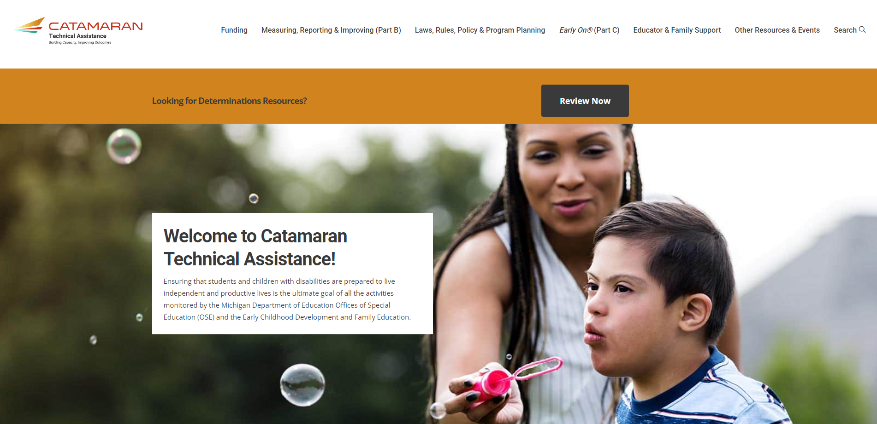
Catamaran Technical Assistance
Notes:
Jamie - The Catamaran Technical Assistance Website focuses on increased technical assistance for Catamaran users.
The following slides highlight some of the features and navigation.
You can access the Catamaran Technical Assistance Website at training dot catamaran dot partners.

Slide 63
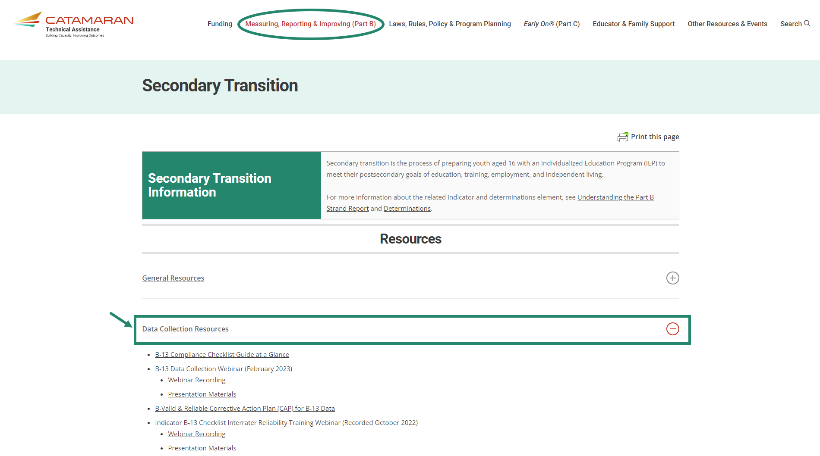
B-13 Secondary Transition Page
Notes:
Jamie - To access the data collection resources, select Measuring, reporting & improving (Part B), then choose the Secondary Transition link to open the page. Data collection resources are located under the Data Collection Resources heading as shown on this slide. Resources available include:
B-13 Checklist
B-13 “At a Glance”
B-13 Manual
Federal Reporting and the Compliance Checklist B-13 side by side – basically, compares the previous questions with the new questions and includes information as to what is considered compliant when using the new checklist questions.

Slide 64
OSE Office Hours
Office Hours are listed on the Upcoming Events page on the Catamaran Technical Assistance Website.
To join, select Join Meeting.
No registration is needed.
Date | Time
April 4 | 2:00 – 4:00 PM
April 10 | 3:00 – 5:00 PM
Notes:
Jamie - Again this year, the OSE will be providing “office hours” to assist the ISDs in verifying the data submission. These live “office hours” are intended for ISDs to ask questions to the OSE regarding specific items on the B-13 checklist. If a transition coordinator contact has a question, the first stop should be the ISD transition coordinator. If the ISD transition coordinator needs clarification, they can log in to Zoom during one of these sessions and have questions answered. It would be great if the ISD would email or Leapfile the particular question to Shawan Dortch the day before the Zoom.

Slide 65
Reminder: Due Date
The data collection window closes April 12, 2024 at 11:59 PM.
Notes:
Jamie

Slide 66
Need More Help?
Catamaran Help Desk:
  Available Monday – Friday 9:00 am – 4:00 pm
  Email: Catamaran Help Desk (help@catamaran.partners)
  Phone: 877-474-9023
  Chat feature in Catamaran
Tell the Help Desk:
  TC or TCC
  Completing B-13 Data Collection
Notes:
Jamie -

Slide 67
Questions?
Notes:
Jamie - If you have questions, please use the chat feature to type in questions.

Slide 68
Contact MDE OSE
Presenters
Nichole Moore
mooren9@michigan.gov
Jamie Swiger
swigerj@michigan.gov
Coordinator
Shawan Dortch
dortchs@michigan.gov
MDE OSE Information Line
888-320-8384
mde-ose@michigan.gov
Notes:
Jamie - If you have any questions about today’s presentation, please contact Christie at m c k e y c @michigan.gov, Jamie at s w i g e r j @michigan.gov or the MTAT Coordinator Shawan Dortch at d o r t c h s @michigan.gov. For more general questions about special education, please contact the MDE OSE Information Line at 888-320-8384 or by email at m d e – o s e @ Michigan.gov.

Slide 69
Contact the Catamaran Team
Project Director
Lynne Clark
lclark@publicsectorconsultants.com
Project Manager
Donna Seeger
dseeger@publicsectorconsultants.com
Catamaran Help Desk
877-474-9023
help@catamaran.partners
Notes:
Jamie -
Finally, for questions concerning Catamaran,
Reach out to Lynne at l c l a r k @publicsectorconsultants.com or Donna at d_s_e_e_g_e_r@publicsectorconsultants.com
As a reminder,
The Catamaran Help Desk is available Monday through Friday from 8-5 PM.
Contact them by email at help@catamaran.partners or by phone at 877-474-9023 or by using the Chat feature within Catamaran.
This concludes the presentation -- thank you for attending!

