Slide 1
How to Complete the Maintenance of Effort Eligibility Test
For District Business Officials
Notes:
Welcome and introductions
Housekeeping:
We will be recording this webinar and posting the recording and the presentation materials on the Catamaran training website by the end of this week.
This webinar will be closed captioned, so if you need to access that feature, you can click the closed captioning button in your webinar browser.
If you have a question for the presenters, please use the Chat or Q&A feature in the webinar browser. The phone will remain muted throughout the webinar, but please send any question our way as we go. We will pause for questions to make sure we can address them.

Slide 2
Agenda
Introduction to MOE and Catamaran
What is Catamaran?
Requesting User Access and Logging In
Providing District Data for MOE Eligibility Testing
Next Steps
Training Resources

Slide 3
Introduction to Maintenance of Effort and Catamaran

Slide 4
What is MOE Eligibility?
Eligibility
Compliance
Subsequent Years Rule
Comparison Years
Timing of testing
ISD level compliance

Slide 5
What is Catamaran?

Slide 6
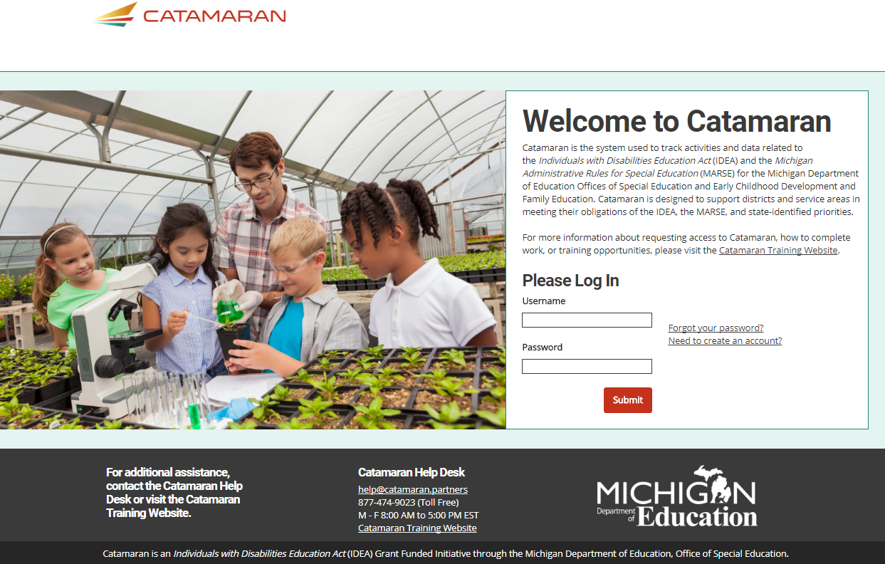
Meet Catamaran
System used to track activities and data related to IDEA and MARSE
Encompasses work for OSE and ECD&FE
Monitoring
Policy
Finance
Notes:
Catamaran is the system used by the MDE to track data and activities related to IDEA and the MARSE.
You may have heard the name CIMS tossed around, and Catamaran has replaced CIMS as of September 2017.
Catamaran holds work for the Office of Special Education and the Office of Early Childhood Development and Family Education, and within those offices, it encompasses work related to Monitoring, Policy and Finance.

Slide 7
Requesting Access and Logging in

Slide 8
Username and Password
All currently identified district business officials have a Catamaran user name and password
As a district business official, if you do not have user credentials, please request Catamaran access
Notes:
All identified business officials have a Catamaran user name and password.
If you do not yet have one, we’ll walk through how to request access on the next slide. If you don’t remember yours, we’ll also walk through how to get a reminder or reset.

Slide 9
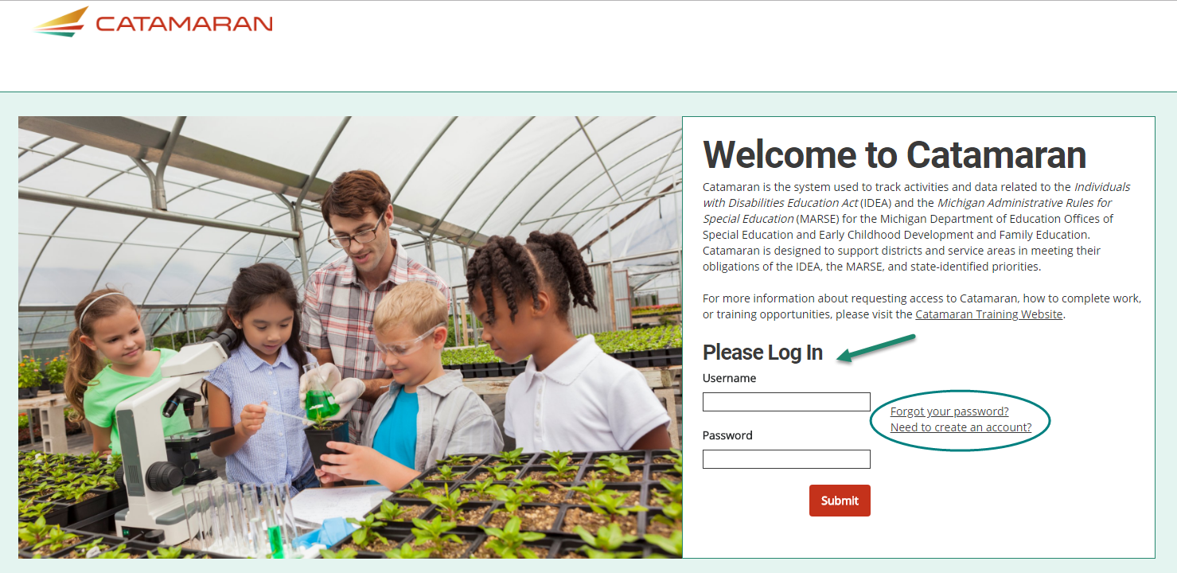
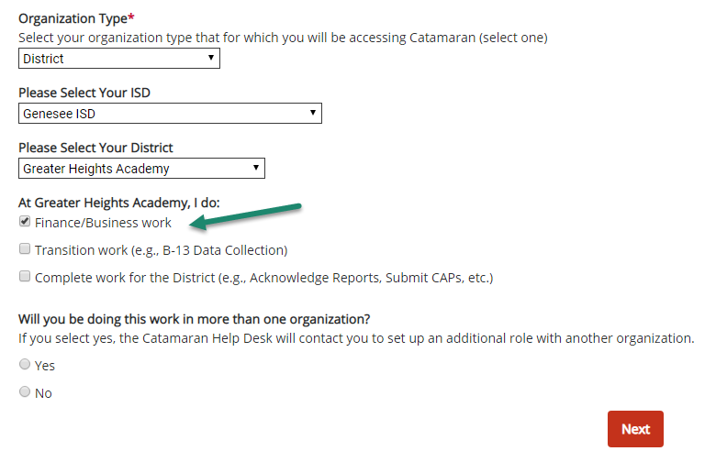
Log in to Catamaran
Visit https://catamaran.partners
Update your bookmarks!
Log in with username and password
If you do not yet have a username and password, request access by clicking Need to create an account
Choose Finance/Business work
Approval for access will come from your ISD business official.
Notes:
To log in, you’ll need to visit https://catamaran.partners. I would suggest bookmarking this url for easy access later.
Most district officials are already Catamaran users from the last round of MOE-Eligibility.
For a new user to request access to Catamaran, you’ll need to click “Need to create a account” next to the log in box.
When you are completing those brief new user forms, make sure you select that you will be completing Finance and/or business work for your ISD. Then, you’ll receive approval within about two business days.
If you need a reminder of your username or password, you can click on the Forgot your password link. Then, you can either get a reminder of your username emailed to the email address associated with your account, or you can request a password reset link to reset your password.

Slide 10
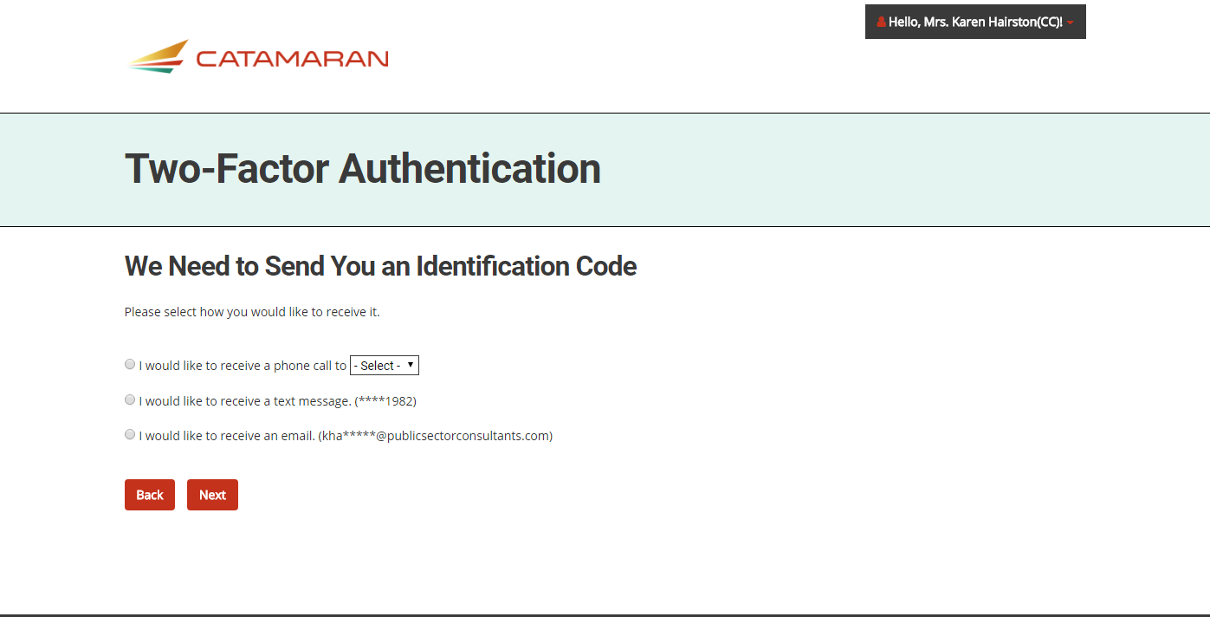
Complete Two-Factor Authentication
Opt to receive the code via email, phone call, or text
Complete every six months
Choose ‘Remember this device’
Will need to complete on each device you use (device specific)
Notes:
Upon logging in, you will be asked to complete Two Factor authentication, which is similar to what many banks are using these days to secure their websites.
With two-factor authentication, you can choose the method by which you want to receive a code. The system is set up to accommodate phone calls, texts, and emails. If you do not provide add a cell phone number when you set up your profile, you will not see this option. Choose your method and click Next. Also, a note about two factor authentication. You will need to complete this about every six months *if you select Remember this device on the next page. This is device specific, so if you completed it on your home computer, you will also need to complete it on your work computer.

Slide 11
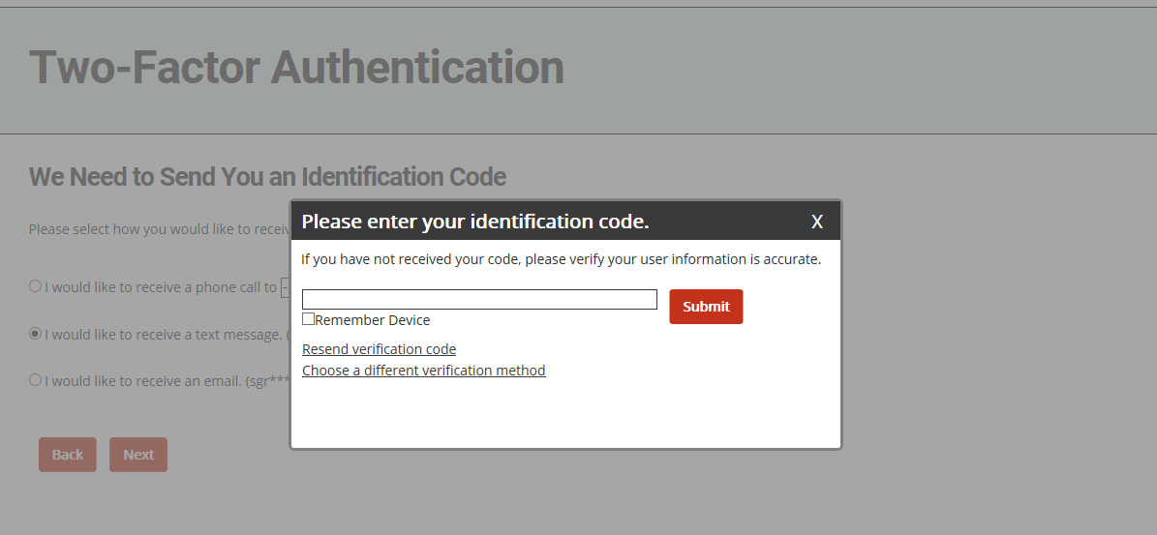
Identification Code
Enter code sent to you
Click Remember this device
Resend code available if necessary
Note: Different email servers have different time lags. Give your email a moment to catch up before resending, or choose a different verification method.
Notes:
Once you click Next, a window will display in which you enter the code and click Submit.
As you can see here, here is the option to select the “Remember this device” option with your 2 factor authentication. Again, you will only have to do this every six months, if you choose “Remember this device.” But keep in mind, if your device does not save cookies or if you delete your cookies or clear your cache, your device will be forgotten, and you’ll be asked to do the 2-factor authentication again next time you log in.
If you don’t get the authentication code you can either have the system Resend one, or you can close the identification code window and select another method. If you are having any problems with this, the Catamaran Help Desk is an excellent resource.
Another note, we’ve noticed that there may be a slight time lag on the email verification depending on the filters that your ISD or organization may have set up. I would encourage you to wait a few minutes to see if the code arrives, but if you are having any problems with this, the Catamaran Help Desk is an excellent resource.

Slide 12
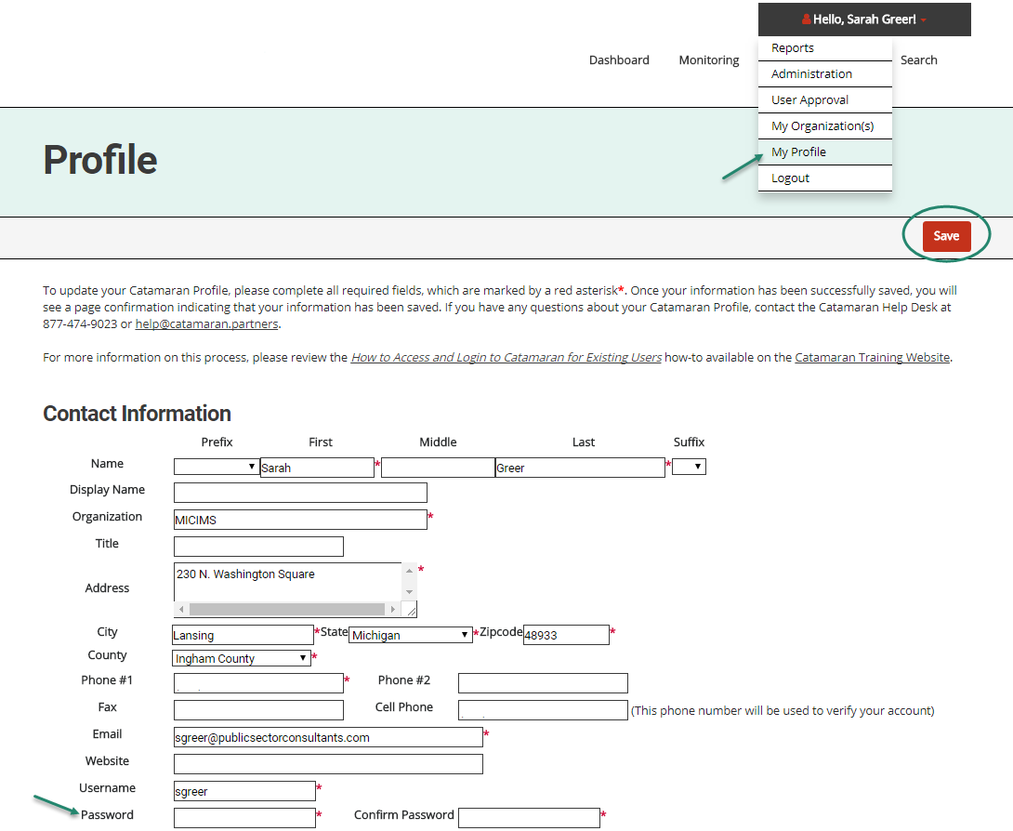
Update Profile
To change your password, use the drop-down menu in the upper right-hand corner of the screen to access your profile.
On your profile page, change your password and click Save.
Note: You may also be prompted to confirm your email address at your first log in.
Notes:
When you log in, you may be prompted to update your profile.
All you really need to do here is review your profile and contact information and hit Save, but you may also want to actually update your profile.
Once you have updated any information or your password, click the Save button in the top right hand corner.

Slide 13
Providing District Data for MOE Eligibility Testing

Slide 14
What is Maintenance of Effort Eligibility?
Demonstrates that the district will maintain the appropriate level of fiscal expenditure (effort) in the upcoming school year
Districts will submit anticipated expenditures to the ISD
The ISD will review and submit to MDE
If the ISD sees the need for any changes, they may return the Eligibility test to the district for modifications. The district is responsible for modifying the data and resubmitting it to the ISD.
Notes:
We had a pretty comprehensive overview at the beginning of this afternoon’s webinar, but here is a quick review.
MOE demonstrates that the districts and ISD will maintain the appropriate level of fiscal effort in the upcoming school year.
Districts will submit their anticipated expenditures to the ISD and then the ISD will review.
If the ISD sees the need for any changes, they may return the eligibility test back to you for modifications. Then you as the district will be responsible for making these changes and resubmitting it to the ISD.
After the ISD has reviewed and accepted your district-level data, they will submit the ISD-level Eligibility Test to the MDE for review.

Slide 15
Access the MOE Eligibility Test
Log in to Catamaran (https://catamaran.partners)
Your district’s MOE Eligibility activity will appear on your Tasks Overview on the Dashboard
Click on the Activity link
Notes:
In order to access MOE, you’ll need to log in to Catamaran with your username and password.
Then, your district’s eligibility test will show on your Tasks Overview, which is on your front page.
Click on the Activity link to access your MOE eligibility activity.

Slide 16
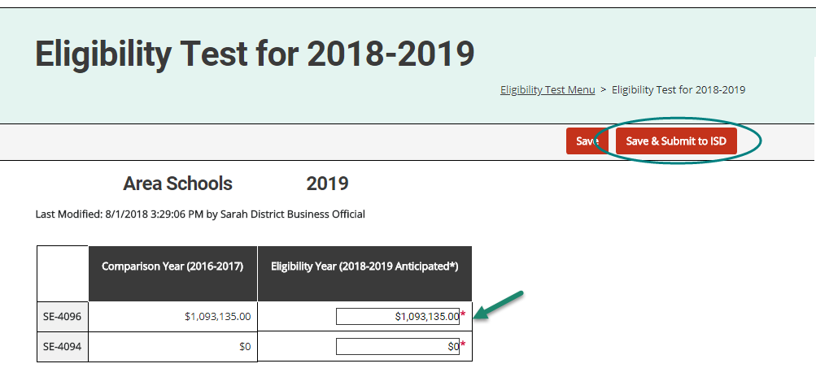
Submit District Data for the Eligibility Test
On the MOE Eligibility Test Menu, click on the Eligibility Test for 2018-2019 link.
On the Eligibility Test page, enter the anticipated budget for the upcoming year for the fields in the rows labeled SE-4096 and SE-4094.
Click Save and Submit to send it to the ISD for review and acceptance
Notes:
This will bring you to the MOE Eligibility Test menu. On this menu, click on the Eligibility Test for 2018-19 link.
On the eligibility test page, enter the anticipated budget for the 2018-19 year in the fields SE 4094 and SE 4096.
Then, either click Save if you want to save and return at a later time, or Save and Submit if your numbers are final and you are ready to submit them to the ISD for review.
For more detail about what amounts from the SE-4094 and SE-4096 to enter, you can view the How To Complete the MOE Eligibility Activity for Districts on the Catamaran Training Website, and we’ll look at where to find that training resource in just a few moments.

Slide 17
Important Dates
MOE Eligibility Test released by Friday, August 10th (at the latest)
ISDs must submit aggregate MOE Eligibility test to MDE within three weeks of the release date
Member districts must submit their information to ISDs before this date to allow time for the ISDs to complete their part of the task
If you do not submit information in a timely manner, the ISD has the option to override your steps and enter zeros for your district in order to submit the activity to MDE on time
Notes:
Prompt John to talk about when funds are released.

Slide 18
Next Steps
Notes:
Lets look at what happens next once you submit your data to the ISD.

Slide 19
What happens next?
Next, the ISD business official will review this information.
If your ISD business official sees the need for any changes, they will return the Eligibility Test to you for modifications.
The district business official will be responsible for modifying this Eligibility Test and resubmitting it to the ISD business official.
The ISD may contact you for more information about exceptions
The ISD will submit the aggregate ISD eligibility test to MDE when complete
Notes:
First, the ISD will review your district information and the information from all other districts In your ISD at an individual and aggregate level.
If the ISD sees any need for changes, they will return the eligibility test to you for modifications. The ISD will put a note in the test for additional context, but please reach out to the ISD if you need additional clarification about the requested changes. Also, the ISD may contact you for additional information about possible exceptions.
After the ISD completes this process, they will submit the ISD-level aggregate test to MDE for review.

Slide 20
Upcoming Activities in Catamaran
Excess Cost coming to Catamaran Fall 2018
Notes:
The next activity that will be coming to Catamaran will be Excess Cost that will be launching this fall.

Slide 21
Training Resources

Slide 22
Training Website
Catamaran Training Website
(http://training.catamaran.partners)
Update your bookmarks!
Notes:
This is the Catamaran Training Website, which is full of training resources that are tailored for the work you are doing.
The URL is http://training.catamaran.partners. I would also suggest that you update your bookmarks with this URL for easy access later.
the training site has been organized to be similar to the Catamaran system. For example, there is the menu across the top from which you’ll be able to link to information about Monitoring, Finance, and Policy activities. There is also a Resources section, which is where you can find general information about the indicators and other items.
There are How To training documents outlining the processes as well as short training videos. this training website will continue to be updated on a rolling basis, constantly adding new content throughout the year. So when those new activities come up, there will be corresponding training pertaining to those activities.

Slide 23
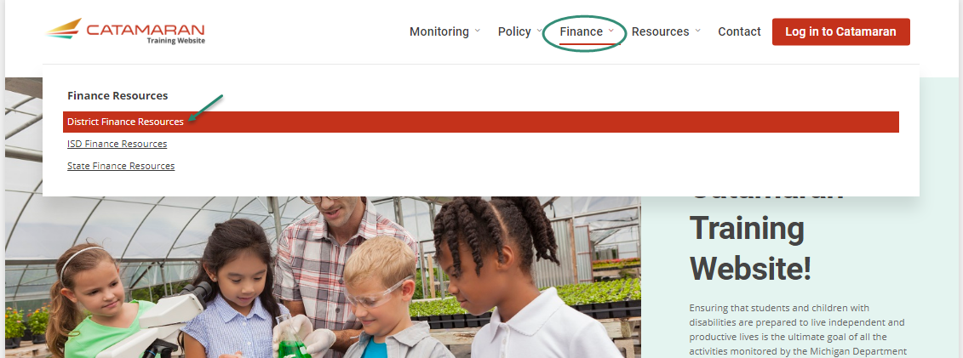
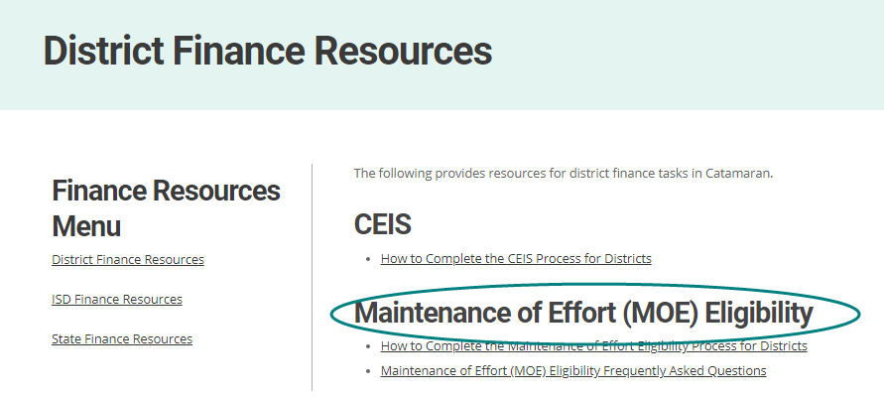
Finance Resources
How Tos organized by topic area and audience
Notes:
The training resources are organized by audience and by topic.
For example, you would want to access the Finance resources and then navigate to the District level finance resources to see information tailored to your role and work in Catamaran. There are some detailed how to documents about how to complete the MOE Eligibility activity in Catamaran as well as some Frequently Asked Questions that we’ve seen over the past few months.

Slide 24
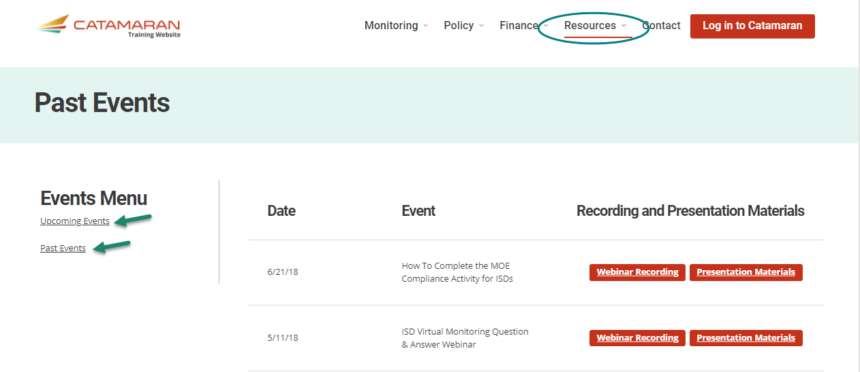
Upcoming and Past Events
Resources: Upcoming and Past Events
Recording and presentation materials under Past Events (including a recording of this webinar)
Notes:
Any upcoming trainings and events be found on the Events page under the Resources tab at http://training.catamaran.partners.
The Past Events link you can see highlighted on the left side of the page is where recordings of past webinars and presentation materials will be posted, including a recording of this webinar and its presentation materials.

Slide 25
Catamaran Help Desk
Need help completing a task? Having trouble with your username and password?
Contact the Catamaran Help Desk
Email: help@catamaran.partners
Phone: 877-474-9023
Chat while logged in to Catamaran
Add help@catamaran.partners to your email address book
Notes:
Lastly, the Catamaran Help Desk that I mentioned earlier is a great resource for all Catamaran users. It is staffed Monday – Friday from 8:00 – 5:00 pm with some really friendly folks who know what they are talking about. So if you have any questions about finding work, completing a task or making sure you can see the right work, give them a call, email or chat.

Slide 26
Questions?
Notes:
Lets pause to see if there are any questions. You may use the chat feature in the webinar to send any questions our way. The phone will remain muted.

Slide 27
Contact Us
Catamaran Team
MDE-OSE
Karen Hairston, Program Director
khairston@publicsectorconsultants.com
Lynne Clark, Operations Manager
lclark@publicsectorconsultants.com
Sarah Greer, Training and Communication
sgreer@publicsectorconsultants.com
John Andrejack, Supervisor
andrejackj@michigan.gov
Joni Jay
JayJ1@michigan.gov
Notes:
If you have any questions feel free to contact anyone you see listed here. These presentation materials will be posted on the Catamaran training website in case you need to reference them later. Also, our Catamaran Help Desk is another great resource, and they can be contacted at help@catamaran.partners or 877-474-9023.
This concludes our webinar training and thank you for attending!

