Slide 1
Welcome!
The How to Write a CAP webinar will begin in a few moments.
The webinar will be recorded and posted on the Catamaran Training Website under Past Events (https://training.catamaran.partners/past-events/)
The PowerPoint presentation materials will also be posted and available for download on the Catamaran Training Website (https://training.catamaran.partners)
To communicate with the presenters during the webinar, please use the “Chat” feature.
Closed captioning is available for this webinar. To select this option, choose the closed caption icon in the webinar player.
Notes:
Updated April 2021

Slide 2
How to Write a CAP
For Districts and ISDs
Notes:
Good morning, everyone. We are so glad that you could join us today.

Slide 3
Meet the team
Office of Special Education (OSE)
Jessica Brady, Supervisor
Jeanne Anderson Tippett
Janet Timbs
Shawan Dortch
Tori Ranusch
Charles Thomas
Aaron Darling
Public Sector Consultants (PSC)
Kelly Rogers
Lynne Clark
Notes:
My name is Janet Timbs, a consultant with the Office of Special Education. Jeanne Anderson-Tippett from our office be presenting with me today, along with Lynne Clark from PSC. Other OSE team members are listed here on this slide.

Slide 4
Agenda
CAP Types
CAP Content
Resources
Questions
Notes:
Today we will be covering types of CAPs, the content of the CAPs, resources and then there will be time for questions. Again, please feel free to ask questions throughout today’s presentation by using the chat box.

Slide 5
CAP Types
Notes:
So, you may be wondering why have a webinar on how to write Corrective Action Plans (CAPs) since many of you have been writing CAPs for quite awhile now? Well, we are finding that in some cases, districts are missing key components or concepts when developing the activities for correction, resulting in the OSE returning them for modifications. Also, over time, the OSE has developed a variety of CAP types that are slightly different from each other. This is an opportunity for us to ensure that districts understand the differences between each CAP type. The next few slides will explain the differences in these CAPs.

Slide 6
Corrective Action Plans (CAPs)
Same workflow and timelines for completion
Describe system level correction
Are verified as corrected by the ISD
Typically include links to either
Student Level Corrective Action Plans (SLCAPs) (if needed) or
District Student Data Report
Notes:
In general, CAPs have the same workflow and timelines for completion, and are focused on system level correction (vs. individual student level correction). System level correction refers to district-wide procedures and practices that contribute to non-compliance. CAPs are verified for correction by the ISD, before submitting to MDE for final verification and closeout. Typically, the CAP cover page has a link to the associated Student Level Corrective Action Plans (SLCAPs) and/or district student data report.
In the case of a monitoring CAP issued following a Procedure Review, there will not be student level correction nor would there be a district student data report

Slide 7
Overview of CAP Differences
Data CAPs (B-11, B-12, B-13, B-Timely IEP)
Issued from a monitoring activity (e.g., B-13 Data Collection)
Issued from a data submission (e.g., B-11 (Child Find))
Monitoring CAPs (B-4A, B-4B, B-4AB, B-9, B-10, GSM)
Issued from a Monitoring Review or Procedure Review
Issued from a Desk Audit
Complaint CAPs
Issued from a Complaint Investigation
Notes:
CAP differences:
There are three types of CAPs in Catamaran:
Data CAPs-which include indicators B-11, B-12, B-13, and timely IEPs. Data CAPs are issued as a result of a monitoring activity like the B-13 file reviews & data collection or from data submissions such as child find.
Monitoring CAPs include indicators B-4A, B-4B, B-4AB, B-9, B-10 and General Supervision Monitoring. These CAPs are issued as a result of a monitoring review, a procedure review or a desk audit. Please note that General Supervision Monitoring or GSM CAPs are being renamed to Part B CAPs. This is to differentiate them from the GSM Monitoring of ISDs. General Supervision Monitoring is typically triggered by anomalies of noncompliance in a district that are brought to the attention of the Office of Special Education and usually involves an on-sight monitoring activity by our office.
Finally, Complaint CAPs are issued as a result of a state complaint investigation.
The next few slides provides an overview of the different types of CAPs and points out some of the main differences.

Slide 8
Data CAPs
District/ISD receives:
Letter of Findings
Student-level data
District/ISD create and write CAP activities without:
Prescriptive finding language or
Predetermined Required Corrective Actions
Notes:
So, what happens when a district receives a data CAP?
Once a CAP is issued, the district/ISD will receive a letter findings and its student-level data. These are issued in Catamaran.
At this point, the district, with support of the ISD, creates and writes the CAP activities to correct the noncompliance. This occurs without prescriptive finding language from the OSE and without predetermined or required corrective actions. Basically, the district determines the underlying cause for the noncompliance and then develops a plan for correction (action plan) with associated timelines for each task or step of the plan. Remember, a well-defined root cause analysis is the foundation for writing the corrective action activities.

Slide 9
Monitoring CAPs
District/ISD receives:
Report of Findings from the Monitoring activity
Student-level data
District/ISD create and write CAP activities with:
Prescriptive finding language,
Items of Noncompliance, and
Required Corrective Action
Notes:
So what happens when a district receives a monitoring CAP?
The district/ISD will receive a report of findings from the monitoring activity and will receive student-level data – similar to the data CAPs. Again, this information is found in Catamaran once the findings are issued.
Next the district/ISD will create and write the CAP activities or action plan to address correction of noncompliance. This is where there are differences from the data CAPs. In the case of monitoring CAPs, activities include prescriptive findings language which specifically identifies areas of noncompliance. The district/ISD will also receive required corrective actions that the district/ISD must address. The district/ISD will still need to identify the steps and timelines (action plan) they plan to take in order to comply with the required corrective actions. For example, the required corrective action may state that the district must provide training to staff on an item of noncompliance. The district/ISD must articulate the steps is will take to implement this, such as develop a powerpoint and other training materials, schedule the training, implement the training, etc.

Slide 10
Complaint CAPs
District/ISD receives:
Final Decision Report from the Complaint Investigation
Student-level data, if applicable
District/ISD create and write CAP activities with:
Prescriptive finding language,
Items of Noncompliance, and
Required Corrective Action
Notes:
Finally, we have compliant CAPs. Again, districts/ISDs will receive a final decision report from the complaint investigation and student-level data if applicable.
Next, the district/ISD will create and write CAP activities. As with monitoring CAPs, complaint CAPs include prescriptive finding language, clearly identified items of noncompliance, and required corrective action(s) directed from the OSE.

Slide 11
CAP Content
Notes:
Now let’s look at the CAP content.

Slide 12
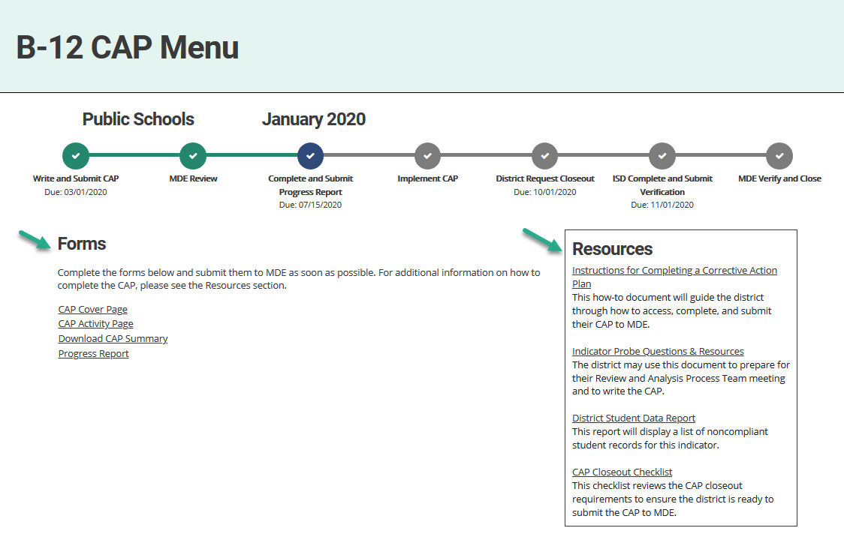
CAP Menu
CAP Menus provide a progress bar
Forms appear on the menu as needed
Resource links are provided to assist the district in completing the CAP.
Notes:
Here is a screen shot of the CAP menu page. The CAP menu page includes a progress bar indicating where the district is in the CAP workflow.
In the example shown, the district’s CAP has been approved and the next available form to complete is the progress report which, in this case, is not due until July 15.
Forms only become available once the district has met certain milestones in the CAP process. (e.g., progress reports)
Resource links to training materials, probe questions and student data to assist the district and its RAP team in completing and submitting the CAP are provided on the right-side of the page. It might be easy to overlook this but there are very helpful information here.

Slide 13
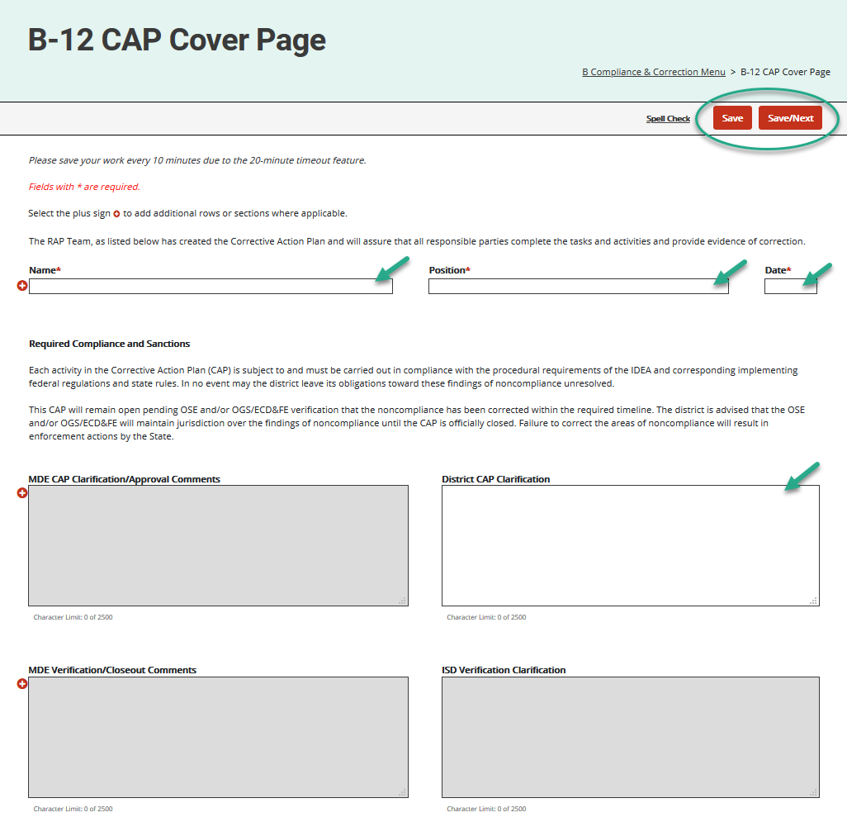
CAP Cover Page
Record the members of the Review and Analysis Process (RAP) Team.
Provide additional clarification concerning the CAP.
Review this page if the CAP is returned.
Notes:
The example shown here is a CAP Cover page from a data CAP (In this case, B-12). The CAP Cover page has the same purpose in all three CAP types – to identify the RAP team and to communicate between MDE and the district.
If a CAP is returned, be sure to review the content provided by MDE in the provided comment boxes.

Slide 14
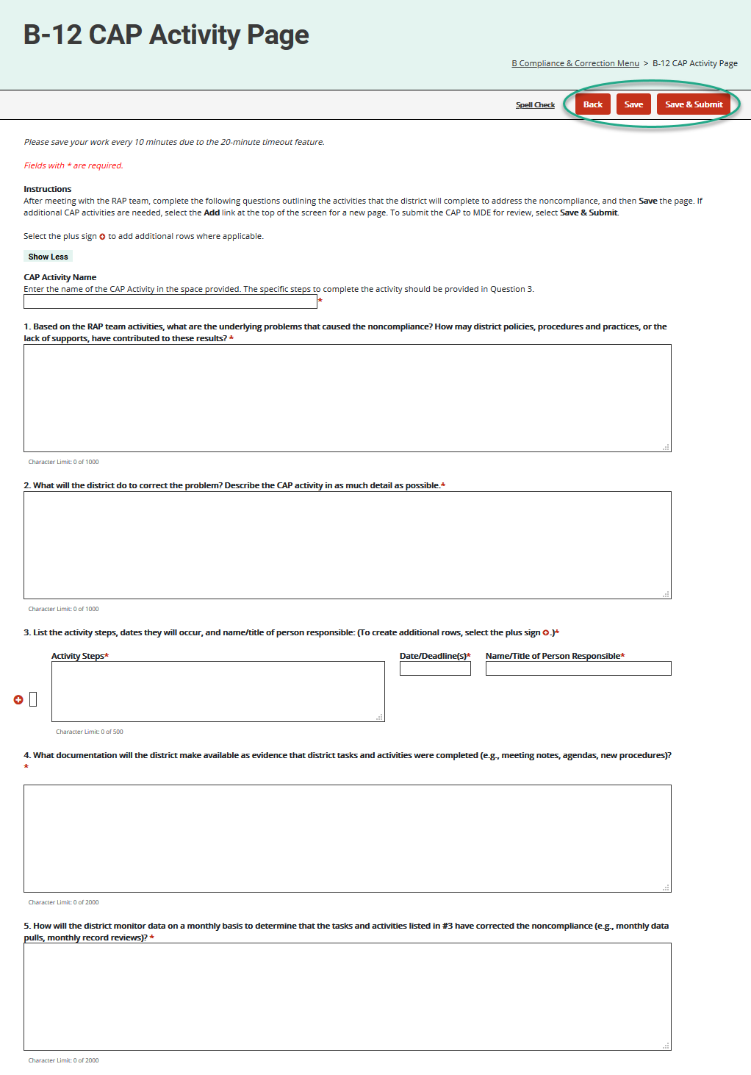
CAP Activity Page
Notes:
The CAP Activity page is available only in Data CAPs.
Both Monitoring and Complaint CAPs receive a similar page, called a CAP Finding page. We will go over the CAP Finding page next after reviewing the CAP Activity page.
The next few slides will go over each question on the CAP Activity page.
Please note the B-13 CAP has a slightly different CAP Activity page and we will go into that example next.

Slide 15
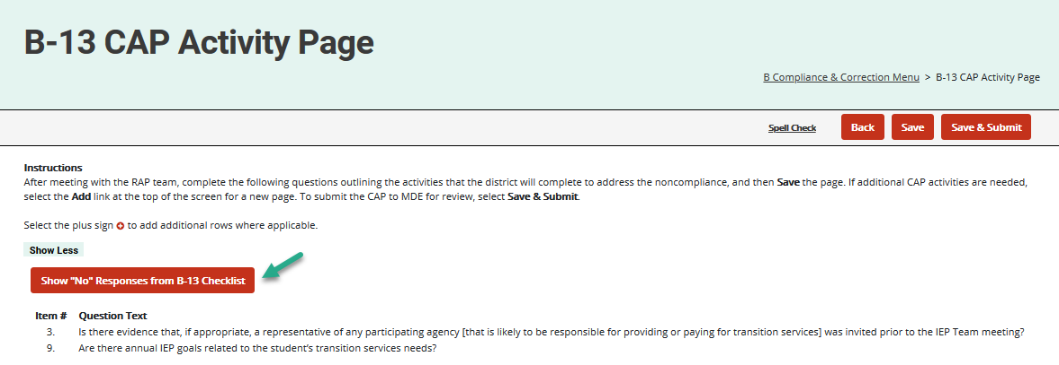
CAP Activity Page: B-13 CAP
Same questions as other Data CAPs.
All “no” responses provided from the B-13 Checklist
Notes:
The questions on the B-13 CAP Activity page are the same questions as all other Data CAPs.
However, before beginning a B-13 CAP Activity page, you will want to select the Show “No” Responses form B-13 Checklist button on the CAP Activity page.
Selecting this button will display all the “no” responses from the district’s checklists. This are the areas of noncompliance that must be addressed in the CAP activities.
Review the questions listed to understand the area of noncompliance.
You may want to consult with the district’s Transition Coordinator for further guidance in responding to this CAP.

Slide 16
CAP Activity Page: Insert Activity Name
Insert the name of the activity in the space provided.
To create additional pages,
Save the page
Select Add
Insert the name of the next page
Notes:
After meeting with the RAP team, the district should complete the CAP activity page.
Start by inserting the name of the activity in the space provided.
If additional CAP activities/pages are needed, save the current page first. Catamaran will not provide a way to add additional pages until the first page is saved.
Catamaran will then provide an Add link.
Select the Add link to create a new page and insert the name of the next page.
If a new page is created in error, choose the provided Delete button.

Slide 17
CAP Activity Page: Naming Considerations
Questions to ask when naming the CAP Activity:
What is the subject of the indicator, if relevant, that CAP is for (i.e. transition, timeliness; suspensions and expulsions; etc.)?
Notes:
Keep it simple.

Slide 18
CAP Activity Page: Question 1
Based on the RAP team activities, what are the underlying problems that caused the noncompliance? How may district policies, procedures and practices, or the lack of supports, have contributed to these results?
It is important that RAP Teams take the time to review the areas of noncompliance and analyze the cause of noncompliance for each item identified. The analysis then serves as the basis for the corrective action plan.
The root cause analysis must specifically identify a root cause for each of the areas of noncompliance.
Notes:
(read the slide)

Slide 19
CAP Activity Page: Question 1 Considerations
Questions to ask when determining the root cause:
What were the root causes of noncompliance?
Has a root cause been determined for each area of noncompliance?
In what ways may policies or procedures have contributed to these results?
Are practices across the district implemented consistently with policies and procedures?
Are the root causes identified factors the district or ISD can address in its plan to prevent future noncompliance? If not, analyze the root cause further to determine a cause the district or ISD can act on.
Notes:
When determining the root cause in question #1, the team should consider the following questions – (above)

Slide 20
CAP Activity Page: Question 2
What will the district do to correct the problem? Describe the CAP activity in as much detail as possible.
The RAP team must identify the district’s plan for correcting the noncompliance and ensuring compliant practices across the district or review required corrective action as directed by the OSE.
Please note: This plan must address practices and policies across the district. This does not refer to holding a new IEP for a specific student. Student level corrective action plans (SLCAPs) will address correcting specific student level items of noncompliance.
Notes:
This question is only on the Data CAP’s activity page.
With the Monitoring CAP and Complaint CAP, the information that appears for Question 2 is provided in the final decision or report of findings.

Slide 21
CAP Activity Page: Question 2 Considerations
Questions to ask when planning for correcting noncompliance:
Does the plan address all areas of noncompliance (these can be found in the statement of noncompliance, statement of findings, or the red dropdown menu in the case of a B-13 CAP)?
Notes:
Remember, when answering question 2, the team must address all areas of noncompliance.

Slide 22
CAP Activity Page: Question 3
List the activity steps, dates they will occur, and name/title of person responsible:
The RAP team must identify each activity or step it will take to implement the corrective action plan identified in Question 2 of the CAP Activity Page.
This includes creating training and guidance materials; scheduling trainings and meetings, implementing the trainings and meeting discussions, etc.
Projected timelines for each task must be included. Remember, tasks cannot exceed the due date for submitting the CAP to the ISD for verification, which is typically 9 months from the date of the CAP.
Notes:
This question allows the user to add additional rows as needed.
Starting with the January 2020 release, the information inserted into the Activity Steps field will be pulled forward to the CAP progress report, request for closeout, and CAP verification activity pages.

Slide 23
CAP Activity Page: Question 3 Considerations
Questions to ask when creating a plan of action:
Does the plan include step by step actions to remedy the noncompliance including timelines for each step that do not exceed the date of submission to the ISD, if relevant?
Is each step clearly outlined and details how it will address the areas of noncompliance?
Do activities address required corrective actions, if relevant?
Notes:
Be sure that the steps or actions are clear so that anyone could pick this up and implement the plan.

Slide 24
CAP Activity Page: Question 4
What documentation will the district make available as evidence that district tasks and activities were completed (e.g., meeting notes, agendas, new procedures)?
The RAP team must identify documents or evidence that demonstrate the completion of tasks laid out in the action plan.
If training is an activity, evidence should show planning and preparation of training, such as an agenda or guidance materials, not just evidence of the date of training.
Notes:
Question 4 relates back to question 3. What is the evidence that the steps in question 3 were completed?

Slide 25
CAP Activity Page: Question 4 Considerations
Questions to ask when selecting documents and evidence:
What documentation demonstrates that corrective actions were completed in full (meeting notes, training materials, agendas & sign-in sheets, updated procedures, etc.)?
Is there documentation and/or evidence to address all areas of noncompliance (these can be found in the statement of noncompliance, statement of findings, or the red dropdown in the case of a B-13 CAP)?

Slide 26
CAP Activity Page: Question 5
How will the district monitor data on a monthly basis to determine that the tasks and activities listed in #3 have corrected the noncompliance (e.g., monthly data pulls, monthly record reviews)?
The RAP Team must determine activities that check for consistent, continual compliance in the areas of noncompliance previously identified.
Notes:
This question is frequently misunderstood. Question 5 relates back to the findings of noncompliance. For example, if the finding of noncompliance was not obtaining written consent prior to inviting an agency to an IEP, then this step would address how the district plans to ensure that IEP teams are now consistently implementing compliant practices across the district for obtaining consent to invite an agency. This is typically accomplished by conducting monthly record reviews or data pulls (e.g., child find timelines). If the monthly reviews demonstrate continued noncompliance, the RAP team must determine how it will correct the continued noncompliance. It is highly recommended that the monthly reviews are documented with results from the review. The ISD will be responsible for verifying that this step has occurred and resulted in consistent compliance across the district.

Slide 27
CAP Activity Page: Question 5 Considerations
Questions to ask when selecting activities for ongoing compliance:
Does the action described in this step ensure district or ISD is now consistently compliant across the district in all areas of noncompliance NOT demonstrate completion of corrective actions (evidence of completion of corrective actions should be noted in the previous step)?
Does the action described in this step include the frequency and method of monitoring data to ensure ongoing compliance (i.e. monthly record reviews)?
Notes:
Once the district has completed all questions on the CAP activity page, be sure to save the page.
Review the information provided on the CAP activity page with the district’s RAP team.
Hint: Select the Download CAP Summary link from the CAP menu, to download a shareable PDF of all completed pages to share with the RAP team members.
Determine if any additional activities will be needed to meet compliance for this specific indicator. If additional activities are needed,
Save the page,
Select Add at the top of the page
Then, complete the next activity page.
Note: Once a second activity page is created, all questions will be required before submitting the CAP to MDE for review.

Slide 28
CAP Finding Page (1)
Available in Monitoring and Complaint CAPs.
Same as the Data CAPs.
Provide specific information concerning:
Area(s) of noncompliance listed above Question 1 and
Required corrective action(s) (Question 2).
Review the CAP Finding page(s) with the RAP team.
Hint: On the CAP Menu, select Download CAP Summary, to download a PDF of all CAP Finding pages.
Notes:
Now let’s talk about the CAP Finding Page. CAP Finding pages are available in monitoring and complaint CAPs. They follow the same basic format as data CAPs,
The team will complete question 1 by providing specific information as to the underlying cause for the noncompliance listed above question 1.
Question 2 is pre-populated with required corrective actions. The team will then complete questions 3, 4 and 5 the same as the data caps activities and save.
If there is more than one finding page, you can toggle between finding pages, by using the provided drop-down menu located directly beneath the button bar (top-right side of the page). Hint, if you return to the CAP menu, and select Download CAP Summary, you will be able to download a PDF of all the CAP findings.

Slide 29
CAP Finding Page (2)
Browse button provided to upload specific documents related to this finding, as needed.
Comment boxes provided to provide additional clarification.
All finding pages must be completed before submitting to MDE.
Notes:
Please note that a browse button is provided near the bottom of the CAP Findings page to upload documents related to the finding. Comment boxes are also provided for additional clarification. Remember, all findings pages must be completed before submitting to MDE.

Slide 30
Resources

Slide 31
Training Website
Catamaran Training Website
(https://training.catamaran.partners)
News bar feature on the front page
Deadlines and due dates on the front page
All resources organized by topic area
Monitoring
Policy
Finance
General Catamaran Resources
And audience
District
ISD
Notes:
The Catamaran training site now has a “news bar” at the top of the front page. This provides any new communications or announcements.
Deadlines and due dates are on the front page near the bottom of the page.
All resources are organized by topic area: Monitoring, Policy, Finance and General Catamaran resources
It also differentiates information by audience - District or ISD

Slide 32
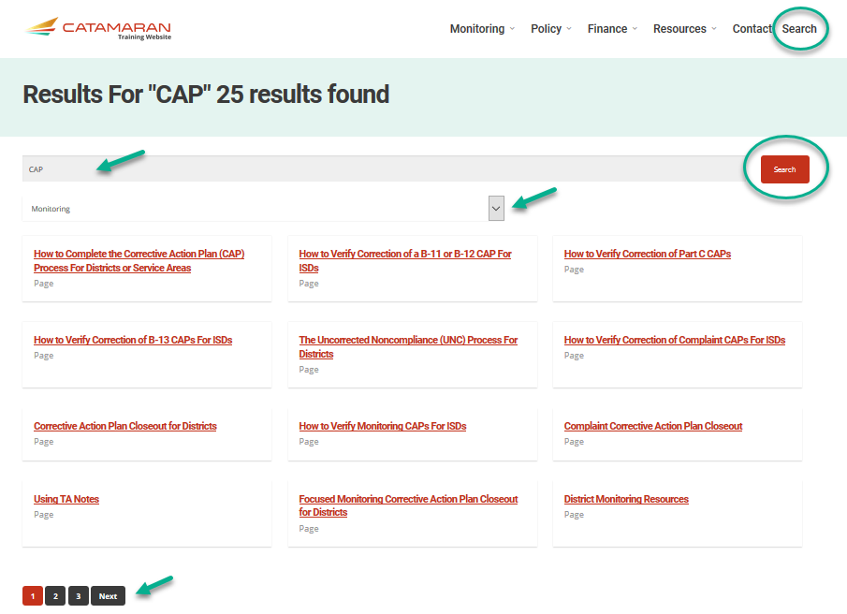
Search Function
Search the entire training website
Enter a key word or phrase and choose Search
Narrow the search by selecting a category if desired
Notes:
The training site also has a search function which searches the entire training website. Simply enter a key word or phrase and choose search.
You can narrow the search by selecting a category if desired.
The search will tell if the search item is a page or a document. We are working to improve how the results are shown to make sure the audience of the resource is clearer.

Slide 33
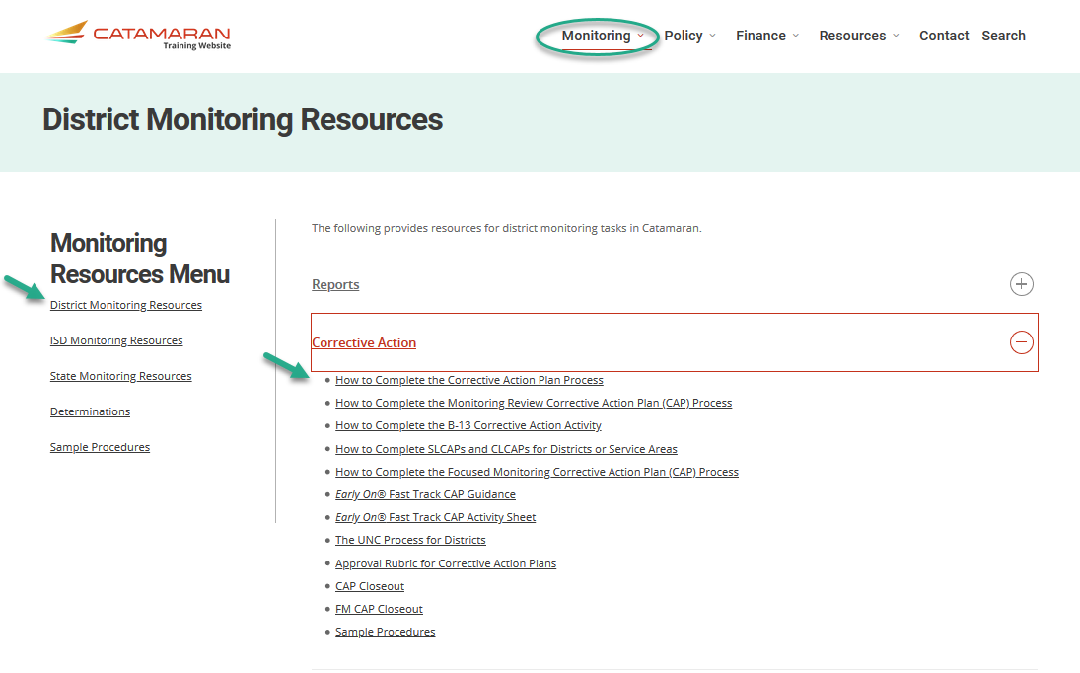
Corrective Action Resources
How to Instructions
Closeout Checklists
Sample Procedures
Notes:
Additional guidance is provided for ISDs under the ISD Monitoring Resources to assist in verification of correction.

Slide 34
B-4 CAP Resources
Indicator | Type | Resources for Root Cause Analysis (Question 1) | Resources for Steps in the Action Plan Questions 2 and 3)
B-4A | Finding – Results | Using the Report of District Data for B-4 Indicator Overview 4A & 4B IDEA Discipline Requirements MDE Guidance for Notice Federal and State Guidance Documents | IDEA Regulations Related to Suspension/Expulsion – Scroll down to the Discipline Procedures section. OSE Discipline Toolkit Promising Practices Ten Alternatives to Suspension Questions and Answers on Discipline Procedures
B-4B | Finding – Compliance | Indicator Overview 4A & 4B IDEA Discipline Requirements MDE Guidance for Notice | IDEA Regulations Related to Suspension/Expulsion – Scroll down to the Discipline Procedures section. IDEA Discipline Requirements OSE Discipline Toolkit Promising Practices Ten Alternatives to Suspension Questions and Answers on Discipline Procedures Racial Disproportionality in School Disciplinary Practices
Notes:
These next 6 slides provides links to some of the materials found on the training site for supporting CAP development and system improvement grouped by indicator. All the information is on the training site but it has been organized into this chart for ease of access. Simply click on the links provided on these slides and they will take you to that page on the Catamaran training site.

Slide 35
B-9 & B-10 CAP Resources
Indicator | Type | Resources for Root Cause Analysis (Question 1)
B-9 | Finding – Compliance | Public Reporting Data - Select B-9 Indicator Calculation Procedures for B-9 and B-10 Disproportionate Representation FAQs
B-10 | Finding – Compliance | Public Reporting Data – Select B-10 Indicator Calculation Procedures for B-9 and B-10 Disproportionate Representation FAQs
Notes:
Public Reporting Data - Select B-9 Indicator
Public Reporting Data – Select B-10 Indicator

Slide 36
B-11 & B-12 CAP Resources
Indicator | Type | Resources for Root Cause Analysis (Question 1)
B-11 | Activity – Compliance | Public Reporting Data – Select B-11 Indicator Initial Evaluations Timelines Guidance Michigan Student Database System Collections Details Manual
B-12 | Activity – Compliance | Public Reporting Data – Select B-12 Indicator OSEP Transition Resources Transition Self-Assessment Michigan Student Database System Collections Details Manual
Notes:
Public Reporting Data – Select B-11 Indicator
Public Reporting Data – Select B-12 Indicator

Slide 37
B-13 CAP Resources
Indicator | Type | Resources for Root Cause Analysis (Question 1) | Resources for Steps in the Action Plan (Questions 2 and 3)
B-13 | Activity – Compliance | Probe Questions for SPP Indicator B-13 | Consent to Invite Agency Representatives Template Special Education Public Reporting from MI School Data
Notes:
Special Education Public Reporting from MI School Data: Special Education Summary (mischooldata.org)
or
https://www.mischooldata.org/selected-indicator-reports/

Slide 38
Complaint CAP Resources
Indicator | Type | Resources for Root Cause Analysis (Question 1) | Resources for Steps in the Action Plan (Questions 2 and 3)
Complaints | Finding – Compliance with IDEA | How to Complete the Complaint Corrective Action Plan Process for Districts Deviations, Waivers, and ISD Plans Training Webinar IDEA Discipline Requirements Shortened School Day Guidance Special Education Reevaluation Process Guidance | Determining Compensatory Education Guidance
Notes:
Determining Compensatory Education Guidance
New Link
https://www.michigan.gov/documents/mde/CompensatoryEducation_707703_7.pdf

Slide 39
Part B Monitoring and Significant Disproportionality CAP Resources
Indicator | Type | Resources for Root Cause Analysis (Question 1)
Part B Monitoring | Finding – Compliance | Probe Questions for MSDS Data
Significant Disproportionality | Finding – Compliance | Disproportionate Representation FAQs

Slide 40
Questions?
Notes:
Use the Q&A chat feature on the webinar to type in questions.

Slide 41
Contact Us
Catamaran Team
MDE-OSE
Kelly Rogers, Project Director
krogers@publicsectorconsultants.com
Lynne Clark, Senior Consultant
lclark@publicsectorconsultants.com
Catamaran Help Desk
help@catamaran.partners
877-474-9023
Teri Chapman, Director
chapmant2@Michigan.gov
Janis Weckstein, Assistant Director
wecksteinj@Michigan.gov
Jessica Brady, Supervisor
bradyj@Michigan.gov
Jeanne Anderson Tippett, Coordinator
andersontippettj@michigan.gov
Janet Timbs, Coordinator
timbsj@michigan.gov
Notes:
If you have any questions about today’s presentation or about Catamaran, feel free to reach out to those listed on this slide.
Also, our Catamaran Help Desk is another great resource, and we have listed their contact information for you as well.

