Slide 1
Welcome!
The Maintenance of Effort Eligibility training webinar will begin soon.
This webinar will be recorded and posted, including PowerPoint presentation materials, on the Catamaran Technical Assistance Website under Past Events (https://training.catamaran.partners/past-events/).
To communicate with the presenters during the webinar, please use the Chat feature.
Closed captioning is available for this webinar. To select this option, select the closed caption icon on your webinar player.

Slide 2
Zoom Webinar Control Panel
Mouse or tab down to the bottom of the webinar screen for the Zoom Webinar Control Panel to become visible.
Features available are:
Chat – select to communicate with presenters.
Closed Captioning (CC) – select the CC icon to turn on captions.
Leave – select to exit the webinar.

Slide 3
Maintenance of Effort Eligibility Training Webinar
For ISD and District Business Officials

Slide 4
Meet the Team
Office of Special Education (OSE)
John Andrejack, Financial Manager, Program Finance
Scott Kemmer-Slater, Financial Manager
Public Sector Consultants
Alex Kontras, Senior Consultant
Lynne Clark, Senior Consultant
Josiah Bear, Research Associate

Slide 5
Agenda
Maintenance of Effort (MOE) Basics
Completing the MOE Eligibility Activity
Webinar Wrap-Up

Slide 6
Maintenance of Effort Basics

Slide 7
Purpose of Maintenance of Effort
The purpose of the Maintenance of Effort (MOE) requirement is to ensure that LEAs do not replace (i.e. supplant) state/local funding with federal funds.
MOE means that, in each year for the education of children with disabilities, an LEA:
Budgets at least as much state/local funds as it expended in the most recent year it met MOE (eligibility standard).
Expends at least as much as state/local funds it expended in the most recent year it met MOE (compliance standard).

Slide 8
Why is MOE Eligibility Important?
ISDs must demonstrate they are planning—in advance of the school year—to meet the MOE standard.
ISDs and their member districts are not eligible to receive IDEA funds if the ISD does not pass the MOE Eligibility Test.

Slide 9
How are expenditures calculated?
Fiscal effort is the term used to describe the expended amounts that are compared from one year to the next.
Fiscal effort can be calculated using four methods.
Each method calculates fiscal effort in a different way, but each uses the SE 4096 and SE 4094 amounts as the basic universe of special education funding.

Slide 10
Four Methods to Calculate Fiscal Effort
Method 1 – Local Funds Only
Sum of SE 4094 and SE 4096 amounts, reduced by certain percentages that eliminate the state-reimbursed portions, leaving only the portion that is spent using local funds.
Method 2 – State and Local Funds
Sum of SE 4094 and SE 4096 amounts.
Method 3 – Local Funds, Per Capita
The Method 1 amount, divided by the number of special education students.
Method 4 – State and Local Funds, Per Capita
The Method 2 amount, divided by the number of special education students.

Slide 11
Member Districts and ISD Aggregation
MOE is tested at the aggregate ISD level.
Member districts input data into Catamaran (SE 4094 and SE 4096). Catamaran then aggregates data to the ISD level and performs MOE calculations.
All individual member districts (LEAs and PSAs) are included in the MOE testing and have a part in ensuring MOE Eligibility is met at the aggregate ISD level ​to demonstrate Eligibility to receive a federal IDEA Part B award.

Slide 12
Aggregation Example
District | SE 4094 | SE 4096 | Headcount
District A | $25 | $100 | 15
District B | $10 | $75 | 8
District C | $15 | $50 | 7
ISD Aggregate | $50 | $225 | 30
Figures from all member districts, including PSAs, are aggregated before MOE calculations are performed.

Slide 13
Fiscal Effort Calculation Example
Method 1 Fiscal Effort (Local Total) | Method 2 Fiscal Effort (State & Local Total) | Method 3 Fiscal Effort (Local Per Capita) | Method4 Fiscal Effort (State & Local Per Capita)
$ 175 | $ 275 | $ 5.83 | $ 9.17
Catamaran uses the aggregated SE 4094, SE 4096, and headcount figures are used to calculate fiscal effort using the four different methods.

Slide 14
MOE Eligibility Standard, Part 1
Requires that each ISD plans to expend (budgets), in the aggregate, at least as much fiscal effort as it expended in the most recent year it met MOE, using at least one of the four calculation methods.
Occurs in the summer, in anticipation of the upcoming school year. For example, MOE Eligibility testing for 2021-22 will occur in the summer of 2021.
In this activity, member districts and ISDs input estimated/budgeted SE 4094 and SE 4096 information.
Catamaran aggregates these figures to the ISD level and calculates fiscal effort using the four methods.
Catamaran compares anticipated fiscal effort in the test year to thresholds established in the previous MOE Compliance activity.

Slide 15
MOE Eligibility Standard, Part 2
Fiscal effort comparisons are made on a per-method basis. By comparing estimated fiscal effort for each method to thresholds for each method, Catamaran calculates which methods have been met or not met.
ISD passes if MOE is met using any one of the four methods.
ISDs that do not pass using any method must add exceptions and/or adjustments ​to demonstrate eligibility to receive a federal IDEA Part B award.

Slide 16
What If My ISD Does Not Pass MOE?
Exceptions/adjustments can be used if an ISD does not pass MOE Eligibility.
Exceptions/adjustments do not increase fiscal effort. Rather, they functionally lower the MOE thresholds, thereby justifying an anticipated reduction in fiscal effort.
Since the SE 4094 and SE 4096, are the universe of special education costs considered for MOE in Michigan, any exceptions taken must be costs that were reported on the SE 4094 or SE 4096.

Slide 17
Exception (a): Personnel Changes
As described in 34 CFR §300.204, an LEA may reduce LEA MOE for…
(a) The voluntary departure, by retirement or otherwise, or departure for just cause, of special education or related services personnel.
Exception (a) is taken when special education or related services staff leave. Departures must be voluntary—someone retires or resigns—or for just cause—such as when an employee is terminated for misconduct. It does not refer to a reduction in force or downsizing.
Replacement staff costs must be entered as well.
Total exception (a) is equal to the departing staff costs, less the replacement staff costs.

Slide 18
Exception (b): Decrease in Students
As described in 34 CFR §300.204, an LEA may reduce MOE for…
(b) A decrease in the enrollment of children with disabilities.
This exception is automatically calculated and applied to all eligible ISDs by Catamaran.

Slide 19
Exception (c): Termination of an Eligible Obligation
As described in 34 CFR §300.204, an LEA may reduce LEA MOE for…
(c) The termination of the obligation of the agency, consistent with this part, to provide a program of special education to a particular child with a disability that is an exceptionally costly program, as determined by the SEA, because the child —
Has left the jurisdiction of the agency;
Has reached the age at which the obligation of the agency to provide FAPE to the child has terminated; or
No longer needs the program of special education.

Slide 20
Exception (d): Termination of an Eligible Costly Expenditure
As described in 34 CFR §300.204, an LEA may reduce LEA MOE for…
(d) The termination of costly expenditures for long-term purchases, such as the acquisition of equipment or the construction of school facilities.

Slide 21
50% Adjustment
As described in 34 CFR §300.205 an LEA may ….
“…for any fiscal year for which the allocation received by an LEA under §300.705 exceeds the amount the LEA received for the previous fiscal year, the LEA may reduce the level of expenditures otherwise required by §300.203(a) by not more than 50 percent of the amount of that excess…”

Slide 22
Conditions for Using 50% Adjustment
The LEA must:
Use the freed-up local (or state and local) funds to carry out Every Student Succeeds Act (ESSA) activities during the FY in which the adjustment takes place.
Have received a determination of “meets requirements” from the Michigan Dept of Education (MDE).
Not have had action taken against it by the MDE under IDEA Section 616.
Not have had the responsibility for providing FAPE taken away by the MDE.
Not be determined to have significant disproportionality for the FY of the adjustment.

Slide 23
50% Adjustment in Catamaran
The 50% Adjustment is elected for use by the ISD.
IMPORTANT: Election to utilize the 50% Adjustment MUST be made during MOE Eligibility testing. The 50% Adjustment will not be available during MOE Compliance testing if the ISD does not elect the Adjustment provision during MOE Eligibility testing.
The ISD must have a Determination of “meets requirements”. For ISDs with a Determination less than “meets requirements, this provision will not be available in Catamaran.
The amount of the 50% adjustment available is affected by the amounts reserved by the ISD and member districts for Coordinated Early Intervening Services.
Must have documentation supporting the use of the “freed-up” funds for ESSA activities.

Slide 24
Questions – Maintenance of Effort Basics

Slide 25
Completing the MOE Eligibility Activity
Finding and Completing Your Work

Slide 26
Who Participates in MOE Eligibility?
Both ISD and district business officials will participate.
MOE Eligibility activity should be completed by officials who have an understanding of financial administration at their ISD or district.
This activity can only be completed by ISD users with the ISD business official role and district users with the district business official role.
Other roles, such as the ISD director role, can view the activity, but cannot complete it.
If you have questions about your user role, please contact the Help Desk.

Slide 27
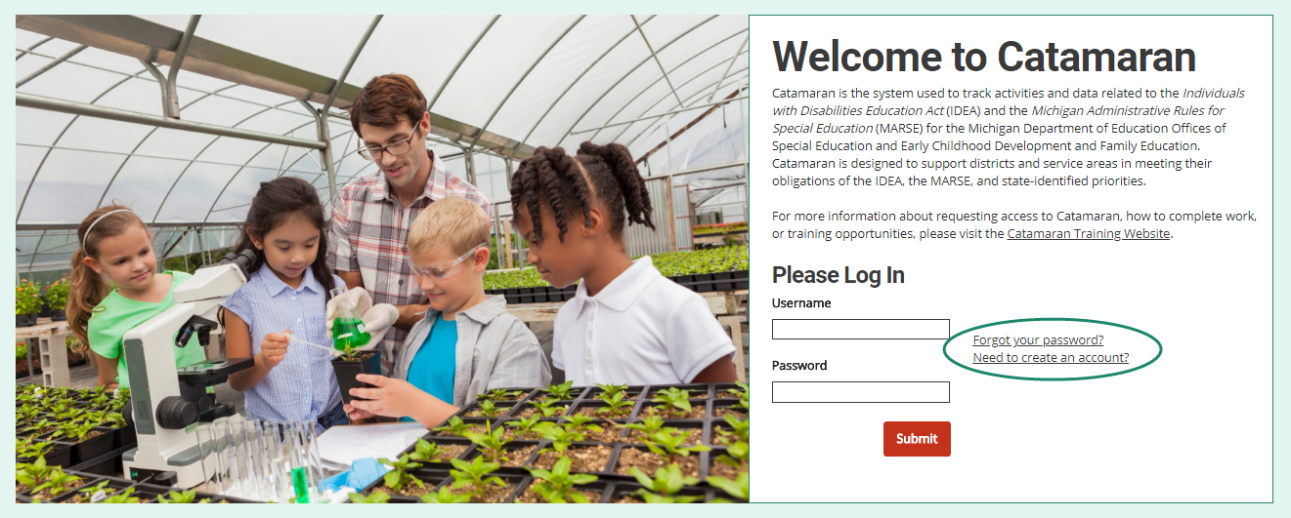
Log in to Catamaran
Log into Catamaran by navigating to https://catamaran.partners.
Create an account, if you don’t already have one.

Slide 28
Locate the Activity the Tasks Overview
MOE Eligibility is expected to launch July 19, 2021.
ISD and district business official users will be notified via email when the activity is available.
After logging in, locate the MOE Eligibility task on the Tasks Overview.
Select the Activity link to open the activity.

Slide 29
The Role of Member Districts in MOE Eligibility
Complete MOE Eligibility Budget Form
Submit form to ISD for review
If ISD returns it for modifications, make required modifications and resubmit.

Slide 30
The Role of ISDs in MOE Eligibility
Complete the MOE Eligibility Budget Form
Review forms submitted by member districts
Review test results
If ISD doesn’t pass, enter exceptions and/or adjustments

Slide 31
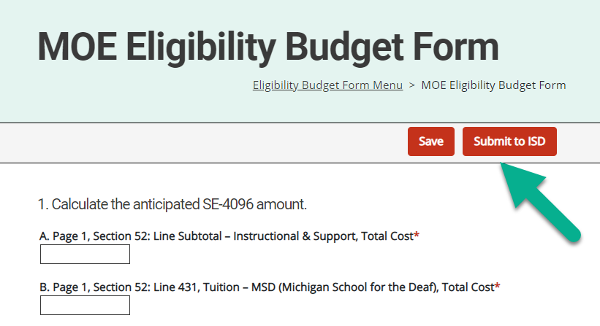
Completing the MOE Eligibility Budget Form
Estimate certain figures you will enter on the upcoming SE 4096 and SE 4094 cost reports, using past reports for reference.
Form will calculate the anticipated SE 4096 and SE 4094 figures at the bottom of each section.
ISD form and district form are slightly different.
More details available in the online How-To guides (see Resources slide for links).

Slide 32
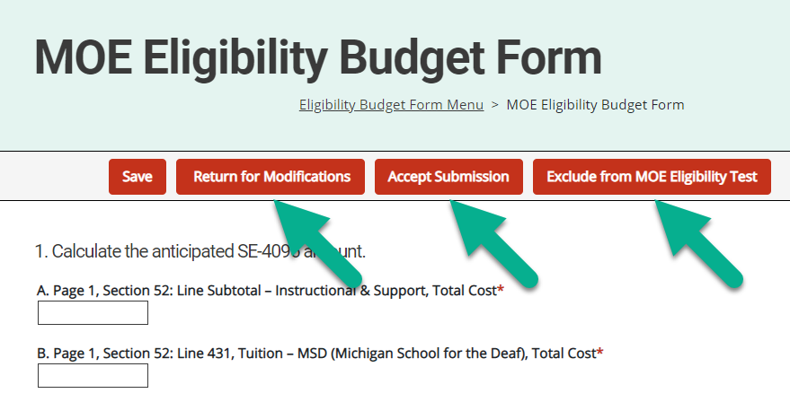
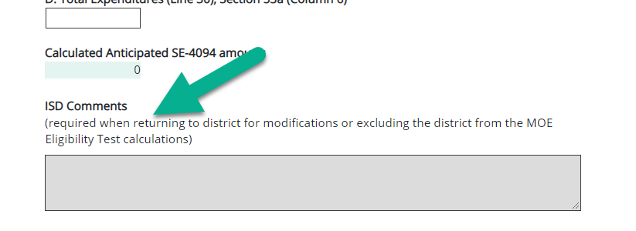
Reviewing Member District Submissions
ISD business officials will be notified via email of new submissions.
Submissions will appear on the ISD Tasks Overview list.
ISDs can accept or return submission (when returning, be sure to enter helpful comments for the district).
ISDs can also exclude member districts from the test. This is useful if the member district has closed, moved to another ISD, or will not report expenditures in the upcoming year. Districts will be notified if their activity is excluded from the test.

Slide 33
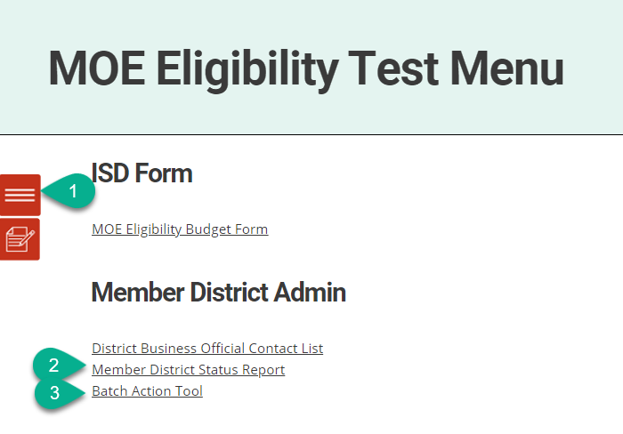
Tips for ISDs When Reviewing Submissions
Use the Quick Menu > Related Documents (red and white icon on the left) to quickly navigate between the ISD activity and the district activities.
Use the Member District Status Report (link on the activity menu) to check the status of your member district’s work.
Use the Batch Action Tool (link on the activity menu) to review multiple districts at a time.

Slide 34
Excluding Member Districts
Excluding member districts from the MOE Eligibility Test activity allows the ISD to submit the ISD’s aggregate test results to the MDE without those member districts ever submitting the MOE Eligibility Budget Form to the ISD.
Excluding member districts can be useful if the member districts recently closed or no SE 4096 or SE 4094 expenditures are anticipated in the upcoming school year.
District business officials will be notified if their district is excluded by the ISD.
In most cases, the ISD business official must navigate to the member district activity using the Quick Menu or Member District Status Report, since these forms will not likely be submitted to the ISD first.

Slide 35
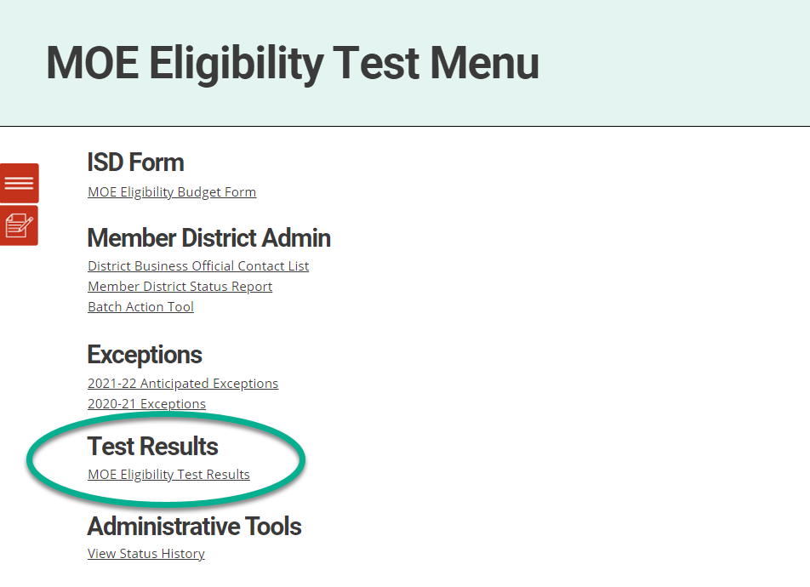
Reviewing Test Results
Includes data entered by the ISD on their MOE Eligibility Budget Form.
Includes data member district submissions that have been accepted by the ISD.
Subject to change until ISD completes their form and all member district submissions are accepted or excluded.
If ISD does not pass at least one method, exceptions and/or adjustments must be entered on the exceptions form(s).

Slide 36
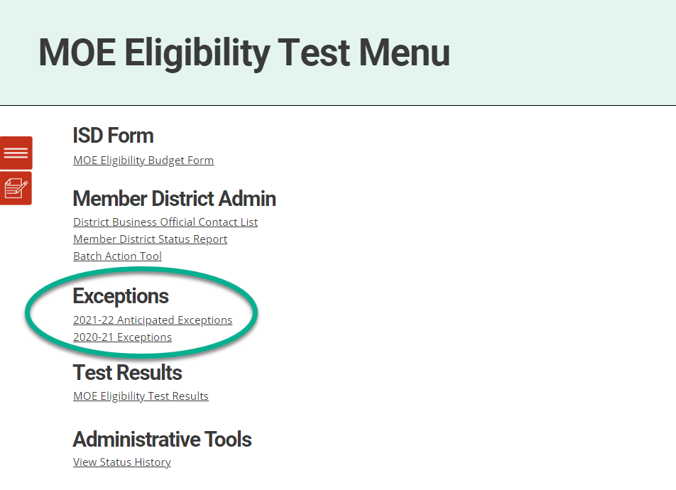
Entering Exceptions or Adjustments, Part 1
Can be entered for the Intervening Year (2020-21) or the Test Year (2021-22).
ISDs may need to contact member district business officials directly (outside of Catamaran) to gather exception/adjustment information.
Exceptions entered by ISD in previous years will prepopulate.
Exception (b) (decrease in enrollment) will have been automatically calculated and accounted for in the test results.

Slide 37
Entering Exceptions or Adjustments, Part 2
Once the exceptions form is saved, any exceptions or adjustments entered will immediately impact the test results.
Refer to the test results frequently to see if enough exceptions have been entered.

Slide 38
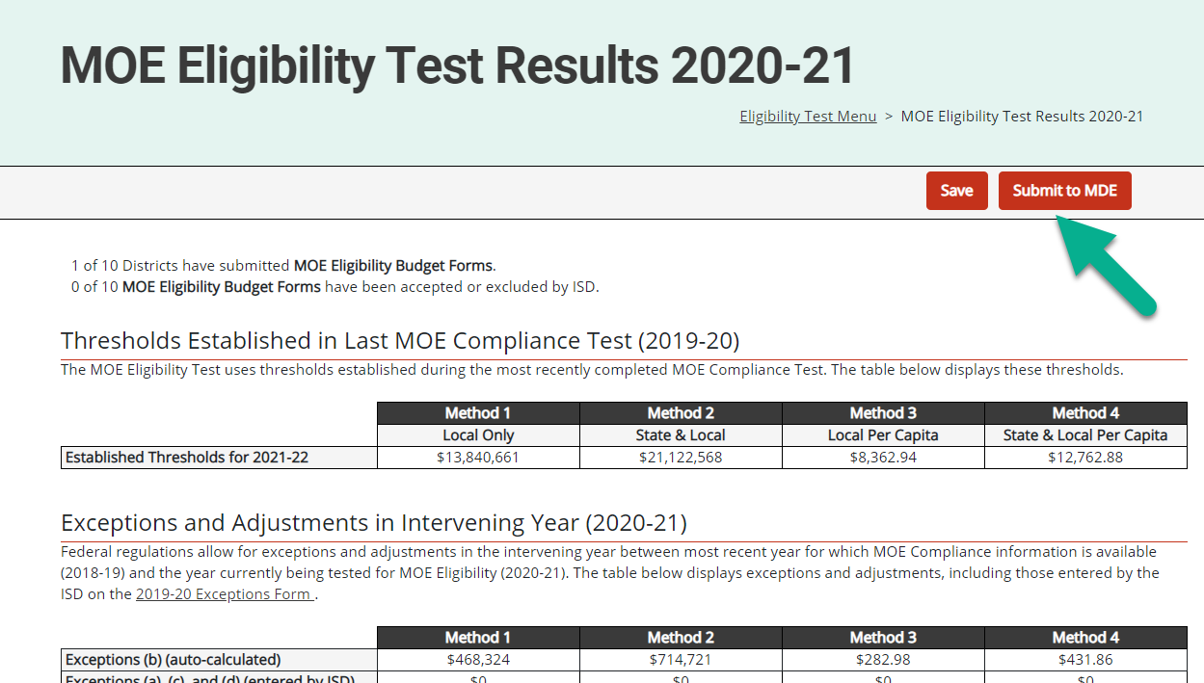
Submitting Test Results to the MDE
The ISD can submit the MOE Eligibility test results to the MDE once the following conditions are satisfied:
The ISD has completed the MOE Eligibility Budget Form
All member district submissions have been accepted
The MOE Eligibility Test Results show “MET” for at least one method (this may or may not involve the use of exceptions and/or adjustments)
Submit to MDE using the MOE Eligibility Test Results form (not the exceptions forms)

Slide 39
Questions – Completing the MOE Eligibility Activity

Slide 40
Webinar Wrap-Up
Resources and Contact Information

Slide 41
MOE Training Materials
Catamaran Technical Assistance Website
https://training.catamaran.partners/
Frequently Asked Questions About Maintenance of Effort
https://training.catamaran.partners/maintenance-of-effort-moe-frequently-asked-questions/
How to Complete MOE Eligibility Activity for ISD Business Officials
https://training.catamaran.partners/how-to-complete-the-maintenance-of-effort-eligibility-test-activity/
How to Complete MOE Eligibility Budget Form for District Business Officials
https://training.catamaran.partners/how-to-complete-the-maintenance-of-effort-eligibility-budget-form/

Slide 42
Contact Us
Catamaran Team
Catamaran Help Desk
877-474-9023
help@catamaran.partners
Kelly Rogers
Project Director
krogers@publicsectorconsultants.com
Alex Kontras
Senior Consultant
akontras@publicsectorconsultants.com
MDE Office of Special Education
Teri Rink
Director
rinkT1@Michigan.gov
John Andrejack
Financial Manager, Program Finance
andrejackj@Michigan.gov
Scott Kemmer-Slater
Financial Manager
kemmerslaters@Michigan.gov

