Slide 1
Welcome!
The January 2022 Catamaran Preview webinar will begin in a few moments.
The webinar recording and presentation materials will be posted on the Catamaran Technical Assistance Website under Past Events (https://training.catamaran.partners/past-events/)
To communicate with the presenters during the webinar, use the Chat feature.
Closed captioning is available for this webinar. To select this option, choose the closed caption icon in the Zoom webinar player.

Slide 2
Zoom Webinar Control Panel
Mouse or tab down to the bottom of the webinar screen for the Zoom Webinar Control Panel to become visible.
Features available are:
Chat – select to communicate with presenters.
Closed Captioning (CC) – select the CC icon to turn on captions.
Leave – select to exit the webinar.
Notes:
Before we get started, I would like to highlight some features available on the Zoom Webinar Control Panel. Move your mouse or tab down to the bottom of the screen and you will find the chat feature which will allow you to communicate with the presenters. You can also select the CC icon to turn on captions and Leave will allow you to exit the webinar.

Slide 3
January 2022 Part B Catamaran Preview
For Districts and ISDs
Notes:
Welcome to the January 2022 Part B Catamaran Preview

Slide 4
Meet the Team
Office of Special Education (OSE)
Jessica Brady, Supervisor
Jeanne Anderson Tippett, Coordinator
Shawan Dortch, Consultant
Tori Ranusch, Consultant
Charles Thomas, Consultant
Aaron Darling, Analyst
Public Sector Consultants (PSC)
Kelly Rogers, Project Director
Lynne Clark, Senior Consultant

Slide 5
Agenda
January 2022 Catamaran Preview
Catamaran Navigation
Updates and Tips
Training Resources
Questions
Notes:
Our agenda today is to deliver a January 2022 Catamaran Preview, explain Catamaran Navigation, provide updates and tips, share training resources, and finally, answer any questions.

Slide 6
January 2022 Catamaran Preview
Notes:
Let’s get started with the January 2022 Catamaran Preview.

Slide 7
What’s Inside?
Reports
Strand Report
Monitoring Activities Report (MAR)
Letters of Findings and Data Alerts
Monitoring Notification Letters
Closeout/Non-closeout Reports
State Complaint Reports
Intermediate School District (ISD) Report
Activities
Corrective Action Plans (CAPs)
B-11, B-12, B-Complaints
Corrective Actions
B-11, B-12
Student Level Corrective Action Plans (SLCAPs) for Complaints
Notes:
When you open Catamaran and acknowledge your reports, you will see a variety of reports and activities. The reports in this release include the Strand Report, the Monitoring Activities Report (MAR), Letters of Findings and Data Alerts, Monitoring Notification Letters, Closeout/Non-closeout Reports, State Complaint Reports and ISD Reports.
The Activities in this release include Corrective Action Plans (CAPs) for B-11, B-12, and State Complaints.
There are Corrective Actions for B-11 and B-12. We will describe the differences between CAPs and Corrective actions late in the presentation.
Finally, there are Student Level Corrective Action Plans (SLCAP) for State Complaints.

Slide 8
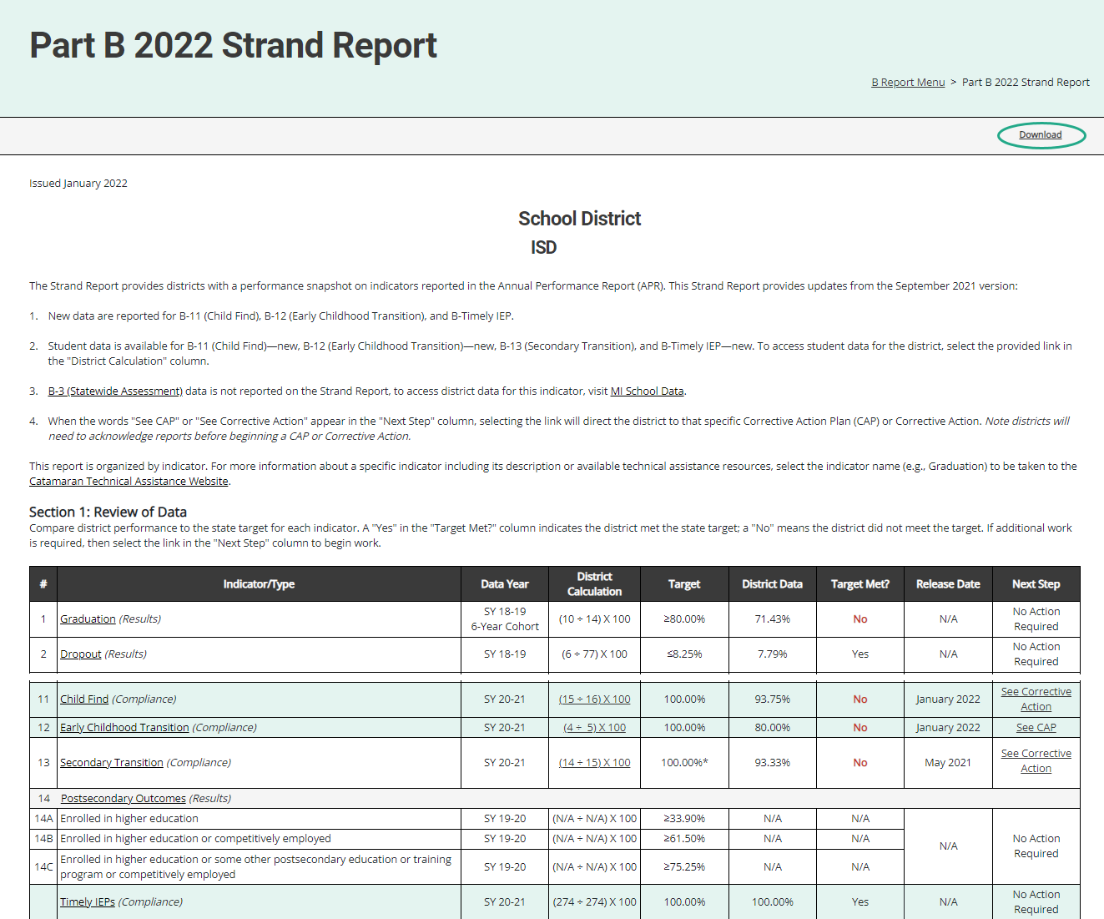
Strand Report
Summarizes district performance on the State Performance Plan (SPP) Indicators and priority areas.
When there is a CAP or Corrective Action, there will be a link in the Next Step column. Select the link to be taken to the specific item.
Use the Download link at the top of the screen to download a PDF.
Notes:
The Strand Report is issued in each release of Catamaran and most of the items are updated in the May release. In the January release of Catamaran, Indicators B-11 (Child Find), B-12 (Early Childhood Transition), and B-Timely IEP will have updated data. These updates will be highlighted. Each line is only updated with new data once per year.
We’ll dive into how to access your reports a little later in the webinar, but if you do have a CAP or a Corrective Action, you can click on the See CAP or See Corrective Action link in the Next Step column to be taken directly to that CAP or Corrective Action. Note, several districts may also receive a “See Data Alert” message on their Strand Report. If this is the case, return to the B Reports page to review the data alert letter.
You can use the download link at the top of the screen to save and then print a copy of your Strand Report to share with your colleagues or RAP team if needed.

Slide 9
Monitoring Activities Report (MAR)
The MAR is included in every major release and provides important information to districts.
The MAR can be accessed from the Reports page
Some messages are universal and go to all districts
Some messages are targeted, and are sent only to specific districts
Reminders to review Letters of Findings or Data Alerts
Notifications of monitoring activities
Notes:
For those who are new to Catamaran, there are 3 “major releases” in Catamaran each year. These differ from the monthly releases because the major releases include additional reports, closeout and non-closeout letters, and must be “acknowledged” by the district. The major releases occur in Jan, May and Sept.
The Monitoring Activities report, or the MAR, can be accessed through the Reports page, which again, we will look at how to view and access the Reports page.
Some messages are universal and go to all districts, and some messages are targeted, and are sent only to specific districts, such as reminders to review Letters of Findings or reminders to review data alert letters

Slide 10
Sample Monitoring Activities Report
Notes:
Here you see one common message from the MAR encouraging all districts to update their district’s personnel in the EEM.

Slide 11
Letters of Findings, Data Alerts, and Reports
B-11 Letter of Findings
B-12 Letter of Findings
B-Timely IEP Data Alert
B-Valid & Reliable Data Alert
B-Complaint Final Decisions
Notes:
In this catamaran release there will be:
B-11 Letters of Findings
B-12 Letters of Findings
B-Timely IEP Data Alerts
B-Valid & Reliable Data Alerts which is new this year
B-Compliant Final Decisions

Slide 12
Closeout/Non-closeout Letters and Reports
B-11 (Child Find)
B-12 (Early Childhood Transition)
B-13 (Secondary Transition)
State Complaints
Notes:
Additionally, you’ll find closeout/non-closeout reports for:
B-11 (Child Find)
B-12 (Early Childhood Transition)
B-13 (Secondary Transition)
State Complaints

Slide 13
ISD Reports
Member District Monitoring Reports
Member District Data Reports (B-11, B-12, B-Timely IEP, and B-Valid & Reliable)
Student Data Report of Member District Data (B-11, B-12, B-Timely IEP, and B-Valid & Reliable)
Notes:
The Member District Monitoring report is a letter which tells ISDs which of their Member Districts are being monitored for B-4 in the coming months.
ISDs will once again have access to their member district data administrative reports right on the ISD’s reports page. New data for indicators B-11, B-12, and B-Timely IEP is provided. In addition to the updated data for those three indicators, there will also be a new data report for Valid and Reliable Data. This data is not available directly to the member districts because there are no corrective actions associated with this, so ISD will need to share that data out.

Slide 14
Corrective Action Plans (CAPs)
All CAPs:
Have the same workflow and timelines for completion.
Describe system level correction.
Are verified as corrected by the ISD.
Include links to either:
Student Level Corrective Action Plans (SLCAPs) or
District Student Data Report (B-11, B-12)
Complaint CAPs:
Are issued each month as needed.
Include link to the complaint final decision.
Notes:
For corrective action plans known as CAPs, there are some general rules that apply to all. All caps have the same workflow and timelines for completion. The first due date for these CAPs is the date by which the CAPs must be written and submitted. CAPs issued in January are due to be written and submitted by March 1.
CAPs must be verified and closed one year from the date the non-compliance is issued. We call this the year of correction. The CAP’s year of correction begins on January 15 for B11 and B12 Data CAPs, but the year of correction begins on the date of the final decision for complaint CAPs. If your district was issued a complaint CAP as a result of noncompliance identified during a state complaint investigation, the date the final report was issued begins your year correction. As an example, if the final decision was issued on January 8, the CAPs must be verified and closed by January 7 of the following year.
All CAPs describe the system level correction the district will complete. As opposed to the student level corrections of SLCAPs. Every CAP is verified for correction by the ISD. Then, the ISD submits the CAP to the OSE for closeout. On the menu page of the CAP there will be a link to either the student level corrective action for complaint CAPs or to a district student data report for B11 and B12 data CAPs. This link to the student level information should help the rap team as they uncover the root causes of noncompliance.
One continuing requirement when it comes to verification and closeout activities is the OSE is reviewing the district’s updated procedures as well as change in practices. At the time the district completes their progress report, the district should upload their updated policies and procedures for review. If changes are needed, the progress report will be returned to the district with directions. If the procedures are compliant, the progress report approval process will continue.
During the verification stage of the CAP, the ISD reviews student files for evidence of change in practice. When the review is complete, the ISD submits to the OSE.
Since 2021, the CAP workflow has been updated with a verification return loop so the ISD may now return the CAP to the district for more work, if needed. This is to assist ISDs in streamlining the review process and to give districts access to the student lists the ISD is reviewing. The ISD should complete all returns to the district before submitting to the OSE for their review.
The OSE will then return the CAP to the ISD indicating which student files need to be uploaded for OSE verification. The ISD will then upload supporting documentation onto the Verification page. We will see some screen shots of this in just a few minutes. This process is true for all CAPs including Complaint CAPs.

Slide 15
Findings and Data Alerts Related to B-12
B-12 CAP or Corrective Action occurs if a student’s IEP is not held by their 3rd birthday.
B-Valid & Reliable Data Alert occurs if there are missing data components in MSDS regardless of whether the student’s IEP was held by their 3rd birthday.
A district may receive both items.
Notes:
New this release, there are two types of findings resulting from B-12 data.
A B-12 CAP or Corrective Action occurs if a student’s IEP is not held by their 3rd birthday
B-Valid & Reliable CAP occurs if there are missing data components in MSDS regardless of whether the student’s IEP was held by their 3rd birthday.
As a reminder, the data components required in MSDS include:
Date of Birth
Referral Date
Part C Transition Timeliness
Special Education Exit Reason and Date*
Initial IEP Date and Result
Timeliness of Initial IEP
The Special Education Exit Reason and Special Education Exit Date may be blank if the student has not exited MMSE but if those fields are blank, then Initial IEP fields are required. There is a memo on the B-12 page of the training site listing those fields if you didn’t get all of them.
A district may receive either a CAP or a Corrective Action and a Valid and Reliable Data Alert if they have students with IEPs not held by their third birthdays and missing data components.
Next, we will go over who might be involved, the foci, and suggested activities for B-12 CAPs and Corrective Actions and responding to B-Valid & Reliable Data Alerts.

Slide 16
B-12 CAPs or Corrective Actions
Review the student data in the Strand Report to see which students’ records were determined to be noncompliant.
For each noncompliant student record, determine the root cause of the noncompliance.
RAP team members should include Early On® staff, district staff, evaluation team members, and administrators.
Revision of policy, procedures, and/or practices should focus on addressing the root cause and ensuring a student’s IEP is in place before their third birthday.
Notes:
For B-12 CAP or Corrective Actions:
Review the student data in the Strand Report to see which students’ records were determined to be noncompliant
For each noncompliant student record, determine the root cause of the noncompliance
RAP team members should include Early On® staff, district staff, evaluation team members, and administrators
Revision of policy, procedures, and/or practices should focus on addressing the root cause and ensuring a student’s IEP is in place before their third birthday
Often times we see a need for increased communication or collaboration with the agency providing Early On services. If you include Early On staff in the RAP team, you will be better able to ensure all partners in the work understand their role and are working for improved practices.

Slide 17
B-Valid & Reliable Data Alerts
With the ISD review the data in the Student Data Report of Member District Data on the ISD’s report page.
Determine which of the required fields are missing (See the technical assistance document for a list of required fields).
For each noncompliant student record, determine the root cause of the noncompliance including whether the ISD or district submit the missing fields.
Convene a team including Early On staff, district staff, administrators and those involved in the data submission process.
Consider revision of policy, procedures, and/or practices to focus on addressing the root cause and ensuring all data fields are submitted for students in the B-12 pool.
Notes:
For B-Valid & Reliable Data Alerts: No action in Catamaran is required but we do recommend you look into the data.
With the ISD review the data in the Student Data Report of Member District Data on the ISD’s report page. This list is only the students for whom the data was incomplete, unlike the B-12 data which has compliant and noncompliant students.
Determine which of the required fields are missing (See the B-12 technical assistance document for a list of required fields)
For each noncompliant student record, determine the root cause of the noncompliance including whether the ISD or district submit the missing fields
RAP team members should include Early On staff, district staff, administrators and those involved in the data submission process
Revision of policy, procedures, and/or practices should focus on addressing the root cause and ensuring all data fields are submitted for students in the B-12 pool
The valid and reliable data CAPs are new this year and we hope that by separating the data submission issues from the late transition issues, the underlying causes of noncompliance will be clearer and easier to address. We also know there will be questions about the data and we have staff to answer those questions. There are office hours listed on the TA site under upcoming events and each ISD has a member of the monitoring team assigned who can help with the data. We will see that map of assignments when we look at the TA site in a few minutes.

Slide 18
Corrective Action
Applies to B-11 and B-12.
Addresses noncompliance to ensure future students are properly identified for special education and current students’ IEPs are updated in a timely manner.
Districts submits to ISDs for verification by October 1.
ISDs submit to MDE for closeout by November 1.
Verification includes a review of student files or interview if no student files are available.
Notes:
Corrective actions are being issued for B11 and B12. The corrective action is less intensive than the traditional CAP process. This activity applies to districts where the submitted B-11 or B-12 data in Michigan Student Data System (MSDS) indicated only one student record contained noncompliance and the district did not have a Corrective action the previous year.
For this activity, the district selects one or more methods to ensure all future students are properly identified for special education and all IDEA regulations are implemented. When the district is ready to request closeout, they will return to the activity to provide evidence for the selected method(s) and then upload any supporting evidence as appropriate. We anticipate that this process can be finished very quickly and will not take the full year of correction to complete. If the district needs the full year, then the District submits to the ISD for verification by October 1 and the ISDs submit to MDE for closeout by November 1 of 2022.
The next slide shows the Corrective Action form from the district’s view.

Slide 19
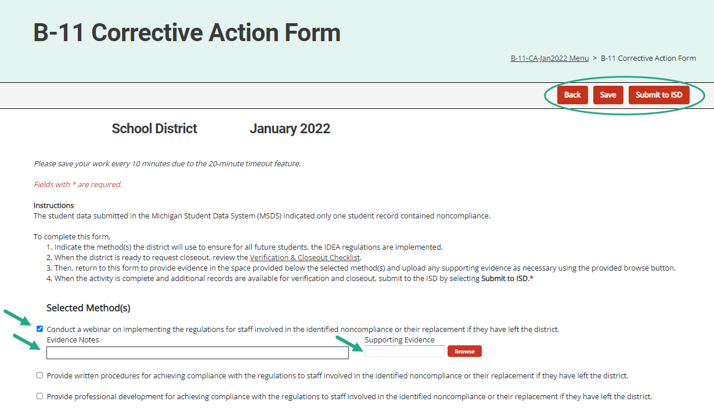
Corrective Action Form (District View)
Notes:
Districts select the method(s) they will complete and save the page. Return to this page after those method(s) have been implemented to enter evidence notes and upload any supporting documents in the space(s) provided.
When complete, districts may submit to the ISD either from the Corrective Action Form or from the Corrective Action Cover page.

Slide 20
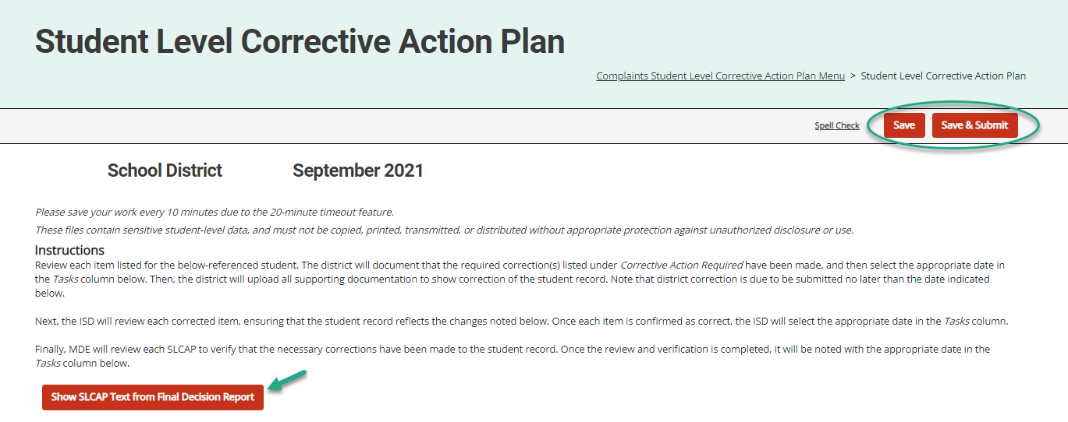
Student Level Corrective Action Plans
Notes:
SLCAPs correct individual student level noncompliance. They are usually due within 30 school days.
SLCAPs are verified as corrected by the ISD and reviewed by the OSE.
Each individual SLCAP must be closed before the CAP is closed.
The example shown here is highlighting a link from a Complaint SLCAP to the more explicit language of the final decision.
There are not SLCAPs for B-11, B-12, B-Timely IEP, or B-Valid & Reliable because those indicators are based on timelines and we can not correct a missed timeline.
Let’s pause here to see if there are any questions about the content of the January release before we move to navigation.

Slide 21
Catamaran Navigation
Notes:
For all of our new users and those of you who are occasional users, let’s take a closer look at navigating in Catamaran.

Slide 22
Login
https://catamaran.partners
Notes:
Note the letter S after http, the S means this is a secure site. It does contain student level information and so passwords should not be shared. Occasionally, districts and ISDs may want to review the Organization member list to verify it is up to date. If any staff at the district or ISD no longer needs access to Catamaran, please contact the Help Desk to end their system access.

Slide 23
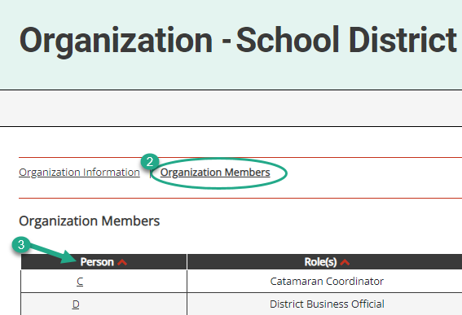
Review Organization Member Names
To review organization member names within Catamaran:
Log in and locate the Tasks Overview.
Select the organization’s name in the Organization column.
Select the Organization Members link from the Organization page.
Review the list. If changes are needed, contact the Catamaran Help Desk for assistance.
Notes:
With the beginning of a new year, please take some time to review organization member names within Catamaran:
To do so, log in and locate the Tasks Overview
Select the organization’s name in the Organization column.
Select the Organization Members link from the Organization page.
Review the list. If changes are needed, contact the Catamaran Help Desk for assistance.
Another reason to view this page, especially for new users is to find out who else in your organization has a Catamaran role. That person or people may be able to help you along as you begin to navigate Catamaran.

Slide 24
View Reports
View available reports on the Tasks Overview at the bottom of the Dashboard.
Select the link in the Activity column (for example, B Report) to access the Reports page.
Notes:
Let’s dive into how to access, view and acknowledge reports. Also, please note there is a How to document on the Catamaran Technical Assistance website that outlines how to acknowledge reports step by step.
When logging in, B Report will be populated on the Tasks Overview. Select the link in the Activity column (for example, B Report) to access the Reports page.
Note: If you have previously applied a filter to the Tasks Overview, it may also be necessary to clear filters before applying a new one. As a reminder, you can narrow tasks down, by applying a filter such as Release, Type, or Organization.

Slide 25
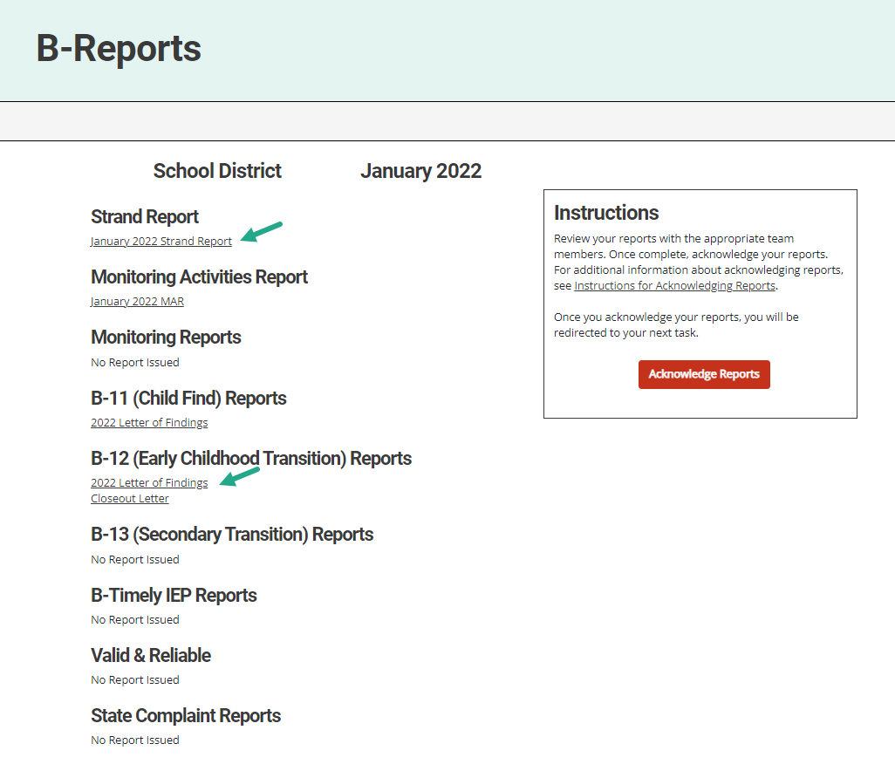
Access Reports
On the Reports page, select any report link to view that report.
Review and share the reports with appropriate team members.
Notes:
Once you reach the Reports page, you can select any report link to view that report.
Then, you can review, print, and share the reports with appropriate team members

Slide 26
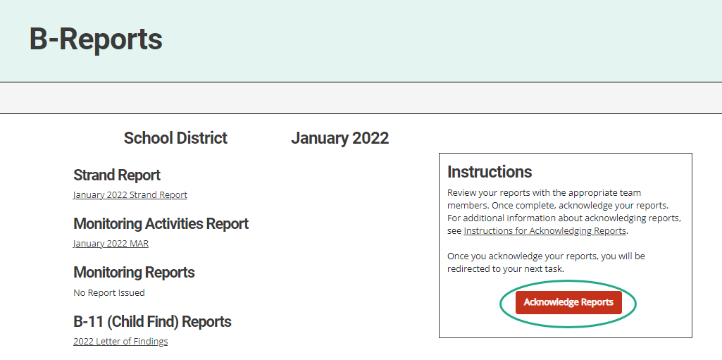
Acknowledge Reports by February 15
Acknowledge reports by selecting the red Acknowledge Reports button on the Reports page.
Note: When reports have been acknowledged, additional tasks become available as appropriate (such as a CAP)
Notes:
Reports must be acknowledged by February 15.
To acknowledge reports, select the red Acknowledge Reports button on the Reports page.
Once reports are acknowledged, the district will be returned to the Dashboard where any additional tasks such as a CAP will be become available. You may need to clear any previous set filters on the Tasks Overview to see any new tasks. If there are no additional tasks, then a message of “You have no tasks to view” will appear in the place of the Tasks Overview list.

Slide 27
After Acknowledging Reports
Work cannot be completed in Catamaran until reports have been acknowledged.
What to do after acknowledging reports:
Review Reports page –Does my district have findings?
Review Strand Report –What are the next steps?
Review MAR.
Decide whether the district should convene a Review and Analysis Process (RAP) Team.
Notes:
New work which has been issued in this release can not be completed in Catamaran until reports are acknowledged. In fact, the work is not even visible in Catamaran until the reports are acknowledged.

Slide 28
Complete Tasks with RAP Team as needed
Check the Tasks Overview or the Strand Report to see if the district has a CAP or Corrective Action.
When there is a CAP or Corrective Action, convene a RAP Team to work through the activity.
Suggested RAP Team members include:
District and ISD personnel such as special and general education administrators
School improvement team representative
Parents
Service providers including general or special education teachers
Data experts or program specialists
Notes:
After sorting through and sharing the information, you’ll need to see if you have a CAP or Corrective Action to work on. You can check your Tasks Overview on the Dashboard (remember to clear any filters before applying a new one) or take another look at the Stand Report to see if you do indeed have a CAP or Corrective Action.
If you do, you need to convene a RAP Team to work through the CAP/Corrective Action.
Important note: if you have a Complaint CAP, it will not be listed on your Strand Report. You will need to check the Tasks Overview for Complaint CAPs.

Slide 29
Access System Reports
Hover over the user’s name
Select Reports from the drop-down menu
Notes:
For ISD personnel who want to see all the work of their member districts when the release happens, there is another report which they can run so see all of the work of their districts even before the districts have all acknowledged their reports.
If you hover your cursor over your name on the upper right side of the screen, you will get a dropdown menu. Select Reports to access system level reports, these are different from the other reports such as the Strand report which are district specific.

Slide 30
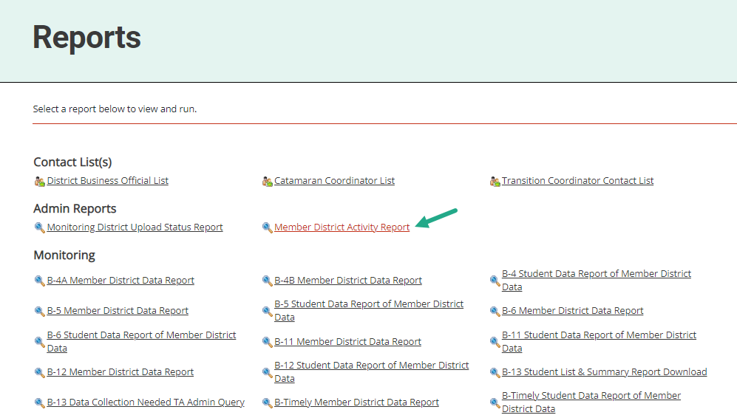
Access Member District Activity Report
Under the topic Admin Reports
Select Member District Activity Report
Notes:
If you have not been to this page, I encourage you to come to this when you have some time. There are many valuable resources here with several years of data. For today, look under the heading of Admin Reports for the Member District Activity Report and click on it.

Slide 31
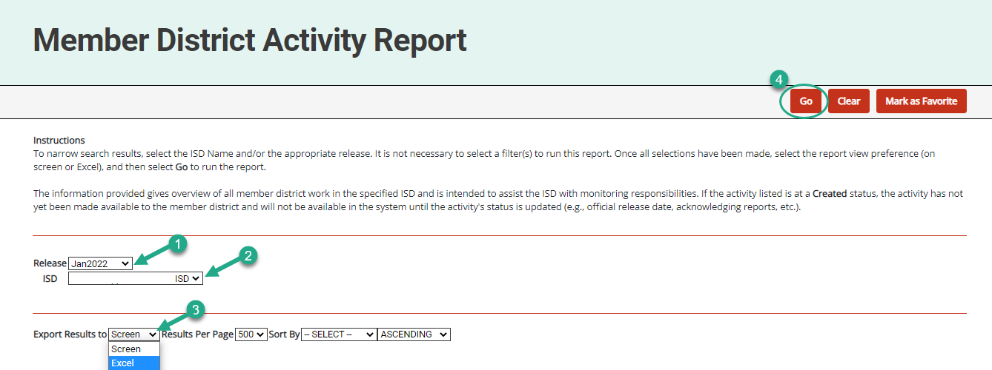
Run Member District Activity Report
Select the
Release
ISD
Format
Choose Go
Notes:
From the Member District Activity Report, you can select the Release, in this case, you will want Jan 2022. Select your ISD, the type of report you want, and then click Go. This will provide ISD users the full list of activities that are being issued to your member districts. You can see, at a glance, the work that is being issued.

Slide 32
Updates and Tips
Notes:
We have made some system updates recently and would like to review previous updates to progress reports, verification pages, the corrective action activity, and the timeout feature. Let’s take a closer look at those.

Slide 33
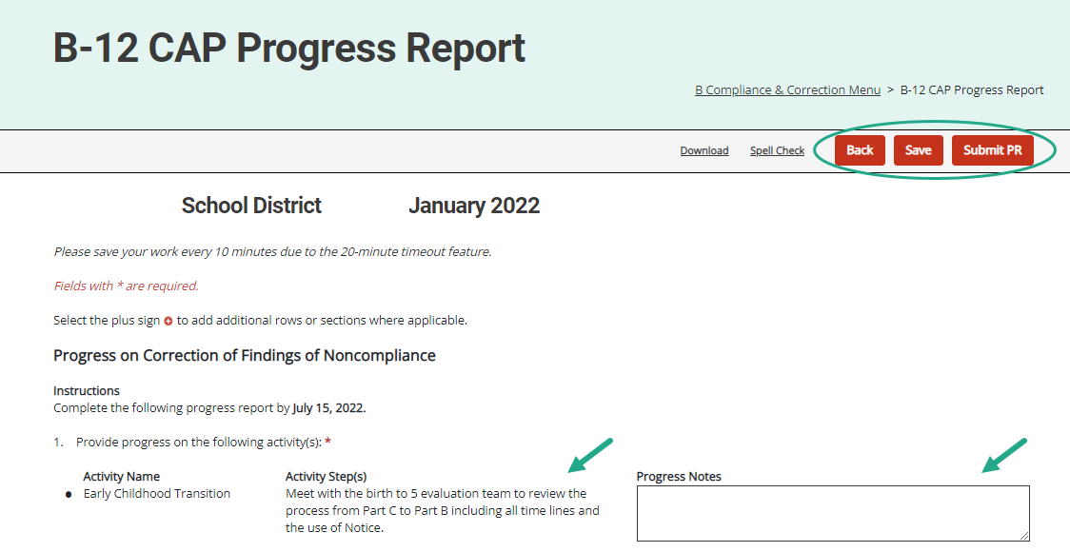
Updated Progress Report
Available for Data and Complaint CAPs.
Activity step(s) from the CAP Activity (or Finding) page will be displayed on the Progress Report.
Member districts will report progress on specific activity step(s).
Notes:
The Activity step(s) from the CAP Activity or CAP Finding page will be displayed on the Progress Report.
Member districts will report progress on each specific activity step(s). It is no longer necessary to return to the CAP Activity or CAP Finding page to complete the Progress Report. This should make the process easier for both the district as they write the progress report and the OSE as they review the report.

Slide 34
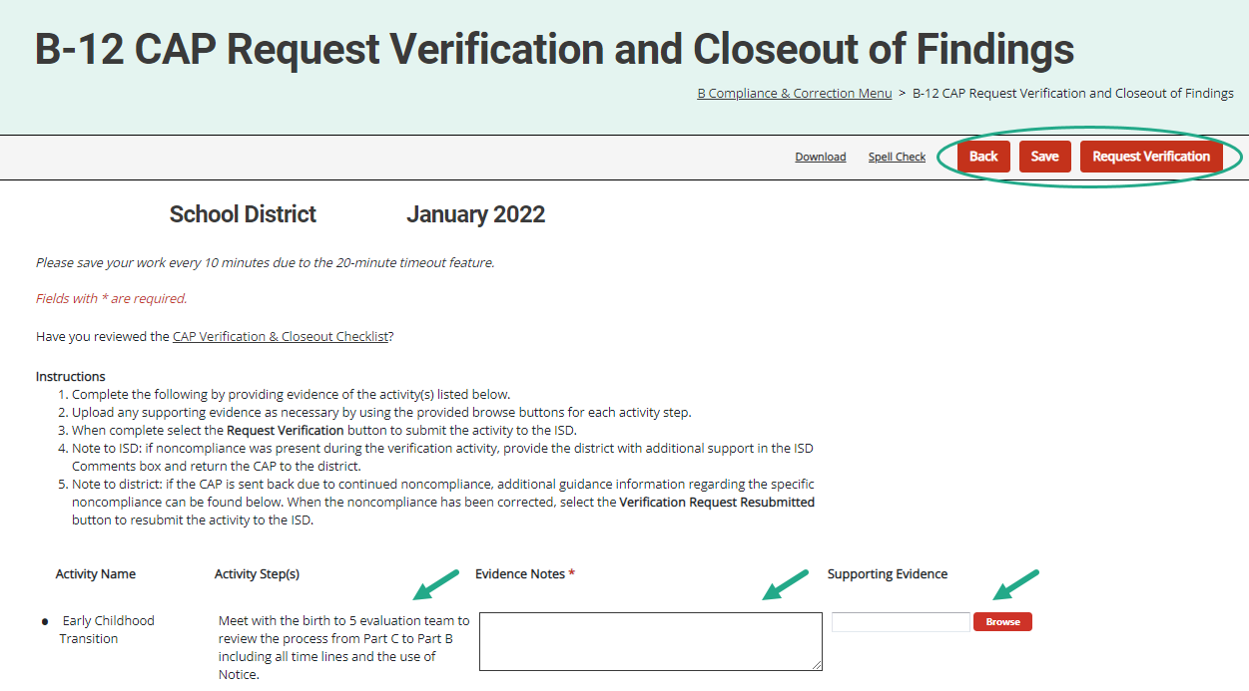
Updated Request Verification & Closeout
Available for Data and Complaint CAPs.
Member districts provide evidence and documentation for specific activity step(s).
This information is available to the ISD to assist with CAP verification.
Notes:
Like the Progress Report update, this update applies to Data, Monitoring, and Complaint CAPs.
It’s no longer necessary to return to the CAP Activity (or Finding) page to complete this form to request closeout.
Also available on the Complaint CAP verification and closeout form, but only on the Complaint CAPs, is a place to upload evidence of ordered compensatory services.
For all CAPs, ISDs may now return a verification request to the district. To do this, from the Request for Verification and Closeout of Findings page, the ISD can return the CAP to the district. If the ISD returns the verification request to the member district, the district can review the files the ISD determined to be noncompliant. The corrections can be made, and the district can resubmit its verification request from this page. There will be an ISD Comments box on this page for any instructions the ISD may want to leave for the district.

Slide 35
Data CAP Verification for ISDs
Available for B-11 and B-12 CAPs.
Member district activity step(s) and evidence, including attachments, display on the CAP Verification page.
ISDs review both activities and evidence from this page to verify completion.
When all activities are verified, the ISD will move to the next section(s) of the CAP Verification Activity page as appropriate.
Notes:
Data CAPs have had this update since the January 2020 release.
This is not new this year, but we wanted to draw attention to this page for any ISDs which didn’t have a data CAP from Jan 2020 or Jan 2021 but may have one this year.
Once a member district has completed their request for verification and closeout, the ISD can use their verification page to view the activities that were required and listed in the activity steps as well as the member districts response to the activities and evidence of those activities.
It is no longer necessary to review multiple pages of the CAP.
Once the activities are verified the ISD can move on to the other sections of the cap verification activity which may include student record reviews or staff interviews.

Slide 36
Data CAP Verification
ISDs complete verification per usual.
MDE reviews verification and writes a comment on CAP Cover Page requesting supporting documentation if needed.
ISDs will upload supporting documentation on the CAP Verification Activity page and resubmit it to MDE.
Notes:
Once the ISD has completed its verification the ISD submits the CAP to MDE. MDE then reviews the verification and writes a comment on the CAP cover page requesting supporting documentation for one or more student files. The ISD then uploads the supporting documentation on the CAP verification activity page and resubmits the CAP to MDE for final review and closeout.

Slide 37
Complaint CAP Verification for ISDs
Verification Appendix will now appear before the closeout verification worksheet on the menu.
Verification Appendix includes a “Date Verified” column in the student record review section.
Member districts may view if the Complaint CAP is returned by the ISD.
When all findings of noncompliance are verified, the ISD will move to the closeout verification worksheet.
Notes:
Another update we recently made to the Verification process is the order of forms on the CAP menu. The Verification Appendix now appears before the closeout verification worksheet.
There is also a new column on the verification form. This new column is labeled date verified. The ISD can use this column to indicate the date the record was determined to be compliant. This may be helpful if you are conducting more than one verification activity. We have also updated the users who have access to this page. In order for member districts to see the files that you have reviewed, member districts are now able to view this page if the ISD returns it to the member district. At that time, they will be able to edit the column of date corrected. The member district will not be able to edit other columns the ISD completes. Once all the noncompliance is corrected and verified, the ISD will submit the closeout request to MDE.

Slide 38
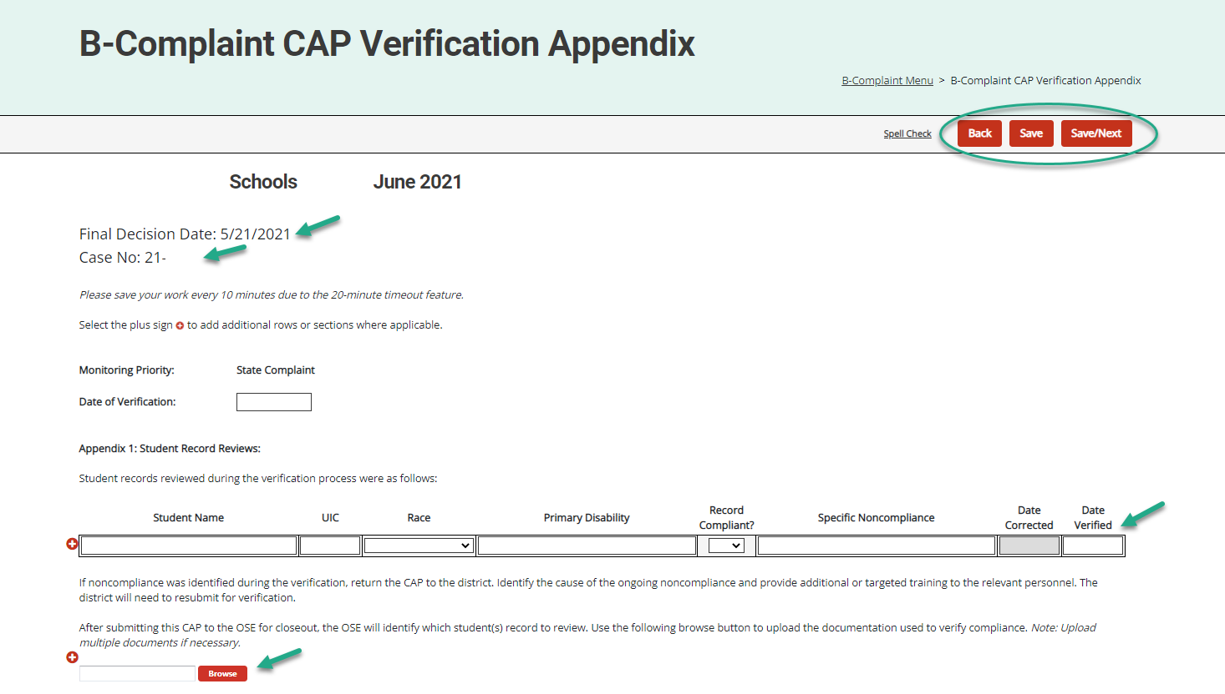
Complaint CAP Verification Appendix
The final decision date and case numbers are now on Complaint CAP forms.
ISDs complete the verification appendix and upload supporting documentation.
Notes:
In February 2021, we added the complaint case number and the Final report date to the menu page and forms of the Complaint CAPs. This information is also on the menu page for older complaint CAPs.
This screen shot shows the Final decision date and case number on the Complaint CAP forms.
As ISDs complete the verification process, they occasionally find ongoing noncompliance. The ISD can return the CAP to the district to correct the records and complete other actions. Remember, to return to the verification request to the district, go to the Request for Verification and Closeout page and select the Verification Request Returned button.
The verification appendix will be viewable by the district and the district will be able to note their date of correction. The district will then resubmit the CAP to the ISD.
Arrows on this slide indicate the fields for the ISD to enter the new verification dates and the browse button to upload supporting documentation.

Slide 39
Corrective Action Form
Districts will:
Select appropriate method(s)
Provide evidence notes
Upload supporting documents as appropriate
Submit to ISD no later than October 1
ISDs will:
Review submitted corrective action
Complete verification activity
Submit to MDE no later than by November 1
Notes:
Let's move on now to the corrective action.
When issued a corrective action, districts will select the appropriate method or methods from the list provided.
Once they have completed the methods, they can return to the form in Catamaran to provide evidence and supporting documents as appropriate.
Once they have completed this they will submit the corrective action to the ISD for verification and closeout no later than October 1st.
This process is different from the regular CAP process in that there is no submission and approval of the CAP nor is their submission or approval of progress reports.
Once the ISD has received the request for verification and closeout they will review the submitted activity, complete their verification and then submit to MDE for closeout no later than November 1st.
As the ISD completes their verification activity they will be looking for files which have been completed after the method of the corrective action was completed.
The ISD will not be looking at files that were completed before the corrective action methods were implemented.

Slide 40
Corrective Action Form Page
Notes:
Here is a screenshot of the corrective action form for B 11. The member district will indicate with a check mark which method they will be implementing. Once implemented they will return to this form upload their evidence in the browse button and click submit to ISD.

Slide 41
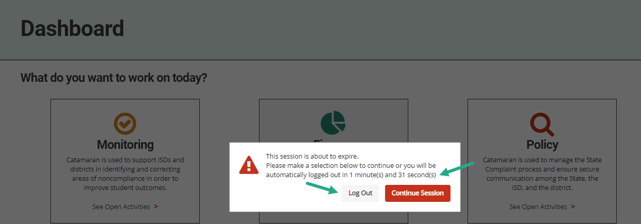
Updated Timeout Feature
Notes:
The timeout feature has recently been updated in Catamaran. This update:
Provides clarity so all users know exactly what will happen due to inactivity and to avoid log out if desired.
Provides an option to either save and logout or to continue your session.
Provides a better countdown timer so a user understands how much time they have left before being logged out.

Slide 42
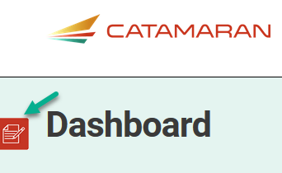
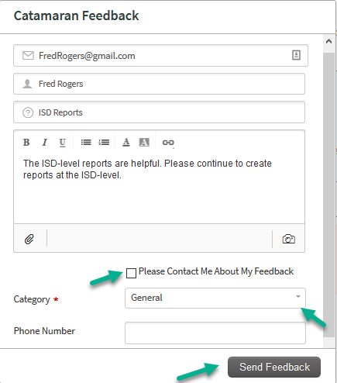
Feedback Feature
Feature available to offer feedback about Catamaran at any time.
Enter contact information.
Choose to be contacted about feedback.
Notes:
Those are the updates we have made to the system from our last major releases. And the next few slides I want to point out some of the continuing features. On the left-hand side of any screen in the system you will find the feedback feature. The OSE as well as our PSC partners appreciate your feedback related to the system.
If you wish to be contacted about your feedback you can enter contact information, and someone will reach out to you.
If you prefer to provide anonymous feedback, we would also like to hear from you. You do not need to leave your contact information.

Slide 43
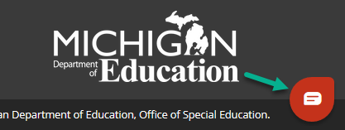
Chat Feature
The Help Desk is available by chat during business hours.
Choose the Chat icon located in the lower right corner of the screen to begin a chat.
Enter basic information.
The issue will still be logged in the Help Desk database (just like a phone call).
Notes:
Another important feature to note is the chat feature. As you work through the system, you may find yourself in need of some support. Rather than going to look for a how to document on the technical assistance website, the help desk is available for chats during regular business hours.
If you select the chat icon in the lower right corner of any screen, you can begin a chat session.
If you do choose to use the chat session, the help desk continues to log the issue so the OSE and our partners at PSC know where more training or support might be needed.

Slide 44
Use breadcrumbs to navigate
Use the breadcrumbs menu to navigate in Catamaran:
The breadcrumbs are a trail to follow back to a previous location
Or click on the Catamaran logo to return to the Dashboard
Notes:
Finally, I would like to remind you about navigating in catamaran.
Do not hit your browser BACK button after submitting work or changing a status.
Many web browsers become confused and will give you an error message. You will be much more successful if you use the breadcrumbs to navigate to previous pages.

Slide 45
Resources
Notes:
Even with the best of training, there may be questions that arise later as you use the system. There are a variety of resources available to support you.

Slide 46
Catamaran Technical Assistance
Notes:
As many of you may already know, the revised Catamaran Training Website is now called the Catamaran Technical Assistance Website. The OSE in partnership with Catamaran users has redesigned the website to focus on increased technical assistance for Catamaran users.
The following slides highlight some of the features and navigation.
You can access the Catamaran Technical Assistance Website at training dot catamaran dot partners.

Slide 47
Catamaran Technical Assistance Page
Notes:
As you scroll down the main landing page, you will see this section pictured here. It includes:
Documents the OSE is spotlighting,
Events and Deadlines (this is where the due dates are located now), and
Quick Links that you may find useful such as the MARSE or SPP.

Slide 48
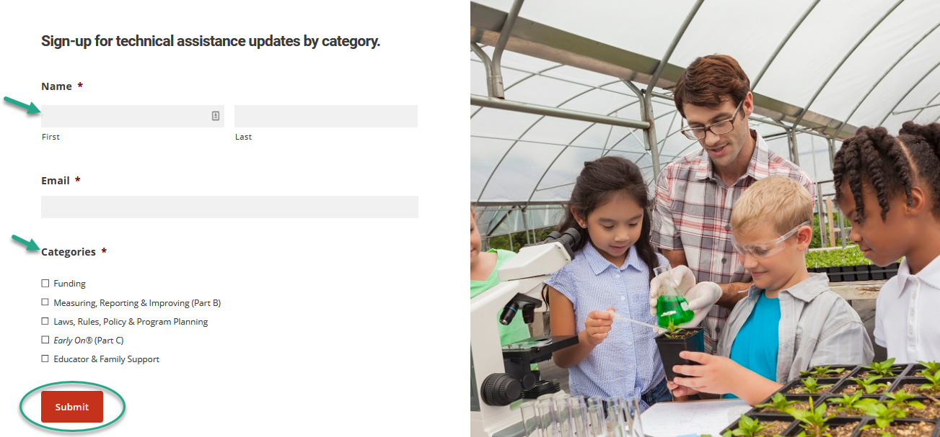
Technical Assistance Updates
Notes:
Website visitors may now sign up for notifications to be kept informed when new technical assistance content is available.
To access the form, from the home page of the site, scroll down and complete the form. Simply select the categories that you want to be kept up to date on and then submit.

Slide 49
Other Resources
Notes:
Catamaran how-to’s are now organized in one place under the Other Resources menu. Search for how-tos either by selecting district or ISD under either Monitoring, Policy, or Finance or by using the how-to search form.

Slide 50
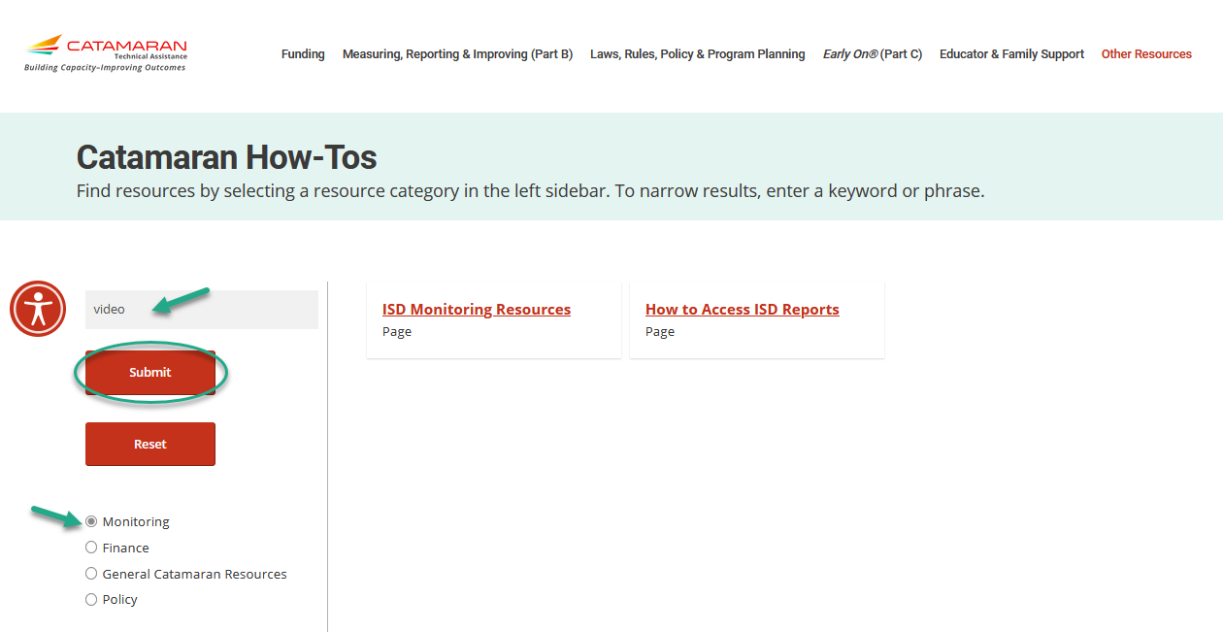
Catamaran How-tos
Notes:
In addition to finding how-to’s and other resources using the main categories under the Other Resources menu, website visitors may also use the Catamaran How-tos form.
Select the resource category from the left sidebar. If you wish to narrow your search results further, enter a keyword or phrase.
In this example, we selected Monitoring and then entered the word “Video”. This quickly narrowed the results to two pages that have the word “video” on them.

Slide 51
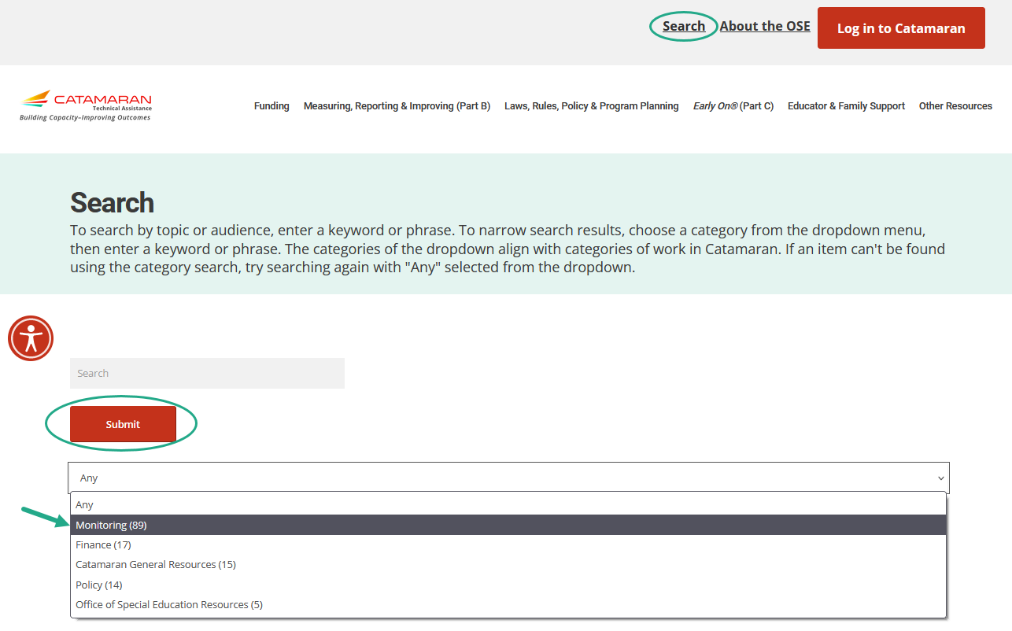
Search
Notes:
In addition to searching for Catamaran How-to’s, website visitors may also do an overall search of the website. To do this, select Search in the upper right-hand corner of the website and then using the provided drop-down menu, select your search category and choose Submit.
Just like on the Catamaran How-to form, you may also enter a key word or phrase to narrow your search results.
Content is continuously being updated and tagged to optimize search results.
I would encourage you to search for the word Assignments and get that map of which monitoring team member is assigned to which ISD. That resources has our contact information on there as well.

Slide 52
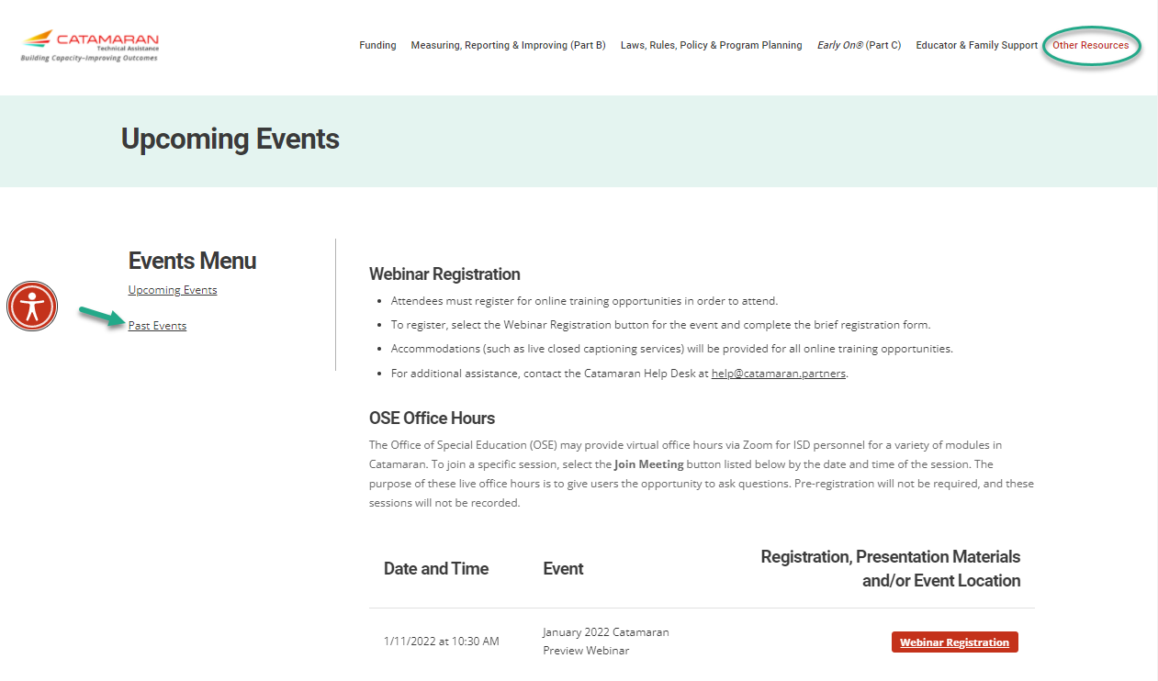
Events
Notes:
Finally, You may get to either the Upcoming Events or Past Events pages through the Other Resources menu or from the main landing page under the Events and Deadlines heading selecting either:
Register for Upcoming Events
View Past Event Recordings
Just as before you may
Register for upcoming events or
Access recordings and presentation materials from past events (including this webinar)
When we schedule the office hours for Valid and Reliable Data Alerts you will see those listed here.

Slide 53
Questions?
Notes:
If you have questions, please use the chat feature to type in questions.

Slide 54
Contact MDE OSE
Presenters
Charles Thomas thomasc29@michigan.gov
Tori Ranusch ranuscht1@michigan.gov
MDE OSE Information Line
888-320-8384
mde-ose@michigan.gov
Notes:
If you have any questions about today’s presentation, please reach out to Charles at t h o ma a s c 29 @ michgian.gov or Tori at r a n u s ch t 1 @michigan.gov. For more general questions about special education, please contact the MDE OSE Information Line at 888-320-8384 or by email at m d e – o s e @ Michigan.gov.

Slide 55
Contact the Catamaran Team
Project Director
Kelly Rogers
krogers@publicsectorconsultants.com
Catamaran Help Desk
877-474-9023
help@catamaran.partners
Senior Consultant
Lynne Clark
lclark@publicsectorconsultants.com
Notes:
Finally, for questions concerning Catamaran,
Reach out to Kelly at k r o g e r s@publicsectorconsultants.com or Lynne at l c l a r k @publicsectorconsultants.com
As a reminder,
The Catamaran Help Desk is available Monday through Friday from 8-5 PM.
Contact them by email at help@catamaran.partners or by phone at 877-474-9023 or by using the Chat feature within Catamaran.
This concludes the presentation -- thank you for attending!

