Slide 1
Welcome!
The September 2022 Catamaran Preview webinar will begin in a few moments.
The webinar recording and presentation materials will be posted on the Catamaran Technical Assistance Website under Past Events.
To communicate with the presenters during the webinar, use the Chat feature.
Closed captioning is available for this webinar. To select this option, choose the closed caption icon in the Zoom webinar player.

Slide 2
Zoom Webinar Control Panel
Mouse or tab down to the bottom of the webinar screen for the Zoom Webinar Control Panel to become visible.
Features available are:
Chat – select to communicate with presenters.
Closed Captioning (CC) – select the CC icon to turn on captions.
Leave – select to exit the webinar.

Slide 3
September 2022 Part B Catamaran Preview
For Districts and ISDs

Slide 4
Meet the Team
Office of Special Education (OSE)
Jessica Brady, Supervisor
Jeanne Anderson Tippett, Coordinator
Chantel Mozden, Coordinator
Shawan Dortch, Consultant
Tori Ranusch, Consultant
Charles Thomas, Consultant
Aaron Darling, Analyst
Public Sector Consultants (PSC)
Kelly Rogers, Project Director
Lynne Clark, Senior Project Manager
Josiah Bear, Project Support Associate
Notes:
Read slide to introduce team.

Slide 5
Agenda
September 2022 Catamaran Preview
Catamaran Navigation
Updates and Tips
Training Resources
Questions

Slide 6
September 2022 Catamaran Preview

Slide 7
What’s Inside?
Reports
Strand Report
Monitoring Activities Report (MAR)
Reports and Letters of Findings
Closeout/Non-closeout Reports
State Complaint Reports
Intermediate School District (ISD) Reports
Activities
Corrective Action Plans (CAPs)
B-9, B-10, B-9-B-10, B-IEP
B-Valid & Reliable
B-Complaints
Student-level Corrective Action Plans (SLCAPs) for Complaints
Notes:
When you open Catamaran and acknowledge your reports, you will see a variety of things. The reports for districts include Strand Report, the Monitoring Activities Report (MAR), Reports of Findings or No Findings, Letters of Findings, Closeout/Non-closeout Reports for CAPs and State Complaint Reports for any completed complaints this month. For ISDs there are Reports of the determinations data and Strand Report Summary of member district data.
The Activities for this release include Corrective Action Plans (CAPs) for B-9 (Disproportionate Representation-Child with a Disability), B-10 (Disproportionate Representation-Eligibility Category), B-9-B-10, B-IEP (IEP implementation), B-Valid & Reliable, and State Complaints.
There are Student Level Corrective Action Plans (SLCAP) for State Complaints.

Slide 8
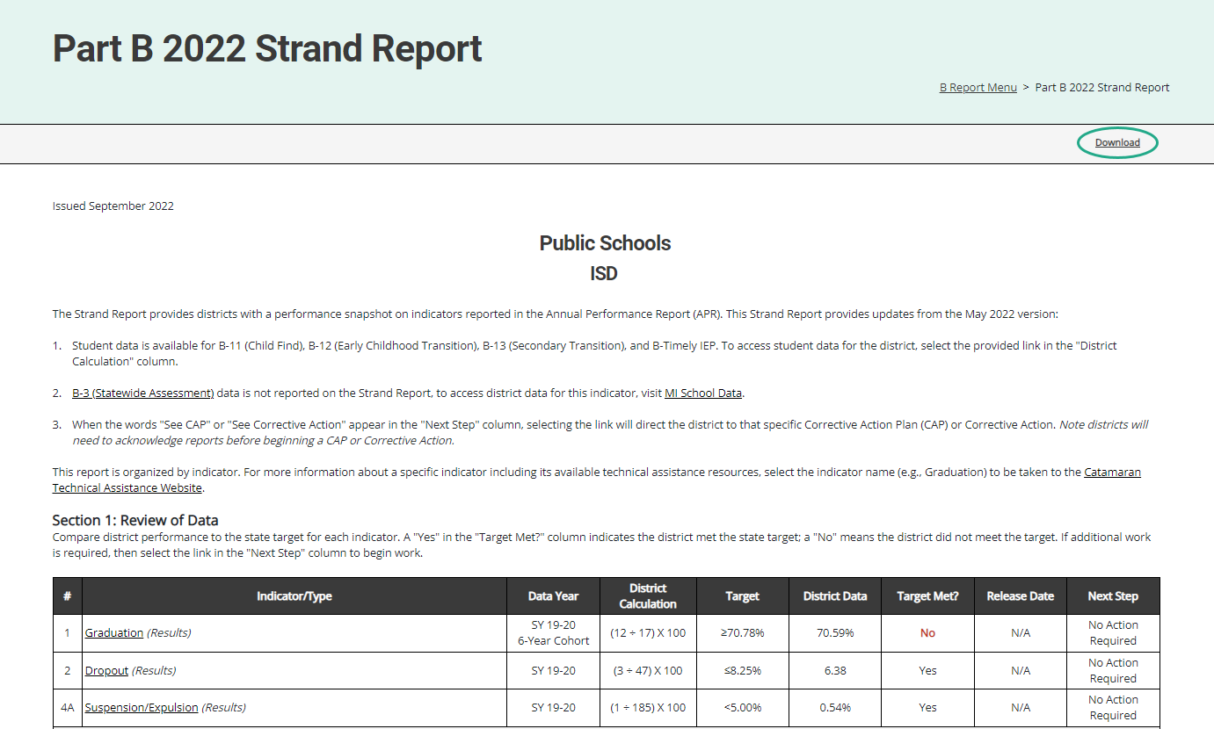
Strand Report
Summarizes district performance on the State Performance Plan (SPP) Indicators and priority areas.
When there is a CAP or Corrective Action, there will be a link in the Next Step column. Select the link to be taken to that specific item.
Use the Download link at the top of the screen to download a PDF.
Notes:
Here is an example of the Strand Report.
The Strand Report summarizes a district’s performance on the State Performance Plan indicators and priority areas.
We will dive into how to access your reports a little later in the webinar, but if you do have a CAP or Corrective action, you can select the See CAP or corrective action link in the Next Step column to be taken directly to that object.
You can use the download link at the top of the screen to save and then print a copy of your Strand Report to share with your administration, colleagues or RAP team if needed.

Slide 9
Monitoring Activities Report (MAR)
The MAR is included in every major release and provides important information to districts.
The MAR can be accessed from the Reports page.
Some messages are universal and go to all districts.
Some messages are targeted and are sent only to specific districts.
Reminders to review Reports of Findings/No Findings
Reminders to review closeout reports
Notes:
The Monitoring and Activities report, or the MAR, can be accessed through the Reports page, which again, we will look at how to view and access the Reports page.
Some messages are universal and go to all districts, and some messages are targeted, and are sent only to specific districts, such as reminders to review Reports of Findings/No Findings or reminders to review data alert letters

Slide 10
Sample Monitoring Activities Report
Notes:
This screenshot includes a universal message asking users to ensure their authorized EEM user has the current information updated in that system. Catamaran uses the EEM for many functions so correct and current data is very helpful.

Slide 11
Reports/Letters of Findings or No Findings
B-10, B-9-B-10, and B-IEP Report of Findings
B-9 and B-10 Report of No Findings
B-Valid & Reliable Data Letter of Findings
State Complaint Final Decisions
Notes:
Another set of reports are those related to completed monitoring activities. We recently completed the monitoring activities for B-9/B-10 and B-IEP so there will be reports of findings or no findings for each of those districts or ISDs which participated.
When reviewing the data that was submitted as part of the B-13 data collection this past spring the Office of Special Education made many changes to data submitted by the ISDs. Valid and reliable data is a requirement of the IDEA. ISDs (or State Agencies) for whom the OSE had to change the data or had interrater reliability issues for one year, will be receiving a valid and reliable letter of findings. This letter will direct the ISD (or State Agency) to complete a corrective action plan and participate in a required training sessions offered by the OSE to ensure the B13 data collection this next year consists of valid and reliable data. More on those in just a minute.
Additionally, each month, state complaint Final Decisions are issued so those are included in the reports as well.

Slide 12
Closeout/Non-closeout Reports
Monitoring
B-9 (Disproportionate Representation – Child with a Disability)
B-10 (Disproportionate Representation – Six Eligibility Categories)
B-9-B-10
State Complaints
Notes:
For CAPs and corrective actions that were issued last year in September, there are closeout or non-closeout reports for all of those. These include B-9, B-10, B-9-B-10, and state complaints. If your district or ISD was not able to close their CAP, the OSE will assign a technical assistance provider to work with the district to achieve compliance.

Slide 13
ISD Reports
2022 Determinations Data
ISD Strand Report Summary of Member Districts
Notes:
In addition to the reports available to all districts, there are additional reports for ISDs.
In June when ISD Determinations was released, the OSE provided an updated Determinations Data Report to ISDs. In this release, we will provide a link to that updated report on the ISD’s Reports page. This report will allow the ISD to review both current and historical Determinations data for the past 4 years. This is not new data but rather a new look and new report filters. The OSE hopes this report will be helpful to ISDs as they look for trends and patterns in their data which might help to drive their TA and improvement activities with their member districts.
The other report available to ISDs in this release is the Strand Report Summary of Member Districts. This report makes it easy for ISDs to see the performance of the member districts at a glance.
For more information on how to access either of these reports, visit the Catamaran Technical Assistance Website’s How to Access ISD Reports training resource (https://training.catamaran.partners/how-to-access-isd-reports/).

Slide 14
ISD Determinations Data
All Determinations data has been previously shared. Review previous Determinations matrices, if needed to understand the data source.
Determinations methodology are available on the technical assistance website.
Results and Compliance Scores
Review the compliance and results scores for each of the four years.
Compare the ISD's scores to the state scores.
Note the gaps between the ISD scores and the state scores.
Look for any trends in the data.

Slide 15
Element Data
Look at the trend for each element.
What are the elements with the lowest scores?
For Compliance?
For Results?
Reminder: The audit number is a count of member districts with special education audit findings. A zero means no districts that were audited had a finding. These numbers are counts of member districts, not points for the score.
Refer to the methodology document for further information.

Slide 16
Member District Element Data
For each element of concern, look at the data from the member districts for the four years.
Is it one district or many districts with low scores?
Is it the same districts each year?
Are some trending up or down?
Are newer data available about any element?
What technical assistance (TA) is needed to address the issue(s)?

Slide 17
Corrective Action Plans (CAPs)
All CAPs:
Have the same workflow and timelines for completion.
Describe system level correction.
Are verified as corrected by the ISD.
Include links to either:
Student Level Corrective Action Plans (SLCAPs) or
District Student Data Report (B-Valid & Reliable)
Monitoring CAPs:
Issued following a monitoring activity.
Include links to the report of findings.
Complaint CAPs:
Issued each month as needed.
Include link to complaint final decision.
Notes:
CAPs are due November 1.
One continuing requirement when it comes to verification and closeout activities is the OSE is reviewing the updated procedures as well as change in practices. At the time when the district completes their progress report, the district should upload their updated policies and procedures for review. If changes are needed, the PR will be returned to the district with directions. If the procedures are compliant, the PR approval process will continue.
During the verification stage of the CAP, the ISD reviews student files for evidence of change in practice. When the review is complete, the ISD submits to the OSE. The OSE will return the CAP to the ISD indicating which student files need to be uploaded for OSE verification. The ISD will then upload supporting documentation onto the Verification page. We will see some screen shots of this in just a few minutes.
This process are true for all monitoring CAPs including Complaint CAPs.
B-Valid & Reliable CAP Verification Activity will look different than the monitoring and Complaint CAPs. During the verification stage of the CAP, The ISD will complete the CAP Activity Verification to include reviewing the activity steps and evidence provided to verify the activities have been completed. The new step includes Data Collection Verification. This section will not be completed until the B-13 (Secondary Transition) Data Collection Activity is available in Catamaran. At that time, the OSE will provide a list of member districts using a chart which will be found in the CAP Verification Activity Page. The OSE will request specific information for each district. The ISD will upload the requested information using the provided browse button on each row. We will see some screen shots of this in just a few minutes.

Slide 18
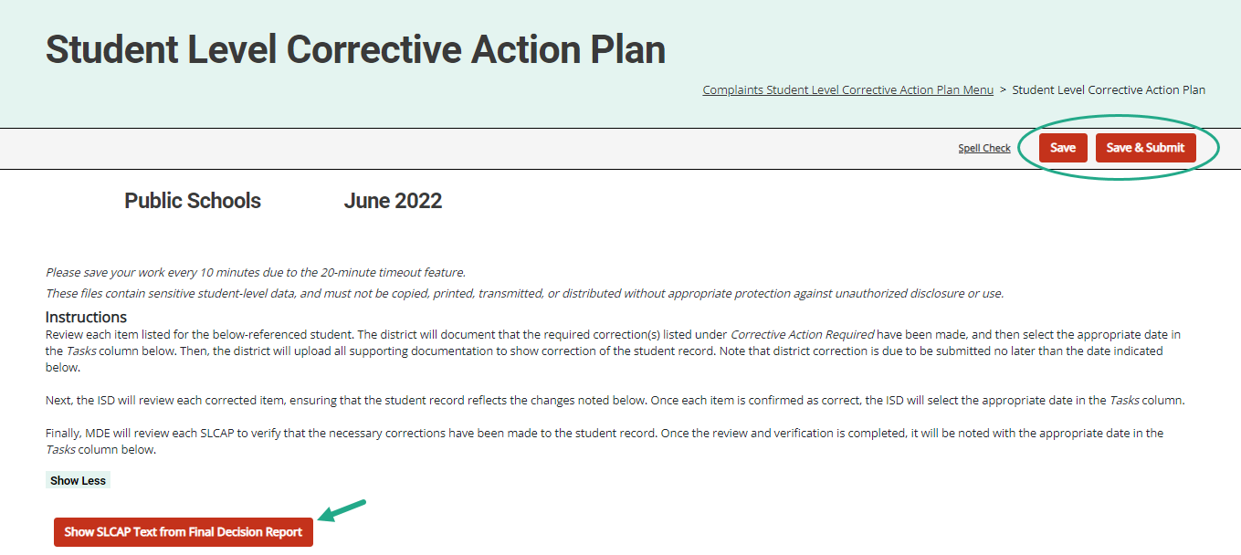
SLCAPs
Notes:
SLCAPs correct individual student level noncompliance. They are due within 30 school days
SLCAPs Are verified as corrected by the ISD and reviewed by the OSE.
Each individual SLCAP must be closed before the CAP or corrective action is closed
The example shown here is highlighting a link from a Complaint SLCAP to the more explicit language of the final decision.
The B-9, B-10, and B-IEP SLCAPs were due 30-school days from the date of review.

Slide 19
Catamaran Navigation
Notes:
For all of our new users and those of you who are occasional users, let’s take a closer look at navigating in Catamaran.

Slide 20
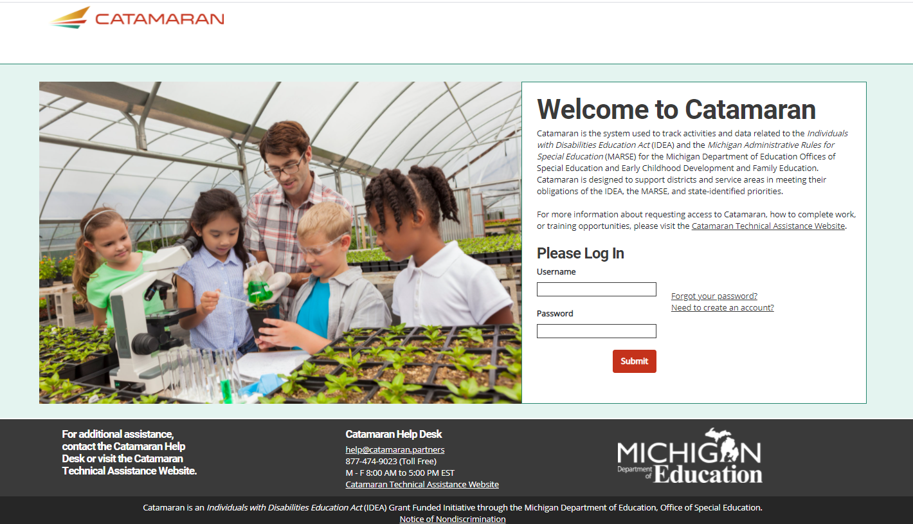
Login
https://catamaran.partners
Notes:
Note the letter S after http, the S means this is a secure site. It does contain student level information and so passwords should not be shared. Occasionally, districts and ISDs may want to review the Organization member list to verify it is up to date. If any staff at the district or ISD no longer needs access to Catamaran, please contact the Help Desk to end their system access.

Slide 21
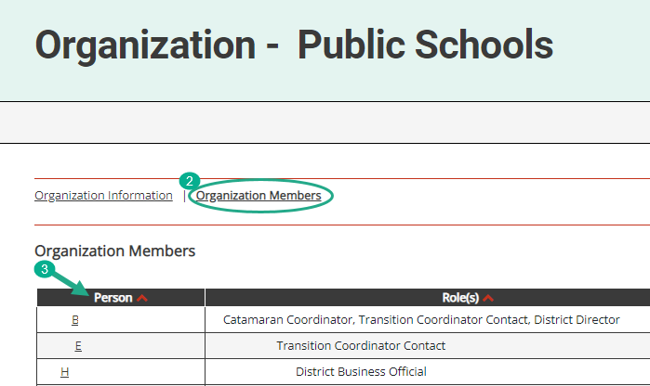
Review Organization Member Names
To review organization member names within Catamaran:
Log in and locate the Tasks Overview.
Select the organization’s name in the Organization column.
Select the Organization Members link from the Organization page.
Review the list. If changes are needed, contact the Catamaran Help Desk for assistance.
Notes:
With the beginning of a new year, please take some time to review organization member names within Catamaran:
To do so, log in and locate the Tasks Overview
Select the organization’s name in the Organization column.
Select the Organization Members link from the Organization page.
Review the list. If changes are needed, contact the Catamaran Help Desk for assistance.
Another reason to view this page, especially for new users is to find out who else in your organization has a Catamaran role. That person or people may be able to help you along as you begin to navigate Catamaran.

Slide 22
View Reports
View available reports on the Tasks Overview at the bottom of the Dashboard.
Select the link in the Activity column (for example, B Report) to access the Reports page.
Notes:
Let’s dive into how to access, view and acknowledge reports. Also, please note there is a How to document on the Catamaran Technical Assistance website that outlines how to acknowledge reports step by step.
When logging in, B Report will be populated on the Tasks Overview. Select the link in the Activity column to access the Reports page.
Note: If you have previously applied a filter to the Tasks Overview, it may also be necessary to clear filters before applying a new one. As a reminder, you can narrow tasks down, by applying a filter such as Release, Type, or Organization.

Slide 23
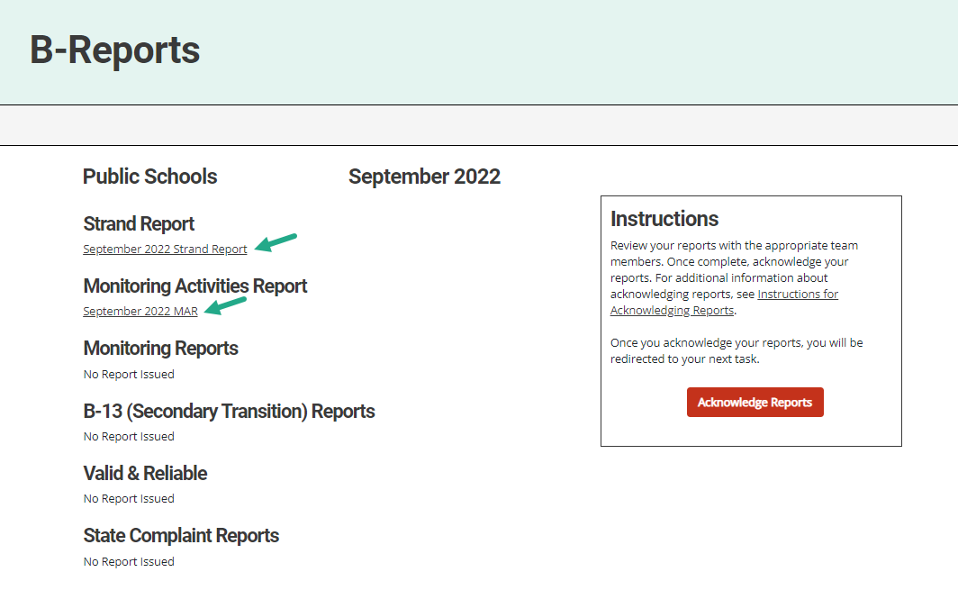
Access Reports
On the Reports page, select any report link to view that report.
Review and share the reports with appropriate team members.
Notes:
Once you reach the Reports page, you can select any report link to view that report.
Then, you can review, print, and share the reports with appropriate team members

Slide 24
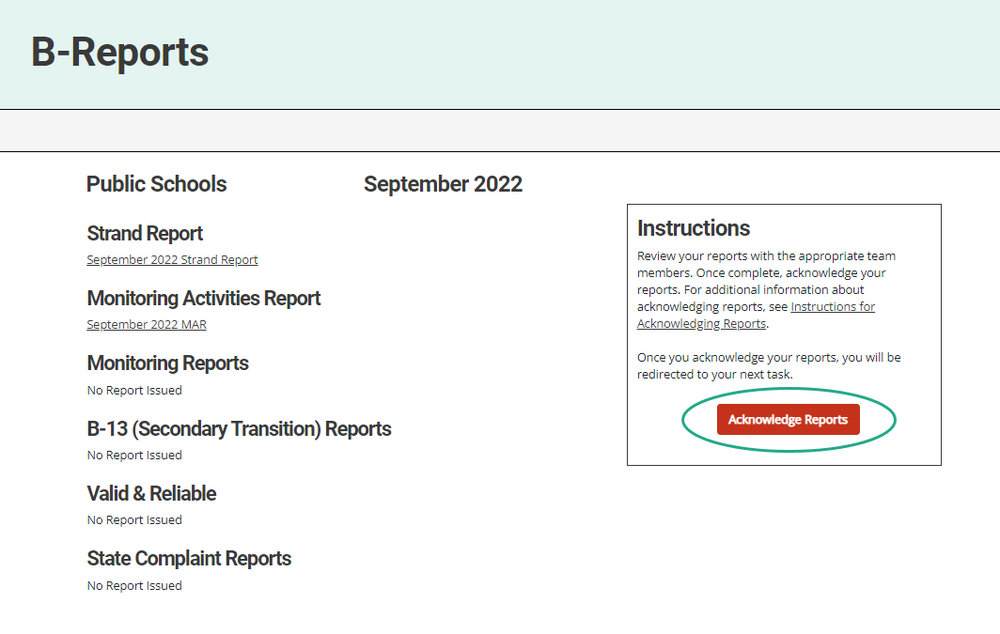
Acknowledge Reports by October 15
Acknowledge reports by selecting the red Acknowledge Reports button on the Reports page.
Note: When reports have been acknowledged, additional tasks become available as appropriate (such as a CAP).
Notes:
Reports must be acknowledged by October 15.
To acknowledge reports, select the red Acknowledge Reports button on the Reports page.
Once reports are acknowledged, the district will be returned to the Dashboard where any additional tasks such as a CAP will be become available. You may need to clear any previous set filters on the Tasks Overview to see any new tasks. If there are no additional tasks, then a message of “You have no tasks to view” will appear in the place of the Tasks Overview list.

Slide 25
After Acknowledging Reports
Work cannot be completed in Catamaran until reports have been acknowledged.
What to do after acknowledging reports:
Review Reports page – Does my district have findings?
Review Strand Report – What are the next steps?
Review MAR
Decide whether the district should convene a Review and Analysis Process (RAP) Team
Notes:
New work which has been issued in this release can not be completed in Catamaran until reports are acknowledged.

Slide 26
Complete Tasks with RAP Team as needed
Check the Tasks Overview or the Strand Report to see if the district has a CAP.
When there is a CAP, convene a RAP Team to work through the activity.
Suggested RAP Team members include:
District and ISD personnel such as special and general education administrators
School improvement team representative
Parents
Service providers including general or special education teachers
Data experts or program specialists
Notes:
After sorting through and sharing the information, you’ll need to see if you have a CAP to work on. You can check your Tasks Overview on the Dashboard (remember to clear any filters before applying a new one) or take another look at the Stand report to see if you do indeed have a CAP.
If you do, you need to convene a RAP Team to work through the CAP. CAPS for B-9 and 10 have had just a minor tweak on the Findings Page but we will see that change in the next part of this presentation. Important note: if you have a Complaint CAP, it will not be listed on your Strand Report. You will need to check the Tasks Overview for Complaint CAPs.

Slide 27
Access System Reports
Hover over the user’s name.
Select Reports from the drop-down menu.
Notes:
For ISD personnel who want to see all the work of their member districts when the release happens, there is another report which they can run so see all the work of their districts even before the districts have all acknowledged their reports.
If you hover your cursor over your name on the upper right side of the screen, you will get a dropdown menu. Select Reports to access system level reports, these are different from the other reports such as the Strand report which are district specific.

Slide 28
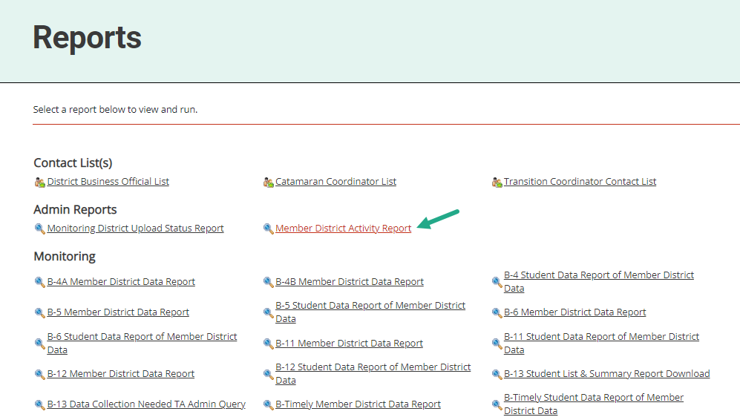
Access Member District Activity Report
Under the topic Admin Reports
Select Member District Activity Report
Notes:
If you have not been to this page, I encourage you to come to this when you have some time. There are many valuable resources here with several years of data. For today, look under the heading of Admin Reports for the Member District Activity Report and click on it.

Slide 29
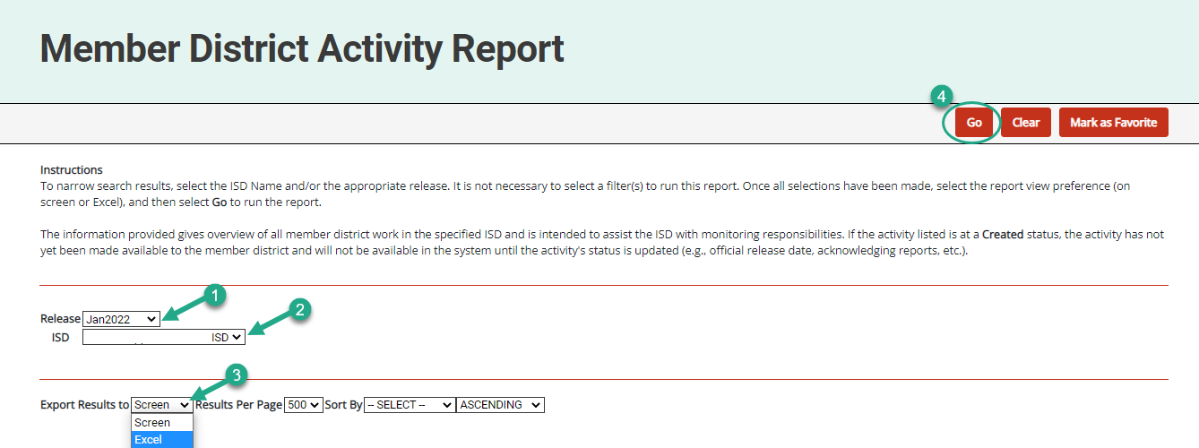
Run Member District Activity Report
Select the
Release
ISD
Format
Choose Go
Notes:
From the Member District Activity Report, you can select the Release, in this case, you will want Jan 2022. Select your ISD, the type of report you want, and then click Go. This will provide ISD users the full list of activities that are being issued to your member districts. You can see, immediately, the work that is being issued.

Slide 30
Updates and Tips
Notes:
Ask any questions and review the chat.
We will now detail monitoring updates and Catamaran tips.

Slide 31
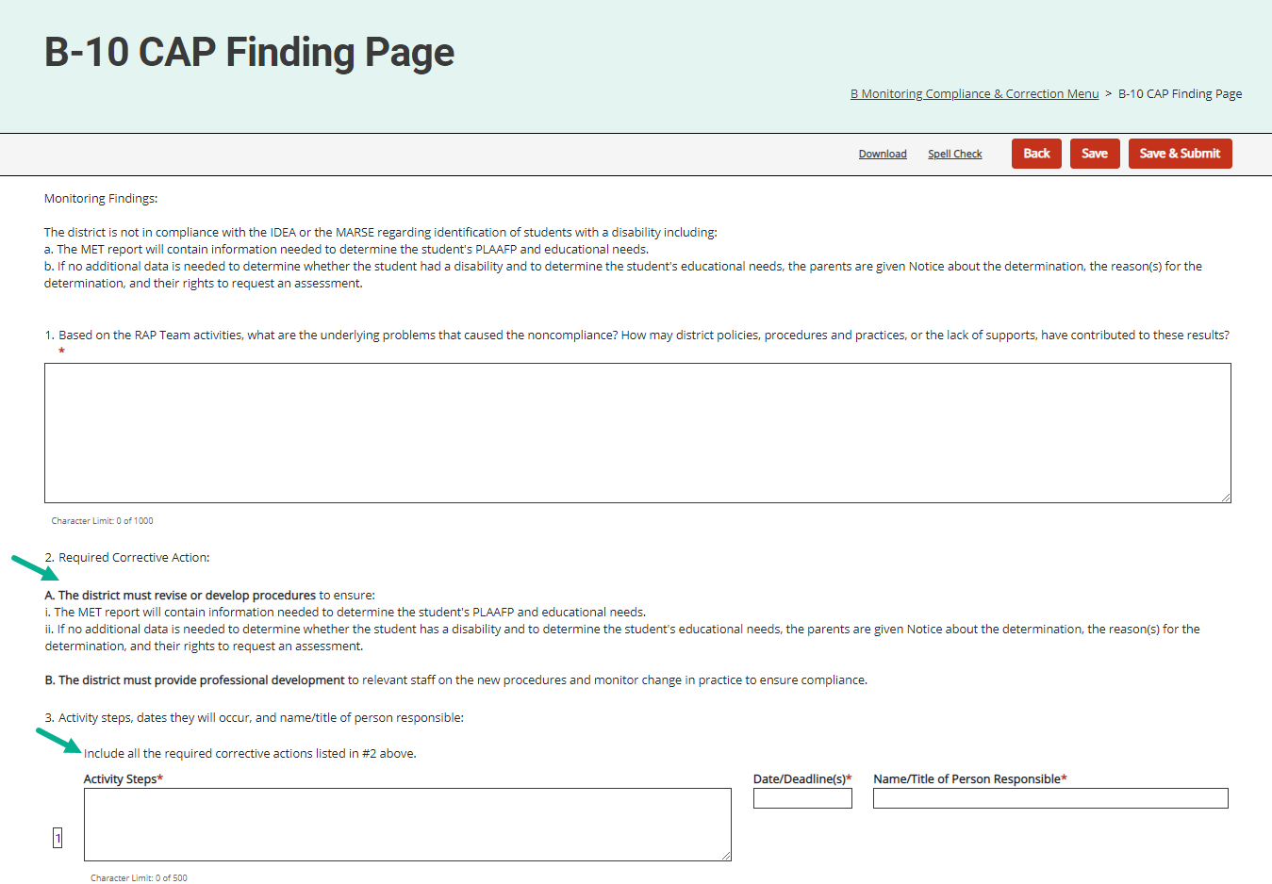
CAP Finding Page
Applies to B-9 and B-10 CAPs.
Actions ordered in Final Reports will be bolded and numbered.
Each action must be detailed in the Action Steps.

Slide 32
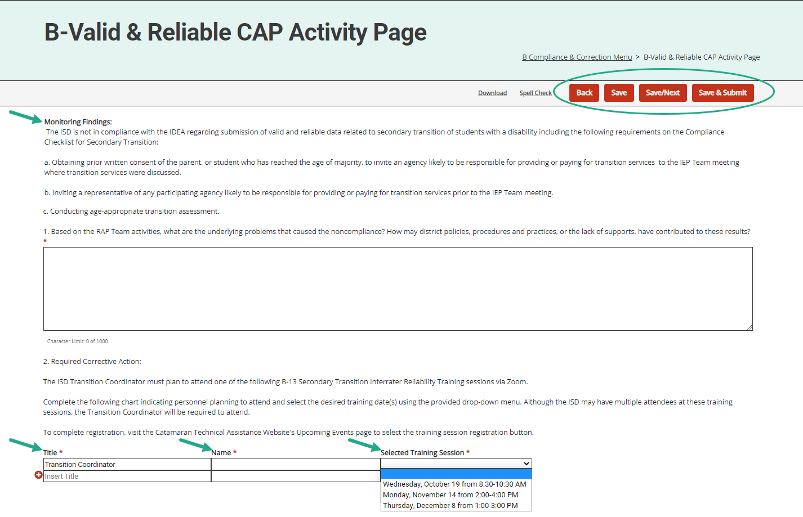
Updated CAP Activity Page
Applies to B-Valid & Reliable CAPs.
Monitoring Finding language displayed.
Required Corrective Action requires the user to indicate the selected OSE training.
Notes:
The Valid & Reliable data CAPs will have monitoring finding language displayed that outlines the questions where the ISD (or State Agency) had interrater reliability issues during the data collection activity.
The information displayed under the Required Corrective Action section will be the same for all who receive this finding. The user will have the opportunity to select the training session(s) they plan to attend. Note, Transition Coordinators will be required to attend; however, users may register multiple personnel to attend these important sessions.
Note the B-13 IRR training sessions are open to all ISDs; however, those with a B-Valid & Reliable finding will be required to attend.

Slide 33
Complaint and Monitoring CAP Verification for ISDs
Verification Appendix appears before the closeout verification worksheet on the menu.
Verification Appendix includes a “Date Verified” column in the student record review section.
Districts may view, if the CAP is returned by the ISD.
When all findings of noncompliance are verified, the ISD will move to the closeout verification worksheet.
Notes:
The Verification Appendix appears before the closeout verification worksheet.
There is also a column on the verification form labeled date verified. The ISD can use this column to indicate the date the record was determined to be compliant. This may be helpful if you are conducting more than one verification activity. We have also updated the users who have access to this page. In order for districts to see the reviewed files, they can view this page if the ISD returns it to the district. At that time, districts will be able to edit the column of date corrected. The district will not be able to edit other columns the ISD completes. Once all the non-compliance is corrected and verified, the ISD will submit the closeout request to MDE.

Slide 34
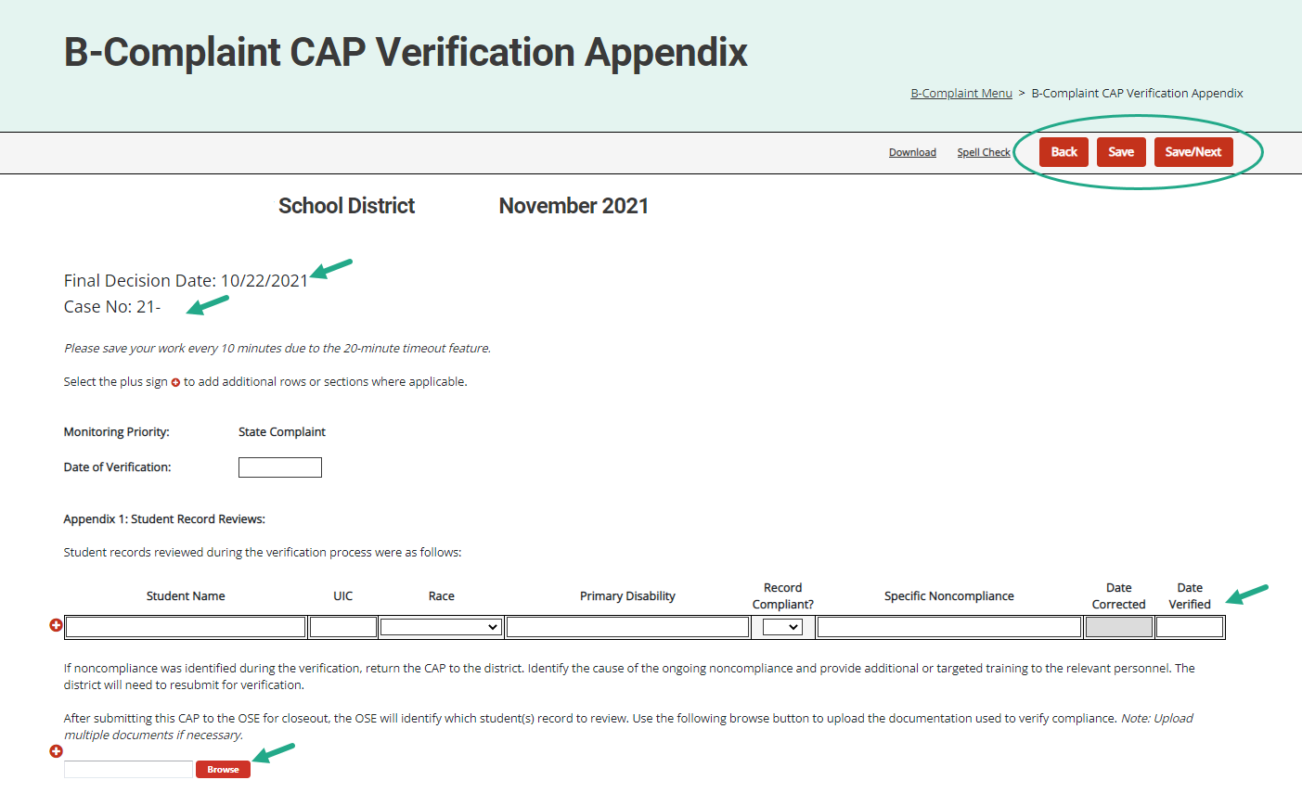
Complaint CAP Verification Appendix
The final decision date and case numbers are now on Complaint CAP forms.
ISDs complete the verification appendix and upload supporting documentation.
Notes:
In February 2021, we added the complaint case number and the Final report date to the menu page and forms of the Complaint CAPs. This information is also on the menu page for older complaint CAPs.
This screen shot shows the Final decision date and case number on the Complaint CAP forms.
As ISDs complete the verification process, they occasionally find ongoing noncompliance. The ISD can return the CAP to the district to correct the records and complete other actions. Remember, to return to the verification request to the district, go to the Request for Verification and Closeout page and select the Verification Request Returned button.
The verification appendix will be viewable by the district and the district will be able to note their date of correction. The district will then resubmit the CAP to the ISD.
Arrows on this slide indicate the fields for the ISD to enter the new verification dates and the browse button to upload supporting documentation.

Slide 35
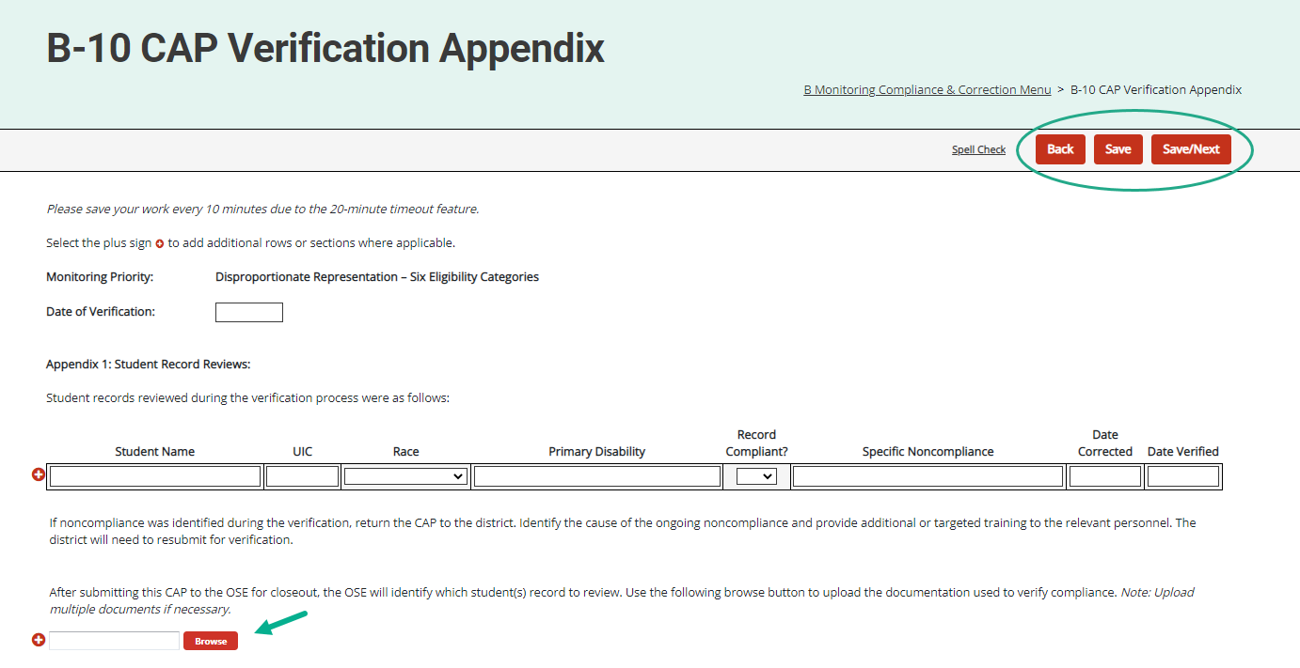
Monitoring CAP Verification Appendix
ISDs complete the verification appendix and upload supporting documentation.
Notes:
The verification process continues when the ISDs submits the CAP to MDE.
MDE reviews the verification, writes a comment on CAP Cover Page requesting supporting documentation and returns the CAP to the ISD.
ISDs will need to upload this supporting documentation on the Verification Appendix page using that browse button also shown on this screen and resubmit the CAP to MDE

Slide 36
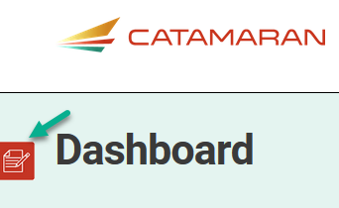
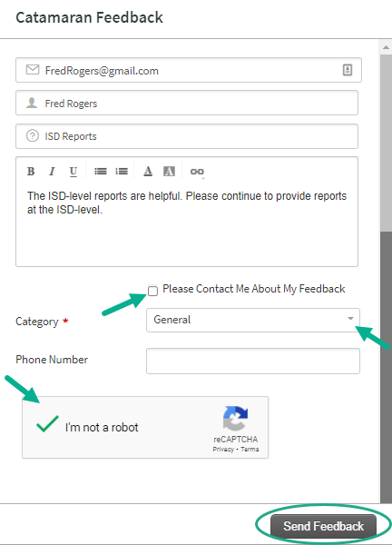
Feedback Feature
Feature available to offer feedback about Catamaran at any time.
Enter contact information.
Choose to be contacted about feedback.
Notes:
The next few slides I want to point out some of the continuing features.
On the left-hand side of any screen in the system you will find the feedback feature.
The OSE as well as our PSC partners appreciate your feedback related to the system.
If you wish to be contacted about your feedback you can enter contact information, and someone will reach out to you.
If you prefer to provide anonymous feedback, we would also like to hear from you. You do not need to leave your contact information.

Slide 37
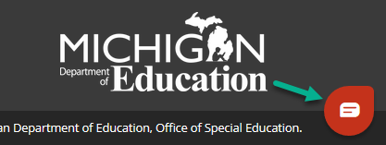
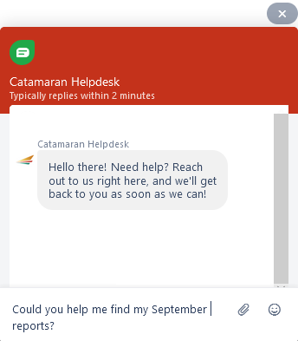
Chat Feature
The Catamaran Help Desk is available by chat during business hours.
Choose the Chat icon located in the lower right corner of the screen to begin a chat.
Enter basic information.
The issue will still be logged in the help desk database (just like a phone call).
Notes:
Another important feature to note is the chat feature. As you work through the system, you may find yourself in need of some support. Rather than going to look for a how to document on the technical assistance website, the Catamaran Help Desk is available for chats during regular business hours.
If you select the chat icon in the lower right corner of any screen, you can begin a chat session.
If you do choose to use the chat session, the help desk continues to log the issue so the OSE and our partners at PSC know where more training or support might be needed.

Slide 38
Use breadcrumbs to navigate
Use the breadcrumbs menu to navigate in Catamaran.
The breadcrumbs are a trail to follow back to a previous location.
Select the Catamaran logo to return to the Dashboard.
Notes:
Finally, I would like to remind you about navigating in catamaran.
Do not hit your browser BACK button after submitting work or changing a status.
Many web browsers become confused and will give you an error message, or as we have discovered recently, information thought to be deleted from a page, may not be deleted in the database which could cause issues, especially in CAPs. You will be much more successful if you use the breadcrumbs to navigate to previous pages.

Slide 39
Training Resources
Notes:
Even with the best of training, there may be questions that arise later as you use the system. There are a variety of resources available to support you.

Slide 40
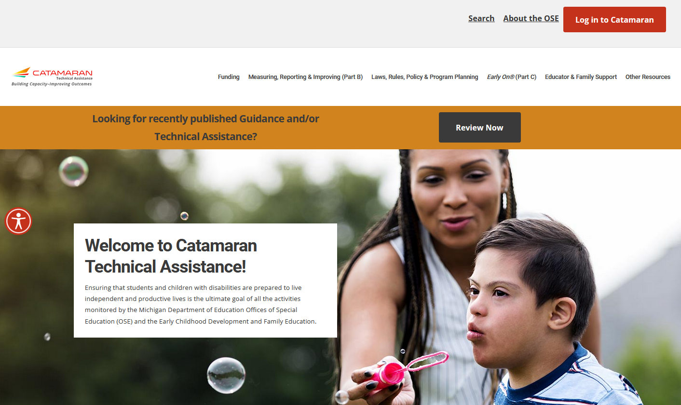
Catamaran Technical Assistance Website
Notes:
As many of you may already know, the revised Catamaran Training Website is now called the Catamaran Technical Assistance Website. The OSE in partnership with Catamaran users has redesigned the website to focus on increased technical assistance for Catamaran users.
The following slides highlight some of the features and navigation.
You can access the Catamaran Technical Assistance Website at training dot catamaran dot partners.

Slide 41
Catamaran Technical Assistance Website (2)
Notes:
As you scroll down the main landing page, you will see this section pictured here. It includes:
Documents the OSE is spotlighting,
Events and Deadlines (this is where the due dates are located now), and
Quick Links that you may find useful such as the MARSE or SPP.

Slide 42
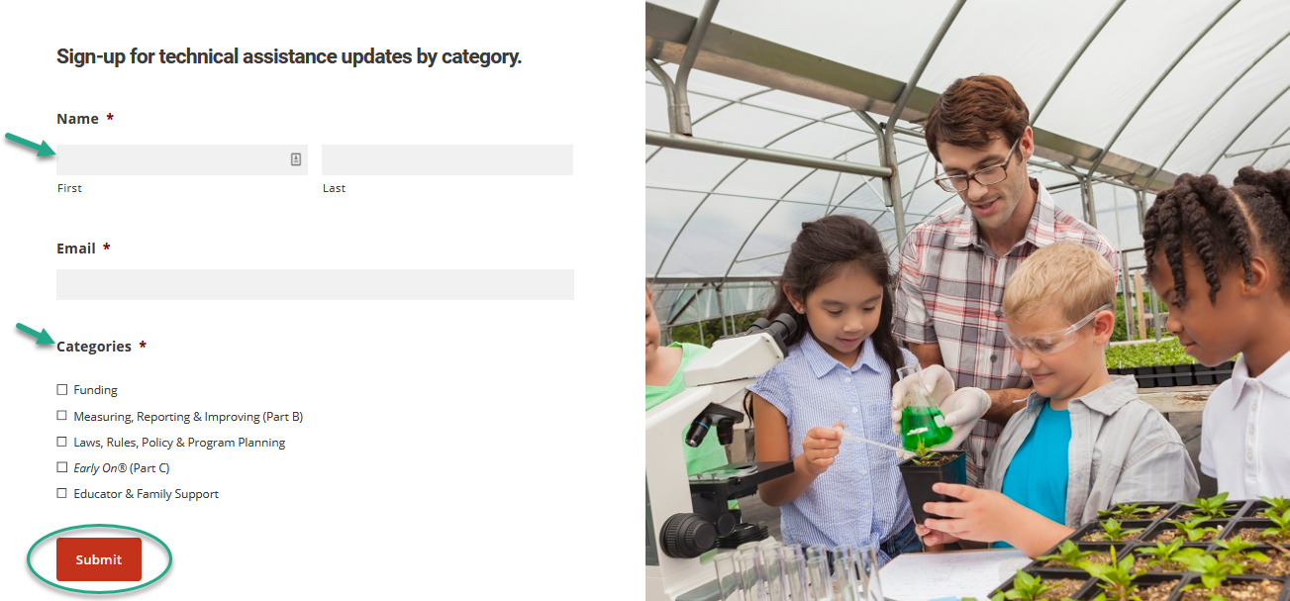
Technical Assistance Updates
Notes:
Website visitors may now sign up for notifications to be kept informed when new technical assistance content is available.
To access the form, from the home page of the site, scroll down and complete the form. Simply select the categories that you want to be kept up to date on and then submit.

Slide 43
Other Resources
Notes:
Catamaran how-to’s are now organized in one place under the Other Resources menu.
Search for how-tos either by selecting district or ISD under either Monitoring, Policy, or Finance or
By using the how-to search form. The next slide will show you how to use the search form

Slide 44
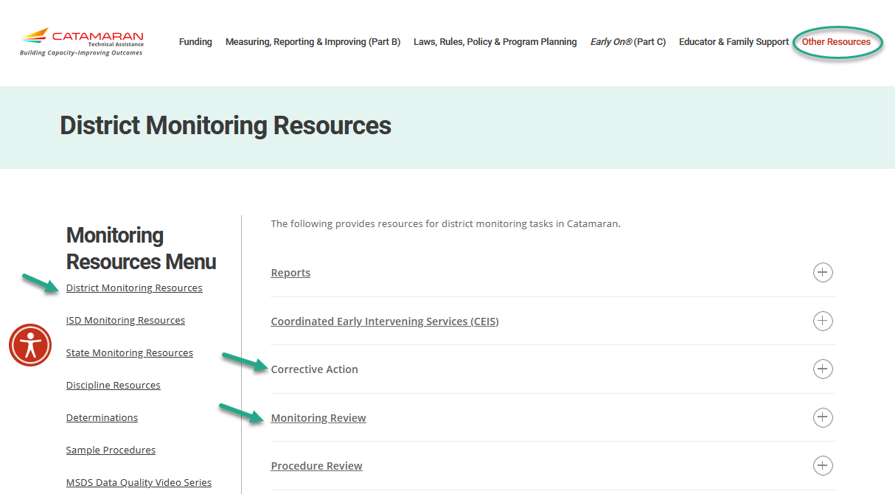
Monitoring Resources
Notes:
As a reminder, districts and ISDs have helpful resources available to them on the TA site.
To access the either the district or ISD monitoring resources pages, select Other Resources, and then choose the District Monitoring Resources link or ISD Monitoring Resources link under the Monitoring heading shown on the previous slide.
Here’s a screenshot of the District Monitoring Resources page.
Topics like Corrective Action and Monitoring Review are here. Select the plus sign on the right to expand the section and view specific resources.
To navigate away from this page, you may select
Any of the links under the Monitoring Resources Menu on the left
Select any of the topics listed above (e.g., Funding, Monitoring, etc.) or
Select the Catamaran logo in the upper left-hand corner to return to the main landing page

Slide 45
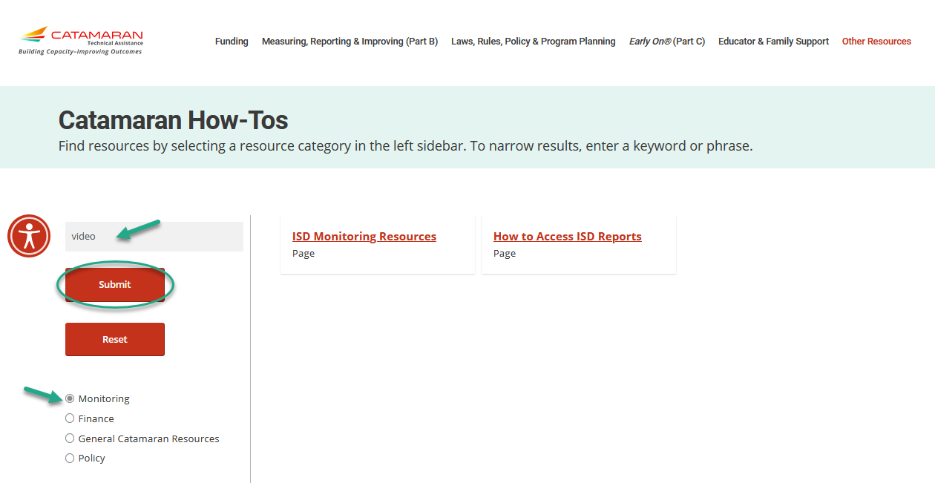
Catamaran How-tos
Notes:
In addition to finding how-to’s and other resources using the main categories under the Other Resources menu, website visitors may also use the Catamaran How-tos form.
Select the resource category from the left sidebar. If you wish to narrow your search results further, enter a keyword or phrase.
In this example, we selected Monitoring and then entered the word “Video”. This quickly narrowed the results to two pages that have the word “video” on them.

Slide 46
Navigating to Updated Indicator Resources
Notes:
OSE has been working over the last year to reformat the Part B Indicator pages. Rather than having to remember a specific indicator SPP number (e.g., B-1 or B-2), you only need look for the category (e.g., Graduation & Dropout). All topics which were previously listed as indicators are listed under the Measuring, Reporting, & Improving (Part B) menu located at the top of the TA site. To open the sub-menu with the list, select Measuring, Reporting & Improving (Part B) and the menu shown here will be displayed. To open a specific page, select the category, for example, Graduation & Dropout. Be careful when you move your cursor from the menu to the submenu. If you don’t move vertically, you may end up on another submenu.
With this update, we also updated the links to these pages too; however, some of you may have bookmarked the older links and that is okay. Not to worry, we are re-directing from the old links to the new ones.
The next slide shows a portion of the updated Graduation & Dropout page.

Slide 47
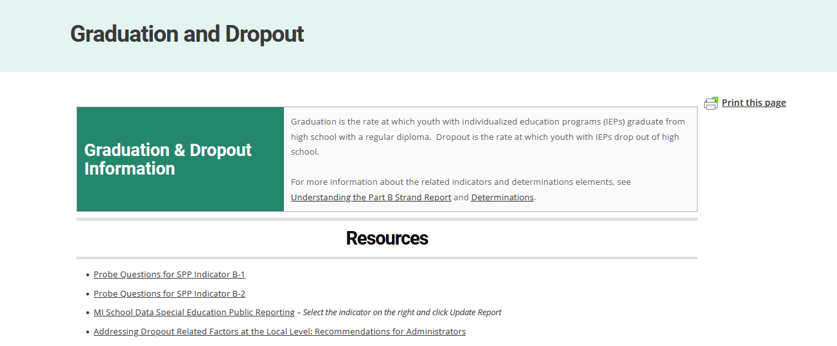
Updated Indicator Resources
Notes:
The example shown here is the Graduation and Dropout page. Each updated page has a brief description of the topic area along with several resource links. If the indicator is located on the Strand Report and/or Determinations, there will also be links to those pages as well.
Note, helpful content such as probe questions are still available along with newer content such as national resources.
We hope this re-organization and updated content will be useful to you.

Slide 48
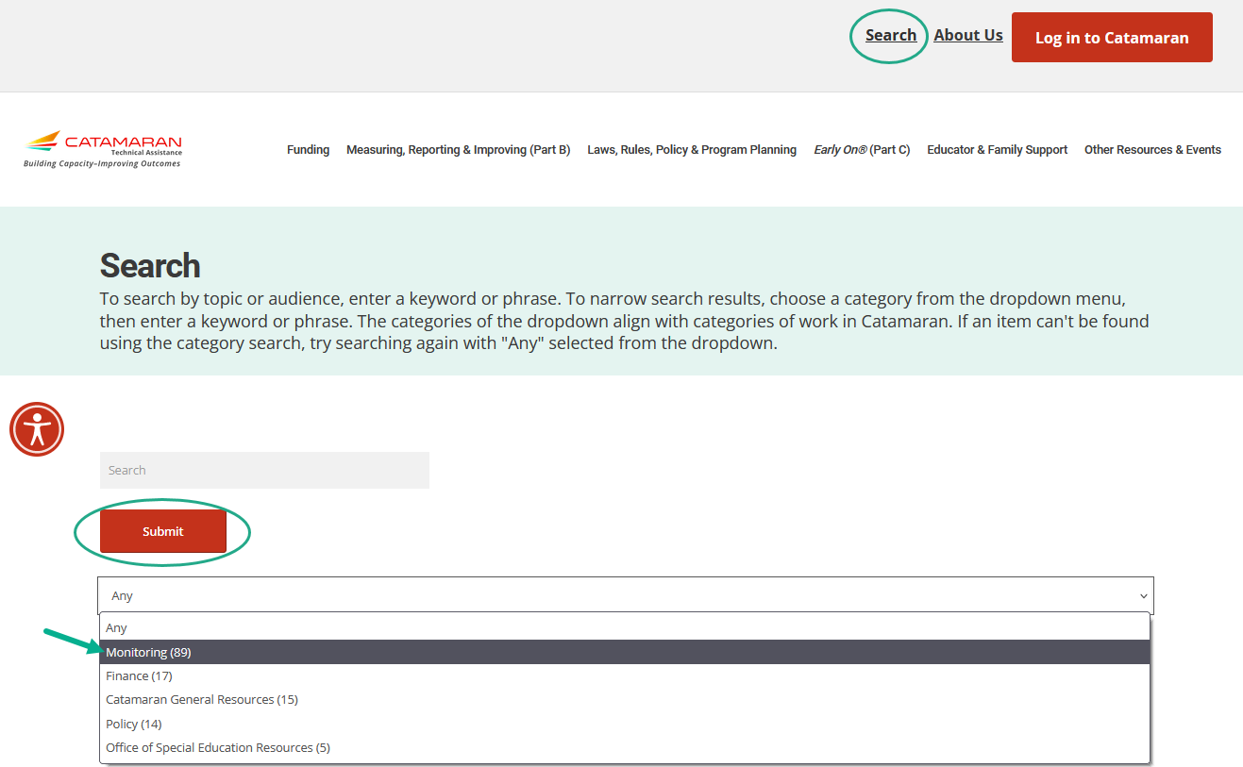
Search
Notes:
In addition to searching for Catamaran How-to’s, website visitors may also do an overall search of the website. To do this, select Search in the upper right-hand corner of the website and then using the provided drop-down menu, select your search category and choose Submit.
Just like on the Catamaran How-to form, you may also enter a key word or phrase to narrow your search results.
Content is continuously being updated and tagged to optimize search results.
I would encourage you to search for the word Assignments and get that map of which monitoring team member is assigned to which ISD. That resources has our contact information on there as well.

Slide 49
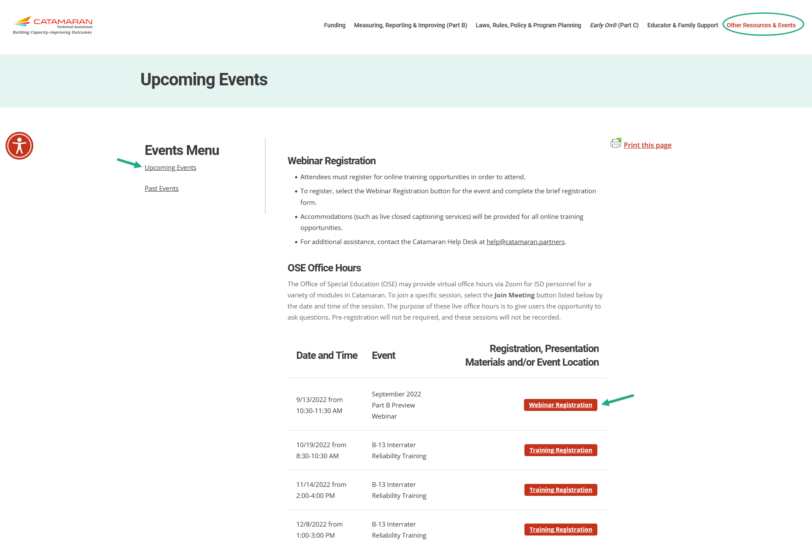
Events
Notes:
Finally, You may get to either the Upcoming Events or Past Events pages through the Other Resources menu or from the main landing page under the Events and Deadlines heading selecting either:
Register for Upcoming Events
View Past Event Recordings
Just as before you may
Register for upcoming events or
Access recordings and presentation materials from past events (including this webinar)
You will notice the B-13 Interrater Reliability Training sessions are now available too. If you wish to register for one of these sessions, you can do so today.

Slide 50
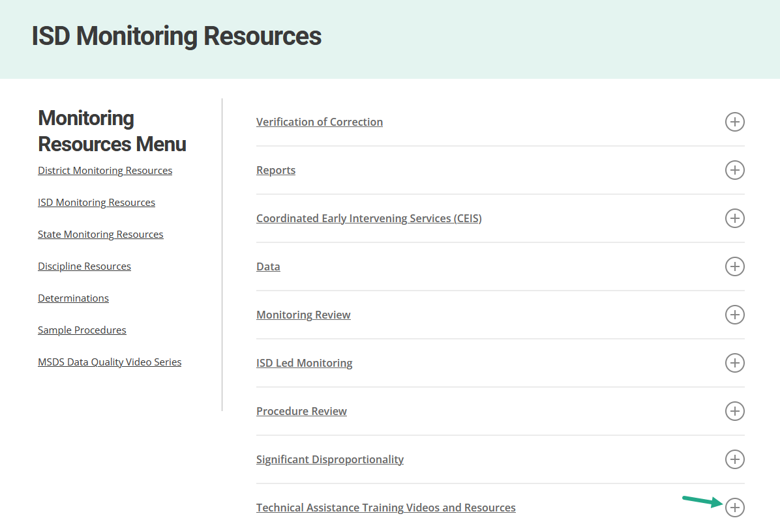
New to the ISD Representative Role?
Technical assistance videos and guidance documents are available.
Introduction to the role
Resources
Uncorrected Noncompliance (UNC) work
Catamaran Navigation and Reports
ISD Support Assignment
Notes:
Another source of information which new ISD representatives may find helpful can be found under technical assistance training videos and resources. You can navigate to this page from the other resources and events menu. When this sub menu appears under monitoring resources select ISD monitoring resources. At the bottom of that page you will find the technical assistance training videos and resources. On this page our videos and documents which will help new ISD representatives understand their role and complete their work in catamaran. One important document is the ISD support assignment handout. This document shows a map of the ISD‘s and provides contact information for the monitoring team member assigned to that ISD.

Slide 51
Questions?
Notes:
Use the chat feature in your webinar player to type in questions.

Slide 52
Contact MDE OSE
Presenters
Chantel Mozden mozdenC@michigan.gov
Kelly Kendrick-Miller KendrickMillerK@michigan.gov
MDE OSE Information Line
888-320-8384
mde-ose@michigan.gov

Slide 53
Contact the Catamaran Team
Catamaran Help Desk
877-474-9023
help@catamaran.partners
Project Director
Kelly Rogers
krogers@publicsectorconsultants.com
Senior Consultant
Lynne Clark
lclark@publicsectorconsultants.com
Notes:
Finally, questions concerning Catamaran,
Reach out to Kelly at krogers@publicsectorconsultants.com or Lynne at lclark@publicsectorconsultants.com
As a reminder,
The Catamaran Help Desk is available Monday through Friday from 8-5 PM.
Contact them by email at help@catamaran.partners or by phone at 877-474-9023 or by using the Chat feature within Catamaran.
This concludes presentation -- thank you for attending!

