Slide 1
Welcome!
The May 2022 Catamaran Preview webinar will begin in a few moments.
The webinar recording and presentation materials will be posted on the Catamaran Technical Assistance Website under Past Events (https://training.catamaran.partners/past-events/)
To communicate with the presenters during the webinar, use the Chat feature.
Closed captioning is available for this webinar. To select this option, choose the closed caption icon in the Zoom webinar player.

Slide 2
Zoom Webinar Control Panel
Mouse or tab down to the bottom of the webinar screen for the Zoom Webinar Control Panel to become visible.
Features available are:
Chat – select to communicate with presenters.
Closed Captioning (CC) – select the CC icon to turn on captions.
Leave – select to exit the webinar.
Notes:
Before we get started, I would like to highlight some features available on the Zoom Webinar Control Panel. Move your mouse or tab down to the bottom of the screen and you will find the chat feature which will allow you to communicate with the presenters. You can also select the CC icon to turn on captions and Leave will allow you to exit the webinar.

Slide 3
May 2022 Part B Catamaran Preview
For Districts and ISDs
Notes:
Welcome to the May 2022 Part B Catamaran Preview

Slide 4
Meet the Team
Office of Special Education (OSE)
Jessica Brady, Supervisor
Jeanne Anderson Tippett, Coordinator
Chantel Mozden, Coordinator
Shawan Dortch, Consultant
Tori Ranusch, Consultant
Charles Thomas, Consultant
Aaron Darling, Analyst
Public Sector Consultants (PSC)
Kelly Rogers, Project Director
Lynne Clark, Senior Project Manager
Notes:
Read slide to introduce team.

Slide 5
Agenda
May 2022 Catamaran Preview
Assigning B-13 work for Intermediate School Districts (ISDs)
Catamaran Navigation
Updates and Tips
Training Resources
Questions
Notes:
Read the agenda on the slide.

Slide 6
May 2022 Catamaran Preview

Slide 7
What’s Inside?
Reports
Strand Report
Monitoring Activities Report (MAR)
Reports and Letters of Findings
Monitoring Notification Letters
Closeout/Non-closeout Reports
State Complaint Reports
ISD Reports
Activities
Corrective Action Plans (CAPs)
B-4B, B-13, and Complaints
B-13 Corrective Actions
Student-level Corrective Action Plans (SLCAPs) for Complaints
B-9, B-10, B-IEP Monitoring and Procedure Reviews
Notes:
When you open Catamaran and acknowledge your reports, you will see a variety of things. The reports for districts include Strand Report, the Monitoring Activities Report (MAR), Letters of Findings, Monitoring Notification Letters, Closeout/Non-closeout Reports for CAPs and State Complaint Reports for any completed complaints this month. For ISDs there are Reports of the member districts’ data and notification summary reports.
The Activities for this release include Corrective Action Plans (CAPs) for B-4B, B-13, and State Complaints.
There are Corrective Actions for B-13.
There are Student Level Corrective Action Plans (SLCAP) for State Complaints as well as B-9 and B-10 Monitoring and Procedure Reviews.
Finally, there are B-IEP Monitoring and Procedure Review. B-IEP is a new monitoring activity this Spring. B-IEP refers to IEP implementation. The details surrounding the activity were shared with ISD directors during the April meeting.

Slide 8
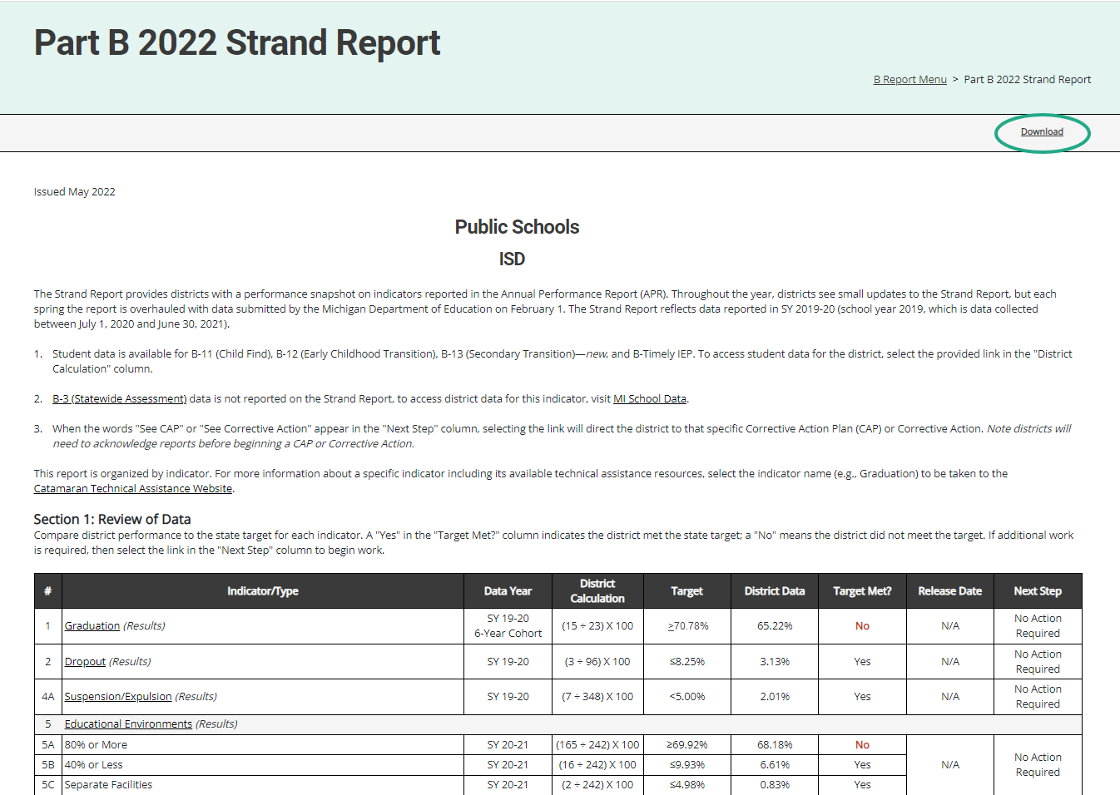
Strand Report
Summarizes district performance on the State Performance Plan (SPP) Indicators and priority areas.
When there is a CAP or Corrective Action, there will be a link in the Next Step column. Select the link to be taken to that specific item.
Use the Download link at the top of the screen to download a PDF.
Notes:
Here is an example of the Strand Report.
The Strand Report summarizes a district’s performance on the State Performance Plan indicators and priority areas.
We will dive into how to access your reports a little later in the webinar, but if you do have a CAP or Corrective action, you can select the See CAP or corrective action link in the Next Step column to be taken directly to that object.
You can use the download link at the top of the screen to save and then print a copy of your Strand Report to share with your administration, colleagues or RAP team if needed.

Slide 9
Monitoring Activities Report (MAR)
The MAR is included in every major release and provides important information to districts.
The MAR can be accessed from the Reports page.
Some messages are universal and go to all districts.
Some messages are targeted and are sent only to specific districts.
Reminders to review Reports and Letters of Findings
Notifications of monitoring activities
Notes:
The Monitoring and Activities report, or the MAR, can be accessed through the Reports page, which again, we will look at how to view and access the Reports page.
Some messages are universal and go to all districts, and some messages are targeted, and are sent only to specific districts, such as reminders to review Reports and Letters of Findings or reminders to review notification letters.

Slide 10
Sample MAR
Notes:
This screenshot includes a universal message asking users to ensure their authorized EEM user has the current information updated in that system. Catamaran uses the EEM for many functions so correct and current data is very helpful.

Slide 11
Reports and Letters of Findings/No Findings
B-4B (Rates of Suspension and Expulsion by Race/Ethnicity) Report of Findings
B-13 (Secondary Transition) Letter of Findings
B-Complaint Final Decisions
Notes:
Another set of reports are those related to completed monitoring activities. We recently completed the monitoring activities for B-4B so there will be reports of findings for each of those districts or ISDs which participated.
For the districts which participated in the B-13 data collection, there will be letters of findings if needed.
Finally, there will be final decision reports for any State complaint investigations that have recently been completed.

Slide 12
Closeout/Non-closeout Letters and Reports
Monitoring
Part B Desk Audits
B-4B (Suspension & Expulsion by Race/Ethnicity)
B-4AB (Suspension & Expulsion and Suspension & Expulsion by Race/Ethnicity)
B-13 (Secondary Transition)
State Complaints
Notes:
Additionally, you will find closeout/non-closeout reports and letters for:
Part B Desk Audit CAPs
B-4B/AB (Suspension & Expulsion and Suspension & Expulsion by Race/Ethnicity)
B-13 (Secondary Transition)
State Complaints

Slide 13
ISD Reports
Desk Audit Notifications
Member District Monitoring Notification Letter
Significant Disproportionality Notification
Personal Curriculum Counts (SY 2020-2021)
Member District Data Reports (B-4, B-5, B-6, and B-13)
Student Data Report of Member District Data (B-4, B-5, B-6, and B-13)
Notes:
In addition to the reports available to all districts, there are additional reports for ISDs. Those include monitoring notifications for desk audits for B-9 , B-10, B-IEP (IEP implementation) as well as a summary of member district notifications.
ISDs will be given a report which explains their significant disproportionality status. If response plans are needed for significant disproportionality, those will be available.
The personal curriculum counts by ISD, member district and building level will be available again this year.
ISDs will receive member district and student level data for indicators B-4, 5, 6 and 13. These are all reports which have been issued in the past.

Slide 14
Corrective Action Plans (CAPs)
All CAPs:
Have the same workflow and timelines for completion.
Describe system level correction.
Are verified as corrected by the ISD.
Include links to either:
Student Level Corrective Action Plans (SLCAPs) or
District Student Data Report (B-13)
Monitoring CAPs:
Issued following a monitoring activity
Include links to the report of findings
Complaint CAPs:
Issued each month as needed
Include link to the complaint final decision

Slide 15
B-13 Corrective Action
Addresses noncompliance at the provider level.
District submits to ISD for verification by February 1.
ISDs submit to MDE for closeout by March 1.
Verification includes a review of student files from the provider or interview, if no student files are available.

Slide 16
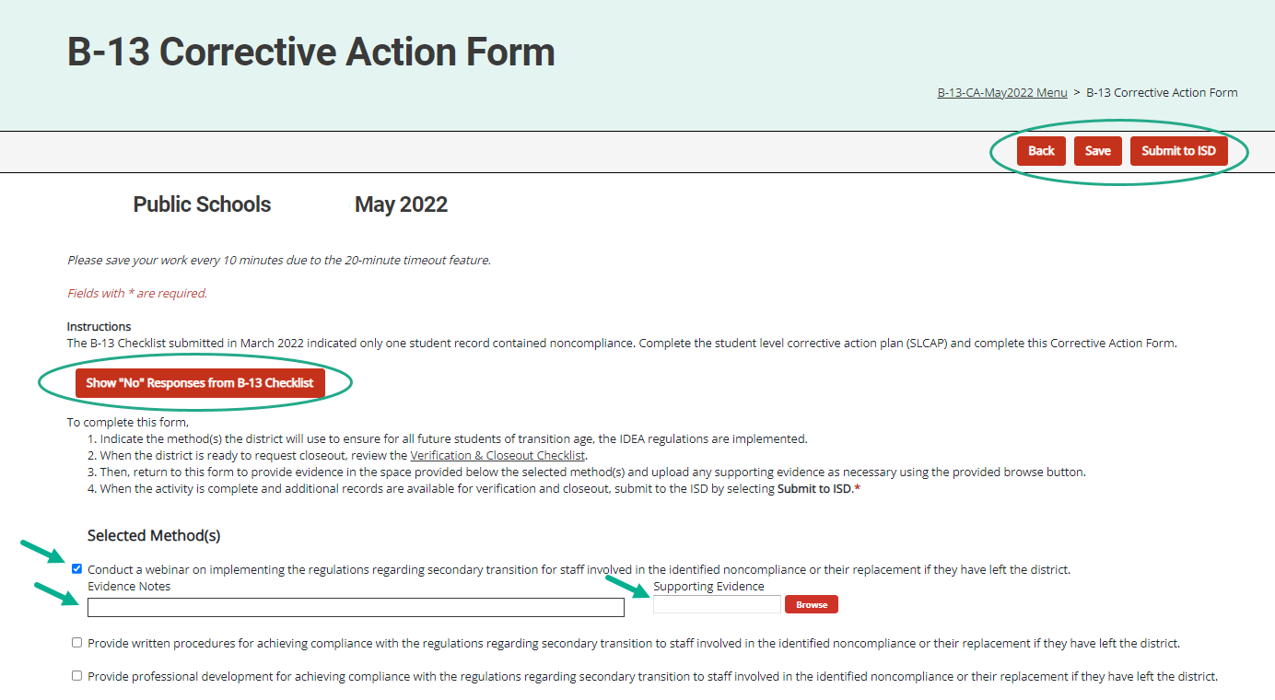
Corrective Action Form (District View)
Notes:
Districts select the method(s) they will complete and save the page. Return to this page after those method(s) have been implemented to enter evidence notes and upload any supporting documents in the space(s) provided.
When complete, districts may submit to the ISD either from the Corrective Action Form or from the Corrective Action Cover page.
**For B-13 Only**
Select the “Show “no” Responses from B-13 Checklist” button on the page to view the questions that were marked with a “no”.

Slide 17
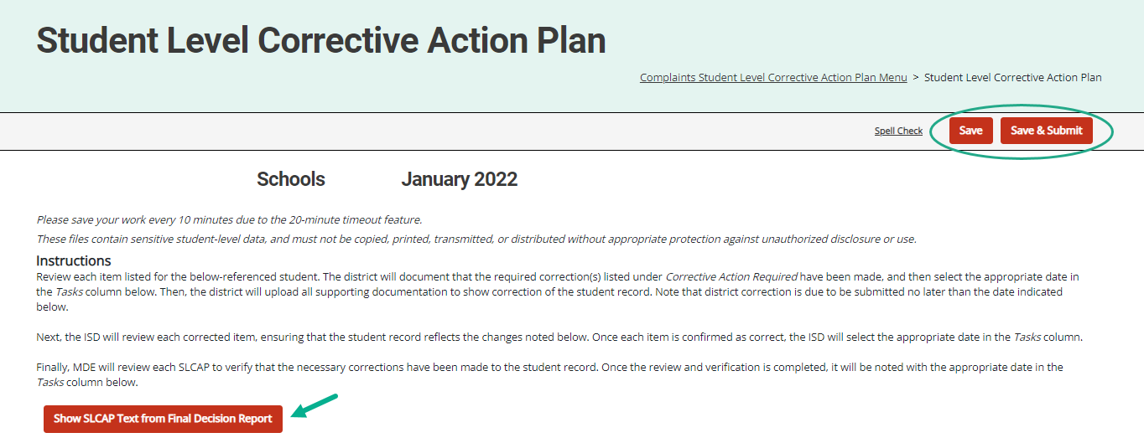
Student Level Corrective Action Plans
Notes:
SLCAPs correct individual student level noncompliance. They are due within 30 school days
SLCAPs Are verified as corrected by the ISD and reviewed by the OSE.
Each individual SLCAP must be closed before the CAP or corrective action is closed
The example shown here is highlighting a link from a Complaint SLCAP to the more explicit language of the final decision.
All B-13 SLCAPs will be due June 1 and B-4B/B-4AB SLCAPs will be due 30-school days from the date of review.

Slide 18
Assigning B-13 CAPS, Corrective Action and SLCAPs
For ISDs
Notes:
Since the September 2019 release, individuals at the ISD in the ISD Monitor user role in Catamaran have been able to assign the verification of B-13 work (CAPs, Corrective Actions, and SLCAPs) to other ISD personnel as warranted. The next few slides describes how to do this.
Since there are significantly fewer B-13 CAPs, Corrective Actions, and SLCAPs this year, you may not even need to use this process. We will go through the process but there is also a How To document available on the technical assistance site.

Slide 19
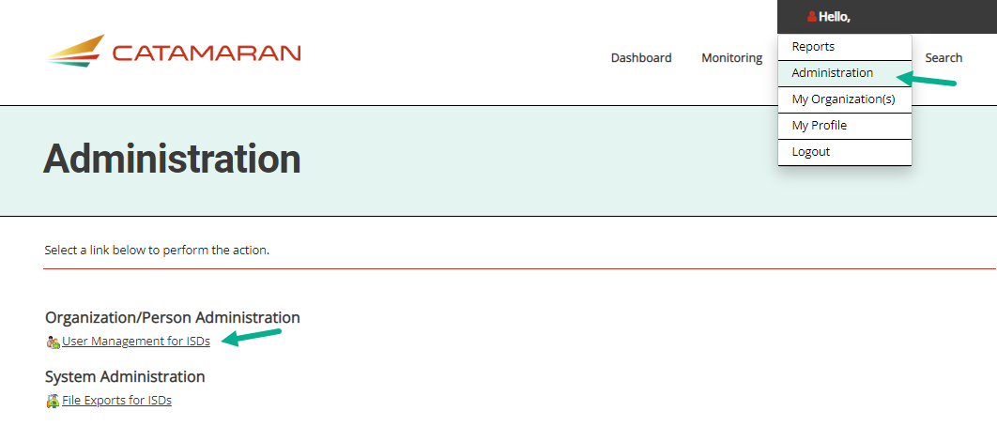
Access the User Management Page
Notes:
If you want to assign the review of B-13 SLCAPs, CAPs or CAs to other ISD personnel, the first step is to Log into Catamaran.
Choose Administration from the dropdown menu beneath your name in the upper right-hand corner
Select User Management for ISDs

Slide 20
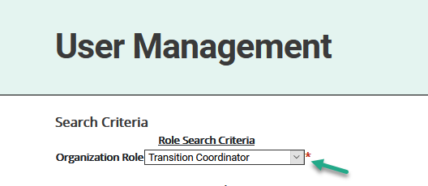
Select Current User Role
Select the current role of the individual from the Organization Role menu (e.g., Transition Coordinator).
Notes:
You will then select the current role of the individual from the Organization Role menu (e.g., Transition Coordinator).

Slide 21
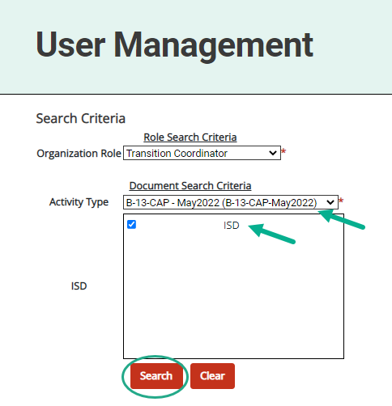
Select Activity Name
Select the activity name from the Activity Type menu.
Choose Search.
Notes:
You will then select the activity name from the Activity Type menu such as:
B-13 CAP – May 2022
B-13 Corrective Action – May 2022
B-13 SLCAP – April 2022
Once the Activity Type has been selected, choose Search.

Slide 22
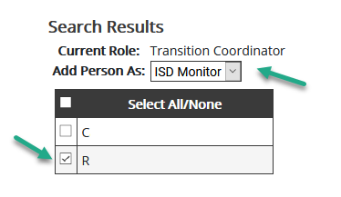
Select ISD Monitor Role
Next, select ISD Monitor from the Add Person As menu.
Notes:
Next, select ISD Monitor from the Add Person As Menu.

Slide 23
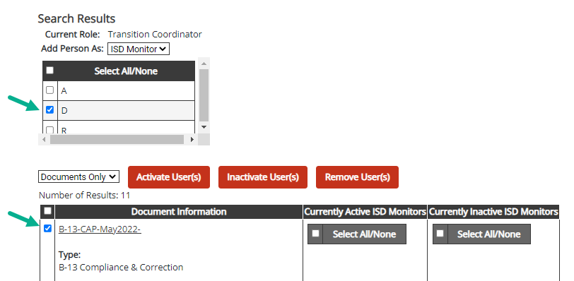
Select Name and Activity
Select the name of the individual from the user list.
Select the activity by checking the box next to the activity name.
Notes:
Select the name of the individual from the user list (see first arrow in screenshot).
Then select the activity you would like the individual assigned to by checking the box next to the activity name.

Slide 24
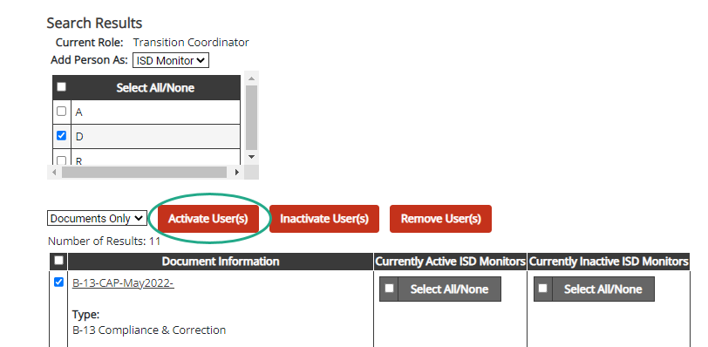
Activate User
Select Activate User.
Notes:
Finally, click Activate User to complete the assignment process.
If an individual is incorrectly assigned, repeat the same process above, but instead select Inactivate User(s) or Remove User(s). This action will remove that individual from the specific activity, but not from Catamaran.
For additional assistance, contact the Catamaran Help Desk.
This process Does not assign the individual to the ISD as an ISD Monitor
Assigned only to the selected activity as an ISD Monitor
Allows the individual to complete verification activities for the selected activity
The current ISD Monitor will continue to retain the same rights and privileges as an ISD Monitor on the activity.
Both the newly assigned individual and the current ISD Monitor will continue to have the activity on their tasks overview, where applicable.
STOP HERE FOR QUESTIONS

Slide 25
Catamaran Navigation
Notes:
For all our new users and those of you who are occasional users, let’s take a closer look at navigating in Catamaran.

Slide 26
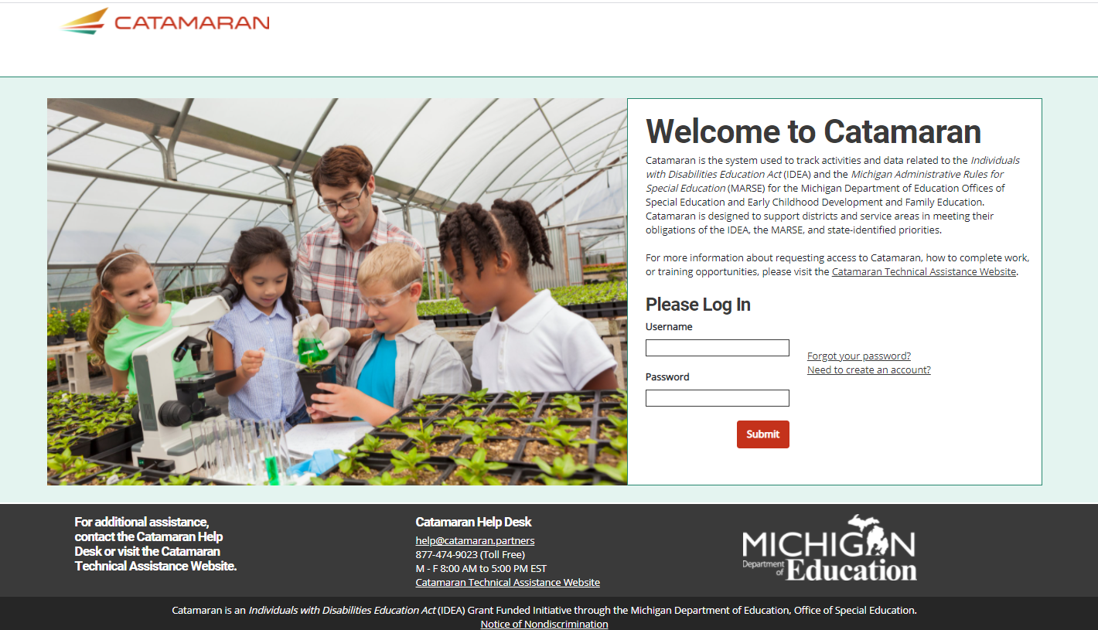
Login
https://catamaran.partners
Notes:
Note the letter S after http, the S means this is a secure site. It does contain student level information and so passwords should not be shared. Occasionally, districts and ISDs may want to review the Organization member list to verify it is up to date. If any staff at the district or ISD no longer needs access to Catamaran, please contact the Help Desk to end their system access.

Slide 27
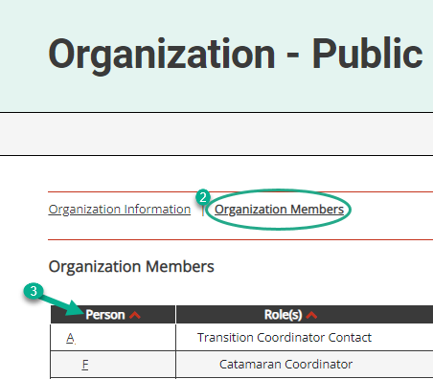
Review Organization Member Names
To review organization member names within Catamaran:
Log in and locate the Tasks Overview.
Select the organization’s name in the Organization column.
Select the Organization Members link from the Organization page.
Review the list. If changes are needed, contact the Catamaran Help Desk for assistance.
Notes:
With the beginning of a new year, please take some time to review organization member names within Catamaran:
To do so, log in and locate the Tasks Overview
Select the organization’s name in the Organization column.
Select the Organization Members link from the Organization page.
Review the list. If changes are needed, contact the Catamaran Help Desk for assistance.
Another reason to view this page, especially for new users is to find out who else in your organization has a Catamaran role. That person or people may be able to help you along as you begin to navigate Catamaran.

Slide 28
View Reports
View available reports on the Tasks Overview at the bottom of the Dashboard.
Select the link in the Activity column (for example, B Report) to access the Reports page.
Notes:
Let’s dive into how to access, view and acknowledge reports. Also, please note that there is a How to document on the Catamaran Technical Assistance website that outlines how to acknowledge reports step by step.
When logging in, B Reports will be populated on the Tasks Overview. Select the link in the Activity column (for example, B Report) to access the Reports page.
Note: If you have previously applied a filter to the Tasks Overview, it may also be necessary to clear filters before applying a new one. As a reminder, you can narrow tasks down, by applying a filter such as Release, Type, or Organization.

Slide 29
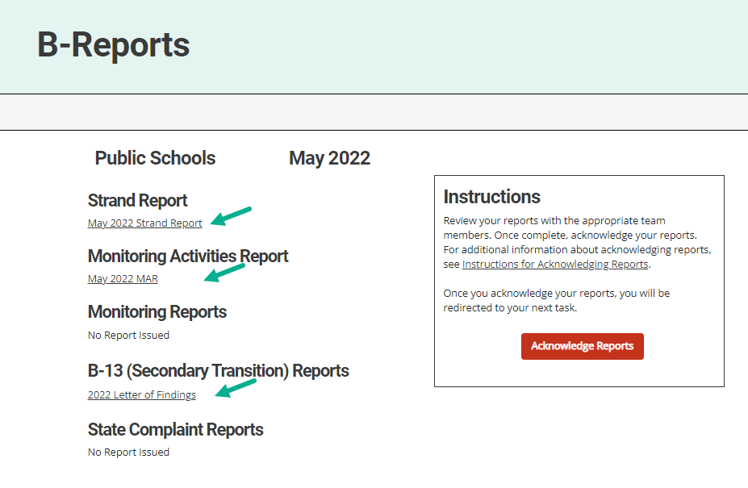
Access Reports
On the Reports page, select any report link to view that report.
Review and share the reports with appropriate team members.
Notes:
Once you reach the Reports page, you can select any report link to view that report.
Then, you can review, print, and share the reports with appropriate team members

Slide 30
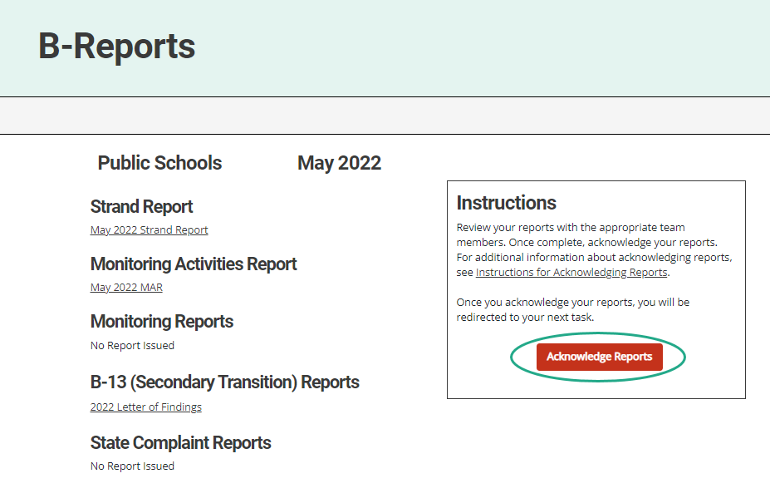
Acknowledge Reports by June 15
Acknowledge the reports by clicking on the red Acknowledge Reports button on the Reports page.
Note: When the reports have been acknowledged, additional tasks will become available as appropriate (such as a CAP or Corrective Action).
Notes:
Reports must be acknowledged by June 15.
To acknowledge reports, select the red Acknowledge Reports button on the Reports page.
Once reports are acknowledged, the district will be returned to the Dashboard where any additional tasks such as a CAP will be become available. You may need to clear any previous set filters on the Tasks Overview to see any new tasks. If there are no additional tasks, then a message of “You have no tasks to view” will appear in the place of the Tasks Overview list.

Slide 31
After Acknowledging Reports
Work cannot be completed in Catamaran until reports have been acknowledged.
What to do after acknowledging reports:
Review Reports page –Does my district have findings?
Review Strand Report –What are the next steps?
Review MAR.
Decide whether the district should convene a Review and Analysis Process (RAP) Team.
Notes:
New work which has been issued in this release can not be completed in Catamaran until reports are acknowledged. In fact, the work is not even visible in Catamaran until the reports are acknowledged.

Slide 32
Complete Tasks with RAP Team as needed
Check the Tasks Overview or the Strand Report to see if the district has a CAP or Corrective Action.
When there is a CAP or Corrective Action, convene a RAP Team to work through the activity.
Suggested RAP Team members include:
District and ISD personnel such as special and general education administrators
School improvement team representative
Parents
Service providers including general or special education teachers
Data experts or program specialists
Notes:
After sorting through and sharing the information, you’ll need to see if you have a CAP or Corrective Action to work on. You can check your Tasks Overview on the Dashboard (remember to clear any filters before applying a new one) or take another look at the Stand Report to see if you do indeed have a CAP or Corrective Action.
If you do, you need to convene a RAP Team to work through the CAP/Corrective Action.
Important note: if you have a Complaint CAP, it will not be listed on your Strand Report. You will need to check the Tasks Overview for Complaint CAPs.

Slide 33
Access System Reports
Hover over the user’s name.
Select Reports from the drop-down menu.
Notes:
For ISD personnel who want to see all the work of their member districts when the release happens, there is another report which they can run so see all the work of their districts even before the districts have all acknowledged their reports.
If you hover your cursor over your name on the upper right side of the screen, you will get a dropdown menu. Select Reports to access system level reports, these are different from the other reports such as the Strand report which are district specific.

Slide 34
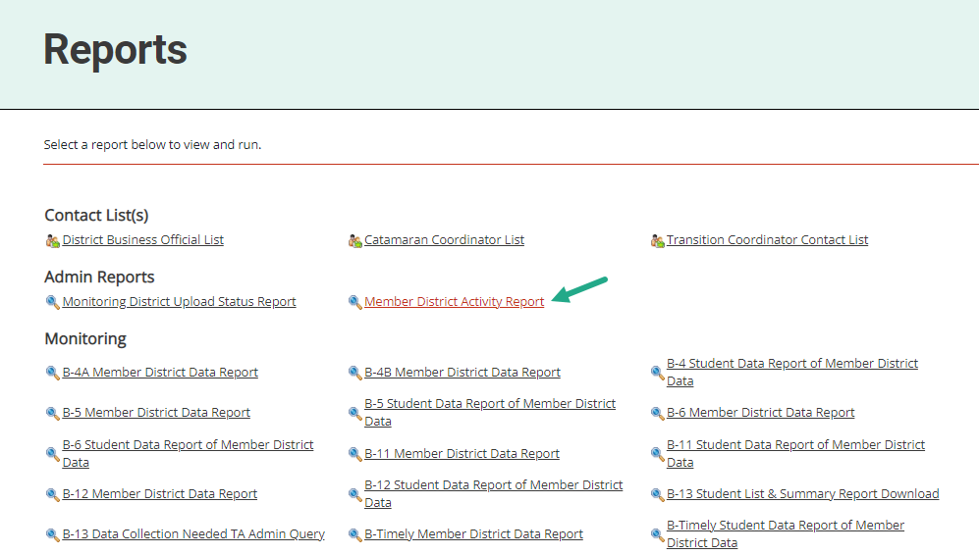
Access Member District Activity Report
Under the topic Admin Reports
Select Member District Activity Report
Notes:
If you have not been to this page, I encourage you to come to this when you have some time. There are many valuable resources here with several years of data. For today, look under the heading of Admin Reports for the Member District Activity Report and click on it.

Slide 35
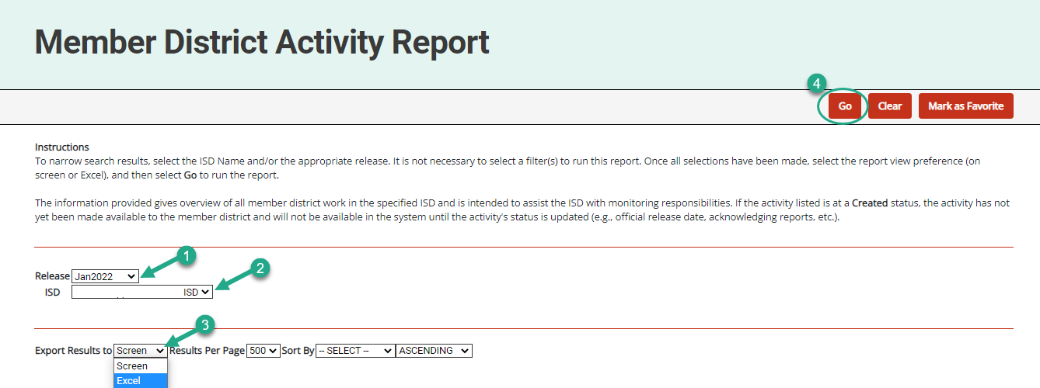
Run Member District Activity Report
Select the
Release
ISD
Format
Choose Go
Notes:
From the Member District Activity Report, you can select the Release, in this case, you will want Jan 2022. Select your ISD, the type of report you want, and then click Go. This will provide ISD users the full list of activities that are being issued to your member districts. You can see, immediately, the work that is being issued.

Slide 36
Updates and Tips
Notes:
Ask any questions and review the chat.
We will now detail monitoring updates and catamaran tips.

Slide 37
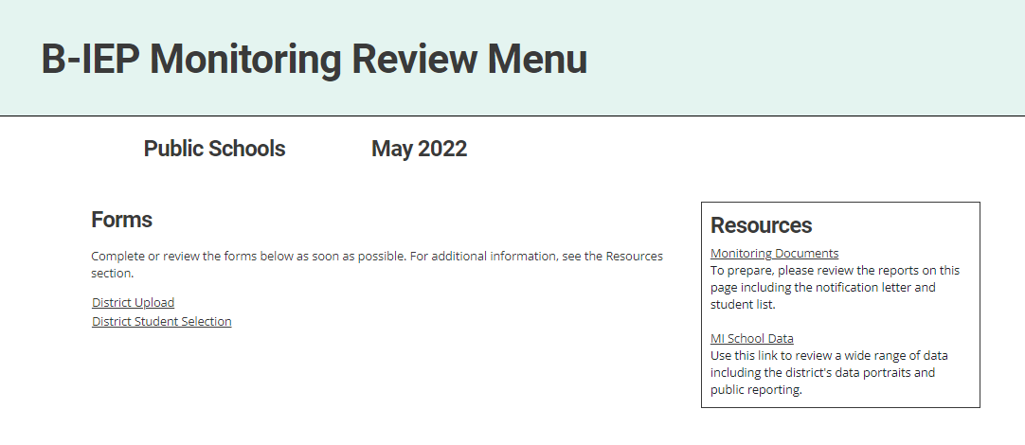
B-IEP Monitoring Review
Notes:
A new monitoring activity was added to the release titled B-IEP. The B-IEP activity will monitor selected districts on their IEP implementation practices and procedures. The districts will be selected for the B-IEP monitoring activity as part of the State’s general supervisory responsibilities to ensure that all districts in the State provide a FAPE to the students with an IEP that meets the requirements of the IDEA and the State’s educational standards. The next few slides will detail the catamaran pages providing direction on documents to upload and what to complete for each section.

Slide 38
Before the Review: Upload Procedures
On the District Upload page, upload the written related district procedures using the Browse button.
If the district does not have written procedures, then check the Not Available box at the bottom of the page to certify procedures are unavailable.
Choose the Save or Save/Next button to confirm and save the upload.
Notes:
The district will upload any procedures related to IEP implementation including times when modality of instruction changed. A few examples of modality of instruction changing could include:
District changing to virtual instruction for all students due to COVID-19
District changing to hybrid instruction for all students due to COVID-19
Classroom changed to virtual instruction for students due to quarantine guidelines.
A student changing to virtual instruction due to quarantine guidelines.
If the district does not have any procedures, then they will need to select “not available” and save the page. The procedures will need to be uploaded by May 27th, 2022.

Slide 39
Before the Review: Verify Current Students
Districts will receive a list of students to verify in Catamaran.
Click the District Student Selection link to access the page.
Review the student list and verify which students are currently enrolled in the district by checking the box next to the student’s name.
Click Verified Students to submit the verified student list.
Notes:
Prior to the visit the district must identify students who are currently enrolled in their district.
From the Monitoring Review Menu, choose District Student Selection to see a list of students.
Review the list and indicate students who are currently enrolled in the district by clicking the box to the left of each student’s name.
When finished identifying enrolled students, click verified students located at the top right side of the page to submit your list.
Once Verified Students is selected, the district will only be able to view the activity and will not be able to upload any other procedures or make changes to this list of students.

Slide 40
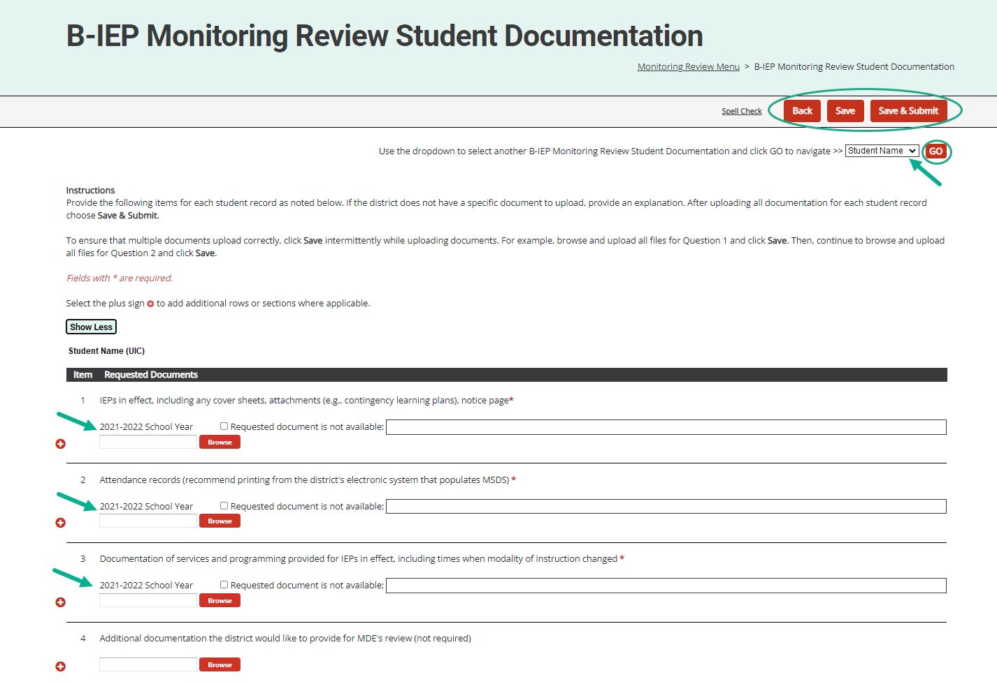
Student Documentation
Notes:
The district will provide the following items for each student record. If the district does not have a requested document to upload, provide an explanation. After uploading all documentation for each student record choose Save & Submit.
IEPs in effect, including any cover sheets, attachments (e.g., contingency learning plans), and notice pages.
Attendance records. It is recommended to print the records from the district’s electronic system that populates MSDS.
Documentation of services and programming provided for IEPs in effect, including times when modality of instruction changed. This could include service log documentation, student schedule, and/or accommodation logs.
The three items listed are required for upload.
The district can upload any additional documentation that they would like to provide for MDE’s review, but this is not required.

Slide 41
Updated CAP Activity or CAP Finding Page
Question 3 was updated to allow users to remove rows, as needed.
To remove a row, check the Delete box next to that row and choose Save.
Updated information will populate onto the following pages.
Notes:
For both the CAP Activity or CAP Finding pages, we have updated the activity step question (question 3) to allow users to delete a row without having to back out any information.
To remove a row, simply check the Delete box next to that row and choose Save. The unwanted row will be removed from the page.
This will make it easier to update the CAP Activity/Finding page should the CAP be returned for modifications. Thus, ensuring the correct activity steps are then populated onto the following pages (e.g., Progress Report, etc.).

Slide 42
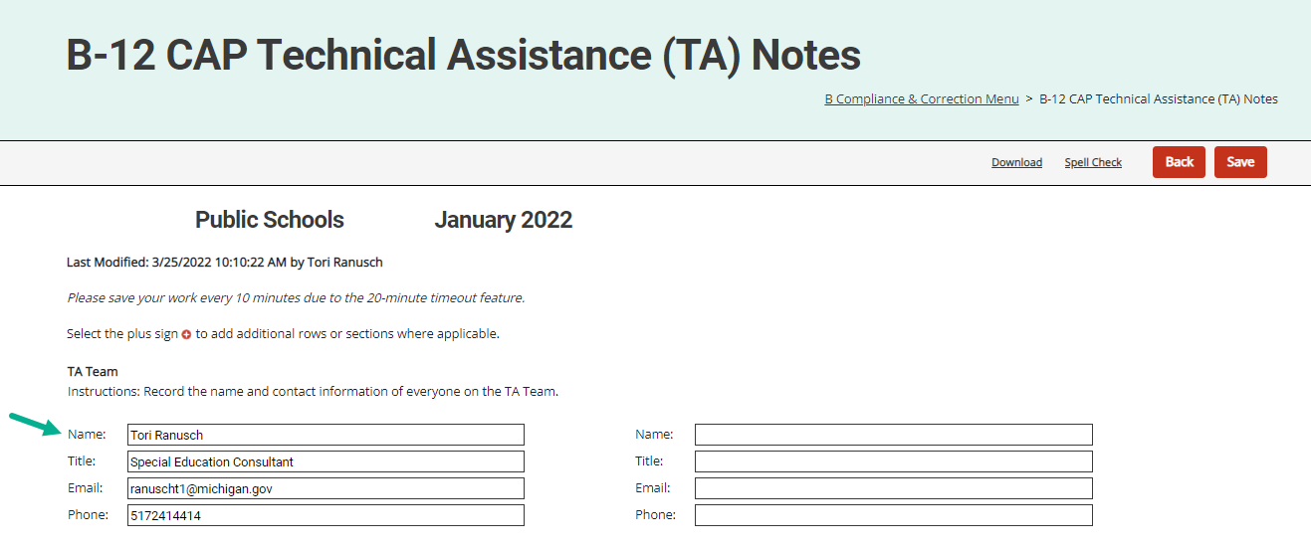
MDE OSE Primary Reviewer in TA Notes
Notes:
We were asked how an ISD can determine which MDE OSE MTAT team member has been assigned as the primary reviewer. MDE OSE Monitoring Technical Assistance Team member will add their name in the TA notes for the Corrective Action and/or Corrective Action Plans to which they have been assigned as primary reviewer.
It is important to note that the TA notes can only be viewed by ISD level catamaran users.

Slide 43
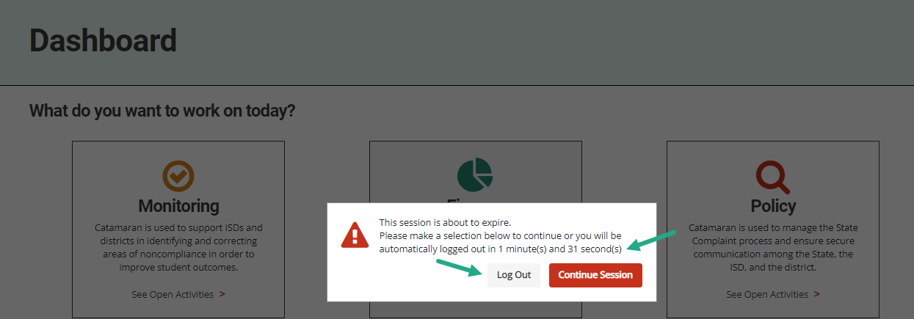
Updated Timeout Feature
Notes:
The timeout feature has recently been updated in Catamaran. This update:
Provides clarity so all users know exactly what will happen due to inactivity and to avoid log out if desired.
Provides an option to either save and logout or to continue your session.
Provides a better countdown timer so a user understands how much time they have left before being logged out.

Slide 44
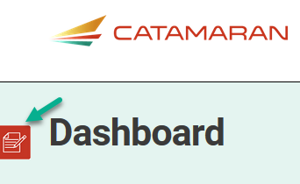
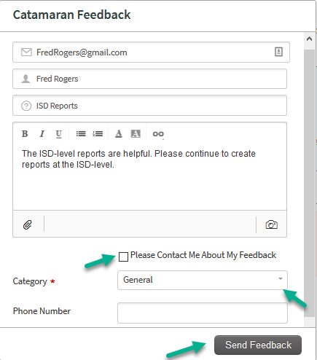
Feedback Feature
Feature available to offer feedback about Catamaran at any time.
Enter contact information.
Choose to be contacted about feedback.
Notes:
Those are the updates we have made to the system from our last major releases. And the next few slides I want to point out some of the continuing features. On the left-hand side of any screen in the system you will find the feedback feature. The OSE as well as our PSC partners appreciate your feedback related to the system.
If you wish to be contacted about your feedback you can enter contact information, and someone will reach out to you.
If you prefer to provide anonymous feedback, we would also like to hear from you. You do not need to leave your contact information.

Slide 45
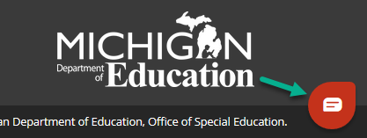
Chat Feature
The Help Desk is available by chat during business hours.
Choose the Chat icon located in the lower right corner of the screen to begin a chat.
Enter basic information.
The issue will still be logged in the Help Desk database (just like a phone call).
Notes:
Another important feature to note is the chat feature. As you work through the system, you may find yourself in need of some support. Rather than going to look for a how to document on the technical assistance website, the help desk is available for chats during regular business hours.
If you select the chat icon in the lower right corner of any screen, you can begin a chat session.
If you do choose to use the chat session, the help desk continues to log the issue so the OSE and our partners at PSC know where more training or support might be needed.

Slide 46
Use breadcrumbs to navigate
Use the breadcrumbs menu to navigate in Catamaran.
The breadcrumbs are a trail to follow back to a previous location.
Select the Catamaran logo to return to the Dashboard.
Notes:
Finally, I would like to remind you about navigating in catamaran.
Do not hit your browser BACK button after submitting work or changing a status.
Many web browsers become confused and will give you an error message. You will be much more successful if you use the breadcrumbs to navigate to previous pages.

Slide 47
Training Resources
Notes:
Even with the best of training, there may be questions that arise later as you use the system. There are a variety of resources available to support you.

Slide 48
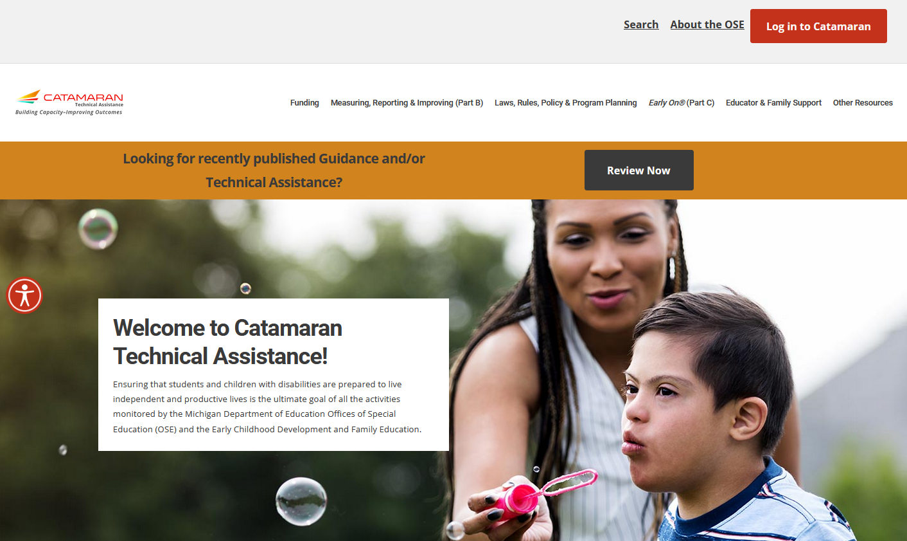
Catamaran Technical Assistance Website
Notes:
As many of you may already know, the revised Catamaran Training Website is now called the Catamaran Technical Assistance Website. The OSE in partnership with Catamaran users has redesigned the website to focus on increased technical assistance for Catamaran users.
The following slides highlight some of the features and navigation.
You can access the Catamaran Technical Assistance Website at training dot catamaran dot partners.

Slide 49
Catamaran Technical Assistance Website (2)
Notes:
As you scroll down the main landing page, you will see this section pictured here. It includes:
Documents the OSE is spotlighting,
Events and Deadlines (this is where the due dates are located now), and
Quick Links that you may find useful such as the MARSE or SPP.

Slide 50
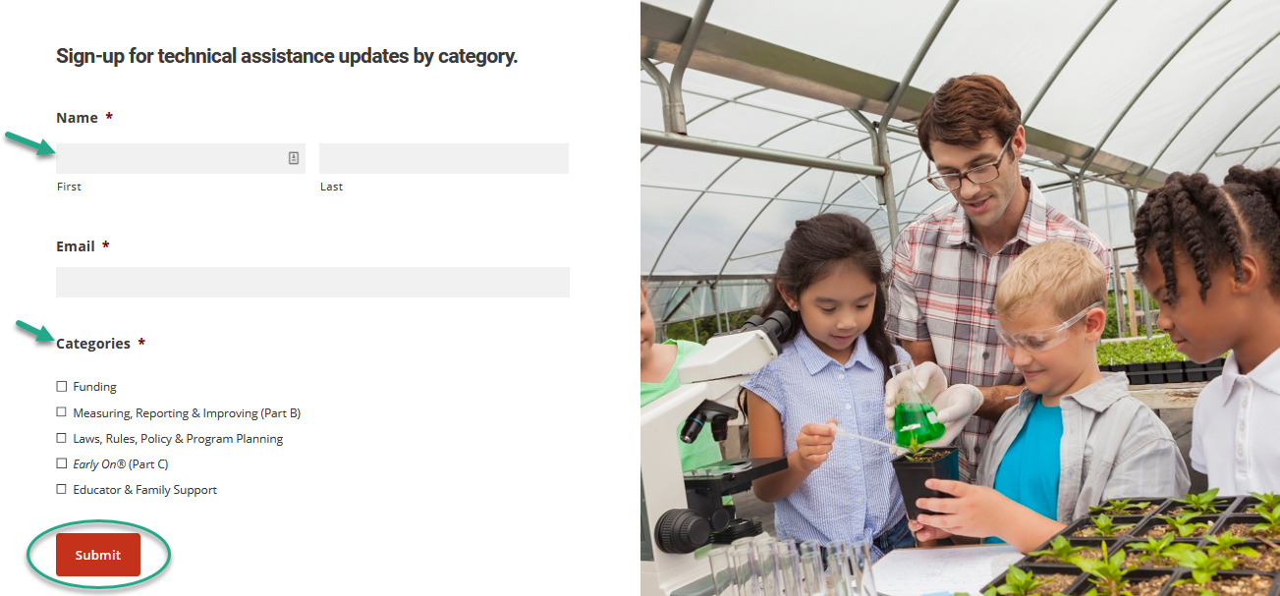
Technical Assistance Updates
Notes:
Website visitors may now sign up for notifications to be kept informed when new technical assistance content is available.
To access the form, from the home page of the site, scroll down and complete the form. Simply select the categories that you want to be kept up to date on and then submit.

Slide 51
Other Resources
Notes:
Catamaran how-to’s are organized in one place under the Other Resources menu.
Search for how-tos either by selecting district or ISD under either Monitoring, Policy, or Finance or
By using the how-to search form. The next slide will show you how to use the search form

Slide 52
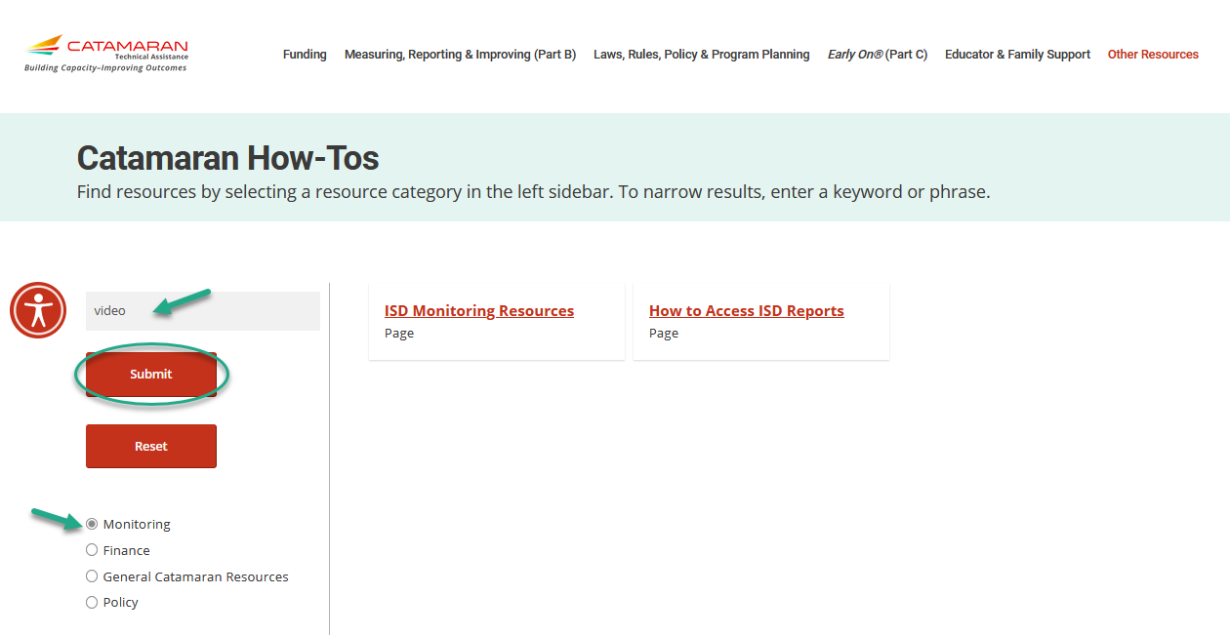
Catamaran How-tos
Notes:
In addition to finding how-to’s and other resources using the main categories under the Other Resources menu, website visitors may also use the Catamaran How-tos form.
Select the resource category from the left sidebar. If you wish to narrow your search results further, enter a keyword or phrase.
In this example, we selected Monitoring and then entered the word “Video”. This quickly narrowed the results to two pages that have the word “video” on them.

Slide 53
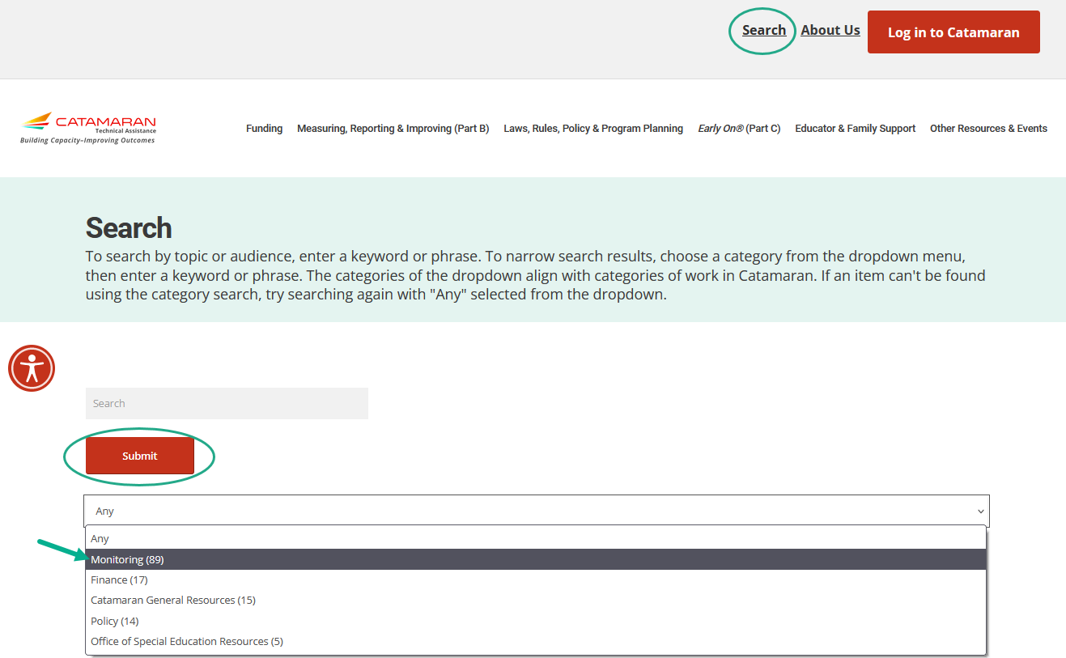
Search
Notes:
In addition to searching for Catamaran How-to’s, website visitors may also do an overall search of the website. To do this, select Search in the upper right-hand corner of the website and then using the provided drop-down menu, select your search category and choose Submit.
Just like on the Catamaran How-to form, you may also enter a key word or phrase to narrow your search results.
Content is continuously being updated and tagged to optimize search results.
I would encourage you to search for the word Assignments and get that map of which monitoring team member is assigned to which ISD. That resources has our contact information on there as well.

Slide 54
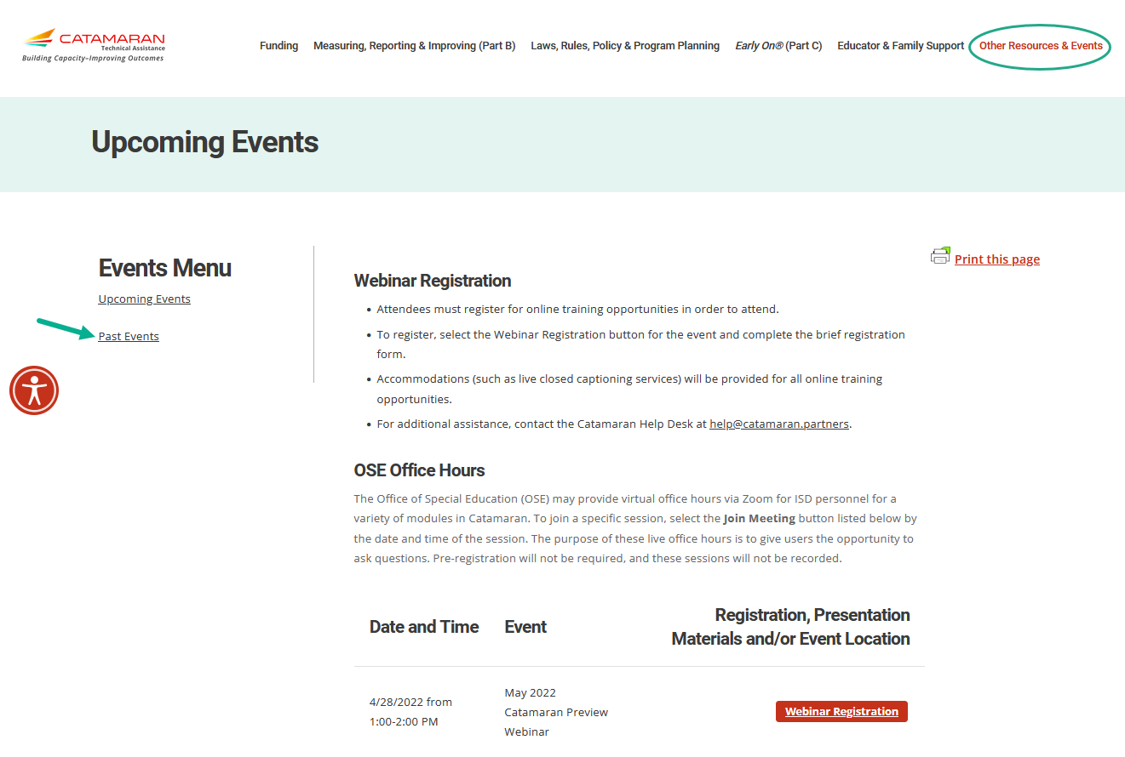
Events
Notes:
Finally, You may get to either the Upcoming Events or Past Events pages through the Other Resources menu or from the main landing page under the Events and Deadlines heading selecting either:
Register for Upcoming Events
View Past Event Recordings
Just as before you may
Register for upcoming events or
Access recordings and presentation materials from past events (including this webinar)
When we schedule the office hours for Valid and Reliable Data Alerts you will see those listed here.

Slide 55
Questions?
Notes:
Use the Q&A chat feature on the webinar to type in questions.

Slide 56
Contact MDE OSE
Presenters
Chantel Mozden mozdenC@michigan.gov
Tori Ranusch RanuschT1@michigan.gov
MDE OSE Information Line
888-320-8384
mde-ose@michigan.gov

Slide 57
Contact the Catamaran Team
Project Director
Kelly Rogers
krogers@publicsectorconsultants.com
Senior Project Manager
Lynne Clark
lclark@publicsectorconsultants.com
Catamaran Help Desk
877-474-9023
help@catamaran.partners

