Slide 1
Monthly Technical Assistance
(1% for Alternate Assessment)
October 2023
Office of Special Education Shannon Dammer Hinman and Jerry Cullum

Slide 2
Agenda
Welcome and Introductions
Purpose of Meeting
Assessment Background Information
Participation in Assessments
Decision Making Process
Justification Forms

Slide 3
Alternate Assessment Participation
Michigan Department of Education Office of Special Education's guidance on who should participate in MI-Access.

Slide 4
Presentation Objectives
Purpose of MI-Access
Implications for a student who takes the MI- Access
Talking with parents about the MI-Access
Evidence-based decisions about which students should participate in the MI-Access
Importance of students participating in state assessments

Slide 5
Federal Every Student Succeeds Act (ESSA)
All states must adhere to ESSA requirements, including those about state and district assessments.
95% of all students with disabilities must participate in state assessments
o no more than 1% of students with disabilities may participate in the alternate assessment, by subject area, across all grades
o only students with the most significant cognitive disabilities may participate in the alternate assessment

Slide 6
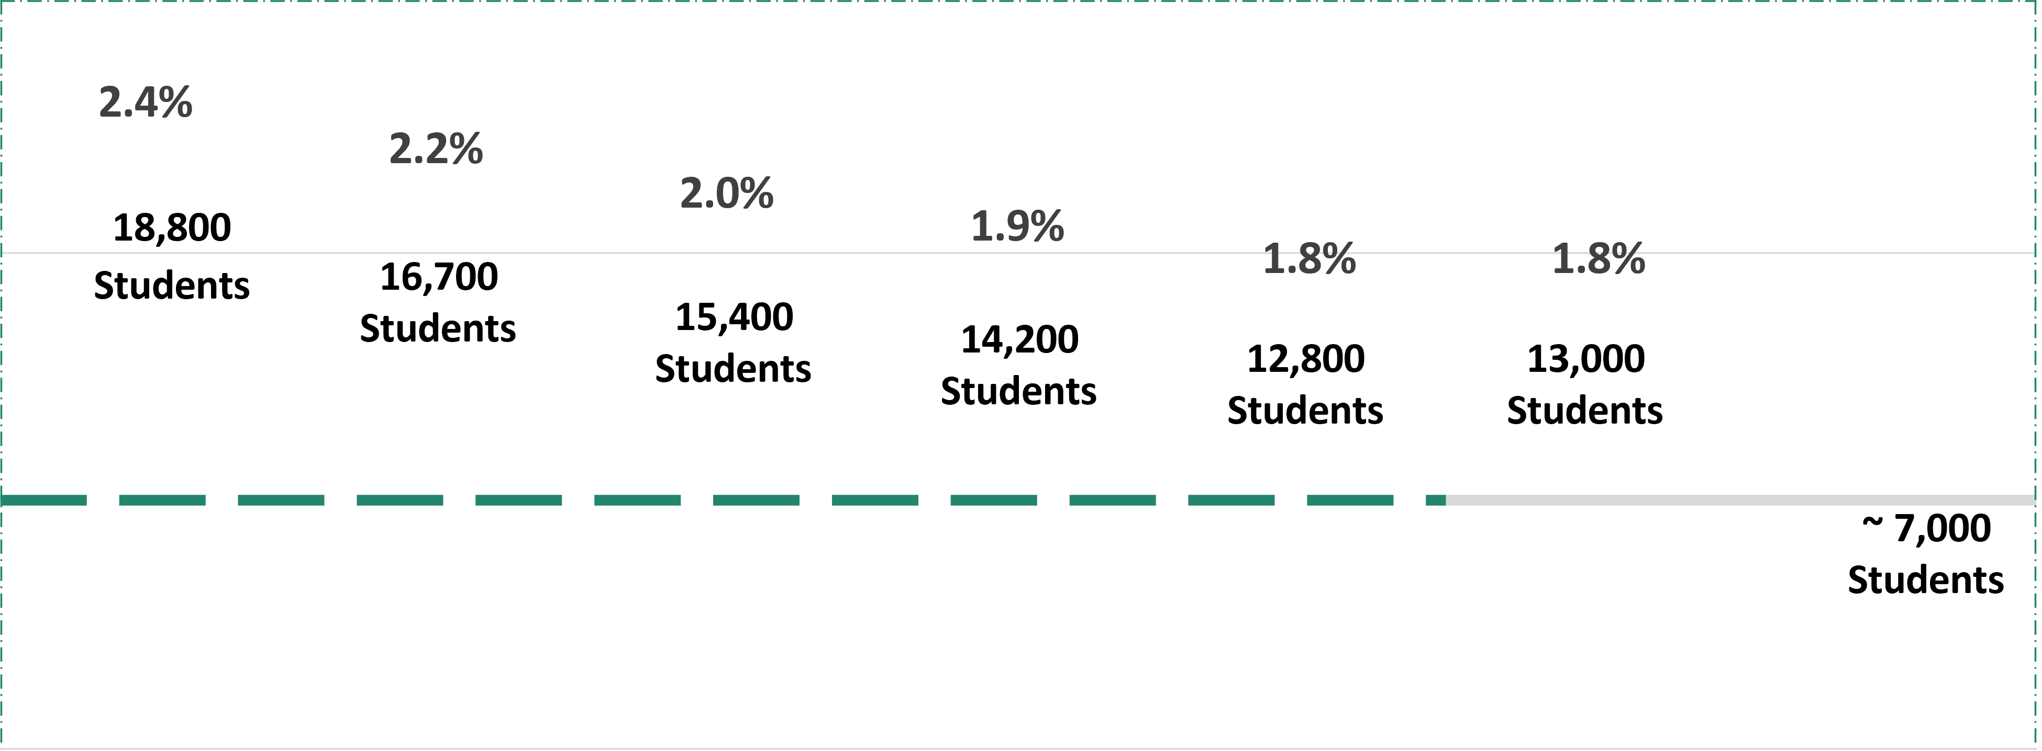
1% Cap: Where Have We Been? Where Are We Headed?
3%
2%
1%
0%
SP17
SP18
SP19
Projected SP21
SP22
SP23
Future
6

Slide 7
Alternate Assessment Purpose
The MI-Access is:
o one part of our state's assessment system for school-age children.
o the MI-Access is designed specifically for those students with "the most significant cognitive disabilities."
o based on alternate achievement standards, which means the performance expected is different.

Slide 8
ESSA: The 95% Participation Requirement
ESSA requires that states assess 95% of all students and 95% of each subgroup in every school with federally mandated annual state tests in English and math.
Michigan did not meet this requirement in 2022, which led to the denial of a waiver extension request in 2023.

Slide 9
Importance of Participating in Assessments
Gauge learning & provide feedback
Participation in state assessments is a matter of educational equity
Balance validity of assessments with equity of access for all students

Slide 10
What Impacts Participation Rates?
Lack of communication
Assessment information and misinformation
Level of understanding about the purpose of the test
Adult attitudes/perceptions about standardized testing in general, standardized annual state assessments or Smarter Balanced, in particular.
Concerns about too much testing/loss of instructional time
Student test anxiety

Slide 11
Administrator Roles in Improving Participation
Provide staff talking points on purpose of assessment
Communicate expectations with school staff about modeling a positive attitude
Establish an orderly testing plan and positive testing environment
Make state assessment part of the academic culture
Employ student voice in this work
Collaborate with faculty and celebrate successes with faculty and students before and after testing

Slide 12
Teacher Roles in Improving Participation
Communicate with students and families about annual assessments
Model a positive attitude about the test
Encourage students to do their best
Ensure students understand the purpose of the test and why it is important
Explain how the results are used

Slide 13
ESSA: The 1% CAP Requirement
ESSA: The 1% CAP Requirement
The purpose of the requirement is about the right student taking the most appropriate assessment.
The intent is to ensure, unless
a student's disability is significant, all students with disabilities should be participating in the general assessment.

Slide 14
Implications for Students
Short-term: Student's instruction is in less depth, breadth, and complexity than the instruction of other students and is aligned to alternate content expectations
Long-term: Student may not meet the requirements or graduate with a regular diploma
Longer-term: Student may not be eligible for some post-secondary training institutions, military service, or jobs. Economic impact to life-
time earnings

Slide 15
Implications for Districts
ESSA requires districts with more than 1.0% participation in the alternate assessment in a subject area to provide to the state:
Assurance that Individualized Education Program (IEP) Teams are adhering to the state's participation guidelines
Justification for a participation rate over 1.0%
Assurance that parents are informed about implications for their child of participation in the alternate assessment

Slide 16
ESSA: The Most Significant Cognitive Disabilities Requirement
Only those students with the "most significant cognitive disabilities (MSCD)"
Roughly only half of students with a primary disability of Cognitive Impairment, Autism, Traumatic Brain Injury, or Severe Multiple Impairment meet the requirements of a student with the MSCD
The decision about which students should participate in the alternate assessment is often very difficult

Slide 17
Definition of "Most Significant Cognitive Disability"
Students with the most significant cognitive disabilities, for the purpose of determining instructional targets and state assessment selection, have a disability or multiple disabilities that significantly impact intellectual functioning
AND
Significantly impact adaptive behaviors, which are essential to live independently and to function safely in daily life. When adaptive behaviors are significantly impacted, the individual is unlikely to develop the skills necessary to live independently and function safely in daily life.
AND
Significant cognitive disabilities impact students both in and out of the classroom and across
multiple life domains, including academic domains. This means that the students have extensive support needs to demonstrate learning and generalize skills across academic and life settings.
AND
Students with the most significant cognitive disabilities are supported with an Individualized
Education Program (IEP) and the primary instruction and summative educational goals are based on Michigan’s alternate content standards in English language arts (ELA), mathematics, science and/or social studies.

Slide 18
Which Students Should Participate (Continued)
Never make a decision based on disability/eligibility alone
Never make a decision based on one piece of data
Must consider curriculum and instruction

Slide 19
Student Participation
The majority of students will participate in general assessments (M-STEP and MME)
Students who participate fully in the general education curriculum without identified disabilities will participate in the general assessment with or without accommodations
Most students with disabilities will be able to participate in the M-STEP and MME when provided with standard, appropriate accommodations

Slide 20
Responsibilities
The IEP team has two responsibilities by law
Determine the appropriate assessment for the student
Determine which accommodations (if any) are necessary for the student

Slide 21
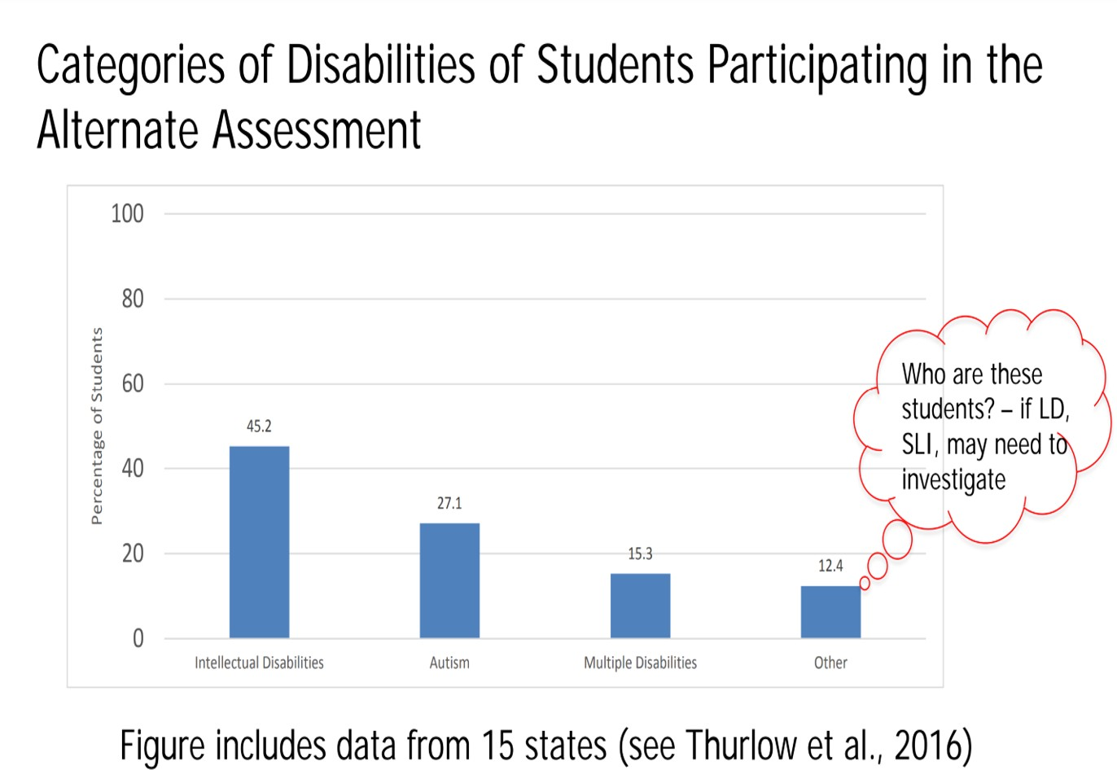
National Data on Disability Categories

Slide 22
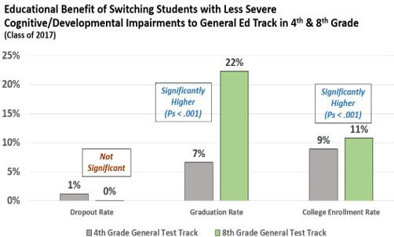
Michigan Data

Slide 23
State Guidelines Across the U.S.
Student's disability significantly affects
o intellectual functioning and
o adaptive behavior
Student requires extensive, direct, and individualized instruction and supports that are not temporary or transient in nature
Student uses substantially adapted materials and individualized methods of accessing materials
Student's instruction is based on alternate academic achievement standards

Slide 24
State Guidelines
Alternate Assessment Inclusion Criteria
Have an IEP
Substantial deficit in cognitive functioning (CF) AND
Substantial deficit in adaptive functioning (AF) in daily life domains of conceptual, social, and practical skills
Have extensive support needs to demonstrate growth or to generalize learning across academic and life settings
Majority of instruction and educational goals in a subject
within Michigan’s alternate achievement expectations

Slide 25
Assessment Selection Guidance

Slide 26
Participation Decision-Making Process
IEP Teams are the frontlines in making the decision about which assessment a student takes.
Parents and guardians are key to the decision and have unique insight into their children's adaptability and support needs for daily living.
School professionals should not make decision without parent or guardian input.
IEP Teams need training, resources, and valid, criterion-relevant data to help with making the participation decision.

Slide 27
Communication with Parents and Guardians
Listen to them and respect their views.
Treat them as equal partners in the education of their child.
Use interpreters to bridge potential cultural and linguistic barriers .
When an alternate assessment is selected, notice should reflect consideration of the general assessment and reasons not selected.
Requirement: Must inform parents of the standards their child is participating and potential impact on ability to graduate high school.

Slide 28
Justification Forms

Slide 29
When Completing the Justification Form, Please Note the Following
Contributing factors, when they apply, do not change the 1% rule, but provide additional context for member districts to think about their data.
A space is provided for other justifications. This is an opportunity for the member district to hypothesize any other factors contributing to participation rates.
Disproportionality must be addressed, only when a member district has been flagged.

Slide 30
What is Required on a District Form?
Justification Forms require member districts to demonstrate a thorough review of alternate
assessment participation rates when participation rates exceed 1%. Some areas to consider, could include but are not limited to:
Students taking the Functional Independence level assessment.
Alignment between instructional standards taught and assessment selected.

Slide 31
Disproportionality
States must address and verify disproportionality in the identification of students with the MSCD.
Must look at differences in the proportions of the students in each subgroup who participated in the alternate assessment compared to the proportion of all other students.
For example:
Race and/or ethnicity
Socio-economic status

Slide 32
Considerations to Include on a District Form (Continued)
Differences in participation between one building and another, or one staff member’s caseload and another.
Eligibility areas not typical for alternate assessments
(if known).
Students who consistently perform at “exceeds standards” level.

Slide 33
Technical Assistance
MDE will provide recommended targeted assistance to the ISD for any district that falls into one or more of the following categories:
A participation rate of 1.4% or higher
Flagged for disproportionality
Required a response to something indicated in the justification form
Districts falling into these categories are required to have a plan to address participation rates and should receive technical assistance from the ISD.

Slide 34
2023-2024 Levels of Support
Tier One = 1.1% - 1.3% or basic disproportionality
Tier Two = 1.4% -2.6% or disproportionality with 1.1% - 1.3% overall
Tier Three = 2.7% and above or disproportionality of 1.4% - 2.6% overall

Slide 35
ISD and Member District Reminders
The Justification Forms activity will be completed by ISD directors and/or monitors and district catamaran coordinators in Catamaran.
All district justification forms must be reviewed and accepted before ISDs can submit the ISD Summary Justification Form.
District Justification Forms only need to be completed by ISDs if they are operating one or more center-based programs.

Slide 36
Training Resource Content
Policy resources are located by selecting the Other
Resources menu and then choosing the appropriate page such as District or ISD Policy Resources.

Slide 37
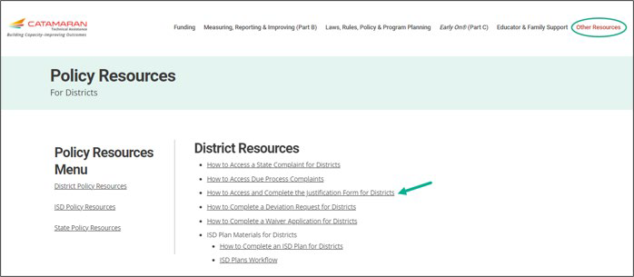
Justification Forms for Districts – How To

Slide 38
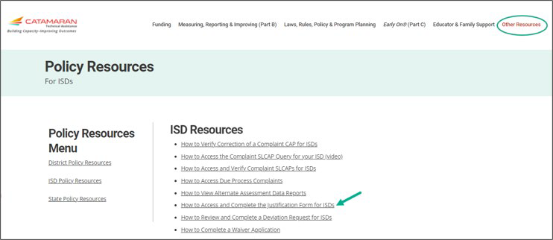
Justification Forms for ISDs How-To

Slide 39
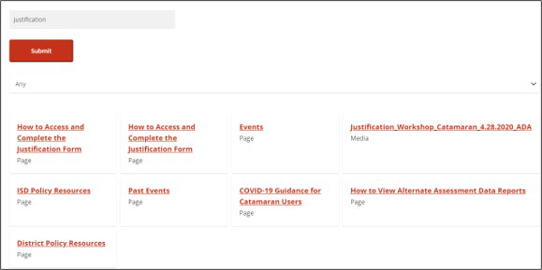
Search Function
Search the entire technical assistance website
Enter a key word or phrase and choose Search
Narrow search by choosing
a category, if desired

Slide 40
Release Date and Due Dates
A webinar on justification forms will be recorded November 2, 2023, and posted on the Catamaran Training Site.
Justification forms will be released in Catamaran November 7, 2023
The due date for LEAs is Tuesday, December 12, 2023
The due date for ISDs is Tuesday, January 23, 2023

Slide 41
Contact Information
Shannon Dammer-Hinman
MDE OSE
HinmanS@Michigan.gov 517-335-1662
Jerry Cullum, PhD
Education Research Consultant
MDE OEAA
CullumJ@Michigan.gov
MDE-OSE Information Line
Interpreter Services Available MDE-OSE@Michigan.gov
1-888-320-8384

