Slide 1
Attention
When the B-13 Interrater Reliability Training Video was recorded, participants responded to polling questions; however, this recording will not include the option to respond to the poll questions.
If you would like to test your knowledge or would like further training on Secondary Transition, enroll in the IEP Boot Camp: Transition Age Students on the Michigan Virtual website.
Notes:
Attention: When the B-13 Interrater Reliability Training Video was recorded, participants could respond to poll questions during the Zoom training sessions. This recording will not include the option to respond to the poll questions.
If, after watching this training video, you would like to test your knowledge or participate in further training on Secondary Transition, we encourage you to enroll in the IEP Boot Camp: Transition Age Students located on the Michigan Virtual website at michiganvirtual.org/ and search for IEP Boot Camp. Participants who complete this course will have the opportunity to earn SCECH credits.

Slide 2
Welcome!
The B-13 Interrater Reliability Training will begin in a few moments.
To communicate with the presenters during the webinar, use the Chat feature.
Closed captioning is available for this webinar. To select this option, choose the closed caption icon in the Zoom webinar player.
MDE Office of Special Education

Slide 3
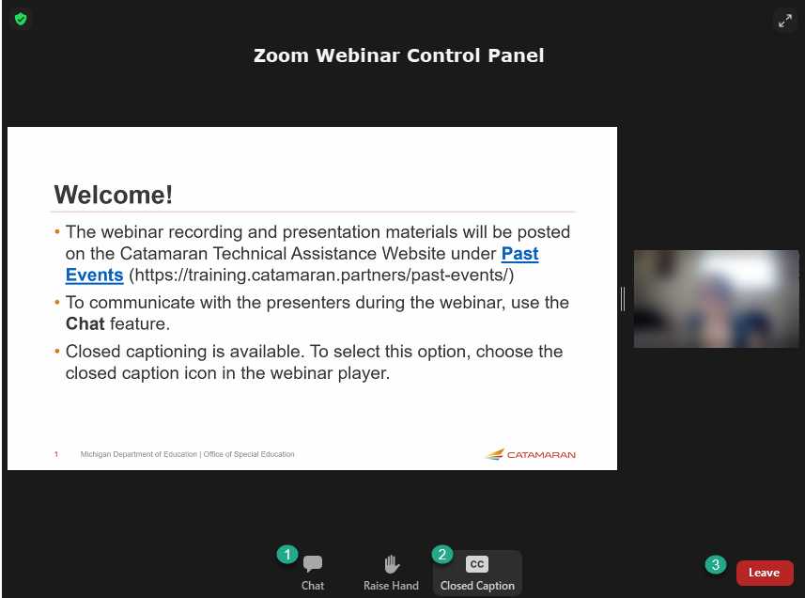
Zoom Webinar Control Panel
Mouse or tab down to the bottom of the webinar screen for the Zoom Webinar Control Panel to become visible.
Features available are:
Chat – select to communicate with presenters.
Live Transcription – select the CC icon to turn on captions and then select Show Subtitles.
Leave – select to exit the webinar.
MDE Office of Special Education

Slide 4
Indicator B-13 Checklist - Interrater Reliability Training
Fall 2023
Michigan Department of Education Office of Special Education
Notes:
Welcome to the Fall 2023 Indicator B-13 Checklist Interrater Reliability Training

Slide 5
Today’s Outcomes
Develop a better understanding of compliance to apply when reviewing individualized education programs (IEPs) for Indicator B-13 data collection.
Improve consistency among reviewers using the Indicator B-13 checklist.
Increase awareness of and familiarity with data collection review tools.
Notes:
Today’s Outcomes include:
Developing a better understanding of compliance versus best practice when reviewing IEPs for B-13 data collection.
Increase interrater reliability to improve consistency among reviewers using the Indicator B-13 checklist
Increase awareness of and familiarity with data collection review tools.

Slide 6
Why Interrater Reliability Matters
Consistency
Methods for improving interrater reliability for Indicator B-13:
  Training
  Written Manual
  5th IEP Upload
Inconsistency results in sanctions at the intermediate school district (ISD) level.
Notes:
Interrater reliability means that no matter which person reviews the data, the results between the reviewers is consistent. Consistency during data collection is key and it is important that different raters are able to yield the same results when viewing the same data. This degree of agreement can help highlight the LEA’s compliance with IDEA requirements or the lack thereof.
The OSE uses a few methods to ensure interrater reliability. The first is through trainings such as this. We work with the individuals who conduct the activity. We also have a webinar in the spring just before the data collection as live support via office hours during the data collection window.
The second method is the B-13 manual. This is updated annually and available on the technical assistance website.
Finally, the OSE reviews at least one IEP from each ISD.
Despite these methods, we have found there is still considerable variation in the data. The data for more than 20 LEAs was changed following the data collection in 2021.
Starting with the data collection in the spring of 2022, inconsistency in data collection will result in sanctions to the Intermediate School District (ISD).
Those sanctions may include a corrective action, a data reliability letter issued in Catamaran, the ISD participating in additional required technical assistance or the impact of the ISD determination rating. The stakes have been raised and so the OSE wants to provide all the additional support necessary to increase consistency among those who complete the checklists.

Slide 7
Indicator B-13 Manual & Checklist
Notes:
We will now review the B-13 Secondary Transition Compliance Checklist and Data Collection Manual. You can locate copies of each on the Catamaran Technical Assistance website.

Slide 8
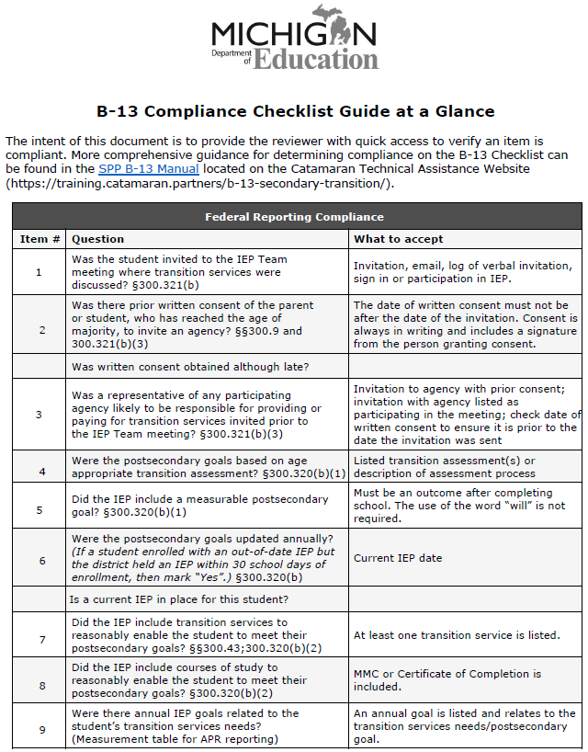
B-13 Checklist Content
9 questions covering
Invitation processes:
  Student
  Agency
IEP development:
  Assessment
  Postsecondary goals
  Transition Services
  Annual goal
Notes:
The B-13 Checklist contains 9 questions covering the Invitation Process and IEP Development
Today we are going to take a deeper look into these 9 questions

Slide 9
B-13 Manual
Addresses each of the checklist questions
Best Practice vs Compliance
The manual is posted to the Catamaran Technical Assistance Website https://training.catamaran.partners/
Notes:
The B-13 Manual reviews each checklist question and outlines IDEA requirements and best practice. Again, this manual can be located on the Catamaran technical assistance website at https://training.catamaran.partners/.
Some schools or ISDs have used this manual as their B-13 procedures.
The OSE does not recommend this practice. We would recommend that you use this manual as a basis for developing procedures. This manual describes what to look for when evaluating for compliance. It does not provide timelines, identify the person responsible for these items, or assign accountability. We know districts are using them and until we have some model procedures written, we will continue to accept them in CAPs but we don’t recommend this practice.
Also, this presentation will not address best practice. We are going to limit the scope of this to the compliant/noncompliant determination.
Now let’s begin our review of the 9 checklist questions.

Slide 10
Question 1
Was the student invited to the IEP Team meeting where transition services were discussed?
  Yes
  No
Notes:
Question 1- Is there evidence the student was invited to the IEP Team meeting where transition services were discussed? Please respond by marking YES or NO

Slide 11
Question 1 Compliance
  Documentation the student was invited prior to the IEP Team meeting:
    note of verbal invite
    phone log
    written invitation
  Documentation that an invitation to the IEP Team meeting was addressed specifically to the student or co-addressed with parent.
  Student is signed in as a participant of the IEP Team or, when there is no sign-in, evidence of participation in the IEP Team meeting.
Notes:
Compliant documentation would be documentation the student was invited prior to the IEP Team meeting. This could include an invitation which is addressed to the student (it may be co addressed with the parent), note of a verbal invite or phone log or evidence the student signed in as a participant or participated in the IEP.

Slide 12
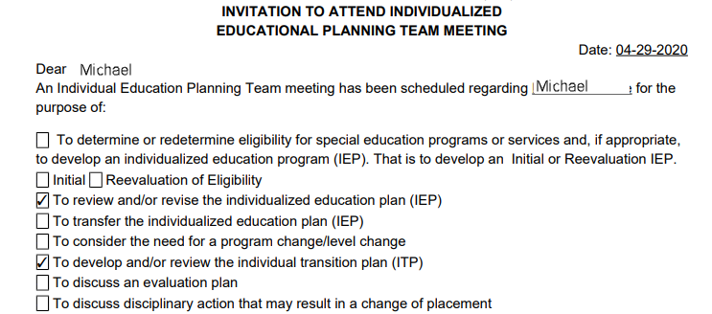
Question 1 Compliance - example 1
Notes:
Here is an example of Compliance for Question #1. This IEP invite is addressed to Michael for the purpose of reviewing his annual IEP and Transition Plan.

Slide 13
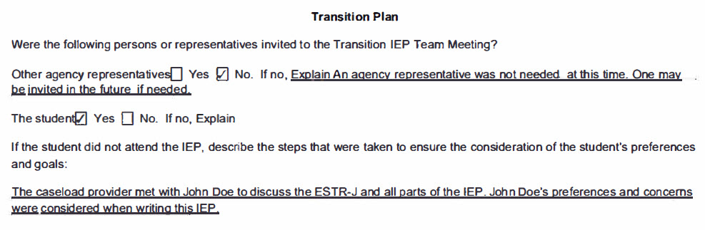
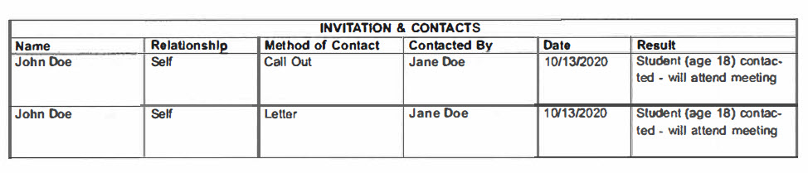
Question 1 Compliance – examples 2-3
Notes:
What does compliance look like?
Here is an example of evidence that a student was invited and participated (Note the student box is checked)
*
Another example of student participation is the varying documented attempts to invite the student. This contact documentation contains multiple methods of contact (call and letter).

Slide 14
Question 1 Noncompliance
  No evidence the student was invited to the IEP Team meeting:
  No written invitation
  No contact log
  No sign in
  No evidence of participation
Notes:
What does non-compliance look like?
There is no evidence that the student was invited or participated in the IEP. There is no written invitation, No contact log, No sign in, and no evidence of participation. You would mark “No” for Question #1

Slide 15
Question 1 You be the judge
Invitation was addressed to the parent.
Participant list on the invitation has the box checked for Student.
IEP has no additional student input.
Notes:
It's time for our first round of you be the judge. In this example the invitation was addressed to the parent. The participants list has the box checked next to the space for the student’s name. When the OSE looked at the IEP, there was no additional student input in the IEP. Is this record compliant for question one on the checklist?
Use poll 1
Collect answers. Display results. Discussion ensues. The answer is No. The invitation needs to be sent to the student (can be co-addressed with the parent) and the student cannot just be listed as a participant on the invitation -there must be evidence the student participated in the IEP.

Slide 16
Question 2
Was there prior consent of the parent or student, who has reached the age of majority, to invite an agency?
  Yes
  No
  N/A
NA
Is an agency likely to provide or pay for transition services?
Notes:
Question 2- Is there evidence of prior consent of the parent or student, who has reached the age of majority, to invite an agency? Please respond with YES, NO or NA.
There is a lot of meaning embedded in this question. First of all, the district has to determine if there is an agency likely to be responsible for paying for or providing transition services. Those services are not time bound. IDEA doesn’t say that schools only need to invite the agency if they are going to provide them during the current year or at a certain age of the student, or when the agency likes to get involved. The IDEA requires that if an agency is likely to provide or pay for services, they be invited to the IEP meeting where transition services will be discussed. In order to make that invitation, the district must seek consent from the parent or the student who has reached the age of majority.
If the Team has decided there is an agency likely to provide or pay for services, did they seek consent to invite the agency prior to inviting the agency? We know from Letter to Gray that the ideal is that the agency representative is identified on the consent form. We also know from practice that the agency representative is not always known. Case managers change, etc. So minimally, the agency must be identified on the consent form to meet the requirements of consent which we will go over on the coming slides.
If there is not an Agency likely to provide or pay for services, then the reviewer can use NA on the checklist. Do Not select “No”.

Slide 17
Question 2 Follow-up
If No for question 2, was written consent obtained although late?
Yes-No SLCAP
No- Obtain written consent which is retroactive to prior IEP or complete IEP or IEP amendment to remove references to the agency in the transition services area of the IEP.
Notes:
Now, we have added a conditional question to question 2. If there is a NO response for question 2, there will be a subquestion asking, was written consent obtained but it was late? If yes, consent was obtained although after the invitation was sent, no student level corrective action plan will be issued. However if the subquestion is also answered no, meaning consent was never obtained, then there will be an SLCAP to obtain written consent that will be retroactive to the prior IEP OR if the district is unable to obtain written consent from the parent or the student who has reached the age of majority, an IEP or IEP amendment must be held. Please do not remove the need of an agency from the IEP.
The IEP team must document that an agency is likely to be responsible for providing or paying for transition services, however, if consent was unable to be obtained document that as well.

Slide 18
Confidentiality Requirements
ISDs/Districts inviting outside agencies without prior consent are violating IDEA and FERPA confidentiality provisions!
Obtaining parent/guardian/student consent prior to inviting an outside agency is imperative to maintain confidentiality provisions.
For more information about confidentiality visit 34 CFR §300.622 visit.
Notes:
When it comes to the agency we need to do a better job about emphasizing that its not just about informed consent under §300.9 but about consent as it relates to confidentiality under §300.622. If teams invite an agency without obtaining prior consent then they are violating IDEA confidentiality requirements AND FERPA. https://sites.ed.gov/idea/regs/b/f/300.622

Slide 19
Consent Defined
Fully informed in native language or another mode of communication
Understands and agrees in writing
Describes activity and lists records (if any) that will be released and to whom
Voluntary and may be revoked at any time
Notes:
Section 300.9 of the Individuals with Disabilities Education Act (IDEA) states consent means:
1. The parent is fully informed of all the relevant information to the activity for which consent is being sought, in their native language or through another mode of communication; Relevant information here means identifying which agency the school wants to invite
2. The parent understands and agrees in writing to the carrying out of the activity for which consent is being sought and
3. The consent describes that activity and lists the records (if any) that will be released and to whom.
4. And finally the parent understands that the granting of consent is voluntary on the part of the parent and may be revoked at any time.

Slide 20
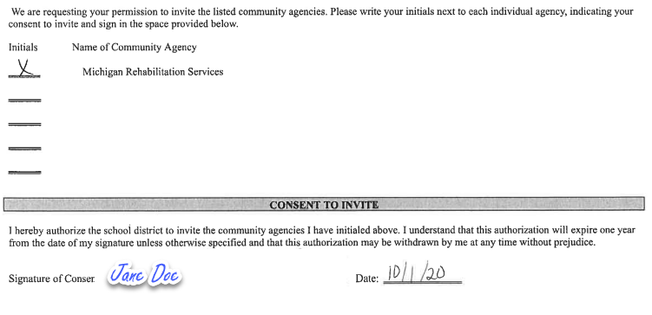
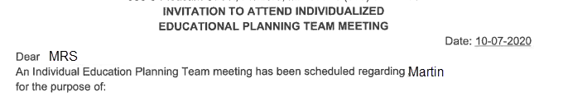
Question 2 Compliance example
Notes:
If an agency is likely to pay for or provide transition services, then compliant documentation would include a request for consent provided to the parent, or student who has reached the age of majority, even if it’s not signed or returned.
*
This example shows consent dated on 10-1-20
*
Next, an invitation to MRS to attend the IEP Team Meeting
*
And that invitation was generated on 10-7-20, after signed consent was obtained.
This is a compliant example.

Slide 21
Acceptable Forms of Written Consent
Documentation:
  Hard copy consent form
  Electronic consent form provided through signature applications such as DocuSign, HelloSign, Adobe Sign
  Consent form emailed which is printed out
Parent, or student who has reached the age of majority, signs, dates, and returns the form.
Notes:
When you're looking at acceptable forms of written consent, that consent can come in many forms. First of all, there might be a hard copy of consent form provided to the parent or student who has reached the age of majority. It could be an electronic consent form which was provided through signature applications such as DocuSign or hellosign. Those are just some examples but there are many, many programs. The consent form could be emailed out and then printed out.
What is important is the consent form has been signed, dated, and returned to the district.
Note that an email to the parent is not considered compliant.
Critical that you document every attempt to obtain consent and note that in the IEP

Slide 22
Question 2 Noncompliance
No documentation the member district determined there was no need to invite an outside agency.
When an agency was likely to pay or provide transition services, written consent was not sought or received from the parent, or student who has reached the age of majority, before inviting an agency.
Parent, or student who has reached the age of majority, agreed verbally but didn’t sign/return the consent, and the agency was invited.
Notes:
Question 2 is non-compliant if the there is no documentation that the member district determined there was no need to invite an outside agency.
Question 2 is non-compliant when an agency was likely to pay or provide transition services, written consent was not sought or received from the parent/student who has reached the age of majority
Or the parent/student who has reached the age of majority, agreed verbally but didn’t sign the consent and the agency was invited

Slide 23
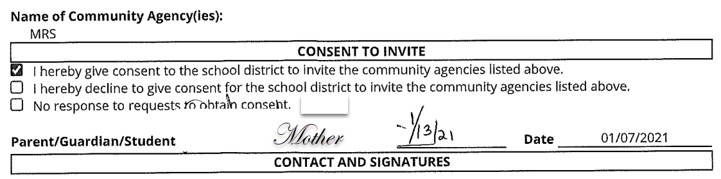
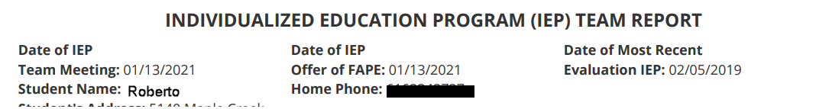
Question 2 You be the judge
Scenario: Teacher has determined the student will be eligible for services from MRS. On 1/7/21 teacher sends form and calls parent to discuss inviting the agency. The parent agrees to this on the phone. Teacher invites agency to the IEP Team meeting. Parent signs consent at the meeting.
Notes:
Here's another opportunity for you to be the judge.
(Read scenario)
Is this compliant?
Launch Poll 2
Collect responses. Discuss. No, not compliant. Consent must be in writing before an invitation is sent.
This scenario refers to the subcategory as discussed earlier. Consent was received late therefore resulting in a CAP and not an SLCAP for this student.

Slide 24
Question 3
Was a representative of any participating agency likely to be responsible for providing or paying for transition services invited prior to the IEP Team meeting?
  Yes
  No
  N/A
Notes:
Question 3- Is there evidence that a representative of any participating agency likely to be responsible for providing or paying for transition services was invited prior to the IEP Team meeting?
This question presumes the district has determined that an agency is likely to be responsible for providing or paying for transition services.
If you have marked NA to question two, then you should just mark NA for question three.
If you marked yes or no for question two, then you have to answer question three with a yes or a no.

Slide 25
Question 3 Compliance
Compliance
Noncompliance
  The meeting invitation must indicate the time, purpose, and location of the meeting and be sent prior to the IEP Team meeting.
  Paper invitation addressed to agency and student/parent.
  Paper invitation addressed to the student/parent with agency listed as potential attendee.
  Copy of a dated email invitation.
  Written log of a verbal invitation.
  No documentation that, if an agency likely to pay or provide transition services was invited to the IEP by the LEA, written consent was provided by the parent, or student who has reached the age of majority.
  No documentation the LEA determined there was no need to invite an outside agency.
  No invitation to the agency
https://training.catamaran.partners/wp-content/uploads/2018/02/Inviting-participating-agencies-clarification-Feb.-2018.pdf
Notes:
What are some things we would expect to see for compliance? (Read the bullets)
Read the bullets
What would we mark as noncompliance (read the bullets)
There is a link for a clarification document for inviting participating agencies with additional information

Slide 26
Put these activities in a compliant order
The district invites an agency which is likely to be responsible for providing or paying for transition services.
The district obtains written consent to invite an agency to an IEP Team meeting.
The district determines there is an agency likely to be responsible for providing or paying for transition services.
The district convenes an IEP Team meeting.
Notes:
(Speaker will read the slide)
Please Launch Poll 3
Collect responses. Display.
Now we will take a look at the order of compliance

Slide 27
The activities in a compliant order
3. The district determines there is an agency likely to be responsible for providing or paying for transition services.
2. The district obtains written consent to invite an agency to an IEP Team meeting.
1. The district invites an agency which is likely to be responsible for providing or paying for transition services.
4. The district convenes an IEP Team meeting.
Notes:
Answer – 3,2,1,4

Slide 28
Knowledge Check
1. Consent must always be in writing and include a date.
2. The agency may be invited before written consent is obtained if the parent agreed by phone.
3. If the student is given a written invitation to the IEP Team meeting, the invitation must be addressed to the student.
4. Electronic signature applications are acceptable forms of written consent.
5. It is acceptable to obtain written consent to invite an outside agency the same day as the IEP meeting if the parent agrees.
Notes:
The first three questions are typically questions where we see the most non-compliance, therefore we are going to pause and do a knowledge check. We are going to read the 5 statements and mark each as True or False based on our knowledge
Read slide
Please Launch the Knowledge Check
Collect responses Display Discuss --- True, False (Hang up the phone...nothing is done by phone), True, True, False (An agency that is likely to pay or provide services needs a reasonable amount of time for meaningful participation)

Slide 29
Question 4
Were the postsecondary goals based on age-appropriate transition assessment(s)?
    Yes
    No
Notes:
Question 4- Is there evidence that postsecondary goals were based on age-appropriate transition assessment?

Slide 30
Question 4 Compliance
Compliance
  There is evidence of age-appropriate transition assessment results.
Noncompliance
  No documentation of transition assessment information/data which were used to develop the postsecondary goals.
Notes:
A variety of sources and instruments can be used for transition assessment data. Evidence of compliance can be found in several places in the IEP such as the PLAAFP statement or the transition plan.
Please mark NO if there is no documentation of transition assessment information/data.
A student or parent interview/questionnaire alone is not sufficient.

Slide 31
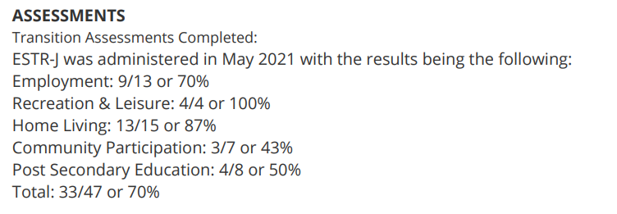
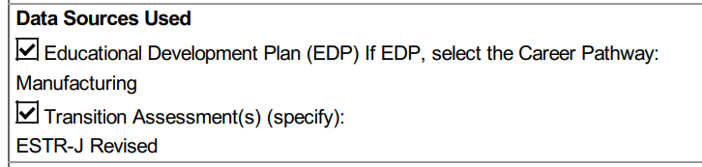
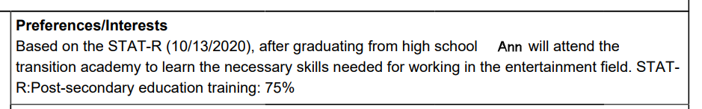
IEP based compliant examples
Notes:
To reiterate this information can be embedded in different places in the IEP, for example,
*we may see it in the Assessments
*Data sources used In the Transition plan
*Or under the students Preferences and Interests , any of these would be acceptable
Now Christie will cover questions 5-9 and Catamaran

Slide 32
Question 5
Did the IEP include a measurable postsecondary goal?
    Yes
    No
Notes:
Moving on to question 5, did the IEP include a measurable postsecondary goal

Slide 33
Question 5 Compliance
Compliance
  There is at least one measurable postsecondary goal in an area of training, education, employment or, where appropriate, independent living that will be achieved after the student exits the public school system.
Noncompliance
  There is no measurable goal in at least one of the areas of training, education, employment or, where appropriate independent living.
Notes:
We are really only looking for a minimum of 1 post-secondary goal to meet B-13 Compliance for the purpose of the checklist
If there is no measurable goal in at least one of the areas, question 5 is noncompliant and should be marked “NO.”

Slide 34
Postsecondary Goals
Measurable = Countable/Observable
Identifies an outcome
At least one measurable postsecondary goal in any area of:
  Education
  Training
  Employment
  Independent Living
Notes:
What is a measurable postsecondary goal? Measurable means it is something that can be counted or observed.
It must identify an outcome
It must be measurable in at least one area: Education, Training, Employment or Independent Living

Slide 35



Examples of Postsecondary Goals
Notes:
Here are some examples of compliant Post-secondary goals
*Zach will attend college
*
Read the examples
Notice In the remaining two goals we see a lead in statement, “Upon completion of school”, although this is best practice it is not required. What’s important is the goals reflect what the student is going to do or achieve after leaving school.
All are acceptable.

Slide 36
Question 5 You be the judge
Goal: Based on the Unique Learning System (ULS) Transition Assessment, Joan will participate in a program that offers social and employability job training with adult support upon completion of school services.
Notes:
Read goal
Poll 5
Collect responses.
Discuss. Yes, this is compliant. This post-secondary goal reflects what the student will do upon the completion of school services.

Slide 37
Question 6
Were the postsecondary goals updated annually? (If a student enrolled with an out-of-date IEP but the district held an IEP within 30 school days of enrollment, then mark “Yes”)
    Yes
    No
Notes:
This is not typically an area where we see non-compliance. You need to verify if the IEP was written within one year of the previous IEP.
The postsecondary goals may be repeated from the previous IEP. If a student is certain about what they want to do, then repeating goals is acceptable.
The MDE received several questions related to out of date IEPs. In previous school years, many students were not attending school despite the best efforts of school personnel and therefore, the students’ IEPs were not updated. Last year, there was some additional text added to the question. The text says if a student enrolled with an out-of-date IEP but the district held an IEP within 30 school days of enrollment, then mark “Yes”. The intent is to determine compliance. If a student enrolled with an out of date IEP, the receiving district is not responsible. What is expected is that the receiving district holds an IEP within 30 school days. If that IEP was held within that timeline, then the compliance standard was met, and the question should be marked yes.
If you mark no to this question, an additional question will be generated.

Slide 38
Question 6 Follow-up
Is a current IEP in place for this student?
  Yes
  No
Notes:
In order to determine an appropriate response to noncompliance identified in question 6, a follow up question is generated with a No response.
If the student has a current IEP, mark yes and no student level corrective action will be triggered.
If there is not a current IEP in place, this question is non-compliant and a student level corrective action plan will be issued.

Slide 39
Question 7
Did the IEP include transition services to reasonably enable the student to meet their postsecondary goals?
    Yes
    No
Notes:
Question 7, did the IEP include transition services to reasonably enable the student to meet their postsecondary goals?

Slide 40
Intent of Transition Services
Relate to and support the attainment of the student's measurable postsecondary goal.
Based on the student's areas of need.
Coordinated set of activities that align with the postsecondary goal.
Notes:
What is the intent of transition services?
To support the attainment of the student’s postsecondary goals based on the student’s areas of needs.
Remember- those services are a coordinated set of activities that align with the student’s goals.

Slide 41
Question 7 Compliance
Compliance
Documentation of transition services including:
  instruction
  related services
  community experience
  development of employment and other post-school adult living objectives
  acquisition of daily living skills and functional vocational evaluation
  courses of study
that will enable the student to meet their postsecondary goals.
Noncompliance
  There are no documented transition services.
Notes:
These are services to be provided during the IEP year which will help the child achieve their postsecondary goals.
There must be at least 1 transition service or activity for compliance and services for any of the postsecondary goals are acceptable.
The transition services must be related to and in support of the student’s measurable postsecondary goal, so the student is actively working towards the attainment of their postsecondary goal.
Question 7 is noncompliant if there is no documentation of transition services.

Slide 42
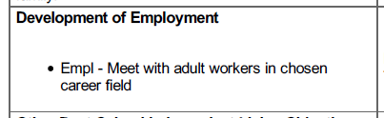
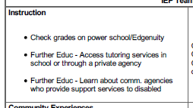
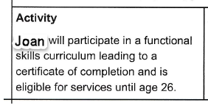
Examples of transition services
Notes:
Examples of transition services may include accessing tutoring services or learning about community agencies in the area of instruction.
*
Or meeting with adult workers in the student’s chosen career field.
*
Or participating in functional skills curriculum.

Slide 43
Question 8
Did the IEP include courses of study that will reasonably enable the student to meet their postsecondary goals?
    Yes
    No
Notes:
Did the IEP include courses of study that will reasonably enable the student to meet their postsecondary goals?

Slide 44
Question 8 Compliance
Compliance
The documented courses of study enable the student to achieve their postsecondary goals:
  Michigan Merit Curriculum
  Certificate of Completion
If they are not aligned, then there are transition services to align the two items.
Noncompliance
  No courses of study documented.
  The documented courses of study do not enable the student to achieve their postsecondary goals and there are no services to align the two items.
Notes:
Courses of study must align with the postsecondary goal for compliance.
The documented courses of study enable the student to achieve their postsecondary goals.
If there is no documented course of study or no transition services to align courses of study and post secondary goals, question 8 noncompliant.

Slide 45
Question 9
Were there annual IEP goals related to the student’s transition services needs?
    Yes
    No
Notes:
Were there annual IEP goals related to the student’s transition services needs?

Slide 46
Question 9 Compliance
Compliance
  Documentation of an annual IEP goal that supports the student’s transition services needs listed in the IEP.
Noncompliance
  No documentation of an annual goal in the IEP related to the student’s transition services needs.
Notes:
We are looking for at least one goal that supports the students transition needs/postsecondary goals.
Do you see the connection between how the transition services support the student in reaching their short- term IEP goal and the long term postsecondary goal?
If there is documentation of an annual goal it is compliant.
If not, question 9 must be marked NO.

Slide 47
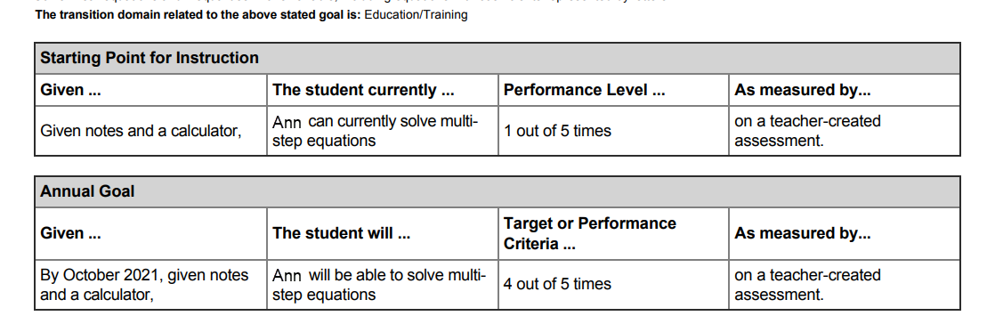
Annual Goal - example 1
Notes:
Note the connection to the transition domain.

Slide 48
Annual Goal – Example 2
Annual goal: Amy will increase her functional spelling skills by learning to spell 50 more sight words with 100% accuracy as measured by weekly spelling test of three to five words by November 2021. As measured by weekly spelling tests.
Notes:
Here’s another goal, not tied directly to transition. Still compliant. The connection doesn’t need to be explicit. If the goal is tied to the MMC and the student is on diploma track, that’s compliant. If the goal is like this one and is tied to a functional skill or related in some way to their transition services, it’s compliant.

Slide 49
Question 9 – You be the judge
Annual Goal: According to the ULS benchmark assessment, the student will identify 16 of 18 coins/bills and their values by Dec. 2021 according to documented teacher observation. (can identify 11.5 of 18 is written elsewhere in the IEP)
Notes:
Poll 9
Read goal
Collect responses. ULS-Unique Learning System
Discuss. Yes, this is a compliant goal. Even if the connection is not made clear, it can be inferred.
Perhaps not the best goal and you can absolutely provide targeted training to improve writing measurable annual goals, this goal would meet compliance for B-13 Data Collection.

Slide 50

Questions?
Notes:
Are there any questions at this time?

Slide 51
Work in Catamaran
The B-13 Data Collection is completed in Catamaran (https://catamaran.partners).
The work is completed by ISD Transition Coordinators, and member district Transition Coordinator Contacts.
Student lists and checklists are available in Catamaran March 1, 2024.
Checklists must be completed, verified by the ISD, and submitted by April 12, 2024.
Notes:
Read each bullet
Remember-The data submitted on the checklist in Catamaran should reflect information obtained from the student’s most current IEP as of March 1st of the current school year.
No revisions, new IEPs, or amendments dated after March 1 will be accepted for indicator B-13 checklist reporting.

Slide 52
Timeline
Activity | Date | Description
Data Collection | March 1 to 28 | Complete data collection checklists
Data Collection Review | March 29 to April 12 | ISD reviews submitted checklists
Checklist Due to MDE | April 12 | ISD submits checklists to MDE
MDE Review | April 15 to 19 | MDE reviews submitted checklists
Student Level Corrective Action | April 25 | SLCAPs issued by April 25 and due by June 10
District Level Corrective Action | May 15 | CAPs or Corrective Action issued
Notes:
New last year, MDE provided a suggested timeline to allow for ISDs to have a review period during the overall data collection window.*
ISDs of course can follow the timeline that works best for them; however, we recommend that you take advantage of the suggested review period of March 29-April 12 to avoid having to ask for items to be changed after the submission or for SLCAPs to be rescinded after they are released.
Now, let’s take a look at the Summary Report!

Slide 53
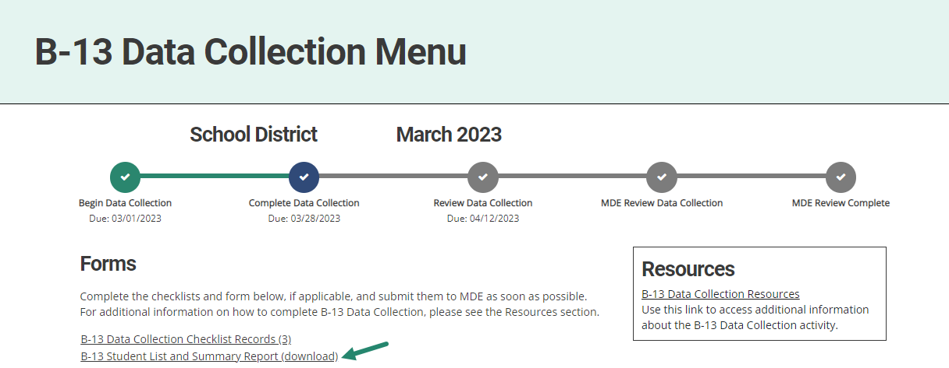
Review the Summary Report
From the B-13 Data Collection Menu, choose B-13 Student List and Summary Report (download).
Notes:
Once all the checklists for a district have been completed, the Transition Coordinator will be able to run the Summary Report using the link from the forms section of the menu page.
The summary report allows the TC to see all the record review responses on one page. This will help to see if there is any missed information or incorrect responses that need to be changed prior to submission.

Slide 54
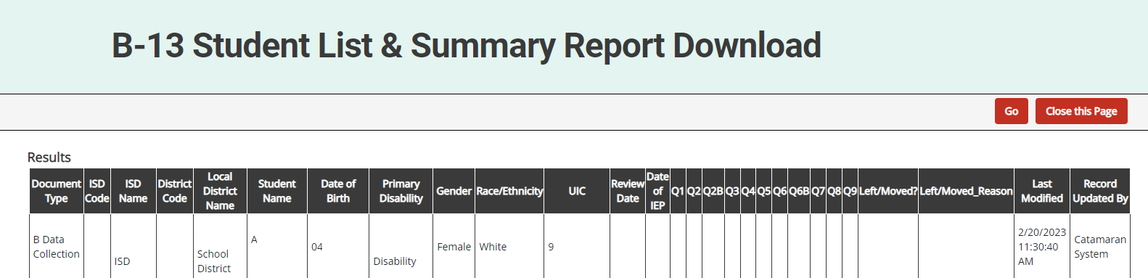
Review the Summary Report (cont.)
Review the summary report for any No or blank responses:
  A No identifies that item is noncompliant. This will result in a finding of noncompliance and the member district will be required to complete a Corrective Action Plan (CAP) and a Student-Level Corrective Action Plan (SLCAP).
Note: If checklists are not completed, all or some of the report will be blank.
Notes:
The summary report also allows the TC to see the checklist responses for each student in one place. There should be no blank responses. If there are, it means the review for that student file was not completed and must either be returned for completion, or the ISD will need to complete the review.
This step can be done with Transition Coordinator Contacts if your ISD uses them to review the district level data before submitting to the ISD.

Slide 55
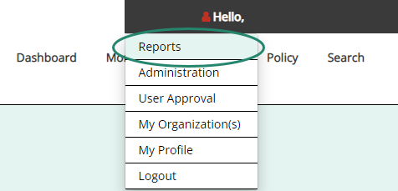
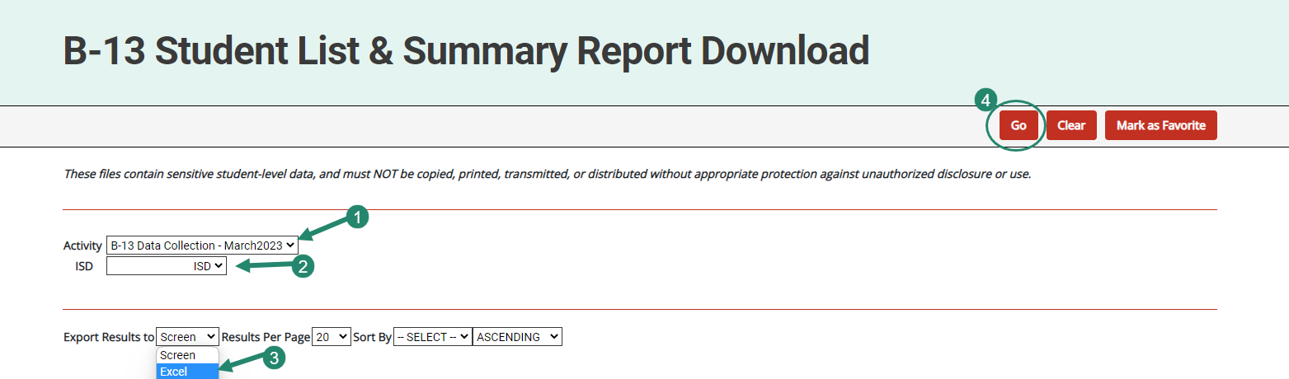
Review Submitted Data
Notes:
Once the data is submitted to the ISD but BEFORE approving the activity, review the submitted data and verify that it is correct.
To do this, open the B-13 Student List and Summary Report Download for the ISD and review the responses for each member district.
Check for any questions where there are No’s or any questions that are blank
A No answer identifies that item as noncompliant. This will result in a finding of noncompliance and the member district will be required to complete an SLCAP and a CAP.
Note: If the member district has not completed all checklists, all or some of the report will be blank. Once exported to Excel, ISDs may choose to filter this report to display districts that have completed checklists.
If the ISD is satisfied the submitted data are accurate, proceed to the next step.

Slide 56
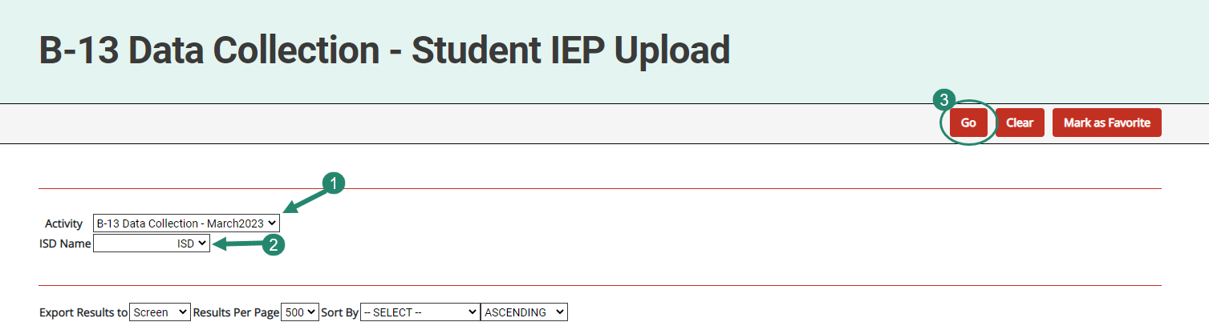
Review Uploaded IEPs
Notes:
Next, review the IEP the member district uploaded. Note that ISDs will have only one to review.
To review these, go to Reports to then open the B-13 Data Collection-Student IEP Upload report.
See a line for the member district with a link to the uploaded IEP.
To review the uploaded document, select the provided link.
If the member district did not provide all of the documentation needed to verify compliance, the ISD must return it to the member district to provide additional documentation.
If the uploaded IEP provides sufficient evidence the checklist is accurate, proceed to the next step.
Note: if the ISD disagrees with the member district’s responses on the checklist, the ISD should change district responses by accessing the individual student’s checklist page in Catamaran.
Only after the data has been reviewed should you accept the work and submit the data collection to the OSE.

Slide 57
Further Questions?
Notes:
Questions

Slide 58
Need Assistance?
Questions?
Need Information?
OSE Information Desk
888-320-8384
M-F 9:00 am-4:00 pm
mde-ose@michigan.gov
Notes:
Read entire slide and spell out the email address.

