Slide 1
Welcome!
The December 2023 Office of Special Education Technical Assistance webinar will begin in a few moments.​
The webinar recording and presentation materials will be posted on the Catamaran Technical Assistance Website under Past Events (https://training.catamaran.partners/past-events/).​
Closed captioning is available for this webinar. To select this option, choose the closed caption icon in the Zoom webinar player.
Notes:
This slide will remain on the screen while participants are entering the zoom meeting and while the moderator completes introductions. Jessica-moderator

Slide 2
Monthly Technical Assistance (General Supervision)
December 2023
Office of Special Education
Notes:
Teri

Slide 3
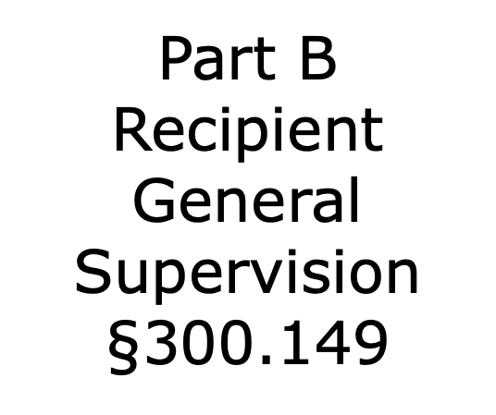
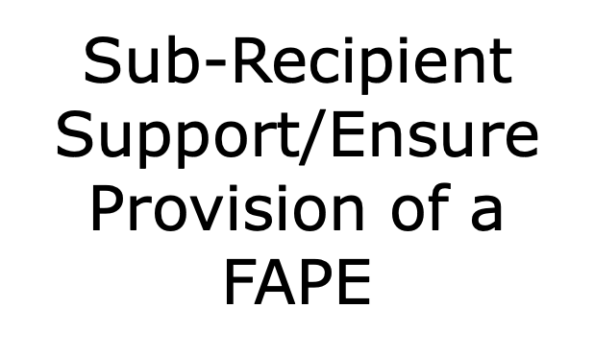
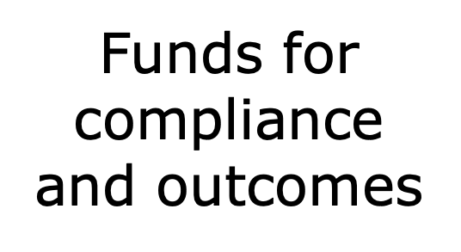
IDEA Supervision: Coordination and Communication
Notes:
Teri

Slide 4
IDEA Supervision: Coordination and Communication (2)
Notes:
Teri

Slide 5
IDEA Supervision: Coordination and Communication (3)
Notes:
Teri

Slide 6
IDEA Supervision: Coordination and Communication (4)
Notes:
Teri

Slide 7
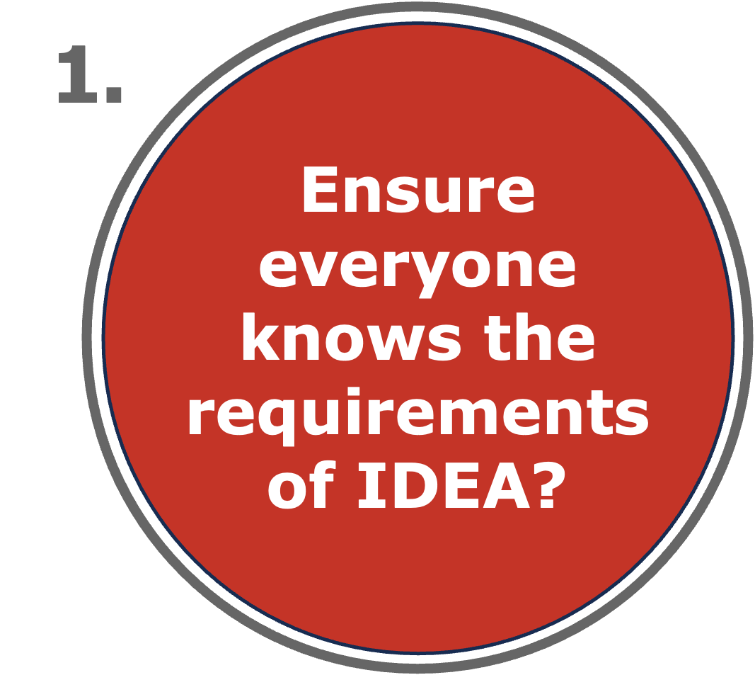
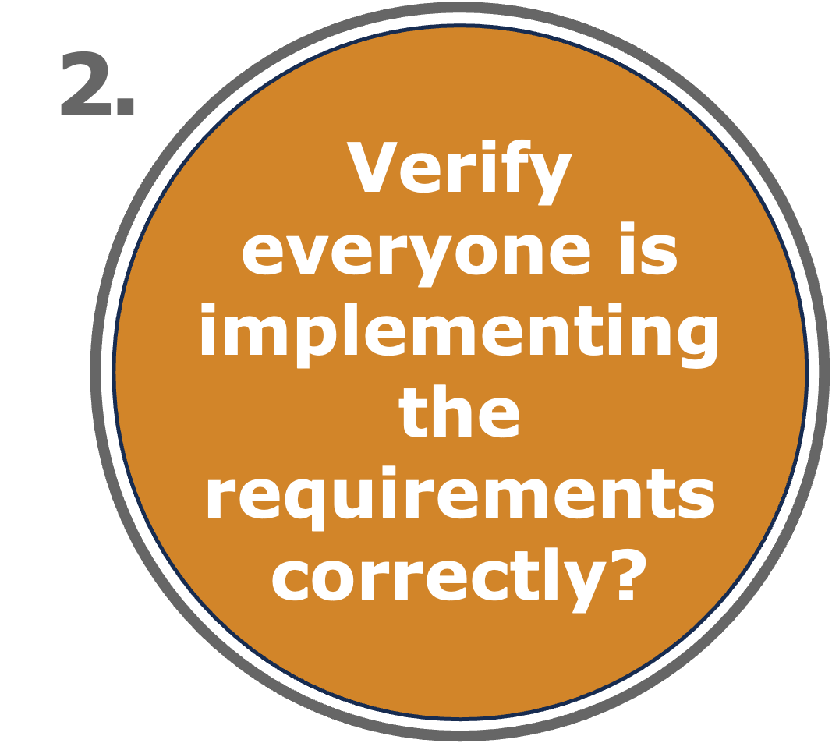
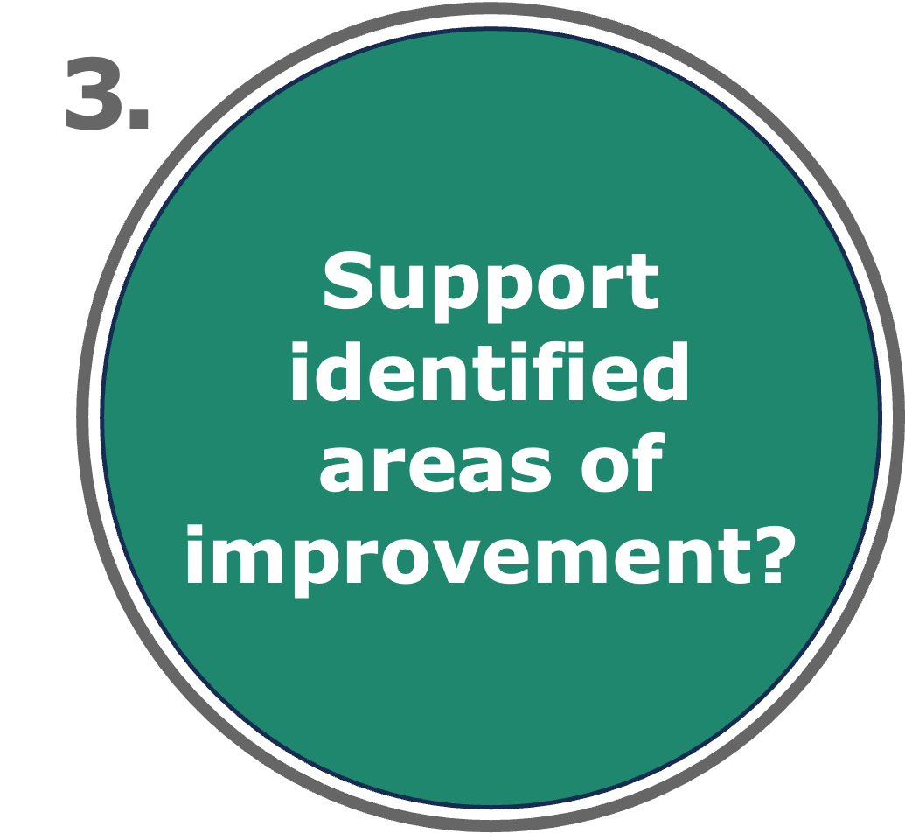
The Three Questions…at every level
1.
Ensure
everyone
knows the
requirements
of IDEA?
WHAT SYSTEM(S) IS IN PLACE TO:
2.
Verify
everyone is
implementing
the
requirements
correctly?
3.
Support
identified
areas of
improvement?
Notes:
Teri

Slide 8
The Three Questions…at every level (2)
1.
Ensure
everyone
knows the
requirements
of IDEA?
WHAT SYSTEM(S) IS IN PLACE TO:
2.
Verify
everyone is
implementing
the
requirements
correctly?
3.
Support
identified
areas of
improvement?
Notes:
Teri

Slide 9
The Three Questions…at every level (3)
1.
Ensure
everyone
knows the
requirements
of IDEA?
WHAT SYSTEM(S) IS IN PLACE TO:
2.
Verify
everyone is
implementing
the
requirements
correctly?
3.
Support
identified
areas of
improvement?
Notes:
Teri

Slide 10
The Three Questions…at every level (4)
1.
Ensure
everyone
knows the
requirements
of IDEA?
WHAT SYSTEM(S) IS IN PLACE TO:
2.
Verify
everyone is
implementing
the
requirements
correctly?
3.
Support
identified
areas of
improvement?
Notes:
Teri

Slide 11
The Three Questions…at every level (5)
1.
Ensure
everyone
knows the
requirements
of IDEA?
WHAT SYSTEM(S) IS IN PLACE TO:
2.
Verify
everyone is
implementing
the
requirements
correctly?
3.
Support
identified
areas of
improvement?
Notes:
Teri

Slide 12
Ensure Provision of a FAPE
Support
Enforcement
CONTINUUM
Notes:
Teri

Slide 13
Ensure Provision of a FAPE (2)
Support
Enforcement
CONTINUUM
Notes:
Teri

Slide 14
Ensure Provision of a FAPE (3)
Support
Enforcement
CONTINUUM
Notes:
Teri

Slide 15
Ensure Provision of a FAPE (4)
Support
Enforcement
CONTINUUM
Notes:
Teri

Slide 16
Ensure Provision of a FAPE (5)
Support
Enforcement
CONTINUUM

Slide 17
Effective Systems of General Supervision
Support Improvement of Educational Results & Functional Outcome
Peak
Effectiveness
Multiple Mechanisms to Encourage & Support Improvement &
Compliance
Multiple Methods to Identify & Correct

Slide 18
Effective Systems of General Supervision (2)
Support Improvement of Educational Results & Functional Outcome
General Supervision System
Multiple Mechanisms to Encourage & Support Improvement &
Compliance
Multiple Methods to Identify & Correct

Slide 19
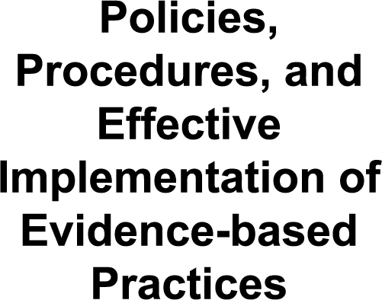
General Supervision System
Notes:
Chantel
The general supervision system is an accountability mechanism for improving educational results and functional outcomes for children and youth with disabilities while ensuring LEAs meet program requirements of IDEA, with a particular emphasis on requirements most closely related to those improvements. In Michigan, Intermediate School Districts (ISDs) are subrecipients of IDEA grant funds and, thus, serve as LEAS, with the responsibility to support member districts in improving results and ensuring program requirements are met.
This visual illustrates the general supervision system, consisting of 8 separate but INTERRELATED components developed by Michigan to meets its obligation under federal law.
The Merriam-Webster online dictionary defines a system as "a regularly interacting or interdependent group of items forming a unified whole." The graphic below (and on the document's cover) shows the interrelatedness of the eight components of general supervision, even though the components are presented in a linear sequence.

Slide 20
General Supervision System (2)
Notes:
Chantel

Slide 21
General Supervision System (3)
Notes:
Chantel

Slide 22
Professional Learning and Development and TA
Notes:
Chantel
MDE OSE uses data and input from stakeholders to identify areas of need for PLD and TA. MDE OSE has developed a Differentiated Framework of Supports to guide the development and delivery of PLD and TA. More to come later in the presentation related to the Differentiated Framework of Supports.
MDE OSE uses several means of providing PLD and TA services, including through information and resources on the MDE OSE website and the Catamaran Technical Assistance site. Catamaran also provides mechanisms to help ISDs and member districts analyze and interpret data. Michigan Virtual University is another source for information and resources (see also Policies, Procedures, and Effective Evidence-based Practices). Michigan Virtual University has sections for students, educators, administrators, and mentors. The section for educators is described as “a flexible online learning community for Michigan educators…Our Professional Learning Services team collaborates with subject-matter experts to develop timely, comprehensive, and action-oriented learning opportunities for teachers, administrators, mentors, and counselors.” Educators taking specific courses can earn continuing education credits.
Other sources of professional development and learning are through MDE OSE IDEA Grant Funded Initiatives (GFI). Current grant-funded initiatives include:
The MDE, Low Incidence Outreach (MDE-LIO) (https://mdelio.org/) operates a field model to support the needs of ISDs and member districts in improving the quality of education for students who are blind or visually impaired and for students who are Deaf or hard of hearing.
Michigan’s Multi-Tiered System of Supports (MiMTSS) Technical Assistance Center (https://mimtsstac.org), previously Michigan’s Integrated Behavior and Learning Support Initiative (MIBLSI), works on behalf of the MDE to provide a continuum of TA to ISDs, member districts, and schools in an MTSS framework. MiMTSS is funded, in part, by the U.S. Office of Special Education Programs (OSEP) as a State Personnel Development Grant (SPDG) “to provide capacity-building tools and resources for member districts that support implementation of MTSS.”
The Statewide Autism Resources and Training Project (START) (https://www.gvsu.edu/autismcenter/) works with schools, community partners, and families to promote and support independence, engagement, and socialization of children and youth with an autism spectrum disorder to become active, engaged members of their schools and local communities.
Michigan Alliance for Families (http://www.michiganallianceforfamilies.org) provides information, support, and education to parents whose children receive special education services from birth to age 26.
Special Education Mediation Services (SEMS) (https://www.mikids1st.org/) is the federally funded mediation center which provides mediation and facilitation services by trained, neutral mediators and facilitators at no cost for parents, ISDs, and member districts. Mediation and facilitation are activities which promote and restore positive home-school relationships and increase family engagement which has a profound impact on outcomes for children and youth with disabilities.
ALT+SHIFT (https://www.altshift.education/) is a dynamic organization collaborating with educators and families to improve educational outcomes for all students. ALT+SHIFT provides professional learning opportunities, resources, tiered TA, and implementation to ensure children and youth with disabilities have access and opportunities to learn at high levels through the use of technology, digital materials, and augmentative and alternative communication options.

Slide 23
Effective Dispute Resolution
Notes:
Chantel.
The IDEA and MARSE entitle children with disabilities to a FAPE in the least restrictive environment (LRE). Parents and school officials may disagree on what special education services and placement a child should receive under this right. MDE OSE promotes effective dispute resolution and ensures procedural safeguards as required by IDEA and MARSE. The IDEA and MARSE provide several approaches parents and schools can use to help resolve their disputes. MDE OSE offers mechanisms for resolving disputes at the earliest point including facilitated meetings⁷ and mediation. When a disagreement cannot be resolved through facilitated meetings and mediation, additional dispute resolution options include filing a state complaint or a due process complaint and request for hearing. When a due process complaint and request for hearing are related to a student’s discipline and alternative educational placement, the hearing will be conducted on an expedited basis. (See Michigan Administrative Rules for Special Education (MARSE) With Related IDEA Federal Regulations, and Dispute Resolution Options (michigan.gov)
MDE OSE has established effective communication mechanisms among all components of its general supervision system integrating data from monitoring, fiscal, dispute resolution, and PLD and TA. Data from dispute resolution systems are used to inform PLD and TA activities and to identify priorities for monitoring.

Slide 24
Fiscal Accountability and Management
Notes:
Chantel
MDE OSE PF Unit oversees the fiscal operations of IDEA and MARSE-supported activities as required under the IDEA and the Uniform Administrative Requirements, Cost Principles, and Audit Requirements for Federal Awards (OMB Uniform Guidance). PF monitors through the review and approval of special education state aid cost reports and reimbursements, ISD Plan millage distribution methodology, IDEA Part B State-level Activities funds, manages IDEA Part B grants by utilizing a comprehensive application review and approval process, universal and targeted technical assistance (TA), risk-based compliance assessment model, and Program Fiscal Reviews.

Slide 25
Improvement, Correction, Incentives, and Sanctions
Notes:
Chantel
As MDE OSE Building Capacity – Improving Results purpose states, “Even as MDE OSE acknowledges the obligations and requirements of the IDEA and the Michigan Administrative Rules for Special Education (MARSE), MDE OSE has a shared vision for why we do the work.” As described, the shared vision includes ensuring “the civil rights of children with disabilities for a FAPE in the LRE” for “children and youth with disabilities [to] receive a meaningful education” leading to “meaningful outcomes.” MDE OSE is committed to building the capacity of members of MDE OSE and those in the ISDs and member districts to improve results for children and youth with disabilities through the components of general supervision, especially through Policies, Procedures, and Effective Implementation of Evidence-based Practices, Data on Results and Processes, Fiscal Accountability and Management, Effective Dispute Resolution, and Integrated Monitoring Activities. Through these components, MDE OSE examines both results and compliance to identify improvement and correction. MDE OSE is also committed to recognizing these results and compliance improvements, even as MDE OSE must ensure correction when noncompliance is identified. To achieve these improvements and corrections, MDE OSE has developed a continuum of incentives and sanctions.
MDE OSE has developed this continuum of improvements, corrections, incentives, and sanctions to support ISDs and member districts to comply with IDEA’s requirement to conduct monitoring focused on activities for “(A) improving educational results and functional outcomes for all children with disabilities; and (B) ensuring that States meet the program requirements under this part, with a particular emphasis on those requirements that are most closely related to improving educational results for children with disabilities” [Section 616, (a)(2)].
This continuum of actions shifts the emphasis from using strictly punitive measures as a first resort to the last available option to meet federal requirements. A continuum also provides a means of recognizing progress toward improvement for both educational results and functional outcomes and compliance with IDEA.

Slide 26
Integrated Monitoring Activities
Notes:
Chantel
MDE OSE has espoused a definition of “monitoring” that focuses on results and integrates data from various sources to support conclusions more broadly than the traditional connotation of compliance monitoring. Specifically:
MDE OSE defines monitoring as a proactive, preventive, and corrective approach to improving educational results and functional outcomes for children and youth with IEPs and compliance with requirements of the IDEA and MARSE using financial and programmatic data and data from other activities to identify the performance and progress of ISDs on elements and indicators of results and compliance through an ongoing and systematic process. Monitoring encourages and supports improvement and enforces compliance combined with technical assistance, professional learning and development, and a continuum of incentives and sanctions.

Slide 27
Data on Results and Processes
Notes:
Chantel
As a part of the state’s general supervision responsibilities, data are used for decision-making about program accountability, management, and improvement. The factors include:
Data collection and verification
Data examination, analyses, and visualization
Public reporting of data
ISD determinations
Improvement activities
In addition to these factors, MDE OSE has adopted a Data Use and Action Process with an iterative eight-step approach. More details regarding this process to come later in the presentation.

Slide 28
SPP/APR/SSIP
Notes:
Chantel
Under Part B of IDEA, each state must have in place a state performance plan that evaluates the state’s implementation of the requirements and purposes of IDEA (IDEA Regulations, Subpart F, Section 300.601). The SPP must also describe how the state will improve educational results and functional outcomes for children and youth with disabilities by reporting on specific indicators.
A key component of the SPP/APR and SSIP process is the engagement of stakeholders. MDE OSE uses the Special Education Advisory Committee (SEAC), mandated by the IDEA, as the primary stakeholder group to provide feedback and input on SPP targets and progress.³ Another stakeholder group includes ISD Directors of Special Education, with whom MDE OSE communicates and meets regularly to provide information and updates and seek input and feedback. Additionally, the General Supervision Accountability Workgroup meets monthly to provide general and specific feedback to MDE OSE on developing and implementing procedures relevant to ISDs and member districts.

Slide 29
Policies, Procedures, and Effective Implementation of Evidence-based Practices
Notes:
Chantel
The foundation for MDE OSE policy guidance documents is the IDEA and the MARSE, that “includes the full Michigan rules and pairs each rule with any of the relevant regulations from the (IDEA)” (p. 2). Guidance documents are on MDE OSE website under a section on Policies – “Policy documents provide information to help interpret and implement the law. The documents are not laws or regulations.” This section has taken on added importance in the last three years as a result of working to ensure children and youth with IEPs receive the special education and related services to which they are entitled during the COVID-19 public health pandemic. MDE OSE has several mechanisms and resources for providing Professional Learning and Development (PLD) and Technical Assistance (TA) to support ISDs to improve and ensure compliant practices.
MDE OSE also has written procedures for conducting compliance monitoring activities, fiscal compliance monitoring activities, and dispute resolution actions. These documents are primarily available through the public-facing Catamaran TA site.

Slide 30
Supports for General Supervision System
Notes:
Rebecca

Slide 31
Supports for General Supervision System (2)
Notes:
Rebecca

Slide 32
Supports for General Supervision System (3)
General Supervision System Grant
General Supervision System Self-Assessment
Data Use and Action Process
Quadrant Framework
General Supervision System Accountability Workgroup
Notes:
Rebecca

Slide 33
Supports for General Supervision System (4)
General Supervision System Grant
General Supervision System Design Tool
Data Use and Action Process
General Supervision System Accountability Workgroup
Notes:
Rebecca

Slide 34
Supports for General Supervision System (5)
General Supervision System Grant
General Supervision System Design Tool
Data Use and Action Process
Notes:
Rebecca

Slide 35
Supports for General Supervision System (6)
General Supervision System Grant
General Supervision System Design Tool
Data Use and Action Process
Quadrant Framework
Notes:
Rebecca

Slide 36
Supports for General Supervision System (7)
General Supervision System Grant
General Supervision System Design Tool
Data Use and Action Process
Quadrant Framework
General Supervision System Accountability Workgroup
Notes:
Rebecca

Slide 37
Data Use and Action Process
Prepare
2.
3.
Inquire
1.
4.
Plan
5.
8.
Act
6.
7.
Notes:
Jessica:)

Slide 38
Data Use and Action Process (2)
Prepare
Organize Data
Assess Data Quality
2.
3.
Inquire
1.
4.
Plan
5.
8.
Act
6.
7.
Notes:
Jessica

Slide 39
Data Use and Action Process (3)
Prepare
Organize Data
Assess Data Quality
2.
3.
Inquire
1.
3. Conduct Data Analyses
4. Determine Actionable Causes
4.
Plan
5.
8.
Act
6.
7.
Notes:
Jessica

Slide 40
Data Use and Action Process (4)
Prepare
Organize Data
Assess Data Quality
2.
3.
Inquire
1.
3. Conduct Data Analyses
4. Determine Actionable Causes
4.
Plan
5.
8.
5. Develop Measurable Outcomes
6. Identify Strategic Activities & Plan
Act
6.
7.
Notes:
Jessica

Slide 41
Data Use and Action Process (5)
Prepare
Organize Data
Assess Data Quality
2.
3.
Inquire
1.
3. Conduct Data Analyses
4. Determine Actionable Causes
4.
Plan
5.
8.
5. Develop Measurable Outcomes
6. Identify Strategic Activities & Plan
Act
6.
7.
7. Implement Plan With Fidelity
8. Evaluate Progress
Notes:
Jessica

Slide 42
Data Use and Action Process (6)
Prepare
Organize Data
Assess Data Quality
2.
3.
Inquire
1.
3. Conduct Data Analyses
4. Determine Actionable Causes
4.
Plan
5.
8.
5. Develop Measurable Outcomes
6. Identify Strategic Activities & Plan
Act
6.
7.
7. Implement Plan With Fidelity
8. Evaluate Progress
Notes:
Jessica

Slide 43
Differentiated Framework of Supports
High Results/Low Compliance
High Results/High Compliance
High
Directed Supports
Universal Supports
Provide directed supports to improve compliance
System review to create plan for improving compliance
System review to identify successful procedures and practices to share with others and identify areas of improvements
Results
Low Results/Low Compliance
Low Results/High Compliance
Intensive Supports
Targeted Supports
Comprehensive system review to create individualized improvement plan based on local capacity, educator competency, experience, and expertise
Provide targeted supports to improve results
System review to create plan for improving results
Low
Low
Compliance
High
Notes:
Jessica

Slide 44
Differentiated Framework of Supports (2)
High Results/Low Compliance
High Results/High Compliance
High
Directed Supports
Universal Supports
Provide directed supports to improve compliance
System review to create plan for improving compliance
System review to identify successful procedures and practices to share with others and identify areas of improvements
Results
Low Results/Low Compliance
Low Results/High Compliance
Intensive Supports
Targeted Supports
Comprehensive system review to create individualized improvement plan based on local capacity, educator competency, experience, and expertise
Provide targeted supports to improve results
System review to create plan for improving results
Low
Low
Compliance
High
Notes:
Jessica

Slide 45
Differentiated Framework of Supports (3)
High Results/Low Compliance
High Results/High Compliance
High
Directed Supports
Universal Supports
Provide directed supports to improve compliance
System review to create plan for improving compliance
System review to identify successful procedures and practices to share with others and identify areas of improvements
Results
Low Results/Low Compliance
Low Results/High Compliance
Intensive Supports
Targeted Supports
Comprehensive system review to create individualized improvement plan based on local capacity, educator competency, experience, and expertise
Provide targeted supports to improve results
System review to create plan for improving results
Low
Low
Compliance
High
Notes:
Jessica

Slide 46
Differentiated Framework of Supports (4)
High Results/Low Compliance
High Results/High Compliance
High
Directed Supports
Universal Supports
Provide directed supports to improve compliance
System review to create plan for improving compliance
System review to identify successful procedures and practices to share with others and identify areas of improvements
Results
Low Results/Low Compliance
Low Results/High Compliance
Intensive Supports
Targeted Supports
Comprehensive system review to create individualized improvement plan based on local capacity, educator competency, experience, and expertise
Provide targeted supports to improve results
System review to create plan for improving results
Low
Low
Compliance
High
Notes:
Jessica

Slide 47
Differentiated Framework of Supports (5)
High Results/Low Compliance
High Results/High Compliance
High
Directed Supports
Universal Supports
Provide directed supports to improve compliance
System review to create plan for improving compliance
System review to identify successful procedures and practices to share with others and identify areas of improvements
Results
Low Results/Low Compliance
Low Results/High Compliance
Intensive Supports
Targeted Supports
Comprehensive system review to create individualized improvement plan based on local capacity, educator competency, experience, and expertise
Provide targeted supports to improve results
System review to create plan for improving results
Low
Low
Compliance
High
Notes:
Jessica

Slide 48
Differentiated Framework of Supports (6)
High Results/Low Compliance
High Results/High Compliance
High
Directed Supports
Universal Supports
Provide directed supports to improve compliance
System review to create plan for improving compliance
System review to identify successful procedures and practices to share with others and identify areas of improvements
Results
Low Results/Low Compliance
Low Results/High Compliance
Intensive Supports
Targeted Supports
Comprehensive system review to create individualized improvement plan based on local capacity, educator competency, experience, and expertise
Provide targeted supports to improve results
System review to create plan for improving results
Low
Low
Compliance
High
Notes:
Jessica

Slide 49
General Supervision System Accountability Workgroup and Teams
Regional - Intermediate School District (ISD) Directors
Member District - Director or Supervisor
Michigan Association of Administrators of Special Education (MAASE) – Executive Director
Special Education Advisory Committee (SEAC)
Special Education Instructional Leadership Network (SEILN) – Executive Director
Michigan Council of Charter School Authorizers (MCCSA)
Office of Special Education (OSE) Staff
Notes:
Teri

Slide 50
Supports for General Supervision System (8)
General Supervision System Grant
General Supervision System Design Tool
Data Use and Action Process
Quadrant Framework
General Supervision System Accountability Workgroup
Notes:
Teri

Slide 51
Contact Information
Questions related to today’s presentation
MDE-OSE-TA-Monthly-Calls@michigan.gov
MDE-OSE Information Line
Interpreter Services Available
MDE-OSE@Michigan.gov
1-888-320-8384
Notes:
Jessica-spell out the entire email address.

