Slide 1
Welcome!
The January 2024 Catamaran Preview webinar will begin in a few moments.
The webinar recording and presentation materials will be posted on the Catamaran Technical Assistance Website under Past Events (https://training.catamaran.partners/past-events/)
To communicate with the presenters during the webinar, use the Chat feature.
Closed captioning is available for this webinar. To select this option, choose the closed caption icon in the Zoom webinar player.

Slide 2
Zoom Webinar Control Panel
Mouse or tab down to the bottom of the webinar screen for the Zoom Webinar Control Panel to become visible.
Features available are:
Chat – select to communicate with presenters.
Closed Captioning (CC) – select the CC icon to show captions.
Leave – select to exit the webinar.
Notes:
Before we get started, I would like to highlight some features available on the Zoom Webinar Control Panel. Move your mouse or tab down to the bottom of the screen and you will find the chat feature which will allow you to communicate with the presenters. You can also select the CC icon to turn on captions and Leave will allow you to exit the webinar.

Slide 3
January 2024 Part B Catamaran Preview
For Districts and ISDs
Notes:
Welcome to the January 2024 Part B Catamaran Preview

Slide 4
Meet the Team
Office of Special Education (OSE)
Jessica Brady, Supervisor
Shawan Dortch, Coordinator
Nichole Moore, Coordinator
Charles Thomas, Consultant
Aaron Darling, Analyst
Public Sector Consultants (PSC)
Lynne Clark, Project Director
Donna Seeger, Project Manager
Gabrielle Steinacker, Project Support Associate
Lynn Delpy, Statewide Monitor
Kelly Kendrick-Miller, Statewide Monitor
Christie McKey, Statewide Monitor
Kaitlyn Pace, Statewide Monitor
Jamie Swiger, Statewide Monitor
Notes:
Read slide to introduce team.

Slide 5
Agenda
January 2024 Catamaran Preview
Catamaran Navigation
Updates and Tips
Training Resources
Questions
Notes:
Our agenda today is to deliver a January 2024 Catamaran Preview, explain Catamaran Navigation, provide updates and tips, share training resources, and finally, answer any questions.

Slide 6
January 2024 Catamaran Preview
Notes:
Let’s get started with the January 2024 Catamaran Preview.

Slide 7
What’s Inside?
Reports
Strand Report
Monitoring Activities Report (MAR)
Letters of Findings and Data Alerts
Monitoring Notification Letters
Closeout/Non-closeout Reports
State Complaint Reports
Intermediate School District (ISD) Reports
Activities
Corrective Action Plans (CAPs)
B-11 (Child Find), B-12 (Early Childhood Transition), B-Timely IEP, B-Valid & Reliable, and Complaints
Corrective Actions
B-11, B-12, and B-Timely IEP
Student Level Corrective Action Plans (SLCAPs) for Complaints
Notes:
When you open Catamaran and acknowledge your reports, you will see a variety of reports and activities. The reports in this release include the Strand Report, the Monitoring Activities Report (MAR), Letters of Findings and Data Alerts, Monitoring Notification Letters, Closeout/Non-closeout Reports, State Complaint Reports and ISD Reports.
The monitoring notification letters will cover Indicator B-4 for discipline. If your district receives a monitoring notification letter, there will be a link to a helpful resource for preparing for this visit. Please follow the link and watch the PowerPoint presentation. The monitoring module will be open in Catamaran on February 15. Please begin to upload your required documentation and verify your student list after February 15. For ISDs with one or more member districts participating in monitoring, you can access the monitoring manual on the TA site and take the ISD-led monitoring course on MVU. Once that monitoring module opens on Feb 15, you will need to select whether the activity will be onsite or virtual for monitoring reviews. If your member district is only participating in a procedure review, those will all be virtual.
The Activities in this release include Corrective Action Plans (CAPs) for B-11, B-12, B-Timely IEP, B-Valid & Reliable (from B-12 data), and State Complaints.
There are Corrective Actions for B-11, B-12, and B-Timely IEP. We will describe the differences between CAPs and Corrective actions later in the presentation.
Finally, there are Student Level Corrective Action Plans (SLCAP) for State Complaints.

Slide 8
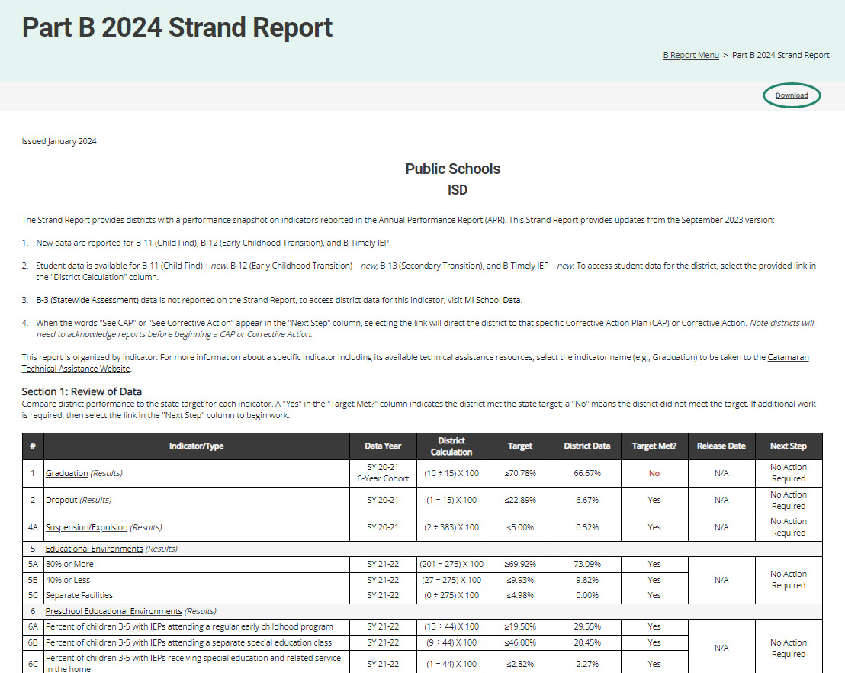
Strand Report
Summarizes district performance on the State Performance Plan (SPP) Indicators and priority areas.
When there is a CAP or Corrective Action, there will be a link in the Next Step column. Select the link to be taken to the specific item.
Use the Download link at the top of the screen to download a PDF.
Notes:
The Strand Report is issued in each release of Catamaran and most of the items are updated in the May release. In the January release of Catamaran, Indicators B-11 (Child Find), B-12 (Early Childhood Transition), and B-Timely IEP will have updated data. These updates will be highlighted. Each line is only updated with new data once per year.
We’ll dive into how to access your reports a little later in the webinar, but if you do have a CAP or a Corrective Action, you can click on the See CAP or See Corrective Action link in the Next Step column to be taken directly to that CAP or Corrective Action. Note, several districts may also receive a “See Data Alert” message on their Strand Report. If this is the case, return to the B Reports page to review the data alert letter.
You can use the download link at the top of the screen to save and then print a copy of your Strand Report to share with your colleagues or review and analysis process or RAP team if needed.

Slide 9
Monitoring Activities Report (MAR)
The MAR is included in every major release and provides important information to districts.
The MAR can be accessed from the Reports page.
Some messages are universal and go to all districts.
Some messages are targeted and are sent only to specific districts.
Reminders to review Letters of Findings or Data Alerts
Notifications of monitoring activities
Notes:
For those who are new to Catamaran, there are 3 “major releases” in Catamaran each year. These differ from the monthly releases because the major releases include additional reports, closeout and non-closeout letters, and must be “acknowledged” by the district. The major releases occur in Jan, May and Sept.
The Monitoring Activities report, or the MAR, can be accessed through the Reports page, which again, we will look at how to view and access the Reports page.
Some messages are universal and go to all districts, and some messages are targeted, and are sent only to specific districts, such as reminders to review Letters of Findings or reminders to review data alert letters.

Slide 10
Sample Monitoring Activities Report
Notes:
Here you see one common message from the MAR encouraging all districts to update their district’s personnel in the EEM. There are a few new notifications with this release. One is to build awareness of the courses on MVU for writing compliant and meaningful IEPs and the other is to spread the word about the Family Matters resources.

Slide 11
Letters of Findings, Data Alerts, and Reports
B-11 Letter of Findings
B-12 Letter of Findings
B-Timely IEP Letter of Findings or Data Alert
B-Valid & Reliable Letter of Findings or Data Alert
B-Complaint Final Decisions
Notes:
In this catamaran release there will be:
B-11 Letters of Findings
B-12 Letters of Findings
B-Timely Letters of Findings or Data Alerts – Many districts will receive a Timely IEP data alert. When your district receives one of these letters, you should work with your ISD personnel to obtain the student list. Following that, you should look into why the student’s IEP was late. Often, the student is no longer enrolled in special education, but the special education exit information was not input into MSDS. Correct any necessary information in future MSDS data submissions. You do not need to submit anything to the OSE.
B-Valid & Reliable Letters of Findings or Data Alerts – we will get more information regarding valid and reliable data in just a few slides.
B-Compliant Final Decisions

Slide 12
Closeout/Non-closeout Letters and Reports
B-11
B-12
B-Timely IEP
B-Valid & Reliable
Part B Monitoring
State Complaints
Notes:
Additionally, you’ll find closeout/non-closeout reports for:
B-11 (Child Find)
B-12 (Early Childhood Transition)
B-Timely IEP
B-Valid & Reliable
Part B Monitoring
State Complaints
These reports are for findings from 2023 or earlier. There may be a few instances where a district has closed a CAP but receives a non-closeout letter. This happens when the activity is closed in the few days preceding a release from Catamaran. If your district has closed the finding but receives the letter, there is no need for further action.

Slide 13
ISD Reports
Member District Monitoring Reports
Member District Data Reports (B-11, B-12, B-Timely IEP, and B-Valid & Reliable)
Student Data Report of Member District Data (B-11, B-12, B-Timely IEP, and B-Valid & Reliable)
Notes:
The Member District Monitoring report is a letter which tells ISDs which of their Member Districts are being monitored for B-4 in the coming months.
ISDs will once again have access to their member district data administrative reports right on the ISD’s reports page. New data for indicators B-11, B-12, and B-Timely IEP is provided. In addition to the updated data for those three indicators, there will also be a data report for Valid and Reliable Data. This data is not available directly to the member districts, so ISD will need to share that data out.

Slide 14
Corrective Action Plans (CAPs)
All CAPs:
Have the same workflow and timelines for completion.
Describe system level correction.
Are verified as corrected by the ISD.
Include links to either:
Student Level Corrective Action Plans (SLCAPs) or
District Student Data Report
Complaint CAPs:
Are issued each month as needed.
Include link to the complaint final decision.
Notes:
For corrective action plans known as CAPs, some general rules apply to all. All caps have the same workflow and timelines for completion. The first due date for these CAPs is the date by which the CAPs must be written and submitted. CAPs issued in January are due to be written and submitted by March 1.
CAPs must be verified and closed one year from the date the non-compliance is issued. We call this the year of correction. The CAP’s year of correction begins on January 15 for B11, B12, B-Timely IEP, and B-Valid & Reliable Data CAPs, but the year of correction begins on the date of the final decision for Complaint CAPs. If your district was issued a Complaint CAP as a result of noncompliance identified during a state complaint investigation, the date the final report was issued begins your year correction. For example, if the final decision was issued on January 8, the CAPs must be verified and closed by January 7 of the following year.
All CAPs describe the system-level correction the district will complete as opposed to the student-level corrections of SLCAPs. Every CAP is verified for correction by the ISD. Then, the ISD submits the CAP to the OSE for closeout. On the menu page of the CAP, there will be a link to either the student-level corrective action for Complaint CAPs or to a district student data report for B11, B12, B-Timely IEP, and B-Valid & Reliable data CAPs. This link to the student-level information should help the rap team as they uncover the root causes of noncompliance.
One continuing requirement when it comes to verification and closeout activities is the OSE is reviewing the district’s updated procedures as well as changes in practices. At the time the district completes its progress report, the district should upload its updated policies and procedures for review. If changes are needed, the progress report will be returned to the district with directions. If the procedures are compliant, the progress report approval process will continue.
During the verification stage of the CAP, the ISD reviews student files for evidence of change in practice. When the review is complete, the ISD submits to the OSE.
Since 2021, the CAP workflow has been updated with a verification return loop, so the ISD may now return the CAP to the district for more work if needed. This is to assist ISDs in streamlining the review process and to give districts access to the student lists the ISD is reviewing. The ISD should complete all returns to the district before submitting to the OSE for their review.
The OSE will then return the CAP to the ISD, indicating which student files need to be uploaded for OSE verification. The ISD will then upload supporting documentation onto the Verification page. We will see some screenshots of this in just a few minutes. This process is true for all CAPs, including Complaint CAPs.

Slide 15
Findings and Data Alerts Related to B-12
B-12 CAP or Corrective Action occurs if a student’s IEP is not held by their 3rd birthday.
B-Valid & Reliable CAP or Data Alert occurs if there are missing data components in MSDS regardless of whether the student’s IEP was held by their 3rd birthday.
A district may receive both items.
Notes:
There are two types of findings resulting from B-12 data.
A B-12 CAP or Corrective Action occurs if a student’s IEP is not held by their 3rd birthday
B-Valid & Reliable CAP or Data Alert occurs if there are missing data components in MSDS regardless of whether the student’s IEP was held by their 3rd birthday.
As a reminder, the data components required in MSDS include:
Date of Birth
Referral Date
Part C Transition Timeliness
Special Education Exit Reason and Date*
Initial IEP Date and Result
Timeliness of Initial IEP
The Special Education Exit Reason and Special Education Exit Date may be blank if the student has not exited MMSE but if those fields are blank, then Initial IEP fields are required. There is a memo on the B-12 page of the training site listing those fields if you didn’t get all of them.
A district may receive either a CAP or a Corrective Action and a Valid and Reliable CAP or Data Alert if they have students with IEPs not held by their third birthdays and missing data components.
Next, we will go over who might be involved, the foci, and suggested activities for B-12 CAPs and Corrective Actions and responding to B-Valid & Reliable CAPs or Data Alerts.

Slide 16
B-12 CAPs or Corrective Actions
Review the student data in the Strand Report to see which students’ records were determined to be noncompliant.
For each noncompliant student record, determine the root cause of the noncompliance.
Review and analysis process (RAP) team members should include Early On® staff, district staff, evaluation team members, and administrators.
Revision of policy, procedures, and/or practices should focus on addressing the root cause and ensuring a student’s IEP is in place before their third birthday.
Notes:
For B-12 CAP or Corrective Actions:
Review the student data in the Strand Report to see which students’ records were determined to be noncompliant
For each noncompliant student record, determine the root cause of the noncompliance
RAP team members should include Early On® staff, district staff, evaluation team members, and administrators
Revision of policy, procedures, and/or practices should focus on addressing the root cause and ensuring a student’s IEP is in place before their third birthday
Often times we see a need for increased communication or collaboration with the agency providing Early On services. If you include Early On staff in the RAP team, you will be better able to ensure all partners in the work understand their role and are working for improved practices.

Slide 17
B-Valid & Reliable CAPs or Data Alerts
With the ISD review the data in the Student Data Report of Member District Data on the ISD’s report page.
Determine which of the required fields are missing (See the technical assistance document for a list of required fields).
For each noncompliant student record, determine the root cause of the noncompliance including whether the ISD or district submit the missing fields.
Convene a team including Early On staff, district staff, administrators and those involved in the data submission process to revise policy, procedures, and/or practices.
Plan to use the EOY collection for verification.
Notes:
For B-Valid & Reliable Data Alerts: No action in Catamaran is required but we do recommend you look into the data.
With the ISD review the data in the Student Data Report of Member District Data on the ISD’s report page. This list is only the students for whom the data was incomplete, unlike the B-12 data which has compliant and noncompliant students.
Determine which of the required fields are missing (See the B-12 technical assistance document for a list of required fields)
For each non-compliant student record, determine the root cause of the noncompliance including whether the ISD or district submit the missing fields
RAP team members should include Early On staff, district staff, administrators and those involved in the data submission process
Revision of policy, procedures, and/or practices should focus on addressing the root cause and ensuring all data fields are submitted for students in the B-12 pool
For the Valid and Reliable data CAPs, we hope that by separating the data submission issues from the late transition issues, the underlying causes of noncompliance will be clearer and easier to address. We also know there will be questions about the data, and we have staff to answer those questions. Each ISD has a monitoring team member assigned who can help with the data. We will show you where you can locate those assignments on theTA site in a few minutes.
Plan to use the end-of-the-year collection in MSDS to verify the revised policies, procedures and practices are now in place and that for all relevant students, the required data fields are submitted. If your district plans to use the end-of-the-year collection for verification, you will still have enough time in case there are any errors to correct again before this CAP will become an UNC.

Slide 18
Corrective Action
Applies to B-11, B-12, and B-Timely IEP.
Addresses noncompliance to ensure future students are properly identified for special education and current students’ IEPs are updated in a timely manner.
Districts submits to ISDs for verification by October 1.
ISDs submit to MDE for closeout by November 1.
Verification includes a review of student files or interview if no student files are available.
Notes:
Corrective actions are being issued for B11, B12, and Timely IEP. The corrective action is less intensive than the traditional CAP process. This activity applies to districts where the submitted B-11 or B-12 data in the Michigan Student Data System (MSDS) indicated only one student record contained noncompliance, and the district did not have a Corrective Action the previous year. For Timely IEP Corrective Actions, if the data indicated that 80-90% of students had an annual IEP review within one year of their previous IEP, the district was issued a Corrective Action.
For this activity, the district selects one or more methods to ensure all future students are properly identified for special education and all IDEA regulations are implemented. When the district is ready to request closeout, they will return to the activity to provide evidence for the selected method(s) and then upload any supporting evidence as appropriate. We anticipate that this process can be finished very quickly and will not take the full year of correction to complete. If the district needs the full year, then the District submits to the ISD for verification by October 1 and the ISDs submit to MDE for closeout by November 1 of 2024.
The Corrective action is less intense than a CAP and many districts are able to complete this activity within a few weeks or months.
The next slide shows the Corrective Action form from the district’s view.

Slide 19
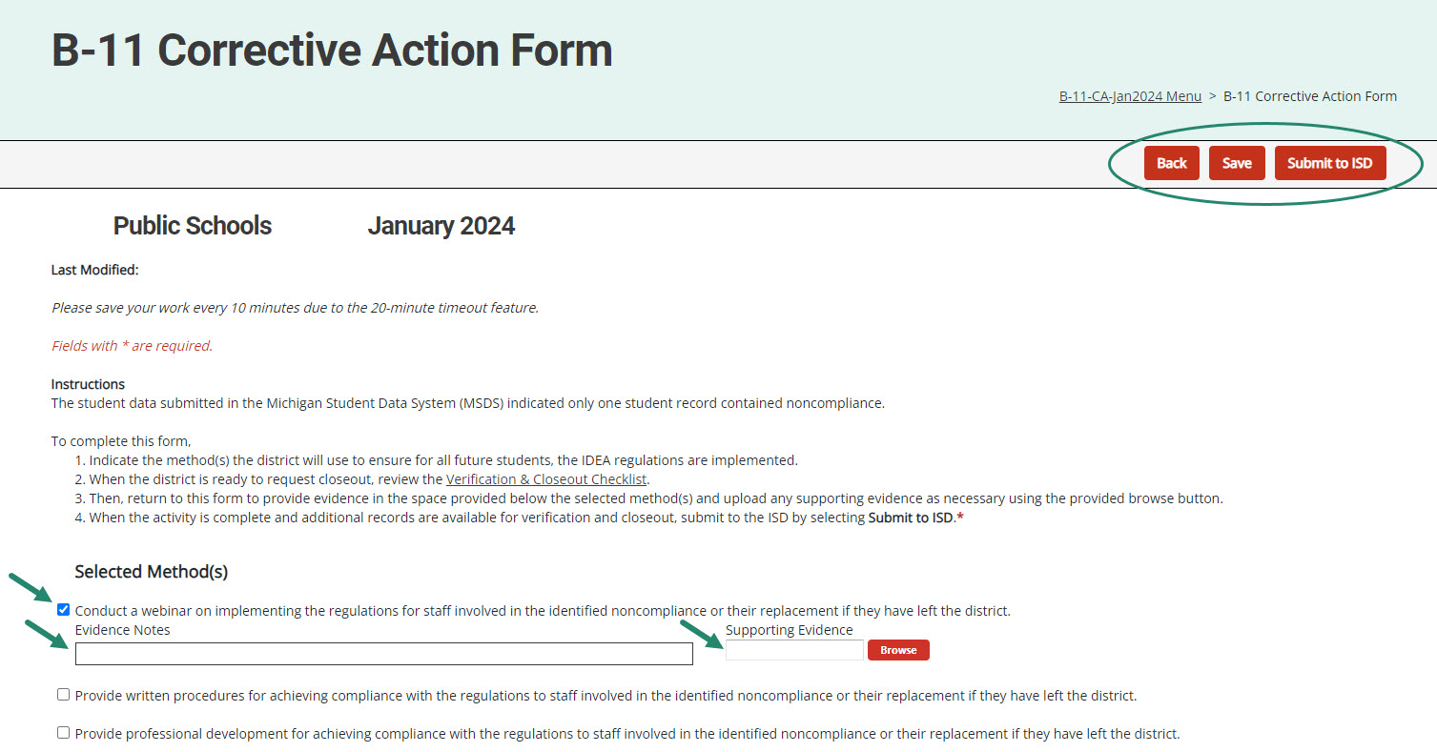
Corrective Action Form (District View)
Notes:
Districts select the method(s) they will complete and save the page. Return to this page after those method(s) have been implemented to enter evidence notes and upload any supporting documents in the space(s) provided.
When complete, districts may submit to the ISD either from the Corrective Action Form or from the Corrective Action Cover page.

Slide 20
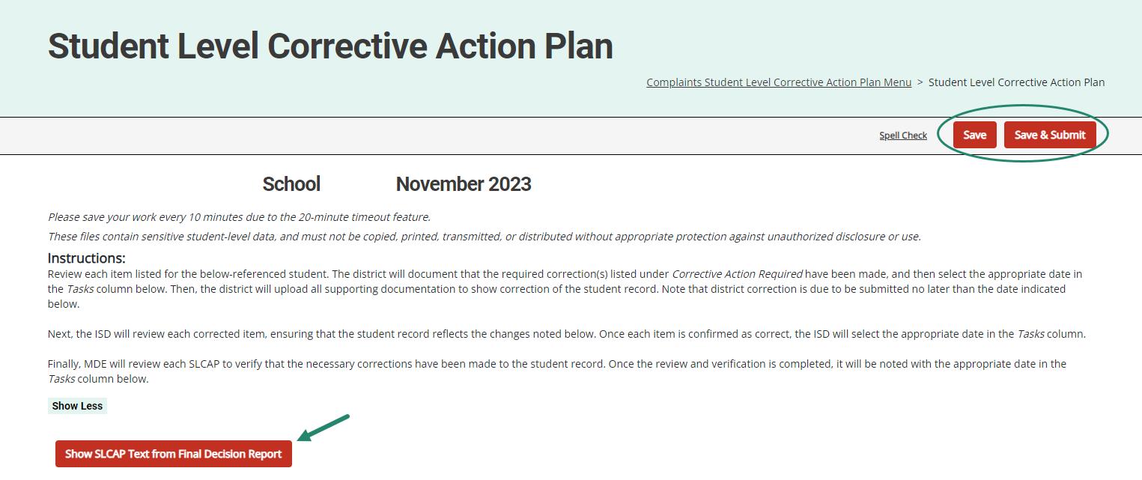
Student Level Corrective Action Plans
Notes:
SLCAPs correct individual student level noncompliance. They are usually due within 30 school days.
SLCAPs are verified as corrected by the ISD and reviewed by the OSE.
Each individual SLCAP must be closed before the CAP is closed.
The example shown here is highlighting a link from a Complaint SLCAP to the more explicit language of the final decision.
There are also SLCAPs for the Part B Monitoring activity which will be included in this release.
Let’s pause here to see if there are any questions about the content of the January release before we move to navigation.

Slide 21
Catamaran Navigation
Notes:
For all of our new users and those of you who are occasional users, let’s take a closer look at navigating in Catamaran.

Slide 22
Catamaran Login
https://catamaran.partners
Notes:
Note the letter S after http, the S means this is a secure site. It does contain student level information and so passwords should not be shared. Occasionally, districts and ISDs may want to review the Organization member list to verify it is up to date. If any staff at the district or ISD no longer needs access to Catamaran, please contact the Help Desk to end their system access.

Slide 23
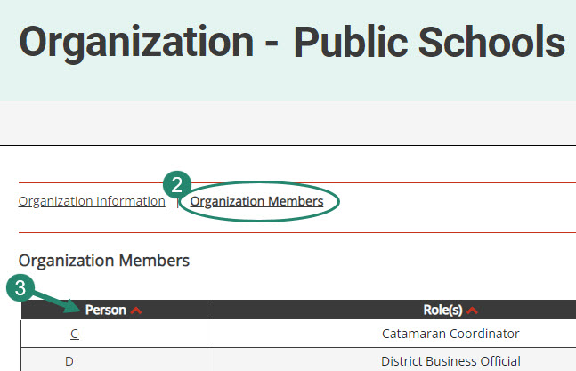
Review Organization Member Names
To review organization member names within Catamaran:
Log in and locate the Tasks Overview.
Select the organization’s name in the Organization column.
Select the Organization Members link from the Organization page.
Review the list. If changes are needed, contact the Catamaran Help Desk for assistance.
Notes:
With the beginning of a new year, please take some time to review organization member names within Catamaran:
To do so, log in and locate the Tasks Overview
Select the organization’s name in the Organization column.
Select the Organization Members link from the Organization page.
Review the list. If changes are needed, contact the Catamaran Help Desk for assistance.
Another reason to view this page, especially for new users is to find out who else in your organization has a Catamaran role. That person or people may be able to help you along as you begin to navigate Catamaran. This is one way to ensure that members who are no longer with your organization will not receive notifications.

Slide 24
View Reports
View available reports on the Tasks Overview at the bottom of the Dashboard.
Select the link in the Activity column (for example, B Report) to access the Reports page.
Notes:
Let’s dive into how to access, view and acknowledge reports. Also, please note there is a How to document on the Catamaran Technical Assistance website that outlines how to acknowledge reports step by step.
When logging in, B Report will be populated on the Tasks Overview. Select the link in the Activity column (for example, B Report) to access the Reports page.
Note: If you have previously applied a filter to the Tasks Overview, it may also be necessary to clear filters before applying a new one. As a reminder, you can narrow tasks down, by applying a filter such as Release, Type, or Organization.

Slide 25
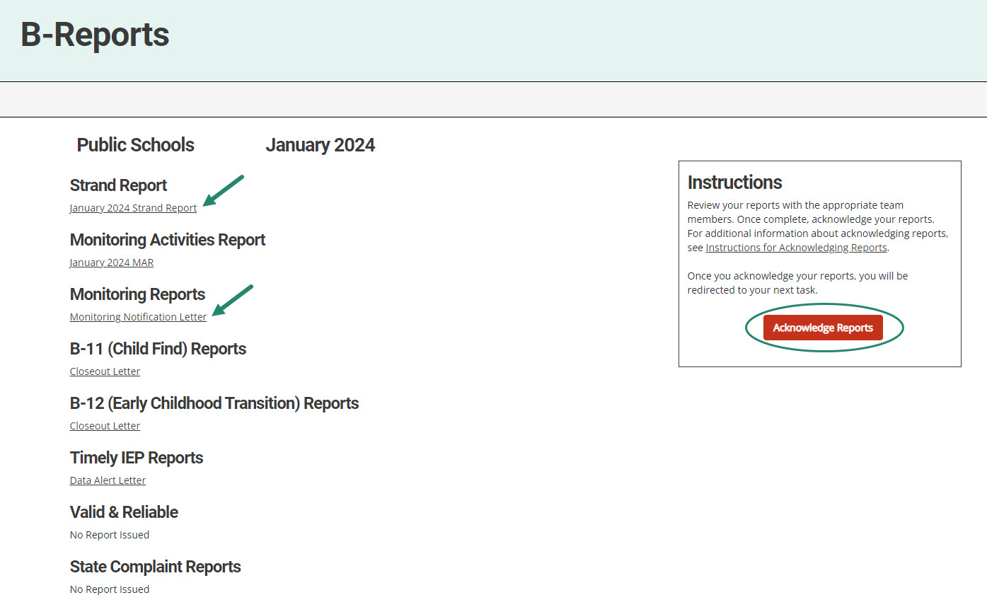
Access Reports
On the Reports page, select any report link to view that report.
Review and share the reports with appropriate team members.
Notes:
Once you reach the Reports page, you can select any report link to view that report.
Then, you can review, print, and share the reports with appropriate team members

Slide 26
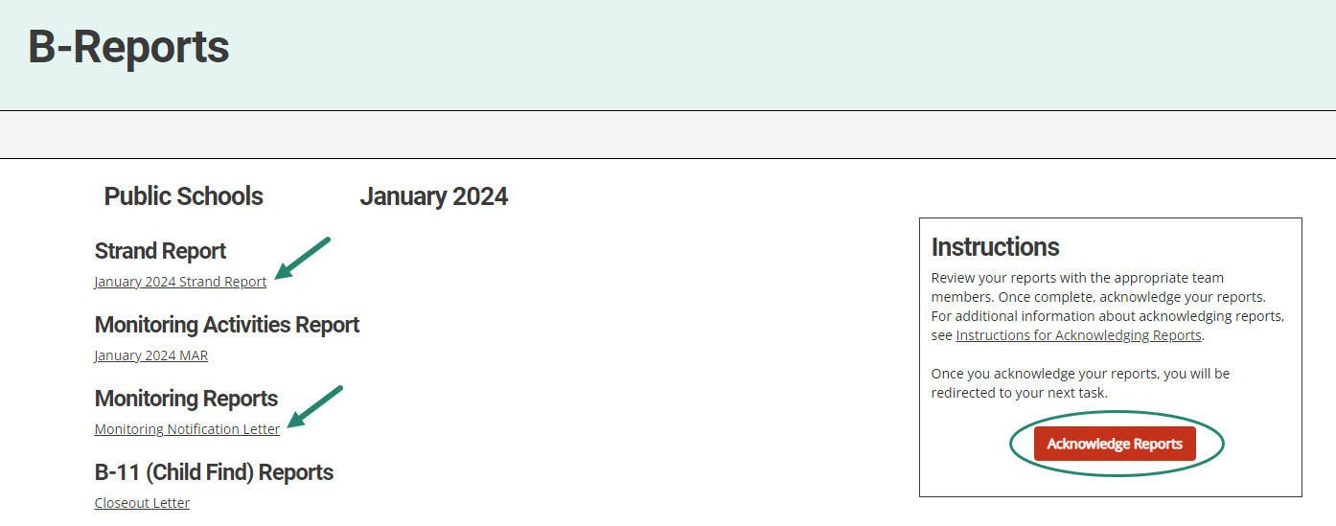
Acknowledge Reports by February 15
Acknowledge reports by selecting the red Acknowledge Reports button on the Reports page.
Note: When reports have been acknowledged, additional tasks become available as appropriate (such as a CAP).
Notes:
Reports must be acknowledged by February 15.
To acknowledge reports, select the red Acknowledge Reports button on the Reports page.
Once reports are acknowledged, the district will be returned to the Dashboard where any additional tasks such as a CAP will be become available. You may need to clear any previous set filters on the Tasks Overview to see any new tasks. If there are no additional tasks, then a message of “You have no tasks to view” will appear in the place of the Tasks Overview list.

Slide 27
After Acknowledging Reports
Work cannot be completed in Catamaran until reports have been acknowledged.
What to do after acknowledging reports:
Review Reports page: Does my district have findings?
Review Strand Report: What are the next steps?
Review MAR.
Decide whether the district should convene a RAP Team.
Notes:
New work which has been issued in this release can not be completed in Catamaran until reports are acknowledged. In fact, the work is not even visible in Catamaran until the reports are acknowledged.

Slide 28
Complete Tasks with RAP Team as needed
Check the Tasks Overview or the Strand Report to see if the district has a CAP or Corrective Action.
When there is a CAP or Corrective Action, convene a RAP Team to work through the activity.
Suggested RAP Team members include:
District and ISD personnel such as special and general education administrators
School improvement team representative
Parents
Service providers including general or special education teachers
Data experts or program specialists
Notes:
After sorting through and sharing the information, you’ll need to see if you have a CAP or Corrective Action to work on. You can check your Tasks Overview on the Dashboard (remember to clear any filters before applying a new one) or take another look at the Stand Report to see if you do indeed have a CAP or Corrective Action.
If you do, you need to convene a RAP Team to work through the CAP/Corrective Action.
Important note: if you have a Complaint CAP, it will not be listed on your Strand Report. You will need to check the Tasks Overview for Complaint CAPs.

Slide 29
Access System Reports
Hover over the user’s name.
Select Reports from the drop-down menu.
Notes:
For ISD personnel who want to see all the work of their member districts when the release happens, there is another report which they can run so see all of the work of their districts even before the districts have all acknowledged their reports.
If you hover your cursor over your name on the upper right side of the screen, you will get a dropdown menu. Select Reports to access system level reports, these are different from the other reports such as the Strand report which are district specific.

Slide 30
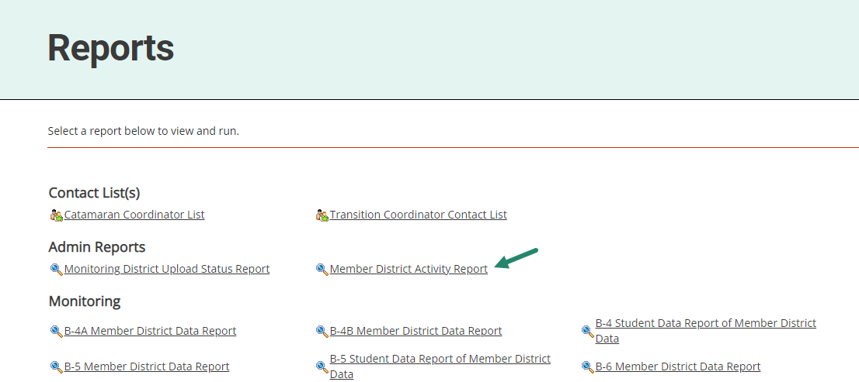
Access Member District Activity Report
Under the topic Admin Reports, select Member District Activity Report.
Notes:
If you have not been to this page, I encourage you to come to this when you have some time. There are many valuable resources here with several years of data. For today, look under the heading of Admin Reports for the Member District Activity Report and click on it.
This report will list all of the items being issued in the ISD and the due dates. It’s a helpful organizational resource.

Slide 31
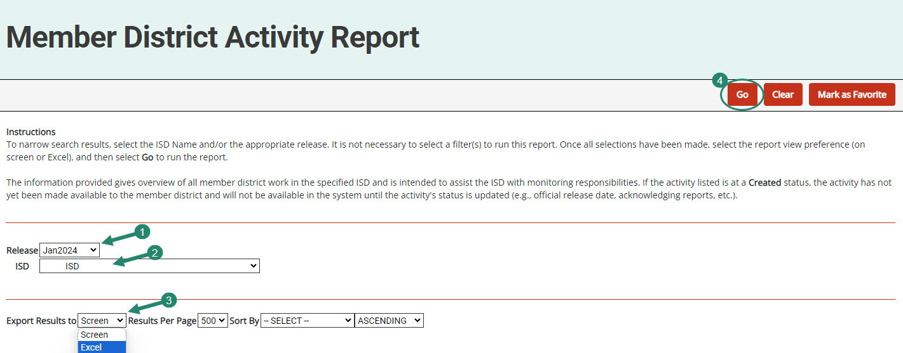
Run Member District Activity Report
Select the
Release
ISD
Format
Choose Go
Notes:
From the Member District Activity Report, you can select the Release, in this case, you will want Jan 2024. Select your ISD, the type of report you want, and then click Go. This will provide ISD users the full list of activities that are being issued to your member districts. You can see, at a glance, the work that is being issued.

Slide 32
Updates and Tips
Notes:
We have made some system updates recently and would like to review previous updates to progress reports, verification pages, the corrective action activity, and the timeout feature. Let’s take a closer look at those.

Slide 33
CAP Activity Page – B-Valid & Reliable CAPs
Available for B-Valid & Reliable CAPs that come from B-12 data
Catamaran will populate:
Monitoring Findings
Required Corrective Actions
First Activity Step – watch Ways to Improve Part C to Part B Transition Data video
Districts will be required to complete these actions and the activity step prior to requesting closeout of the CAP.
Notes:
For the B-Valid & Reliable CAPs that come from B-12 data, we will populate monitoring findings, required corrective actions, and the first activity step for you. Districts may choose to provide additional activity steps where appropriate.
The Monitoring Findings states:
The district is not in compliance with the Individuals with Disabilities Education Act (IDEA) regarding the submission of valid and reliable data related to early childhood transition of students from Part C to Part B.
An analysis of the district's 2022-2023 data as submitted to the Michigan Student Data System (MSDS) related to indicator B-12 (Early Childhood Transition) indicates the district did not submit all the data fields necessary to determine compliance for indicator B-12.
The Required Corrective Action states:
The district should work with the intermediate school district (ISD) to review the data that was submitted, determine which data fields were not submitted and why, and then develop procedures and practices to support the district in submitting valid and reliable data.
The district should also identify one or more individuals to watch the training resource video, Ways to Improve Part C to Part B Transition Data in the first row of Question 3 below. This training resource video is part of a series of training videos in the MSDS Data Quality Videos found on the Catamaran Technical Assistance Website. The video is appropriate for staff with programmatic or data responsibilities at either the district or ISD level.
To access this video, select the link above and then enter the viewer’s name and email address. The viewer will have an opportunity to respond to questions throughout the video to verify understanding of the presented material.
When the CAP is submitted for Verification and Closeout, MDE will verify its records to ensure the video was watched by the individual(s) identified with this question.
The first activity step is provided. Districts will need to write additional activity steps where appropriate.
Staff will watch the training resource video, Ways to Improve Part C to Part B Transition Data. The individual(s) named here will watch the video on the date shown with this statement.
For the additional work of meeting with the ISD and developing procedures, the RAP team will develop those steps and add them.
The next two slides show the updated CAP Activity Page for the Valid & Reliable CAP.

Slide 34
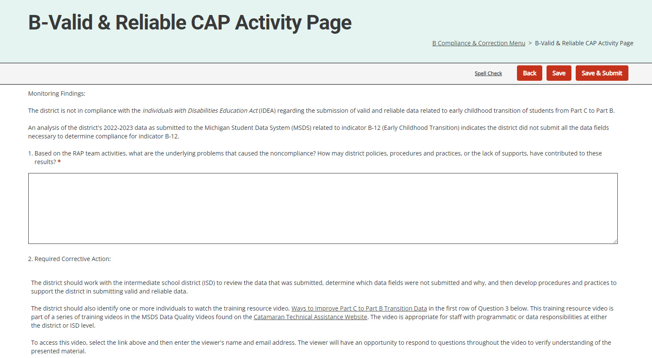
Updated CAP Activity Page (2)
Notes:
Here is a screenshot of the updated CAP Activity Page for the Valid & Reliable CAP.

Slide 35
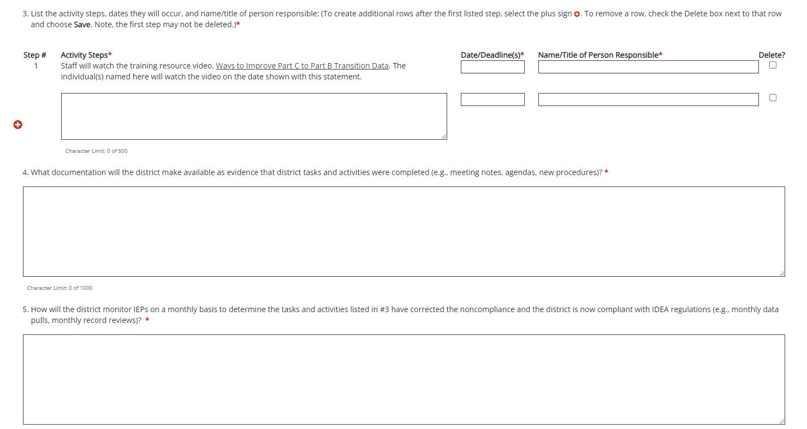
Updated CAP Activity Page (3)

Slide 36
Question 3: CAP Activity or CAP Finding
The Delete? checkbox allows users to remove rows as needed.
The Step # field has been updated to auto-number rows.
Notes:
Last year, we updated the activity step question (question 3) for the CAP Activity or CAP Finding pages to allow users to delete a row without having to back out any information. We wanted to remind you of this feature and how to use it.
To remove a row, check the Delete box next to that row and choose Save. The unwanted row will be removed from the page.
This will make updating the CAP Activity/Finding page easier should the CAP be returned for modifications. Thus ensuring the correct activity steps are then populated onto the following pages (e.g., Progress Report, etc.).
Also, as we mentioned in September, we have updated the Step # field for Question 3 to auto-number for you. This will be helpful if you delete a row ☺ Once you save the page, Catamaran will apply the numbering to the listed steps. This new update will be important with other updates we have made for you in the CAP. This update should streamline the process of entering information into Catamaran.

Slide 37
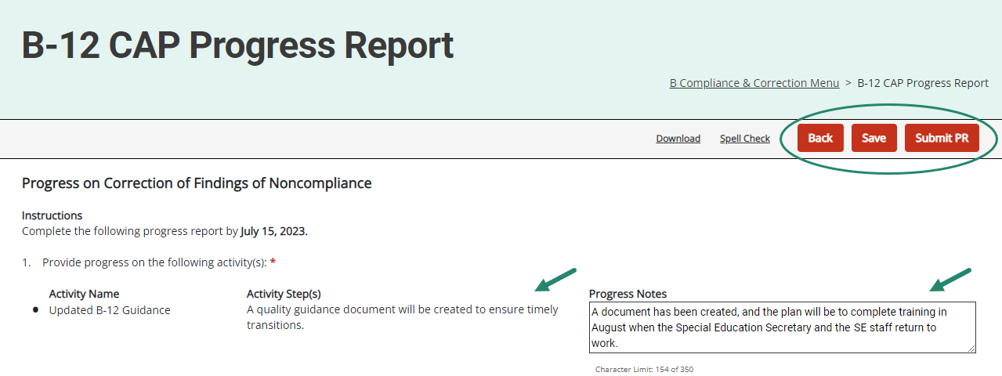
Progress Report
Available for all CAPs
Activity step(s) from the CAP Activity (or Finding) page will be displayed on the Progress Report.
Member districts will report progress on specific activity step(s).
Notes:
The Activity step(s) from the CAP Activity or CAP Finding page will be displayed on the Progress Report.
Member districts will report progress on each specific activity step(s). It is no longer necessary to return to the CAP Activity or CAP Finding page to complete the Progress Report. This should make the process easier for both the district as they write the progress report and the OSE as they review the report.
On those Valid & Reliable CAPs from B-12 data, the progress report will have the populated activity step displayed. The additional activity steps provided by the district for this CAP will also be displayed.
When submitting the progress report, the district will upload the relevant procedures for the OSE’s review.

Slide 38
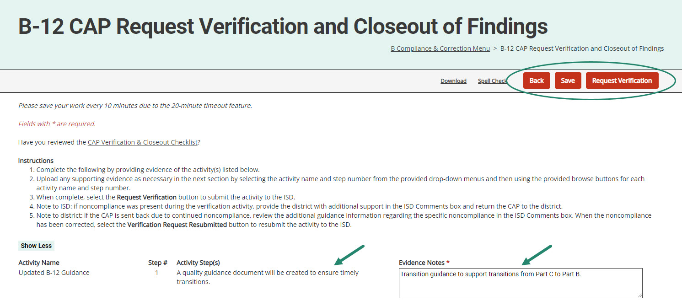
Request Verification & Closeout
Districts provide evidence and documentation for specific activity step(s).
This information is available to the ISD to assist with CAP verification.
Notes:
Like the Progress Report update, this update applies to Data, Monitoring, and Complaint CAPs.
It’s unnecessary to return to the CAP Activity (or Finding) page to complete this form to request closeout.
Also available on the Complaint CAP verification and closeout form, but only on the Complaint CAPs, is a place to upload evidence of ordered compensatory services.
For all CAPs, ISDs may return a verification request to the district. To do this, the ISD can return the CAP to the district from the Request for Verification and Closeout of Findings page. If the ISD returns the verification request to the member district, the district can review the files the ISD determined to be non-compliant. The corrections can be made, and the district can resubmit its verification request from this page. There will be an ISD Comments box on this page for any instructions the ISD may want to leave for the district.
For B-Valid & Reliable CAPs from B-12 data, the request verification & closeout form will have the populated activity step displayed and the district provided activity steps for this CAP.

Slide 39
Supporting Evidence Uploads
Notes:
In May 2023, the Request Verification & Closeout page was updated to provide a new Supporting Evidence Uploads section. This will allow you to upload multiple documents per activity step!
Once you have provided your evidence notes, scroll down below the listed activity steps to upload any supporting evidence. Remember, this is not a requirement at this step; however, we wanted to make this easier for you.
To do this, below the listed activity steps, select from the provided drop-down menu(s) the appropriate step # (and/or finding # if a Monitoring CAP), then upload/tag your specific documentation to a specific finding/step.
NOTE: This update now applies to Monitoring and Data CAPs issued beginning May 2023 and will now be included with Complaint CAPs issued January 2024.

Slide 40
Data CAP Verification for ISDs
Available for B-11, B-12, and B-Timely IEP CAPs
Activity step(s) and evidence, including attachments, will be displayed on the CAP Verification page.
ISDs review both activities and evidence from this page to verify completion.
When all activities are verified, the ISD will move to the next section(s) of the CAP Verification Activity page as appropriate.
Notes:
Once a district has completed its request for verification and closeout, the ISD can use this verification page to view the required activities listed in the activity steps and the district’s response to the activities and evidence of those activities.
It is no longer necessary to review multiple pages of the CAP.
Once the activities are verified, the ISD can move on to the other sections of the cap verification activity, which may include student record reviews or staff interviews.
Note: With the updates made to the Request for Verification & Closeout page, it was necessary to update the CAP Activity Verification section to display multiple uploads on the page. To do this, we are listing all District Evidence Uploads directly below this section on this slide. The next slide shows this new section.

Slide 41
District Evidence Uploads
Notes:
Once the ISD has reviewed the district evidence in the above table shown on the previous slide, scroll down to review any uploaded district evidence. Remember, since this was not a requirement at the Request Verification & Closeout step, there may not be any uploads in this section.
Once all reviews are complete, you can move to the next section(s) on the verification page.

Slide 42
B-Valid & Reliable CAP Activity Verification
District activity step(s) and evidence, including attachments, will be displayed on the CAP Verification page.
ISDs review both activities and evidence from this page to verify completion.
When all activities are verified, the ISD will move to the next section(s) of the CAP Verification Activity page as appropriate.
Note: the first activity step will be verified by MDE.
Notes:
For Valid & Reliable CAPs from B-12 data, the first activity step will be verified by MDE. ISDs will proceed with the verification of any additional activity steps. ISDs may want to look back at the progress report page to see any notes or items there.
Once a district has completed its request for verification and closeout, the ISD can use this verification page to view the activities that were required and listed in the activity steps, as well as the member districts’ response to the activities and evidence of those activities.
After reviewing the activities, the ISD will then proceed to the next section on the verification form.

Slide 43
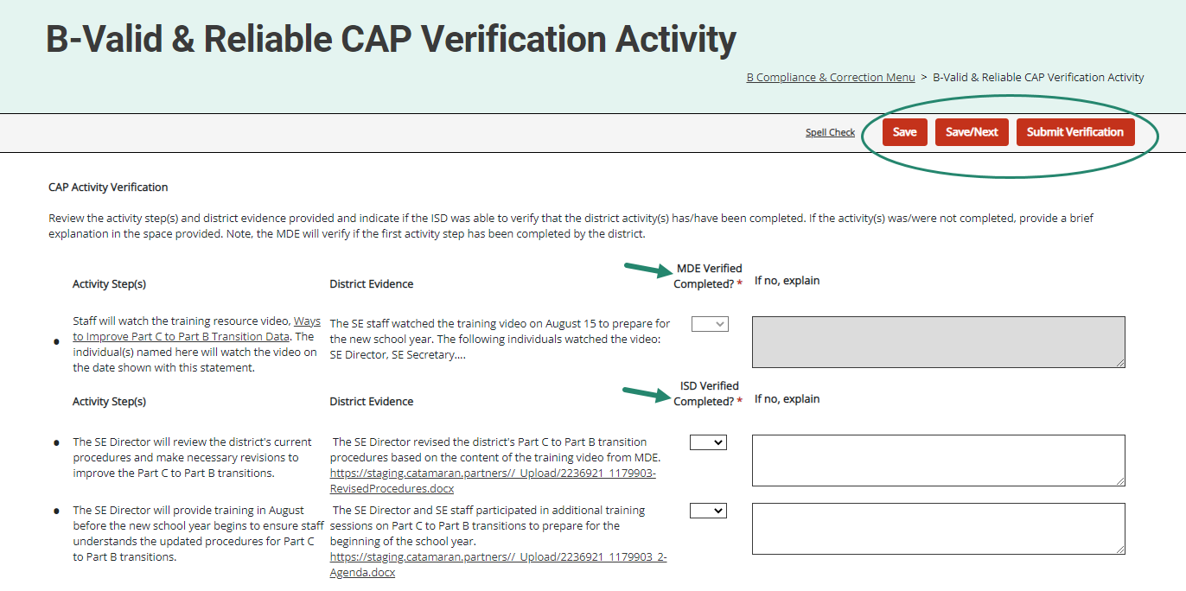
Valid & Reliable CAP Verification Activity Section
Notes:
Here’s a screenshot showing the CAP Activity Verification section for the B-Valid & Reliable CAP.

Slide 44
B-Valid & Reliable CAP Verification Student Record Reviews
ISD will review the district’s most recent Michigan Student Data Systems (MSDS) data submission.
Follow the procedures in the training resource B-Valid and Reliable Corrective Action Plan (CAP) Verification Activity for B-12 Data.
When noncompliance is identified during the verification, return the CAP to the district.
When the district has completed the requested tasks and/or training, it will resubmit the CAP for verification.
Notes:
The second section on the CAP Verification for B-Valid & Reliable CAPs is the Data Verification through Student Record Reviews.
ISDs will review the district’s most recent MSDS data submission and then follow the procedures outlined in the training resource, B-Valid and Reliable Corrective Action Plan (CAP) Verification Activity for B-12 Data, on the TA site.
If noncompliance was identified during the verification, the ISD should return the CAP to the district. Identify the cause of the ongoing noncompliance and provide additional or targeted training to the relevant personnel.
When the district has completed any requested tasks and/or training, then they will resubmit the CAP for verification.
Note: if there are no additional student records to review for B-12, then the ISD may skip this section student record section and complete interviews instead before submitting the CAP to MDE for verification and closeout.

Slide 45
B-Valid & Reliable CAP Verification Student Record Reviews Section

Slide 46
Data CAP Verification
ISDs complete verification per usual.
MDE reviews verification and writes a comment on the CAP Cover Page requesting supporting documentation when needed.
ISDs will upload supporting documentation on the CAP Verification Activity page and resubmit it to MDE.
Notes:
Once the ISD has completed its verification the ISD submits the CAP to MDE. MDE then reviews the verification and writes a comment on the CAP cover page requesting supporting documentation for one or more student files. The ISD then uploads the supporting documentation on the CAP verification activity page and resubmits the CAP to MDE for final review and closeout.

Slide 47
Complaint CAP Verification for ISDs
Verification Appendix will appear before the closeout verification worksheet on the menu.
Verification Appendix includes a “Date Verified” column in the student record review section.
Districts may view if the Complaint CAP is returned by the ISD.
When all findings of noncompliance are verified, the ISD will move to the closeout verification worksheet.
Notes:
The Complaint CAP Verification Appendix appears before the closeout verification worksheet.
There is a column on the verification form labeled “date verified.” The ISD can use this column to indicate the date the record was determined to be compliant. This may be helpful if you are conducting more than one verification activity. Member districts can view this page if the ISD returns the Complaint CAP to the district. At that time, the district can edit the date-corrected column. The member district cannot edit other columns the ISD completes. Once all the noncompliance is corrected and verified, the ISD will submit the closeout request to MDE.

Slide 48
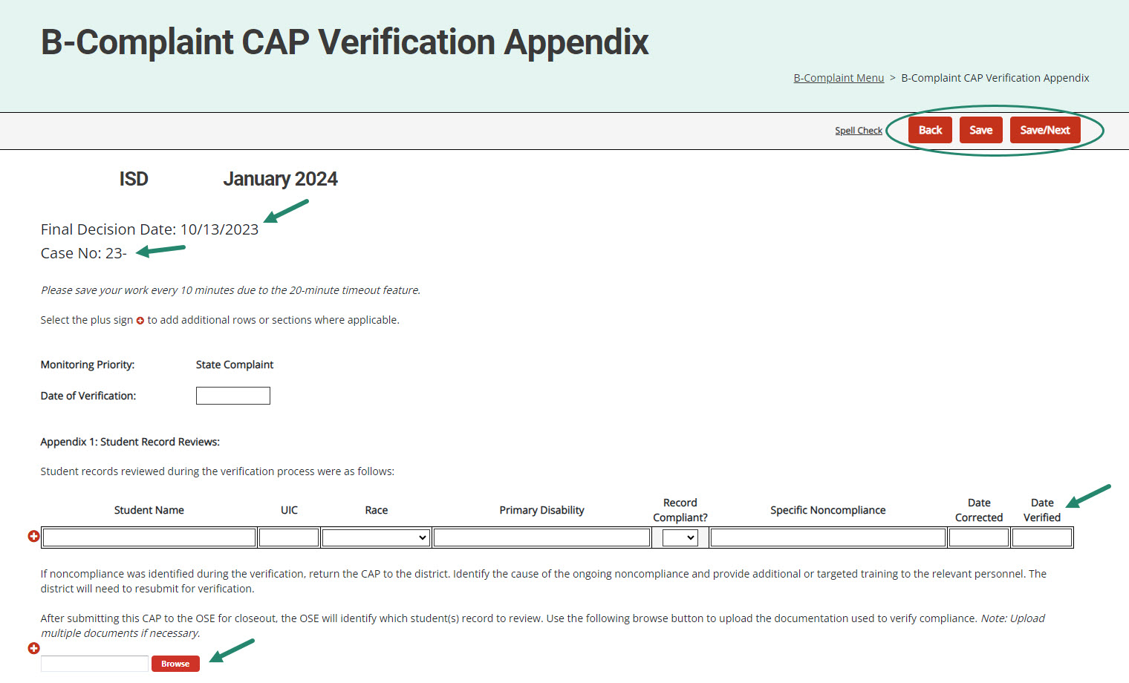
Complaint CAP Verification Appendix
The final decision date and case numbers are now on Complaint CAP forms.
ISDs complete the verification appendix and upload supporting documentation.
Notes:
Complaint case numbers and the Final report date are included on the Complaint CAP menu and forms.
This screenshot shows the Final decision date and case number on the Complaint CAP forms.
As ISDs complete the verification process, they occasionally find ongoing non-compliance. The ISD can return the CAP to the district to correct the records and complete other actions. Remember, to return the verification request to the district, go to the Request for Verification and Closeout page and select the Verification Request Returned button.
The verification appendix will be viewable by the district, and the district will be able to note the date of correction, as mentioned previously. The district will then resubmit the CAP to the ISD.
Arrows on this slide indicate the fields for the ISD to enter the new verification dates and the browse button to upload supporting documentation.

Slide 49
Corrective Action Form
Districts will:
Select appropriate method(s)
Provide evidence notes
Upload supporting documents as appropriate
Submit to ISD no later than October 1
ISDs will:
Review submitted corrective action
Complete verification activity
Submit to MDE no later than by November 1
Notes:
Let's move on now to the corrective action.
When issued a corrective action, districts will select the appropriate method or methods from the list provided.
Once they have completed the methods, they can return to the form in Catamaran to provide evidence and supporting documents as appropriate.
Once they have completed this they will submit the corrective action to the ISD for verification and closeout no later than October 1st although this can happen much sooner.
This process is different from the regular CAP process in that there is no submission and approval of the CAP nor is their submission or approval of progress reports.
Once the ISD has received the request for verification and closeout they will review the submitted activity, complete their verification and then submit to MDE for closeout no later than November 1st.
As the ISD completes their verification activity they will be looking for files which have been completed after the method of the corrective action was completed.
The ISD will not be looking at files that were completed before the corrective action methods were implemented.
October 1st and November 1st are the deadlines for these activities, but in most cases, districts could request verification and closeout before the end of the school year.

Slide 50
Corrective Action Form Page
Notes:
Here is a screenshot of the corrective action form for B 11. The member district will indicate with a check mark which method they will be implementing. Once implemented they will return to this form upload their evidence in the browse button and click submit to ISD.

Slide 51
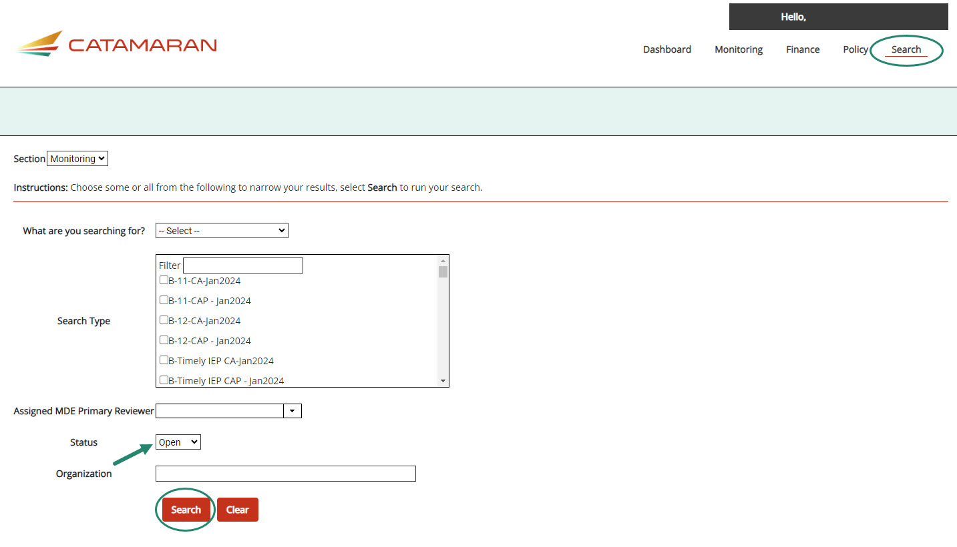
Monitoring Search Page Update
Notes:
New with the January 2024 release, users will have the ability to filter on “Open” or “Closed” statuses for their Monitoring work. We anticipate this will be useful for those who manage multiple types of work for larger school districts and ISDs.
To search for Open work, navigate to the Search tab, select Monitoring for the section you want, and then select the type of work (e.g., CAP, Reports, etc.) and then choose “Open” for the Status and then choose Search.
Catamaran will return all “Open” work in the selected category.
Note, it is not necessary to pick a specific category such as CAP or Reports; however, you will need to select “Monitoring” to run this search.
We hope this added feature will be useful to you manage your work.

Slide 52
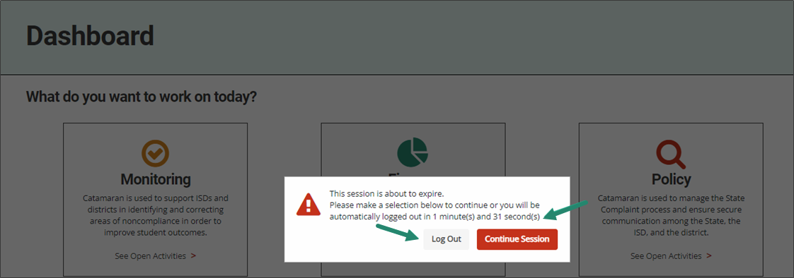
Timeout Feature
Notes:
And the next few slides I want to point out some of the continuing features.
The timeout feature in Catamaran :
Provides clarity so all users know exactly what will happen due to inactivity and to avoid log out if desired.
Provides an option to either save and logout or to continue your session.
Provides a better countdown timer so a user understands how much time they have left before being logged out.

Slide 53
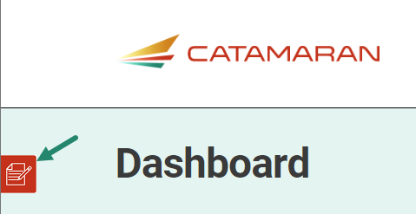
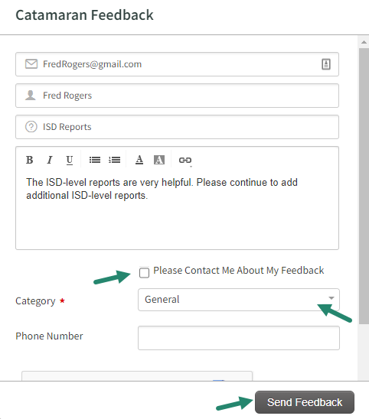
Feedback Feature
Feature available to offer feedback about Catamaran at any time.
Enter contact information.
Choose to be contacted about feedback.
Notes:
On the left-hand side of any screen in the system you will find the feedback feature. The OSE as well as our PSC partners appreciate your feedback related to the system.
If you wish to be contacted about your feedback you can enter contact information, and someone will reach out to you.
If you prefer to provide anonymous feedback, we would also like to hear from you. You do not need to leave your contact information.

Slide 54
Chat Feature
The Help Desk is available by chat during business hours.
Choose the Chat icon located in the lower right corner of the screen to begin a chat.
Enter basic information.
The issue will still be logged in the Help Desk database (just like a phone call).
Notes:
Another important feature to note is the chat feature. As you work through the system, you may find yourself in need of some support. Rather than going to look for a how to document on the technical assistance website, the help desk is available for chats during regular business hours.
If you select the chat icon in the lower right corner of any screen, you can begin a chat session.
If you do choose to use the chat session, the help desk continues to log the issue so the OSE and our partners at PSC know where more training or support might be needed.

Slide 55
Use breadcrumbs to navigate
Use the breadcrumbs menu to navigate in Catamaran:
The breadcrumbs are a trail to follow back to a previous location, or click on the Catamaran logo to return to the Dashboard
Notes:
Finally, I would like to remind you about navigating in catamaran.
Do not hit your browser BACK button after submitting work or changing a status.
Many web browsers become confused and will give you an error message. You will be much more successful if you use the breadcrumbs to navigate to previous pages.

Slide 56
Resources
Notes:
Even with the best of training, there may be questions that arise later as you use the system. There are a variety of resources available to support you.

Slide 57
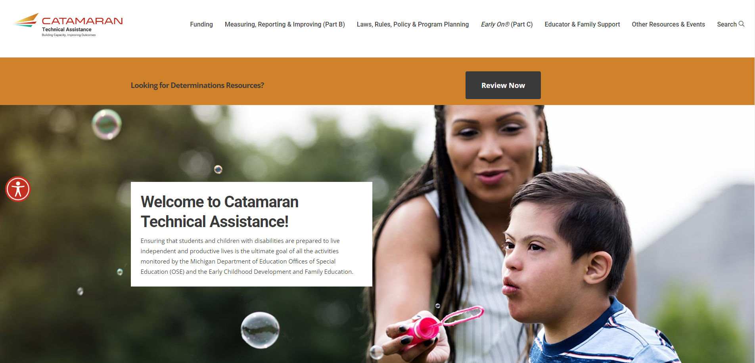
Catamaran Technical Assistance Website
Notes:
As many of you may already know, the revised Catamaran Training Website is now called the Catamaran Technical Assistance Website. The OSE in partnership with Catamaran users has redesigned the website to focus on increased technical assistance for Catamaran users.
The following slides highlight some of the features and navigation.
You can access the Catamaran Technical Assistance Website at training dot catamaran dot partners.

Slide 58
Catamaran Technical Assistance Website (2)
Notes:
As you scroll down the main landing page, you will see this section pictured here. It includes:
Documents the OSE is spotlighting,
Events and Deadlines (this is where the due dates are located now), and
Quick Links that you may find useful such as the MARSE or SPP.

Slide 59
Other Resources & Events
Notes:
Catamaran how-to’s are organized in one place under the Other Resources & Events menu.
Search for how-tos either by selecting district or ISD under either Monitoring, Policy, or Finance or
By using the how-to search form.

Slide 60
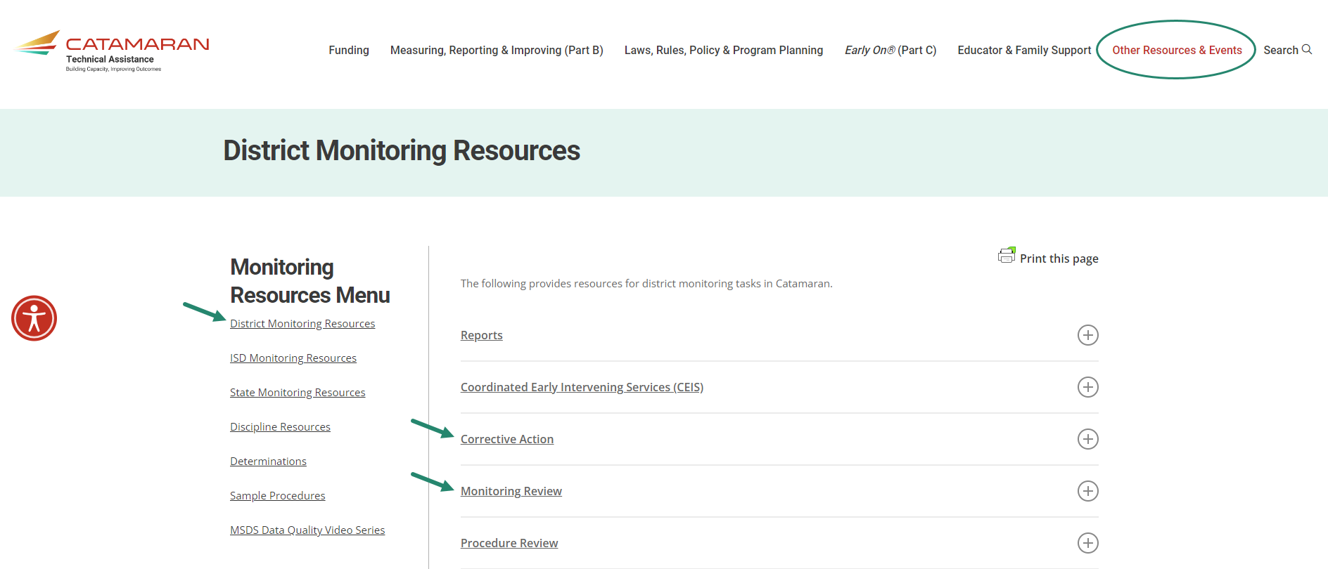
Monitoring Resources
Notes:
As a reminder, districts and ISDs have helpful resources available to them on the TA site.
To access the either the district or ISD monitoring resources pages, select Other Resources & Events, and then choose the District Monitoring Resources link or ISD Monitoring Resources link under the Monitoring heading shown on the previous slide.
Here’s a screenshot of the District Monitoring Resources page.
Topics like Corrective Action and Monitoring Review are here. Select the plus sign on the right to expand the section and view specific resources.
To navigate away from this page, you may select
Any of the links under the Monitoring Resources Menu on the left
Select any of the topics listed above (e.g., Funding, Monitoring, etc.) or
Select the Catamaran logo in the upper left-hand corner to return to the main landing page

Slide 61
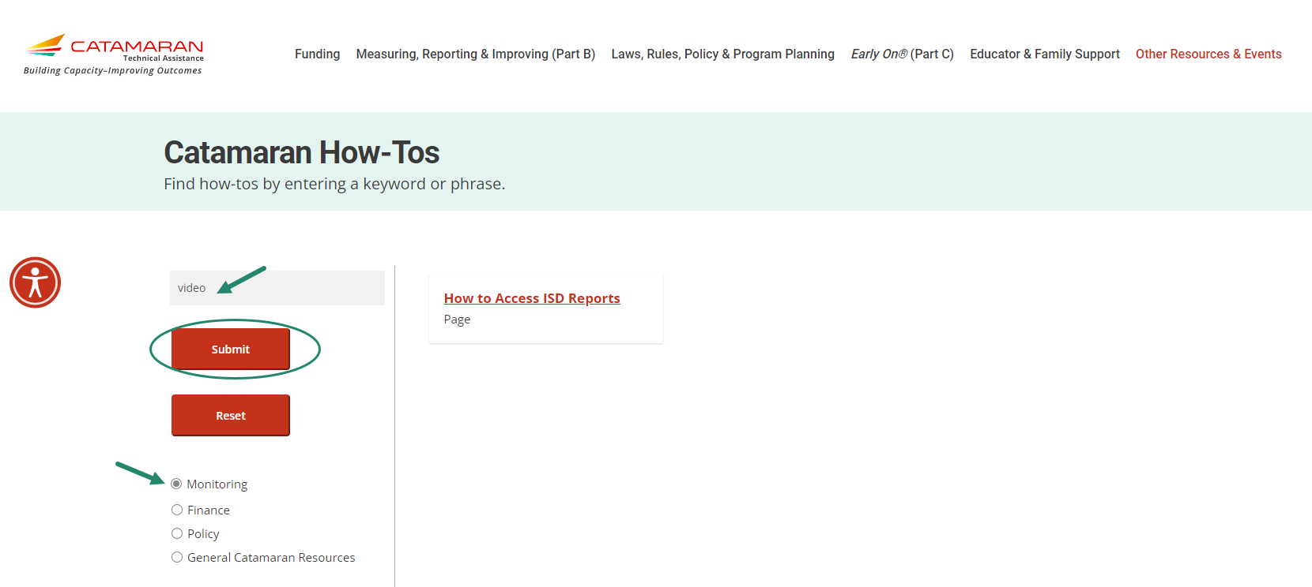
Catamaran How-tos
Notes:
In addition to finding how-to’s and other resources using the main categories under the Other Resources menu, website visitors may also use the Catamaran How-tos form.
Select the resource category from the left sidebar. If you wish to narrow your search results further, enter a keyword or phrase.
In this example, we selected Monitoring and then entered the word “Video”. This quickly narrowed the results to two pages that have the word “video” on them.

Slide 62
Navigating to Updated Indicator Resources
Notes:
OSE has been working over the last year to reformat the Part B Indicator pages. Rather than having to remember a specific indicator SPP number (e.g., B-1 or B-2), you only need look for the category (e.g., Graduation & Dropout). All topics which were previously listed as indicators are listed under the Measuring, Reporting, & Improving (Part B) menu located at the top of the TA site. To open the sub-menu with the list, select Measuring, Reporting & Improving (Part B) and the menu shown here will be displayed. To open a specific page, select the category, for example, Graduation & Dropout. Be careful when you move your cursor from the menu to the submenu. If you don’t move vertically, you may end up on another submenu.
With this update, we also updated the links to these pages too; however, some of you may have bookmarked the older links and that is okay. Not to worry, we are re-directing from the old links to the new ones.
The next slide shows a portion of the updated Graduation & Dropout page.

Slide 63
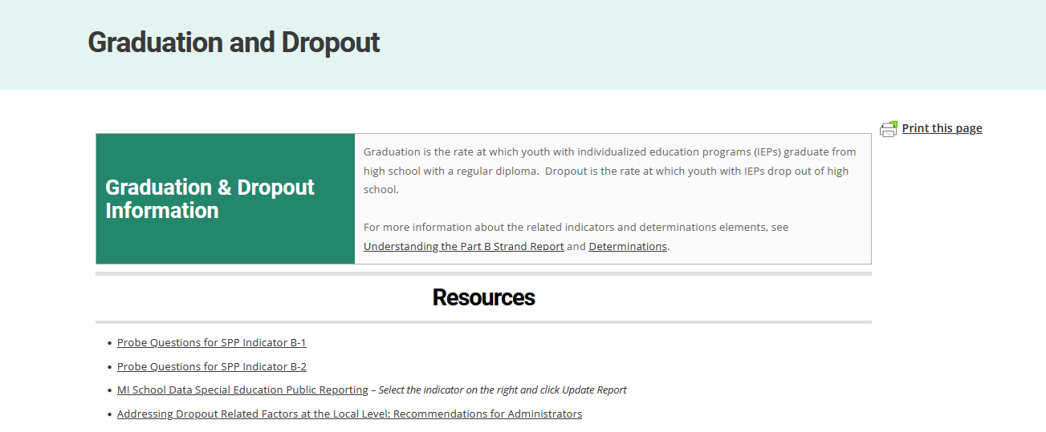
Updated Indicator Resources
Notes:
The example shown here is the Graduation and Dropout page. Each updated page has a brief description of the topic area along with several resource links. If the indicator is located on the Strand Report and/or Determinations, there will also be links to those pages as well.
Note, helpful content such as probe questions are still available along with newer content such as national resources.
We hope this re-organization and updated content will be useful to you.

Slide 64
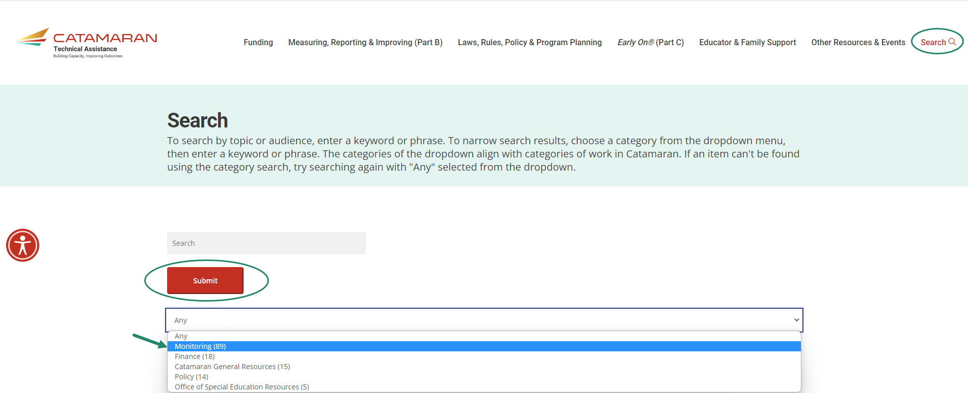
Search
Notes:
In addition to searching for Catamaran How-to’s, website visitors may also do an overall search of the website. To do this, select Search in the upper right-hand corner of the website and then using the provided drop-down menu, select your search category and choose Submit.
Just like on the Catamaran How-to form, you may also enter a key word or phrase to narrow your search results.
Content is continuously being updated and tagged to optimize search results.
I would encourage you to search for the word Assignments and get that map of which monitoring team member is assigned to which ISD. That resources has our contact information on there as well.

Slide 65
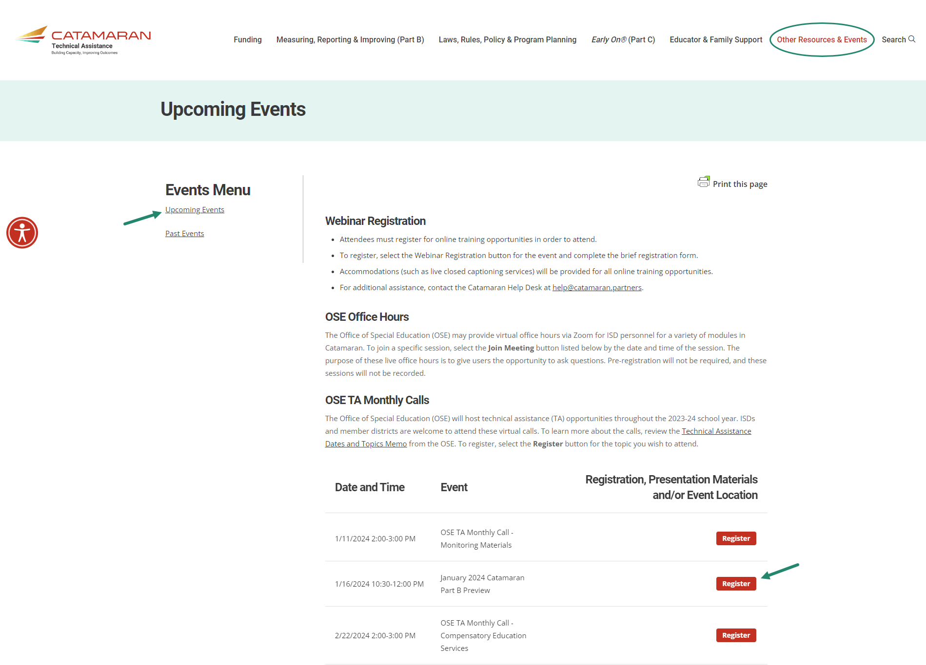
Events
Notes:
Finally, You may get to either the Upcoming Events or Past Events pages through the Other Resources menu or from the main landing page under the Events and Deadlines heading selecting either:
Register for Upcoming Events
View Past Event Recordings
Just as before you may
Register for upcoming events or
Access recordings and presentation materials from past events (including this webinar)
You will also notice you may now register for one of the OSE TA Monthly Calls on this page. If you missed one of the calls, the recordings will be available on the Past Events page.

Slide 66
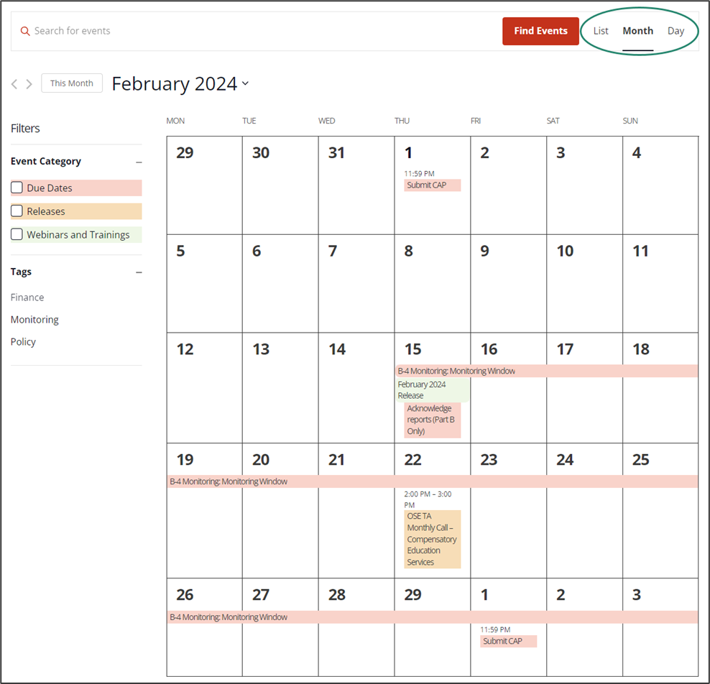
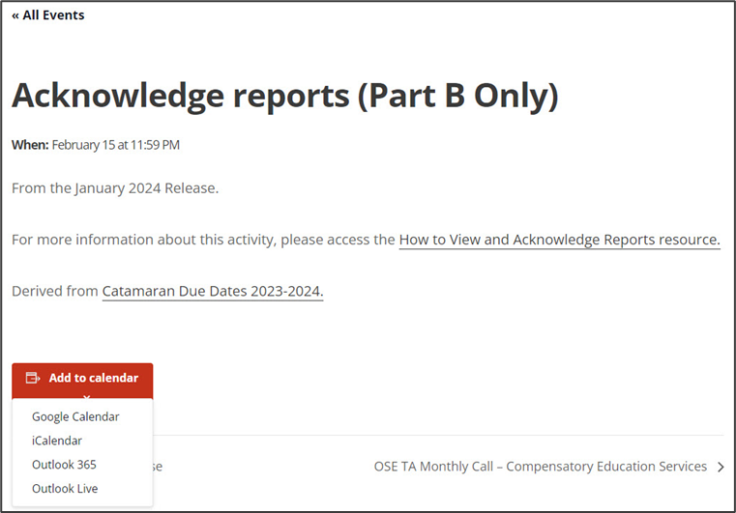
Catamaran Calendar
Coming Soon
Notes:
Coming soon on the Catamaran Technical Assistance site is a programmed Catamaran Calendar where users can view all upcoming events and due dates in one place. At the top right of the page, you can view the calendar in the view that works best for you by list, month, or day.
*From the month view shown here, you can drill down on a specific event for more information and add the event to your calendar.*
For upcoming due dates that have a how-to associated with it*, there will be a clickable link to the how-to.

Slide 67
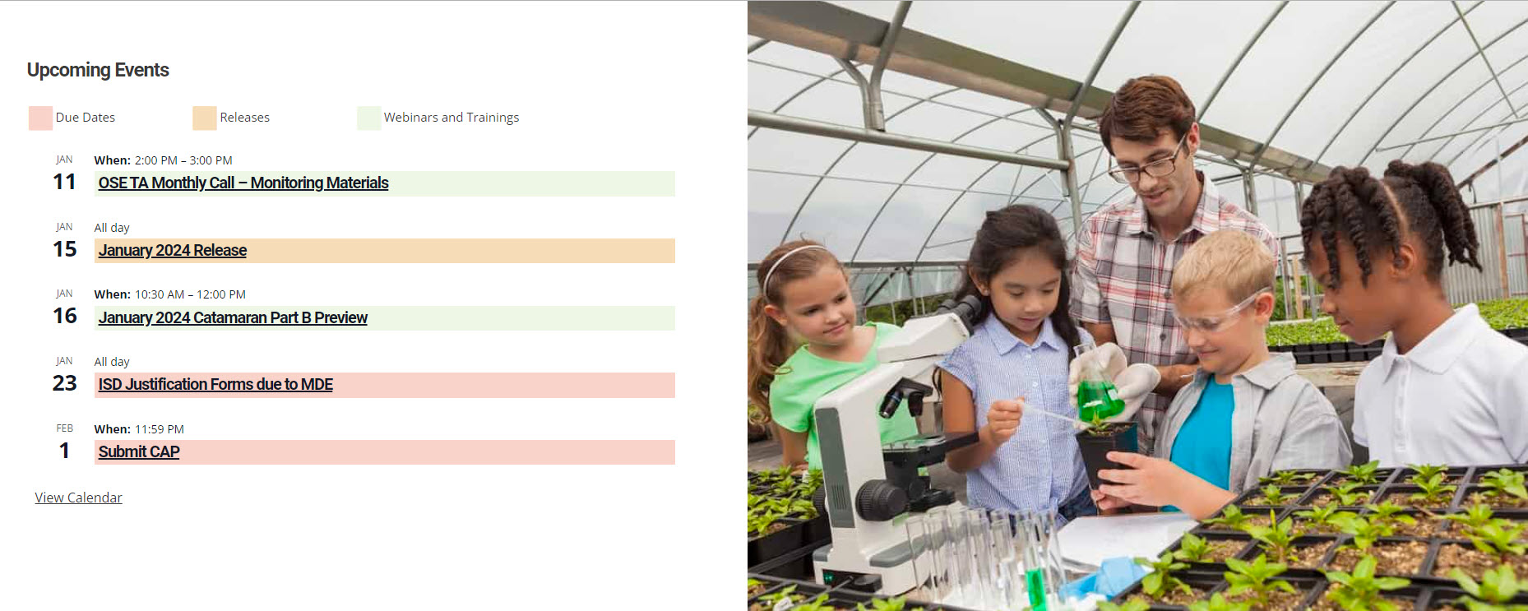
Catamaran Calendar List View
Notes:
You may access the Catamaran Calendar on the home page of the Catamaran Technical Assistance Website by scrolling to the bottom of the page. This calendar will display 5 calendar items in a list-view format.* To view the full-sized calendar select the View Calendar link at the bottom of the calendar. We hope this new page is useful for you and helps you to plan your work.

Slide 68
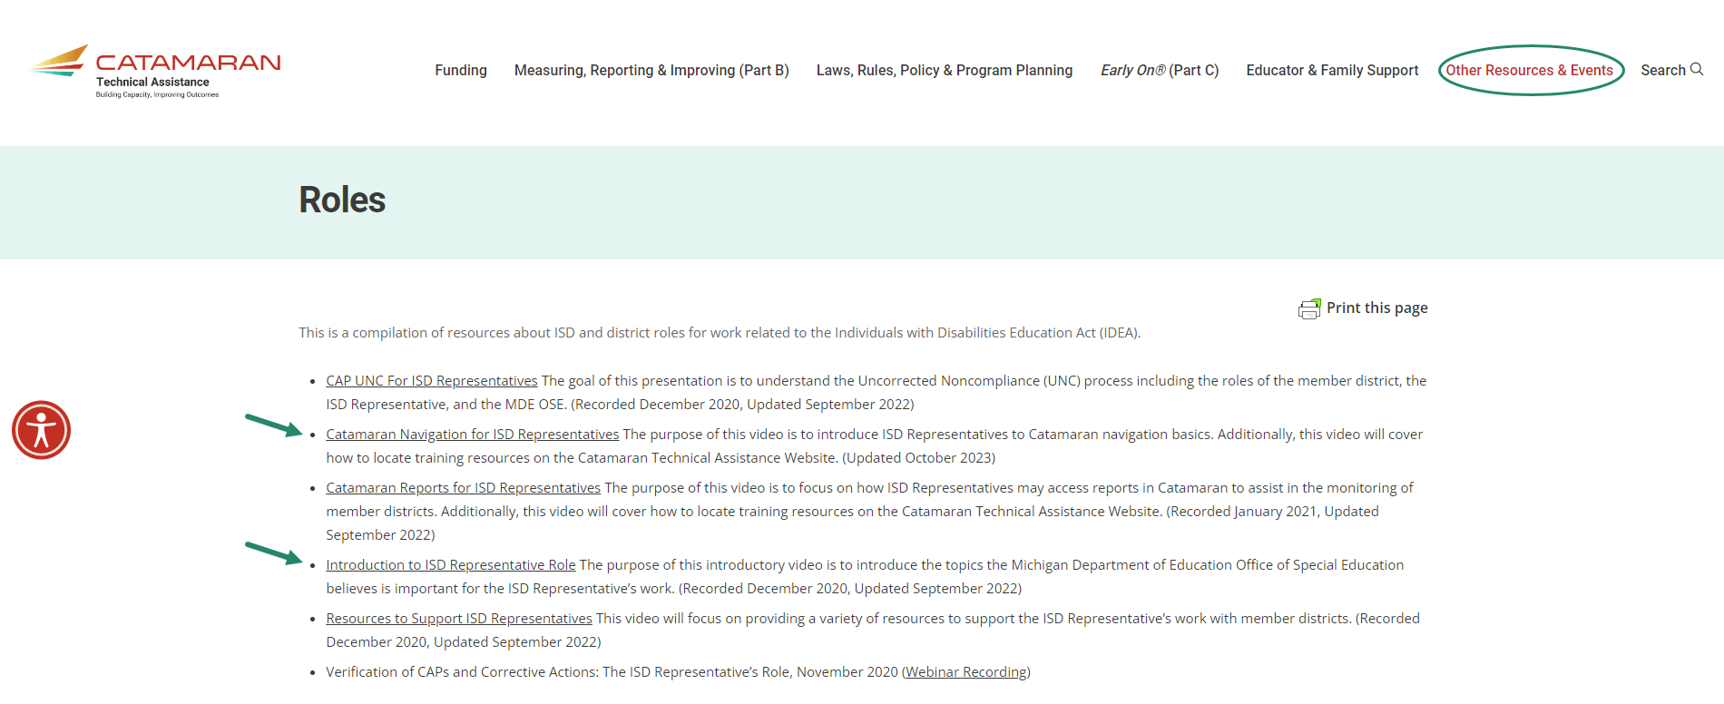
New to the ISD Representative Role?
Notes:
Another source of information that new ISD representatives may find helpful can be found on the Roles page, which can be found through the Other Resources & Events menu under the heading Staffing & Personnel. To open this page, select “Roles” or navigate directly to this page by going to training.catamaran.partners/roles
On this page, you will find technical assistance training videos and resources to help new ISD representatives understand their role and complete work in Catamaran. Information includes training videos on navigating Catamaran, completing UNC work, running reports, and an introduction to this role.

Slide 69
Questions?
Notes:
If you have questions, please use the chat feature to type in questions.

Slide 70
Contact MDE OSE
Presenters
Shawan Dortch dortchs@michigan.gov
Kaitlyn Pace pacek1@michigan.gov
MDE OSE Information Line
888-320-8384
mde-ose@michigan.gov
Notes:
If you have any questions about today’s presentation, please reach out to Shawan at d o r t c h s @ michgian.gov or Kaitlyn at p a c e k 1 @michigan.gov.
For more general questions about special education, please contact the MDE OSE Information Line at 888-320-8384 or by email at m d e – o s e @ Michigan.gov.

Slide 71
Contact the Catamaran Team
Project Director
Lynne Clark lclark@publicsectorconsultants.com
Project Manager
Donna Seeger dseeger@publicsectorconsultants.com
Catamaran Help Desk
877-474-9023
help@catamaran.partners
Notes:
Finally, for questions concerning Catamaran,
Reach out to Lynne at l c l a r k @publicsectorconsultants.com or Donna at d s e e g e r @publicsectorconsultants.com
As a reminder,
The Catamaran Help Desk is available Monday through Friday from 8-5 PM.
Contact them by email at help@catamaran.partners or by phone at 877-474-9023 or by using the Chat feature within Catamaran.
This concludes the presentation -- thank you for attending!

