Slide 1
Welcome!
The January 2024 Office of Special Education Technical Assistance webinar will begin in a few moments.​
The webinar recording and presentation materials will be posted on the Catamaran Technical Assistance Website under Past Events (https://training.catamaran.partners/past-events/).​
Closed captioning is available for this webinar. To select this option, choose the closed caption icon in the Zoom webinar player.
Notes:
This slide will remain on the screen while participants are entering the zoom meeting and while the moderator completes introductions. Jessica-moderator

Slide 2
Monthly Technical Assistance (Monitoring Materials)
January 2024
Office of Special Education

Slide 3
Relevant Terms
Corrective Action Plans/ Student Level Corrective Action Plans(CAPs/SLCAPs)
Free Appropriate Public Education (FAPE)
Individualized Education Program (IEP)
Individuals with Disabilities Education Act (IDEA)
Intermediate School District (ISD)
Least Restrictive Environment (LRE)
Michigan Administrative Rules for Special Education (MARSE)
Michigan Department of Education Office of Special Education (MDE OSE)
State Performance Plan (SPP)
Student with a Disability (SWD)

Slide 4
State Performance Plan (SPP) Manual for Directed Monitoring of Member Districts
B-4 (Suspension/Expulsion)
B-9 and B-10 (Disproportionate Representation)
SPP Monitoring Manual

Slide 5
Contents of the SPP Manual
Introduction to Monitoring
Monitoring Criteria
Procedures for Procedure Review
Procedures for Monitoring Review

Slide 6
Why Monitor?
The provision of a FAPE in the LRE.
Disproportionate representation of racial and ethnic groups in special education and related services, to the extent the representation is the result of inappropriate identification.
State and ISD exercise of general supervisory authority including child find, IEP development and implementation, effective monitoring, the use of resolution sessions, mediation, voluntary binding arbitration, and a system of transition services.
Notes:
Michigan’s monitoring system ensures MDE along with intermediate school districts (ISDs) and the member districts are fully implementing the requirements of the Individuals with Disabilities Education Act (IDEA) Part B. This system requires ISDs to take an active role in monitoring member districts for compliance with specific State Performance Plan (SPP) indicators. In Michigan, IDEA grant funds are issued to ISDs as subrecipients. The state and each subrecipient of the grant have a shared obligation to ensure every eligible student is provided a free appropriate public education (FAPE) in the least restrictive environment (LRE). Monitoring activities examine performance for compliance and results. This manual includes on-site and virtual monitoring activities. Monitoring protocols focus on specific priority areas selected based on state and district performance and improvement needs.

Slide 7
Monitoring Criteria
B-4A (Rates of Suspension and Expulsion)
B-4B (Rates of Expulsion and Expulsion by Race/Ethnicity)
B-9 (Disproportionate Representation- Child with a Disability)
B-10 (Disproportionate Representation- Eligibility Categories)
Notes:
Member district data are analyzed annually to determine performance related to B-4A (Rates of Suspension and Expulsion), B-4B (Rates of Suspension and Expulsion by Race/Ethnicity), B-9 (Disproportionate Representation – Child with a Disability), and B10 (Disproportionate Representation – Eligibility Categories). Criteria are reviewed annually based on guidance from the U.S. Office of Special Education Programs (OSEP) and other factors. After analyzing district data, a district which meets the criteria will either participate in a Procedure Review or a Monitoring Review.

Slide 8
Procedure Review
Notification of the ISD
Notification of the Member District
Procedure Review
Analysis of Results and Reporting
Report of Findings/No Findings
Submission of Report of Findings/No Findings to MDE OSE
Report Issued to Member District in Catamaran
Notes:
The Monitoring Technical Assistance Team (MTAT) will send an email to the ISD monitor when data is available from the data analyst. The letter will include the list of districts to be monitored, the type of monitoring activity, and the monitoring window dates.
Member districts selected for monitoring are notified via Catamaran with a notification letter. Notification letters are included on the reports page in major releases.
The notification includes the reason for the visit and contact information of the team lead from the ISD. The notification is addressed to the member district superintendent. The notification letter includes directions for the member district to upload into Catamaran on the District Upload page relevant member district procedures.
The ISD team lead schedules a mutually convenient time with the ISD’s monitoring team members to review the uploaded documents. The team reviews the documents together and comes to consensus on the compliance of the items. The team lead completes the Procedure Review Form in Catamaran. The ISD conducts interviews with member district staff.
The ISD team lead prepares the Report of Findings/No Findings. This is a standard template in Catamaran to describe the purpose, process, and results of the monitoring activity.
The ISD team lead submits the member district’s Report of Findings/No Findings in Catamaran no later than one week following the procedure review. MDE OSE staff collaborates with the ISD team lead to resolve discrepancies. MDE OSE staff review/edit the report within one week and submit it to MDE OSE director/assistant director for approval.
The Report of Findings/No Findings is issued through Catamaran, in the next major release according to the Catamaran release calendar (see Appendix B for the Catamaran release schedule)

Slide 9
Procedures for Monitoring Review Activity
Preparation
On-site or Virtual
Schedule and Assignment of Team Members
Notification of Member District
Training of Monitoring Team
Contact Member District by ISD Team Lead
Monitoring Review
Student Record Reviews
Interviews
Procedure Reviews
Preliminary Summary
Exit Conference with Member District Superintendent of Designee
Analysis of Results and Reporting
Submission of Findings/No Findings to MDE OSE
Report to Member District in Catamaran
Notes:
Preparation
On-site or Virtual
Schedule and Assignment of Team Members
Notification of Member District
Training of Monitoring Team
Contact Member District by ISD Team Lead
Monitoring Review
Student Record Reviews
Interviews
Procedure Reviews
Preliminary Summary
Exit Conference with Member District Superintendent of Designee
Analysis of Results and Reporting
Submission of Findings/No Findings to MDE OSE
Report to Member District in Catamaran

Slide 10
Findings
Member District Response and Follow-Up When Findings of Noncompliance are Issued
Member District Development of CAPs
Submission of CAPs
Returned CAPs
Implementation of CAPs
Submission of Progress Reports
Certification of Correction and Closeout
Uncorrected Noncompliance
Notes:
Member District Development of CAPs The purpose of CAPs is to: ■ Identify the root cause(s) of noncompliance. ■ Plan activities to achieve compliance with the IDEA and the MARSE, as soon as possible, but in no case longer than a year, ■ Ensure systemic improvements lead to positive educational results and functional outcomes for students with an IEP and the students’ families. The ISD meets with the member district to develop the CAP. The CAP is due 45 calendar days after the finding has been issued in Catamaran. One or more meetings may be required to finalize the plans within the 45-day timeline.
The CAPs must contain specific information regarding the tasks or activities to be conducted, when they are to be conducted, who conducts them, what the deliverables of tasks and activities are, and how the member district will ensure compliance. The CAP template is found in Catamaran.

Slide 11
Monitoring Criteria 1 of 2
Disproportionate Representation (B-9 and B-10)
Member districts are identified as having disproportionate representation when data indicate a risk ratio greater than 2.5 for two years in the same racial/ethnic group and eligibility category or in all eligibility categories.
Notes:
Member districts monitored for disproportionate representation and/or significant disproportionality for the same racial/ethnic group and eligibility category in the 2022-2023 school year with findings of noncompliance will have the progress on correction of noncompliance reviewed as well as progress toward reducing the risk ratio. Depending on the level of progress, MDE OSE will contact the ISD to determine actions necessary to improve performance and ensure correction of noncompliance. B. Member districts who were not visited (for the same racial/ethnic group and category) with a risk ratio for either year at 3.5 or greater will receive an onsite or virtual monitoring review. C. Member districts with a risk ratio between 2.51 and 3.49 in each data year will receive a procedure review

Slide 12
Monitoring Criteria 2 of 2
Suspension/Expulsion (B-4)
For B-4A, member districts with fewer than 30 students with an IEP enrolled in 2022 – 2023 are exempt from the calculation. For B-4B, member districts with fewer than 10 students in a racial/ethnic group are also exempted. For B-4B, member districts whose data for 2022 – 2023 show a percentage greater than 2.6 were identified with a significant discrepancy.
Notes:
A. When a member district was monitored in the previous school year for B-4 – the member district will have the progress on correction of noncompliance reviewed as well as progress toward reducing the risk ratio. Depending upon the level of progress, MDE OSE will contact the ISD to determine actions necessary to improve performance and ensure correction of noncompliance.
When the member district is on the B-4B list with a percentage of greater than 2.6 with 4 or more students who have been suspended/expelled greater than 10 days and was not monitored in the previous school year for B-4 will receive an on- site or virtual monitoring review. C. When the member district is on the B-4B list with a percentage of greater than 2.6 with only one to three students (incidents) who have been suspended/expelled for greater than 10 days will receive a procedure review.

Slide 13
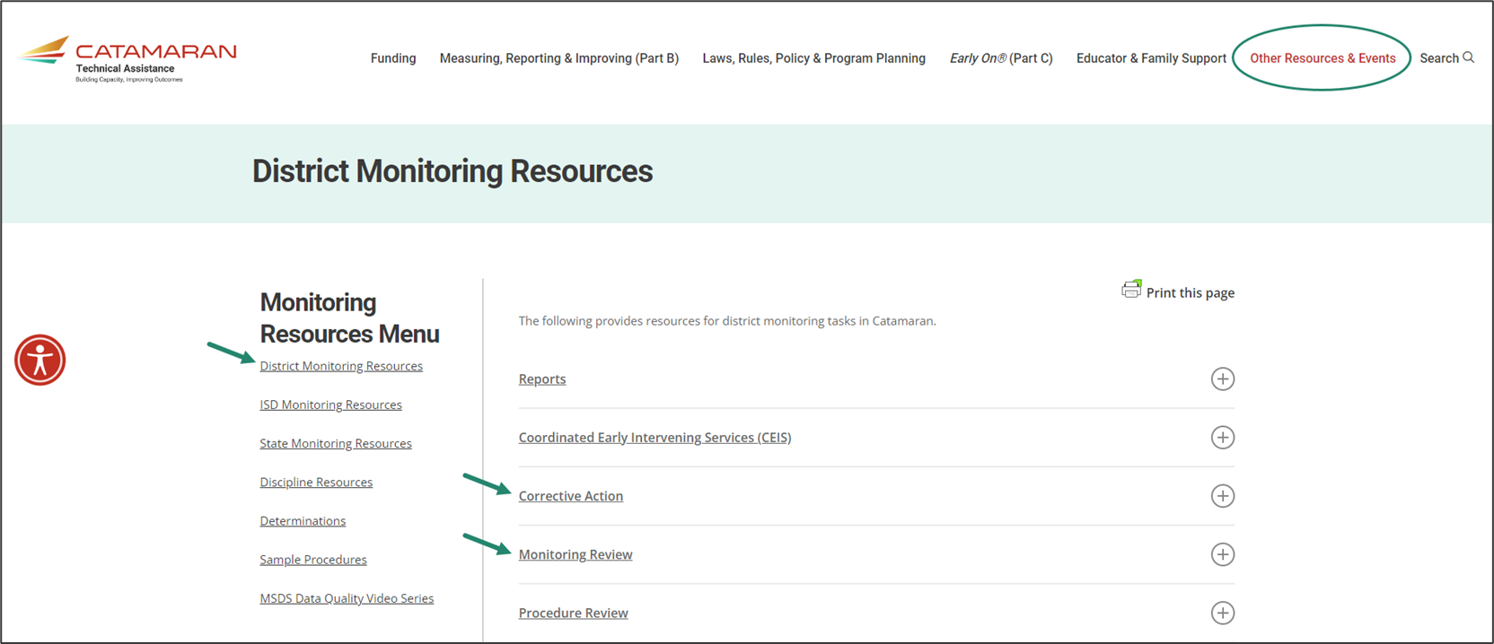
Monitoring Resources
Notes:
•As a reminder, districts and ISDs have helpful resources available to them on the TA site.
•To access the either the district or ISD monitoring resources pages, select Other Resources & Events, and then choose the District Monitoring Resources link or ISD Monitoring Resources link under the Monitoring heading.
•Here’s a screenshot of the District Monitoring Resources page.
•Topics like Corrective Action and Monitoring Review are here. Select the plus sign on the right to expand the section and view specific resources.
•To navigate away from this page, you may select
•Any of the links under the Monitoring Resources Menu on the left
•Select any of the topics listed above (e.g., Funding, Monitoring, etc.) or
•Select the Catamaran logo in the upper left-hand corner to return to the main landing page

Slide 14
The SPP Monitoring Manual
Contains all Procedure Review items, Student Record Review items and Interview Questions!

Slide 15
Contact Information
Questions related to today’s presentation
MDE-OSE-TA-Monthly-Calls@michigan.gov
MDE-OSE Information Line
Interpreter Services Available
MDE-OSE@michigan.gov
1-888-320-8384
Notes:
Jessica-spell out the entire email address.

