Slide 1
State Complaints 2025 Changes and Updates
For Districts
Notes:
Hello, and welcome to State Complaints 2025 Changes and Updates for Districts. In this video we will be discussing the updated State Complaints module in Catamaran.

Slide 2
Meet the Team
Office of Special Education (OSE)
Public Sector Consultants (PSC)
Shannon Hinman, State Complaint Coordinator
Jennifer Perrone, Training and Coaching Coordinator
Lynne Clark, Project Director
Jeanne Anderson Tippett, Senior Project Manager
Gabrielle Steinacker, Project Support Associate
Notes:
Let's meet the team. From the Office of Special Education (OSE), we have Shannon Hinman, State Complaint Coordinator, and Jennifer Perrone, Training and Coaching Coordinator. From our partners at Public Sector Consultants (PSC), we have Lynne Clark, Project Director, Jeanne Anderson Tippett, Senior Project Manager, and Gabrielle Steinacker, Project Support Associate.

Slide 3
Agenda
District Information Pages
Systemic Complaint Pages
Resources
Notes:
In this presentation, we will take a look at the pages in the State Complaints modules that apply to districts. We will start by looking at the District Information section, which has the Information to District page, as well as the updated District Response page. If your district has been the subject of a state complaint in the past, you are probably familiar with both of these pages.
We will also cover additional pages required for systematic complaints. Finally, Resources.
Note, this presentation does not cover all information related to state complaints. This presentation focuses only on new information for 2025. For more complete resources regarding state complaints, please visit the Policy Resources for Districts page on the Catamaran Technical Assistance Website.

Slide 4
Information to District Section
Notes:
Let’s begin by looking at the Information to District Section of State Complaints.

Slide 5
Access the Information to District Page
Notes:
After logging into Catamaran, locate the complaint on your Tasks Overview or by using the Search feature. From the Complaints Module Menu, select the Information to District page.

Slide 6
Information to District
Notes:
The Information to District page will contain links to the original state complaint for the district to use as a reference. This page will also include any letters or other documents MDE OSE has provided for the district’s review.

Slide 7
Access the District Response Page
Notes:
New for 2025 is the way districts will provide documentation in response to the issues letter from the OSE. To provide documentation, the district must first select the District Response page from the Complaints Module Menu.

Slide 8
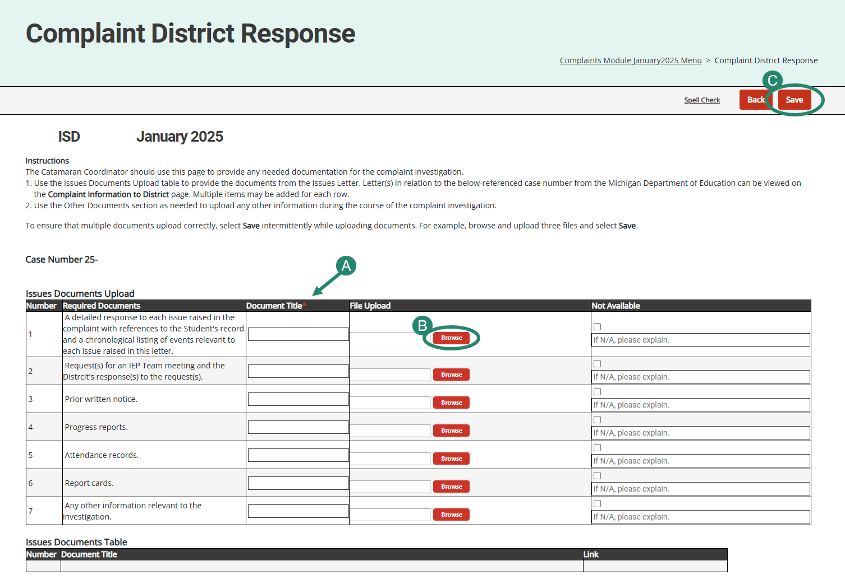
District Response Page
Notes:
Any item the OSE listed on the issues letter will also be listed on the District Response page. For each required document, the district will enter a document title and use the browse button to select the correct file. They will then save the page, which will automatically move the documents to the Issue Documents table, as seen in the first screenshot. The district can enter multiple documents. If a required document is not available, the district will check the “not available” box and provide an explanation.
At the bottom of the page, there is another section called Other Documents. If the district would like to provide other documents the OSE has not requested, the district will provide a document title and explanation in the District Comments box and use the Browse button to upload the files. These documents will populate a separate Other Documents Table at the bottom of the page, as seen in the second screenshot.

Slide 9
New Page on the Menu
Notes:
One new resource is available on the menu. This is the Document Repository. Let’s take a closer look.

Slide 10
Document Repository
Easy access to documents from
Information to District
District Response
Systemic Student Documentation (if applicable)
Notes:
The Document Repository compiles all documents in the state complaints module for convenient viewing. This page will compile documents from the Information to District page, the District Response page, and, when applicable, the Systemic Student Documentation page. You will be able to select an item from the Attachment Link column of the table to see a specific document. When finished, select Return to Menu to go back to the Complaints Module Menu.

Slide 11
Systemic Investigations
Notes:
Now, let’s take a look at the additional pages required if there is a systemic investigation.

Slide 12
Access the District Student Confirmation Page
Notes:
When MDE OSE determines that a complaint is systemic, the system will prompt the ISD to upload a list of students for the member district. Catamaran will then prompt the district to confirm which students are enrolled on the District Student Confirmation page. This page can be accessed from the Complaints Module Menu.

Slide 13
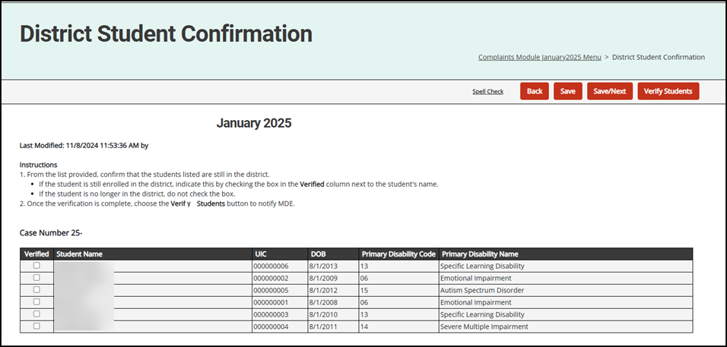
Confirm Students
Notes:
This is a screenshot from the District Student Confirmation page that shows the list of students the ISD uploaded. The district will review the list and verify each student still enrolled in the district by selecting the Verified radio button next to the student's information. Once verification is complete, select the Save button to save your progress. Once the appropriate students have been verified, and all progress is saved, choose the Verify Students button to notify MDE for their review of the student list.

Slide 14
Complaints Module Menu
Notes:
The OSE will review the list submitted by the district and will make their student selections.
When the OSE has completed their selections, a new page will appear on the Complaints Module Menu. This is the Systemic Student Documentation page.

Slide 15
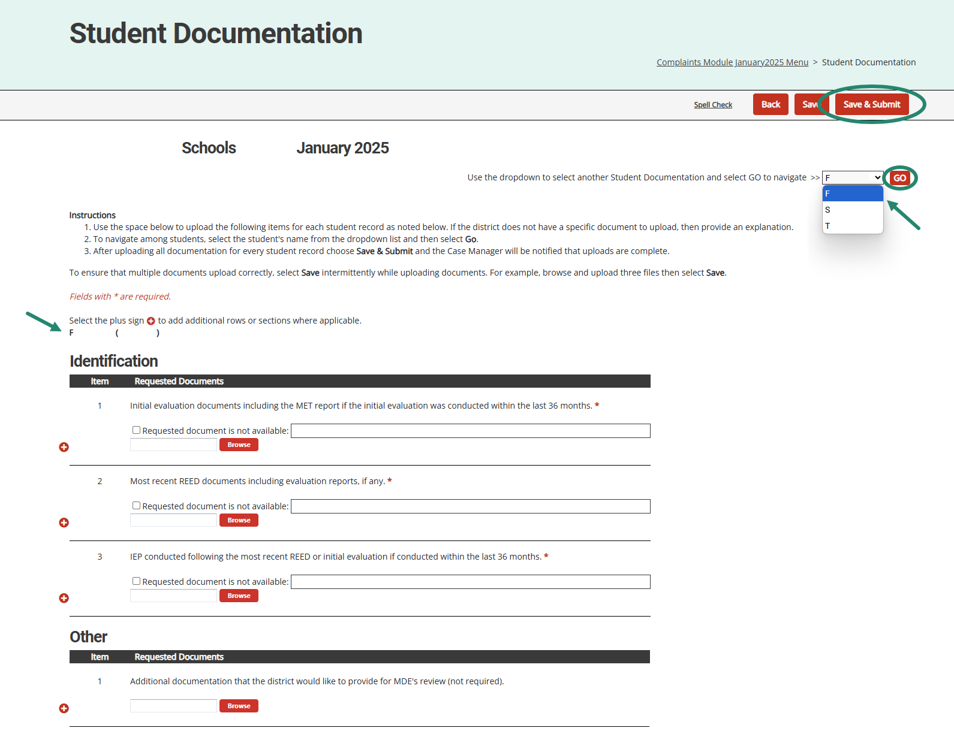
Systemic Student Documentation
Notes:
On the Systemic Student Documentation page, based on the categories being reviewed, different items will be required. The district will provide required documentation for each student by using the Browse button. If there are no documents to upload, the district can provide an explanation.
Districts should navigate between students by selecting the students name from the drop down menu in the upper right and then selecting the go button. One way to ensure that you are uploading documentation for the correct student is to look to see that the name and the drop down list matches the name just above the upload section.
Remember to use the Save button often to avoid any loss of work. When districts are finished with their uploads, they will use the Save and Submit button to return the activity to the OSE.
Even though this page will be used by districts, ISDs have access and can assist the district if necessary.

Slide 16
Resources
Notes:
Finally, let’s take a look at some Resources available to you to help with this process.

Slide 17
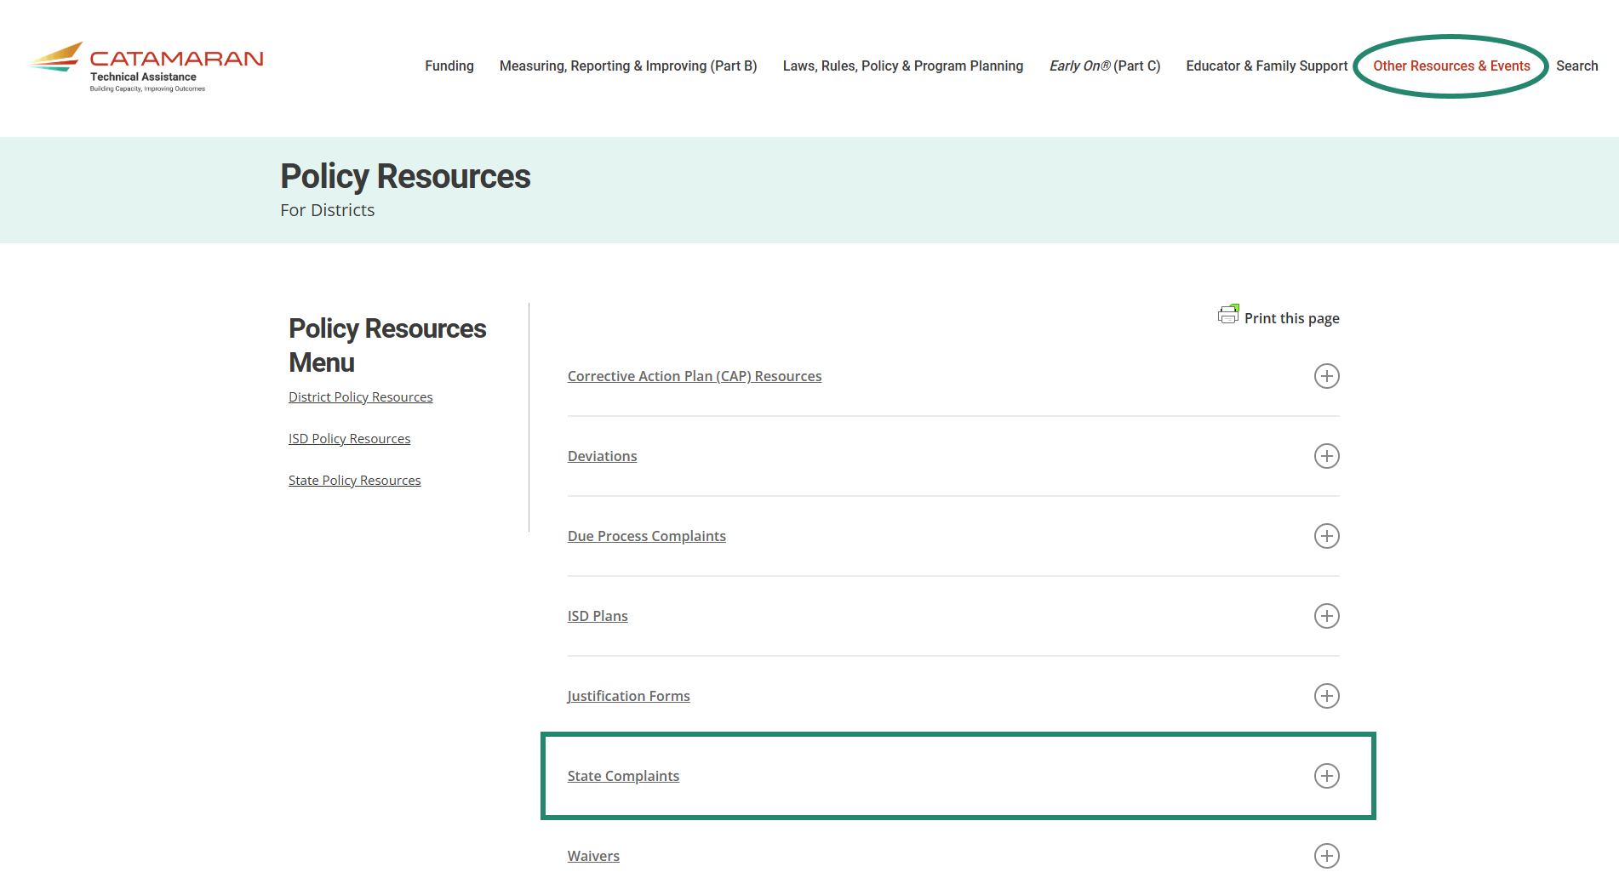
Catamaran Technical Assistance Website
Catamaran Technical Assistance Website
Notes:
For more detailed information regarding these new pages, or State Complaints in general, visit the Catamaran Technical Assistance Website where you can find various how-to’s and informational videos. This screenshot shows the Policy Resources for districts, and the section for State Complaints.

Slide 18
Contact MDE OSE
Presenters
Shannon Hinman hinmans@michigan.gov
Jennifer Perrone perronej2@michigan.gov
MDE OSE Information Line
888-320-8384
mde-ose@michigan.gov
Notes:
If you have any questions about this presentation, please reach out to Shannon at h I n m an s @ michgian.gov or Jen at P e r r o n e j 2@michigan.gov.
For more general questions about special education, please contact the MDE OSE Information Line at 888-320-8384 or by email at m d e – o s e @ Michigan.gov.

Slide 19
Contact the Catamaran Team
Project Director
Lynne Clark lclark@publicsectorconsultants.com
Project Manager
Jeanne Anderson Tippett jatippett@publicsectorconsultants.com
Catamaran Help Desk
877-474-9023
help@catamaran.partners
Notes:
Finally, for questions concerning Catamaran,
Reach out to Lynne at l c l a r k @publicsectorconsultants.com or Jeanne j a t i p p e t t @publicsectorconsultants.com
As a reminder,
The Catamaran Help Desk is available Monday through Friday from 8-5 PM.
Contact them by email at help@catamaran.partners or by phone at 877-474-9023 or by using the Chat feature within Catamaran.
This concludes the presentation -- thank you for attending!

