Slide 1
February 2025 Part B Catamaran Preview
For Districts and ISDs
Notes:
Welcome to the February 2025 Part B Catamaran Preview for districts and ISDs.

Slide 2
Office of Special Education (OSE) Monitoring Team
Jessica Brady, Supervisor
Shawan Dortch, Monitoring Coordinator
Lynn Delpy, Statewide Monitor
Kelly Kendrick-Miller, Statewide Monitor
Christie McKey, Statewide Monitor
Kaitlyn Pace, Statewide Monitor
Notes:
READ SLIDE.

Slide 3
Agenda
February 2025 Catamaran Preview
Reviewing and Acknowledging Reports
Reminders for CAPs and Corrective Actions
Resources
Notes:
This agenda includes a preview of the February 2025 Catamaran release, instructions for reviewing and acknowledging reports, reminders about CAPs and Corrective Actions, and available training resources.
You may notice that we will not be reviewing Catamaran navigation tips or going page-by-page on the Catamaran Technical Assistance Website. This will be a recorded video available on the TA site’s homepage. Instead, this presentation will be focused on the February release.

Slide 4
February 2025 Catamaran Preview
Notes:
Let’s get started with the February 2025 Catamaran Preview.
Welcome to OSE February preview.

Slide 5
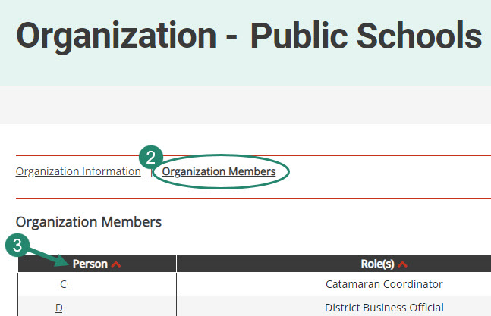
Review Organization Member Names
To review organization member names within Catamaran:
Log in and locate the Tasks Overview.
Select the organization’s name in the Organization column.
Select the Organization Members link from the Organization page.
Review the list. If changes are needed, contact the Catamaran Help Desk for assistance.
Notes:
Before we review what is inside the February release, we wanted to take a few moments to remind everyone that with the beginning of a new year, its time to review organization member names within Catamaran. We do this to ensure our system security.
To do so, log in and locate the Tasks Overview
Select the organization’s name in the Organization column.
Select the Organization Members link from the Organization page.
Review the list. If changes are needed, contact the Catamaran Help Desk for assistance.
Another reason to view this page, especially for new users is to find out who else in your organization has a Catamaran role. That person or people may be able to help you along as you begin to navigate Catamaran. This is one way to ensure that members who are no longer with your organization will not receive notifications.

Slide 6
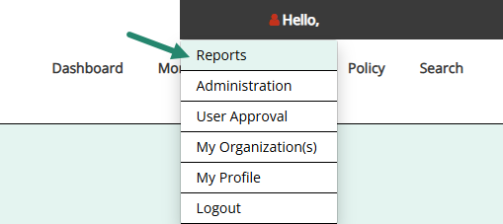
ISD Monitor Contact List
Notes:
In addition to reviewing your local district’s members, we also want to ensure that each ISD verifies the ISD Monitors assigned to their ISD in Catamaran. New this year, ISD Directors will have access to the ISD Monitor Contact List in Catamaran. ISD Directors should plan to review this report annually to confirm that the ISD Monitor(s) listed are correct for their ISD.
To access this report, hover over your name in the top-right-hand corner and select Reports. To view the list of ISD Monitors, select “ISD Monitor List” under the Contact List(s) heading.
If the information listed is incorrect or out of date, please contact the Catamaran Help Desk to make the requested changes.

Slide 7
What’s Inside?
Reports
Strand Report
Monitoring Activities Report (MAR)
Letters of Findings
Monitoring Notification Letters
Closeout/Non-closeout Reports
State Complaint Reports
Intermediate School District (ISD) Reports
Activities
Corrective Action Plans (CAPs)
B-Timely IEP, B-Valid & Reliable, and Complaints
Corrective Actions
B-11, B-12, and B-Timely IEP
Student Level Corrective Action Plans (SLCAPs) for Complaints
Notes:
When you log in to Catamaran to open and acknowledge your reports, you will see a variety of reports and activities. The reports in this release include the Strand Report, the Monitoring Activities Report (MAR), Letters of Findings, Monitoring Notification Letters, Closeout/Non-closeout Reports, State Complaint Reports and ISD Reports.
The monitoring notification letters will cover Indicator B-4 for discipline. If your district receives a monitoring notification letter, there will be a link to a helpful resource for preparing for this visit. Please follow the link and watch the PowerPoint presentation. The monitoring module will be open in Catamaran on February 15. Please begin to upload your required documentation and verify your student list after February 15. For ISDs with one or more member districts participating in monitoring, you can access the monitoring manual on the TA site and take the ISD-led monitoring course on MVU. Once that monitoring module opens on Feb 15, you will need to select whether the activity will be onsite or virtual for monitoring reviews. If your member district is only participating in a procedure review, those will all be virtual.
The Activities in this release include Corrective Action Plans (CAPs) for B-Timely IEP, B-Valid & Reliable (from B-12 data), and State Complaints.
There are Corrective Actions for B-11, B-12, and B-Timely IEP. We will describe the differences between CAPs and Corrective actions later in the presentation.
Note: Michigan Department of Education Office of Special Education (OSE) will be providing ISDS with their member district noncompliance for indicators B-11 and B12. Corrective action findings will be issued to the ISD only. ISD and member districts can review B11 and B12 data in catamaran.
Finally, there are Student Level Corrective Action Plans (SLCAP) for State Complaints.

Slide 8
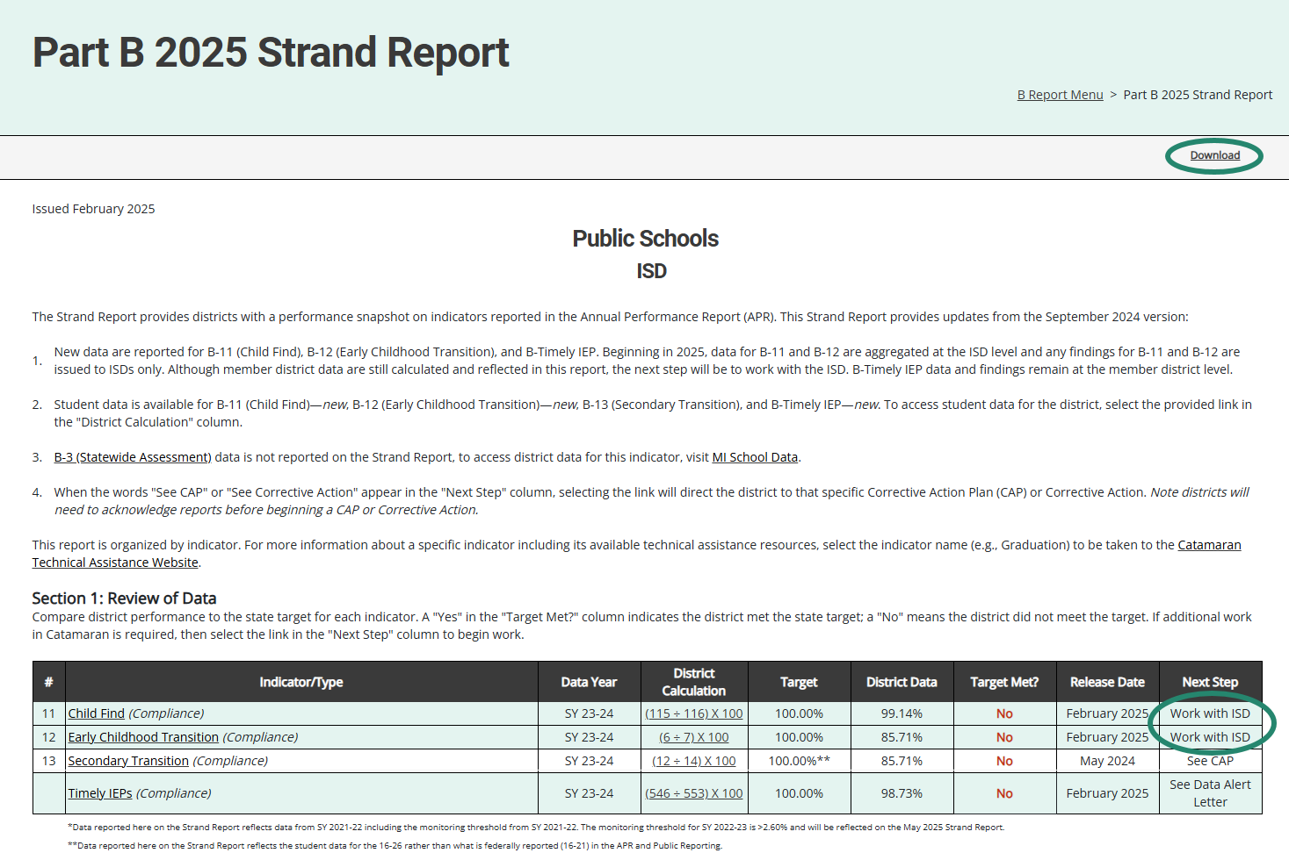
Strand Report (1)
Notes:
The Strand Report is issued with each major Catamaran release with most of the indicators updated with the May release. For February 2025, Indicators B-11 (Child Find), B-12 (Early Childhood Transition), and B-Timely IEP will have updated data, which will be highlighted. Each line is only updated with new data once per year.
We’ll dive into how to access your reports a little later in the webinar, but if you have a CAP or a Corrective Action, you can click on the See CAP or See Corrective Action link in the Next Step column to be taken directly to that CAP or Corrective Action.
For member districts with noncompliance for B-11 or B-12, you will notice a new Next Step called “Work with ISD.” This is because findings are now issued at the ISD level for these indicators. Please contact your ISD representative if you see this on your Strand Report.

Slide 9
Strand Report Continued
Summarizes district performance on the State Performance Plan (SPP) Indicators and priority areas.
When there is a CAP or Corrective Action, there will be a link in the Next Step column. Select the link to be taken to the specific item.
Use the Download link at the top of the screen to download a PDF version of the Strand Report.
Notes:
READ SLIDE

Slide 10
Monitoring Activities Report (MAR)
The MAR is included in every major release and provides important information to districts.
The MAR can be accessed from the Reports page.
Some messages are universal and go to all districts.
Some messages are targeted and are sent only to specific districts.
Reminders to review Letters of Findings.
Notifications of monitoring activities.
Notes:
For those who are new to Catamaran, there are 3 “major releases” in Catamaran each year. These differ from the monthly releases because the major releases include additional reports, closeout and non-closeout letters, and must be “acknowledged” by the district. The major releases occur in January, May and September. This year, the January Release was changed to a February Release.
The Monitoring Activities report, or the MAR, can be accessed through the Reports page. Later in this presentation, we will look at how to access the Reports page.
Some messages are universal and go to all districts, and some messages are targeted, and are sent only to specific districts, such as reminders to review Letters of Findings.

Slide 11
Sample Monitoring Activities Report
Notes:
Here you see one common message from the MAR encouraging all districts to update their district’s personnel in the EEM. There are a few new notifications with this release. One is to build awareness of the free courses through Michigan Virtual University for writing compliant and meaningful IEPs and the other is to spread the word about available Family Matters resources.

Slide 12
Letters of Findings and Reports
B-11 Letter of Findings (ISDs only)
B-12 Letter of Findings (ISDs only)
B-Timely IEP Letter of Findings
B-Valid & Reliable Letter of Findings
B-Complaint Final Decisions
Notes:
In this Catamaran release there will be:
B-11 Letters of Findings
B-12 Letters of Findings
Both B-11 and B-12 findings will be issued to the ISD. ISDs will work with their member districts to resolve any noncompliance.
B-Timely Letters of Findings – When your district receives one of these letters, you should work with your ISD personnel to obtain the student list. Following that, you should look into why the student’s IEP was late. Often, the student is no longer enrolled in special education, but the special education exit information was not input into MSDS. Correct any necessary information in future MSDS data submissions. You do not need to submit anything to the OSE.
B-Valid & Reliable Letters of Findings – we will get more information regarding valid and reliable data in just a few slides.
B-Compliant Final Decisions

Slide 13
Closeout/Non-closeout Letters and Reports
B-11
B-12
B-Timely IEP
B-Valid & Reliable
Part B Monitoring
State Complaints
Notes:
Additionally, you’ll find closeout/non-closeout reports for:
B-11 (Child Find)
B-12 (Early Childhood Transition)
B-Timely IEP
B-Valid & Reliable
Part B Monitoring
State Complaints
These reports are for findings from 2024 or earlier. There may be a few instances where a district has closed a CAP but receives a non-closeout letter. This happens when the activity is closed in the few days preceding a release from Catamaran. If your district has closed the finding but receives the Non-closeout letter, there is no need for further action.

Slide 14
ISD Reports
Member District Monitoring Reports
Member District Data Reports (B-11, B-12, B-Timely IEP, and B-Valid & Reliable)
Student Data Report of Member District Data (B-11, B-12, B-Timely IEP, and B-Valid & Reliable)
Notes:
The Member District Monitoring report is a letter which tells ISDs which of their Member Districts are being monitored for B-4 in the coming months.
ISDs will once again have access to their member district data administrative reports right on the ISD’s reports page. New data for indicators B-11, B-12, and B-Timely IEP is provided. In addition to the updated data for those three indicators, there will also be a data report for Valid and Reliable Data. This data is not available directly to the member districts, so the ISD will need to share that data out.

Slide 15
Corrective Action Plans (CAPs)
All CAPs:
Have the same workflow and timelines for completion.
Describe system level correction.
Are verified as corrected first by the ISD and second by the OSE.
Include links to either:
Student Level Corrective Action Plans (SLCAPs) or
District Student Data Report
Complaint CAPs:
Are issued each month as needed.
Include link to the complaint final decision.
Notes:
For corrective action plans known as CAPs, some general rules apply to all. All caps have the same workflow and timelines for completion. The first due date for these CAPs is the date by which the CAPs must be written and submitted. CAPs issued in February are due to be written and submitted by March 1.
CAPs must be verified and closed one year from the date the non-compliance is issued. We call this the year of correction. The CAP’s year of correction begins on February 15 for B11, B12, B-Timely IEP, and B-Valid & Reliable Data CAPs, but the year of correction begins on the date of the final decision for Complaint CAPs. If your district was issued a Complaint CAP as a result of noncompliance identified during a state complaint investigation, the date the final report was issued begins your year correction. For example, if the final decision was issued on February 8, the CAPs must be verified and closed by February 7 of the following year.
All CAPs describe the system-level correction the district will complete as opposed to the student-level corrections of SLCAPs. Every CAP is verified for correction by the ISD, with exception of CAPs issued to an ISD. Then, the ISD submits the CAP to the OSE for additional verification and closeout. On the menu page of the CAP, there will be a link to either the student-level corrective action for Complaint CAPs or to a district student data report for B11, B12, B-Timely IEP, and B-Valid & Reliable data CAPs. This link to the student-level information should help the rap team as they uncover the root causes of noncompliance. ​
​One continuing requirement when it comes to verification and closeout activities is the OSE is reviewing the district’s updated procedures as well as changes in practices. At the time the district completes its progress report, the district WILL upload its updated policies and procedures for review. If changes are needed, the progress report will be returned to the district with directions. If the procedures are compliant, the progress report approval process will continue. ​
​During the verification stage of the CAP, the ISD reviews student files for evidence of change in practice. When the review is complete, the ISD submits to the OSE for additional verification. ​
Since 2021, the CAP workflow has been updated with a verification return loop, so the ISD may now return the CAP to the district for more work if needed. This is to assist ISDs in streamlining the review process and to give districts access to the student lists the ISD is reviewing. The ISD should complete all returns to the district before submitting to the OSE for their review and verification.​
The ISD will maintain documentation and evidence of verification for each student file reviewed for correction. OSE will request student(s) records for final verification.​
​
​

Slide 16
Findings Related to B-12
B-12 Corrective Action occurs when a student’s IEP is not held by their 3rd birthday. The finding will be issued at the ISD level.
B-Valid & Reliable CAP occurs if there are missing data components in MSDS regardless of whether the student’s IEP was held by their 3rd birthday.
Notes:
There are two types of findings resulting from B-12 data.
A B-12 Corrective Action occurs if a student’s IEP is not held by their 3rd birthday and is issued at the ISD level. ISDs should work with each member district where non-compliance was found with this indicator.
B-Valid & Reliable CAP occurs if there are missing data components in MSDS regardless of whether the student’s IEP was held by their 3rd birthday.
As a reminder, the data components required in MSDS include:
Date of Birth
Referral Date
Part C Transition Timeliness
Special Education Exit Reason and Date*
Initial IEP Date and Result
Timeliness of Initial IEP
The Special Education Exit Reason and Special Education Exit Date may be blank if the student has not exited MMSE but if those fields are blank, then Initial IEP fields are required. There is a memo on the B-12 page of the training site listing those fields if you didn’t get all of them.
A Valid and Reliable CAP may be issued if a district or ISD has students with IEPs not held by their third birthdays and missing data components.
Next, we will go over who might be involved, the focus, and suggested activities for B-12 Corrective Actions and responding to B-Valid & Reliable CAPs.

Slide 17
B-12 Corrective Actions for ISDs
Review the student data in the Strand Report or the ISD’s Member District Data Report to see which member districts have student records determined to be noncompliant.
For each non-compliant student record, work with the member district to determine the root cause of the noncompliance.
Review and analysis process (RAP) team members should include Early On® staff, district staff, evaluation team members, and administrators.
Revision of policy, procedures, and/or practices should focus on addressing the root cause and ensuring a student’s IEP is in place before their third birthday.
Notes:
For B-12 Corrective Actions:
Review the student data in the Strand Report or the ISD’s member district admin report to see which students’ records were determined to be non-compliant
For each non-compliant student record, the ISD will work with the member district to determine the root cause of the noncompliance
RAP team members should include Early On® staff, district staff, evaluation team members, and administrators
Revision of policy, procedures, and/or practices should focus on addressing the root cause and ensuring a student’s IEP is in place before their third birthday
We often see a need for increased communication or collaboration with the agency providing Early On services. If you include Early On staff in the RAP team, you will be better able to ensure that all partners in the work understand their role and are working for improved practices.

Slide 18
B-Valid & Reliable CAPs
With the ISD, review the data in the Student Data Report of Member District Data on the ISD’s report page.
Determine which of the required fields are missing (See the technical assistance document for a list of required fields).
For each noncompliant student record, determine the root cause of the noncompliance including whether the ISD or district submit the missing fields.
Convene a team including Early On staff, district staff, administrators and those involved in the data submission process to revise policy, procedures, and/or practices.
Plan to use the EOY collection for verification.
Notes:
For the Valid and Reliable data CAPs, we hope that by separating the data submission issues from the late transition issues, the underlying causes of noncompliance will be clearer and easier to address. We also know there will be questions about the data, and we have staff to answer those questions. Each ISD has a monitoring team member assigned who can help with the data. You can locate the ISD Support Assignment Handout on the About Us page of the TA site at training.catamaran.partners/abouttheose
Plan to use the end-of-the-year collection in MSDS to verify the revised policies, procedures and practices are now in place and that for all relevant students, the required data fields are submitted. If your district plans to use the end-of-the-year collection for verification, you will still have enough time in case there are any errors to correct again before this CAP will become an UNC.

Slide 19
Corrective Action: B-11 and B-12
Beginning in February 2025, ISDs will receive B-11 and B-12 Corrective Actions when one or more of its member districts are determined to be non-compliant.
Addresses non-compliance to ensure future students are properly identified for special education and current students’ IEPs are updated in a timely manner.
ISDs will work with member districts to bring them into compliance.
ISDs submit to MDE for verification & closeout by December 1.
OSE will verify and confirm the correction from new MSDS data.
Notes:
Corrective actions are being issued for B11, B12, and Timely IEP.
First, we will cover B-11 and B-12 Corrective Actions issued at the ISD level; then we will review the B-Timely IEP Corrective Actions issued at the district level.
This activity applies to ISDs with one or more member districts where the submitted B-11 or B-12 data in the Michigan Student Data System (MSDS) indicated non-compliance. The ISD will work with each member district to ensure all future students are properly identified for special education, and all IDEA regulations are implemented.
When the ISD is ready to request verification and closeout, they will return to the activity to provide documentation and upload any supporting evidence where appropriate. Unlike a typical Corrective Action issued in the past, the Corrective Action’s issued at the ISD level may take the entire year as the ISD will be working to bring each non-compliant member district into compliance. Once the ISD has determined the member districts are compliant, they will provide the appropriate documentation and submit the activity to MDE no later than December 1, 2025.
The next slide shows the updated ISD Corrective Action Form.

Slide 20
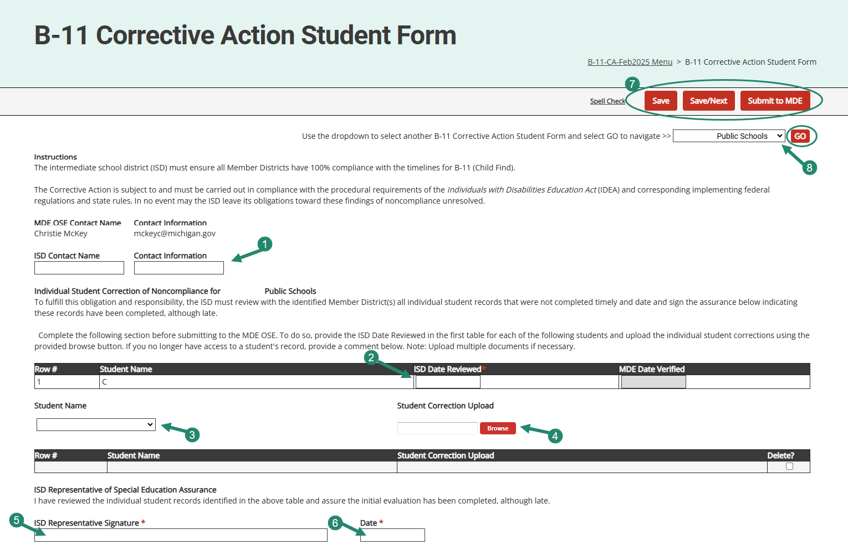
Corrective Action Student Form (ISDs)
Notes:
New this release, the B-11 and B-12 Corrective actions will be for ISDs only….shown on this slide is the Corrective Action Student Form for B-11. The B-12 Corrective Action Student Form will look the same.
To assist the ISD with this Corrective Action, MDE OSE has provided MDE OSE contact information right on the page. If questions arise, feel free to contact your MDE OSE contact for assistance.
Before you begin completing this activity, please review the ISD’s letter of findings located on the B Reports page, the page instructions on this page, as well as the Student Data Report which you can access from the ISD’s Corrective Action Menu.
ISDs will be asked to complete this page for each member district with noncompliance by providing the requested information including:
The ISD’s contact information
The date the ISD reviewed each noncompliant student record for the member district
Uploading documents for each student record that demonstrates compliance by selecting the student’s name from the drop-down menu and then,
Using the provided browse button to upload that information.
Providing the ISD representative’s name in the signature field and then,
The date when the ISD completed this section.
Be sure to save the page.
If the ISD has more than one member district with noncompliance, use the provided drop-down menu underneath the save buttons to navigate to the next page. Be sure to select the next district’s name and then select the Go button.
Once all noncompliance has been addressed for each member district, then the ISD can proceed to the Data Reviews page when the ISD has data that demonstrates compliance for the Member District.
The activity is set up so the ISD may submit or resubmit this page as many times as needed to ensure each noncompliant student record has been corrected.

Slide 21
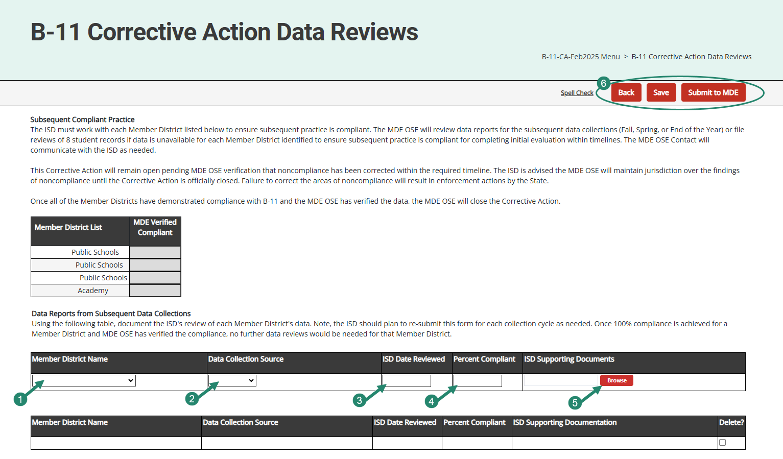
Corrective Action Data Reviews (ISDs)
Notes:
As mentioned on the previous slide, once all noncompliance has been addressed for each member district, then the ISD can proceed to the Data Reviews page shown here.
Please review the instructions on the page and then provide data reports for each member district that demonstrates 100 percent compliance. ISDs can choose a data collection source from any one of the following: End of Year, Fall, Spring, or File Reviews. Once compliance is confirmed based on a specific data collection source,
Select the member district this applies to from the drop-down menu
Select the appropriate data source
Provide the date the ISD reviewed the data
Provide the percent compliance
Provide supporting documents using the provided browse button – ISDs may upload as many documents as needed.
Once a member district has been verified compliant, the ISD may choose to submit this page to MDE for their review. The activity is set up so the ISD may submit or resubmit this page as many times as needed to ensure each member district has achieved compliance.
After compliance is verified for the ISD, then MDE OSE will close this finding.
Although ISDs have one year to complete this activity, it is recommended that if the ISD has data that demonstrates compliance from even the most recent count (e.g., Spring count) to go ahead and provide that information.

Slide 22
Corrective Action: B-Timely IEP
Addresses non-compliance to ensure future students are properly identified for special education and current students’ IEPs are updated in a timely manner.
Districts will:
Select appropriate method(s)
Provide evidence notes
Upload supporting documents as appropriate
Submit to ISD no later than November 1
ISDs will:
Review submitted corrective action
Complete verification activity
Submit to MDE for review of verification and closeout no later than December 1
Notes:
Even though the issuing of findings for B-11 and B-12 have changed to the ISD level, B-Timely IEP findings will continue to be issued at the member district level.
The B-Timely IEP corrective action is less intensive than the traditional CAP which means this activity may be completed within a few weeks or months.
For B-Timely IEP, if the data indicated that 80-90% of students had an annual IEP review within one year of their previous IEP, the district was issued a Corrective Action.
When issued a corrective action, districts will select the appropriate method or methods from the list provided.
Once they have completed the methods, they can return to the form in Catamaran to provide evidence and supporting documents as appropriate.
Once they have completed this they will submit the corrective action to the ISD for verification and closeout no later than November 1st although this can happen much sooner.
This process is different from the regular CAP process in that there is no submission and approval of the CAP nor is their submission or approval of progress reports.
Once the ISD has received the request for verification and closeout they will review the submitted activity, complete their verification and then submit to MDE for closeout no later than December 1st.
As the ISD completes their verification activity they will be looking for files which have been completed after the method of the corrective action was completed. If no student files are available, interviews will be conducted.
The ISD will not be looking at files that were completed before the corrective action methods were implemented.
November 1st and December 1st are the deadlines for these activities, but in most cases, districts could request verification and closeout before the end of the school year.
The next slide shows the Corrective Action form from the district’s view.

Slide 23
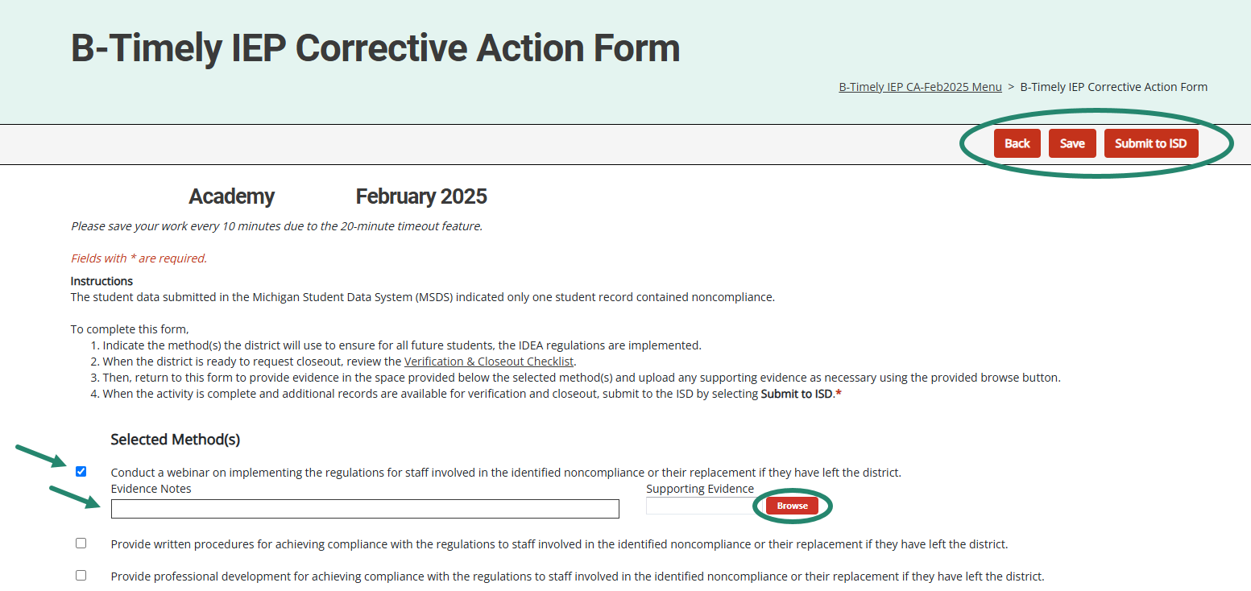
B-Timely IEP Corrective Action (Districts)
Notes:
Districts select the method(s) they will complete and save the page. Return to this page after those method(s) have been implemented to enter evidence notes and upload any supporting documents in the space(s) provided.
When complete, districts may submit to the ISD either from the Corrective Action Form or from the Corrective Action Cover page.

Slide 24
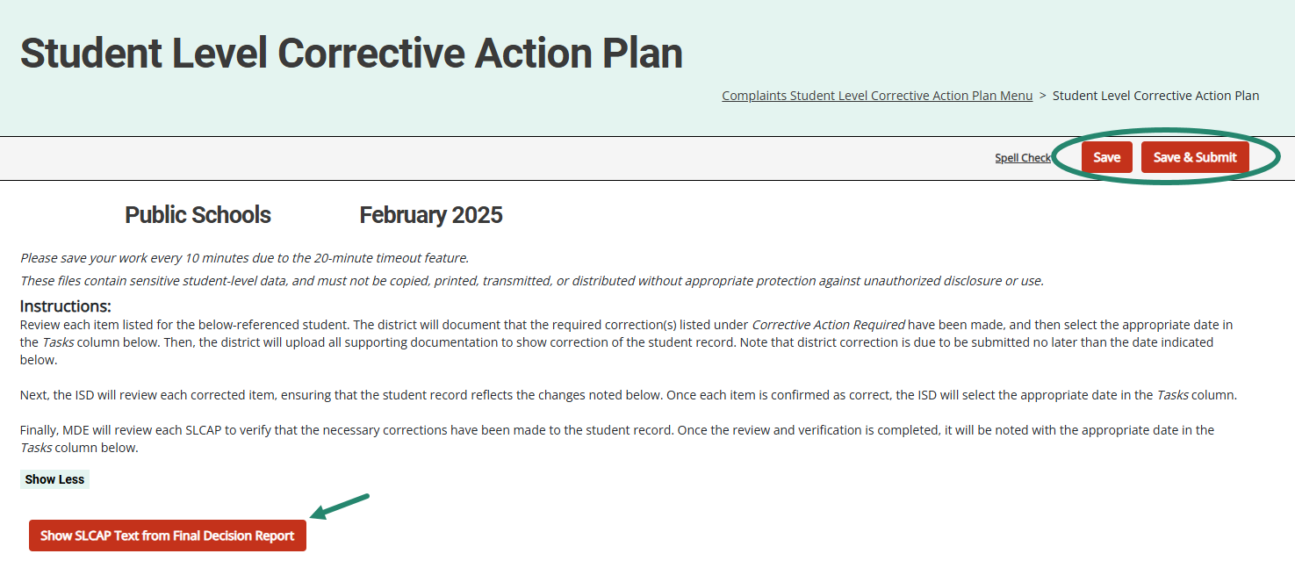
Student Level Corrective Action Plans
Notes:
SLCAPs correct individual student level noncompliance. They are usually due within 30 school days.
SLCAPs are verified as corrected by the ISD and reviewed by the OSE.
Each individual SLCAP must be closed before the CAP is closed.
The example shown here is highlighting a link from a Complaint SLCAP to the more explicit language of the final decision.
There are also SLCAPs for the Part B Monitoring activity which will be included in this release.

Slide 25
Reviewing and Acknowledging Reports
Notes:
The next sections will be for our new and occasional users. For our experienced users, you may also wish to stick around for these reminders.
Let’s take a closer look at reviewing and acknowledging reports in Catamaran.

Slide 26
View Reports
View available reports on the Tasks Overview at the bottom of the Dashboard.
Select the link in the Activity column (for example, B Report) to access the Reports page.
Notes:
Let’s dive into how to access, view and acknowledge reports. Also, please note there is a How to document on the Catamaran Technical Assistance website that outlines how to acknowledge reports step by step.
When logging in, B Report will be populated on the Tasks Overview. Select the link in the Activity column (for example, B Report) to access the Reports page.
Note: If you have previously applied a filter to the Tasks Overview, it may also be necessary to clear filters before applying a new one. As a reminder, you can narrow tasks down, by applying a filter such as Release, Type, or Organization.

Slide 27
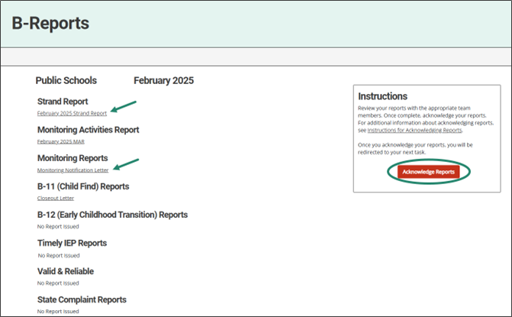
Access Reports
On the Reports page, select any report link to view that report.
Review and share the reports with appropriate team members.
Notes:
Once you reach the Reports page, you can select any report link to view that report.
Then, you can review, print, and share the reports with appropriate team members

Slide 28
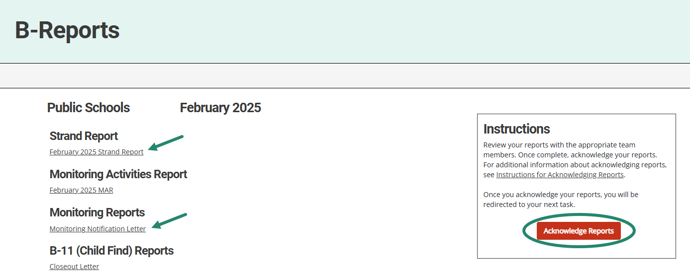
Acknowledge Reports by March 15
Acknowledge reports by selecting the red Acknowledge Reports button on the Reports page.
Note: When reports have been acknowledged, additional tasks become available as appropriate (such as a CAP).
Notes:
Reports must be acknowledged by March 15.
To acknowledge reports, select the red Acknowledge Reports button on the Reports page.
Once reports are acknowledged, the district will be returned to the Dashboard where any additional tasks such as a CAP will be become available. You may need to clear any previous set filters on the Tasks Overview to see any new tasks. If there are no additional tasks, then a message of “You have no tasks to view” will appear in the place of the Tasks Overview list.

Slide 29
After Acknowledging Reports
Work cannot be completed in Catamaran until reports have been acknowledged.
What to do after acknowledging reports:
Review Reports page: Does my district have findings?
Review Strand Report: What are the next steps?
Review MAR.
Decide whether the district should convene a RAP Team.
Notes:
New work which has been issued in this release can not be completed in Catamaran until reports are acknowledged. In fact, the work is not even visible in Catamaran until the reports are acknowledged. After acknowledging the reports, review the report page to see if your district has findings. Review the strand report and figure out next steps. Review the MAR and decide whether the district should convene a RAP or Review and Analysis Process Team.

Slide 30
Complete Tasks with RAP Team as needed
Check the Tasks Overview or the Strand Report to see if the district has a CAP or Corrective Action.
When there is a CAP or Corrective Action, convene a RAP Team to work through the activity.
Suggested RAP Team members include:
District and ISD personnel such as special and general education administrators
School improvement team representative
Parents
Service providers including general or special education teachers
Data experts or program specialists
Notes:
After sorting through and sharing the information, you’ll need to see if you have a CAP or Corrective Action to work on. You can check your Tasks Overview on the Dashboard (remember to clear any filters before applying a new one) or take another look at the Stand Report to see if you do indeed have a CAP or Corrective Action.
If you do, you need to convene a RAP Team to work through the CAP/Corrective Action. Suggested RAP Team members include district and ISD personnel, school improvement team representative, parents, service provides, or data experts or program specialists.
Important note: if you have a Complaint CAP, it will not be listed on your Strand Report. You will need to check the Tasks Overview for Complaint CAPs.

Slide 31
Reminders for CAPs and Corrective Actions
Notes:
After acknowledging reports, you will want to begin addressing any findings that may have been issued to your district. In this section we will review some reminders about the process of a CAP and Corrective Action. Let’s take a closer look at those.

Slide 32
CAP Activity Page – B-Valid & Reliable CAPs
Available for B-Valid & Reliable CAPs that come from B-12 data.
Catamaran will populate:
Monitoring Findings
Required Corrective Actions
First Activity Step – watch Ways to Improve Part C to Part B Transition Data video
Districts will be required to complete these actions and the activity step prior to requesting closeout of the CAP.
Notes:
For the B-Valid & Reliable CAPs that come from B-12 data, we will populate monitoring findings, required corrective actions, and the first activity step for you. Districts may choose to provide additional activity steps where appropriate.
The Monitoring Findings states:
The district is not in compliance with the Individuals with Disabilities Education Act (IDEA) regarding the submission of valid and reliable data related to early childhood transition of students from Part C to Part B.
An analysis of the district's 2023-2024 data as submitted to the Michigan Student Data System (MSDS) related to indicator B-12 (Early Childhood Transition) indicates the district did not submit all the data fields necessary to determine compliance for indicator B-12.
The Required Corrective Action states:
The district should work with the intermediate school district (ISD) to review the data that was submitted, determine which data fields were not submitted and why, and then develop procedures and practices to support the district in submitting valid and reliable data.
The district should also identify one or more individuals to watch the training resource video, Ways to Improve Part C to Part B Transition Data in the first row of Question 3 below. This training resource video is part of a series of training videos in the MSDS Data Quality Videos found on the Catamaran Technical Assistance Website. The video is appropriate for staff with programmatic or data responsibilities at either the district or ISD level.
To access this video, select the link above and then enter the viewer’s name and email address. The viewer will have an opportunity to respond to questions throughout the video to verify understanding of the presented material.
When the CAP is submitted for Verification and Closeout, MDE will verify its records to ensure the video was watched by the individual(s) identified with this question.
The first activity step is provided. Districts will need to write additional activity steps where appropriate.
Staff will watch the training resource video, Ways to Improve Part C to Part B Transition Data. The individual(s) named here will watch the video on the date shown with this statement.
For the additional work of meeting with the ISD and developing procedures, the RAP team will develop those steps and add them.
The next two slides show the updated CAP Activity Page for the Valid & Reliable CAP.

Slide 33
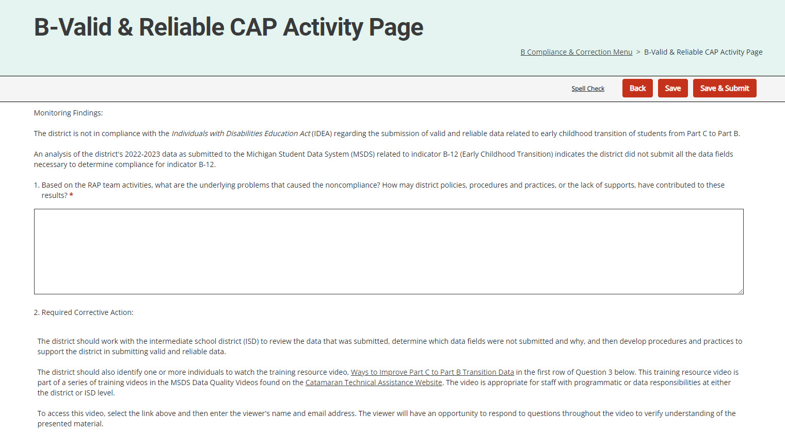
Updated CAP Activity Page (2)
Notes:
Here is a screenshot of the updated CAP Activity Page for the Valid & Reliable CAP. *Notice question one is in reference to Monitoring Findings, and the second question references required corrective action.

Slide 34
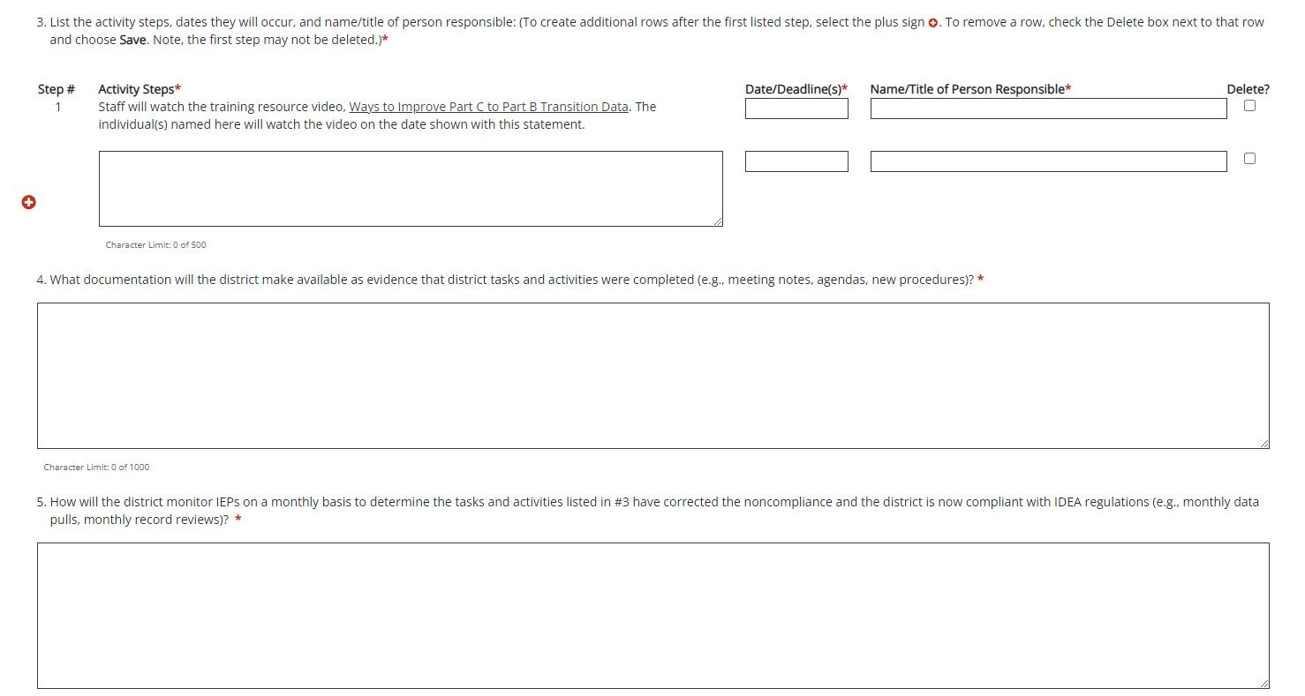
Updated CAP Activity Page (3)
Notes:
Here is the second half of the B-Valid & Reliable CAP Activity page. *The third question is in reference to the activity steps that will be taken.

Slide 35
Question 3: CAP Activity or CAP Finding
The Delete? checkbox allows users to remove rows as needed.
The Step # field has been updated to auto-number rows.
Notes:
On the CAP Activity or CAP Finding pages, the activity step question (question 3) allow users to delete a row without having to back out any information.
To remove a row, check the Delete box next to that row and choose Save. The unwanted row will be removed from the page.
This will make updating the CAP Activity/Finding page easier should the CAP be returned for modifications. Thus, ensuring the correct activity steps are then populated onto the following pages (e.g., Progress Report, etc.).
Also, notice the Step # field for Question 3 will auto-number steps as you add or remove them. Be sure to save the page after you finishing entering your information.

Slide 36
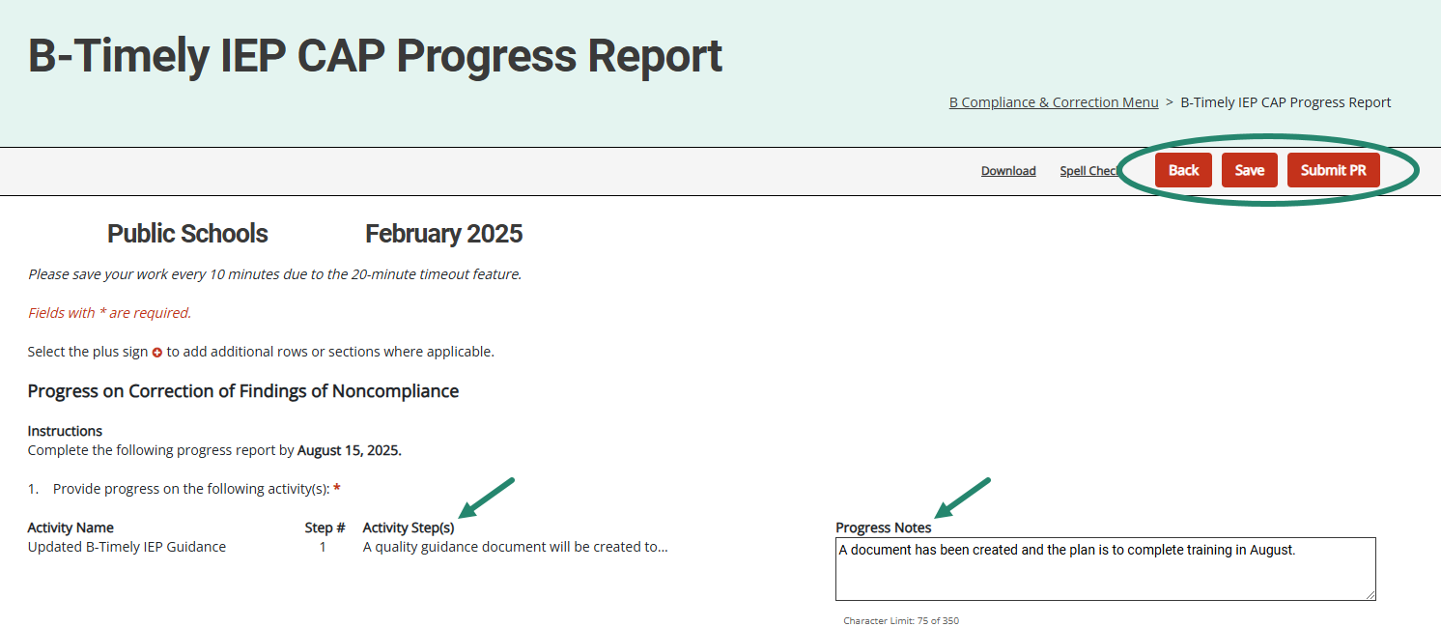
Progress Report
Activity step(s) from the CAP Activity (or Finding) page will be displayed on the Progress Report.
Member districts will report progress on specific activity step(s).
Notes:
The activity step(s) from the CAP Activity or CAP Finding page will be displayed on the Progress Report.
Member districts will report progress on each specific activity step(s). It is no longer necessary to return to the CAP Activity or CAP Finding page to complete the Progress Report. This should make the process easier for both the district as they write the progress report and the OSE as they review the report.
On those Valid & Reliable CAPs from B-12 data, the progress report will have the populated activity step displayed. The additional activity steps provided by the district for this CAP will also be displayed.
When submitting the progress report, the district will upload the relevant procedures for the OSE’s review.

Slide 37
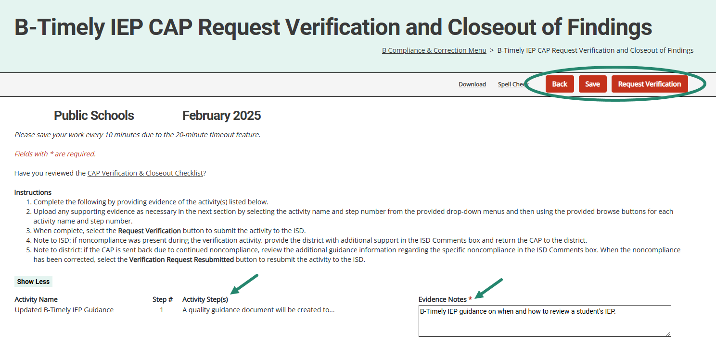
Request Verification & Closeout
Districts provide evidence and documentation for specific activity step(s).
This information is available to the ISD to assist with CAP verification.
Notes:
Like the Progress Report, the Request Verification and Closeout of Findings page will have information pulled from the CAP Activity or CAP Finding pages. Because of this,
It’s unnecessary to return to the CAP Activity (or Finding) page to complete this form to request closeout.
This information is also available on the Complaint CAP verification and closeout form, but only on the Complaint CAPs, is a place to upload evidence of ordered compensatory services.
For all CAPs, ISDs may return a verification request to the district. To do this,
the ISD can return the CAP to the district from the Request for Verification and Closeout of Findings page.
If the ISD returns the verification request to the member district, the district can review the files the ISD determined to be non-compliant.
The corrections can be made, and the district can resubmit its verification request from this page. There will be an ISD Comments box on this page for any instructions the ISD may want to leave for the district.
For B-Valid & Reliable CAPs from B-12 data, the request verification & closeout form will have the populated activity step displayed and the district provided activity steps for this CAP.

Slide 38
Supporting Evidence Uploads
Notes:
The Request Verification & Closeout page also includes a Supporting Evidence Uploads section at the bottom of the page. This will allow you to upload multiple documents per activity step!
Once you have provided your evidence notes, scroll down below the listed activity steps to upload any supporting evidence. Remember, this is not a requirement at this step.
To do this, below the listed activity steps, select from the provided drop-down menu(s) the appropriate step # (and/or finding # if a Monitoring CAP), then upload/tag your specific documentation to a specific finding/step.
After uploading documentation to this page, you may realize that you uploaded the wrong attachment. Because of this, we have provided a way to delete attachments as needed. To do this, locate the attachment in the document upload table and select the delete checkbox by the row you wish to remove, and then Save the page to confirm your selection.

Slide 39
Timely IEP CAP Verification for ISDs
Activity step(s) and evidence, including attachments, will be displayed on the CAP Verification page.
ISDs review both activities and evidence from this page to verify completion.
When all activities are verified, the ISD will move to the next section(s) of the CAP Verification Activity page as appropriate.
Notes:
Once a district has completed its request for verification and closeout, the ISD can use this verification page to view the required activities listed in the activity steps and the district’s response to the activities and evidence of those activities.
It is no longer necessary to review multiple pages of the CAP.
Once the activities are verified, the ISD can move on to the other sections of the cap verification activity, which may include student record reviews or staff interviews.
Note: With the updates made to the Request for Verification & Closeout page, it was necessary to update the CAP Activity Verification section to display multiple uploads on the page. *To do this, we are listing all District Evidence Uploads directly below the CAP Activity Verification.
Once all reviews are complete, you can move to the next section(s) on the verification page.

Slide 40
B-Valid & Reliable CAP Activity Verification
District activity step(s) and evidence, including attachments, will be displayed on the CAP Verification page.
ISDs review both activities and evidence from this page to verify completion.
When all activities are verified, the ISD will move to the next section(s) of the CAP Verification Activity page as appropriate.
Note: the first activity step will be verified by MDE.
Notes:
For Valid & Reliable CAPs from B-12 data, the first activity step will be verified by MDE. ISDs will proceed with the verification of any additional activity steps. ISDs may want to look back at the progress report page to see any notes or items there.
Once a district has completed its request for verification and closeout, the ISD can use this verification page to view the activities that were required and listed in the activity steps, as well as the member districts’ response to the activities and evidence of those activities.
After reviewing the activities, the ISD will then proceed to the next section on the verification form.

Slide 41
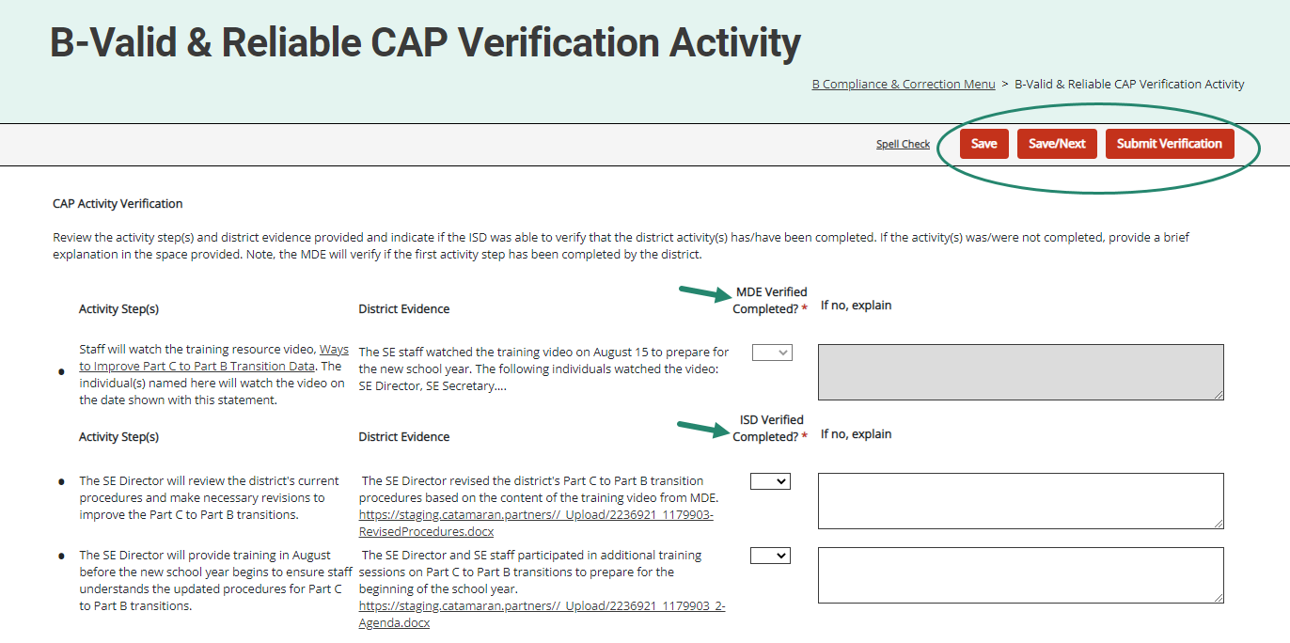
Valid & Reliable CAP Verification Activity Section
Notes:
Here’s a screenshot showing the CAP Activity Verification section for the B-Valid & Reliable CAP.

Slide 42
B-Valid & Reliable CAP Verification Student Record Reviews
ISDs will review the district’s most recent Michigan Student Data Systems (MSDS) data submission.
Follow the procedures in the training resource B-Valid and Reliable Corrective Action Plan (CAP) Verification Activity for B-12 Data.
When noncompliance is identified during the verification, return the CAP to the district.
When the district has completed the requested tasks and/or training, it will resubmit the CAP for verification.
Notes:
The second section on the CAP Verification for B-Valid & Reliable CAPs is the Data Verification through Student Record Reviews.
ISDs will review the district’s most recent MSDS data submission and then follow the procedures outlined in the training resource, B-Valid and Reliable Corrective Action Plan (CAP) Verification Activity for B-12 Data, on the TA site.
If noncompliance was identified during the verification, the ISD should return the CAP to the district. Identify the cause of the ongoing noncompliance and provide additional or targeted training to the relevant personnel.
When the district has completed any requested tasks and/or training, then they will resubmit the CAP for verification.
Note: if there are no additional student records to review for B-12, then the ISD may skip this student record section and complete interviews instead before submitting the CAP to MDE for verification and closeout.

Slide 43
B-Valid & Reliable CAP Verification Student Record Reviews Section
Notes:
Here is a screenshot of the B-Valid & Reliable CAP Verification Student Record Reviews Section to input student information.

Slide 44
Data CAP Verification
ISDs complete verification per usual.
MDE reviews verification and writes a comment on the CAP Cover Page requesting supporting documentation when needed.
ISDs will upload supporting documentation on the CAP Verification Activity page and resubmit it to MDE.
Notes:
Once the ISD has completed its verification the ISD submits the CAP to MDE. MDE then reviews the verification and writes a comment on the CAP cover page requesting supporting documentation for one or more student files. The ISD then uploads the supporting documentation on the CAP verification activity page and resubmits the CAP to MDE for final review and closeout.

Slide 45
Complaint CAP Verification for ISDs
Verification Appendix will appear before the closeout verification worksheet on the menu.​
Verification Appendix includes a “Date Verified” column in the student record review section.​
Districts may view if the Complaint CAP is returned by the ISD.​
When all findings of noncompliance are verified, the ISD will move to the closeout verification worksheet.​
Notes:
The Complaint CAP Verification Appendix appears before the closeout verification worksheet.​
​
There is a column on the verification form labeled “date verified.” The ISD can use this column to indicate the date the record was determined to be compliant. This may be helpful if you are conducting more than one verification activity. Member districts can view this page if the ISD returns the Complaint CAP to the district. At that time, the district can edit the date-corrected column. The member district cannot edit other columns the ISD completes. Once all the noncompliance is corrected and verified, the ISD will submit the closeout request to MDE. MDE will conduct an additional verification prior to closeout.​
​

Slide 46
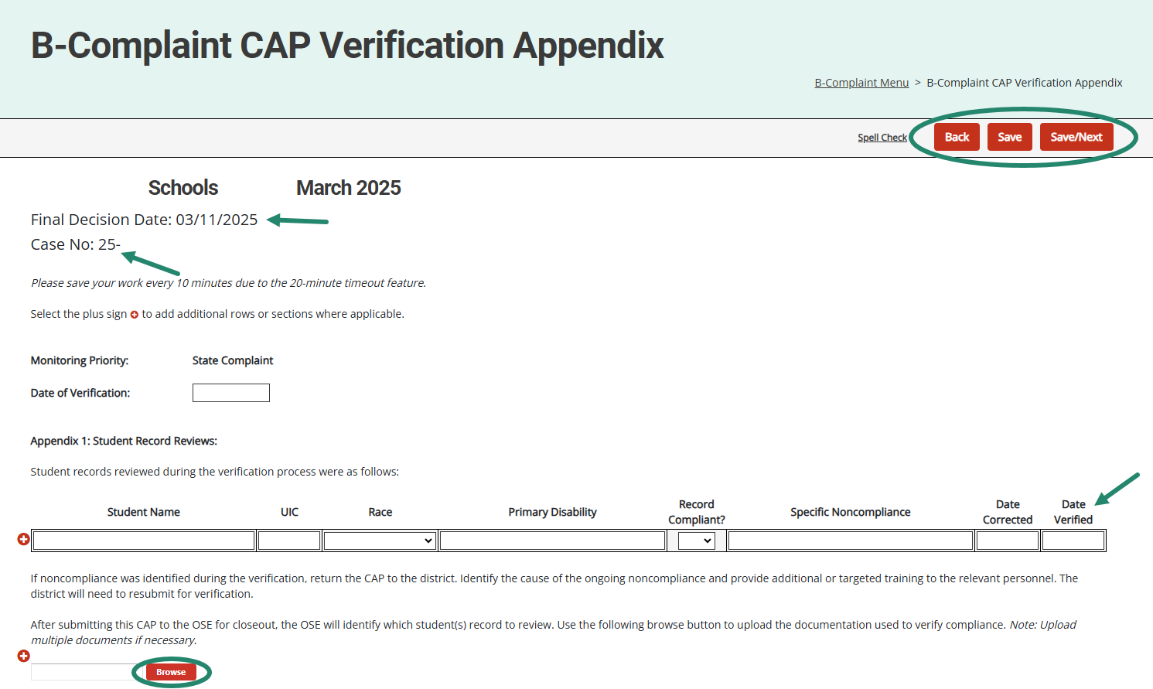
Complaint CAP Verification Appendix
The final decision date and case numbers are now on Complaint CAP forms.
ISDs complete the verification appendix and upload supporting documentation.
Notes:
Complaint case numbers and the Final report date are included on the Complaint CAP menu and forms.
This screenshot shows the Final decision date and case number on the Complaint CAP forms.
As ISDs complete the verification process, they occasionally find ongoing non-compliance. The ISD can return the CAP to the district to correct the records and complete other actions. Remember, to return the verification request to the district, go to the Request for Verification and Closeout page and select the Verification Request Returned button.
The verification appendix will be viewable by the district, and the district will be able to note the date of correction, as mentioned previously. The district will then resubmit the CAP to the ISD.
Arrows on this slide indicate the fields for the ISD to enter the new verification dates and the browse button to upload supporting documentation.

Slide 47
Resources
Notes:
Even with the best of training, there may be questions that arise later as you use the system. There are a variety of resources available to support you.

Slide 48
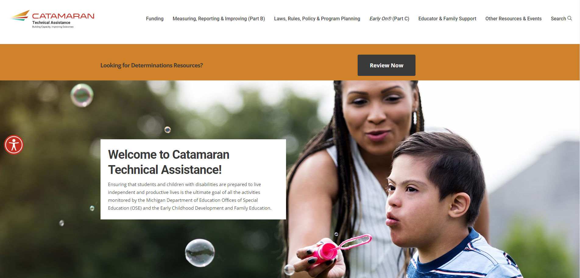
Catamaran Technical Assistance Website
Notes:
One of the most valuable resources is the Catamaran Technical Assistance Website, located at training dot catamaran dot partners. This site offers helpful resources such as training videos, how-to documents, indicator resources, and due-date calendars. We will take a closer look at the calendar in the next two slides.

Slide 49
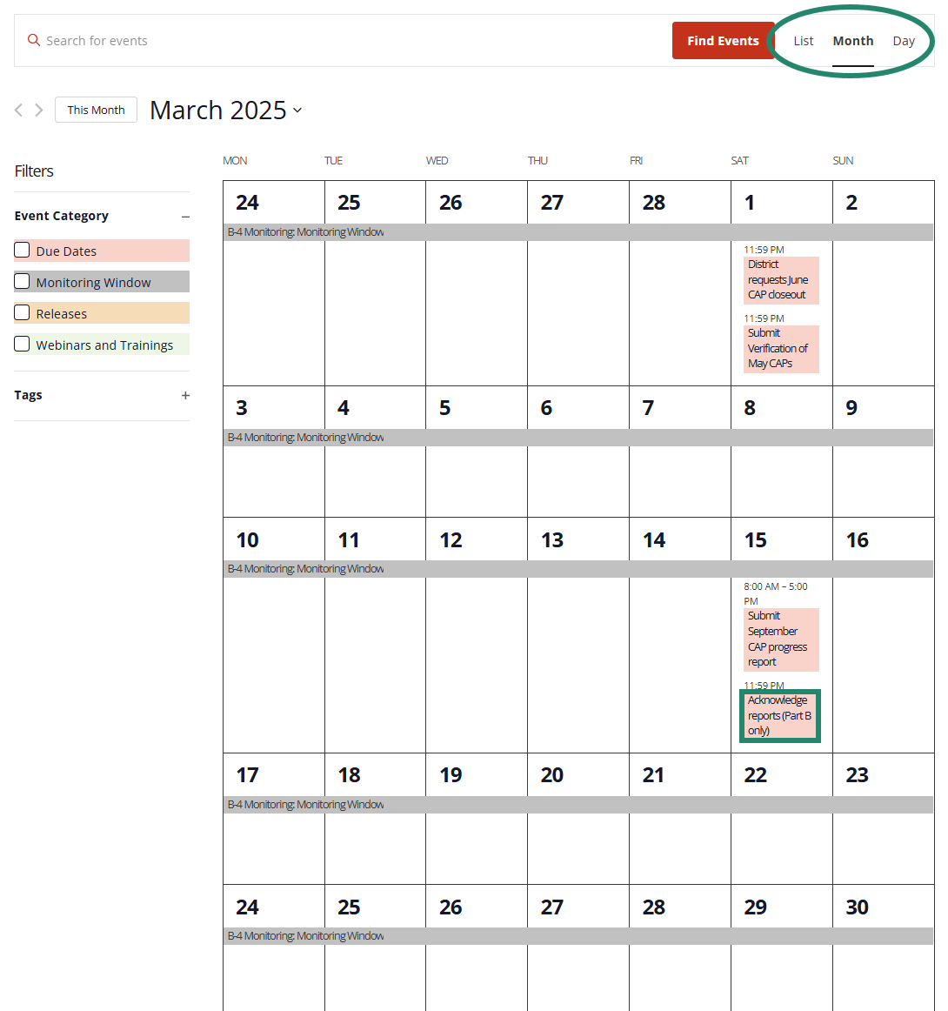
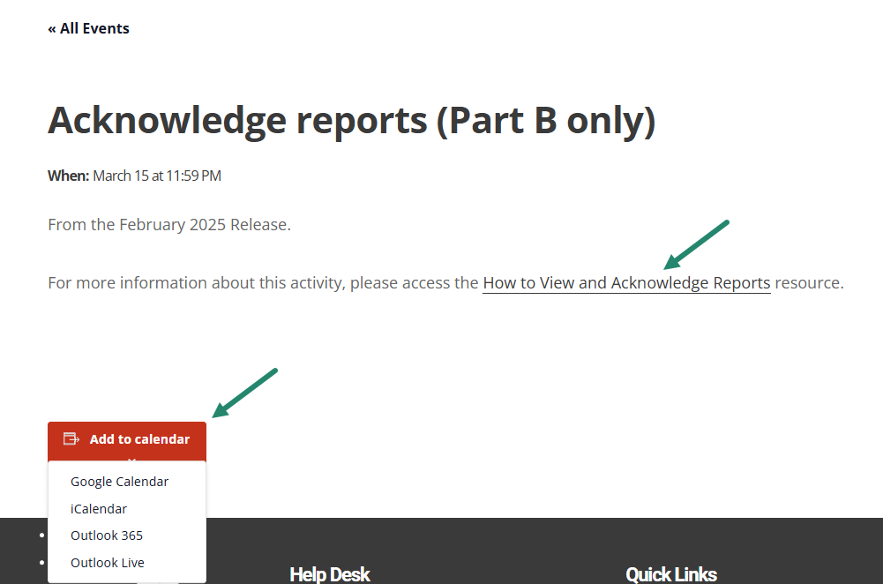
Catamaran Calendar
Notes:
On the Catamaran Technical Assistance site is a programmed Catamaran Calendar where users can view all upcoming events and due dates in one place. At the top right of the page, you can view the calendar in the view that works best for you by list, month, or day.
From the month view shown here, you can drill down on a specific event for more information and add the event to your calendar.
For upcoming due dates that have a how-to associated with it, there will be a clickable link to the how-to.

Slide 50
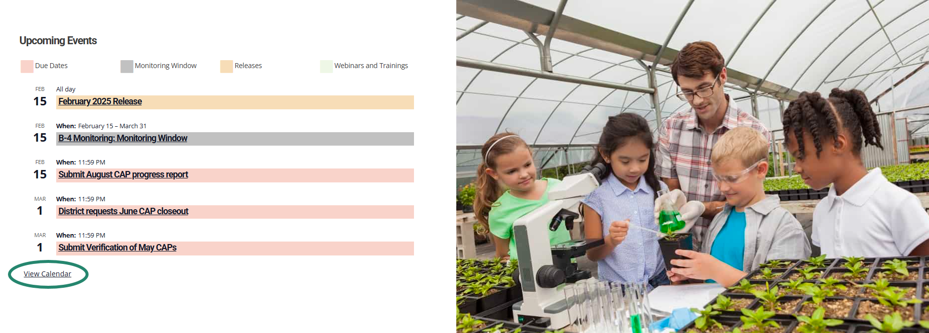
Catamaran Calendar List View
Notes:
You may access the Catamaran Calendar on the home page of the Catamaran Technical Assistance Website by scrolling to the bottom of the page. This calendar will display 5 calendar items in a list-view format. To view the full-sized calendar select the View Calendar link at the bottom of the calendar. We hope this page is useful for you and helps you to plan your work.

Slide 51
Catamaran Navigation Tips Training Video
Now available as a separate training video.
Located in the Spotlight section on the homepage of the Catamaran Technical Assistance Website.
Notes:
Finally, as we mentioned at the beginning of the presentation, we now have a separate training video that includes Catamaran navigation tips. This video can be found in the Spotlight section on the homepage of the Catamaran Technical Assistance Website.

Slide 52
Need Assistance?
MDE OSE Information Line
888-320-8384
mde-ose@michigan.gov
Catamaran Help Desk
877-474-9023
help@catamaran.partners
Notes:
If you have any questions about this recording, contact the MDE OSE Information Line at 888-320-8384 or by email at m d e – o s e @ Michigan.gov.
For questions about Catamaran, contact the Catamaran Help Desk.
The Catamaran Help Desk is available Monday through Friday from 8-5 PM.
Contact them by email at help@catamaran.partners or by phone at 877-474-9023 or by using the Chat feature within Catamaran.
This concludes the presentation -- thank you for watching!

