Slide 1
May 2025 Part B Catamaran Preview
For Districts and Intermediate School Districts (ISDs)
Notes:
Welcome to the May 2025 Part B Catamaran Preview for districts and ISDs.

Slide 2
Meet the Team
Office of Special Education (OSE)
Jessica Brady, Supervisor
Shawan Dortch, Coordinator
Nichole Moore, Coordinator
Charles Thomas, Consultant
Mary Diedrich, Consultant
Sharon Trolian-Kerr, Consultant
Aaron Darling, Analyst
Public Sector Consultants (PSC)
Lynne Clark, Project Director
Donna Seeger, Project Manager
Gabrielle Steinacker, Project Support Associate
Statewide Monitors:
Lynn Delpy, Contractor
Kelly Kendrick-Miller, Contractor
Christie McKey, Contractor
Kaitlyn Pace, Contractor
Jamie Swiger, Contractor
Notes:
Meet the Team (Read slide)

Slide 3
Agenda
May 2025 Catamaran Preview
Reviewing and Acknowledging Reports
Assigning B-13 work for ISDs
Reminders for Corrective Action Plans (CAPs) and Corrective Actions
Resources
Notes:
On our agenda today, we will discuss:
(read slide)

Slide 4
May 2025 Catamaran Preview
Notes:
Let’s dive into the May 2025 Catamaran Preview.

Slide 5
What’s Inside?
Reports
Strand Report
Monitoring Activities Report (MAR)
Reports and Letters of Findings
Monitoring Notification Letters
Closeout/Non-closeout Reports
State Complaint Reports
ISD Reports
Activities
Corrective Action Plans (CAPs)
B-4A, B-4B, B-4AB, B-13, and Complaints
B-13 Corrective Actions
Student Level Corrective Action Plans (SLCAPs) for Complaints
B-9 and B-10 Monitoring and Procedure Reviews
Notes:
When you open Catamaran and acknowledge your reports, you will see a variety of things. The reports for districts include the Strand Report, the Monitoring Activities Report (MAR), Letters of Findings, Monitoring Notification Letters, Closeout/Non-closeout Reports for CAPs, and State Complaint Reports for any completed complaints this month. For ISDs, there are Reports of the member districts’ data and notification summary reports.
The Activities for this release include Corrective Action Plans (CAPs) for B-4A (Rates of Suspensions and Expulsions), B-4B (Rates of Suspensions and Expulsions by Race/Ethnicity), B-4AB, B-13 (Secondary Transition), and State Complaints.
There are Corrective Actions for B-13.
There are Student Level Corrective Action Plans (SLCAP) for State Complaints, and
There are B-9 and B-10 Monitoring and Procedure Reviews.

Slide 6
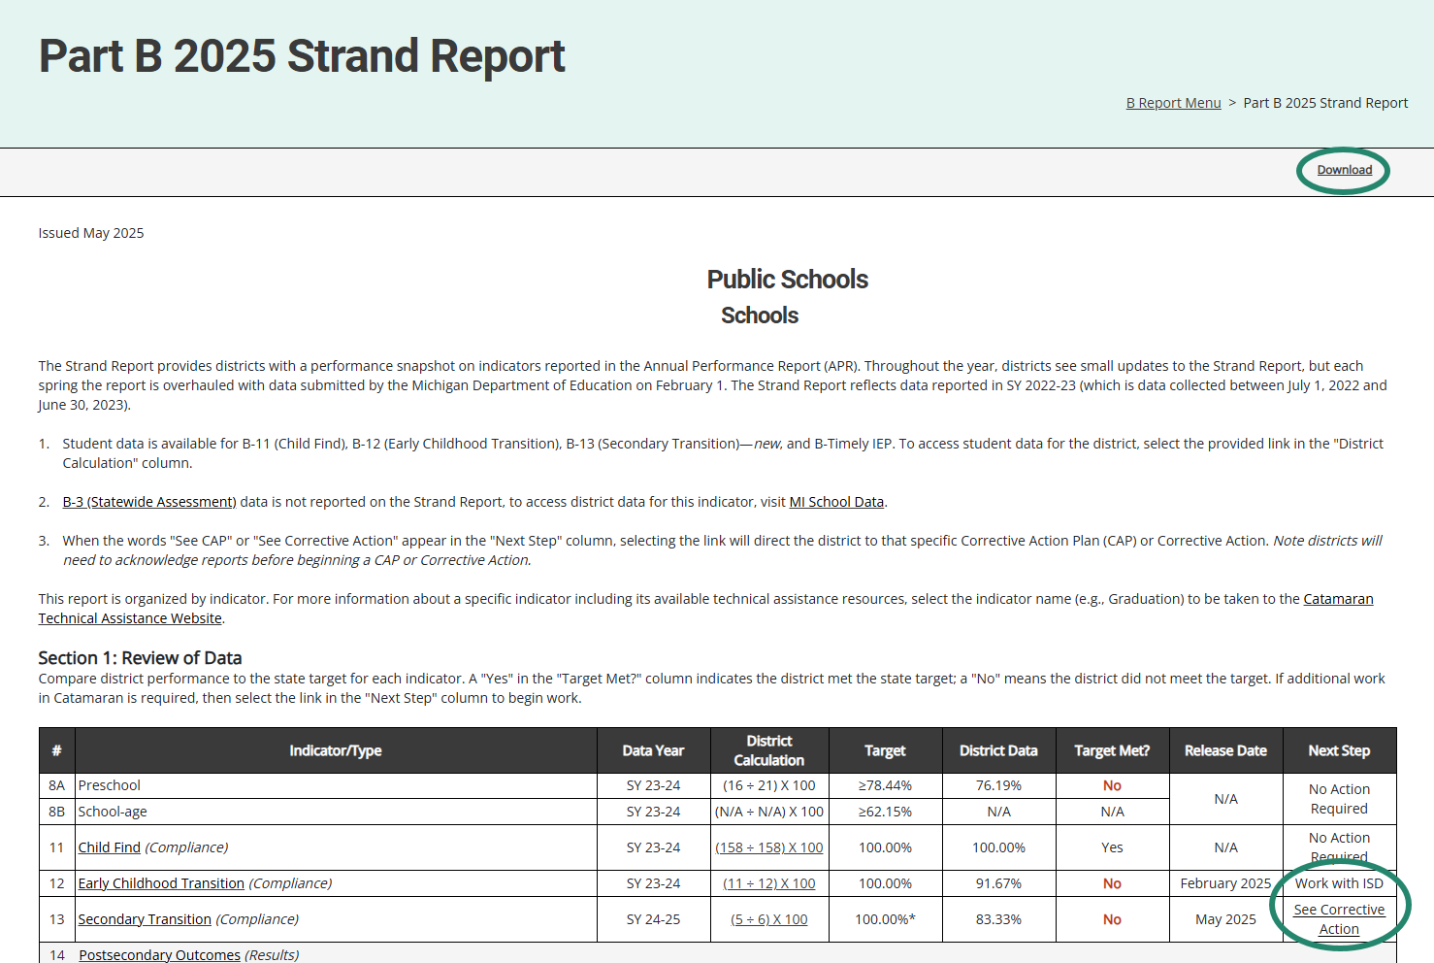
Part B 2025 Strand Report
Notes:
Here is an example of the Strand Report. The Strand Report is issued with each major Catamaran release with most of the indicators updated with the May release.
The Strand Report summarizes a district’s performance on the State Performance Plan indicators and priority areas.
We will dive into how to access your reports a little later in the webinar, but if you do have a CAP or Corrective action, you can select the See CAP or corrective action link in the Next Step column to be taken directly to that object.
*For member districts who receive a finding for Indicators B11 Child Find or B12 Early Childhood Transition, contact your ISD to discuss next steps to correct the noncompliance.
You can use the download link at the top of the screen to save and then print a copy of your Strand Report to share with your administration, colleagues or RAP team if needed.

Slide 7
Monitoring Activities Report (MAR)
The MAR is included in every major release and provides important information to districts.
The MAR can be accessed from the Reports page.
Some messages are universal and go to all districts.
Some messages are targeted and are sent only to specific districts.
Reminders to review Reports and Letters of Findings
Notifications of monitoring activities
Notes:
The Monitoring and Activities report, or the MAR, can be accessed through the Reports page, which again, we will look at how to view and access the Reports page.
Some messages are universal and go to all districts, and some messages are targeted, and are sent only to specific districts, such as reminders to review Reports and Letters of Findings or reminders to review notification letters.

Slide 8
Sample Monitoring Activities Report
Notes:
This screenshot includes a universal message asking users to ensure their authorized EEM user has the current information updated in that system. Catamaran pulls contact names and emails for ISD Directors, superintendents, and transition coordinators from the EEM. Catamaran cannot make changes to contacts, an authorized representative from your district will need to update the EEM.

Slide 9
Reports and Letters of Findings/No Findings
B-4A (Rates of Suspension and Expulsion) Report of Findings
B-4B (Rates of Suspension and Expulsion by Race/Ethnicity) Report of Findings
B-4AB (Rates of Suspension & Expulsion and Suspension & Expulsion by Race/Ethnicity)
B-13 (Secondary Transition) Letter of Findings
B-Complaint Final Decisions
Notes:
Another set of reports are those related to completed monitoring activities. We recently completed the monitoring activities for B-4A, B-4B, and B-4AB, so there will be reports of findings for each of those districts or ISDs which participated.
For the districts which participated in the B-13 data collection, there will be letters of findings if needed.
Finally, there will be final decision reports for any State complaint investigations that have recently been completed.

Slide 10
Closeout/Non-closeout Letters and Reports
Monitoring
B-4A (Rates of Suspension and Expulsion) Report of Findings
B-4B (Rates of Suspension and Expulsion by Race/Ethnicity) Report of Findings
B-4AB (Rates of Suspension & Expulsion and Suspension & Expulsion by Race/Ethnicity)
B-13 (Secondary Transition)
B-IEP (Implementation of Individual Educational Programs)
State Complaints
Notes:
Additionally, you will find closeout/non-closeout reports and letters for:
B-4A (Rates of Suspension and Expulsion) Report of Findings
B-4B (Rates of Suspension and Expulsion by Race/Ethnicity) Report of Findings
B-4AB (Rates of Suspension & Expulsion and Suspension & Expulsion by Race/Ethnicity)
B-13 (Secondary Transition)
B-IEP (Implementation of Individual Educational Programs) issued in May 2024 and State Complaints

Slide 11
ISD Reports
Desk Audit Notifications
ISD Strand Report Summary of Member Districts
Member District Monitoring Notification Letter
Significant Disproportionality Notification
Personal Curriculum Counts (SY 2023-2024)
Member District Data Reports (B-4, B-5, B-6, and B-13)
Student Data Report of Member District Data (B-4, B-5, B-6, and B-13)
Notes:
In addition to the reports available to all districts, there are additional reports for ISDs. Those include monitoring notifications for desk audits for B-9 , B-10, and a summary of member district notifications. The Member District Monitoring notification is a letter that tells ISDs which of their Member Districts are being monitored for B-9 and B-10 in the coming months
New for the May release is the ISD Strand Report Summary of Member Districts. In the past, this report would be available in September and did not include all SPP indicators. This May, the report will be available to ISDs and include the same indicators normally included in Section 1 of the district’s Strand Report. This report will make it easier for ISDs to view member district performance at-a-glance across multiple indicators.
ISDs will be given a report which explains their significant disproportionality status. If response plans are needed for significant disproportionality, those will be available later in the month.
The personal curriculum counts by ISD, member district and building level will be available again this year.
ISDs will receive member district and student level data for indicators B-4, 5, 6 and 13. These are all reports which have been issued in the past.

Slide 12
Corrective Action Plans (CAPs)
All CAPs:
Have the same workflow and timelines for completion.
Describe system level correction.
Are verified as corrected by the ISD and OSE.
Include links to either:
Student Level Corrective Action Plans (SLCAPs) or
District Student Data Report (B-13)
Monitoring CAPs:
Issued following a monitoring activity.
Include links to the report of findings.
Complaint CAPs:
Issued twice monthly as needed.
Include link to the complaint final decision.
Notes:
For corrective action plans known as CAPs, there are some general rules that apply to all. All CAPs have the same workflow and timelines for completion. The first due date for these CAPs is the date by which the CAPs must be written and submitted. CAPs issued in May are due to be written and submitted by July 1.
CAPs must be verified and closed one year from the date the non-compliance is issued. We call this the year of correction. The CAP’s year of correction begins on May 15 for B-4A, B-4B, B-4AB, and B-13, but the year of correction begins on the date of the final decision for complaint CAPs. If your district was issued a complaint CAP as a result of noncompliance identified during a state complaint investigation, the date the final report was issued begins your year correction. As an example, if the final decision was issued on May 8, the CAP must be verified and closed by May 7 of the following year. Complaint CAPs are released twice a month in catamaran.
All CAPs describe the system-level correction the district will complete. As opposed to the student-level corrections of SLCAPs. Every CAP is verified for correction by the ISD. Then, the ISD submits the CAP to the OSE for closeout. On the menu page of the CAP, there will be a link to either the student-level corrective action for Monitoring CAPs (B-4A, B-4B, B-4AB) and complaint CAPs or to a district student data report for B-13 data CAPs. This link to the student-level information should help the RAP team as they uncover the root causes of noncompliance.
One continuing requirement when it comes to verification and closeout activities is the OSE is reviewing the district’s updated procedures as well as change in practices. At the time the district completes their progress report, the district should upload their updated policies and procedures for review. If changes are needed, the progress report will be returned to the district with directions. If the procedures are compliant, the progress report approval process will continue.
During the verification stage of the CAP, the ISD reviews student files for evidence of change in practice. When the review is complete, the ISD uploads all documentation reviewed to demonstrate compliance. If the ISD needs additional documentation from the district, the ISD will return the activity to the district to upload documentation on the Verification Appendix page. Once the review is complete, and all relevant documentation is uploaded, the ISD submits to the OSE. The ISD should complete all returns to the district before submitting to the OSE for their review and verification of correction.
This change in practice is based on OSEP’s 23-01 memo which states the State must retain documentation of correction of noncompliance for each individual case of previously noncompliant files, records, etc.

Slide 13
B-13 Corrective Action
Addresses noncompliance at the provider level.
District submits to ISD for verification by February 1.
ISDs submit to MDE for closeout by March 1.
Verification includes:
a review of student files
Up to eight if available
From the provider
Reflecting work after the corrective action
or interview, if no student files are available.
Notes:
B-13 Corrective Action…(read slide)

Slide 14
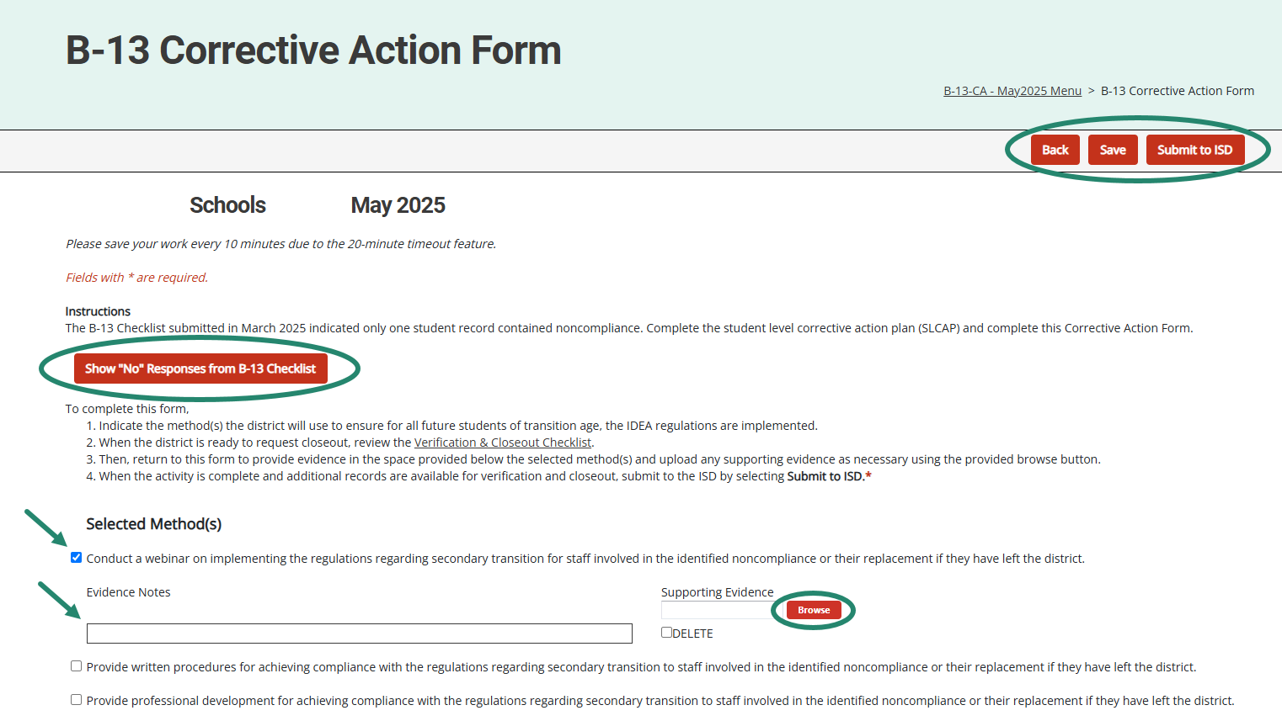
Corrective Action Form (District View)
Notes:
Districts select the method(s) they will complete and save the page. Return to this page after those method(s) have been implemented to enter evidence notes and upload any supporting documents in the space(s) provided.
When complete, districts may submit to the ISD either from the Corrective Action Form or from the Corrective Action Cover page.
**For B-13 Only**
Select the “Show “no” Responses from B-13 Checklist” button on the page to view the questions that were marked with a “no”.

Slide 15
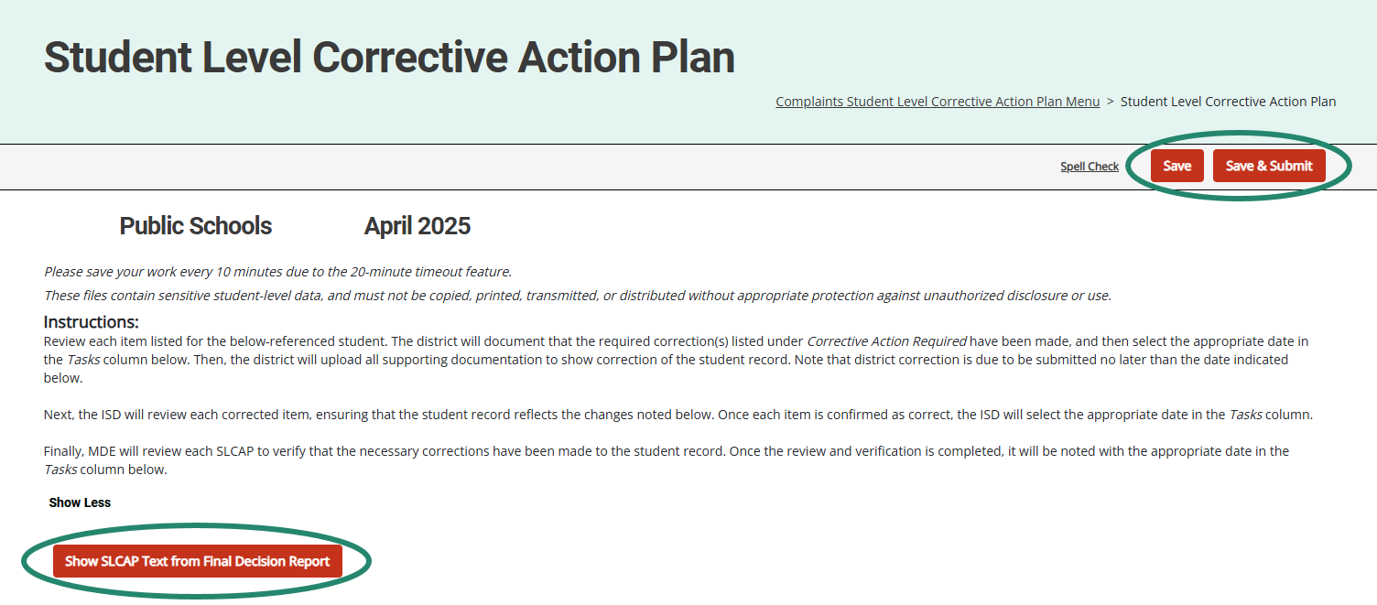
Student Level Corrective Action Plans
Notes:
SLCAPs correct individual student level noncompliance. They are due within 30 school days
SLCAPs Are verified as corrected by the ISD and OSE.
When verifying correction of noncompliance, States must ensure each individual SLCAP is corrected and closed before the CAP or corrective action is closed
The example shown here is highlighting a link from a Complaint SLCAP to the more explicit language of the final decision.
All B-13 SLCAPs will be due June 10 and B-4B/B-4AB SLCAPs will be due 30-school days from the date of review.

Slide 16
Reviewing and Acknowledging Reports
Notes:
The next sections will be for our new and occasional users. For our experienced users, you may also wish to stick around for these reminders.
Let’s take a closer look at reviewing and acknowledging reports in Catamaran.

Slide 17
View Reports
View available reports on the Tasks Overview at the bottom of the Dashboard.
Select the link in the Activity column (for example, B Report) to access the Reports page.
Notes:
Let’s dive into how to access, view and acknowledge reports. Also, please note that there is a How to document on the Catamaran Technical Assistance website that outlines how to acknowledge reports step by step.
When logging in, B Reports will be populated on the Tasks Overview. Select the link in the Activity column (for example, B Report) to access the Reports page.
Note: If you have previously applied a filter to the Tasks Overview, it may also be necessary to clear filters before applying a new one. As a reminder, you can narrow tasks down, by applying a filter such as Release, Type, or Organization.

Slide 18
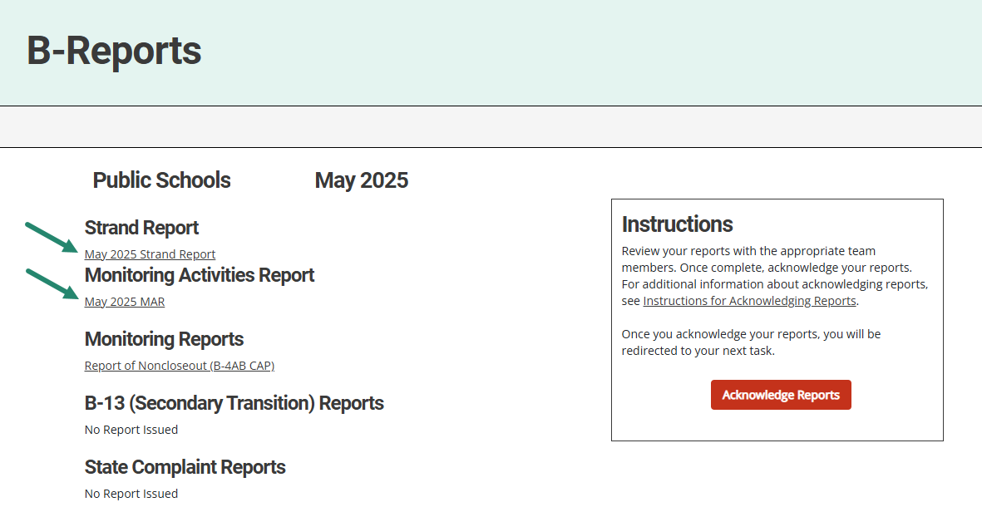
Access Reports
On the Reports page, select any report link to view that report.
Review and share the reports with appropriate team members.
Notes:
Once you reach the Reports page, you can select any report link to view that report.
Then, you can review, print, and share the reports with appropriate team members

Slide 19
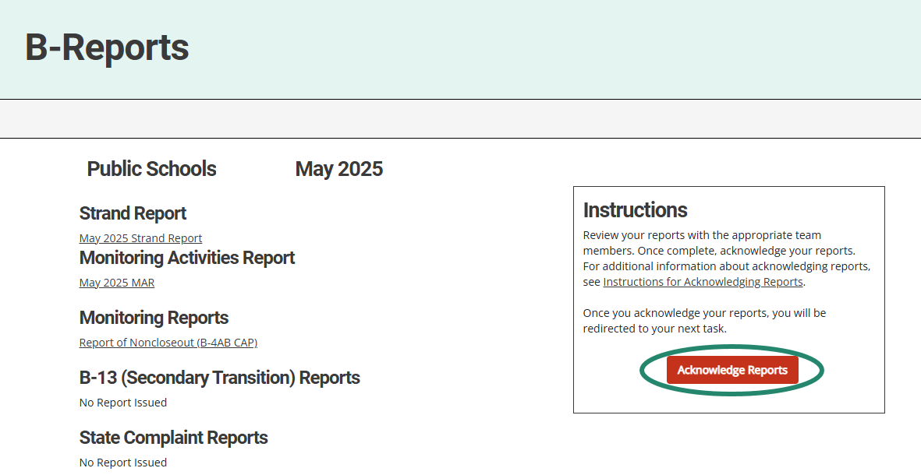
Acknowledge Reports by June 15
Acknowledge the reports by selecting the red Acknowledge Reports button on the Reports page.
Note: When the reports have been acknowledged, additional tasks will become available as appropriate (such as a CAP or Corrective Action).
Notes:
Reports must be acknowledged by June 15.
To acknowledge reports, select the red Acknowledge Reports button located on the right of the reports on the Reports page.
Once reports are acknowledged, the district will be returned to the Dashboard where any additional tasks such as a CAP will be become available. You may need to clear any previous set filters on the Tasks Overview to see any new tasks. If there are no additional tasks, then a message of “You have no tasks to view” will appear in the place of the Tasks Overview list.

Slide 20
After Acknowledging Reports
Work cannot be completed in Catamaran until reports have been acknowledged.
What to do after acknowledging reports:
Review Reports page – Does my district have findings?
Review Strand Report – What are the next steps?
Review MAR.
Decide whether the district should convene a Review and Analysis Process (RAP) Team.
Notes:
New work which has been issued in this release can not be completed in Catamaran until reports are acknowledged. In fact, the work is not even visible in Catamaran until the reports are acknowledged.
What to do after acknowledging reports:
Review Reports page – Does my district have findings?
Review Strand Report – What are the next steps?
Review MAR.
Decide whether the district should convene a Review and Analysis Process (RAP) Team.

Slide 21
Complete Tasks with RAP Team as needed
Check the Tasks Overview or the Strand Report to see if the district has a CAP or Corrective Action.
When there is a CAP or Corrective Action, convene a RAP Team to work through the activity.
Suggested RAP Team members include:
District and ISD personnel such as special and general education administrators
School improvement team representative
Parents
Service providers including general or special education teachers
Data experts or program specialists
Notes:
After sorting through and sharing the information, you’ll need to see if you have a CAP or Corrective Action to work on. You can check your Tasks Overview on the Dashboard (remember to clear any filters before applying a new one) or take another look at the Stand Report to see if you do indeed have a CAP or Corrective Action.
If you do, you need to convene a RAP Team to work through the CAP/Corrective Action.
Suggested RAP Team members include:
District and ISD personnel such as special and general education administrators
School improvement team representative
Parents
Service providers including general or special education teachers
Data experts or program specialists
Important note: if you have a Complaint CAP, it will not be listed on your Strand Report. You will need to check the Tasks Overview for Complaint CAPs.

Slide 22
Assigning B-13 CAPS, Corrective Action and SLCAPs
For ISDs
Notes:
Individuals at the ISD in the ISD Monitor user role in Catamaran can assign the verification of B-13 work (CAPs, Corrective Actions, and SLCAPs) to other ISD personnel as warranted. The next few slides describe how to do this.
Since there are significantly fewer B-13 CAPs, Corrective Actions, and SLCAPs this year, you may not even need to use this process. We will go through the process, but there is also a “How To” document available on the technical assistance site.

Slide 23
Access the User Management Page
Notes:
If you want to assign the review of B-13 SLCAPs, CAPs or CAs to other ISD personnel, the first step is to Log into Catamaran.
Choose Administration from the dropdown menu beneath your name in the upper right-hand corner
Select User Management for ISDs

Slide 24
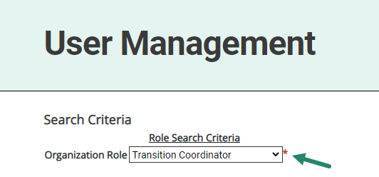
Select Current User Role
Select the current role of the individual from the Organization Role menu (e.g., Transition Coordinator).
Notes:
You will then select the current role of the individual from the Organization Role menu (e.g., Transition Coordinator).

Slide 25
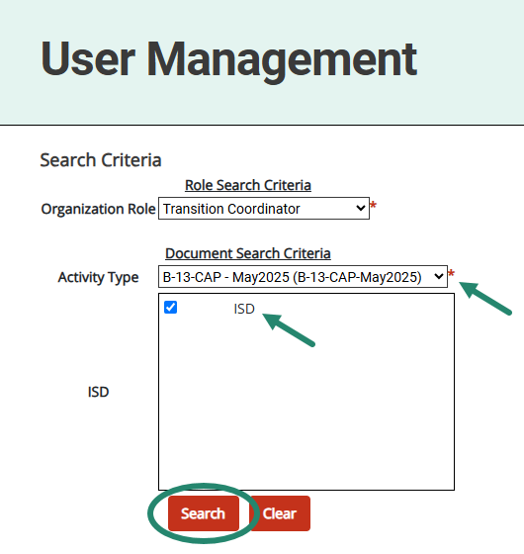
Select Activity Name
Select the activity name from the Activity Type menu.
Choose Search.
Notes:
You will then select the activity name from the Activity Type menu such as:
B-13 CAP – May 2025
B-13 Corrective Action – May 2025
B-13 SLCAP – April 2025
Once the Activity Type has been selected, choose Search.

Slide 26
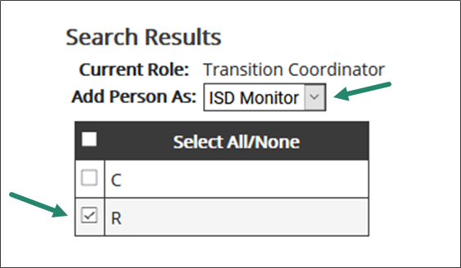
Select ISD Monitor Role
Next, select ISD Monitor from the Add Person As menu.
Notes:
Next, select ISD Monitor from the Add Person As Menu.

Slide 27
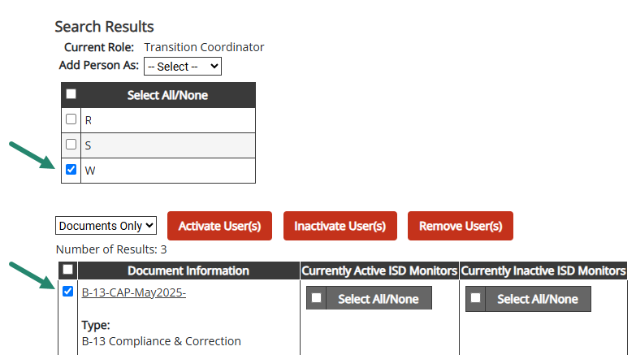
Select Name and Activity
Select the name of the individual from the user list.
Select the activity by checking the box next to the activity name.
Notes:
Select the name of the individual from the user list (see first arrow in screenshot).
Then select the activity you would like the individual assigned to by checking the box next to the activity name.

Slide 28
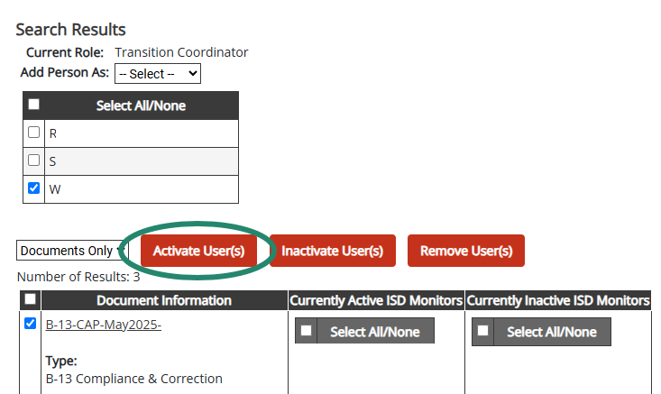
Activate User
Select Activate User.
Notes:
Finally, select Activate User to complete the assignment process.
If an individual is incorrectly assigned, repeat the same process above, but instead select Inactivate User(s) or Remove User(s). This action will remove that individual from the specific activity, but not from Catamaran.
For additional assistance, contact the Catamaran Help Desk.
This process Does not assign the individual to the ISD as an ISD Monitor
Assigned only to the selected activity as an ISD Monitor
Allows the individual to complete verification activities for the selected activity
The current ISD Monitor will continue to retain the same rights and privileges as an ISD Monitor on the activity.
Both the newly assigned individual and the current ISD Monitor will continue to have the activity on their tasks overview, where applicable.

Slide 29
Reminders for CAPs and Corrective Actions
Notes:
After acknowledging reports and assigning personnel, you will want to begin addressing any findings that may have been issued to your district. In this section we will review some reminders about the process of a CAP and Corrective Action. Let’s take a closer look at those.

Slide 30
Question 3: CAP Activity or Finding Page
The Delete? checkbox allows users to remove rows as needed.
The Step # field has been updated to auto-number rows.
Notes:
For both the CAP Activity or CAP Finding pages, the activity step question (question 3) allows users to delete a row without having to back out any information. We wanted to remind you of this feature and how to use it.
To remove a row, simply check the Delete box next to that row and choose Save. The unwanted row will be removed from the page.
This will make updating the CAP Activity/Finding page easier should the CAP be returned for modifications. Thus, ensuring the correct activity steps are then populated onto the following pages (e.g., Progress Report, etc.).
Also, the Step # field for Question 3 will auto-number for you. This will be helpful if you delete a row ☺ Once you save the page, Catamaran will apply the numbering to the listed steps.

Slide 31
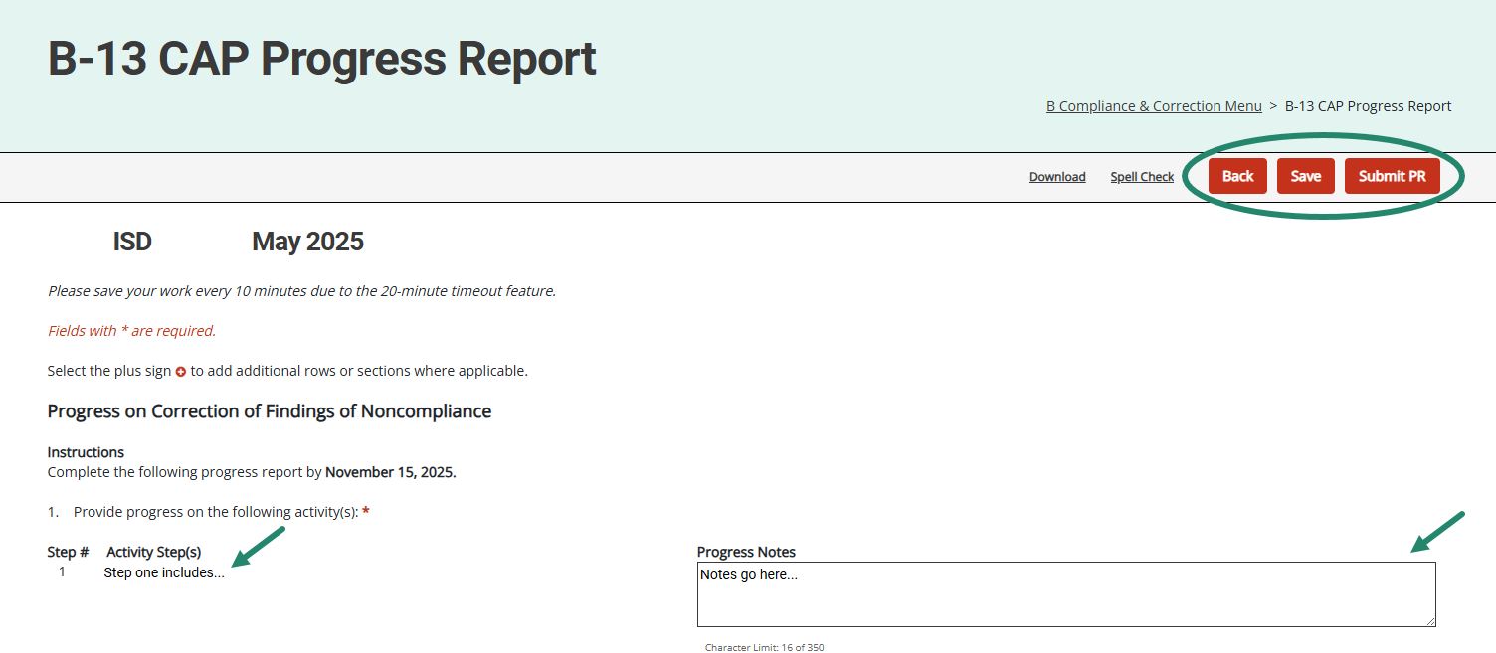
Progress Report
Activity step(s) from the CAP Activity (or Finding) page will be displayed on the Progress Report.
Districts will report progress on specific activity step(s).
Notes:
The Activity step(s) from the CAP Activity or CAP Finding page will be displayed on the Progress Report. With the updates to Question 3 on these pages, this means the Activity Steps will now be numbered on this page too.
Member districts will report progress on each specific activity step(s). It is no longer necessary to return to the CAP Activity or CAP Finding page to complete the Progress Report. This should make the process easier for both the district as they write the progress report and the OSE as they review the report.
On the B-13 CAP, the progress report will have the populated activity step displayed. The additional activity steps provided by the district for this CAP will also be displayed.
On the Monitoring CAPs (B-4A, B-4B, B-4AB), both the Finding number and Activity Step number will also be displayed here.
When submitting the progress report, the district may upload the relevant procedures for the OSE’s review.

Slide 32
Request Verification & Closeout
Districts provide evidence and documentation for specific activity step(s).
This information is available to the ISD to assist with CAP verification.
Notes:
Like the Progress Report, this page applies to Data, Monitoring, and Complaint CAPs.
It’s unnecessary to return to the CAP Activity (or Finding) page to complete this form to request closeout.
Also available on the Complaint CAP verification and closeout form, but only on the Complaint CAPs, is a place to upload evidence of ordered compensatory services.
Based on OSEP's 23-01 Memo, for all CAPs, ISDs may return a verification request to the district. To do this, the ISD can return the CAP to the district from the Request for Verification and Closeout of Findings page. If the ISD returns the verification request to the member district, the district can review the files the ISD determined to be non-compliant. Once the corrections are made, the district should upload documentation of correction to the Verification Appendix page, then resubmit the verification request from the Request Verification & Closeout page. There is an ISD Comments box on this page for any instructions the ISD may want to leave for the district.

Slide 33
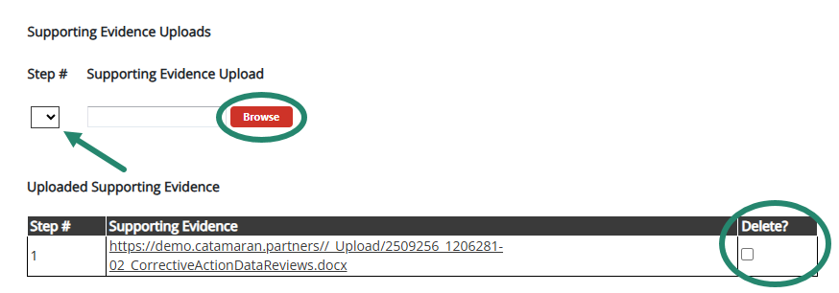
Supporting Evidence Uploads
Notes:
The Request Verification & Closeout page also includes a Supporting Evidence Uploads section at the bottom of the page. This will allow you to upload multiple documents per activity step!
Once you have provided your evidence notes, scroll down below the listed activity steps to upload any supporting evidence. Remember, this is not a requirement at this step.
To do this, below the listed activity steps, select from the provided drop-down menu(s) the appropriate step # (and/or finding # if a Monitoring CAP), then upload/tag your specific documentation to a specific finding/step.
After uploading documentation to this page, you may realize that you uploaded the wrong attachment. Because of this, we have provided a way to delete attachments as needed. To do this, locate the attachment in the Uploaded Supporting Evidence table and select the delete checkbox by the row you wish to remove, and then Save the page to confirm your selection.

Slide 34
B-13 CAP Verification Activity
Gather up to 8 student records, if available, for students aged 16-26. The ISD must have selected these records before they begin completing the CAP Verification page.
Ensure that all students selected are currently in the district and data is available. There will not be an opportunity to delete student records after entry.
Ensure that documentation used to verify completion of district activities (e.g., training, procedures) is uploaded to the CAP Verification page.
Notes:
Once you have your complete list of students for verification, choose the CAP Verification Link from the B-13 CAP Menu.
It is important to only add pages for students included in your review. Please do not add any pages before you’ve compiled your list.
The first time you access the B-13 CAP Verification page in Catamaran, a system alert will be displayed as a reminder of the steps you should complete before you start this activity.
• Gather up to 8 student records, if available, for students aged 16-26. The ISD must have selected these records before they begin completing the CAP Verification page.
• Ensure that all students selected are currently in the district and data is available. There will not be an opportunity to delete student records after entry.
• Ensure documentation that demonstrates compliance for each student record is uploaded to the CAP Verification page. This change in practice is based on OSEP’s 23-01 memo which states the State must retain documentation of correction of noncompliance for each individual case of previously noncompliant files, records, etc.

Slide 35
Resources
Notes:
Even with the best of training, there may be questions that arise later as you use the system. There are a variety of resources available to support you.

Slide 36
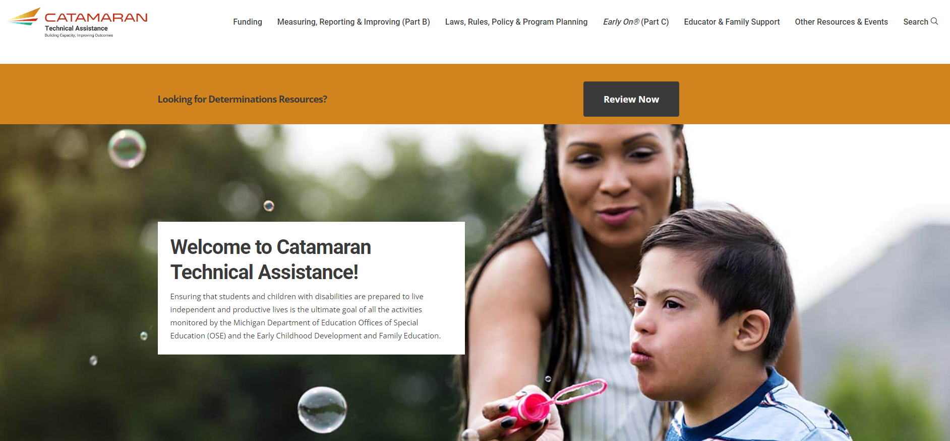
Catamaran Technical Assistance Website
Notes:
The Catamaran Technical Assistance Website focuses on increased technical assistance for Catamaran users.
The following slides highlight some of the features and navigation.
You can access the Catamaran Technical Assistance Website at training dot catamaran dot partners.

Slide 37
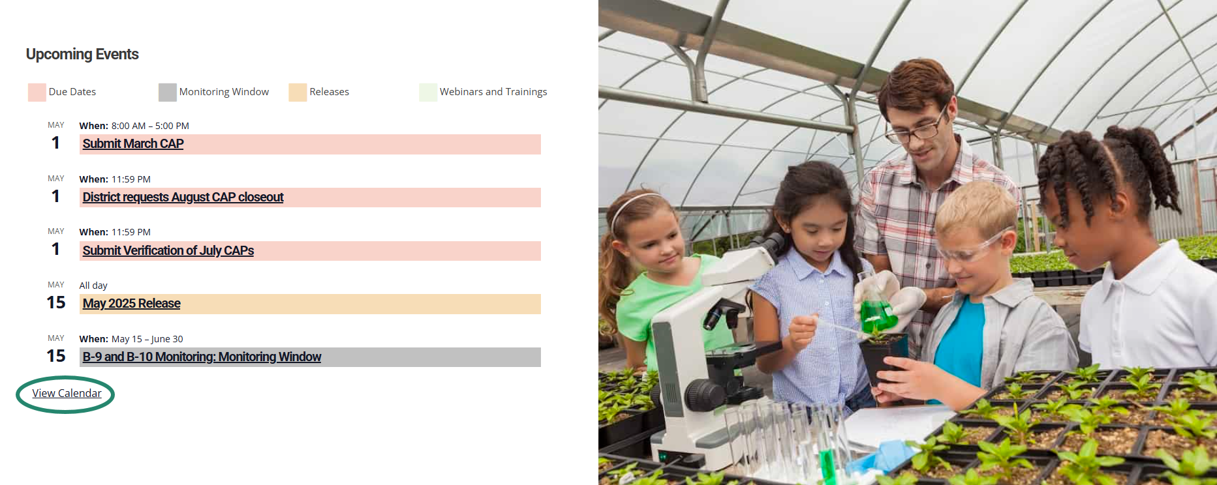
Catamaran Calendar List View
Notes:
You may access the Catamaran Calendar on the home page of the Catamaran Technical Assistance Website by scrolling to the bottom of the page. This calendar will display 5 calendar items in a list-view format. To view the full-sized calendar, select the View Calendar link at the bottom of the calendar.

Slide 38
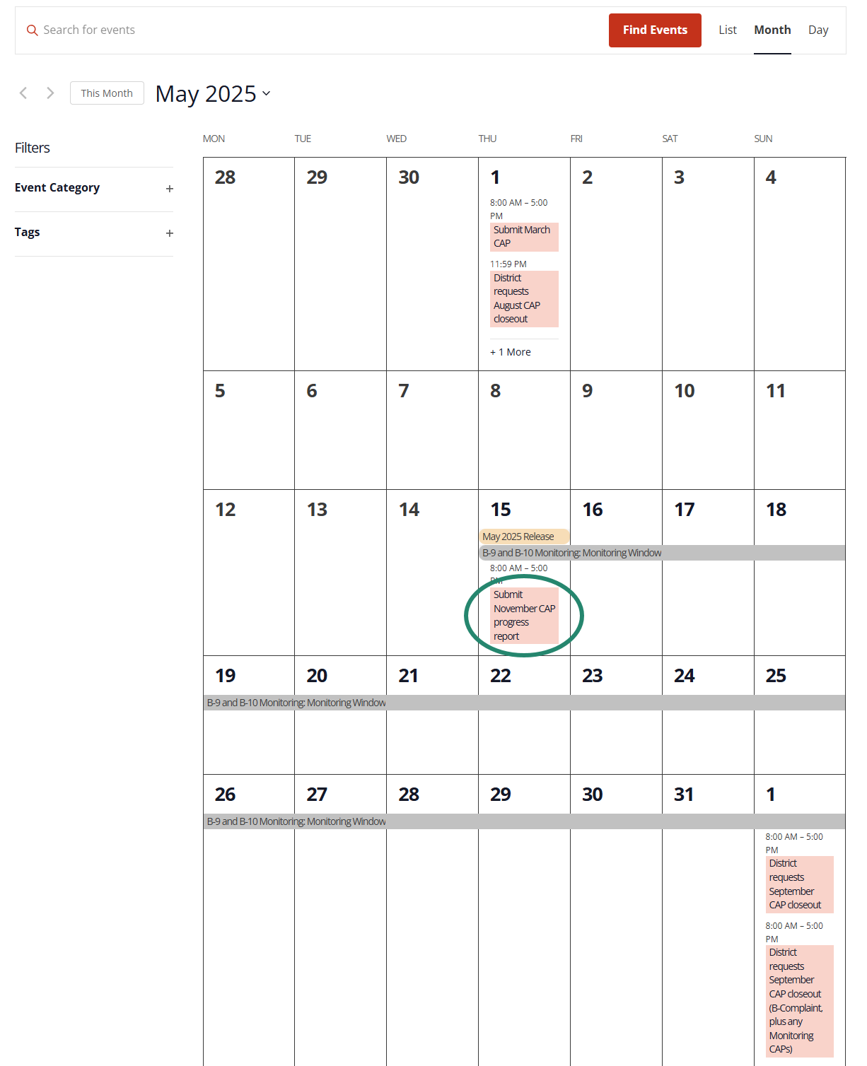
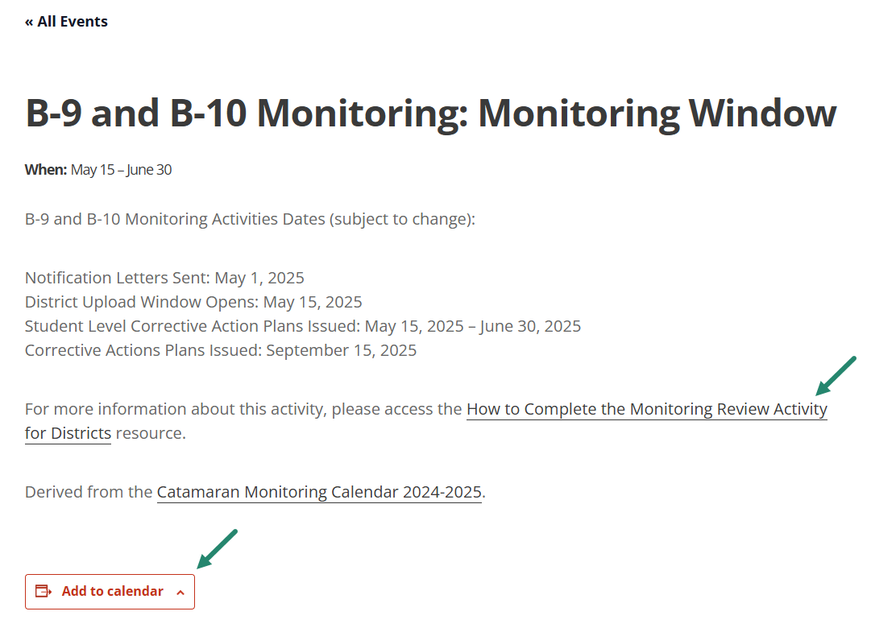
Catamaran Calendar (Continued)
Notes:
After selecting View Calendar, then the full-size calendar will be displayed as shown here. At the top right of the full-size calendar, you can choose to view the calendar in the view that works best for you by list, month, or day.
From the month view, you can drill down on a specific event for more information and add the event to your calendar.
For upcoming due dates that have a how-to associated with it, there will be a clickable link to the how-to.
We hope this page is useful for you and helps you to plan your work.

Slide 39
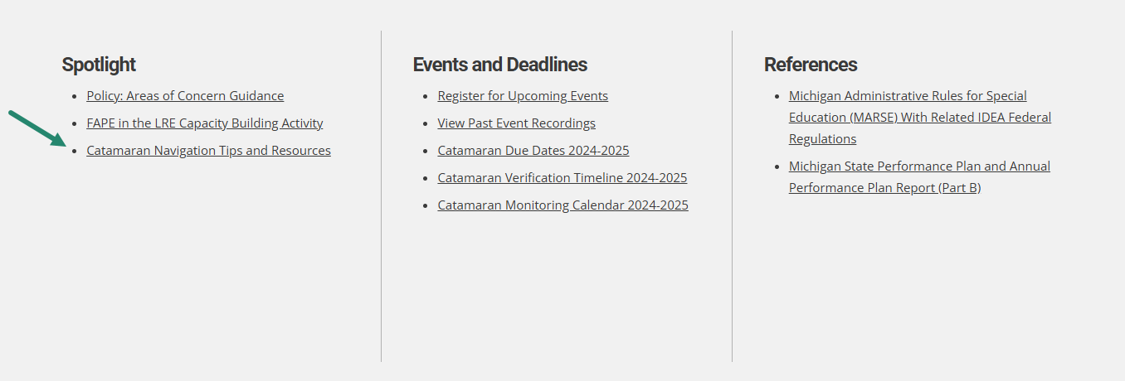
Catamaran Navigation Tips Training Video
Notes:
We have a separate training video that includes Catamaran navigation tips. This video can be found in the Spotlight section on the homepage of the Catamaran Technical Assistance Website. This video is encouraged for new users, as well as refreshing experienced users in navigating Catamaran.

Slide 40
Need Assistance?
MDE OSE Information Line
888-320-8384
mde-ose@michigan.gov
Catamaran Help Desk
877-474-9023
help@catamaran.partners
Notes:
If you have any questions about this recording, contact the MDE OSE Information Line at 888-320-8384 or by email at m d e – o s e @ Michigan.gov.
For questions about Catamaran, contact the Catamaran Help Desk.
The Catamaran Help Desk is available Monday through Friday from 8-5 PM.
Contact them by email at help@catamaran.partners or by phone at 877-474-9023 or by using the Chat feature within Catamaran.
This concludes the presentation -- thank you for watching!

