Slide 1
Significant Cognitive Disability
2025 MSDS characteristic

Slide 2
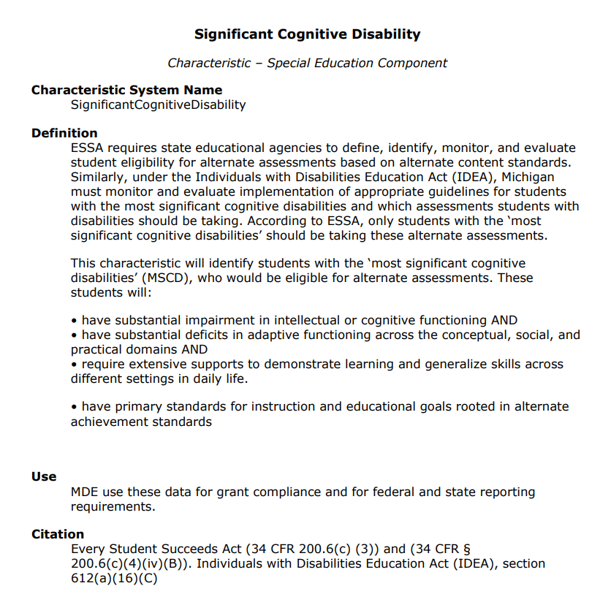
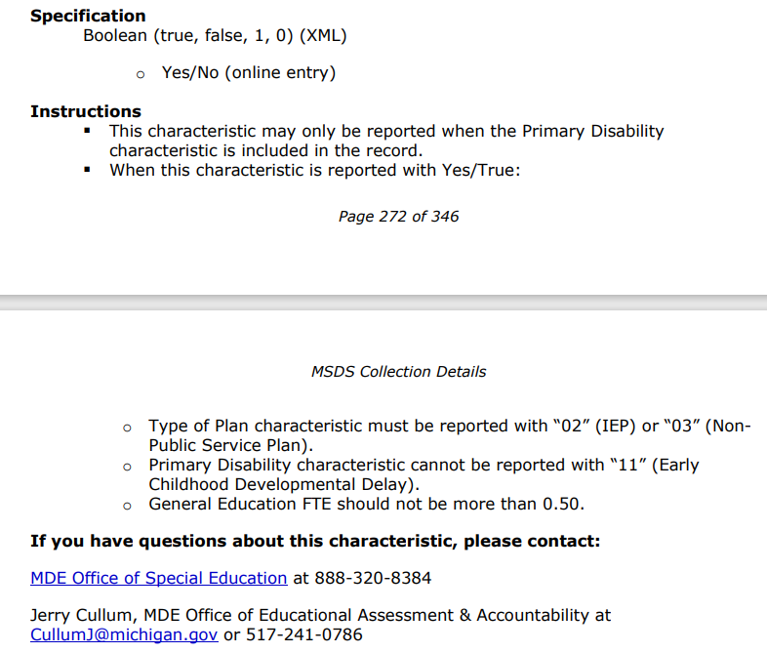
MSDS Collection Details Manual
Manual is located at https://www.michigan.gov/cepi/pk-12/msds The manual covers every characteristic reported within MSDS collections.
Notes:
Manual is located at https://www.michigan.gov/cepi/pk-12/msds The manual covers every characteristic reported within MSDS collections.

Slide 3
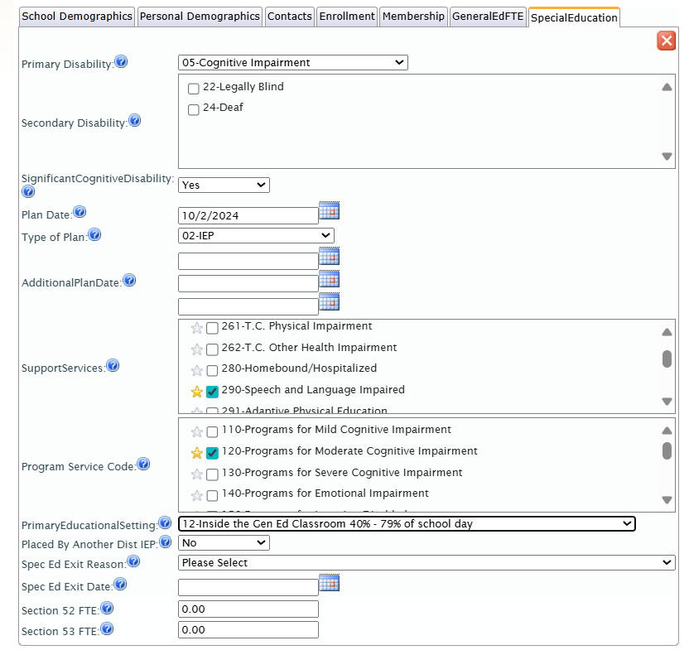
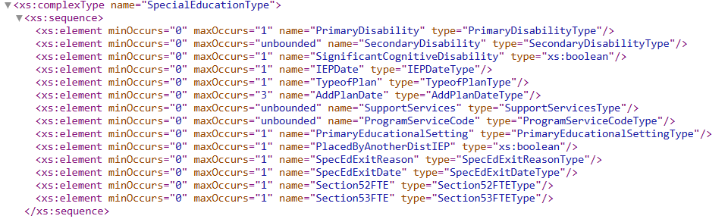
What it looks like in MSDS and in the Schema
Screenshot of what it looks like within MSDS staging area
Example of the technical specification within the schema

Slide 4
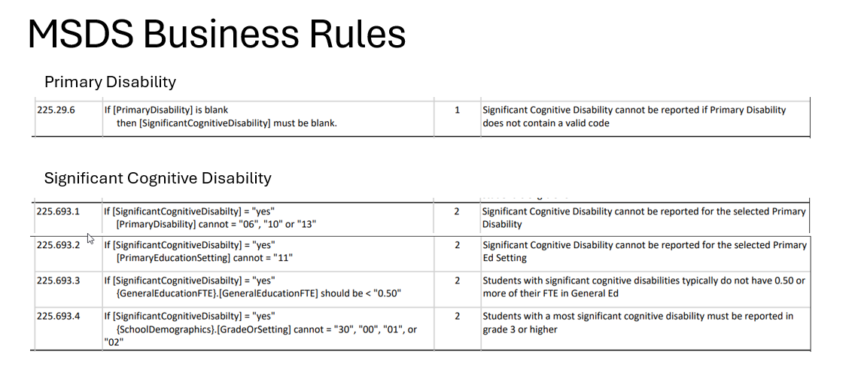
System checks… aka…
Business rules are located at https://www.michigan.gov/cepi/pk-12/msds within the Technical Specifications> Collection Component Matrix link

