Slide 1
Waivers Training Webinar
For Districts and ISDs
Notes:
Hello and welcome to the Michigan Department of Education Office of Special Education Webinar on Waivers. This webinar is pre-recorded.

Slide 2
Meet the Team
Office of Special Education (OSE)
  Beth Cooke, Policy Consultant
  Sheryl Diamond, Policy Consultant
Notes:
Hello, my name is Beth Cooke and joining me today is Sheryl Diamond. We are policy consultants in the Office of Special Education.

Slide 3
Agenda
The Revised School Code
When to Apply for a Waiver
Types of Waivers
Waiver Renewals
Waiver Applications and Review Process
Waivers Activity in Catamaran
Catamaran Navigation Tips
Resources
Notes:
In this webinar, we will cover the definition of a waiver according to the Revised School Code, when to apply for a waiver, the circumstances under which waivers are allowed, the types of waiver applications, and the application process in Catamaran. We will also cover basic Catamaran navigation tips.

Slide 4
The Revised School Code
Notes:
The authority to grant administrative rule waivers is found in the Michigan Compiled Laws Chapter 380 and is titled the Revised School Code.

Slide 5
The Revised School Code: MCL 380.1281(3)
Pursuant to MCL 380.1281(3) and Executive Order 1996-12, the superintendent of public instruction may grant a waiver for certain rules in the Michigan Administrative Rules for Special Education (MARSE), if specific criteria in this subsection of the statute are met.
Who may apply for a waiver?
  District
    Local Educational Agency (LEA)
    Public School Academy (PSA)
  Intermediate School District (ISD)
Notes:
Section 380.1281, subsection 3, of the Revised School Code gives the superintendent of public instruction the authority to grant an administrative rule waiver to a local educational agency (LEA), public school academy (PSA), or intermediate school district (ISD) when criteria in this subsection are met.
A waiver for a rule found in the Michigan Administrative Rules for Special Education (MARSE) allows a district to operate a special education program or service differently from a specific rule requirement. A teacher flexibility waiver allows a district to assign a special education teacher to a special education program that does not match the teacher’s endorsement.

Slide 6
The Revised School Code - 2
The superintendent of public instruction may grant an administrative rule waiver only if the requesting district or ISD demonstrates that:
  The district or ISD can address the intent of the rule in a more effective, efficient, or economical manner, or
  The waiver is necessary to stimulate improved pupil performance.
A waiver may be granted for not more than 3 years. A waiver may be renewed. Conditions may be placed on a waiver or its renewal.
Notes:
Michigan Compiled Law Section 380.1281, subsection 3, includes specific criteria re: the application for and granting of waivers.
Districts applying for waivers must demonstrate the district will address the intent of the rule in a more effective, efficient, or economical manner or that the waiver is necessary to stimulate improved pupil performance.
The superintendent of public instruction may place conditions on a waiver or its renewal.

Slide 7
The Revised School Code - 3
A waiver may be revoked by the superintendent of public instruction if it is determined the waiver:
  No longer meets the criteria of this statute,
  Compromises equal opportunities for learning, or
  Is detrimental to the educational interests of pupils.
Notes:
The superintendent of public instruction may revoke a waiver if the waiver no longer meets waiver criteria, compromises equal opportunities for learning, or is detrimental to the educational interests of pupils.

Slide 8
The Revised School Code - 4
The superintendent of public instruction may not grant a waiver from the duty to comply with:
  A provision of the Revised School Code, or
  Another state statute unless and to the extent a waiver is specifically allowed by the other state statute.
Notes:
Waivers are for administrative rules.
Waivers may not be granted from the duty to comply with a provision of the Revised School Code or another state statute, unless a waiver is specifically allowed by the other state statute.

Slide 9
When to Apply for a Waiver
Notes:
Districts may consider applying for a waiver when the district is seeking approval to meet the intent of an administrative rule in a more effective, efficient, or economical manner, or determines the waiver is necessary to stimulate improved pupil performance.

Slide 10
Do I need a waiver?
A waiver is necessary when:
  A district is requesting approval to place a special education teacher in a special education program that does not match the teacher’s endorsement.
  A district is requesting approval to operate a program differently from a requirement in an administrative rule.
Notes:
Read the slide.

Slide 11
Types of Waivers
Notes:
Next, we will go through the different types of waivers.

Slide 12
Types of Waivers list
Teacher Flexibility Rules:
  R 340.1754(2)(a) Early Childhood Special Education (ECSE) Program Teacher Requirement
  R 340.1755(2)(a) Early Childhood Special Education (ECSE) Services Teacher Requirement
  R 340.1758(a) Program for Students with Autism Spectrum Disorder (ASD) Teacher Requirement
  R 390.1105(3) Teacher Certification Code Requirement
Other MARSE Rules
Notes:
The waivers break down into two main groups: The first group includes teacher flexibility waivers. This group includes the MARSE rules about teacher requirements for ECSE and ASD programs. This group also includes R 390.1105(3) from the Teacher Certification Code for teacher requirements in other special education programs. This is the only rule related to waivers in special education that falls outside of the MARSE.
The second group includes MARSE rules not related to teacher flexibility.

Slide 13
Teacher Flexibility Waivers
Notes:
Teacher flexibility waivers refer to waivers allowing a district to place a special education teacher in a special education program that does not match the teacher’s endorsement due to the teacher shortage.

Slide 14
ECSE Teacher Requirements:
R 340.1754(2)(a) and R 340.1755(2)(a)
The purpose of these waivers is to address the teacher shortage in early childhood special education (ECSE) programs and services.
Allows a district, which has met waiver criteria, to hire a teacher endorsed in another area of special education to teach in an early childhood special education program.
Approved waivers are valid from the date the application is submitted through June 30th of that academic year.
Notes:
Waivers for Rules 340.1754(2)(a) and 340.1755(2)(a) - Teacher Requirements are to address the teacher shortage in programs and services in early childhood special education (ECSE).
Districts must meet waiver criteria by providing documentation of sufficient attempts to fill the position with a properly endorsed teacher.
When a district meets waiver criteria, the waiver approval allows a district to place a teacher with an endorsement in another area of special education to teach in the ECSE program or provide ECSE services. Note: the teacher should have general education endorsement and/or experience in early elementary.
The waiver is approved from the date the application is submitted in Catamaran through June 30th of that academic year.

Slide 15
ASD Teacher Requirement:
R 340.1758(a)
The purpose of the waiver is to address the teacher shortage in programs for students with autism spectrum disorder (ASD).
Allows a district, which has met waiver criteria, to hire a teacher endorsed in Emotional Impairment (EI), Cognitive Impairment (CI), or Learning Disabilities (LD) to teach in the program for students with ASD.
Approved waivers are valid from the date the application is submitted through June 30th of that academic year.
Notes:
The waiver for Rule 340.1758(a) - Teacher Requirement is to address the teacher shortage in programs for students with autism spectrum disorder (ASD).
Districts must meet waiver criteria by providing documentation of sufficient attempts to fill the position with a teacher endorsed in the area of ASD.
When a district meets waiver criteria, the waiver approval allows a district to place a teacher endorsed in Emotional Impairment (EI), Cognitive Impairment (CI), or Learning Disabilities (LD) to teach in the program for students with Autism Spectrum Disorder (ASD).
The waiver is approved from the date the application is submitted in Catamaran through June 30th of that academic year.

Slide 16
Teacher Certification Code Requirement:
R 390.1105(3)
The purpose of the waiver is to address the teacher shortage in specific special education programs.
Allows a district, which has met waiver criteria, to assign a teacher endorsed in any area of special education to teach in the following programs for students with disabilities in the areas of cognitive impairment, emotional impairment, learning disabilities, physical impairment and other health impairments, and severe multiple impairments.
Approved waivers are valid from the date the application is submitted through June 30th of that academic year.
Notes:
The waiver for Rule 390.1105(3) in the Teacher Certification Code is to address the teacher shortage in the following special education programs for students with disabilities in the areas of: cognitive impairment, emotional impairment, learning disabilities, physical impairment and other health impairments, and severe multiple impairments.
Districts must meet waiver criteria by providing documentation of sufficient attempts to fill the position with a teacher with an endorsement that matches the program.
When a district meets waiver criteria, the waiver approval allows a district to place a teacher with a special education endorsement in a different area than the program in which the teacher is placed.
The waiver is approved from the date the application is submitted in Catamaran through June 30th of that academic year.

Slide 17
Teacher Flexibility Waiver Renewals
Teacher flexibility waivers may be renewed for one academic year for the same teacher in the same position by completing the abbreviated renewal application.
The abbreviated renewal application requires assurance of satisfactory teacher performance but does not require the district to post the position.
The district is required to complete a new waiver application if a waiver is sought for the same position after the academic year for which a renewal was granted.

Slide 18
Teacher Flexibility Application Requirements
Notes:
All teacher flexibility waiver applications are available in Catamaran.

Slide 19
Requirements for all Teacher Flexibility Waiver Applications
A description of how the district will address the intent of the rule being waived or why the waiver is necessary to stimulate improved pupil performance.
The name of the special education program, grades included, and building location.
The candidate’s name and current endorsements, including Personal Identification Code (PIC) number and expiration date.
Notes:
Read the slide.

Slide 20
Requirements for all Teacher Flexibility Waiver Applications - 2
The district must provide the following:
  A copy of the job posting for candidates with an endorsement that matches the special education program for which the waiver is requested.
  The number of candidates with the matching endorsement who applied and reasons they were not selected.
  If a substitute teacher was assigned to fill the position.
  A dated communication to the district’s certified teachers which includes the following:
    The availability of the open position due to the teacher shortage.
    The option to obtain temporary approval.
    The availability of tuition reimbursement.
Notes:
The waiver application indicates the specific documentation required to show these conditions have been met, including:
1. A dated copy of the original job posting and subsequent job postings.
2. The number of candidates with a matching endorsement who applied and reasons they were not selected.
3. Documentation indicating if a substitute teacher has been assigned and dates of coverage.
4. A dated communication to all the district’s certified teachers.
5. The communication must include information about the critical teacher shortage, the option to obtain temporary approval as a special education teacher for certified teachers willing to enroll in a special education teacher preparation program at an institute of higher education, and the potential availability of tuition reimbursement.
6. A written assurance statement indicating no district staff were willing to seek temporary approval.

Slide 21
Renewal Application Requirements for Teacher Flexibility Waivers
Teacher flexibility waivers may be renewed for one academic year for the same teacher in the same position by completing the abbreviated renewal application.
The abbreviated renewal application requires assurance of satisfactory teacher performance but does not require the district to post the position.
When the district chooses the rule in the application, a question will appear asking if the district is seeking a renewal.
Checking Yes to: “Is this a renewal?” will populate the abbreviated renewal application.
Notes:
Read the slide.
To summarize:
The application process is the same. Choose the rule, and you will be given the question: Is this a Renewal?
Checking Yes will populate the abbreviated renewal application.

Slide 22
Waiver Application Requirements for Other MARSE Rules
Notes:
The following information applies to waiver applications for rules that are not related to teacher endorsement requirements. Common examples include rules that determine caseloads, class size, and age span.

Slide 23
Application Requirements
  Include the rule number to be waived.
  Indicate length of time requested not to exceed three years.
  Describe how the district will meet the intent of the rule in a more effective, efficient, or economical manner, or why the waiver is necessary for improved pupil performance.
  Describe how student needs will be met under the requested waiver.
Notes:
Read the slide.

Slide 24
Application Requirements - 2
Include a statement of how interested parties were involved in the application process.
Describe the plan for ensuring how the district, if granted the waiver, will continue to meet requirements of the waiver, including evaluating the waiver’s effectiveness.
Notes:
Examples of interested parties may include teachers, staff, parents, community members. How were people involved in the district’s decision to apply for the waiver and in determining what the district is requesting under the waiver?
A description of the plan needs to include how the district will evaluate that the waiver is working as intended and that it is not detrimental to the educational interest of any student.
Note: Supporting documents are requested to illustrate and support the points made in the descriptions.

Slide 25
Waiver Renewals
Include data to illustrate:
  How interested parties were notified and involved in the renewal application process.
  Accountability measures from the current waiver.
  Impact of the current waiver on effectiveness, efficiency, or improved pupil performance.
Notes:
As part of the application process for a waiver renewal, districts are required to provide data to illustrate and support:
1. How interested parties were notified and involved in the renewal process. Examples of supporting documents include: PAC meeting agenda and meeting minutes, emails and on-line notices announcing discussion of the waiver application.
2. Examples of supporting documents to illustrate accountability measures and the impact of the current waiver include: spreadsheet or tracking document on students’ goal progress, class roster summaries without names, aggregate assessment data.

Slide 26
Waiver Renewals - 2
A description of the plan for addressing local accountability and how the district will document that the waiver renewal will continue to meet waiver criteria.
To allow for processing time, districts are encouraged to submit applications for renewal 60 days prior to a currently approved waiver’s expiration date.
Notes:
After providing data on the effectiveness of the current waiver, the application requires the district to provide information on the accountability measures to be used for the renewal waiver, if granted.
Districts are reminded to submit renewal waiver applications 60 days prior to the current waiver’s expiration date to allow adequate time for processing.

Slide 27
Application Review Process for all Waivers

Slide 28
MDE Review Process
The district submits the application to MDE via Catamaran.
OSE staff ensure the application is complete. When incomplete, OSE staff returns the application to the district. The district must then complete the application and re-submit it to MDE.
Once the application is complete, the OSE review team reviews the application then forwards it to the superintendent of public instruction for a final decision.
The district is notified through Catamaran of the superintendent of public instruction’s decision.
Notes:
Read the slides.
Each rule requires a separate application. The application is first reviewed by the Office of Special Education team and then forwarded to the Office of the Superintendent of Public Instruction.

Slide 29
Waivers Activity in Catamaran
Notes:
Now we will walk you through the steps to create a waiver application in Catamaran.

Slide 30

Log into Catamaran
Log into Catamaran (https://catamaran.partners)
Notes:
Log into Catamaran by providing your username and password.

Slide 31
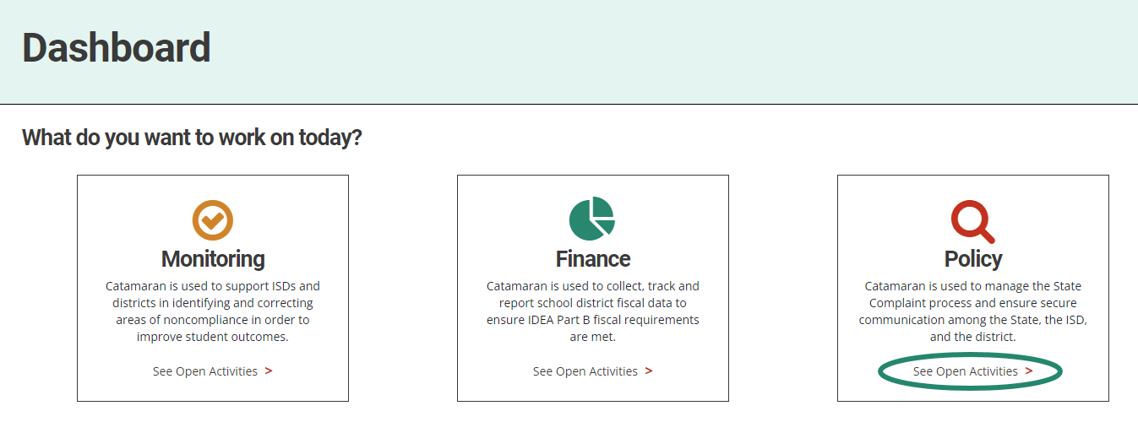
Locate the Activity
Once you login, navigate to the Policy homepage by selecting See Open Activities on the Policy tile.
Notes:
Read the slide.

Slide 32
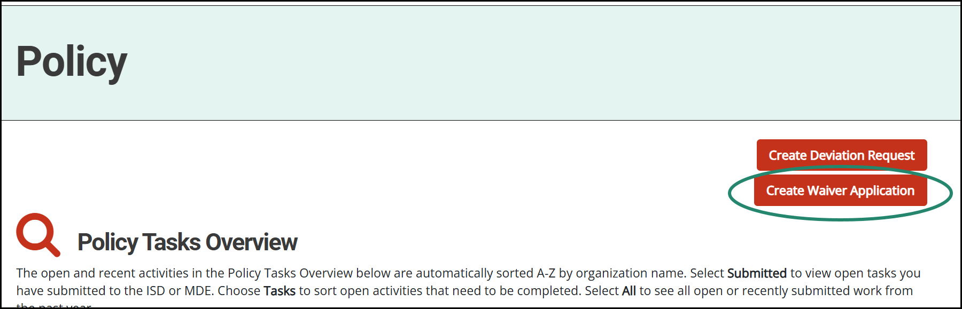
Create Waiver Application
Initiate the Waivers activity by selecting the Create Waiver Application button on the Policy Tasks Overview.
Notes:
Once you log in, you can begin the Waivers activity by navigating to the Policy homepage and using the Create Waiver Application button.
The waiver application button will be found in the upper right-hand corner of the Policy homepage directly below the deviation request button. The waiver application button is available to catamaran coordinators at districts and ISDs.

Slide 33
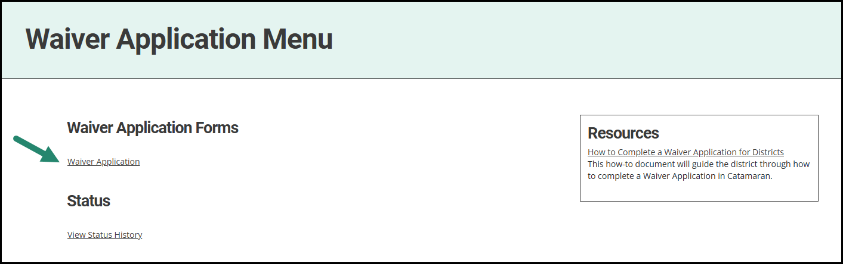
Start the Waiver Application
From the activity menu, select the Waiver Application to get started.
Notes:
From the activity menu, select the waiver application link, located under the waiver application forms header, to get started.

Slide 34
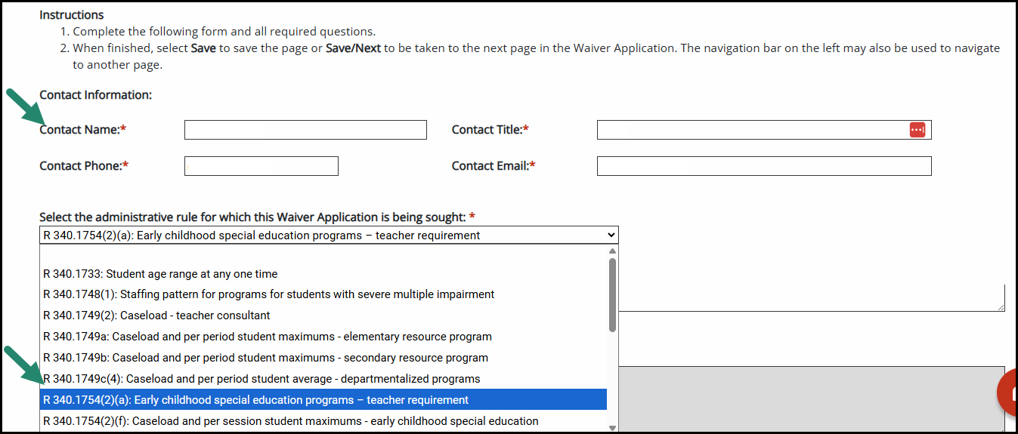
Waiver Information
Select the application type.
Select the appropriate rule for the waiver application.
Choose Save/Next and all additional forms will automatically load.
Notes:
Catamaran Coordinators will first complete the Waiver Information page.
The question will appear: Is this a renewal of a previously approved waiver? Check Yes or No.
Select the rule related to the waiver application from the drop-down menu.
Select Save and all additional forms will automatically load.
The system will load the appropriate forms for the application type.
In addition to the initial and renewal type applications, if Rule 340.1758(a) – Teacher Requirement, Rule 340.1754 – ECSE Program, R 340.1755 ECSE Service, or R 390.1105 is selected, a different application and set of forms will be required for a waiver from those rules. These forms will auto-load if any of these rules are selected.
Complete all forms and required questions.
For the next few slides, we will walk through the supporting documentation needed for various rules for new applications.

Slide 35
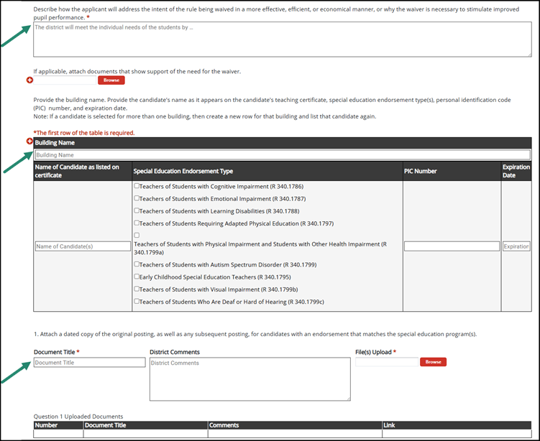
ECSE Supporting Documentation
Notes:
For both early childhood special education programs and early childhood special education services you will be required to provide the same supporting documentation. The first question will require you to describe how you will address the intent of the rule in a more effective efficient or economical manner or why the waiver is necessary to stimulate improved pupil performance. An optional browse box is provided if you wish to upload documents for this question.
You will then be required to complete a table including the building name, the name of the candidate as listed on their teaching certificate, their special education endorsement type, PIC number, and expiration date.
You will then be required to upload the dated copy of the original job posting for this position as well as any subsequent postings. Please complete the document title and upload the document. There is a box for any additional comments.

Slide 36
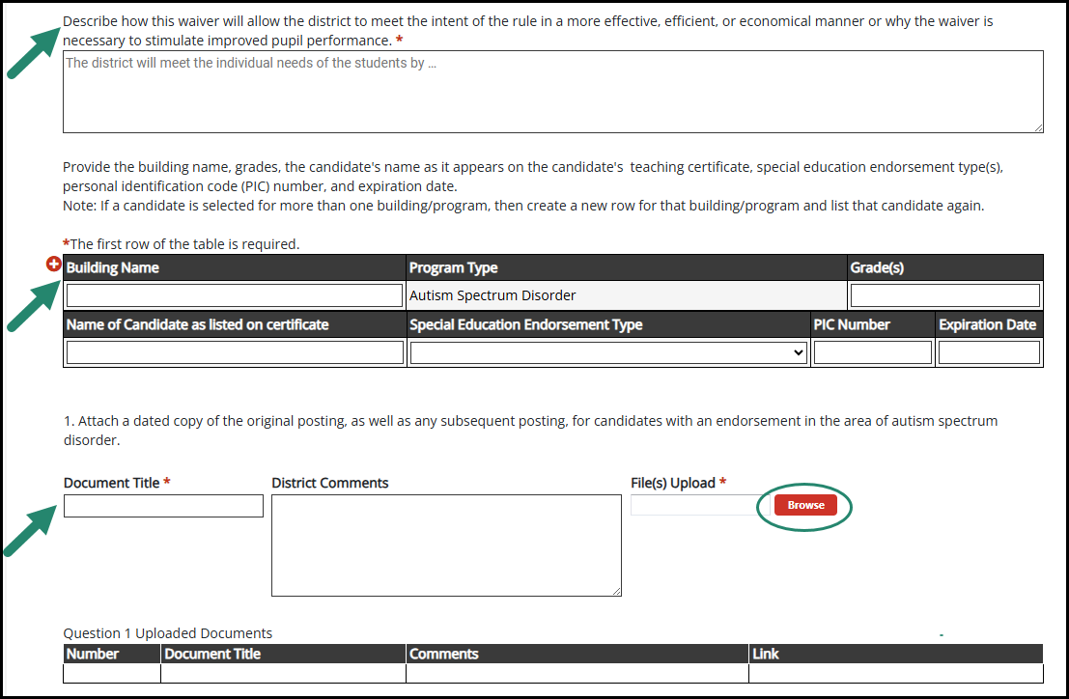
Supporting Documentation – ASD Teacher Requirement
Notes:
When you select the ASD teacher requirement rule, you are required to describe how the waiver will allow the district to meet the intent of the rule, then complete a table providing the name of the building and the grades for which the waiver would apply. The program type will automatically say autism spectrum disorder.
The second row of this table requires the name of the candidate as listed on their teaching certificate, current special education endorsement in the area of emotional impairment, cognitive impairment, or learning disabilities, PIC number, and expiration date.
You will then be required to upload the dated copy of the original job posting for this position as well as any subsequent postings. Please complete the document title and upload the document. There is a box for any additional comments.

Slide 37
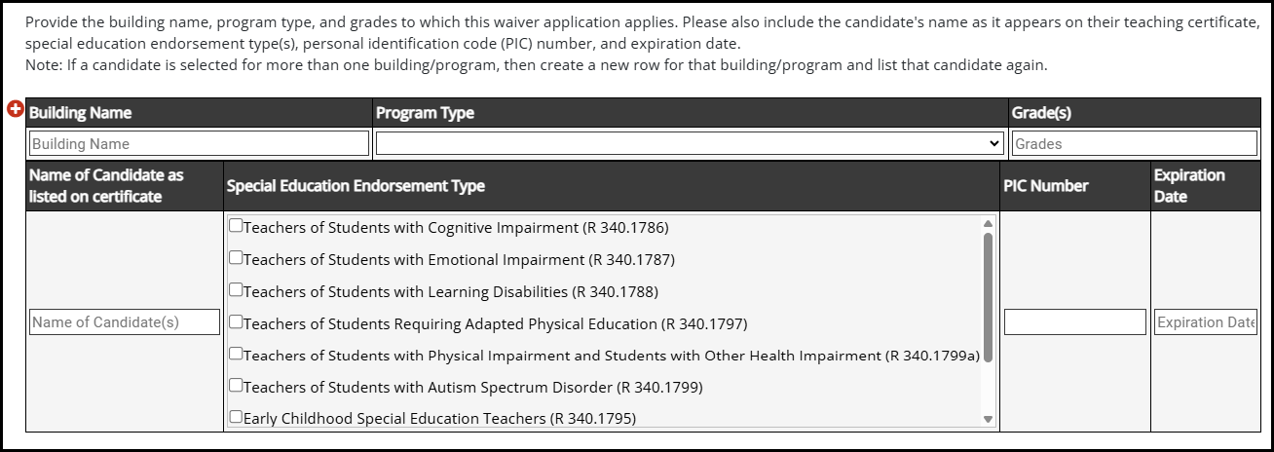
Supporting Documentation – Teacher Endorsement Flexibility
Notes:
The only difference for the supporting documentation for the waiver under 390.1105(3) is the table that you will be asked to complete. This table will ask for the building name, the program type, and the grade levels to which this waiver applies. You will still be asked to provide the name of the candidate as listed on their teaching certificate, special education endorsement type, PIC number, and expiration date. Next, we will cover the remainder of the questions on this page which are the same for ECSE, ASD, and 1105 waivers.

Slide 38
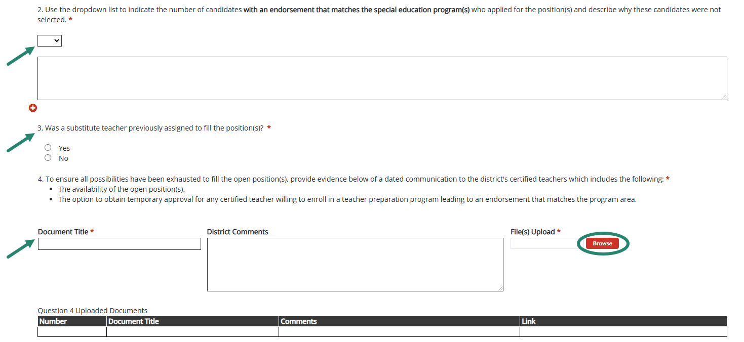
Supporting Documentation Questions
Notes:
For each of these waivers, you will be required to use the drop down list to indicate the number of candidates with an endorsement that matches the special education program who applied for the position and reasons these candidates were not selected. You will be asked if a substitute teacher was previously assigned to fill the position. The fourth question requires you to provide evidence of a dated communication to all of the district’s certified teachers which includes the availability of the open position in the area of teacher shortage, the option to obtain temporary approval for any certified teacher willing to enroll in a teacher preparation program, and the potential availability of tuition reimbursement. Please provide a document title and upload the file. There is a box for any additional district comments.

Slide 39
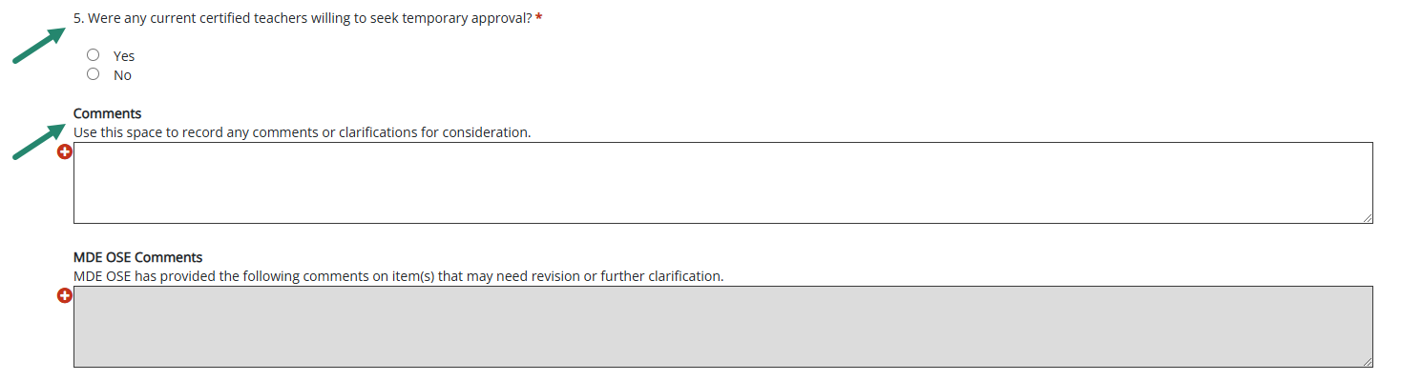
Supporting Documentation Questions - 2
Notes:
The third part of this form asks if there were any current teachers willing to seek temporary approval. If yes, a text box will appear for you to explain why the teacher was not selected. A Comment box is available for any needed clarification.

Slide 40
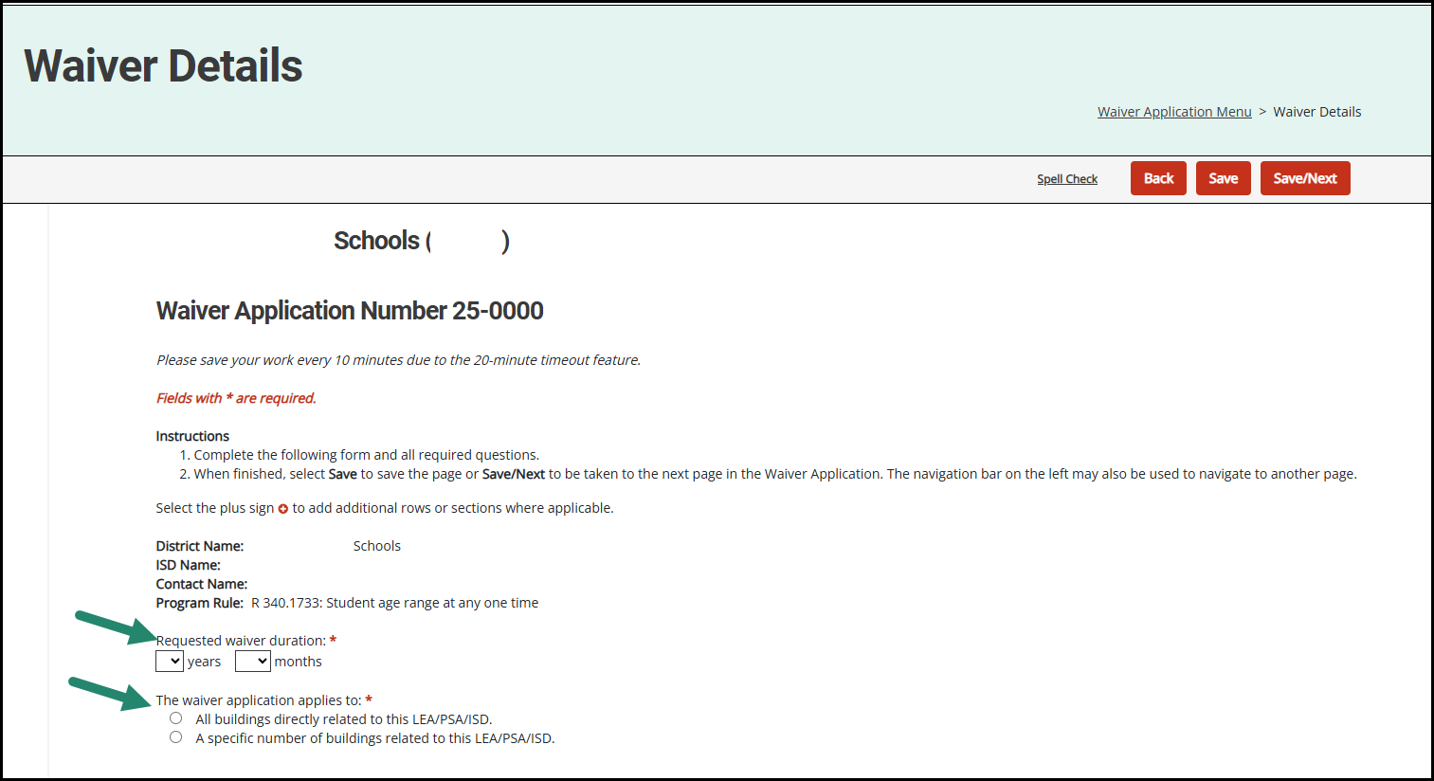
Waiver Details
Choose the requested waiver duration period.
Choose where the waiver application applies.
Notes:
For rules that are not related to teacher flexibility, you will see a page named Waiver Details. Choose the requested waiver duration period and the buildings to which the waiver would apply.
If you select certain buildings, you will be prompted to name them.

Slide 41
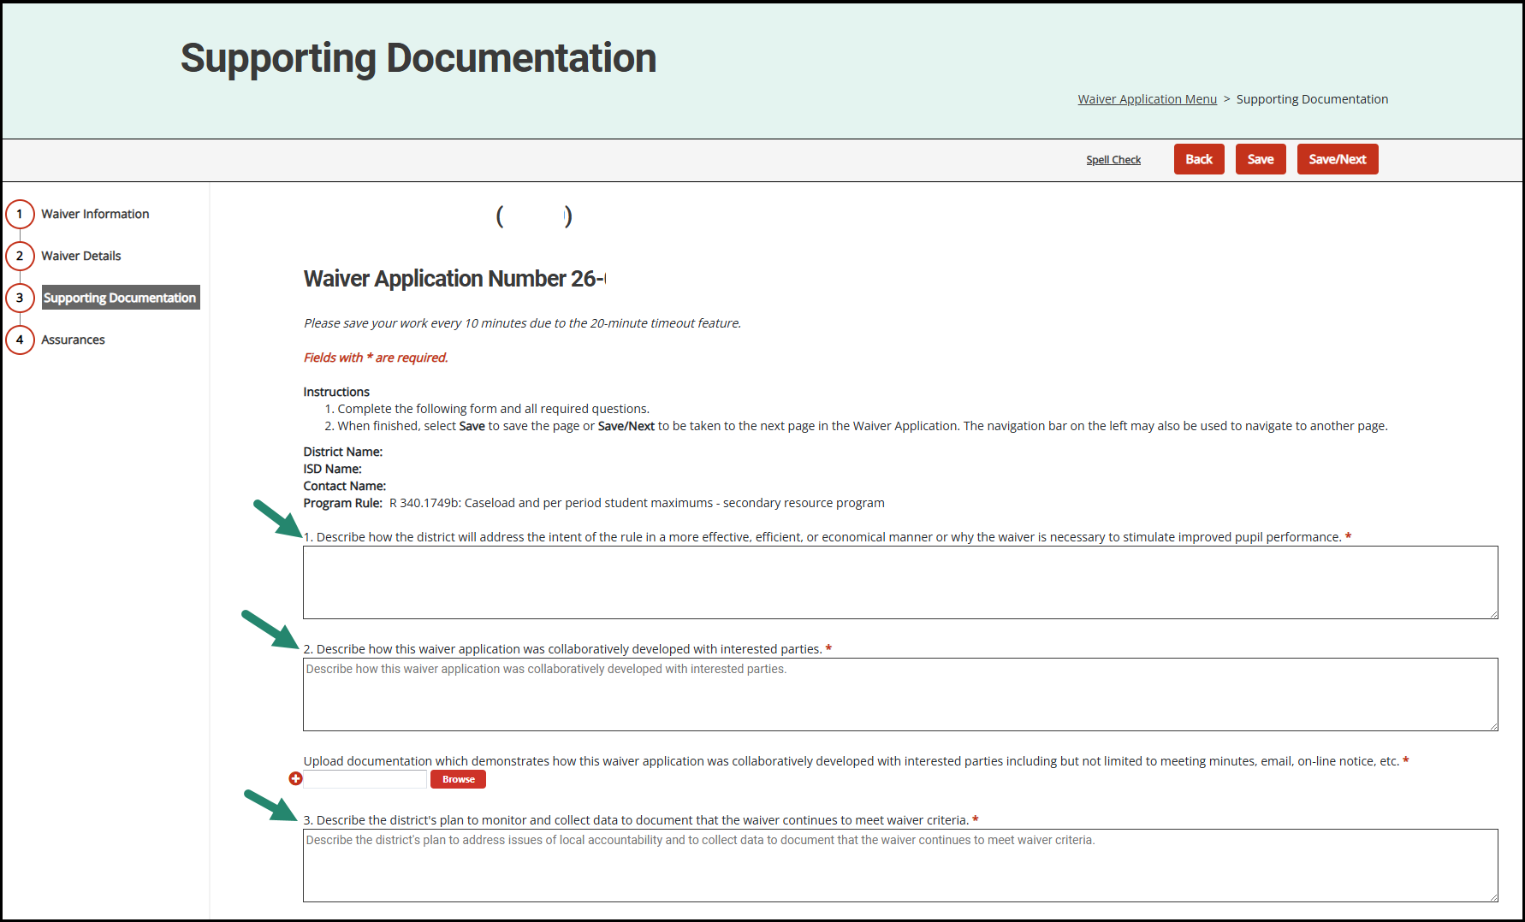
Supporting Documentation
Notes:
For all rules not related to teacher flexibility, the supporting documentation page will require you to answer 3 questions.
The first question requires you to describe how the district will address the intent of the rule in a more effective efficient or economical manner or why the waiver is necessary to stimulate improved pupil performance.
The second question requires you to describe how the waiver application was collaboratively developed with interested parties. Interested parties may include the parent advisory committee, members of the community, parents, and teachers. This question also requires an upload of documentation which demonstrates outreach and involvement. Examples include meeting minutes, emails, and online notices.
The third question requires you to describe the district's plan to address issues of local accountability and to collect data to document that the waiver continues to meet waiver criteria.

Slide 42
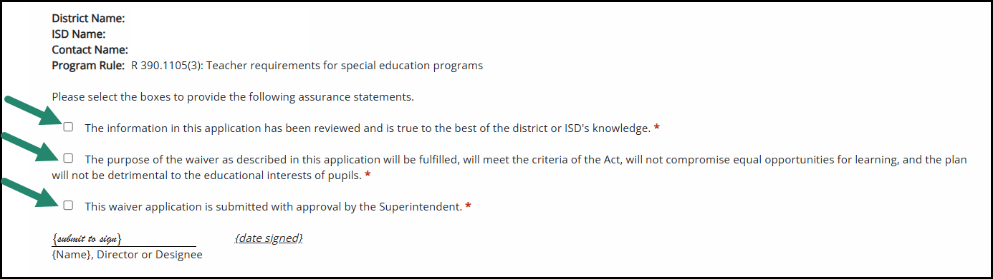
Assurances
Fill out all required fields.
Utilize the Comments box on all pages of the activity.
Notes:
The assurances form is identical for all waiver types which are completed within catamaran. You will be asked to complete a check box for a series of statements. The first statement indicates that the information on this application has been reviewed and is true to the best of the district or ISD's knowledge. The second statement provides assurance that the waiver described in the application will be fulfilled, will meet the criteria of the act, will not compromise equal opportunities for learning, and will not be detrimental to the educational interests of pupils. The third statement indicates that the waiver application is submitted with approval by the Superintendent.

Slide 43
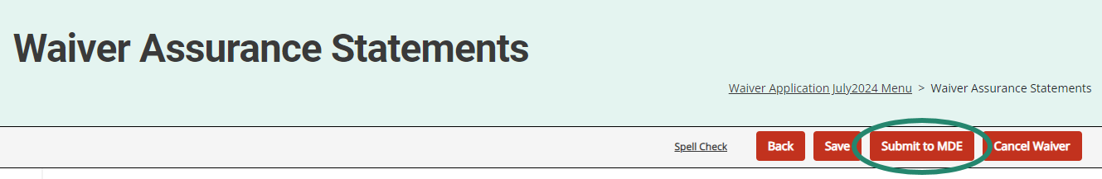
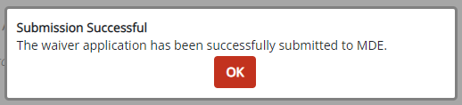
Submit Waiver Application
When all forms are completed, submit the waiver application using the Submit to MDE button.
When submitted, CCs will see a pop-up notification.
Notes:
When all forms are completed, submit the waiver request using the Submit button.
A system notification will be sent to confirm the waiver application submission.

Slide 44
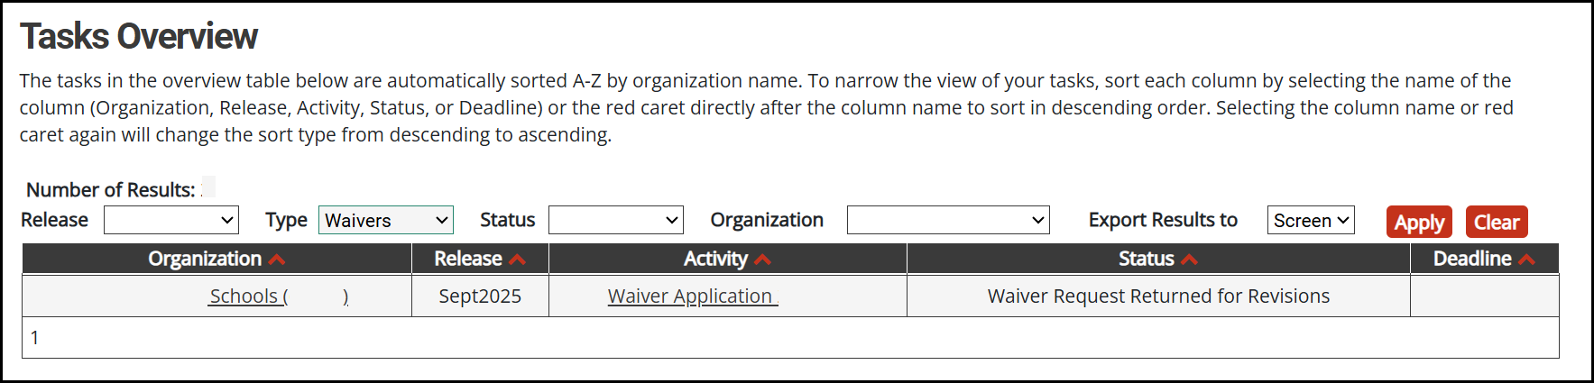
Waiver Revisions Required
A notification will be sent to the district or ISD and the activity will appear on the Tasks Overview.
Notes:
If a waiver application is returned for revisions, the submitting district or ISD will receive a notification.
Find the Waiver application activity on the tasks overview. To more easily find the activity if you have a lot open work on your tasks overview, use the type drop down box and filter by waivers. Then select Apply to see the shortened list.
Review each page for comments from MDE and make the necessary updates or revisions before resubmitting.

Slide 45
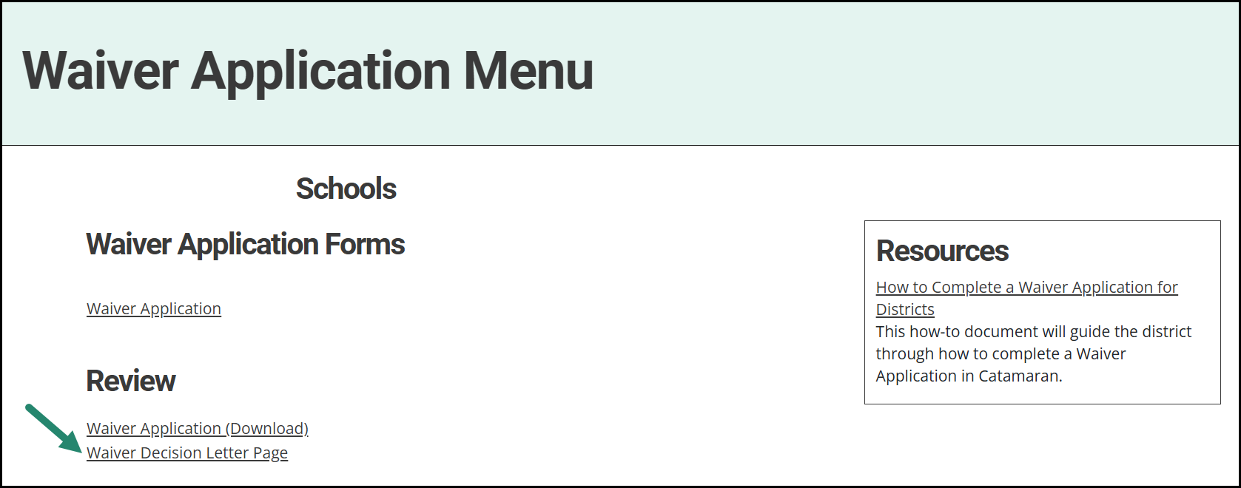
Waiver Decision
A notification will be sent to the district or ISD to notify of the decision made.
Notes:
Once a waiver decision is made by MDE, the submitting district or ISD will receive a notification.
A letter signed by the State Superintendent will be mailed and it will also be made available on the waiver activity menu.
Find the Waiver application activity at anytime by using the search feature in Catamaran.

Slide 46
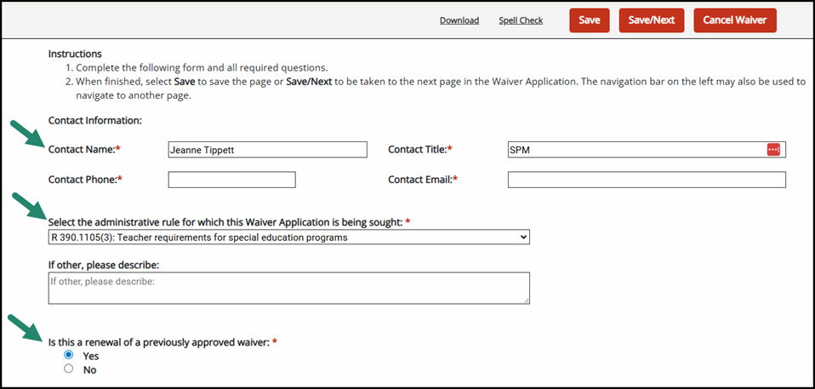
Teacher Flexibility Waiver Renewal Application
Notes:
On the first page of all applications, if the question “Is this a Renewal? is marked Yes by the district, a renewal application will appear.

Slide 47
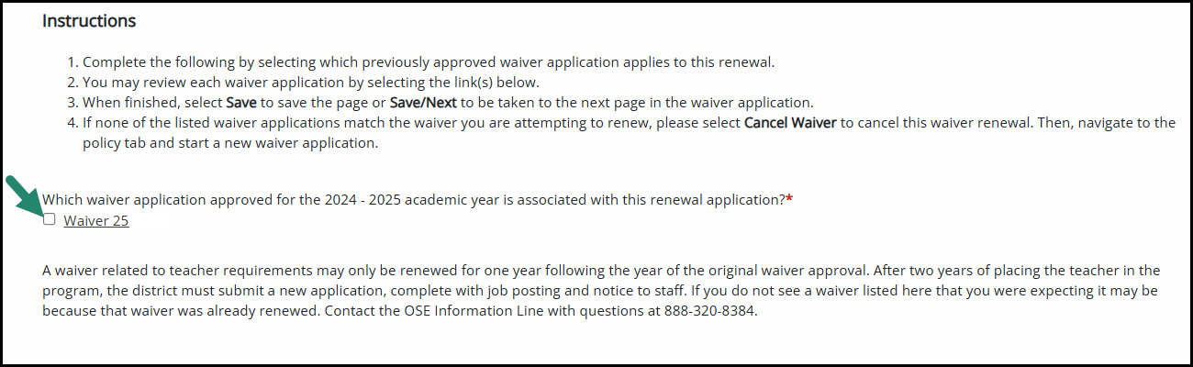
Teacher Flexibility Waiver Renewal Selection
Notes:
Read the slide.

Slide 48
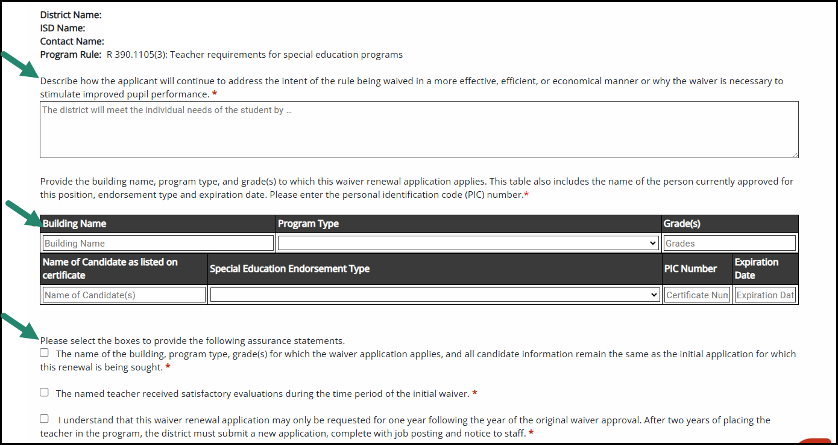
Teacher Flexibility Waiver Renewal Questions
Notes:
The first question will require you to describe how you will continue to address the intent of the rule in a more effective efficient or economical manner or why the waiver is necessary to stimulate improved pupil performance.
You will then be required to complete a table including the building name, program type, grades, the name of the candidate as listed on their teaching certificate, their special education endorsement type, PIC number, and expiration date.
Read the assurance statements.

Slide 49
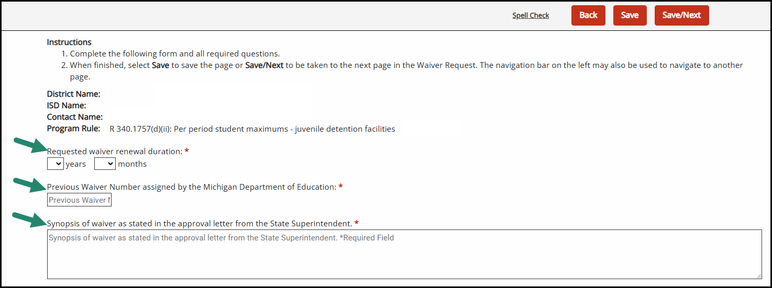
All Other Waiver Renewals
Notes:
Complete the requested duration, the previous waiver number for the waiver being renewed, and a synopsis of the previous waiver approval.

Slide 50
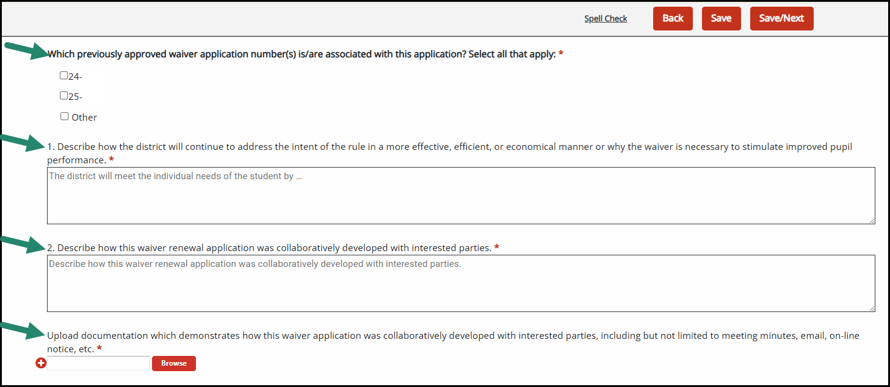
Waiver Renewal Supporting Documentation
Notes:
Read the slide. Go through each question.

Slide 51
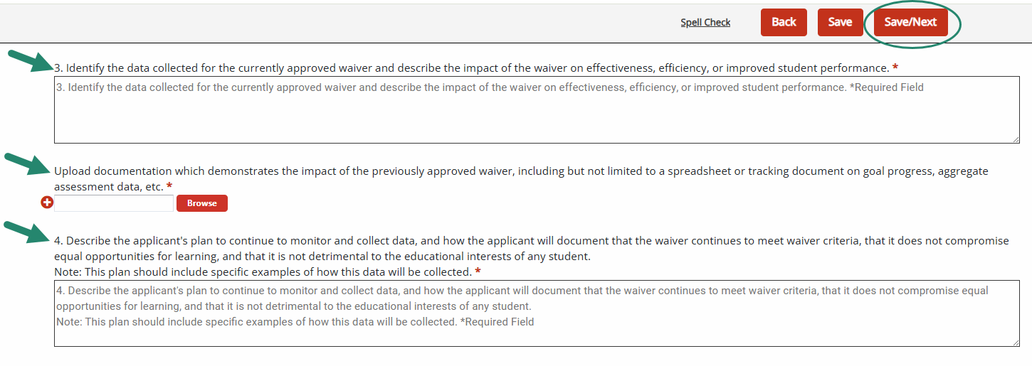
Waiver Renewal Supporting Documentation - 2
Notes:
Read the questions. Then state: Upon completion, you will see Assurance Statements and a red Submit Waiver button as previously described.

Slide 52
Resources
Notes:
Lastly, we have some resources to share with you about Catamaran and the waiver application activity.

Slide 53

Catamaran Technical Assistance Website
Notes:
The Catamaran Technical Assistance Website focuses on increased technical assistance for Catamaran users.
The following slides highlight some of the features and navigation.
You can access the Catamaran Technical Assistance Website at training dot catamaran dot partners.

Slide 54
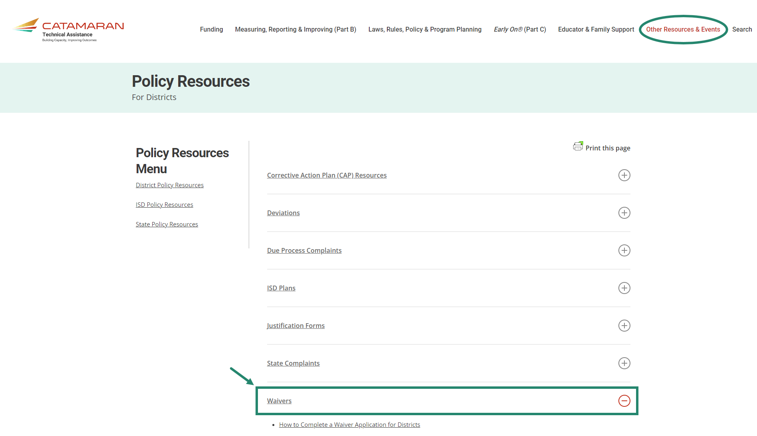
Policy Resources for Districts
Notes:
To access Waiver Resources for Districts, select Other Resources & Events, then choose District Policy Resources to open the page. Waiver resources are located under the Waiver heading as shown on this slide. Resources available include:
How to Complete a Waiver Application for Districts.

Slide 55
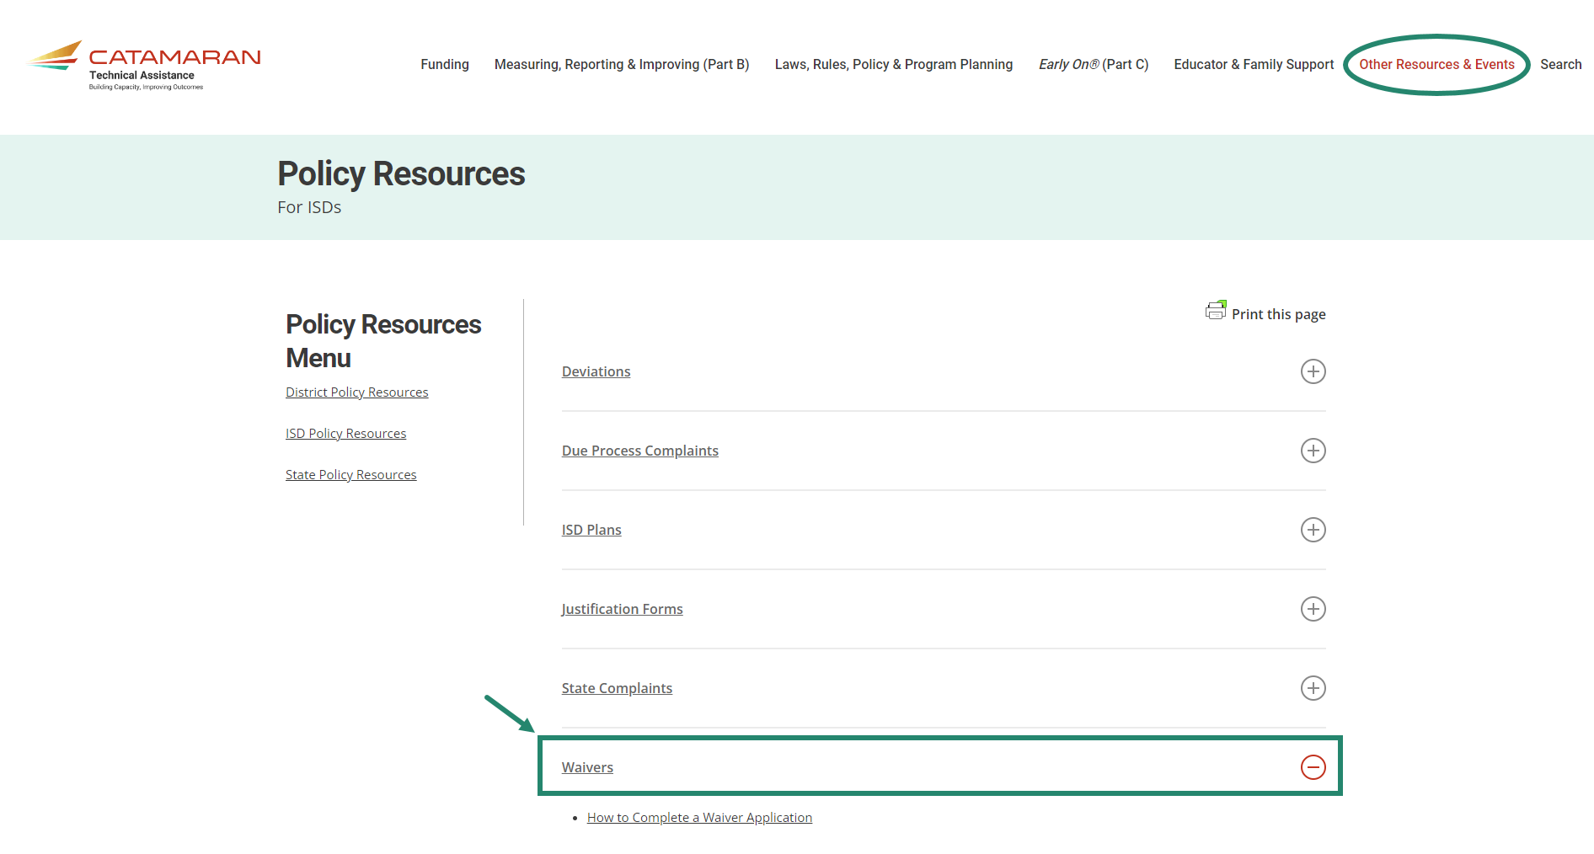
Policy Resources for ISDs
Notes:
To access Waiver Resources for ISDs, select Other Resources & Events, then choose ISD Policy Resources to open the page. Waiver resources are located under the Waiver heading as shown on this slide. Resources available include:
How to Complete a Waiver Application.

Slide 56
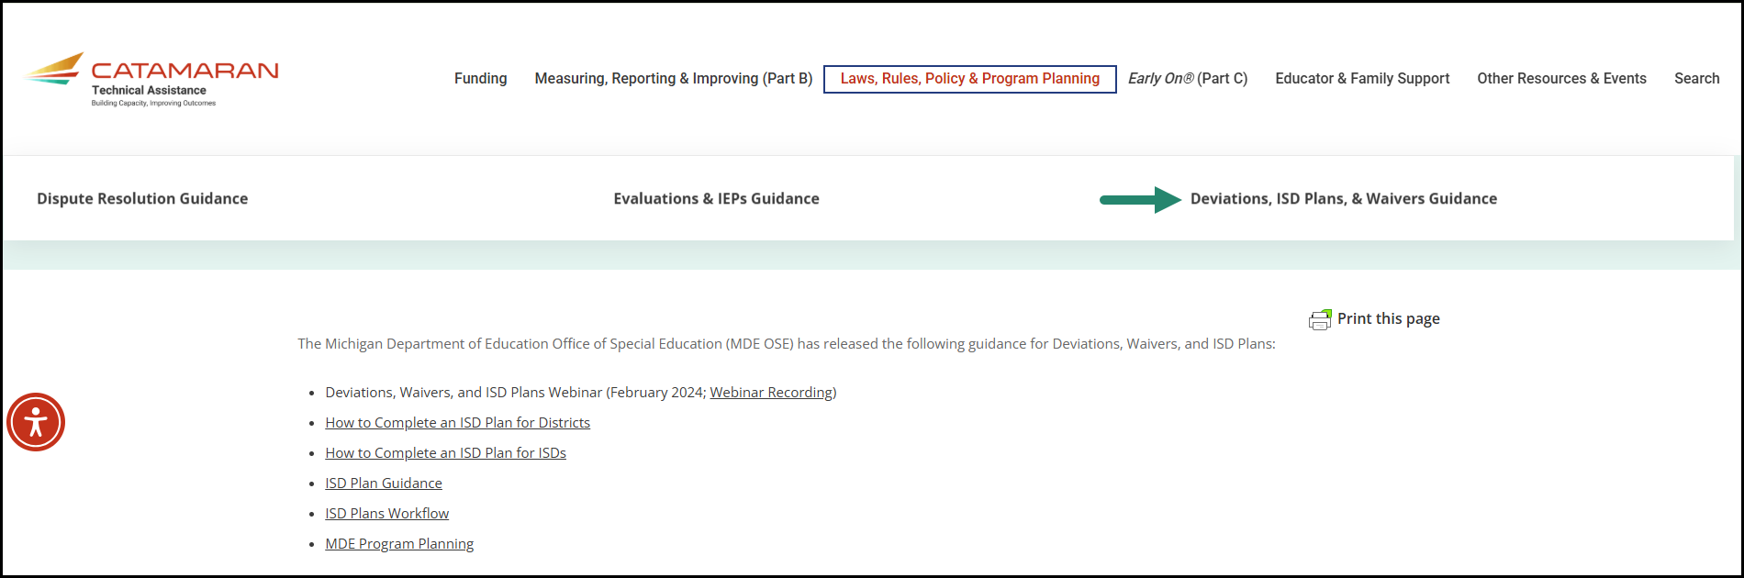
ISD Plans, Waivers & Deviations page
Notes:
Also available under the laws rules policy and program planning tab is an ISD plans waivers and deviations page.

Slide 57
Need More Help?
Catamaran Help Desk:
  Available Monday – Friday 9:00 am – 4:00 pm
  Email: Catamaran Help Desk (help@catamaran.partners)
  Phone: 877-474-9023
  Chat feature in Catamaran
Tell the Help Desk:
  Catamaran Coordinator or ISD Director
  Waiver Application
Notes:
Read slide.

Slide 58
Contact MDE OSE
Presenters
Beth Cooke
CookeE@michigan.gov
Sheryl Diamond
DiamondS@michigan.gov
MDE OSE Information Line
888-320-8384
mde-ose@michigan.gov
Notes:
If you have any questions about today’s presentation, please contact Beth at cookee@michigan.gov or Sheryl at diamonds@michigan.gov. For more general questions about special education, please contact the MDE OSE Information Line at 888-320-8384 or by email at m d e – o s e @ Michigan.gov.

Slide 59
Contact the Catamaran Team
Project Director
Lynne Clark
lclark@publicsectorconsultants.com
Senior Project Manager
Jeanne Anderson Tippett
jatippett@publicsectorconsultants.com
Catamaran Help Desk
877-474-9023
help@catamaran.partners
Notes:
Finally, for questions concerning Catamaran,
Reach out to Lynne at l c l a r k @publicsectorconsultants.com or Jeanne at jatippett@publicsectorconsultants.com
As a reminder,
The Catamaran Help Desk is available Monday through Friday from 8-5 PM.
Contact them by email at help@catamaran.partners or by phone at 877-474-9023 or by using the Chat feature within Catamaran.
This concludes the presentation -- thank you for your attention!

