Slide 1
General Supervision System Grant (GSSG)
Application Preview
2026-27 Grant Year
For Intermediate School District (ISD) Directors of Special Education
Notes:
Welcome to the General Supervision System Grant, or GSSG, Application Preview for the 2026-27 grant year. This presentation is intended for Intermediate School District, or ISD, Directors of Special Education.

Slide 2
Agenda
Application Overview
  Focus Area
  Priority Area Update
Completing the Application in Catamaran
Resources
Notes:
On today’s agenda, we will cover five topics. Application Overview, focus area, priority area update, completing the application in Catamaran, and finally, available resources.

Slide 3
Application Overview
Notes:
Let’s start by looking at the application overview.

Slide 4
GSSG 2026-27 Application Timelines
Application
  Live July 1, 2026
  Due August 3, 2026 at 5:00 PM
Notes:
The GSSG Application will go live on July 1, 2026, and will be due on August 3, 2026 at 5:00 PM EST. In NexSys, these application timelines will be the same.

Slide 5
Completing the GSSG Application
Getting Started
General Supervision Activities
Priority Area
Fiscal
Notes:
This year's GSSG application looks a little different than last year. Just like in years past, there will be four sections of the application.
Each ISD has been engaged in meaningful work on a number of the eight components of general supervision. This year, all ISDs will focus on strengthening and enhancing their system of general supervision in alignment with OSE's FAPE in the LRE capacity building effort. This activity should serve to improve and impact results and compliance data across all eight components of general supervision, thus continuing to build an overall system of general supervision. We will explain more about this later in the presentation.
The order of the pages have changed this year and will look this way going forward. Getting Started is the first page, with Priority Area now following. ISDs can respond to their selected priority area(s) on the third page, General Supervision Activities.
On the last page, Fiscal, it will look the same as last year.
Now, let’s review each of these pages.

Slide 6
Getting Started: Prep and Planning
General Supervision System Grant Team
Lessons learned
Activities
Review and use of historical information and data
Notes:
As we begin a new grant cycle, this is a good time for the ISD to review its general supervision system grant team. Has the team lost some members? Are there additional members who should join? What lessons have been learned over the past several years when completing the GSSG activities? Were the activities accurate? Do the activities need revision?
GSSG teams should also review the historical information and data regarding the ISD’s performance on the priority area. In light of this year's work around LRE, ISDs have the option to select a new priority area or may choose to continue with the previous priority area.

Slide 7
2026-27 Components of General Supervision
Activities
GSSG Components
Notes:
As you review the Getting Started page, you will see a list of the eight components of general supervision.
The Eight Components of General Supervision are:
State Performance Plan/Annual Performance Report/State Systemic Improvement Plan (SPP/APR/ SSIP)
Data on Results and Processes (Data)
Integrated Monitoring Activities (Monitoring)
Policies, Procedures, and Effective Implementation of Evidence-based Practices (PPEBP)
Professional Learning and Development and Technical Assistance (PLD/TA)
Fiscal Accountability and Management (FAM)
Effective Dispute Resolution (DR)
Improvement, Correction, Incentives, and Sanctions (ICIS)
An ISD may continue to work on developing each of the eight components in addition to the focus area. However, that additional work would happen outside of Catamaran. If you wish to continue this work, please refer to the General Supervision Design Tool on the Catamaran Technical Assistance Website on the General Supervision System Grant Information page at training.catamaran.partners/office-of-special-education-resources/

Slide 8
Priority Area: Progress Toward Improvement
Select 1-3 priority area(s).
Provide a rationale for the selected priority area(s).
Complete the Application Priority Area Data Sources table using local data sources.
Notes:
There is a slight adjustment to the way the Priority Area page work for the 2026-27 GSSG cycle. All ISDs will be asked to
Select 1-3 priority area(s) from the available selections
Provide a rationale for the selected priority area(s)
Complete the Application Priority Area Data Sources table using local data sources.
The next few slides will show what this will look like in Catamaran.
Given that all ISDs will focus on strengthening and enhancing their system of general supervision, this activity should improve and impact results and compliance data across priority areas, thus continuing to build an overall system of general supervision supporting the provision of a FAPE in the LRE.

Slide 9
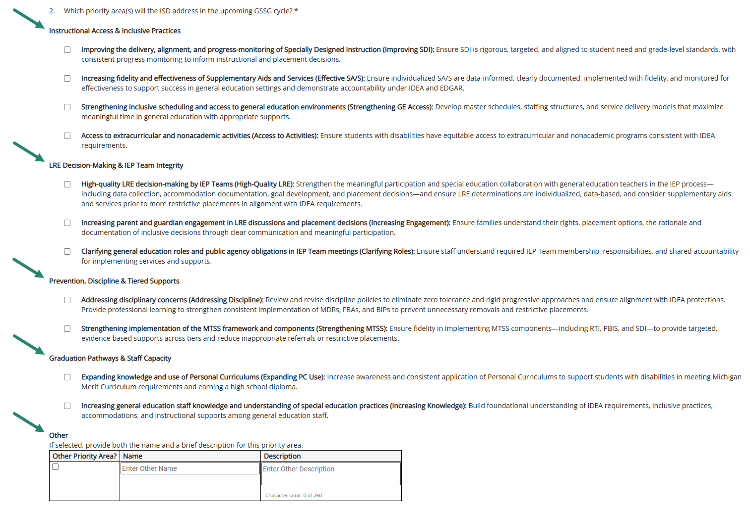
Selecting Priority Area(s)
Notes:
Beginning in the 2026-27 GSSG cycle, the ISD can select 1-3 priority area choices on the Priority Area page. The major categories of the selections focus on Instruction Access & Inclusive Practices, LRE Decision-Making & IEP Team Integrity, Prevention, Discipline & Tiered Supports, and Graduation Pathways & Staff Capacity. Other is also available for ISDs that wish to focus on a priority area that may not be listed above. The ISD is limited to one “Other” priority area selection.
The available priority area selections are as follows:
Improving the delivery, alignment, and progress-monitoring of Specially Designed Instruction (Improving SDI)
Increasing fidelity and effectiveness of Supplementary Aids and Services (Effective SA/S)
Strengthening inclusive scheduling and access to general education environments (Strengthening GE Access)
Access to extracurricular and nonacademic activities (Access to Activities)
High-quality LRE decision-making by IEP Teams (High-Quality LRE)
Increasing parent and guardian engagement in LRE discussions and placement decisions (Increasing Engagement)
Clarifying general education roles and public agency obligations in IEP Team meetings (Clarifying Roles)
Addressing disciplinary concerns (Addressing Discipline)
Strengthening implementation of the MTSS framework and components (Strengthening MTSS)
Expanding knowledge and use of Personal Curriculums (Expanding PC Use)
Increasing general education staff knowledge and understanding of special education practices (Increasing Knowledge)
And “Other”
Use the checkboxes by each individual selection to populate the Application Priority Area Data Sources table near the bottom of the page.
ISDs will choose up to three priority areas every GSSG cycle going forward.

Slide 10
Application Priority Area Data Sources
Local data sources
Sensitive to changes over the course of one year
May reflect ISD aggregate and/or Member District level data
Selecting 1-3 Priority Area(s) and data sources for the General Supervision System Grant (GSSG)
Notes:
After determining the priority area(s) for the 2026-2027 school year, the ISD is required to complete at the data sources table. To complete the data source table, ISDs are encouraged to use the data use and action process to determine actionable causes and improvement activities. Once those improvement activities are determined, the ISD will decide how they can be measured, and those measures should be used for the data source table.
Local data sources should be used rather than APR, MI School Data, or Strand Report data. In the past, when ISDs were completing the midyear report and the final report, we often heard that no new data was available. Many ISDs had chosen APR data as the measure of their improvement. APR data will no longer be accepted in the data source table. It is only collected once per year, is often unavailable due to data analysis timelines, and is not sensitive to change. ISDs should choose data sources which will have updated data available by the time of the final report which will be due in May of 2027.
The data sources do not need to be the indicator data which demonstrated the need to select a priority area. The data could be any measure of the improvement activities. Data should be sensitive to change over the course of one year.
Data sources may reflect ISD aggregate and/or Member District level data.
See the training resource “Selecting 1-3 Priority Area(s) and data sources for the General Supervision System Grant” available on the TA site at training.catamaran.partners/office-of-special-education-resources/

Slide 11
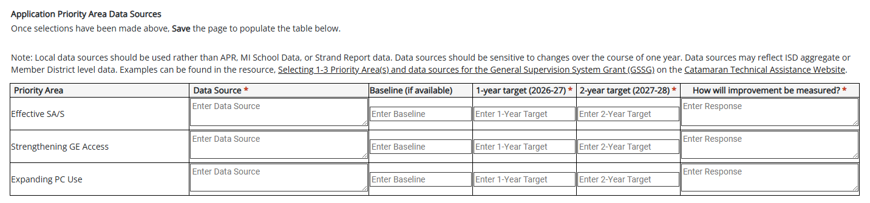
Priority Area Data Source Table
Notes:
Once the ISD has identified a priority area or area(s) for the 2026-27 school year, the ISD will determine which data sources will be used to measure progress. The table shown on this slide shows the priority area data source table, with the priority areas of Strengthening MTSS and Expanding PSC Use selected. The ISD must enter a data source and complete the table to indicate the baseline (if available) data and their targets for one year and two years from now. They will also indicate how the improvement will be measured in the last column.

Slide 12
Priority Area Data Source Table Example
Priority Area | Data Source | Baseline (if available) | 1-year target (2026-27) | 2-year target (2028-29) | How will improvement be measured?
Strengthening MTSS | MTSS fidelity tools; intervention tracking logs; referral trend data | - | 3.25% | 2.60% | Increase in MTSS fidelity scores; % of students receiving tiered interventions prior to referral; reduction in inappropriate referrals
Expanding PC Use | PC utilization data; graduation tracking data; PC alignment reviews | 5.67% | 5.52% | 4.50% | % increase in appropriate PC use; graduation rate of students using PCs; % of PCs aligned to MMC requirements
Notes:
This slide provides an example of a priority area data table. In this example, the ISD has selected Strengthening MTSS and Expanding PSC use as their two priority areas for the 2026-27 GSSG cycle.
Both of these localized data sources will be available at the time of the final report. Note that attempting to use data sources that are state level, indicator specific, on a data lag, or available after the school year will not serve the purposes of this work.

Slide 13
General Supervision Activities (part 1)
Describe how the ISD ensures written policies, procedures, and guidance are aligned with IDEA and MARSE and support the provision of a FAPE in the LRE across Member Districts.
Describe how the ISD ensures all personnel (ISD and Member District) responsible for implementing IDEA requirements are appropriately prepared, qualified, and supported to provide FAPE in the LRE to every student with an IEP.
Describe how the ISD has identified area(s) of improvement for member districts related to providing a FAPE in the LRE.
Notes:
For the General Supervision Activities portion of the application there are main 6 questions related to the provision of a FAPE in the LRE. The ISD will be asked to address:
How the ISD ensures written policies, procedures, and guidance are aligned with IDEA and MARSE and support the provision of a FAPE in the LRE across Member Districts
How the ISD ensures all personnel (ISD and Member District) responsible for implementing IDEA requirements are appropriately prepared, qualified, and supported to provide FAPE in the LRE to every student with an IEP
How the ISD has identified area(s) of improvement for member districts related to providing a FAPE in the LRE.

Slide 14
General Supervision Activities (part 2)
Describe how the ISD ensures procedures and practices related to IEP development, placement decisions, and LRE practices are implemented with fidelity across Member Districts.
Describe how the ISD provides training, technical assistance, and ongoing support to Member Districts regarding the development of compliant, appropriate, and individualized IEPs, LRE decision-making, and individual student placement in order to ensure the offer FAPE in the LRE to every student with an IEP.
Describe how the ISD ensures data accuracy and use of data analysis to drive improvements in the system of general supervision, specifically around ensuring the provision of a FAPE in the LRE.
Notes:
As well as how the ISD:
Ensures procedures and practices related to IEP development, placement decisions, and LRE practices are implemented with fidelity across Member Districts.
How the ISD provides training, technical assistance, and ongoing support to Member Districts regarding the development of compliant, appropriate, and individualized IEPs, LRE decision-making, and individual student placement in order to ensure the offer FAPE in the LRE to every student with an IEP.
How the ISD ensures data accuracy and use of data analysis to drive improvements in the system of general supervision, specifically around ensuring the provision of a FAPE in the LRE.
The next section we will look at is Fiscal.

Slide 15
General Supervision Activities (part 3)
Describe what the ISD is currently doing.
Document what the ISD will provide.
List any next steps the ISD will take, and
List the personnel responsible for each activity.
Notes:
For each of the 6 main questions, ISDs will respond to the same four statements. ISDs should respond to each statement rooted in the General Supervision Design Tool to describe what the ISD is currently doing, document what the ISD will provide, any next steps the ISD will need to take, and list the personnel responsible for each activity the ISD will complete. There are six new statements to respond to this year. We will look at these on the next few slides.
The ISD will not be required to address the other general supervision components or the design tool within Catamaran, although they may continue that work outside of the Catamaran system.

Slide 16
Fiscal Table – Personnel
Name | Position/Title | Amount | FTE Staff | Description
Enter the staff member’s name | Enter the staff member’s title | Enter the budgeted amount | Enter the FTE (Decimal) | Provide a description
Notes:
The fiscal page is the same as last year. It is important to work closely with the ISD Business Official to complete this section, which includes both Personnel and Non-Personnel related grant costs. Allocations for 2026-27 General Supervision Grant will be the same as last year.
This slide shows the first table on the fiscal page, the personnel table.
The information in this table should include personnel and staffing resources that the ISD plans to use in developing and implementing a system of general supervision. All personnel funded by this grant must hold a current special education credential recognized by MDE.
The dollar amount entered should be the budgeted amount rounded to the nearest whole dollar.
The column labeled “FTE Staff” should represent the percentage of the budgeted time to be spent by the staff member. The percentage should be in decimal format (e.g., 50% would be 0.50 FTE).
When completing the Personnel Table, a separate row should be completed for each staff member.

Slide 17
Fiscal Table – Non-Personnel
Expense Type | Amount | Description
Select the non-personnel expense type | Enter the budgeted amount | Provide a description
Notes:
The second table focuses on how General Supervision System Grant funds will be utilized for Non-Personnel related budgeted items for 2026-27. This table is optional. To complete this table:
Select from the “Expense Type” drop-down menu the type of non-personnel expense the ISD believes will be incurred. Drop-down options include audit costs, indirect, and travel to member districts to provide TA.
Enter the budgeted amount the ISD plans to spend in the “Amount” column.
If “Travel to Member Districts to Provide TA” is selected, please provide the staff member’s name the ISD plans to use in the “Description” column.

Slide 18
Fiscal: Access to Grant Funds
Initial 50 percent awarded upon submission of the application in Catamaran and OSE approval of the budget and current credential(s) in NexSys.
Final 50 percent awarded once the Catamaran application is at Michigan Department of Education (MDE) Accepted.
Notes:
There is a second application for this grant in Nexsys that will be available on July 1st and due on August 15st. The Nexsys application contains the budget and all appropriate credentials for staff being funded by this grant. Once the Catamaran application has been submitted and the Nexsys application is approved by OSE then 50% of the funds can be awarded. Once the Catamaran application has been approved the remaining 50% of funds can be awarded. OSE will upload the approved Catamaran application into Nexsys, this will not be a requirement of the ISD.

Slide 19
Remaining GSSG 2026-27 Timelines
Final Report
  Live May 1, 2027
  Due June 15, 2027
Final Expenditure Report
  Due August 29, 2027 (in NexSys)
Notes:
After ISDs submit the application in Catamaran and in NexSys and OSE approves them, the remaining items for the 2026-27 fiscal year include:
Final Report – it will become available on May 1, 2027, and will be due to the OSE on June 1, 2027.
Final Expenditure Report – will be due in NexSys on August 29, 2026.

Slide 20
Completing the Application in Catamaran
Notes:
Now that we’ve seen an overview of the application, let’s take a look at what completing the application in Catamaran looks like.

Slide 21

Catamaran Login
Notes:
First, you will want to go to catamaran.partners to log in to Catamaran.
If you do not have a username and password or if you have forgotten it, you can either select the Need to create an account? or Forgot Password? link on the login screen or you may contact the Catamaran Help Desk.

Slide 22
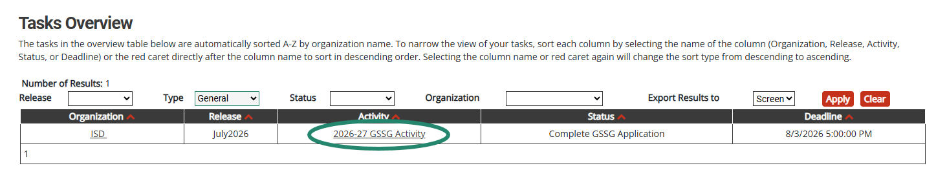
Access the Activity
Log into Catamaran (https://catamaran.partners)
On the Dashboard, scroll down to the Tasks Overview section.
Use the filters, as needed, to narrow tasks.
Select the link in the Activity column to open the activity.
  Note: The activity name is 2026-27 GSSG Activity
Notes:
Once you have logged into Catamaran, scroll down to the Tasks Overview section on the Dashboard.
You may use the provided filters to narrow your tasks down as needed.
Then, select the 2026-27 GSSG Activity link in the Activity column to open the activity.

Slide 23
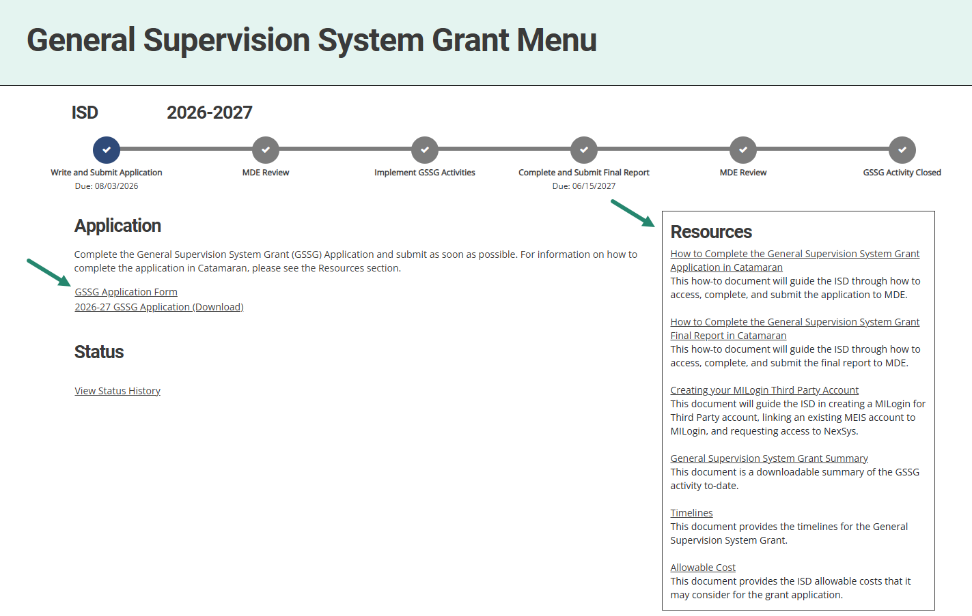
General Supervision System Grant Menu
Notes:
Next, on the menu, ISDs may access and review the provided resources in the Resources box. Resources include a how-to document, General Supervision System Grant Summary, Creating your MILogin Third Party Account how-to, and other links such as Timelines and Allowable Cost.
To begin the application, select the GSSG Application Form link under the Application heading.

Slide 24
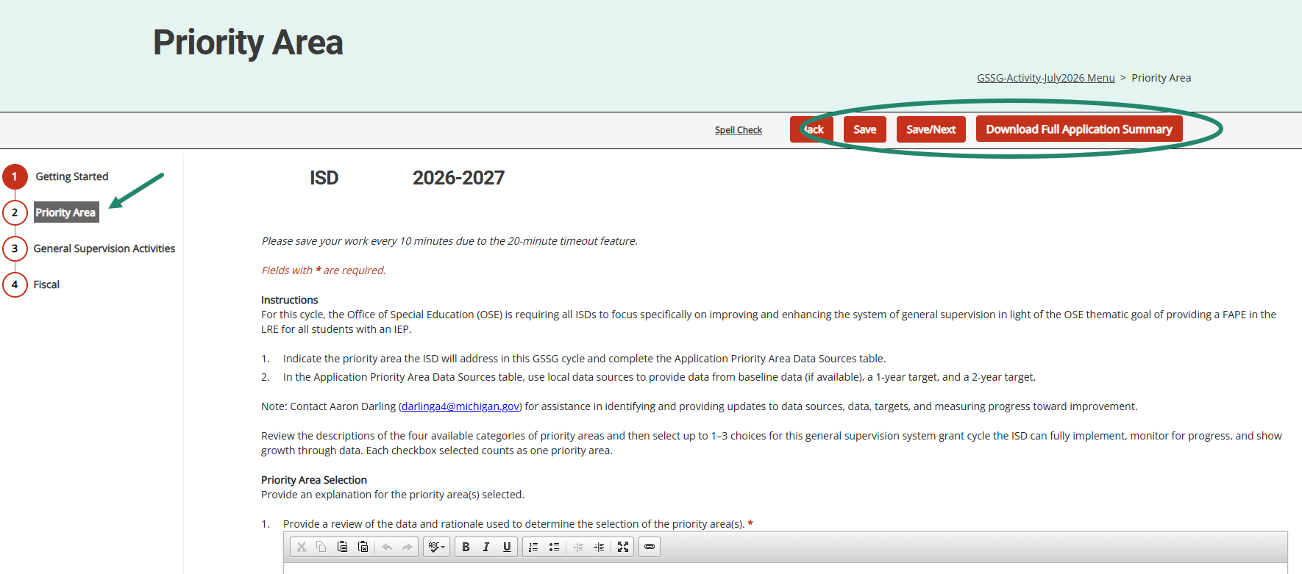
Components of General Supervision Page
Notes:
Be sure to complete each section of the application.
Complete the application and choose Save or Save/Next to progress to the next section of the form.
Use the navigation menu on the left to move between sections of the report.
As a reminder, those sections include:
Getting Started
Priority Area
General Supervision Activities
Fiscal
It is recommended to review all application sections before submitting to MDE.
To complete this review, download a full summary of the application by either selecting the “Download Full Application Summary” button within the application or by selecting the 2026-27 GSSG Application (Download) link from the menu.

Slide 25
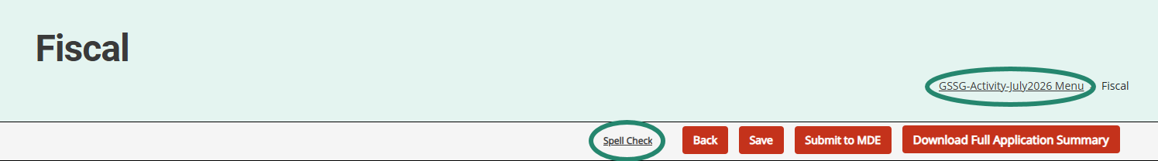
Navigation Notes
Access spell check by selecting the Spell Check link at the top of the page. The spell check feature functions within each field/cell of text that is currently being completed.
Users may return to the menu by selecting the breadcrumbs link at the top of the page.
Notes:
With many users logging in remotely, there may be page refreshing delays. Please make sure to allow time for report pages to completely load so that full functionality such as the text editor become available.
From anywhere with the application, users may run spell check by selecting the Spell Check link at the top of the page. The spell check feature functions within each field/cell of text that is currently being completed.
To return to the menu, select the breadcrumbs link at the top of the page. The breadcrumbs link shown here is labeled “GSSG Activity-July 2026 Menu”.

Slide 26
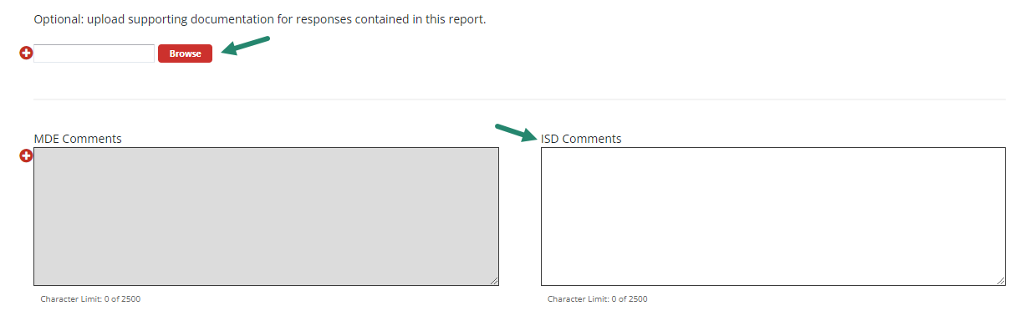
Additional Supporting Documentation or Comments (optional)
Notes:
On each page in the application, we have provided a set of comment boxes. ISDs may enter any additional clarification, as needed.
On the Fiscal page (last page of the application), the ISD may also upload additional supporting documentation.
Remember, the uploads are OPTIONAL, and the intention is to enhance the information provided in the application.

Slide 27
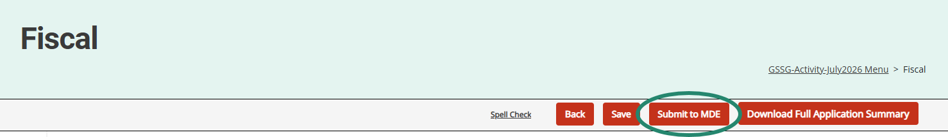
Submit the Application
The GSSG Application is due by August 3.
After completing the application, select the Submit to MDE button at the top of the page.
Notes:
The Application is due by August 3 at 5:00 PM.
After completing the application, the ISD Director must select the Submit to MDE button at the top of the Fiscal page.
The MDE will review all applications. If concerns are identified, applications may be returned to the ISD for additional work. ISDs should check the MDE comment box on the application’s Getting Started page for additional information.
MDE requests that ISDs resubmit any returned applications within one week from the modification request notification.
As a reminder, 50% of the funds are released when the application is received and the other 50% when the application is approved.
Once the application is approved, you will not have other GSSG work in Catamaran until the Final Report in May.

Slide 28
Resources
Notes:
We will wrap up this training video by providing you some valuable resources.

Slide 29
Catamaran Help Desk
Questions about system navigation or accessing the activity
Available Monday–Friday from 8:00 am to 5:00 pm
Contact by:
  Email at help@catamaran.partners
  Phone 877-474-9023
  Chat feature within Catamaran
Notes:
The first resource you have available is the Catamaran Help Desk. The help desk is available Monday-Friday from 8 am-5 pm. You can contact the Catamaran help desk by email, phone or by using the chat feature within Catamaran.

Slide 30
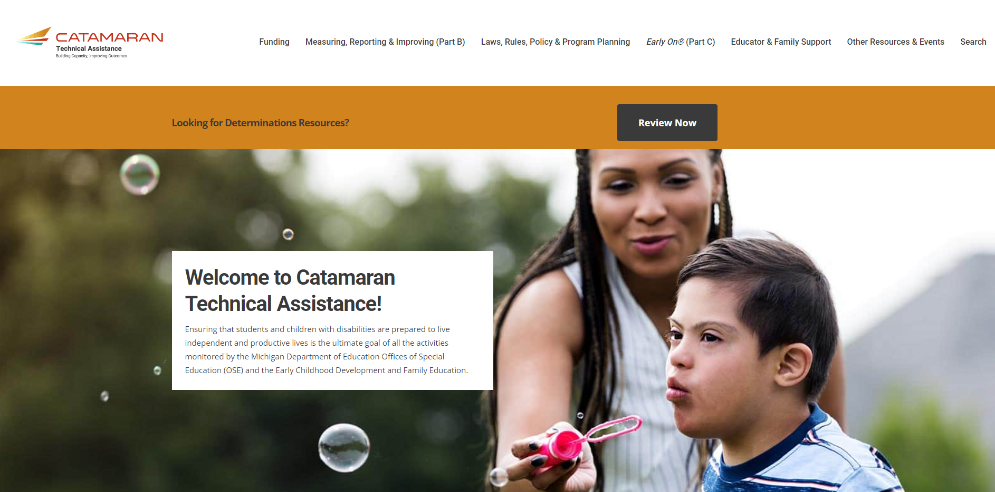
Catamaran Technical Assistance Website
Notes:
The Catamaran Technical Assistance Website is another valuable resource for ISDs. You can access the site at training.catamaran.partners.
Examples of resources available on this site are recordings of past webinars, step-by-step how-to documents, as well as guidance documents.

Slide 31
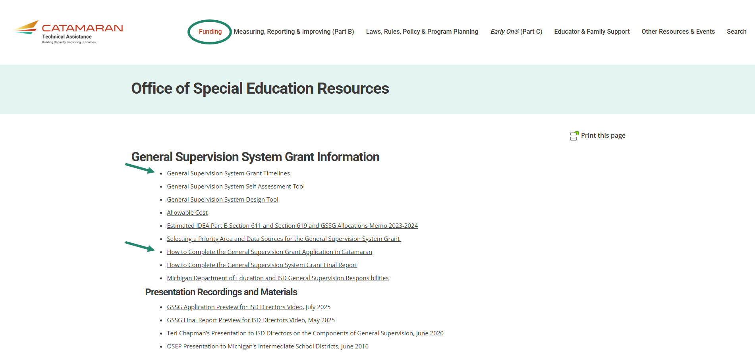
GSSG Information Page
Notes:
Also available on the Catamaran Technical Assistance Website is the General Supervision System Grant Information page.
As a reminder, ISDs may locate the General Supervision System Grant Information by navigating to the top of the home page and selecting the Funding header. Resources available include the General Supervision System Grant Timelines and How to Complete the General Supervision System Grant Application in Catamaran.

Slide 32
Contact MDE OSE
Presenters
Aaron Darling
darlinga4@michigan.gov
Chris Kelley
kelleyc9@michigan.gov
MDE OSE Information Line
888-320-8384
mde-ose@michigan.gov
Notes:
If you have questions about the content of this webinar, please contact Aaron at DarlingA4@michigan.gov or Chris at KelleyC9@michigan.gov.
For general questions about special education, you are encouraged to call the OSE information line at 888-320-8384, or email at mde-ose@michigan.gov.
That concludes our training video for today. Thank you for watching.

