Slide 1
September 2026
Part B Catamaran Preview
For Districts and ISDs
Notes:
Welcome to the September 2026 Part B Catamaran Preview

Slide 2
Agenda
September 2026 Catamaran Preview
Reviewing and Acknowledging Reports
Reminders for CAPs and Corrective Actions
Resources
Notes:
This agenda includes a preview of the September 2026 Catamaran release, instructions for reviewing and acknowledging reports, reminders about CAPs and Corrective Actions, and available training resources.

Slide 3
September 2026 Catamaran Preview

Slide 4
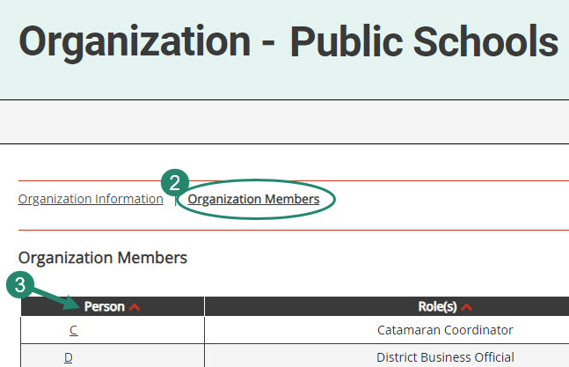
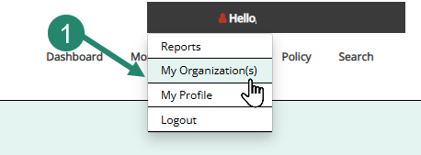
Review Organization Member Names
To review organization member names within Catamaran:
  Hover over your name in the top-right-hand corner and select My Organization(s).
  Select the Organization Members link from the Organization page.
  Review the list. If changes are needed, contact the Catamaran Help Desk for assistance.
Notes:
Before we review what is inside the September release, we wanted to take a few moments to remind everyone that with the beginning of a new school year, its time to review organization member names within Catamaran. We do this to ensure our system security.
To do so, log in to Catamaran, then hover over your name in the top-right-hand corner and select My Organization.
Once on the Organization page, select the Organization Members link to see the list of members within your organization.
Review the list. If changes are needed, contact the Catamaran Help Desk for assistance.
Another reason to view this page, especially for new users is to find out who else in your organization has a Catamaran role. That person or people may be able to help you along as you begin to navigate Catamaran. This is one way to ensure that members who are no longer with your organization will not receive notifications.

Slide 5
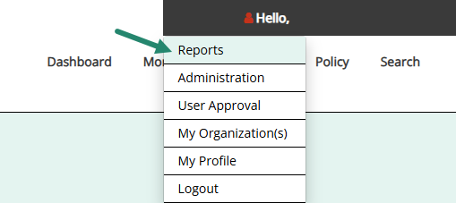
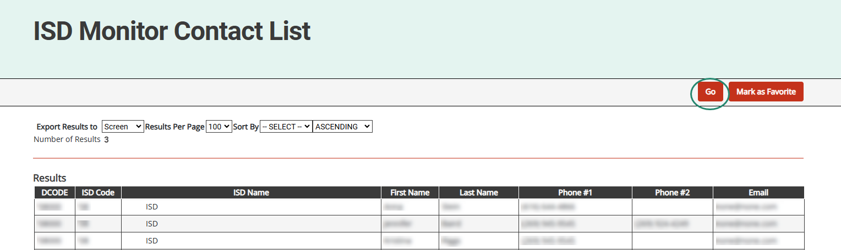
ISD Monitor Contact List
Notes:
In addition to reviewing your local district’s members, we also want to ensure that each ISD verifies the ISD Monitors assigned to their ISD in Catamaran. ISD Directors now have access to the ISD Monitor Contact List in Catamaran. ISD Directors should plan to review this report annually to confirm that the ISD Monitor(s) listed are correct for their ISD.
To access this report, hover over your name in the top-right-hand corner and select Reports. To view the list of ISD Monitors, select “ISD Monitor List” under the Contact List(s) heading.
If the information listed is incorrect or out of date, please contact the Catamaran Help Desk to make the requested changes.

Slide 6
What’s Inside?
Reports
  Strand Report
  Monitoring Activities Report (MAR)
  Reports and Letters of Findings
  Closeout/Non-closeout Reports
  State Complaint Reports
  Intermediate School District (ISD) Reports
Activities
  Corrective Action Plans (CAPs)
    Indicator B-9 (Disproportionate Representation-Child with a Disability)
    Indicator B-10 (Disproportionate Representation-Eligibility Category)
    Indicator B-9-B-10 (Disproportionate Representation-Child with a Disability and Disproportionate Representation-Eligibility Category)
    B-Valid & Reliable
    B-Complaints
  Student Level Corrective Actions (SLCAs) for Complaints
Notes:
When you open Catamaran and acknowledge your reports, you will see a variety of things. The reports for districts include the Strand Report, the Monitoring Activities Report (MAR), Reports of Findings or No Findings, Letters of Findings, Closeout/Non-closeout Reports for CAPs and State Complaint Reports for any completed complaints this month. For ISDs there are Reports of the determinations data that were issued earlier this summer.
The Activities for this release include Corrective Action Plans (CAPs) for B-9 (Disproportionate Representation-Child with a Disability), B-10 (Disproportionate Representation-Eligibility Category), B-9-B-10 (Disproportionate Representation-Child with a Disability and Disproportionate Representation-Eligibility Category), Part B Monitoring, B-Valid & Reliable, and State Complaints. State complaint CAPs are issued twice a month.
There are Student Level Corrective Actions (SLCAs) for State Complaints. SLCAs for State Complaints are released with the conclusion of the state complaint so those can be released any day.

Slide 7
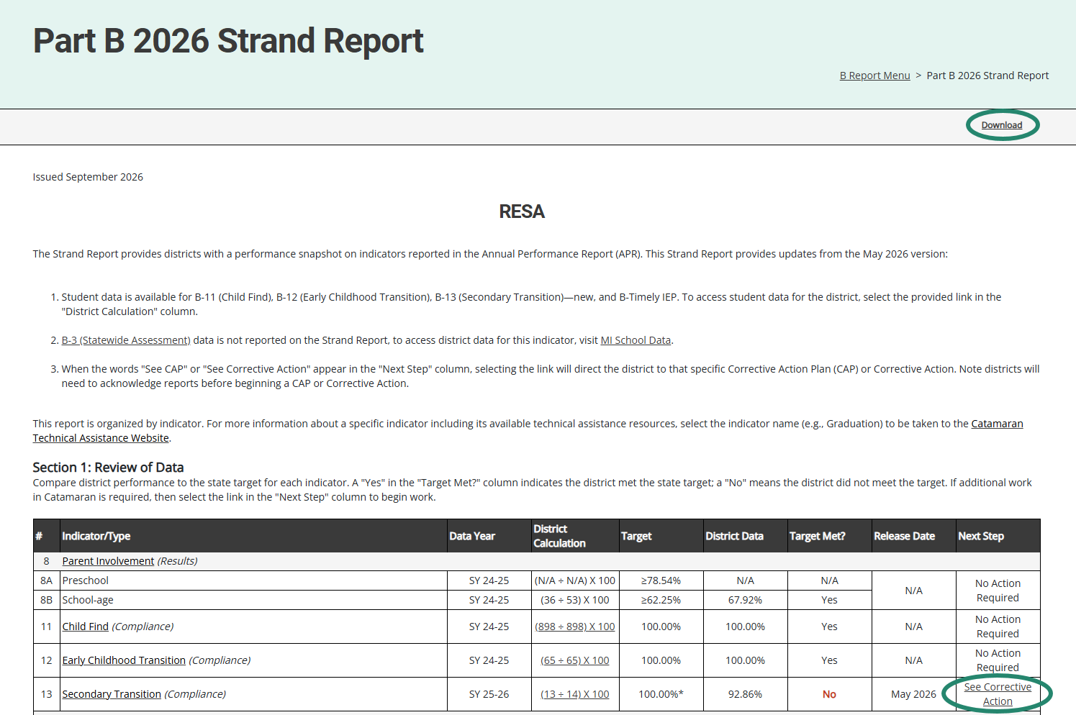
Part B 2026 Strand Report
Notes:
Here is an example of the Strand Report. The Strand Report is issued with each major Catamaran release with most of the indicators updated with the May release.
The Strand Report summarizes a district’s performance on the State Performance Plan indicators and priority areas.
We will dive into how to access your reports a little later in this training video, but if you do have a CAP or Corrective action, you can select the See CAP or corrective action link in the Next Step column to be taken directly to that object.
You can use the download link at the top of the screen to save and then print a copy of your Strand Report to share with your administration, colleagues or RAP team if needed.

Slide 8
Monitoring Activities Report (MAR)
The MAR is included in every major release and provides important information to districts.
The MAR can be accessed from the Reports page.
Some messages are universal and go to all districts.
Some messages are targeted and are sent only to specific districts.
  Reminders to review Reports of Findings/No Findings
  Reminders to review closeout reports
Notes:
The Monitoring and Activities report, or the MAR, can be accessed through the Reports page, which again, we will look at how to view and access the Reports page.
Some messages are universal and go to all districts, and some messages are targeted, and are sent only to specific districts, such as reminders to review Reports of Findings/No Findings.

Slide 9
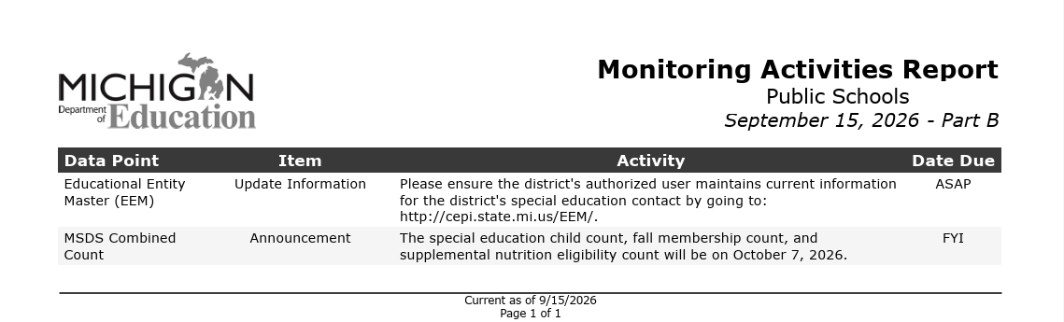
Sample Monitoring Activities Report
Notes:
This screenshot includes a universal message asking users to ensure their authorized EEM user has the current information updated in that system. Catamaran uses the EEM for many functions so correct and current data is very helpful.

Slide 10
Reports/Letters of Findings or No Findings
Indicator B-9
Indicator B-10
Indicators B-9 and B-10
B-Valid & Reliable (based on B-13)
B-Complaint Final Decisions
Notes:
Another set of reports are related to completed monitoring activities. We recently completed the monitoring activities for B-9/B-10 so there will be reports of findings or no findings for each of those districts or ISDs which participated.
When reviewing the data that was submitted as part of the B-13 data collection this past spring the Office of Special Education made many changes to data submitted by the ISDs. Valid and reliable data is a requirement of the IDEA. ISDs (or State Agencies) for whom the OSE had to change the data or had interrater reliability issues for one year, will be receiving a valid and reliable letter of findings. This letter will direct the ISD (or State Agency) to complete a corrective action plan and participate in a required training video and quiz offered by the OSE to ensure the B13 data collection this next year consists of valid and reliable data. More on those in just a minute.
Additionally, each month, state complaint Final Decisions are issued so those are included in the reports as well.

Slide 11
Closeout/Non-closeout Letters and Reports
Monitoring
  Indicator B-9
  Indicator B-10
  B-Valid & Reliable (based on B-13)
State Complaints
Notes:
For CAPs that were issued last year in September, there are closeout or non-closeout reports for all of those. These include B-9, B-10, B-Valid & Reliable, and State Complaints. If your district or ISD is not able to close its CAP, the OSE will assign a technical assistance provider to work with the district to achieve compliance.

Slide 12
ISD Determinations Data
All Determinations data has been previously shared. Review previous Determinations matrices, if needed to understand the data source.
Determinations methodology and resources are available on the technical assistance website on the Determinations page (https://training.catamaran.partners/determinations/).
Results and Compliance Scores
  Review the compliance and results scores for each of the six years.
  Compare the ISD's scores to the state scores.
  Note the gaps between the ISD scores and the state scores.
  Look for any trends in the data.
Notes:
ISD Determinations Data.
All Determinations data has been previously shared. Review previous Determinations matrices, if needed to understand the data source.
Determinations methodology and resources are available on the technical assistance website on the Determinations page (https://training.catamaran.partners/determinations/).
Results and Compliance Scores
Review the compliance and results scores for each of the six years.
Compare the ISD's scores to the state scores.
Note the gaps between the ISD scores and the state scores.
Look for any trends in the data.

Slide 13
Element Data
Look at the trend for each element.
What are the elements with the lowest scores?
  For Compliance?
  For Results?
Reminder: The audit number is a count of member districts with special education audit findings. A zero means no districts that were audited had a finding. These numbers are counts of member districts, not points for the score.
Refer to the methodology document for further information.
Notes:
Element Data.
Look at the trend for each element.
What are the elements with the lowest scores?
For Compliance?
For Results?
Reminder: The audit number is a count of member districts with special education audit findings. A zero means no districts that were audited had a finding. These numbers are counts of member districts, not points for the score.
Refer to the methodology document for further information.

Slide 14
Member District Element Data
For each element of concern, look at the data from the member districts for the six years.
Is it one district or many districts with low scores?
Is it the same districts each year?
Are some trending up or down?
Are newer data available about any element?
What technical assistance (TA) is needed to address the issue(s)?
Notes:
Member District Element Data.
For each element of concern, look at the data from the member districts for the six years.
Is it one district or many districts with low scores?
Is it the same districts each year?
Are some trending up or down?
Are newer data available about any element?
What technical assistance (TA) is needed to address the issue(s)?

Slide 15
Corrective Action Plans (CAPs)
All CAPs:
Have the same workflow and timelines for completion.
Describe system level correction.
Are verified as corrected by the ISD.
Include links to either:
  Student Level Corrective Actions (SLCAs) or
  District Student Data Report
  (B-Valid & Reliable)
Monitoring CAPs:
  Issued following a monitoring activity.
  Include links to the report of findings.
Complaint CAPs:
  Issued twice a month as needed.
  Include link to complaint final decision.
Notes:
For corrective action plans known as CAPs, there are some general rules that apply to all. All CAPs have the same workflow and timelines for completion. The first due date for these CAPs is the date by which the CAPs must be written and submitted. CAPs issued in September are due to be written and submitted by November 1.
CAPs must be verified and closed one year from the date the non-compliance is issued. We call this the year of correction. The CAP’s year of correction begins on September 15 for B-9, B-10, and B-Valid&Reliable (based on B-13), but the year of correction begins on the date of the final decision for complaint CAPs. If your district was issued a complaint CAP as a result of noncompliance identified during a state complaint investigation, the date the final report was issued begins your year correction. As an example, if the final decision was issued on September 8, the CAP must be verified and closed by September 7 of the following year. Complaint CAPs are released twice a month in catamaran.
All CAPs describe the system-level correction the district will complete. As opposed to the student-level corrections of SLCAs.
Every CAP is verified for correction by the ISD. Then, the ISD submits the CAP to the OSE for closeout. On the menu page of the CAP, there will be a link to either the student-level corrective action for Monitoring CAPs (B-9, B-10, B-9-B-10) and complaint CAPs or to a district student data report for B-Valid & Reliable (based on B-13) CAPs. This link to the student-level information should help the RAP team as they uncover the root causes of noncompliance.
One continuing requirement when it comes to verification and closeout activities is the OSE review of the district’s updated procedures as well as change in practices. At the time the district completes their progress report, the district should upload their updated policies and procedures for review. If changes are needed, the progress report will be returned to the district with directions. If the procedures are compliant, the progress report approval process will continue.
During the verification stage of the CAP, the ISD reviews student files for evidence of change in practice. When the review is complete, the ISD uploads all documentation reviewed to demonstrate compliance. If the ISD needs additional documentation from the district, the ISD will return the activity to the district to upload documentation on the Verification Appendix page. Once the review is complete, and all relevant documentation is uploaded, the ISD submits to the OSE. The ISD should complete all returns to the district before submitting to the OSE for their review and verification of correction.
This change in practice is based on OSEP’s 23-01 memo which states the State must retain documentation of correction of noncompliance for each individual case of previously noncompliant files, records, etc.
The processes we’ve discussed so far are true for all monitoring CAPs including Complaint CAPs.
B-Valid & Reliable CAP Verification Activity will look different than the monitoring and Complaint CAPs. During the verification stage of the CAP, The ISD will complete the CAP Activity Verification to include reviewing the activity steps and evidence provided to verify the activities have been completed. The new step includes Data Collection Verification. This section will not be completed until the B-13 (Secondary Transition) Data Collection Activity is available in Catamaran. At that time, the OSE will provide a list of member districts using a chart which will be found in the CAP Verification Activity Page. The OSE will request specific information for each district. The ISD will upload the requested information using the provided browse button on each row. We will see some screen shots of this in just a few minutes.

Slide 16
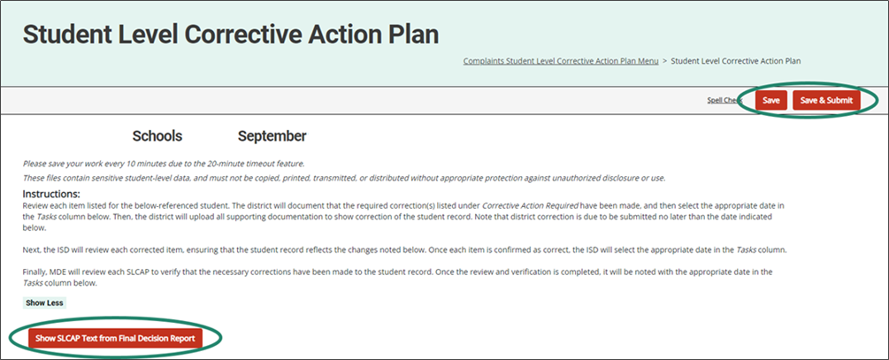
SLCAs
Notes:
SLCAs correct individual student level noncompliance. They are due within 30 school days
SLCAs Are verified as corrected by the ISD and reviewed by the OSE.
Each individual SLCA must be closed before the CAP or corrective action is closed
The example shown here is highlighting a link from a Complaint SLCA to the more explicit language of the final decision.
The B-9, B-10 and B-9-B-10 SLCAs were due 30-school days from the date of review.

Slide 17
Reviewing and Acknowledging Reports
Notes:
The next sections will be for our new and occasional users. For our experienced users, you may also wish to stick around for these reminders.
Let’s take a closer look at reviewing and acknowledging reports in Catamaran.

Slide 18
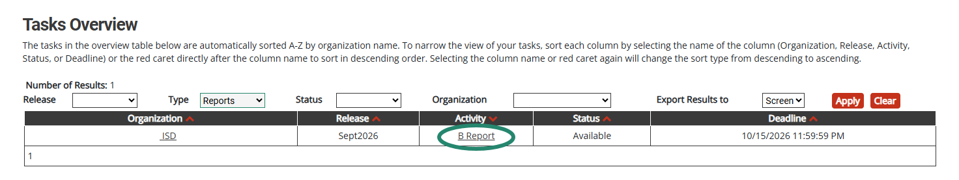
View Reports
View available reports on the Tasks Overview at the bottom of the Dashboard.
Select the link in the Activity column (for example, B Report) to access the Reports page.
Notes:
Let’s dive into how to access, view and acknowledge reports. Also, please note there is a How to document on the Catamaran Technical Assistance website that outlines how to acknowledge reports step by step.
When logging in, B Report will be populated on the Tasks Overview. Select the link in the Activity column to access the Reports page.
Note: If you have previously applied a filter to the Tasks Overview, it may also be necessary to clear filters before applying a new one. As a reminder, you can narrow tasks down, by applying a filter such as Release, Type, or Organization.

Slide 19
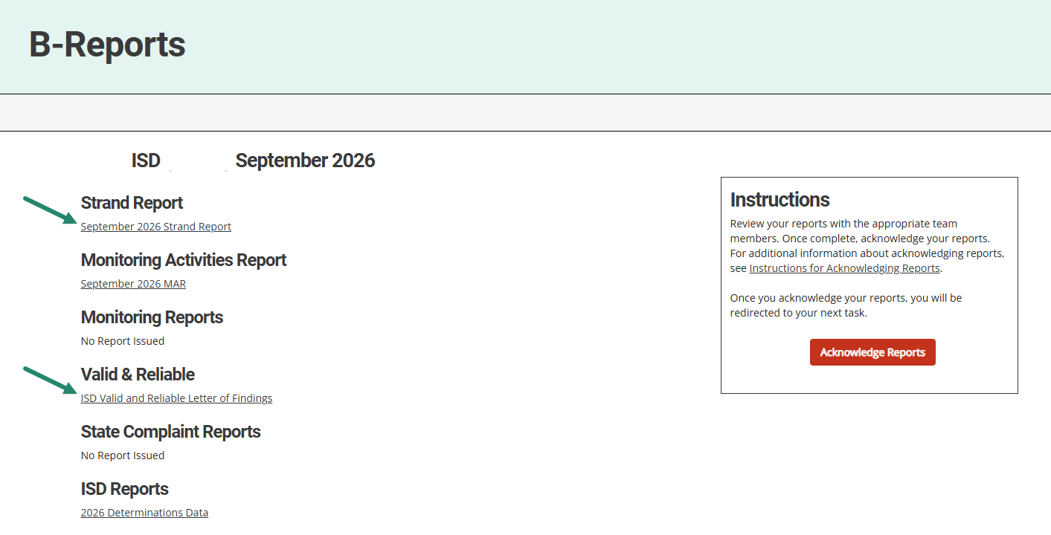
Access Reports
On the Reports page, select any report link to view that report.
Review and share the reports with appropriate team members.
Notes:
Once you reach the Reports page, you can select any report link to view that report.
Then, you can review, print, and share the reports with appropriate team members.

Slide 20
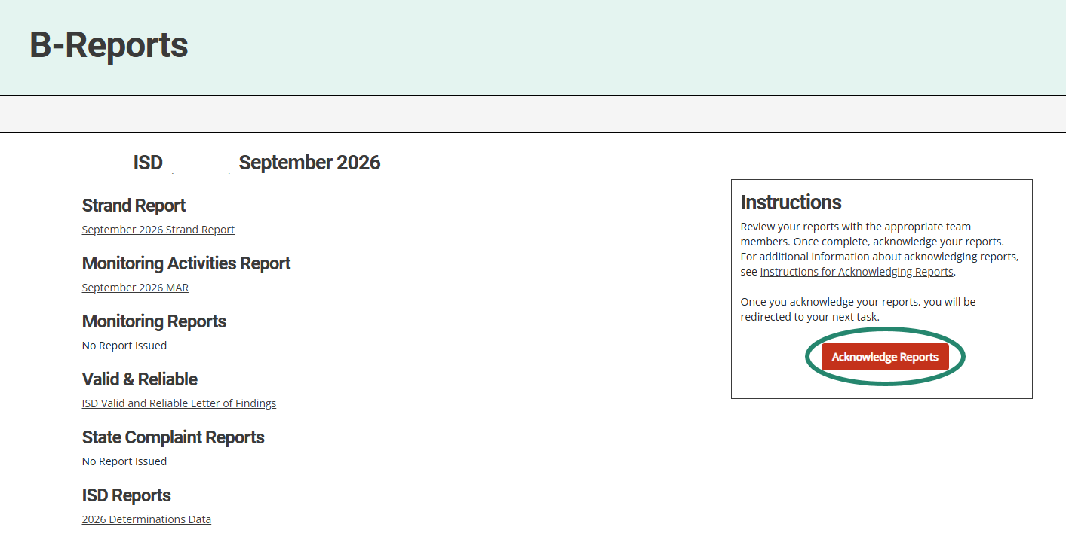
Acknowledge Reports by October 15
Acknowledge reports by selecting the red Acknowledge Reports button on the Reports page.
Note: When reports have been acknowledged, additional tasks become available as appropriate (such as a CAP).
Notes:
Reports must be acknowledged by October 15.
To acknowledge reports, select the red Acknowledge Reports button on the Reports page.
Once reports are acknowledged, the district will be returned to the Dashboard where any additional tasks such as a CAP will become available. You may need to clear any previously set filters on the Tasks Overview to see any new tasks. If there are no additional tasks, then a message of “You have no tasks to view” will appear in the place of the Tasks Overview list.

Slide 21
After Acknowledging Reports
Work cannot be completed in Catamaran until reports have been acknowledged.
What to do after acknowledging reports:
  Review Reports page – Does my district have findings?
  Review Strand Report – What are the next steps?
  Review MAR
  Decide whether the district should convene a Review and Analysis Process (RAP) Team
Notes:
New work which has been issued in this release can not be completed in Catamaran until reports are acknowledged.
What to do after acknowledging reports?
Review the Reports page – Does my district have findings?
Review the Strand Report – What are the next steps?
Review the MAR. Decide whether the district should convene a Review and Analysis Process (RAP) Team.

Slide 22
Complete Tasks with RAP Team as needed
Check the Tasks Overview or the Strand Report to see if the district has a CAP.
When there is a CAP, convene a RAP Team to work through the activity.
Suggested RAP Team members include:
  District and ISD personnel such as special and general education administrators
  School improvement team representative
  Parents
  Service providers including general or special education teachers
  Data experts or program specialists
Notes:
After sorting through and sharing the information, you’ll need to see if you have a CAP to work on. You can check your Tasks Overview on the Dashboard (remember to clear any filters before applying a new one) or take another look at the Strand report to see if you do indeed have a CAP.
If you do, you need to convene a RAP Team to work through the CAP.
Important note: if you have a Complaint CAP, it will not be listed on your Strand Report. You will need to check the Tasks Overview for Complaint CAPs.

Slide 23
Reminders for CAPs and
Corrective Actions
Notes:
After acknowledging reports, you will want to begin addressing any findings that may have been issued to your district. In this section we will review some reminders about the process of a CAP and Corrective Action. Let’s take a closer look at those.

Slide 24
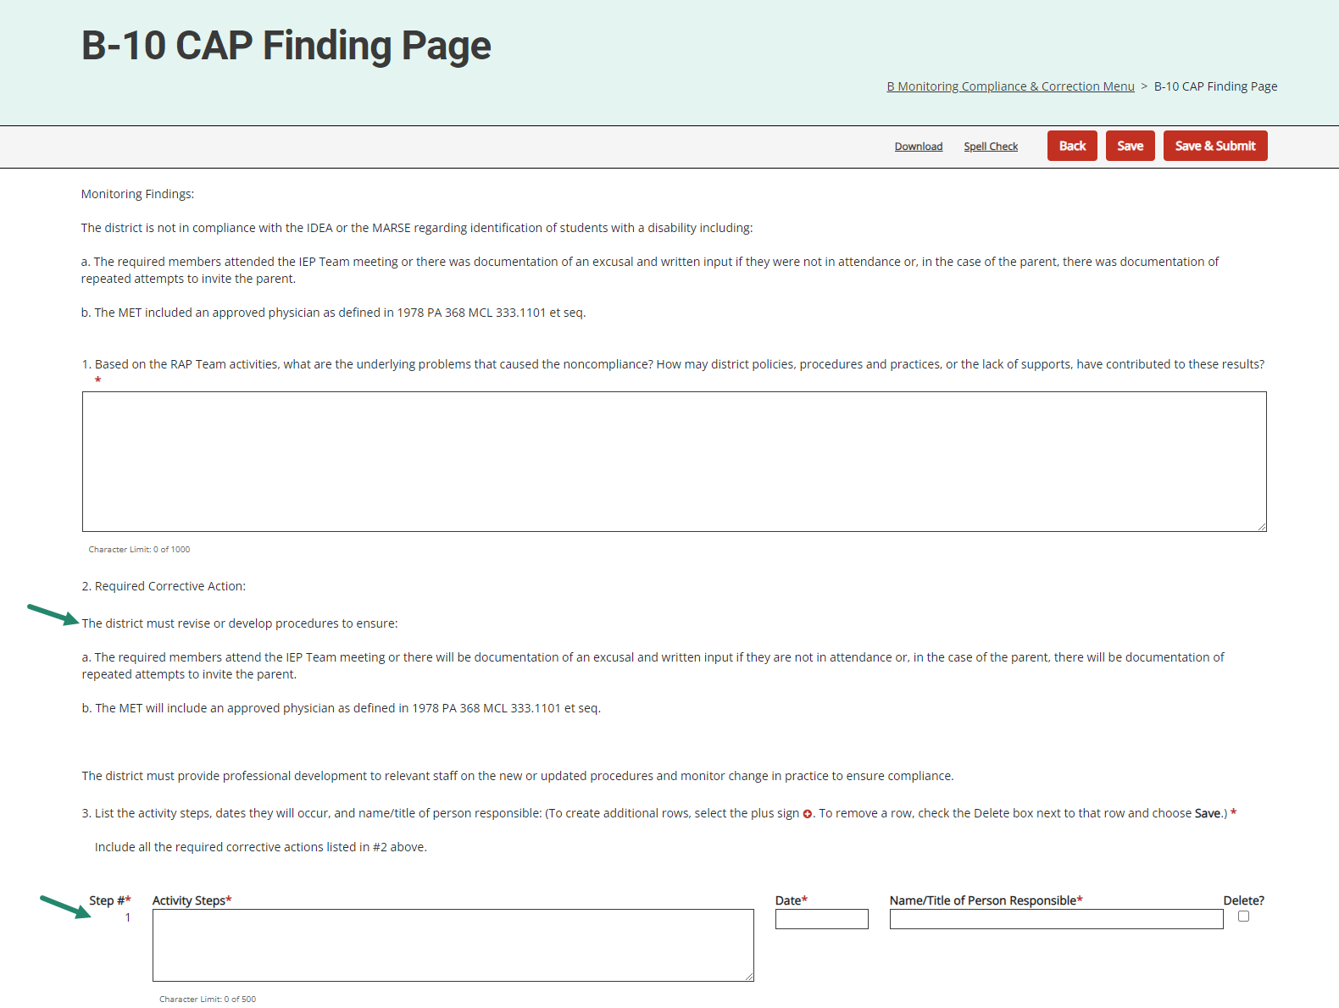
CAP Finding
Page
Applies to Indicator
B-9, B-10, B-9-B-10, and Part B CAPs.
Actions ordered in Final Reports will be bolded and numbered.
Each action must be detailed in the Action Steps.
Notes:
The CAP Finding Page applies to Indicator B-9, B-10, B-9-B-10, and Part B CAPs. Actions ordered in the Final Reports will be bolded and numbered. Each action must be detailed in the Action Steps.

Slide 25
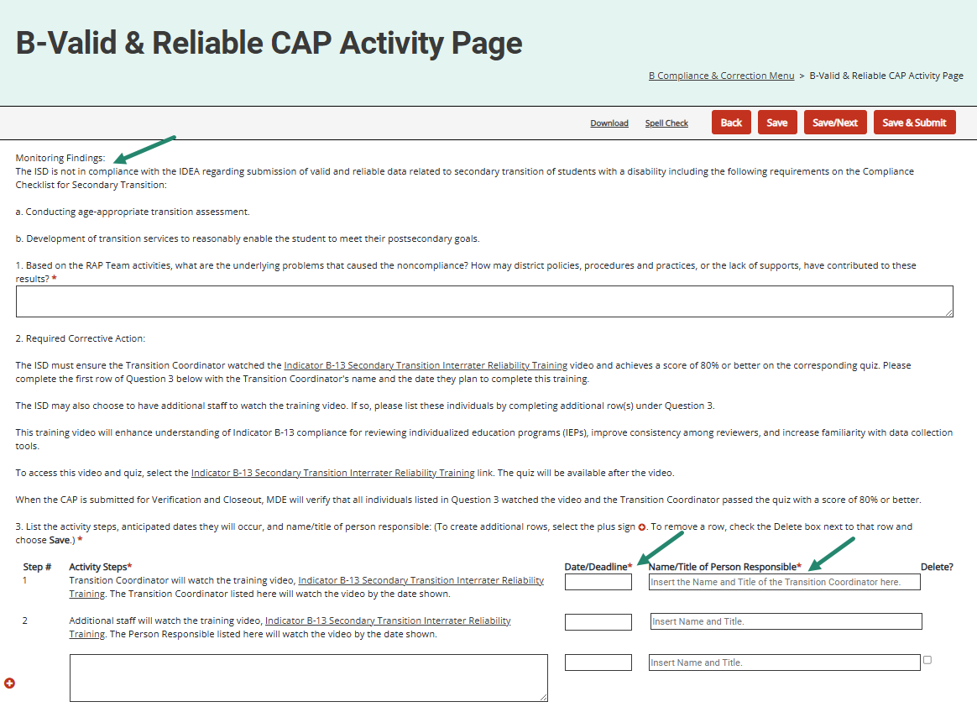
CAP Activity Page (B-Valid & Reliable only)
Applies to B-Valid & Reliable CAPs based on B-13.
Monitoring Finding language displayed.
User required to indicate Transition Coordinator’s name and date they will complete the required OSE training & quiz.
Notes:
The Valid & Reliable data CAPs will have monitoring finding language displayed that outlines the questions where the ISD (or State Agency) had interrater reliability issues during the data collection activity.
The information displayed under the Required Corrective Action section will be the same for all who receive this finding. The Interrater Reliability training video will be available on the Catamaran Technical Assistance website for the Transition Coordinator and other staff to complete at their convenience. In addition, the Transition Coordinator will be required to achieve a score of 80% or better on the corresponding quiz. Instead of selecting a scheduled training session date (as was done in September 2024 and prior), the user will indicate on the CAP Activity Page the date by which the Transition Coordinator (and others) will complete the training video and quiz.
Note all ISDs are open to watch the B-13 IRR training video; however, ISDs with a B-Valid & Reliable finding will be required to watch.

Slide 26
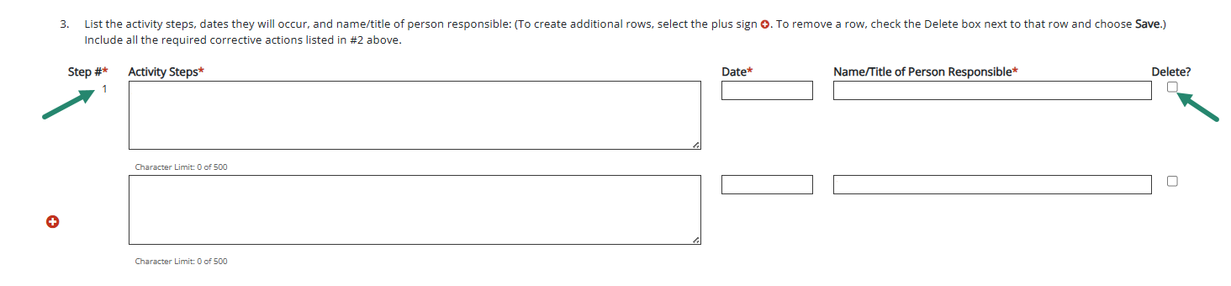
Question 3: CAP Activity or Finding Page
The Step # field will auto-number rows.
The Delete? checkbox allows users to remove rows as needed.
Notes:
For both the CAP Activity or CAP Finding pages, the activity step question (question 3) allows users to delete a row without having to back out any information. We wanted to remind you of this feature and how to use it.
To remove a row, check the Delete box next to that row and choose Save. The unwanted row will be removed from the page.
This will make updating the CAP Activity/Finding page easier should the CAP be returned for modifications. Thus, ensuring the correct activity steps are then populated onto the following pages (e.g., Progress Report, etc.).
Also, the Step # field for Question 3 auto-numbers each step. This will be helpful if you delete a row ☺ Once you save the page, Catamaran will apply the numbering to the listed steps. Users are not required to enter the Step # to complete the activity step row.

Slide 27
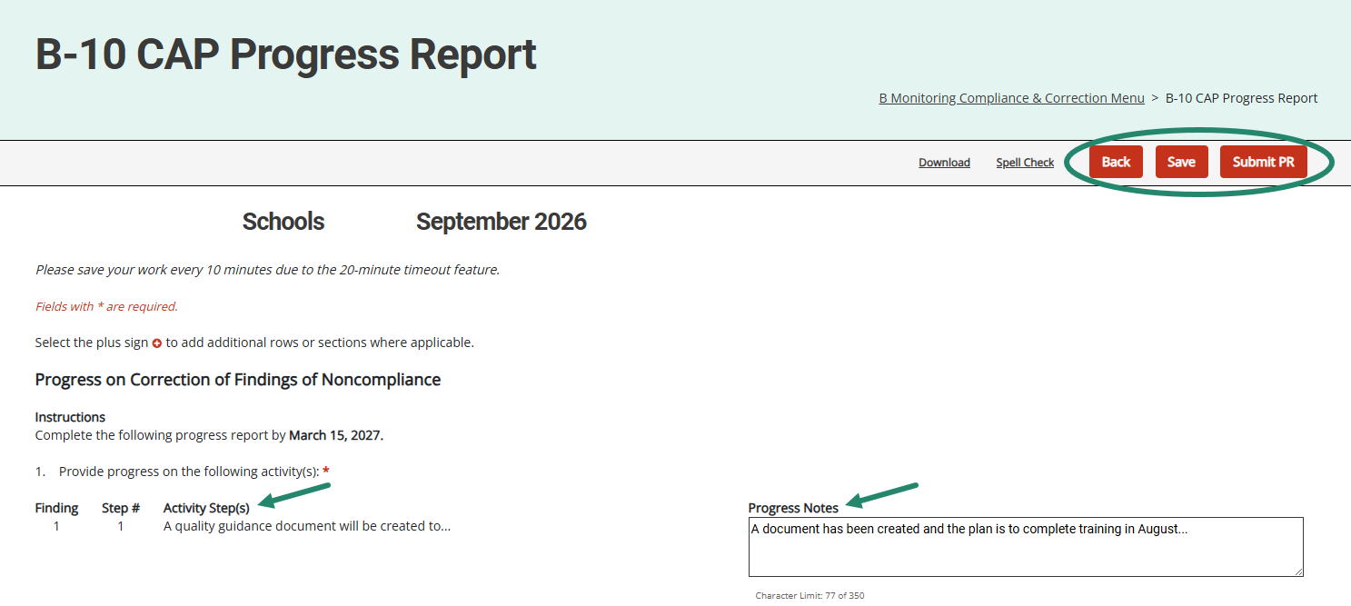
Progress Report
Activity step(s) from the CAP Activity (or Finding) page will be displayed on the Progress Report.
Member districts will report progress on specific activity step(s).
Notes:
The activity step(s) from the CAP Activity or CAP Finding page will be displayed on the Progress Report.
Member districts will report progress on each specific activity step(s). It is no longer necessary to return to the CAP Activity or CAP Finding page to complete the Progress Report. This should make the process easier for both the district as they write the progress report and the OSE as they review the report.
On those Valid & Reliable CAPs from B-13 data, the progress report will have the populated activity step displayed. The additional activity steps provided by the district for this CAP will also be displayed.
When submitting the progress report, the district will upload the relevant procedures for the OSE’s review.

Slide 28
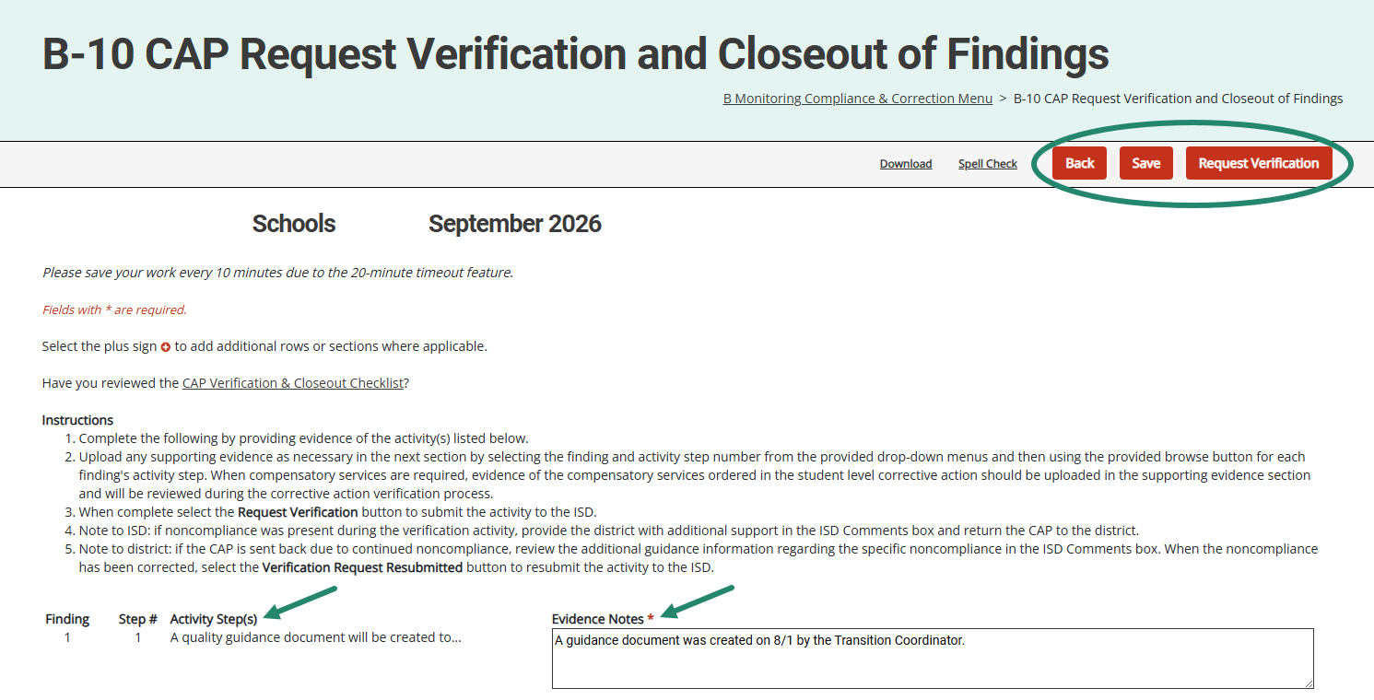
Request Verification & Closeout
Districts provide evidence and documentation for specific activity step(s).
This information is available to the ISD to assist with CAP verification.
Notes:
Like the Progress Report, the Request Verification and Closeout of Findings page will have information pulled from the CAP Activity or CAP Finding pages. Because of this,
It’s unnecessary to return to the CAP Activity (or Finding) page to complete this form to request closeout.
This information is also available on the Complaint CAP verification and closeout form, but only on the Complaint CAPs, is a place to upload evidence of ordered compensatory services.
Based on OSEP's 23-01 Memo, for all CAPs, ISDs may return a verification request to the district. To do this,
The ISD can return the CAP to the district from the Request for Verification and Closeout of Findings page.
If the ISD returns the verification request to the member district, the district can review the files the ISD determined to be non-compliant.
The corrections can be made, and the district can resubmit its verification request from this page. There will be an ISD Comments box on this page for any instructions the ISD may want to leave for the district.
For B-Valid & Reliable CAPs from B-13 data, the request verification & closeout form will have the populated activity step displayed and the district provided activity steps for this CAP.

Slide 29
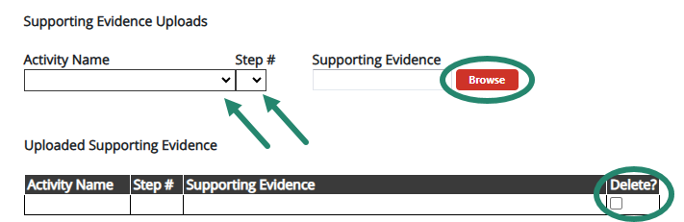
Supporting Evidence Uploads
Notes:
The Request Verification & Closeout page also includes a Supporting Evidence Uploads section at the bottom of the page. This will allow you to upload multiple documents per activity step!
Once you have provided your evidence notes, scroll down below the listed activity steps to upload any supporting evidence. Remember, this is not a requirement at this step.
To do this, below the listed activity steps, select from the provided drop-down menu(s) the appropriate step # (and/or finding # if a Monitoring CAP), then upload/tag your specific documentation to a specific finding/step.
After uploading documentation to this page, you may realize that you uploaded the wrong attachment. Because of this, we have provided a way to delete attachments as needed. To do this, locate the attachment in the document upload table and select the delete checkbox by the row you wish to remove, and then Save the page to confirm your selection.

Slide 30
Complaint and Monitoring CAP Verification for ISDs
Verification Appendix appears before the closeout verification worksheet on the menu.
Verification Appendix includes a “Date Verified” column in the student record review section.
Districts may view, if the CAP is returned by the ISD.
When all findings of noncompliance are verified, the ISD will move to the closeout verification worksheet.
Notes:
The Verification Appendix appears before the closeout verification worksheet.
There is also a column on the verification form labeled date verified. The ISD can use this column to indicate the date the record was determined to be compliant. This may be helpful if you are conducting more than one verification activity. We have also updated the users who have access to this page. In order for districts to see the reviewed files, they can view this page if the ISD returns it to the district. At that time, districts will be able to edit the column of date corrected. The district will not be able to edit other columns the ISD completes. Once all the non-compliance is corrected and verified, the ISD will submit the closeout request to MDE.

Slide 31
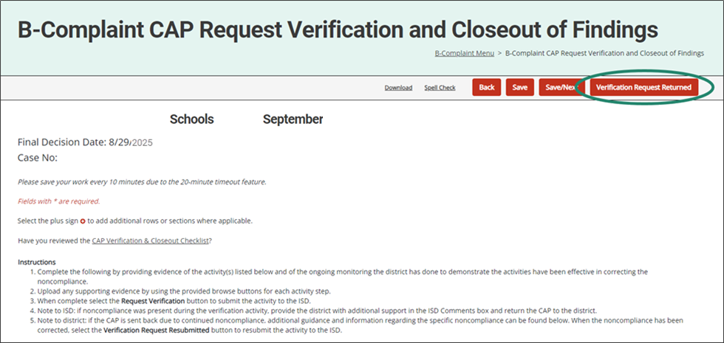
Complaint CAP Request for Verification and Closeout
Notes:
As ISDs complete the verification process, they occasionally find ongoing non-compliance. The ISD may return the CAP to the district to correct the records and complete other actions. Remember, to return the verification request to the district, go to the Request for Verification and Closeout page and select the Verification Request Returned button.

Slide 32
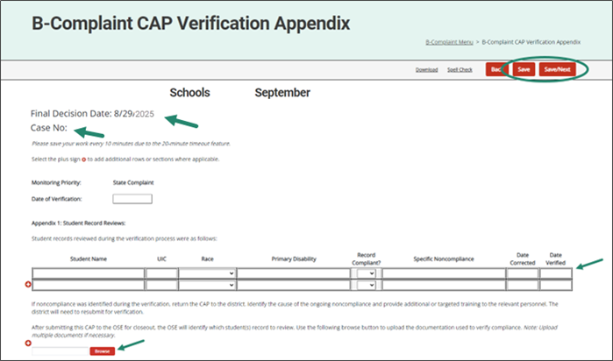
Complaint CAP Verification Appendix
The final decision date and case numbers are now on Complaint CAP forms.
ISDs complete the verification appendix and upload supporting documentation.
Notes:
This screenshot shows the Final Decision Date and Case Number on the Complaint CAP forms.
The Verification Appendix will be viewable by the district, and the district will be able to note the date of correction. The district will then resubmit the CAP to the ISD.
Arrows on this slide indicate the fields for the ISD to enter the new verification dates and the browse button to upload supporting documentation.

Slide 33
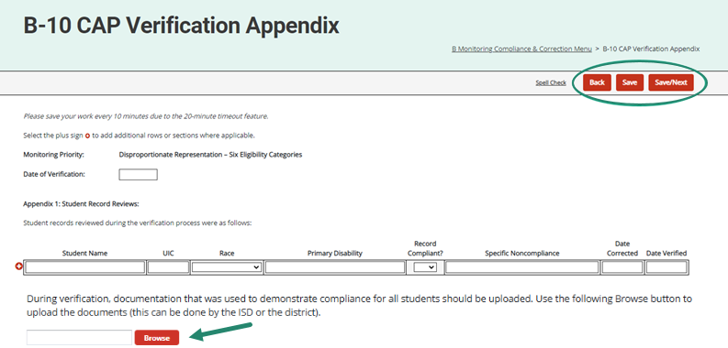
Monitoring CAP Verification Appendix
ISDs complete the verification appendix and upload supporting documentation.
Notes:
Prior to submitting the verification request to MDE, the ISD should upload documentation that was used to demonstrate compliance for all students on the CAP Verification Appendix page using the browse button. If additional documentation is required, MDE will return the CAP to the ISD. This change in practice is based on OSEP’s 23-01 memo which states the State must retain documentation of correction of noncompliance for each individual case of previously noncompliant files, records, etc.

Slide 34
Resources
Notes:
Even with the best of training, there may be questions that arise later as you use the system. There are a variety of resources available to support you.

Slide 35
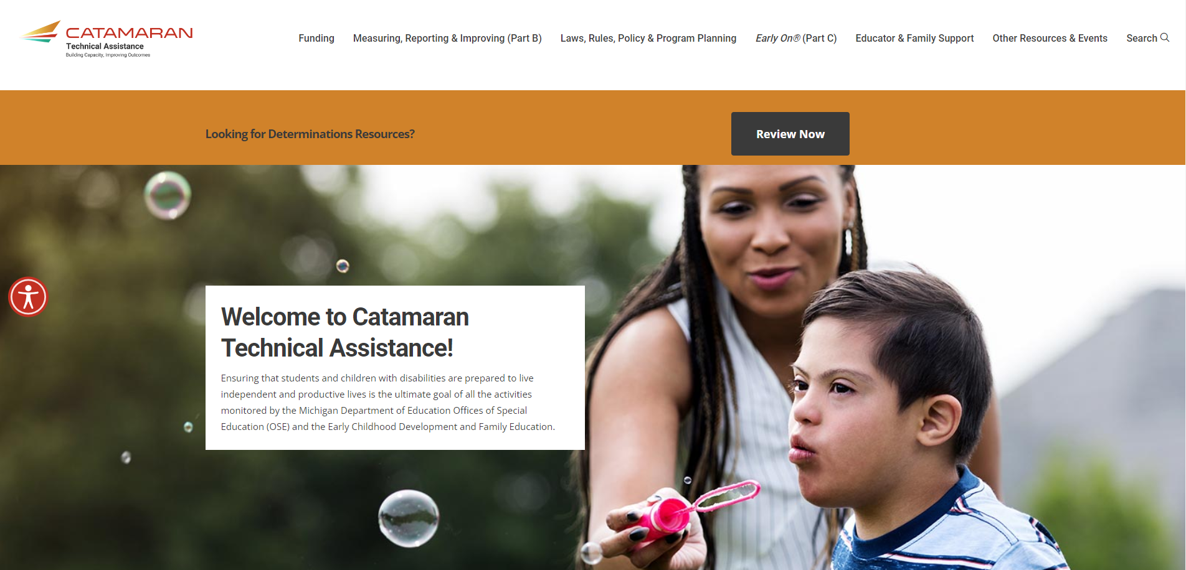
Catamaran Technical Assistance Website
Notes:
The following slides highlight some features and navigation for our Catamaran Technical Assistance Website or TA site.
You can access the Catamaran Technical Assistance Website at training dot catamaran dot partners.

Slide 36
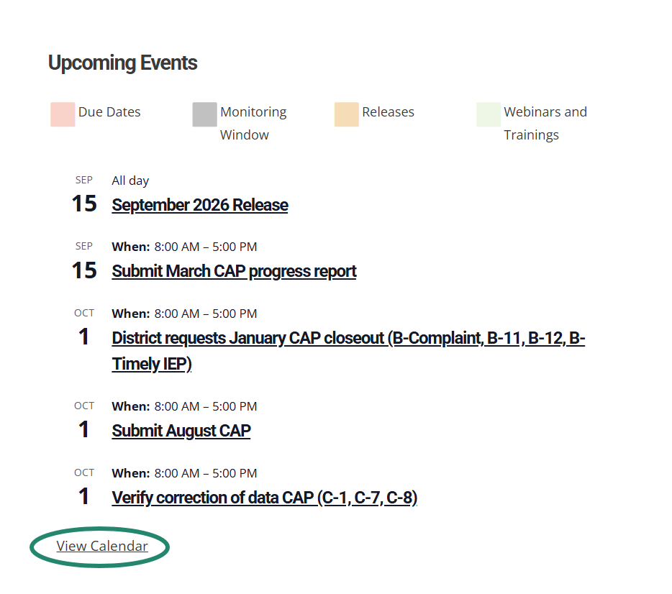
Catamaran Calendar
Notes:
As many of you know, we now have a programmed calendar on our Catamaran Technical Assistance Website where users can view all upcoming events and due dates in one place.
This calendar has recently been updated with the upcoming due dates for 2026-27.
You may access the Catamaran Calendar from the home page of the Catamaran Technical Assistance Website by scrolling to the bottom of the page. This calendar displays 5 calendar items in a list-view format.* To view the full-sized calendar, select the View Calendar link at the bottom of the calendar.

Slide 37
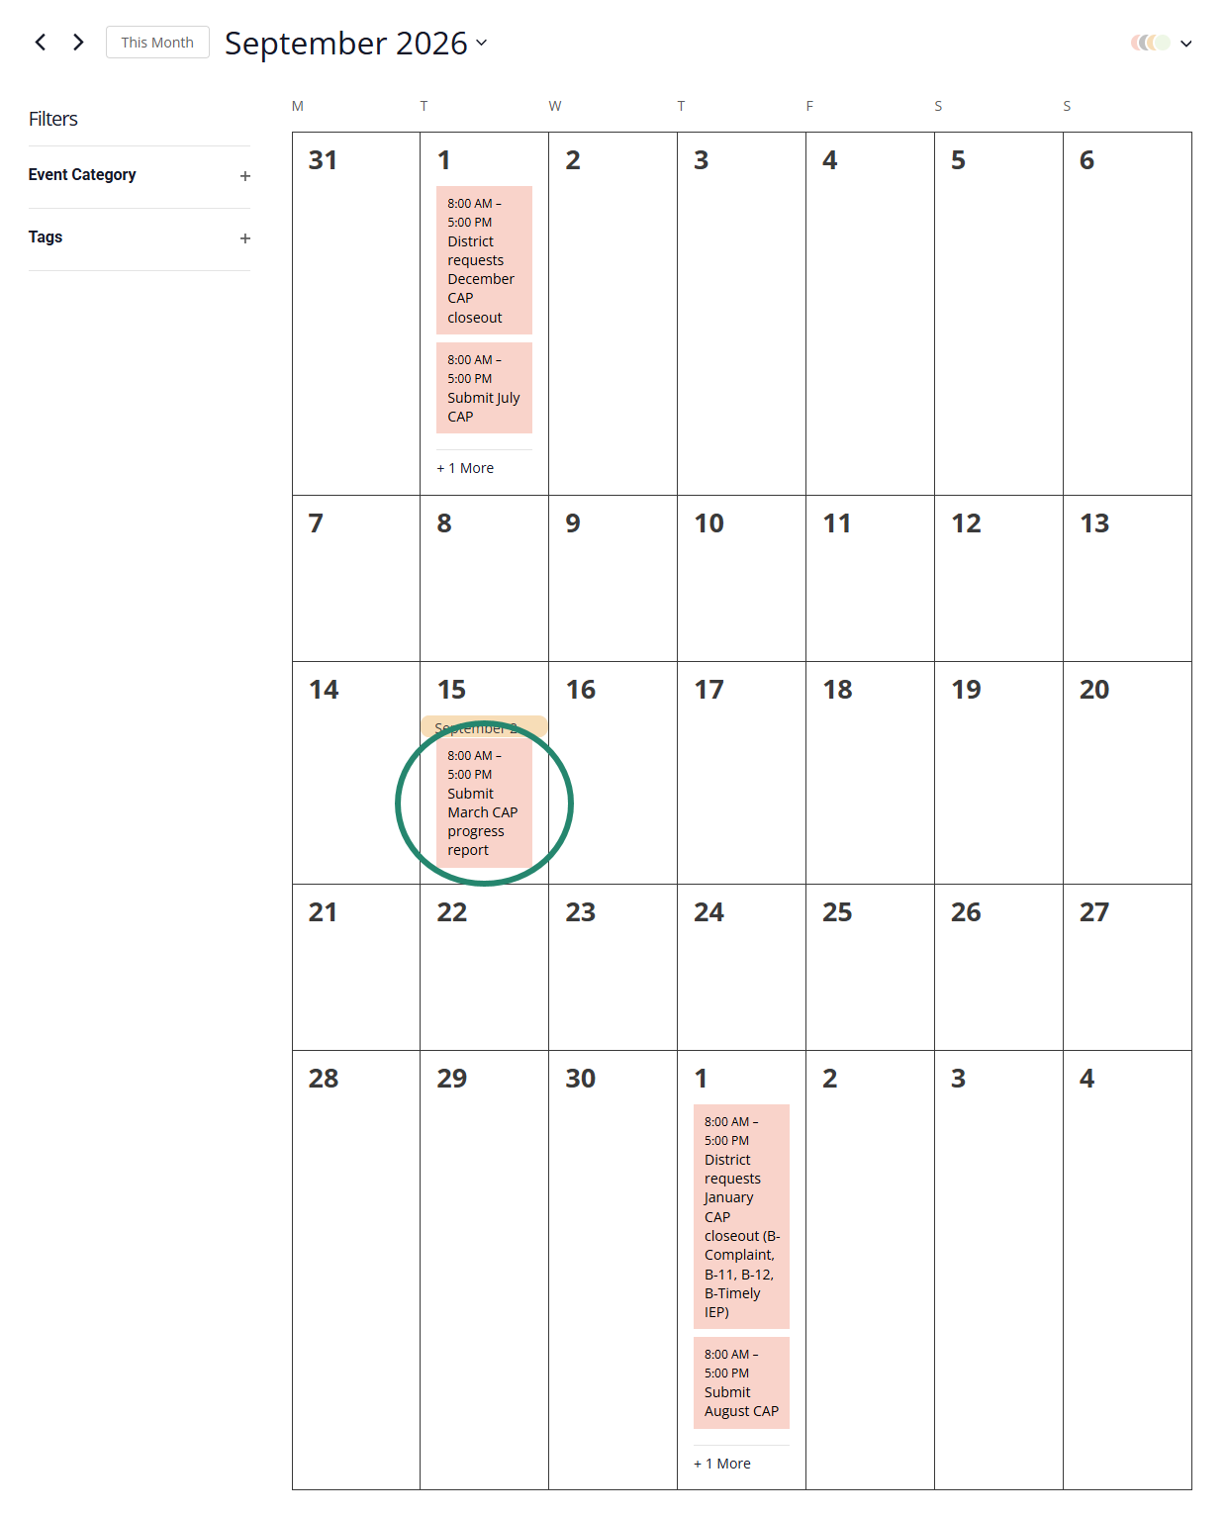
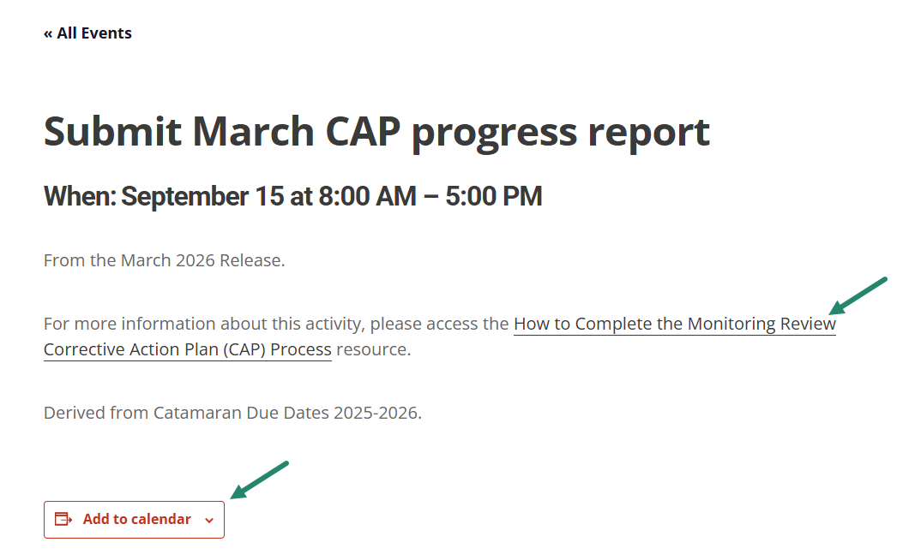
Catamaran Calendar (Continued)
Notes:
At the top right of the page, you can view the calendar in the view that works best for you by list, month, or day.
From the month view shown here, you can drill down on a specific event for more information and add the event to your calendar.
For upcoming due dates that have a how-to associated with it, there will be a clickable link to the how-to.
We hope this page is useful for you and helps you to plan your work.

Slide 38
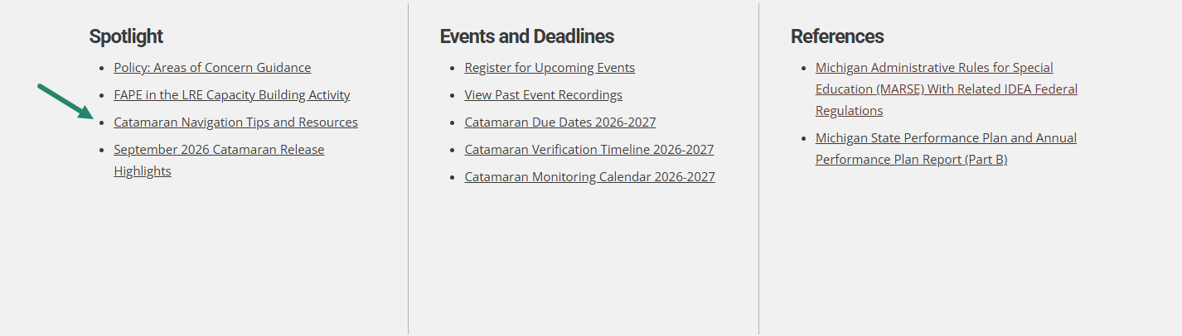
Catamaran Navigation Tips Training Video
Notes:
We have a separate training video that includes Catamaran navigation tips. This video can be found in the Spotlight section on the homepage of the Catamaran Technical Assistance Website. This video is encouraged for new users, as well as refreshing experienced users in navigating Catamaran.

Slide 39
Need Assistance?
MDE OSE Information Line
888-320-8384
mde-ose@michigan.gov
Catamaran Help Desk
877-474-9023
help@catamaran.partners
Notes:
If you have any questions about this training video, contact the MDE OSE Information Line at 888-320-8384 or by email at m d e – o s e @ Michigan.gov.
For questions about Catamaran, contact the Catamaran Help Desk.
The Catamaran Help Desk is available Monday through Friday from 8-5 PM.
Contact them by email at help@catamaran.partners or by phone at 877-474-9023 or by using the Chat feature within Catamaran.
This concludes the presentation -- thank you for watching!

