Slide 1
Justification Forms Preview Webinar
For Districts and ISDs
Notes:
Welcome to the Justification Forms Preview Webinar. The purpose of this webinar is to give ISD and district personnel guidance on how to complete the required justification activity related to the 1% cap on student participation in the alternate assessment.

Slide 2
Agenda
About District and Intermediate School District (ISD) Justification Forms
Completing the Activity in Catamaran
Catamaran Navigation Tips
Resources
Notes:
Specifically, we will cover four broad topics. First, we will talk a bit

Slide 3
About District and ISD
Justification Forms
Notes:
In this first section, we will give you some background on the Justification process.

Slide 4
What is Required on a District Justification Form?
Justification Forms require member districts to demonstrate a thorough review of alternate assessment participation rates when participation rates exceed 1%. Some areas to consider could include but are not limited to:
Students taking the Functional Independence assessment.
Alignment between instructional standards taught and assessment selected.
Notes:
The Every Student Succeeds Act places a cap on the number of students participating in an alternate assessment, aligned to alternate content expectations to no more than 1% of students who are tested. Michigan’s participation rate for MI-Access, Michigan’s alternate assessment for students with the most significant cognitive disabilities, was 1.8%, which represents a higher percentage than was tested with MI-Access in 2021. Under ESSA, districts that contribute to a state exceeding the 1% cap must provide justification for doing so, as well as their plans for reducing the number of students taking the alternate assessment. These justification forms, completed in Catamaran, serve this purpose for Michigan. When districts complete these forms, they should consider areas they plan to review, to ensure students are being assessed with the most appropriate assessment related to the instruction that they receive and to ensure that instructional targets represent high expectations for all students. These areas could include but are certainly not limited to looking critically at students taking the Functional Independence level of the assessment, to ensure that such students meet the definition of a student with the most significant cognitive disabilities. Regardless of disability or student eligibility for services, another critical area to look at is the alignment between the content expectations toward which a student is taught and the assessment they are taking. MI-Access is only designed for students with the most significant cognitive disabilities, whose primary instruction is aligned with Michigan’s alternate content expectations.

Slide 5
What is Required on a District Justification Form? (continued)
Differences in participation between one building and another, or one staff member’s caseload and another.
Eligibility areas not typical for alternate assessments (if known).
Students who consistently perform at “exceeds standards” level on the alternate assessment.
Notes:
Some additional areas to look at and comment on, are trends that may occur within your district. Some of these trends may make sense, for example, if there are programs that serve students with the most significant cognitive disabilities that are located in one building but not another. However, sometimes differences occur among different buildings that would warrant the district to look more closely at student cases. Another factor to review and comment on are students whose eligibilities are not consistent with students with the most significant cognitive disabilities. While there are no inclusionary or exclusionary rules regarding eligibility for assessment selection, it is important to keep in mind that MI-Access is not designed for students with mild disabilities. This would often include most students whose primary eligibilities include a specific learning disability, emotional impairment, mild health impairments, or speech-language impairments. Another factor that was introduced in the past for many districts was to review students who consistently perform at the “Exceeds Standards” on MI-Access. IEP teams for students who consistently perform at this level, should consider meeting to determine if the instructional expectations for such students should be raised and the general assessment taken.

Slide 6
Why is a District Justification Form Available to ISDs?
Only ISDs operating one or more center-based programs will need to complete a District Justification Form.
  Note: If the ISD operates more than one center-based program, the alternate assessment data is averaged in the report – this is the information that will need to be provided in the data portion of the District Justification Form.
The District Justification Form will be available as a link on all ISD's Justification Form menu.
Notes:
Intermediate School Districts may also need to complete a district justification form. This would be true if the district offers any educational programming. For example, an ISD that operates a center-based special education program alone may have a very high percentage of students that take MI-Access. An ISD that runs both specific general education programming and a center-based special education program, may have a lower percentage, but usually still well above 1%. Other ISDs may not run any direct educational programming, in which case their participation rates will likely show 0%. While this is expected, the justification process is still required by federal law. The district Justification Form will be available as a link on all ISD justification forms.

Slide 7
When Completing the Justification Form:
Contributing factors, when they apply, do not change the 1% rule, but provide additional context for member districts to think about their data.
A space is provided for other justifications. This is an opportunity for the member district to hypothesize any other factors contributing to participation rates.
Disproportionality must be addressed, only when a district has been flagged.
Notes:
It is important to note that nothing in the justification form process changes or excludes a district or ISD from the 1% rule. As districts work through the justification form process, please note that the contributing factors, when they apply, provide additional context for member districts to think about their data, but do not change the 1% rule. Often times, districts will have done a deep dive of their data and created a hypothesis regarding alternate assessment participation that is not already indicated on the justification form. This information should be included in the “Other Justifications” section.
If a district has been flagged for disproportionality, this an additional page of the justification forms must be completed. If a district does not see this additional page, labeled Disproportionality, then they were not flagged for disproportionality in regards to participation for MI-Access.

Slide 8
What is Required on an ISD Summary Justification Form?
The ISD Justification Form is a review and summary of all member districts within an ISD.
The ISD Justification Form can be worked on at any time but cannot be submitted until 100% of the member districts have submitted district level forms.
This measure was intentionally put in place to ensure all member district data and justification forms are accounted for and considered.
Notes:
The ISD justification forms synthesize the information for all member districts in an ISD. This form can be very useful to ISDs in determining where and how to prioritize technical assistance and also allows the ISD a way to organize the collection of the justification forms. These forms can be worked on at any time after they are open but cannot be submitted until 100% of the member districts have submitted their forms. This is an intentional feature, as 100% of district participation is required under ESSA for this activity.

Slide 9
What is Required on an ISD Summary Justification Form? (continued)
Some areas to consider when completing the ISD Justification Form, could include but are not limited to:
Students taking the Functional Independence level alternate assessment.
Differences in participation between one district and another.
Differences in participation between grade bands.
Eligibility areas not typical for alternate assessments (if known).
Students who consistently perform at “exceeds standards” or “proficient” level.
Member district participation rate trends.
Notes:
Like the district justification forms, there are several trends and factors to consider in the data for an ISD. These would include students taking the Functional Independence level of the assessment and alignment with the definition of a student with the most significant cognitive disabilities, difference among member districts, differences among grade bands, both overall and among member districts, eligibility areas that may not be consistent with the definition of students with the most significant cognitive disabilities, a critical eye on students who have consistently scored in the “Surpassed the Standards” performance level for MI-Access, and long term trends of MI-Access participation among member districts.

Slide 10
ISD and Member District Reminders
The Justification Forms activity will be completed by ISD directors and/or monitors and district Catamaran coordinators in Catamaran.
All district Justification Forms must be reviewed and accepted before ISDs can submit the ISD Summary Justification Form.
District Justification Forms only need to be completed by ISDs if they are operating one or more center-based programs.
Notes:
Each justification form, be it member district or ISD, will be complete by the ISD Director and/or monitor and district Catamaran coordinators. Completion of these forms must be done in Catamaran. As a reminder, all district justification forms must be reviewed and accepted by the ISD before the full ISD Justification Form (which includes the member district forms) can be submitted. If an ISD does not run any special education center-based programs (meaning they have a participation rate of zero), they do not need to submit a district justification form. Please note, all Justification Forms will eventually be posted to the MI-Access page. Making Justification Forms publicly available is another requirement under ESSA.

Slide 11
Targeted Activities
Districts are placed into tiers based on alternate participation rates.
Tier 1: 1.1% to 1.2% or basic disproportionality
Tier 2: 1.3% to 1.6% or disproportionately with 1.2% or less
Tier 3: 1.7% or more or disproportionately with 1.3 to 1.6% overall
Notes:
MDE will provide recommended targeted assistance to the ISD for any district whose participation rate was 1.3% or higher, and/or was flagged for disproportionality, and/or required a response to something indicated in the justification form. Districts falling into this category are required to have a plan to address participation rates and should receive technical assistance from the ISD.

Slide 12
Tier 1
Receive universal guidance around the appropriate use of alternate standards for instruction and assessments.
Refer to the decision-making flow chart as a resource.
Notes:
Activities for the tiers are as follows:

Slide 13
Tier 2
Train staff.
Review flagged student case files who are at high risk for not meeting one or more of the four required criteria to be eligible for the use of MI-Access based on alternate educational standards.
Have IEP Teams complete the Rubric for Assigning Students to Alternate Standards for Instruction and Assessment using relevant data for all flagged cases in each Tier 2 district.
Districts must submit the results of the completed High-Risk Summary to their ISD by February 15, 2027.
ISDs will only submit the Assurance Statement for evidence to MDE by
June 1, 2027.
Notes:
Tier 2 Districts must complete an action plan including training around the four necessary criteria for appropriate use of alternate standards and assessments,
A list of students who are flagged for high risk of not meeting the required criteria to be eligible for alternate assessments, from the Spring 2026 testing data is provided in Catamaran.
For districts falling within Tier 2, a review must be done of students who continue to meet the definition of a “student with the most significant cognitive disabilities” yet are scoring in the “Surpassed the Standards” performance level.
An educational Benefit review of such cases should be completed to determine if instructional targets are rigorous enough for such students. Monitoring of action taken by Tier 2 districts will be done by the ISD, using universal and targeted guidance resources provided by MDE. Tier 2 districts and their ISD may request additional assistance from MDE as needed. The district should review the rubric with criterion relevant data.

Slide 14
Tier 3
Train staff.
Review flagged student case files who are at high risk for not meeting one or more of the four required criteria to be eligible for the use of MI-Access based on alternate educational standards.
Have IEP Teams complete the Rubric for Assigning Students to Alternate Standards for Instruction and Assessment using relevant data for all flagged cases in each Tier 3 district.
Districts must submit the results of the completed High-Risk Summary to their ISD by February 15, 2027.
ISDs must submit the High-Risk Summary to MDE for feedback by April 1, 2027.
Notes:
Tier 3 districts must complete an action plan including training around the four necessary criteria for appropriate use of alternate standards and assessments.
A list of students who are flagged for high risk of not meeting the required criteria to be eligible for alternate assessments, from the spring 2026 testing data is provided in Catamaran.
If the district has flagged student cases, then IEP team members complete the IEP team facing rubric using criterion-relevant data. Outcomes of the review for all districts per ISD are expected to be completed by April 1, 2027, and a summary of the data and decisions around each criterion must be reviewed by MDE with directed guidance provided. For districts falling within Tier 3, a review must also be done of students who continue to meet the definition of a “student with the most significant cognitive disabilities” yet are scoring in the “Surpassed the Standards” performance level. Monitoring of Tier 3 actions will be completed by MDE with the involvement of the ISD. This includes targeted and directed technical assistance. Reminder: The High-Risk Excel Summary will be the only format accepted, a PDF of the high-Risk summary will not be accepted.

Slide 15
Disproportionality
Districts with only disproportionality need to review the student records for 8 students in the subgroup(s) identified with disproportionality (e.g., Hispanic students) to determine if they meet all four requirements of the definition of a student with the most significant cognitive disabilities.
  Any districts with less than 8 students will submit all records with disproportionality.
Districts submit the High-Risk Summary to their ISD by February 15, 2027.
ISDs submit the High-Risk Summary to MDE by April 1, 2027.
Notes:
Whether the district is in Tier 2 or 3, if they have disproportionality, they must also review the student records of 8 students in the subgroup or subgroups identified for the district to determine if they meet all four requirements of the definition of a student with the most significant cognitive disabilities.
Just to make it clear, all the required additional actions should be completed and evidence submitted by June 1, 2027.

Slide 16
Important Dates
October 15: Catamaran module opens
December 15: Districts submit Justification Forms to ISD
January 25: ISDs submit Summary Justification Forms to MDE
February 15: Districts submit High-Risk Summaries to ISD
April 1: ISDs submit all Tier 3 High-Risk Summaries to MDE
June 1: ISDs submit all evidence of Tier 3 Additional Actions along with Tier 2 Additional Actions assurance statements
Notes:
Note: February 15th date is not being submitted in Catamaran, This date is for the districts to return their High-Risk Summary to the ISDs, so they have time to review before their April 1 deadline.

Slide 17
Completing the Activity in Catamaran
Notes:
Now we are going to talk about the Justification Forms Activity in Catamaran. You will see some differences from last year’s forms to this year’s forms. There are less forms and more explicit instructions. Let’s see some of these changes.

Slide 18

Catamaran Login
Notes:
First, you will go to catamaran.partners to log into Catamaran.
If you do not have a username and password or if you have forgotten it, you can either select the Need to create an account? or Forgot Password? link on the login screen or you may contact the Catamaran Help Desk.

Slide 19
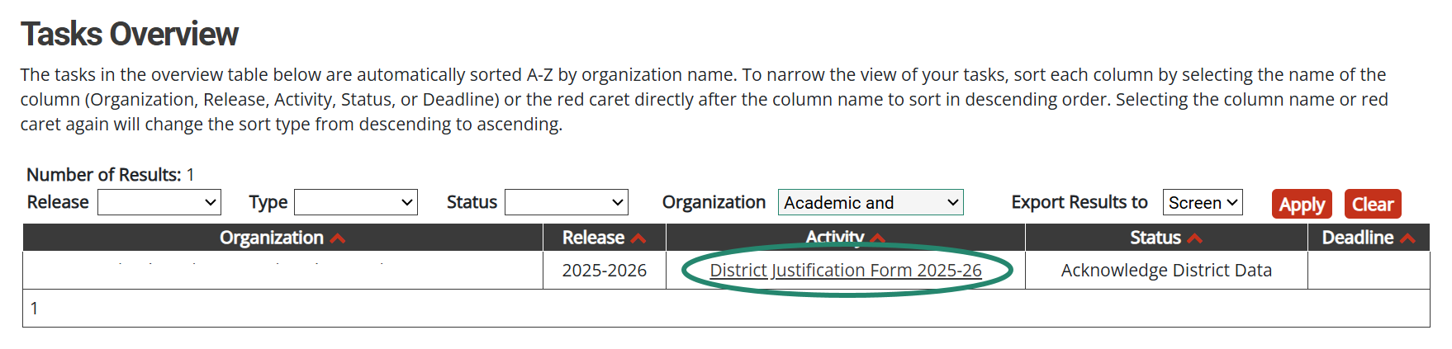
Locate the Activity (District View)
After logging in, locate the Justification Forms activity on the Tasks Overview.
Notes:
Locate the district justification form from the tasks overview.
If you have a lot of items on your dashboard, you may want to filter using the Justification Forms option in the Type drop down filter.

Slide 20
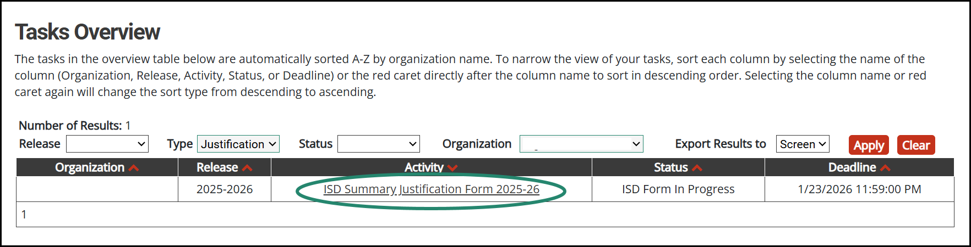
Locate the Activity (ISD View)
Notes:
Similarly, the ISD Summary Justification form will be available on the ISD tasks overview on the release date.

Slide 21
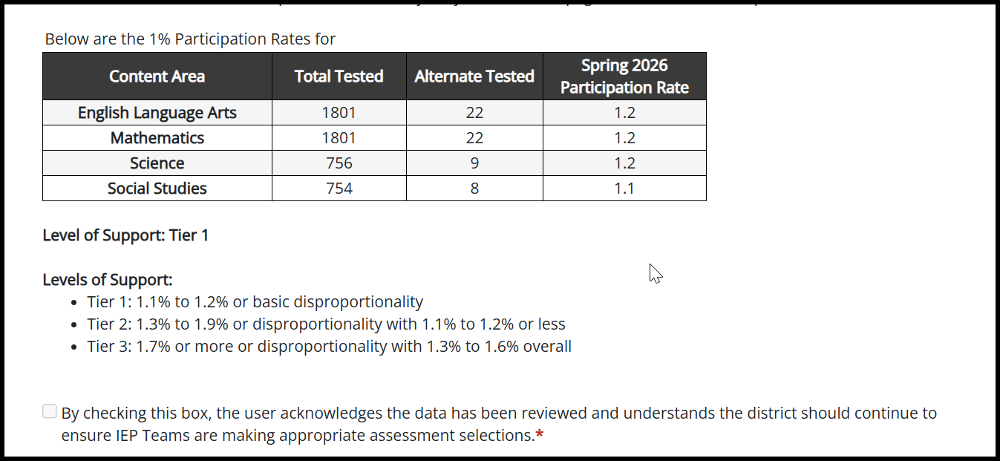
District Data Table
Notes:
The first step in the district activity is to review the district data table. Data is pre-populated using the Alternate Assessment data as provided by MDE.
District Catamaran Coordinators will review and acknowledge the data table has been reviewed by choosing the checkbox. If your district is Standard or Tier 1, this will trigger the end of your Justification Form.
A note for ISDs: If a district had tested students in the spring of the prior school year, alternate assessment data is made available in Catamaran, and a justification form will be created for them. However, if the district has since closed, the ISD can request a bypass for the work at that specific district. Contact MDE or the Help Desk for a bypass for that district or districts.

Slide 22
Districts: Acknowledge Data Table
If any spring participation rate is 1.1 or higher, then there will be additional pages to complete.
If all spring participation rates are 1.0 or below, then the activity is complete once the box for acknowledgement is selected.
Notes:
If any spring participation rate is 1.1% or higher, there will be additional pages to complete. These will auto-load upon acknowledging the data table.
If all spring participation rates are 1.0% or below, the activity is complete. No further action is required from the district.

Slide 23
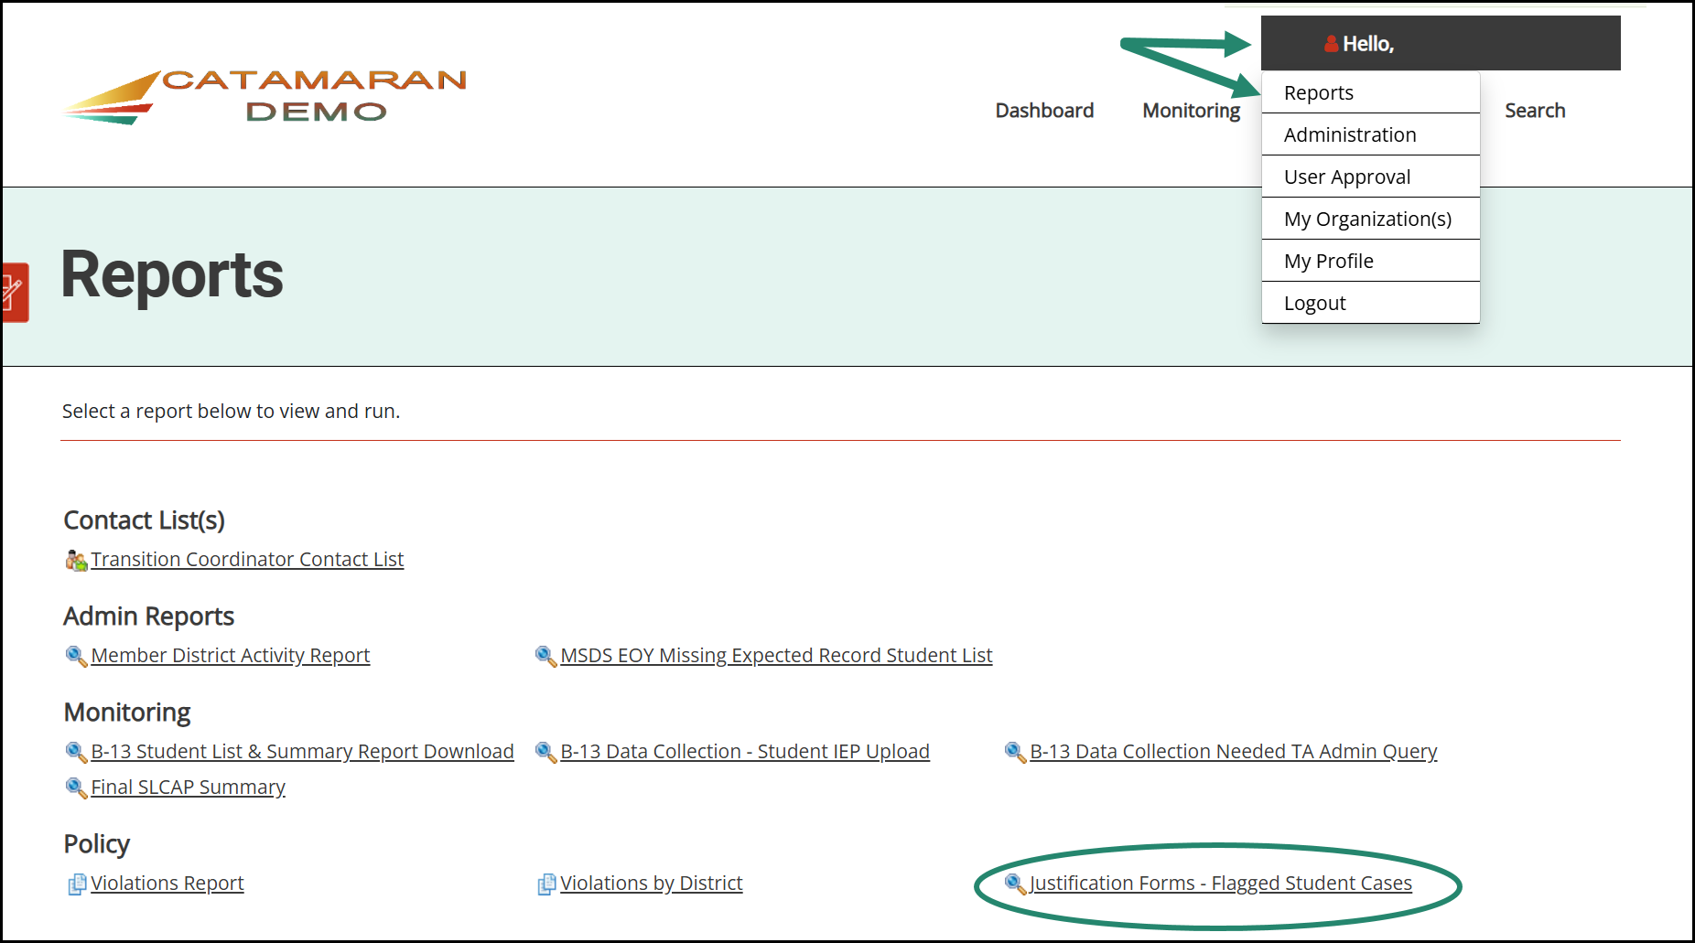
Access the Flagged Student Cases Report
Notes:
Once you have accessed the data form, you can see whether your district is in level Tier 2 or Tier 3 support. If you are in Tier 2 or Tier 3 then you will have additional actions required. For a list of students visit the reports page. You can find this page by hovering your cursor over your name in the upper right-hand corner of the screen and then selecting Reports from the dropdown list.
Scroll down the page to the Policy section and select Justification Forms - Flagged Student Cases

Slide 24
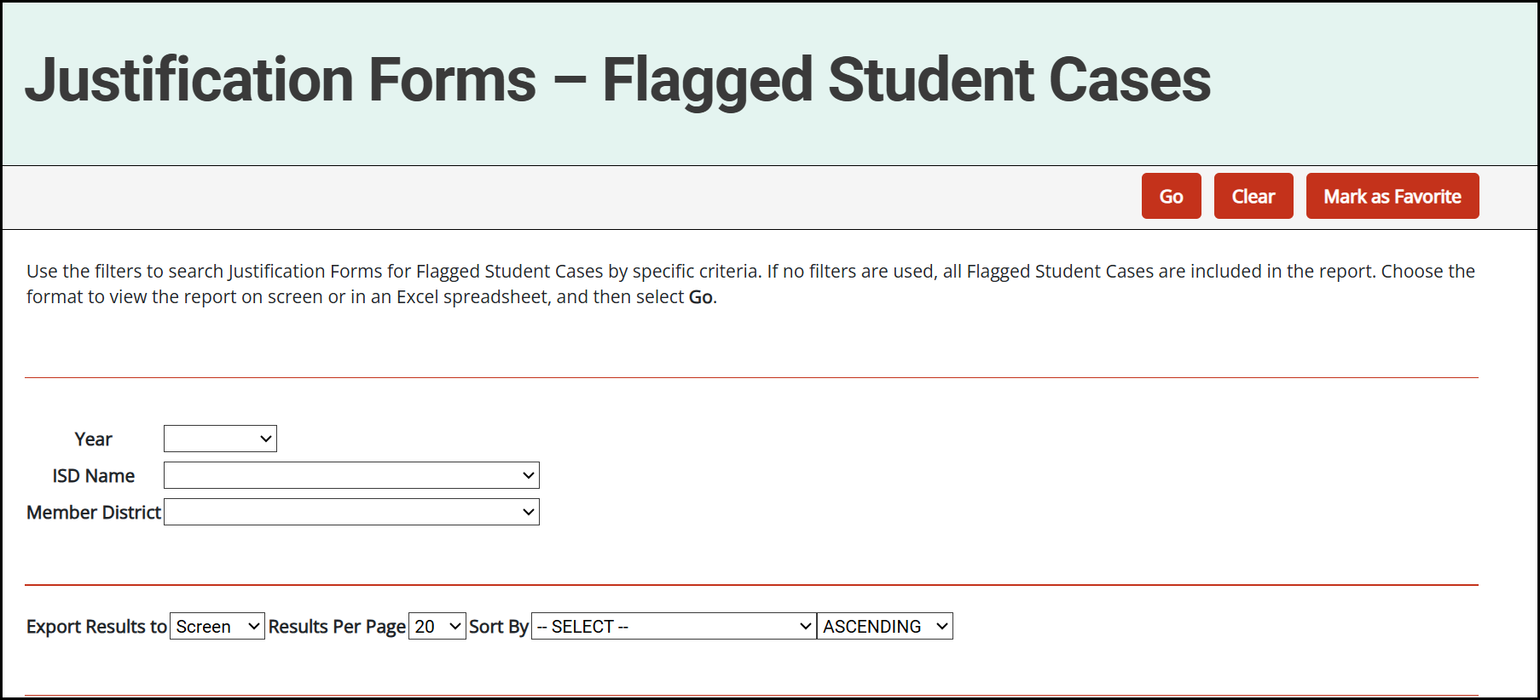
Access the Flagged Student Cases Report (part 2)
Notes:
Here is a screenshot of the filters you can apply to see the flagged student cases. District personnel will only be able to see the students in their District, but ISD personnel will be able to access the reports for any of their member districts. Select your filters or leave them blank and then select Go to see the student list.

Slide 25
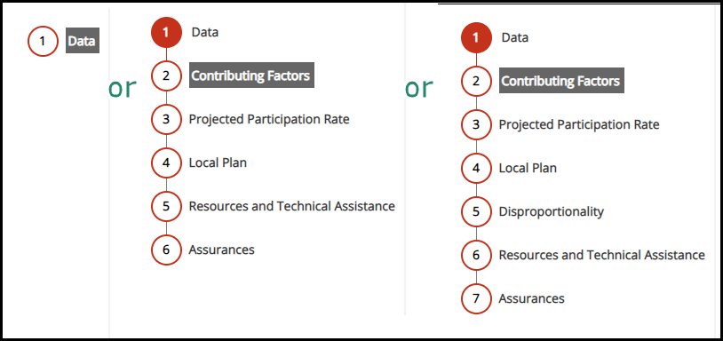
District Justification Form
The District Justification Form consists of 6 pages. When a district has been flagged for disproportionality, there will be 7 pages.
The appropriate pages will be auto-loaded for the district.
Notes:
There will be 6 pages required for those districts with any rate at 1.1 or higher.
There will be a 7th form for those districts flagged for disproportionality.
Again, all these forms will be pre-loaded by the system.
You have already seen the Data table but now let’s look at the other pages which may be required.

Slide 26
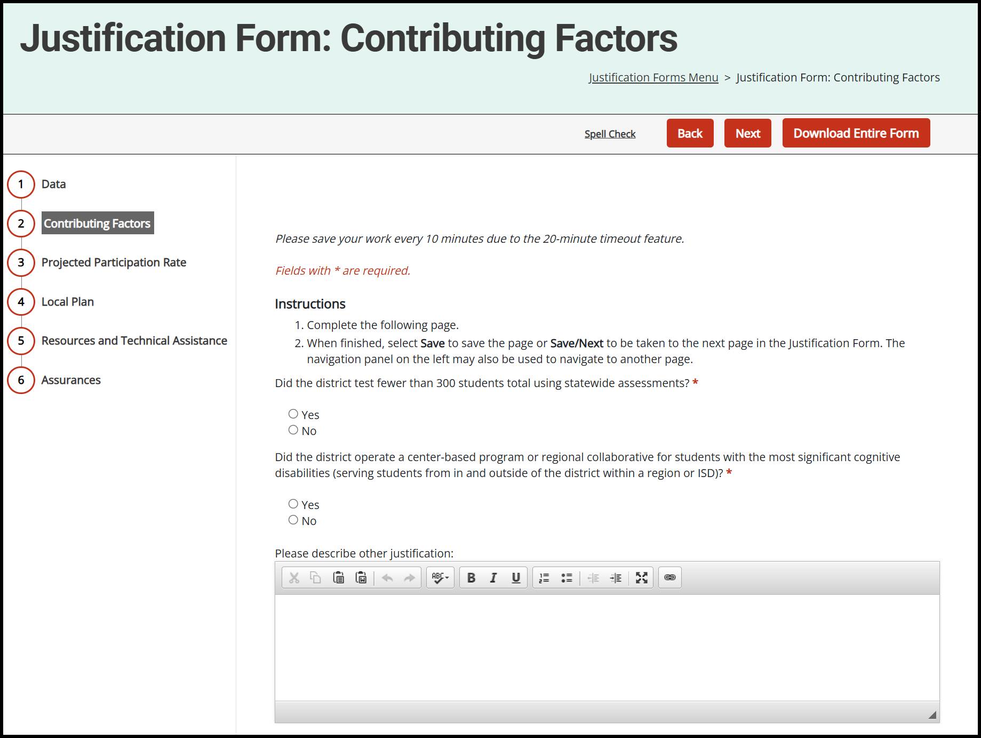
Contributing Factors
Did the district test fewer than 300 students?
Did the district operate a center-based program?
Provide other justification for participation over 1% cap.
Notes:
If a district has any participation rates higher than 1.1%, they will be asked to complete additional forms. The first will be the contributing factors form. On this form the district is asked if less than fewer then 300 total students were tested using the statewide assessments. They are also asked if the district operated a center-based program. If there is another justification for testing more than 1% of students with alternative assessments, the district will be able to enter that justification in the provided text box.

Slide 27
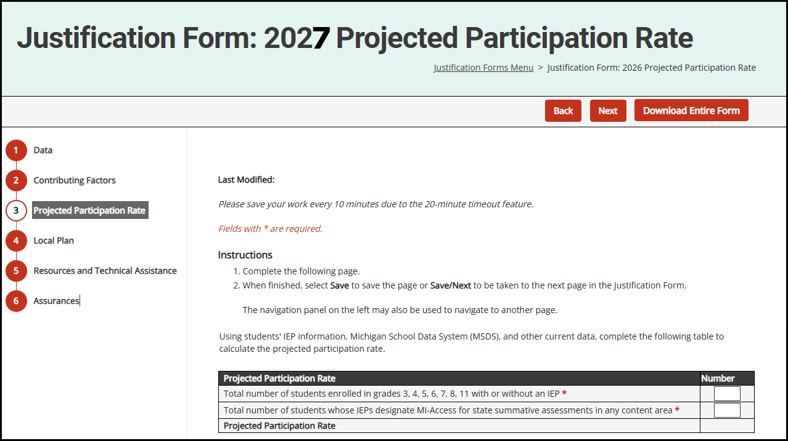
Projected Participation Rate
Input the number of students who will be participating in assessments in the spring of 2027, and the number of students whose IEP designate MI-Access.
Notes:
The next form the district will be asked to complete is the projected participation rate. On this form the district will input the number of students enrolled in grades 3, 4, 5, 6, 7, 8, and 11 with or without an IEP who will be participating in assessments in the spring of 2027. They will also input the number of students whose IEPs designate my access for state summative assessments in any content area. The system will then calculate the projected participation rate when the page is saved.

Slide 28
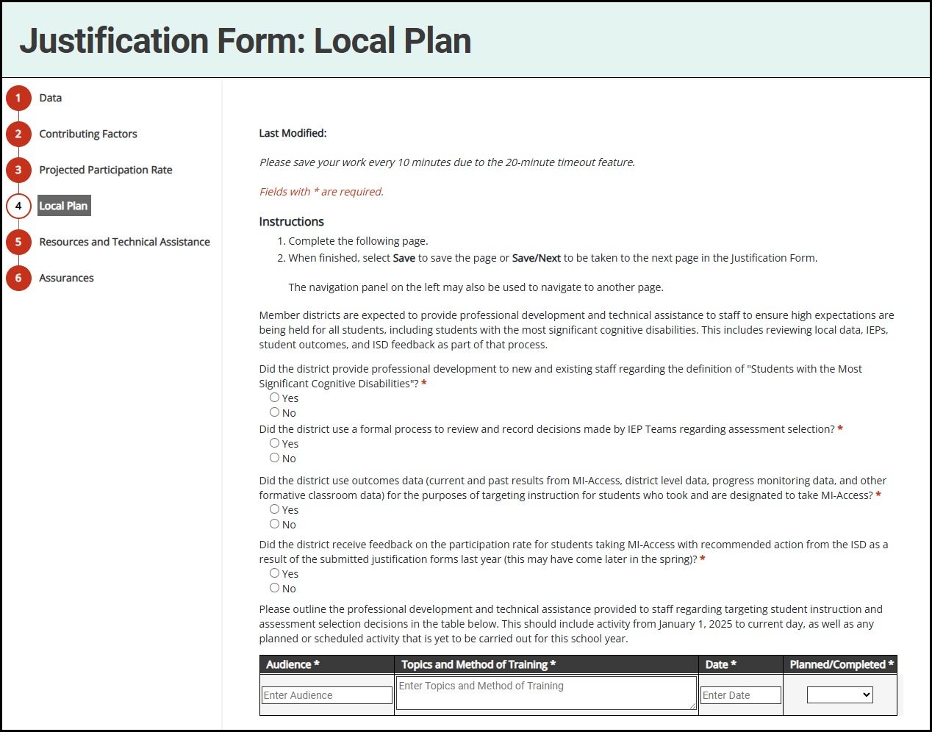
Local Plan
Answer required questions.
Outline professional development (PD) and technical assistance (TA) that have been or will be provided.
Notes:
On the local plan page, the district will answer a series of questions. The first question asks if the district provided professional development to new and existing staff regarding the definition of students with the most significant cognitive disabilities. The second question asks did the district use a formal process to review and record decisions made by IEP teams regarding assessment selection. The third question asked did the district use outcomes data for the purposes of targeting instruction for students who took and are designated to take MI access. The 4th question asked did the district receive feedback on the participation rate for students taking MI- access with recommended action from the ISD because of the submitted justification forms last year. Finally, on the page, the district will outline the professional development and technical assistance that has been provided to staff regarding targeting student instruction and assessment selection decisions in the table. This should include any activity from January of 2026 to the current day as well as any planned or scheduled activity that is yet to be carried out for the 26-27 school year

Slide 29
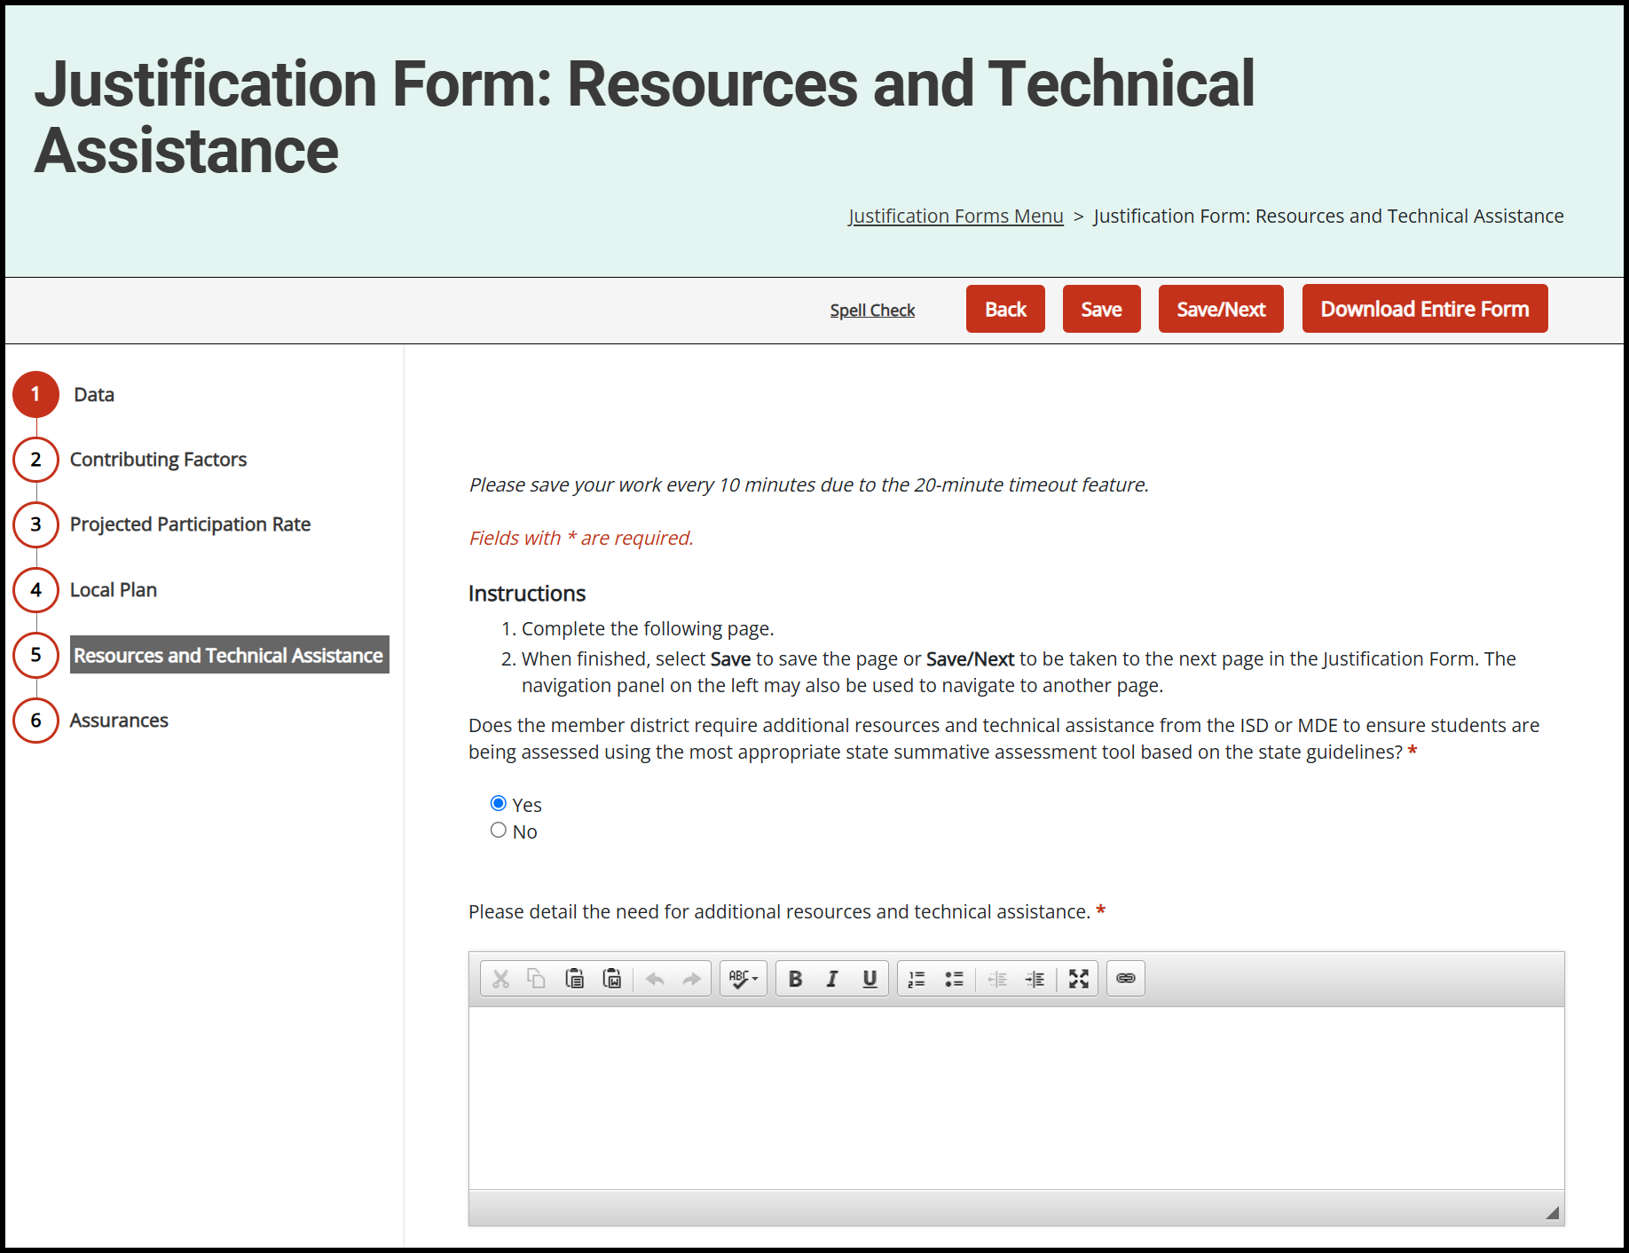
Resources and Technical Assistance
Answer if additional resources or TA is needed from the ISD or MDE.
If yes, provide additional information regarding the request.
Notes:
On the resources and technical assistance page, the district will first answer whether additional resources and technical assistance from the ISD or MDE are necessary to ensure students are being assessed using the most appropriate state summative assessment tool based on the state guidelines. If the member district requires additional resources, they will be asked to provide information regarding that request.

Slide 30
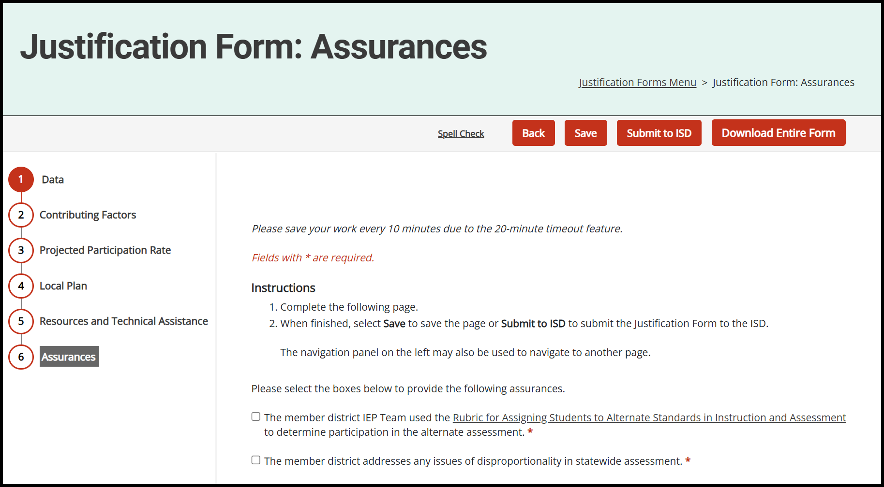
Assurances
Select the checkbox for each assurance statement.
Provide comments if needed.
Notes:
For most districts who have additional pages to complete, the assurances page will be the last one. They will be asked to provide check marks for a series of assurance statements. The first one assures the member district IEP team members follow the state guidelines for participation in the alternate assessment. The second assures the member district allows IEP team members to decide which students take an alternate assessment. The final statement assures the member district has addressed any issues of disproportionality in statewide assessment. The district is also able to enter comments as needed.

Slide 31
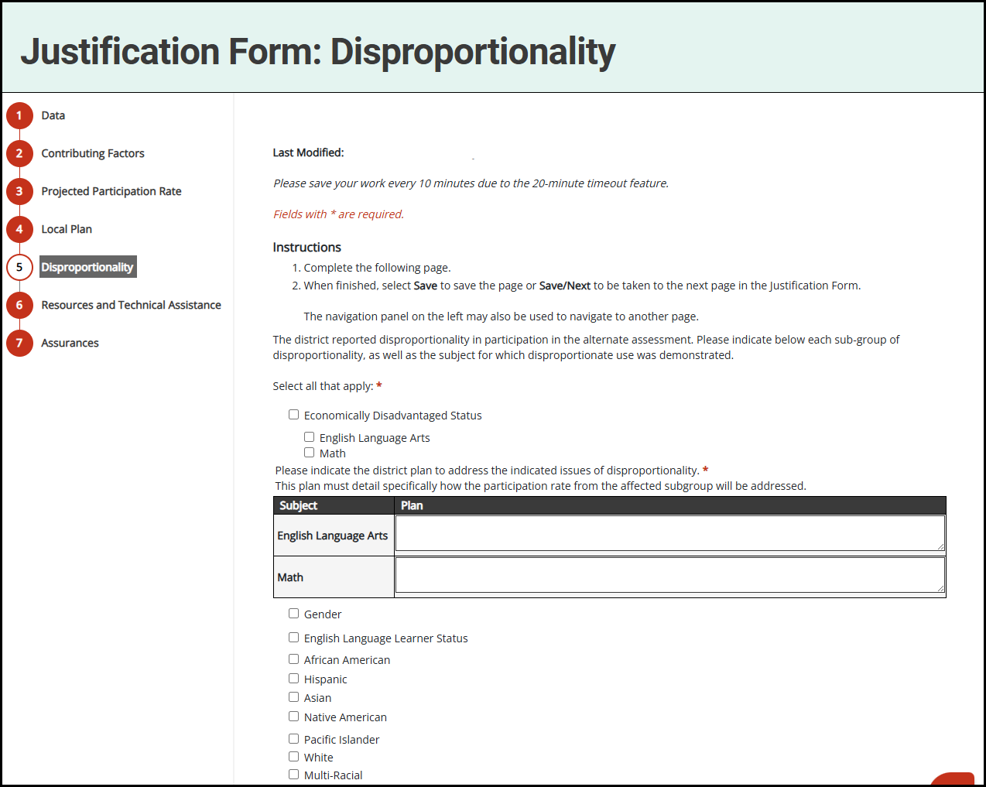
Disproportionality
Indicate the subgroup(s) with disproportionality.
Select the test subject(s) with disproportionality.
Describe how the participation rate from the affected subgroup will be addressed.
Notes:
The disproportionality page is only completed by those districts whose participation in alternate assessments showed disproportionality in one or more areas.
The district must indicate each subgroup of disproportionality. Once a subgroup is indicated the district will then select the test subject for which disproportionality was demonstrated. For each subgroup and testing subject the district must detail the district’s plan to address the issues of disproportionality. They must describe how the participation rate from the affected subgroup will be addressed.

Slide 32
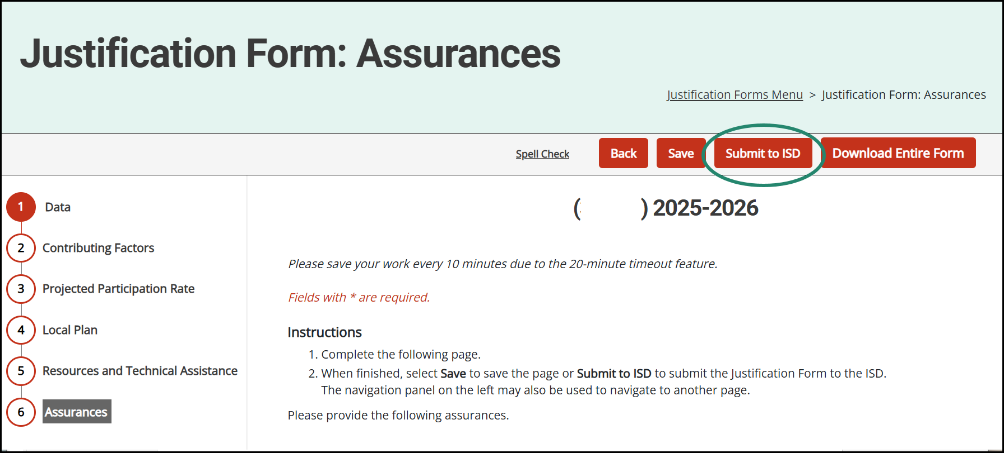
District Justification Form Submission
Proceed through the District Justification Form using the Save/Next button or via the navigation panel on the left.
When complete, choose the Submit to ISD button.
Notes:
Navigation is simple throughout the activity. Complete the required work on each page and navigate through using the save/next button.
You may also skip to any page using the navigation panel on the left.
When the work is complete, choose the submit to ISD button on the assurances page.

Slide 33
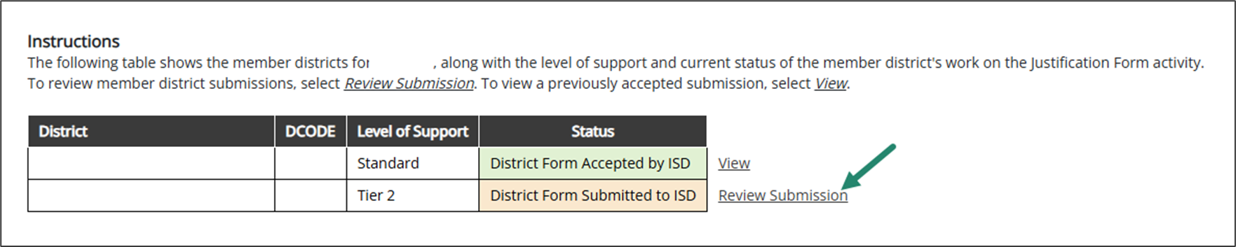
ISDs: Review Member District Submissions
ISDs must review member district submissions using the Member District Review Tool.
The status of member district submissions can be tracked within the status column.
Notes:
ISDs must review member district submissions using the Member District Review Tool. This link can be found on the activity menu.
Each district will be listed along with the status of their work. When a district has submitted their form, the status will appear orange and a Review Submission link will be available, and when a district form has been submitted and accepted it will appear green with a view link next to it.
When work has yet to begin, it will remain white with no link

Slide 34
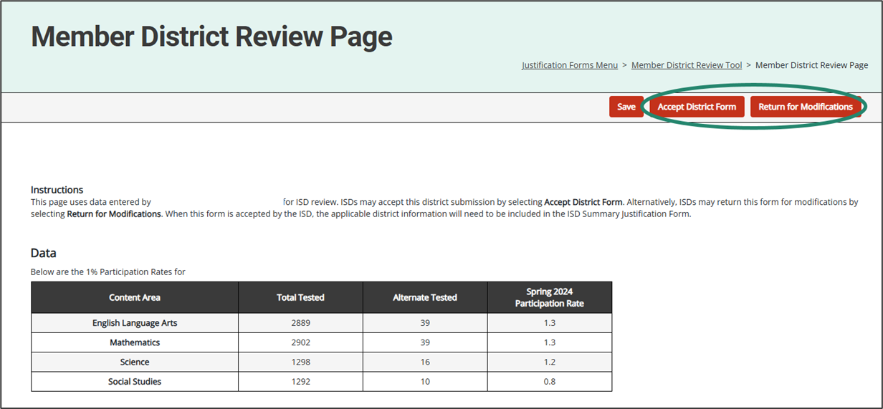
ISDs: Accept or Return Member District Submissions
Utilize the Alternate Assessment Data Report to assist in reviewing member district submissions.
Notes:
Upon submission from the districts, ISDs must review and either:
Accept the district form as submitted.
Return the district form for modifications (comments to the district will be necessary in this case).
When reviewing a submission, these buttons will be available to ISDs on the assurances page of the district submission

Slide 35
District Catamaran Coordinators:
What to do with a Returned Submission
Review comments from the ISD.
Make the necessary modifications and proceed through the district Justification Form as done previously using the Save/Next button.
When complete, choose the Resubmit to ISD button.
Notes:
If a form is returned to the district
First, review the comments made by the ISD. Make necessary changes as detailed by the ISD and proceed through the activity using the save/next button.
When all updates have been made, resubmit to the ISD using the resubmit to ISD button.

Slide 36
ISDs: Submit Summary Justification Forms to MDE
Once all member district submissions have been received and accepted, an ISD Summary Justification Form must be submitted.
The ISD Summary Justification Form consists of 3 pages.
Proceed through the form using the Save/Next button.
When complete, choose the Submit to MDE button.
Notes:
The ISD Summary Justification Form cannot be submitted until all member district submissions have been received and accepted.
The ISD form consists of 3 total pages.
Navigation is simple using the save/next button or the navigation panel on the left of the screen.
When complete, chose the submit to MDE button on the assurances page.

Slide 37
ISDs: MDE Response
When ISD Summary Justification Forms are submitted to MDE, one of three responses will be given:
Modifications Required
Accepted
Additional Actions Required
Notes:
A response by the MDE will be given to all ISD submissions.
ISDs will be notified of one of 3 decision by the MDE:
Modifications Required
ISD Form Accepted
and Additional Action Required.
So, what do all these scenarios mean for the ISD?

Slide 38
ISDs: What to do with a Returned Submission
Review comments from MDE.
Make necessary modifications and proceed through the summary Justification Form as done previously using the Save/Next button.
When complete, choose the Resubmit to MDE button.
Notes:
If an ISD form is returned to the ISD for modifications:
ISDs should review comments made by the MDE (they will always be required in this scenario)
Make necessary updates and revisions and proceed through the activity
Resubmit to the MDE using the resubmit to MDE button on the assurances page

Slide 39
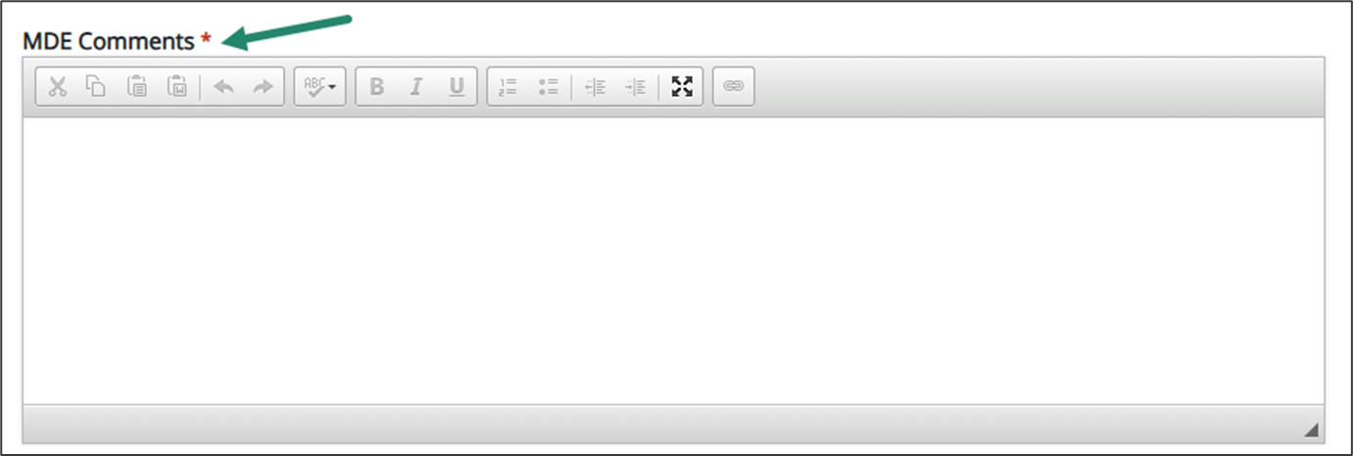
ISDs: What to do with an Accepted Submission
Review member district recommendations made by MDE.
These comments will be found on the assurances page of the Summary Justification Form, within the MDE comments section.
Notes:
If the submitted form requires no revisions or additional actions, MDE will still be making member district recommendations to each ISD.
The ISD will be notified of the decision and be directed to review these comments within the assurances page of the Summary Justification Form. At the bottom of the page, you will find an MDE comments box with all these recommendations.

Slide 40
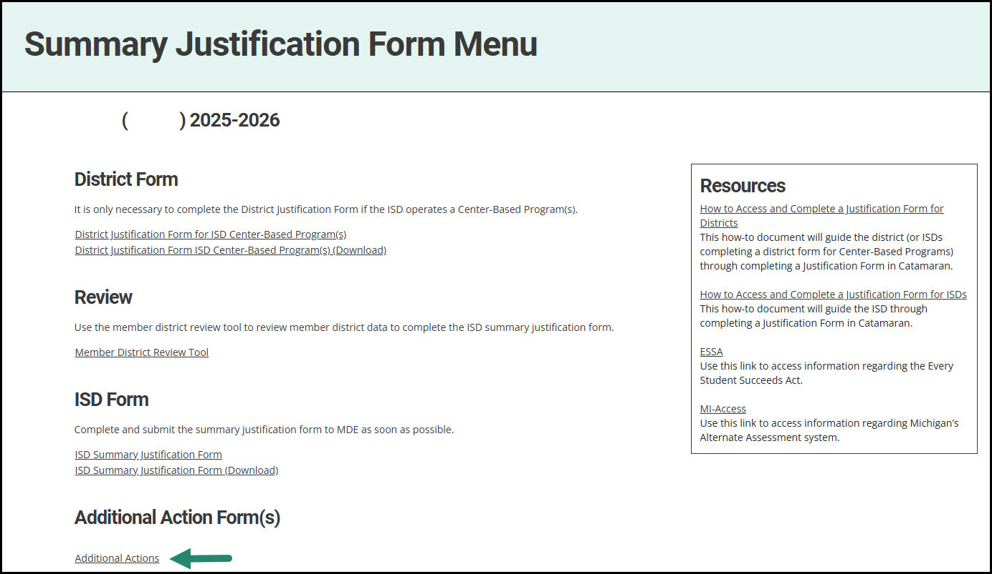
ISDs: What to do with a Request for Additional Action
A notification will be sent to the ISD when additional action is required by MDE.
The Additional Actions Form can be found on the activity menu.
Notes:
If MDE requires additional action from any ISD, a notification will be sent with a link to the activity where you will find the additional actions form.
We heard from the workgroup that you wanted access to this form earlier in the process as well. This year, this form is available to you when the activity opens in October. You will be able to see the required activities and start working on them right away.

Slide 41
ISDs: What to do with a Request for Additional Action (continued)
Review information provided regarding:
  Determining the Tiers
  Flagged Student Cases
  District Lists
  Guidance for Tier 2 and Tier 3
Begin necessary activities and note the deadline for all district reviewed files is (April 1).
Upload Tier 2 Assurance Statement and evidence of Tier 3 activities by (June 1).
Notes:
When an ISD has member districts in Tier 2 or Tier 3, additional actions will be required. Access the form and you will be able to review information regarding how MDE determined the tiers; a flagged student case file will be provided if available. Please note that this is the same file available through the reports page. There will be links for district lists and Guidance documents for Tier 2 and Tier 3 with a list of required additional actions. Review the information carefully. The biggest change for the 26-27 school year is that Districts will send ISDs their Flagged Student cases and the ISD will review and give feedback. The Tier 2 district High-Risk Summaries are not turned into MDE, only an Assurance Statement will need to be uploaded for evidence. Begin necessary activities and note the deadlines for all Tier 3 file reviews (April 1) and the upload of Tier 2 assurance statement and evidence of Tier 3 activities (June 1).

Slide 42
Tips on Entering Information
For both the district and ISD forms, summarize the information as best as possible.
Read the How-To Documents in the resources section of the menu for important guidance.
The Alternate Assessment Data Report is available for ISDs on the Catamaran Reports page.
Member districts should contact their ISD with any questions about data for the Justification Form.
Notes:
For both the district and ISD forms, summarize the information as best as possible.
Read the How-To Documents in the resources section of the menu for important guidance.
The Alternate Assessment Data Report is available for ISDs on the Catamaran Reports page.
Member districts should contact their ISD with any questions about data for the Justification Form.

Slide 43
Catamaran Navigation Tips
Notes:
Now for some quick Catamaran Navigation Tips

Slide 44
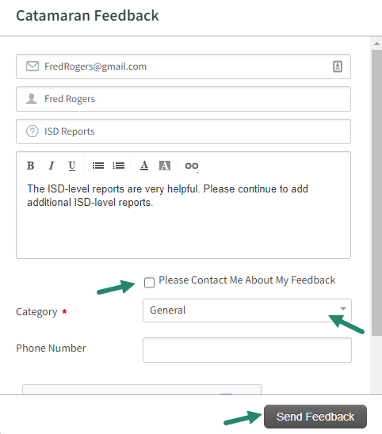
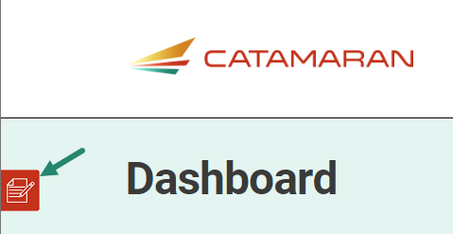
Feedback Feature
Feature available to offer feedback about Catamaran at any time.
Enter contact information.
Choose to be contacted about feedback.
Notes:
The next few slides I want to point out some of the continuing features. On the left-hand side of any screen in the system, you will find the feedback feature. The OSE as well as our PSC partners appreciate your feedback related to the system.
If you wish to be contacted about your feedback you can enter contact information, and someone will reach out to you.
If you prefer to provide anonymous feedback, we would also like to hear from you. You do not need to leave your contact information.
Because we have made some significant changes to this activity this year, we really would like to hear from you about the changes. Were they helpful? Are there other changes you would like to see? Please complete the feedback form and let us hear from you.

Slide 45
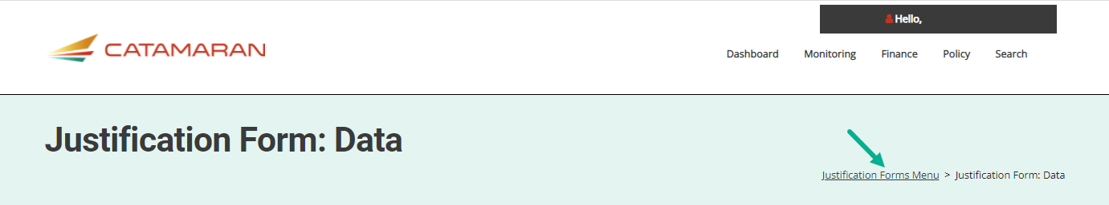
Use Breadcrumbs to Navigate
Use the breadcrumbs menu to navigate in Catamaran.
The breadcrumbs are a trail to follow back to a previous location.
Selecting the Catamaran logo will return the user to the Dashboard.
Notes:
If at any time you need to navigate to a previous location within the activity, use breadcrumbs
If you ever wish to return to the dashboard, select the catamaran logo

Slide 46
Resources
Notes:
Now we are going to discuss a few resources available to you.

Slide 47

Catamaran Technical Assistance Website
Notes:
The Catamaran Technical Assistance Website focuses on increased technical assistance for Catamaran users.
The following slides highlight some of the features and navigation.
You can access the Catamaran Technical Assistance Website at training dot catamaran dot partners.

Slide 48
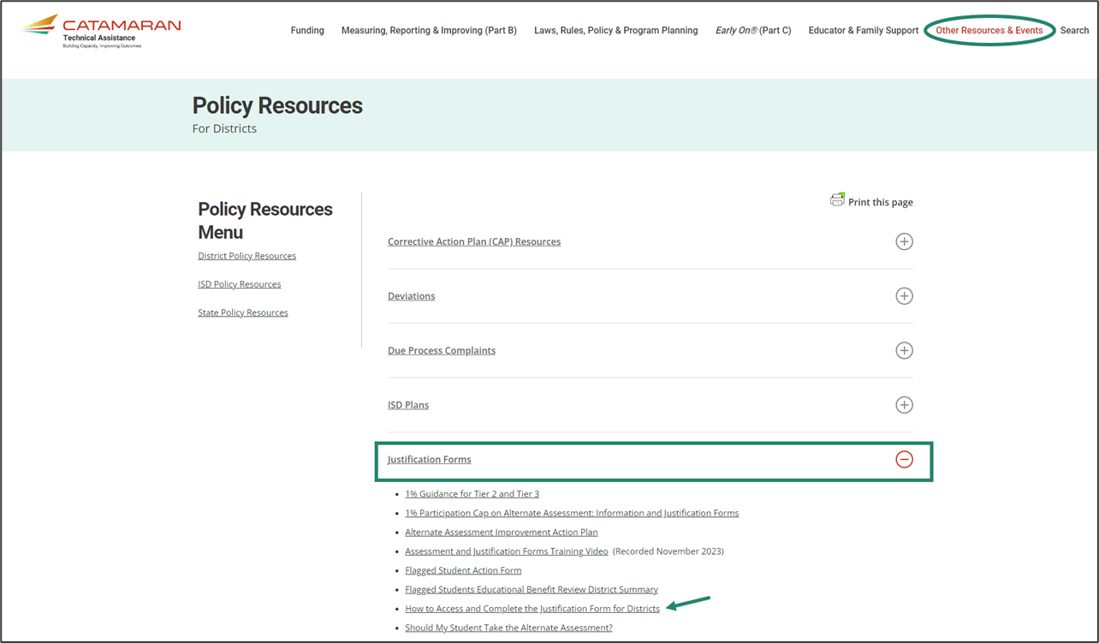
Policy Resources for Districts
Notes:
This is a screenshot of the policy resources for districts page on the TA site. The justification forms section is highlighted. If you’re looking for forms or guidance to complete this activity, they will all be found here.

Slide 49
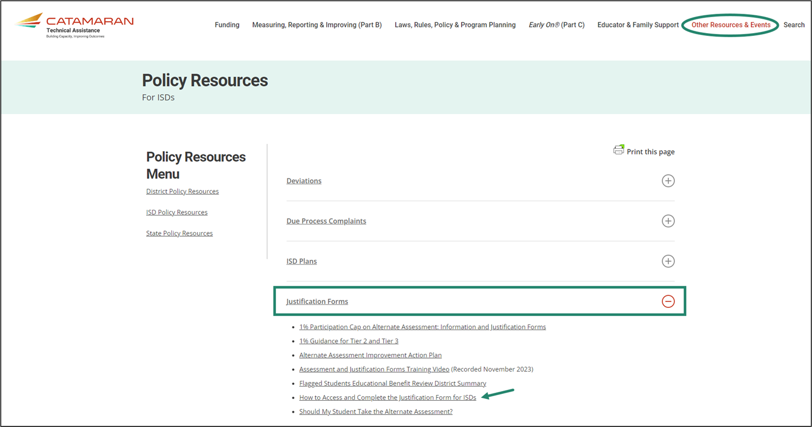
Policy Resources for ISDs
Notes:
This is a screenshot of the policy resources for ISDs page on the TA site. The justification forms section is highlighted here as well. It has many of the same items on the district page but additional items to explain the ISD review process.

Slide 50
Need More Help?
Catamaran Help Desk:
  Available Monday – Friday 8:00 am – 5:00 pm
  Email: Catamaran Help Desk (help@catamaran.partners)
  Phone: 877-474-9023
  Chat feature in Catamaran
Tell the Help Desk:
  District or ISD
  Justification Forms
Notes:
If you need more help to complete this activity, you can contact the catamaran help desk. They are available Monday through Friday from 8:00 AM to 5:00 PM. You can reach them via e-mail at help at catamaran dot partners or by phone at 877-474-9023. As a reminder the chat feature is available from every page in catamaran during normal business hours.
When you contact the help desk please tell them which district or ISD you are from and that you are working on justification forms. That will help them tailor their response.

Slide 51
Contact MDE OSE
Presenters
Bethanie Eggleston Egglestonb1@michigan.gov
Tori Steingreaber
SteingreaberT@michigan.gov
MDE OSE Information Line
Interpreter Services Available
1-888-320-8384
MDE-OSE@michigan.gov
Notes:
If you have any questions about this presentation, please contact Bethanie e g g l e s t o n @michigan.gov or Tori at s t e i n g r e a a b e r t @michigan.gov. For more general questions about special education, please contact the MDE OSE Information Line at 888-320-8384 or by email at m d e – o s e @ Michigan.gov.

