Slide 1
ISD Plan Addendum and Annual Acknowledgement Processes
For Intermediate School Districts (ISDs)
Notes:
In this video we will review the Intermediate School District Plans Addendum and Annual Acknowledgement Processes.

Slide 2
OSE Goals for ISD Plans
Consistent revision/updates of ISD plans to ensure plans reflect current programs and services
Develop a streamlined system of adding and removing Public School Academies (PSA)
Notes:
The annual acknowledgment and addendum processes support the goals of the Office of the Special Education
to create a system of consistent revision/updates of ISD plans to ensure those plans reflect current programs and services AND
To develop a streamlined system of adding and removing Public School Academies to the ISD plan

Slide 3
R 340.1831(4)
The department may require an intermediate school district to modify its plan if, after the effective date of the individuals with disabilities education act, 20 U.S.C. §1400 et seq., the provisions of that act, its regulations, 34 C.F.R. 300.1, et seq., 1976 PA 451, MCL 380.1 et seq. or these rules are amended, there is a new interpretation of any of these laws or regulations by the United States Department of Education, the department, or court, or the department finds noncompliance.
Notes:
Michigan Administrative Rule 340.1831 indicates that the Michigan Department of Education may require an ISD to modify their plan for delivery of special education programs and services when there is a new interpretation of rules, laws or regulation or if the department finds non-compliance.

Slide 4
General Supervision System Self Assessment
Component 3: Integrated Monitoring Activities
Item #3 The ISD monitors the components of the ISD plan to ensure implementation of the delivery system of special education programs and services by member districts.
MCL 380.1711(1)(a) and R 340.1831-340.1839
Notes:
In the General Supervision Self Assessment Component 3 the ISD is asked about the system in place to monitor the components of the ISD Plan in order to ensure implementation of the delivery system of special education programs and services by Member Districts, in accordance with the revised school code and the Michigan Administrative Rules for Special Education.

Slide 5
Annual Review of Plans
Develop systems for regular revision/update of ISD plans including:
Self-Identification: Annual acknowledgement in Catamaran prior to release date for ISDs to self-identify needed revisions/updates.
OSE Identification: Annual OSE identified plans for revision and ISD plan review activity process.
Notes:
To support these requirements of regular review and revision of ISD plans, the OSE has developed an annual acknowledgement activity for ISD plans within Catamaran in which:
ISDs can self identify the need to revise their plan prior to the module being opened for release in Catamaran
The OSE can also annually identify plans in need of revision due to risk factors.

Slide 6
Addendum Process
Toggle sections to provide
  Public Awareness and Child Find contact information
  Diagnostic and Related Services
  Special Education Programs and Services including virtual programming
MDE Review
Signature collection
Notes:
Starting in October 2025, a new step was created in the annual acknowledgement process for ISDs with a new school district.
The OSE will begin the process in Catamaran by selecting the affected ISDs. The system will populate new district information from the EEM.
ISDs which have a newly opened PSA should encourage those PSAs to make sure the EEM is up to date with appropriate personnel email addresses.
For each new district the ISD will be required to input information into three toggle sections on this page.
They will enter public awareness and child find contact information under the first toggle.
In the second toggle section they will enter the diagnostic and related services. This will be a yes/no list just like all other member districts inputted into the original ISD plan. This will identify all diagnostic and related services AVAILABLE to the new district.
The third toggle section will be for special education programs and services, again just like other districts saw in the original ISD plan. The ISD will enter yes or no for whether or not the district provides the listed programs and services.
When all of the new districts’ information has been entered, this form will be submitted to MDE. MDE will then review the information and either request modifications or return this activity for the signature process for the new districts.
An e-mail will be sent to the lead administrator named on the page to collect their signature. Access to Catamaran is not required. When all of the signatures for the new districts have been collected, this activity will auto advance to MDE and MDE will create and send an acceptance letter.
Following this process, the ISD will move into the annual acknowledgement process.

Slide 7
Acknowledgment Form Content
Section I: Public Awareness and Child Find
Section II: Diagnostic and Related Services
Section III: Special Education Programs and Services
Section IV: Paraprofessional Qualifications
Section V: Transportation
Section VI: Millage Distribution
Section VII: Parent Advisory Committee
Section VIII: Surrogate Parents
Notes:
When completing the annual acknowledgement form, the ISD will review sections of the plan outlined on this slide to determine if any changes are necessary. These sections are as follows:
Section I: Public Awareness and Child Find
Section II: Diagnostic and Related Services
Section III: Special Education Programs and Services which includes alternate programs under R 340.1832(e)
Section IV: Paraprofessional Qualifications
Section V: Transportation
Section VI: Millage Distribution
Section VII: Parent Advisory Committee
Section VIII: Surrogate Parents
While the only entity responsible for the completion of the annual acknowledgment form is the ISD, it is important that the ISD communication with member districts to determine if any of the district entered information such as child find contacts, available diagnostic and related services or programs and services provided will need to be changed on district forms.

Slide 8
Next Steps
OSE reviews content of annual acknowledgment.
OSE determines the next steps for the ISD plan.
  No revision necessary
  Modifications needed
ISD receives Catamaran Notification of Plan Status.
Notes:
The OSE will then review the areas that the ISD has identified as needing changed. The OSE will also review any risk factors such as the age of the plan or other content needing revisions as requested by the OSE. Once this review is completed the ISD will receive a Catamaran notification indicating the plan’s status and next step for the ISD plan.

Slide 9
Timeline
Addendum or Annual Acknowledgement released in Catamaran on October 15.
ISD completes annual acknowledgment by November 19.
Notes:
The Addendum or Annual Acknowledgment form will be released in Catamaran on October 15^{th.} Those ISDs whose plans are at the approved status when the 2019 version sunsets on Oct 9th will start with this process. If an ISD’s plan is not approved, then they will continue working on their plan at the same status in the new 2026 object.
The ISD must submit their annual acknowledgment to the OSE by November 19th.

Slide 10
Catamaran Annual Acknowledgement
Notes:
Now, let’s look at how the annual acknowledgment process works within Catamaran.

Slide 11

Catamaran Log In Screen
Notes:
First, you will want to go to catamaran.partners to log in to Catamaran.
If you do not have a username and password or if you have forgotten it, you can either select the Need to create an account? or Forgot Password? link on the login screen or you may contact the Catamaran Help Desk.

Slide 12
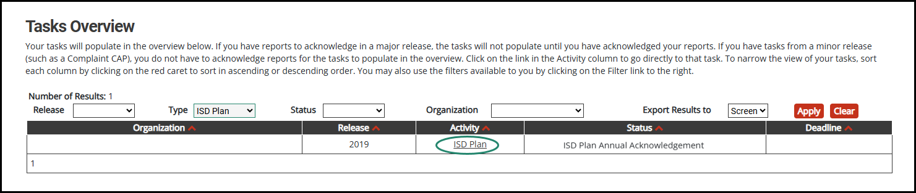
Locate the Activity
Notes:
The ISD Plan Annual Acknowledgement will be available on the ISD tasks overview on the release date.
If your ISD has to complete the Addendum, then the status will be Complete Addendum.
For all other ISDs, the status will be ISD Plan Annual Acknowledgement.

Slide 13
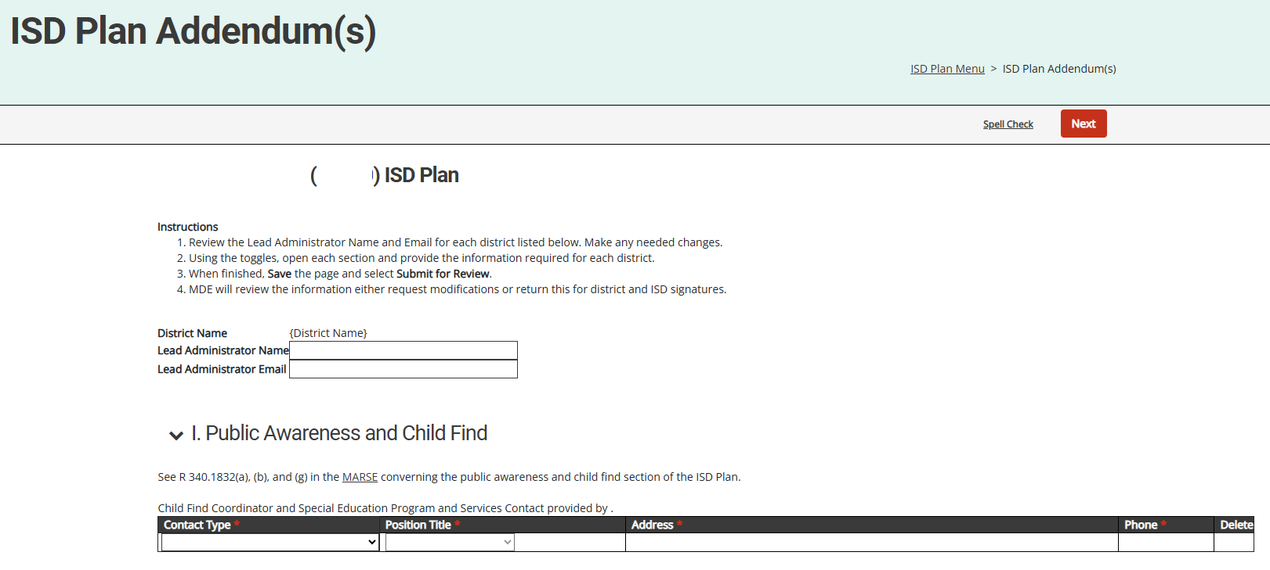
Addendum Form part 1
Notes:
On the Addendum form, Review the Lead Administrator name and email. These are pulled from the EEM so if that information is not correct, you can correct it here but the district should also correct it in the EEM.
Use the toggle to open section one and add the Public Awareness and Child Find contact information.

Slide 14
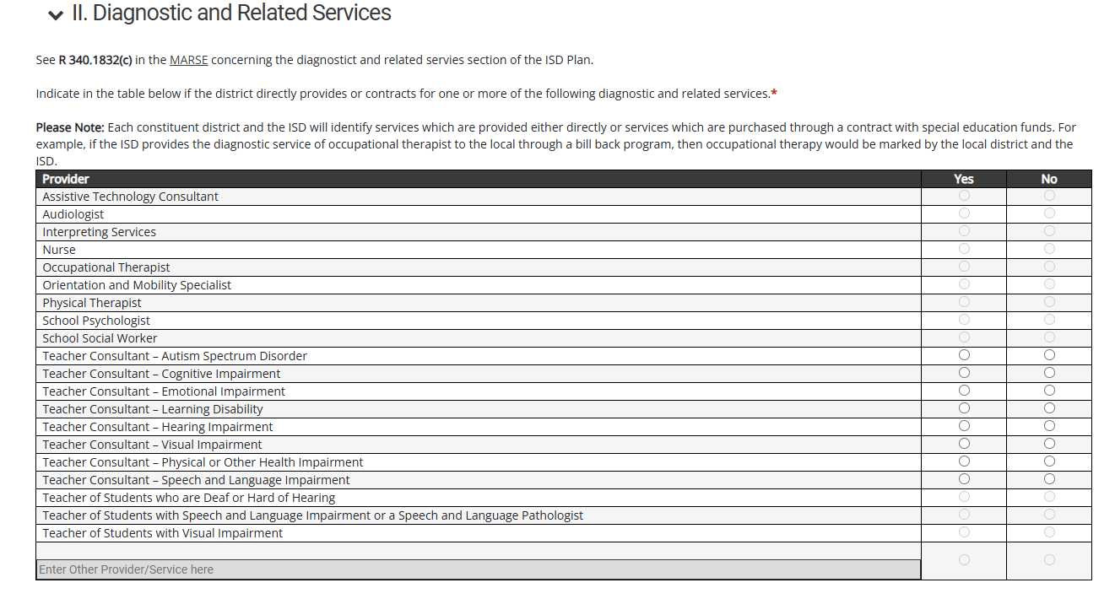
Addendum Form part 2
Notes:
Use the toggle to open section 2 and select yes or no for each diagnostic or related service available to the district.

Slide 15
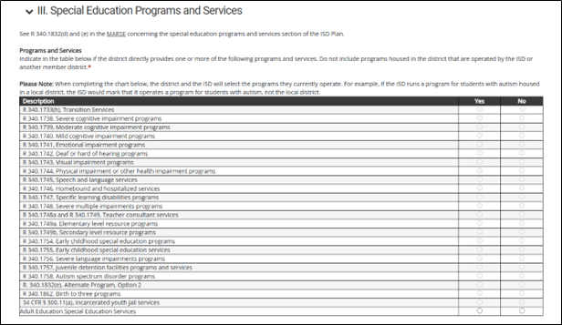
Addendum Form part 3
Notes:
Use the toggle to open section 3 and select yes or no for each special education program or service provided by the district.
Finally save the page and submit to MDE.
The new district and the ISD Superintendent will be notified to provide signatures.
Following the collection of signatures, the Annual Acknowledgement process will begin.

Slide 16
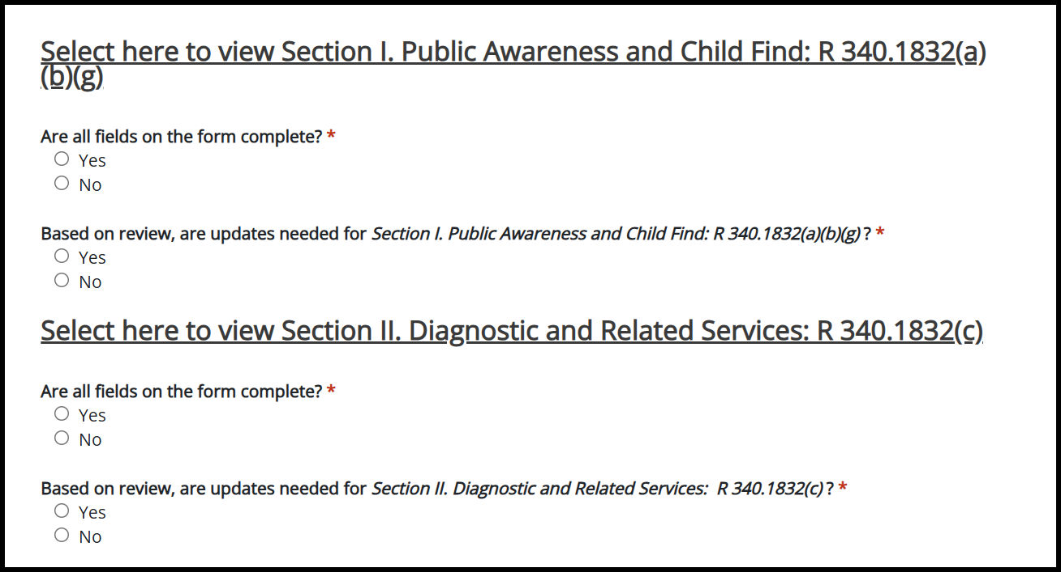
Acknowledgment Form
Notes:
All ISDs whose ISD Plans are at ISD Plan approved status as of October 9th will be required to complete the Annual Acknowledgement form.
For each section of the ISD plan the ISD will be asked to mark if there are any updates needed.
The ISD should carefully review each section of the ISD Plan. For some sections, if the ISD marks yes that updates are needed, then there will be additional questions to determine the breadth of the changes. After submitting the form to MDE, it will be reviewed and then the ISD Plan will be accepted if there are no changes or returned to the ISD to make the necessary updates.

Slide 17
Resources
Notes:
Now we are going to discuss a few resources available to you.

Slide 18
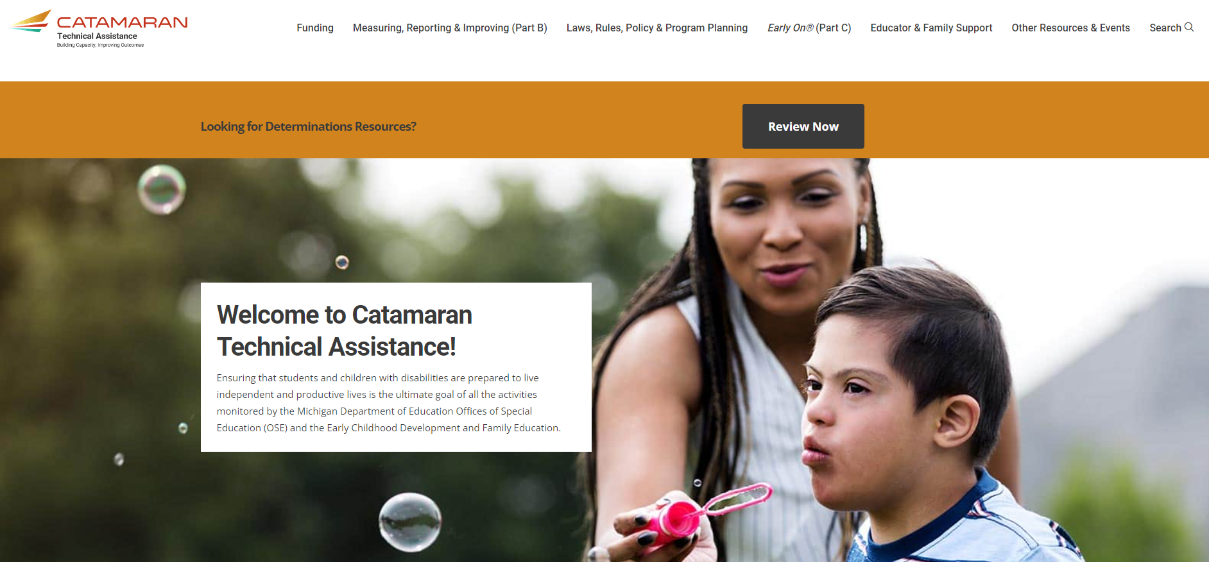
Catamaran Technical Assistance Website
Notes:
The Catamaran Technical Assistance Website focuses on increased technical assistance for Catamaran users.
The following slides highlight some of the features and navigation.
You can access the Catamaran Technical Assistance Website at training dot catamaran dot partners.

Slide 19
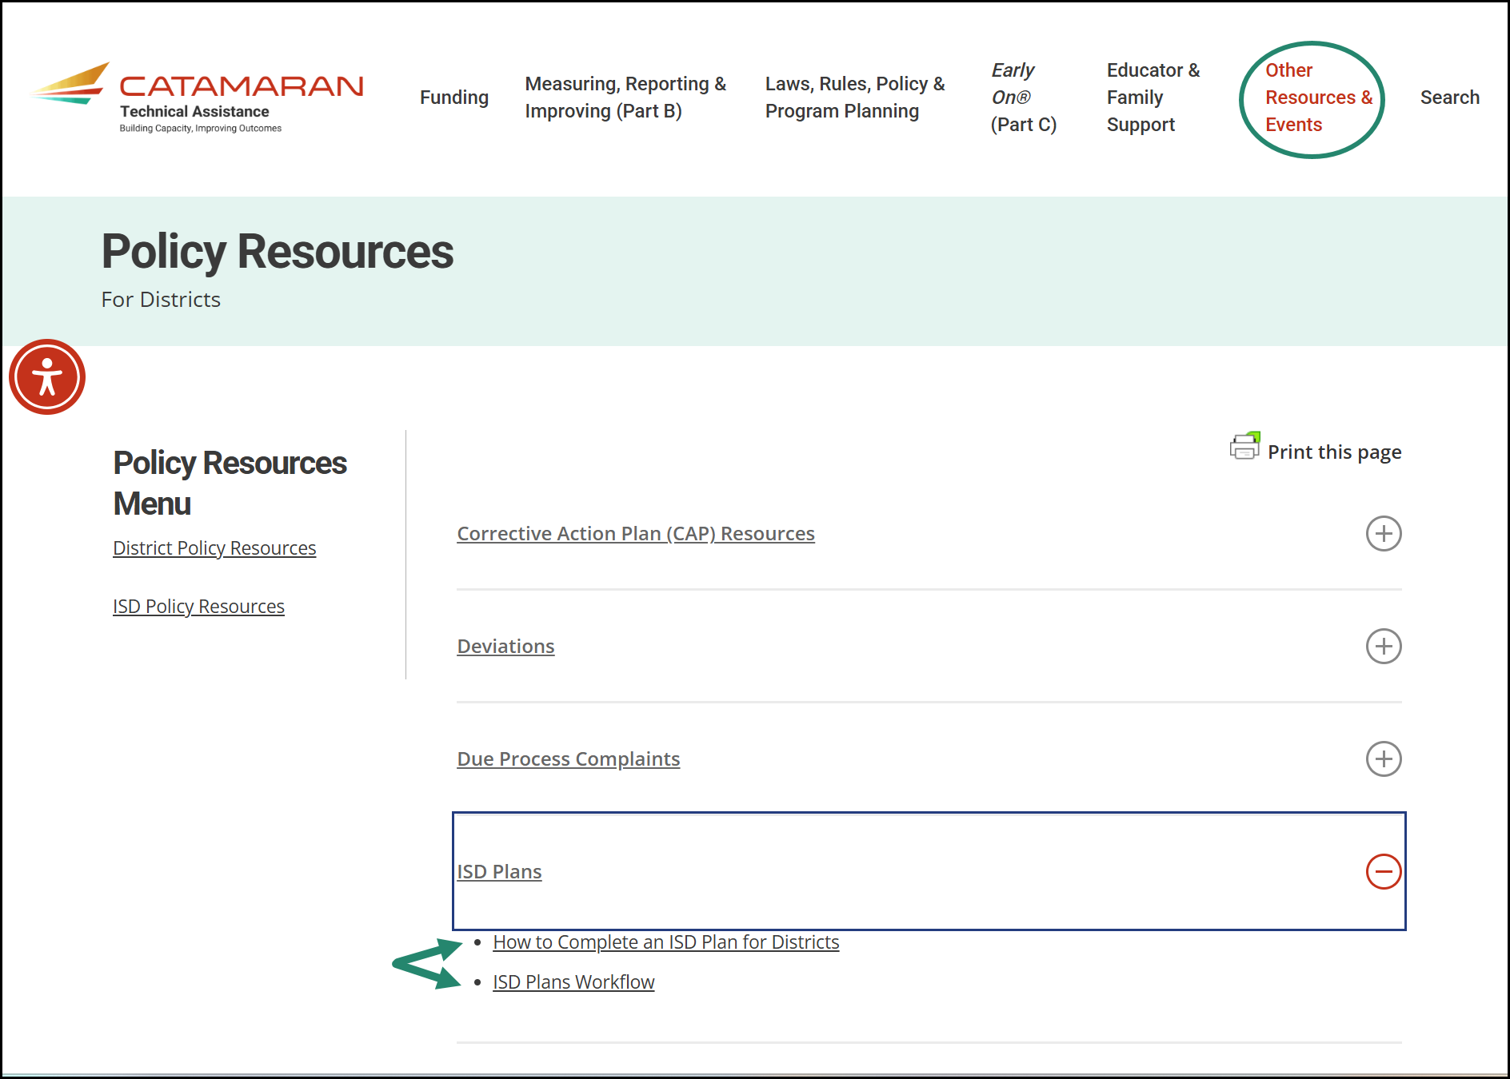
Policy Resources for Districts
Notes:
This is a screenshot of the policy resources for districts page on the TA site. The ISD Plans section is highlighted. If you’re looking for a how to guide or a visual of the workflow to complete this activity, they will be found here.

Slide 20
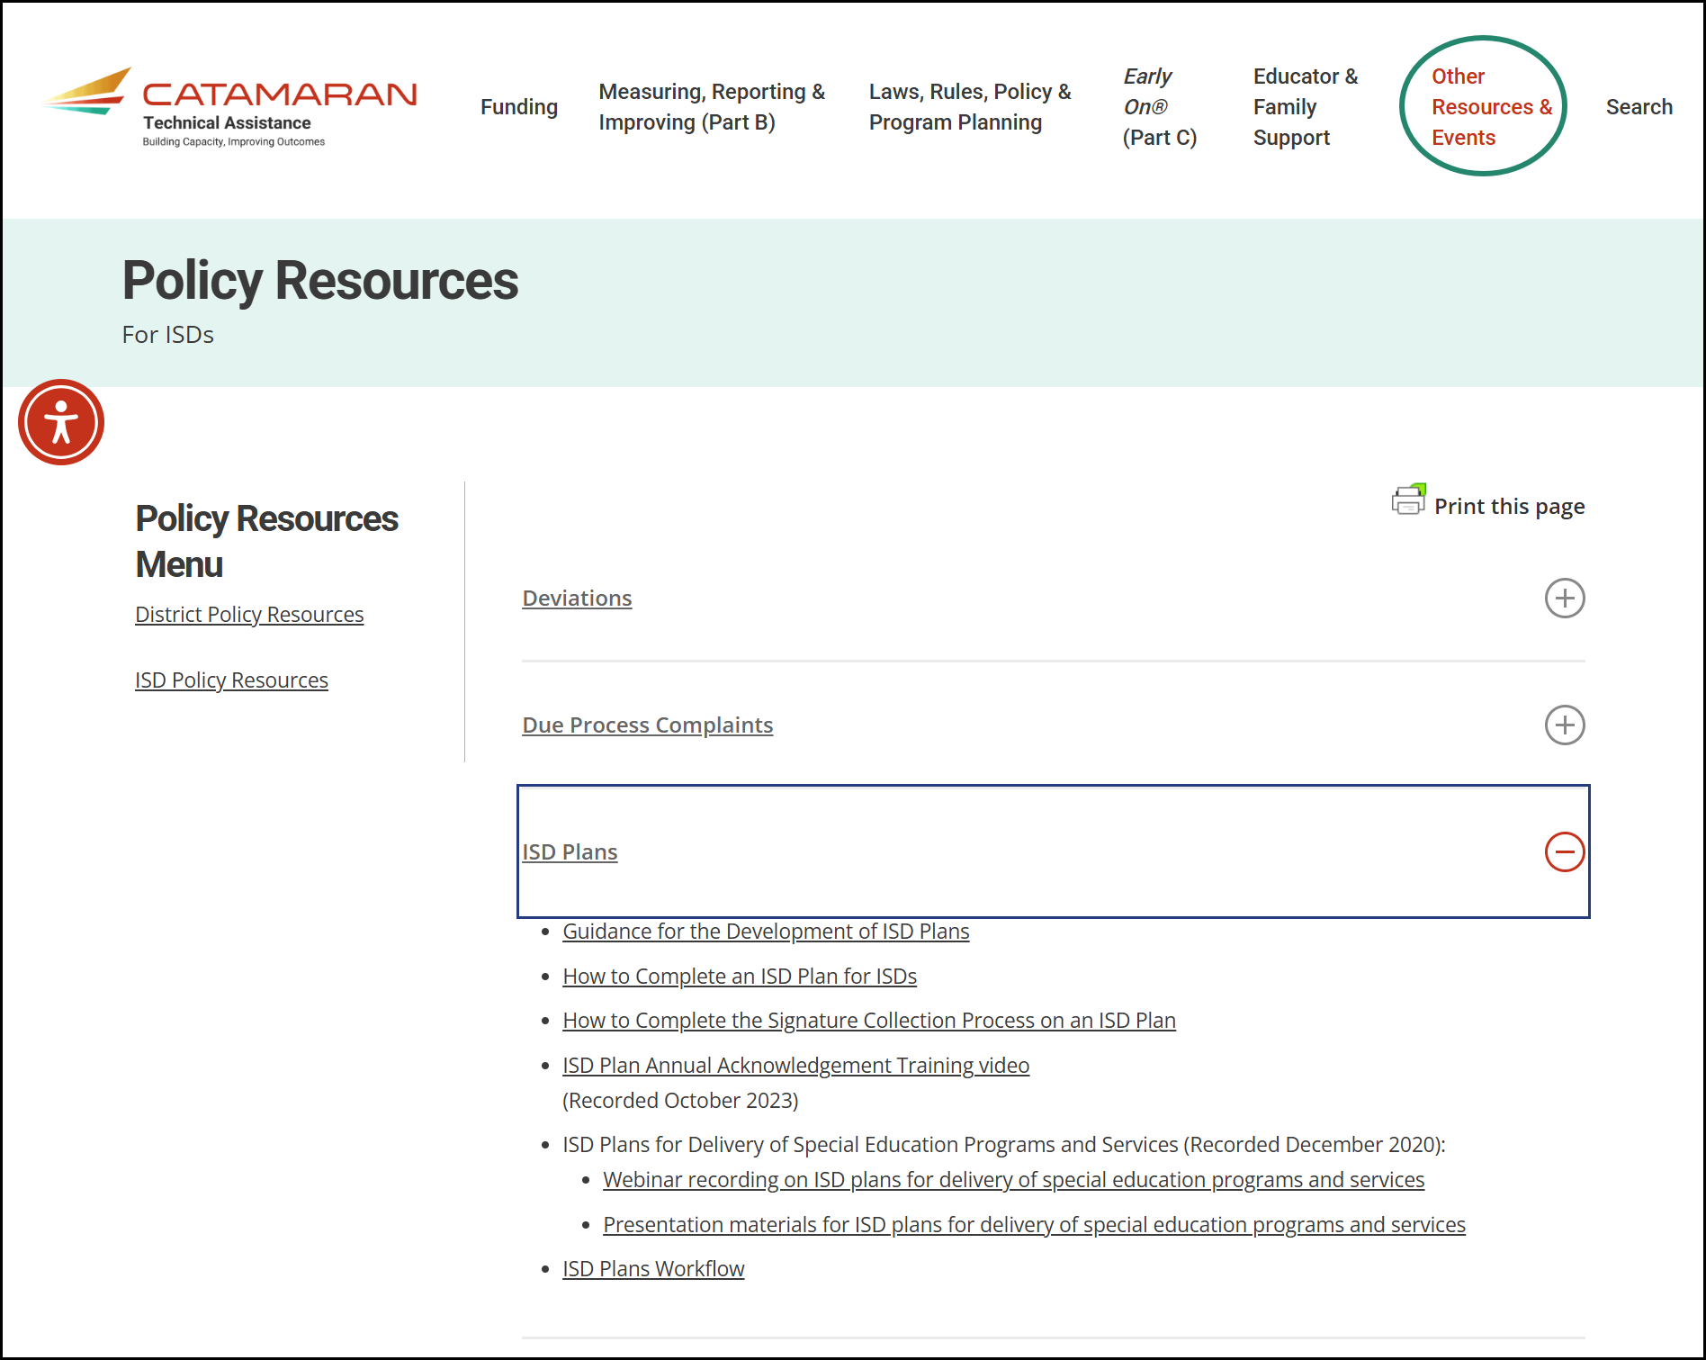
Policy Resources for ISDs
Notes:
This is a screenshot of the policy resources for ISDs page on the TA site. The ISD Plans section is highlighted here as well. It has similar items to the district page but also additional items to explain the ISD’s process.

Slide 21
Need More Help?
Catamaran Help Desk:
  Available Monday – Friday 8:00 AM – 5:00 PM
  Email: Catamaran Help Desk (help@catamaran.partners)
  Phone: 877-474-9023
  Chat feature in Catamaran
Tell the Help Desk:
  District or ISD
  ISD Plans
Notes:
If you need more help to complete this activity, you can contact the catamaran help desk.
They are available Monday through Friday from 8:00 AM to 5:00 PM. You can reach them via e-mail at help at catamaran dot partners or by phone at 877-474-9023. As a reminder the chat feature is available from every page in catamaran during normal business hours.
When you contact the help desk please tell them which district or ISD you are from and that you are working on ISD Plans. That will help them tailor their response.

Slide 22
Contact MDE OSE
Nancy Rotarius
517-335-0448
rotariusn@michigan.gov
MDE OSE Information Line
888-320-8384
mde-ose@michigan.gov
Notes:
If you have any questions about today’s presentation or the completion of an ISD plan addendum, acknowledgment or plan revisions, please contact Nancy Rotarius at R O T A R I U S N @michigan.gov or 517 335 0448.
For more general questions about special education, please contact the MDE OSE Information Line at 888-320-8384 or by email at m d e – o s e @ Michigan.gov.
Thank you for watching!

